Slide 1

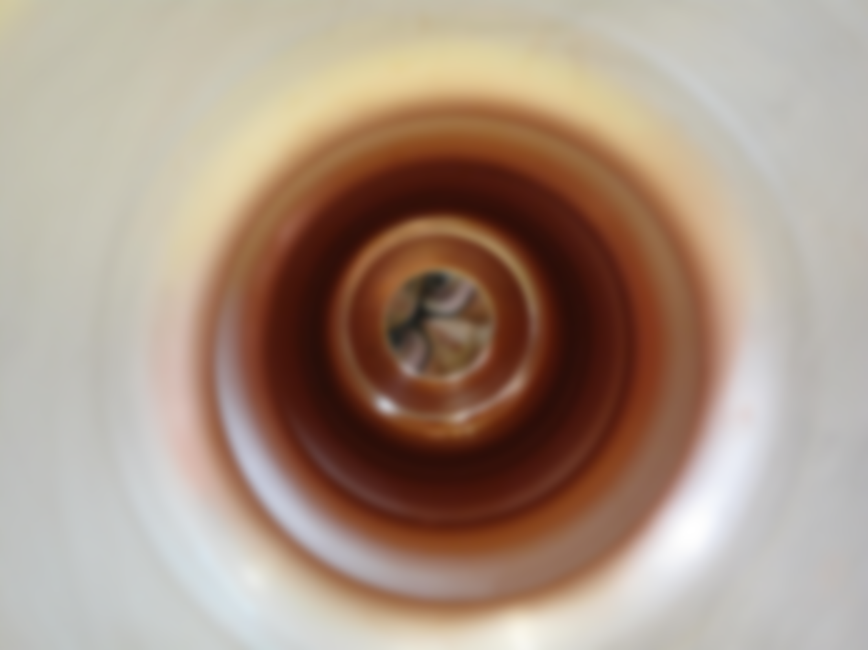

SPL cavity construction: Status and lessons
On behalf of SPL team

Slide 2
Overview
Niobium cavities
R&D
Conclusions
Material procurement
Monocell
5–cell cavities (Research Instruments) x 4
5–cell cavity (CERN)
Helium tanks

Slide 3
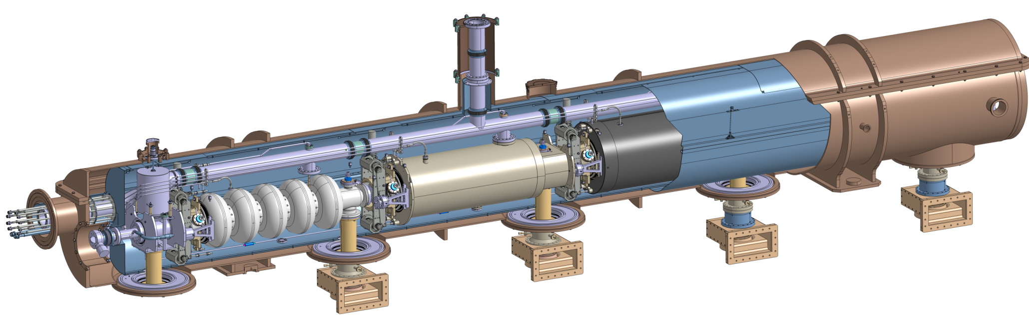
Overview
Cryogenic circuit
burst disk
Insulation vacuum
relief plate
Thermal shield
Cryogenic lines port
Vacuum vessel
Helium tank
Magnetic shielding
Two-phase pipe
He phase separator
Thermal shield tie-rod
Cavity tuner
RF coupler
Inter-cavity
support
Gate valve
Cold-to-warm
transition
Cavity
Double-walled
tube
Thanks to R. Bonomi and V. Parma

Slide 4
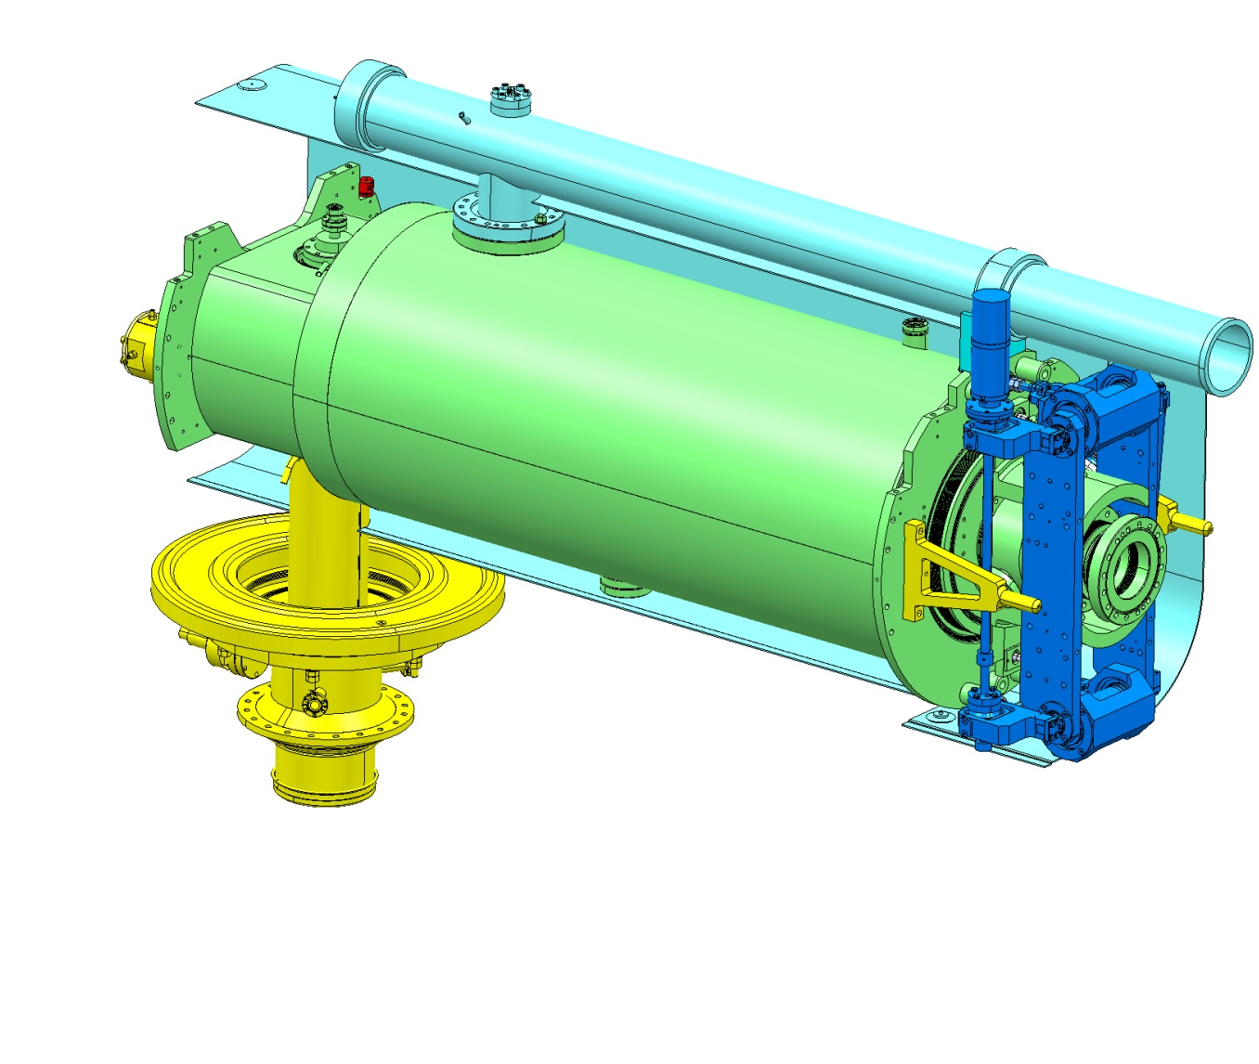
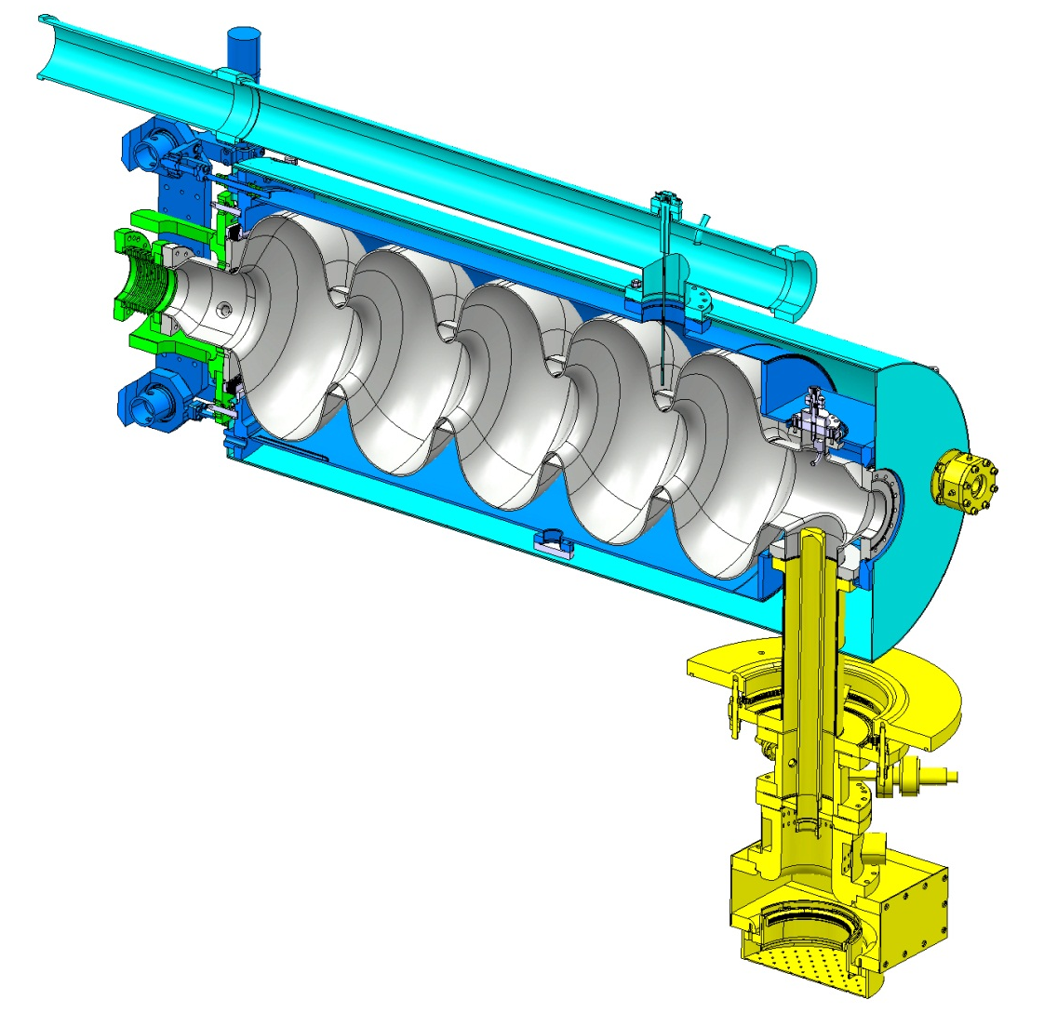
Overview
Pumping line & Magnetic shield to be provided IPN Orsay.
Bulk Niobium 5Cells cavity
Tuners provided by CEA. Under testing at CERN
4 niobium cavities delivered by Research Instruments
Stainless steel (316L /316LN) helium tank designed by CERN, supplied by CEA and welded to the cavity at CERN.

Slide 5
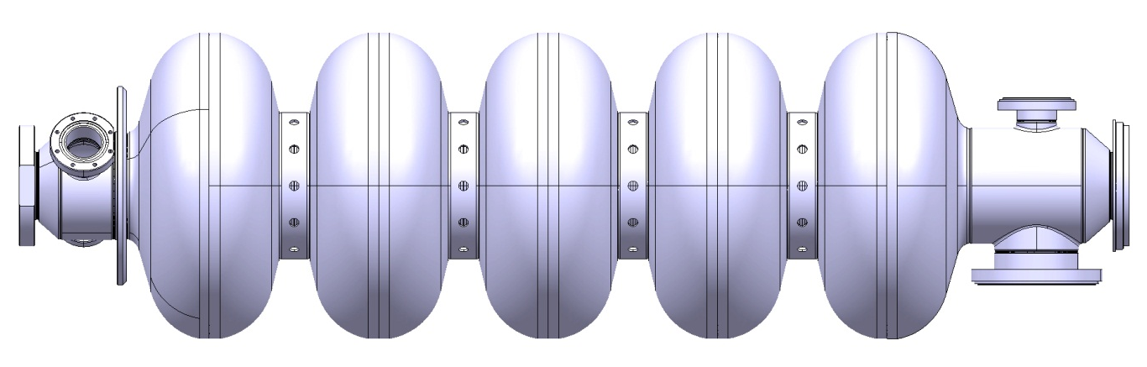
Overview: 5-cell Cavity
PROPERTIES
5-cell cavity β=1
Material: Bulk Niobium RRR300
Flanges: 316LN
Frequency: 704.4 MHz
Quality factor: 10¹⁰
Nominal gradient E_{acc}= 25 MV/m
Cavities:
4 niobium 5-cell cavities β=1 by Research Instruments (RI)
1 niobium monocell by RI
1 niobium 5-cell cavity β=1 under fabrication at CERN
2 copper 5-cell cavities β=1 (prototypes) fabricated at CERN

Slide 6
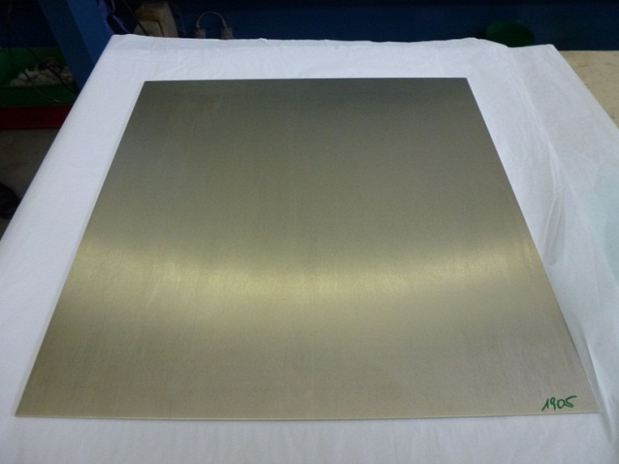
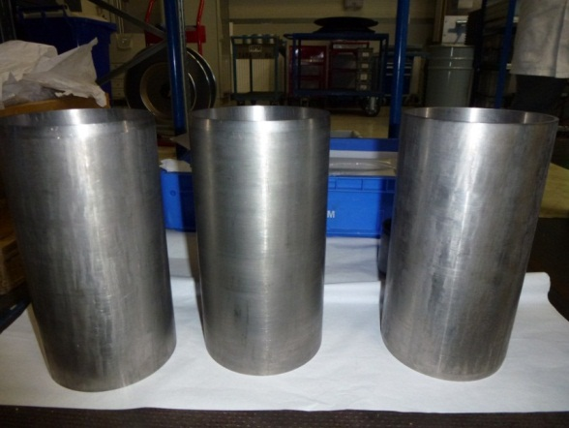
Niobium cavity-Material procurement
Plates
Seamless tubes
To avoid welds which could lower the RRR value.
Company | Price | Lead time | Qty
A | 472 € / Kg | 16 months | 72 plates
B | 503 € / Kg | 10 weeks | 8 plates
High prices
Bad tolerances
Problems during fabrication: overlapping

Slide 7

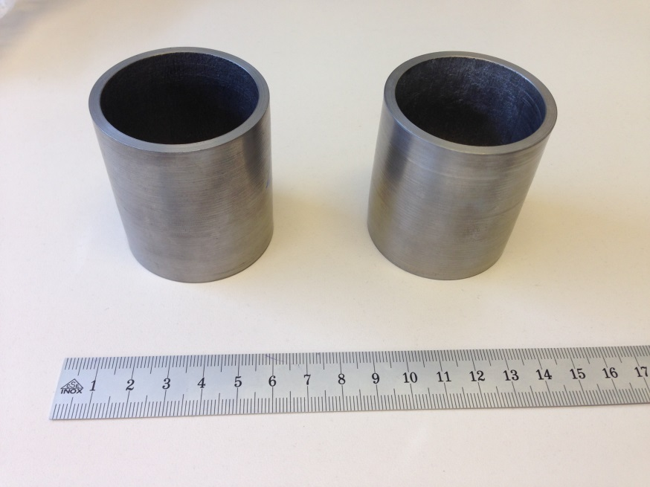
Niobium cavity-Material procurement
Lessons learnt:
Grain size is not that important (at least for fabrication), and it was accepted material with bigger GS than initially wanted (up to G = 4)
Seamless tubes are extremelly difficult to fabricate with the good tolerances, and we believe that surface defects appear during their fabrication. It is recomended for the fabrication of the end groups to opt for the bent + weld solution or spinnig from plates
Notes:
Machining in the inside of the spun tubes is required as the surface finishing is not as specified

Slide 8
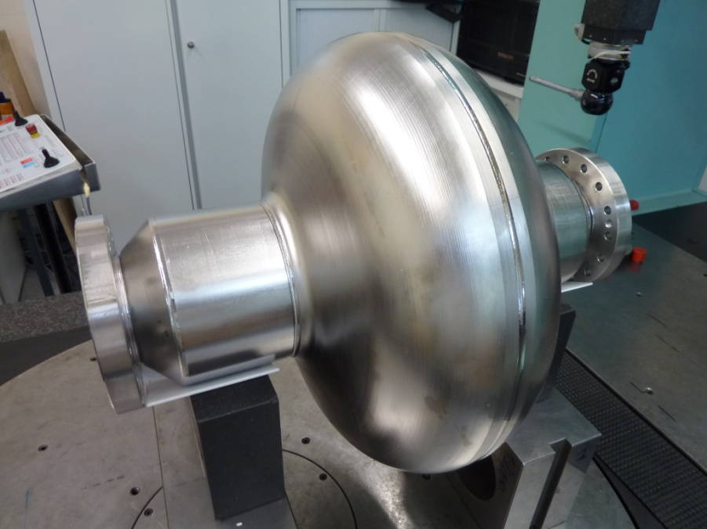
Niobium cavity-Monocell from RI
Threefold purpose:
Validate RI fabrication processes (forming, welding, brazing)
Electropolishing tests
Cold tests

Slide 9
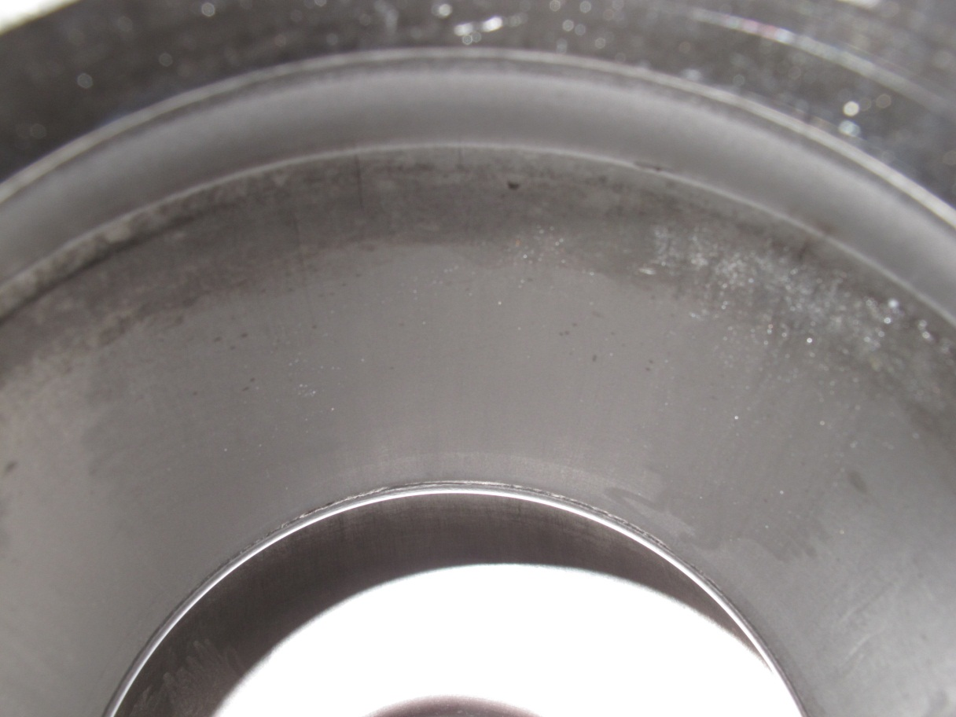
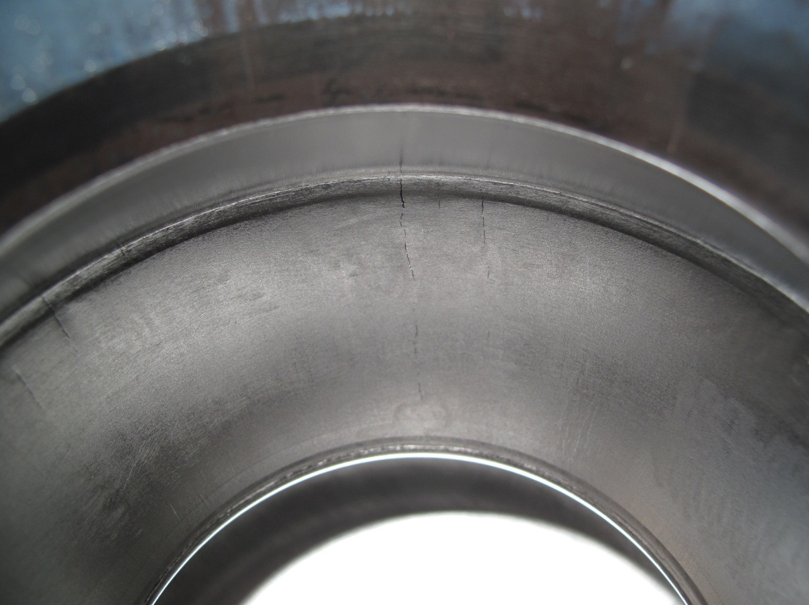
Niobium cavity-Monocell from RI
Material defects made evident after EP

Slide 10
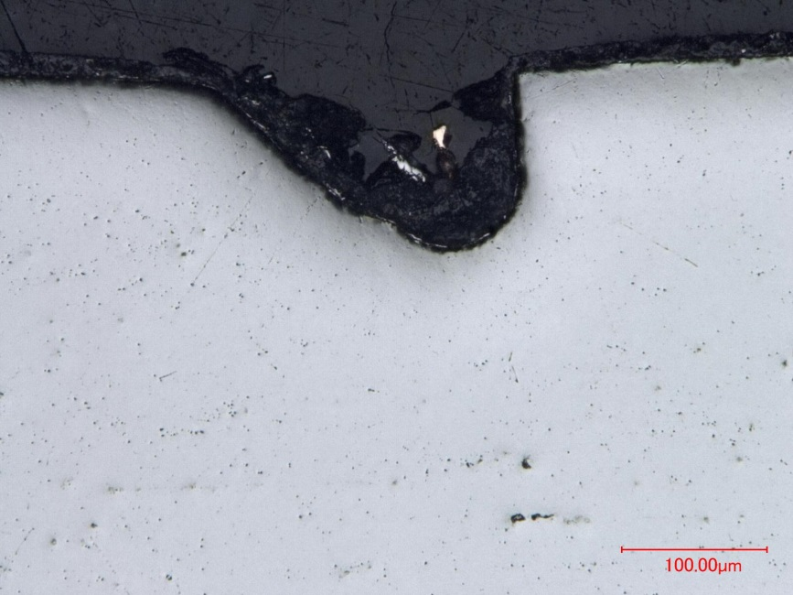
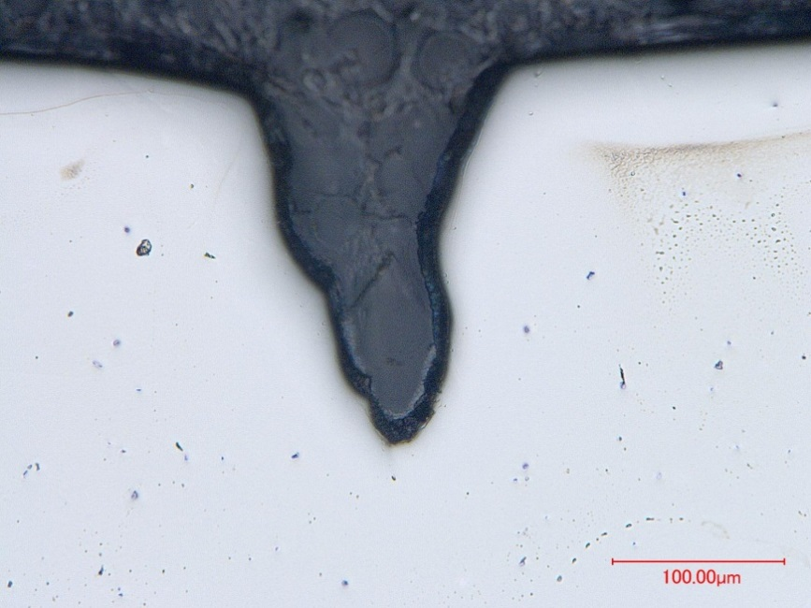
Niobium cavity-Monocell from RI
Cutting of the monocell in order to inspect the defects and assess their origin
Different defects were inspected in several cross sections
Shallow
No progression
Aspect of chemical dissolution
Surface discontinuities most likely are originated during fabrication and / or handling emphasised after EP

Slide 11
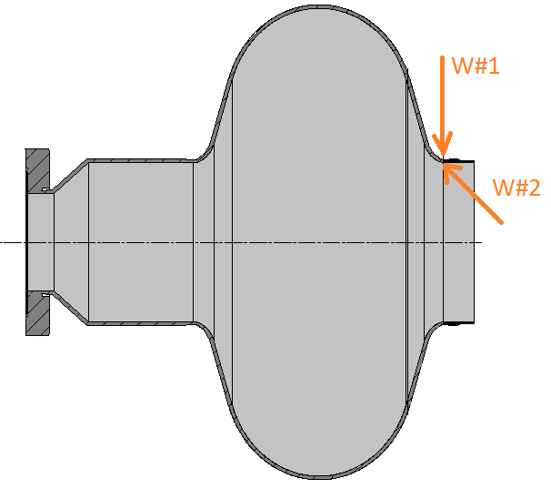
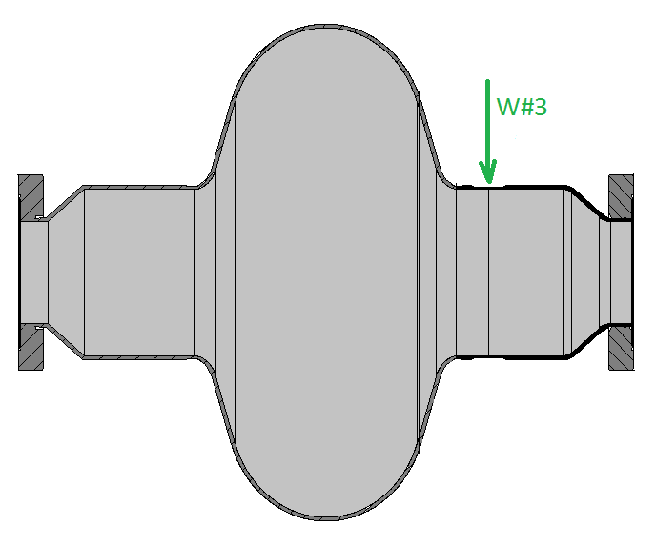
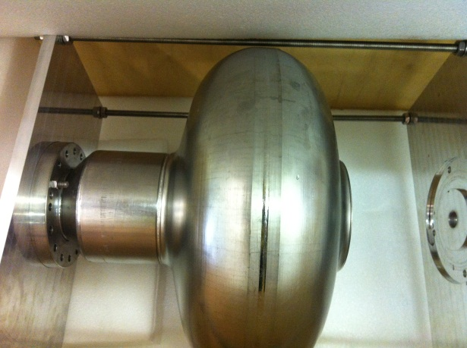
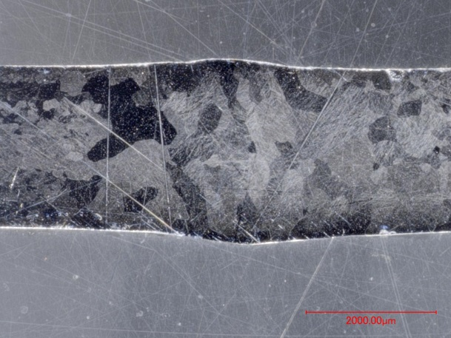
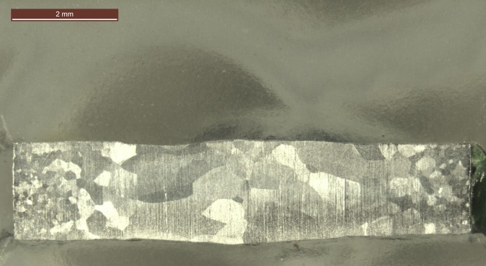
Reparation monocell from RI at CERN
The monocell was repaired in order to continue with the electropolishing and cold tests.
EB Welding from the outside (W#1) and inside (W#2)
Full penetration: 2.4 mm
EB Welding from the outside (W#3)
Full penetration: 1.7 mm
Cross section of the EB weld (W#1 +W#2)
Cross section of the EB weld (W#3)
Notes:
The monocell was repaired in order to continue with the electropolishing and cold tests.

Slide 12
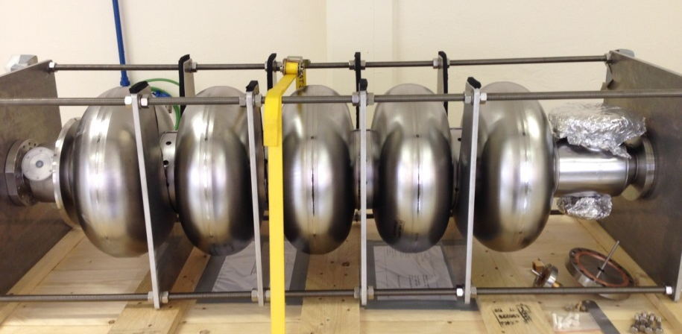
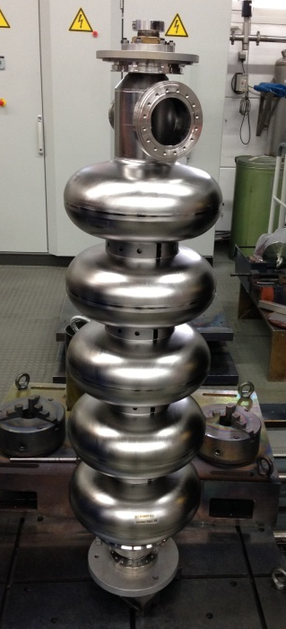
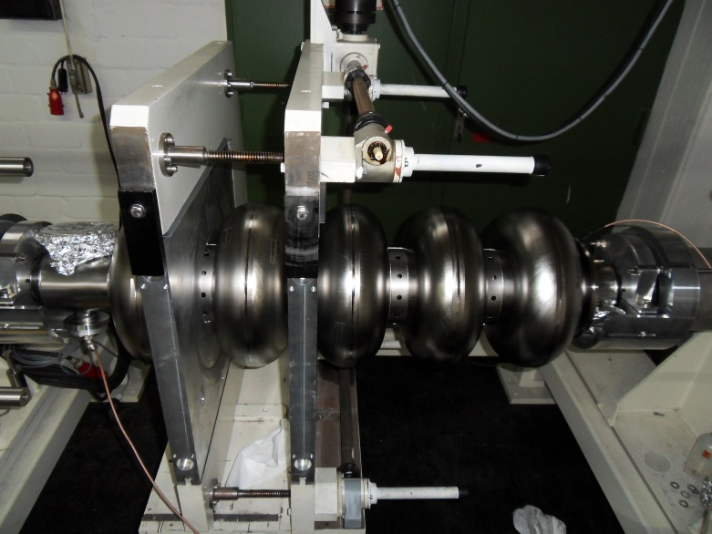
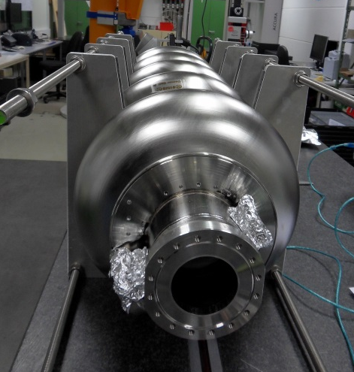
Niobium cavities at RI
4 niobium cavities fabricated by Research Instruments (RI) arrived to CERN Dec. 2013.

Slide 13


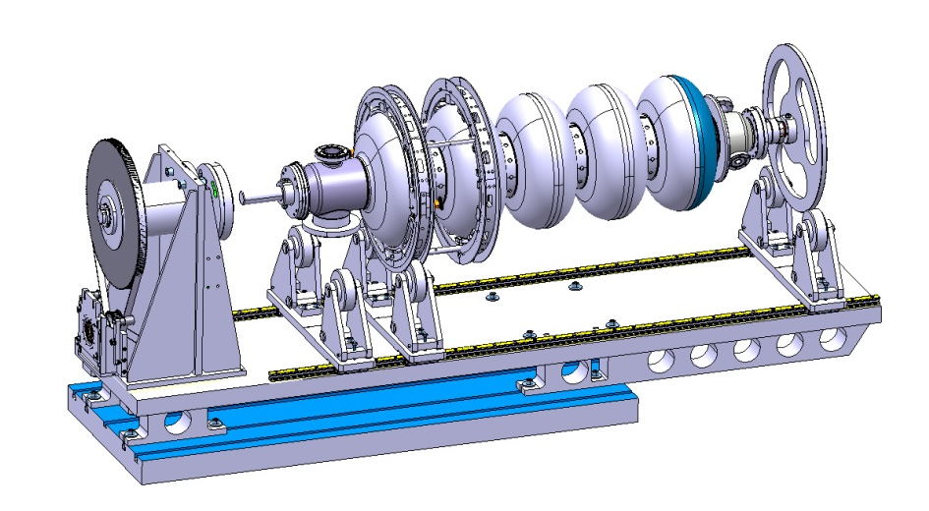
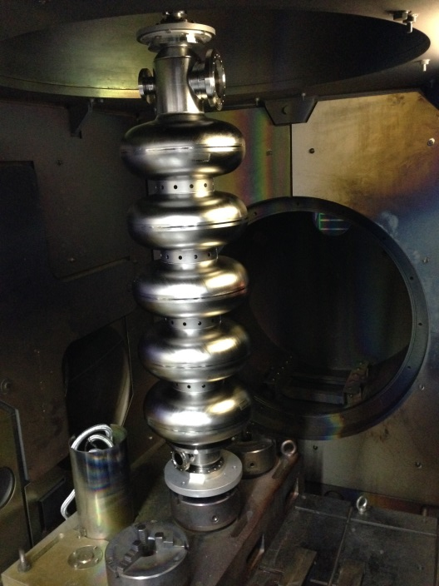
Differences in fabrication RI versus CERN
RI
CERN
Electron beam
Electron beam
EB welding with step joint design
EB welding with butt joint design
EB welding of the complete cavity in vertical- no need of special tooling
EB welding of the complete cavity in horizontal position- special tooling neede

Slide 14
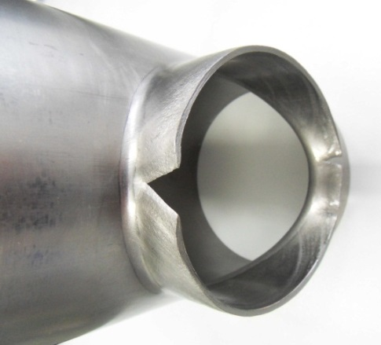
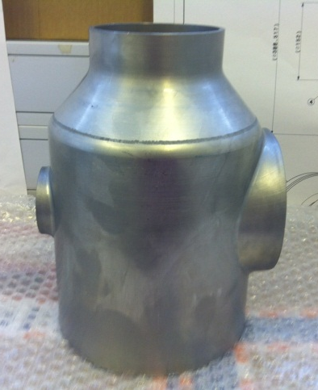
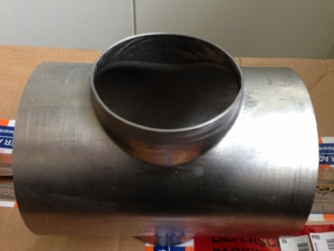
Niobium cavities-RI
Lesson learnt:
Challenge: Necking – out of the end groups
Studies at CERN to optimize the necking out parameters in order to minimize the deformation:
  Ellipse diameters
  Necking height
  Tooling
The new set of parameters (which gave satisfactory results at CERN) were adopted by RI for the necking out of their end groups
For the end groups to be done at CERN, a specially dedicated tooling has been designed and is under construction
All material properties were according to the specification but the material cracked due to excessive deformation.

Slide 15
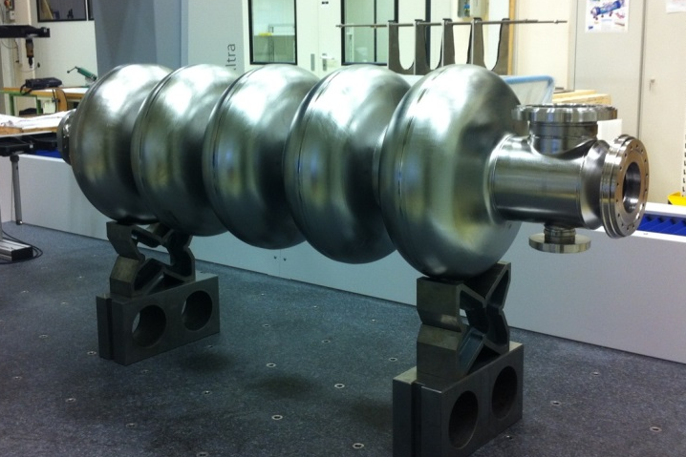
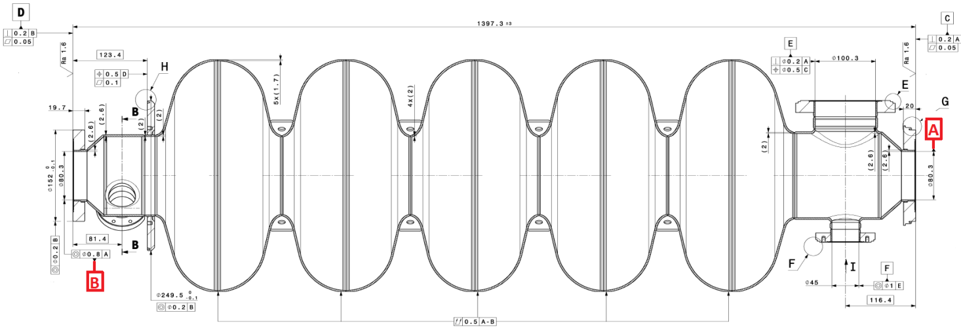
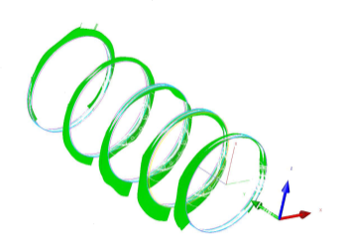
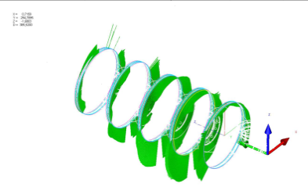
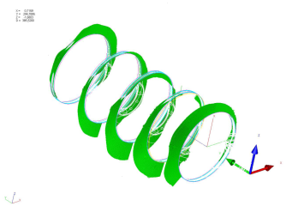
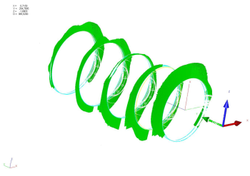

Niobium cavities-RI:Dimensional contol
 | CAVITY 1 | CAVITY 2 | CAVITY 3 | CAVITY 4
Run-out 0.5 /A-B | 5.359 | 7.725 | 5.223 | 4.714
Length of the cavity 1397.3 ± 3 | 1395.886 | 1393.831 | 1395.592 | 1395.229

Slide 16
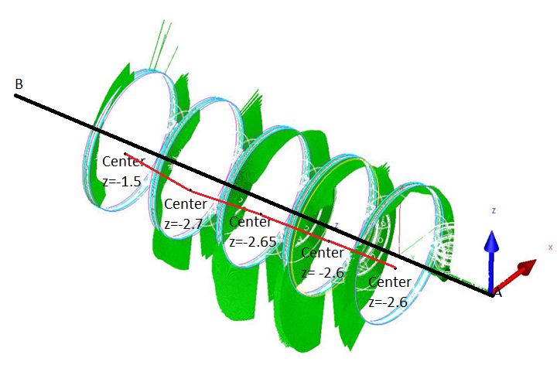
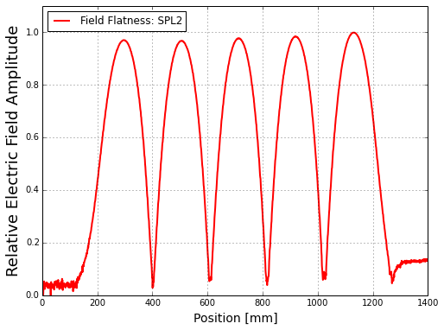
Niobium cavities-RI
If we measure the center point of the cells and the extremity flanges we can see that there is huge deviation. The cells are shifted with respect to the axis defined by the extremity flanges.
Field flatness value 3.26 %
Cavity 2
Thanks to S. Mikulas and A. Macpherson
 | Cavity 1 | Cavity 2 | Cavity 3 | Cavity 4
Axis straightness (of the 5-cells) | 1.075 | 1.803 | 1.167 | 1.078
Concentricity (between axis AB and the axis created by the 5-cells) | 5.014 | 6.883 | 4.282 | 4.240
Cylindricity (of the 5-cells) | 1.308 | 2.122 | 1.372 | 1.330

Slide 17
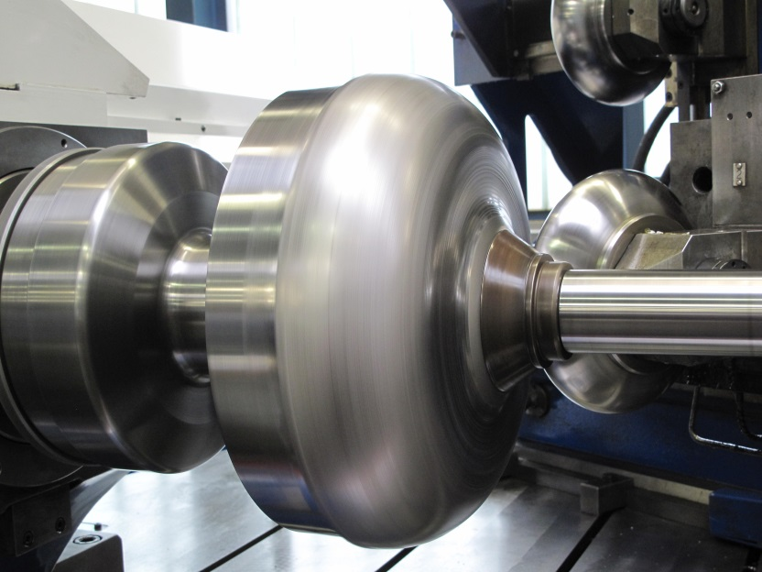
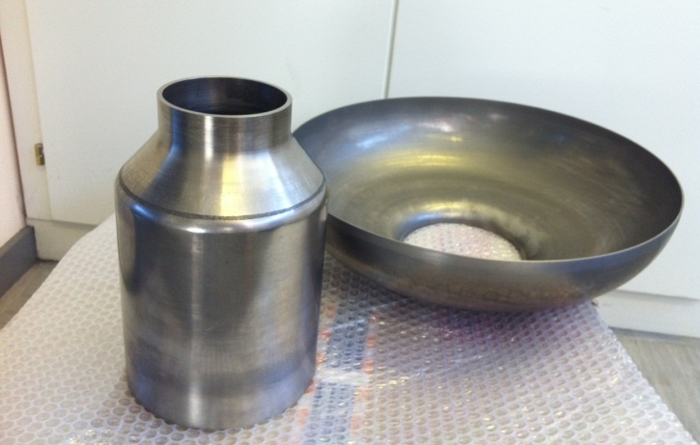
Niobium cavity at CERN
Spinning of half-cells and beam tubes at HEGGLI
Extensive testing has been done in order to optimize the spining parameters and tooling to achieve the required tolerances. It was proven that it is a process difficult to control and the results were not as expected . New forming techniques are being considered

Slide 18
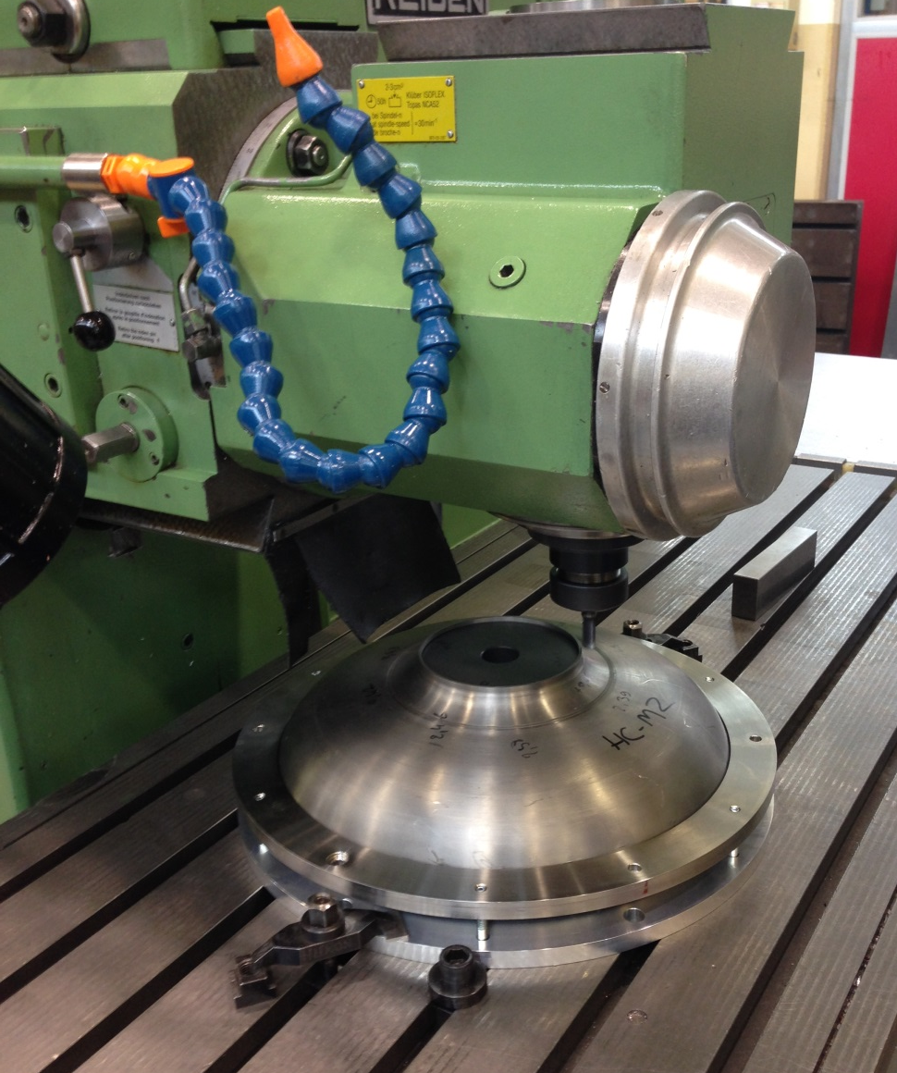
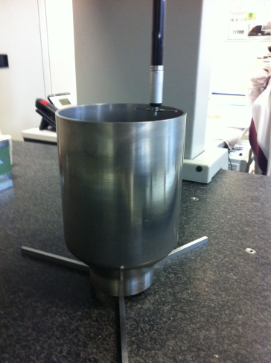
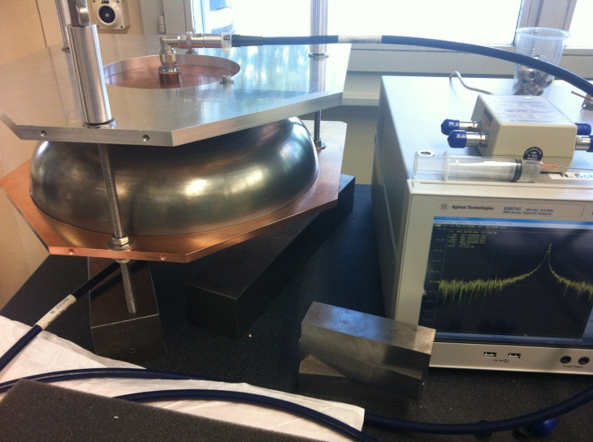
Niobium cavity at CERN
Machining of the iris (at CERN)
Dimensional control by CMM
RF measurements

Slide 19


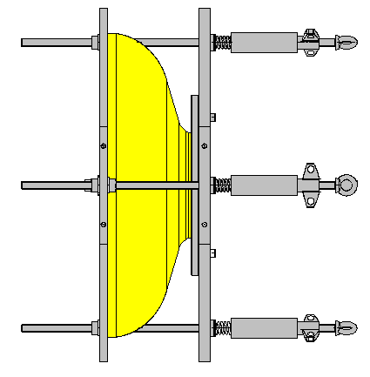



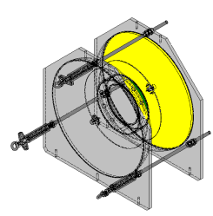


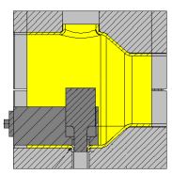
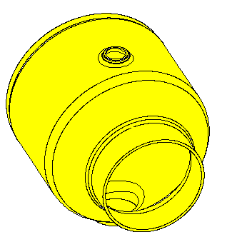
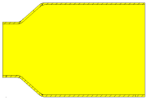
Niobium cavity at CERN
Spinning
Machining
Cutting cell length
RF measurement
CP (chemical polishing)
RF measurements
Machining – Welding preparation (Iris & rings)
Spinning
CP
HALF-CELLS
Nb
Assembly half-cell+ half-cell+ stiffening ring=> Dumb-bell
Degreasing + CP (8 h before EBW)
EBW half-cell + half-cell
Degreasing +CP (8 hours before EBW)
EBW dumb-bell+ stiffening ring
RF measurements
Trimming equators
RF measurements
Grinding and CP (if needed)
EBW
EBW
CP
EBW
DUMB-BELLS
Trimming equators
Grinding and CP (if needed)
Degreasing +CP
EBW
Nb
Spinning
Necking-out
Machining
CP
Necking-out
CP
BEAM TUBES
Spinning
Machining

Slide 20



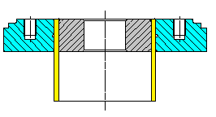
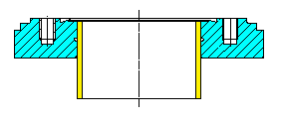
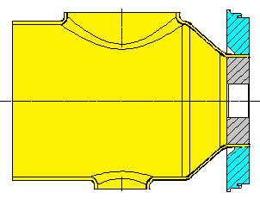
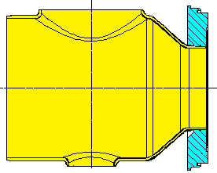






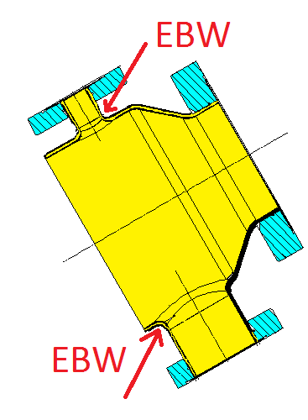
Niobium cavity at CERN
Machining SS Flange + Nb tube + SS insert
Degreasing + CP
Brazing
Machining- Removal of SS insert
Degreasing
Brazing
Machining
FLANGES
Nb
SS
SS
Machining SS Flange + Nb beam tube + SS insert
Degreasing + CP
Brazing
Machining-Removal of SS insert
Machining
Degreasing
Brazing
BEAM FLANGES
SS
SS
Nb
Machining SS Flange + Nb beam tube + SS insert
Degreasing + CP
Brazing
Machining-Removal of SS insert
TANK CONNECTOR
Brazing
Machining
SS
Nb
SS
Assembly beam tube + ports=> end group
Degreasing + CP ( 8h before EBW)
Electron beam welding (EBW)
CP
EBW
END GROUP
2

Slide 21







Niobium cavity at CERN
Assembly end group+ tank connector + half-cell=> extremity 1
Degreasing + CP ( 8h before EBW)
EBW end group + tank connector
Degreasing + CP ( 8h before EBW)
EBW end group + half-cell
RF measurements
Trimming equator
RF measurements
EBW
CP
EBW
EXTREMITY 1
Cp
EBW
Trimming
RF measurements
RF measurements
Assembly end group + half-cell=> extremity 2
Degreasing + CP ( 8h before EBW)
EBW end group + half-cell
RF measurements
Trimming equator
RF measurements
EXTREMITY 2
CP
EBW
Trimming
RF measurements
RF measurements

Slide 22









Niobium cavity at CERN
Final assembly
CP - 8 h before each EBW
EB Tack weld
EBW
EB Tack weld
EBW
EB Tack weld
EBW
EB Tack weld
EBW

Slide 23

Niobium cavity at CERN
New EB welding machine at CERN (11 m³);
SS vacuum chamber;
Vacumm level 10⁻⁵ mbar up to 10⁻⁷ mbar (cryo. pump)→ Suitable for high RRR niobium welds (see R&D → RRR).

Slide 24


Tunning tests: Cell – by – cell tunning system
The tests were done with a prototype copper cavity
Mechanical measurements: frequency shift with respect to stress and deformation
Cell-by-cell tuning system with RF bead-pull measurements
Thanks to M. Guinchard
Measured cavity frequency change vs. mechanical deformation of cell no 4.

Slide 25

Tunning tests: cavity tunner
The tests were done with a prototype copper cavity
Cavity tuner: measurement of cavity detuning versus mechanical deformation.
Thanks to M. Guinchard

Slide 26

Tunning tests: cavity tunner
Tunning tests are being repeated with a niobium cavity

Slide 27




Procurement of He tanks
5 stainless steel (316L / 1.4404) helium tanks designed by CERN and ordered by CEA have been fabricated at SDMS.
Many dimensions are out of tolerances and we are checking if they are acceptable.

Slide 28

Procurement of He tanks
When defining the technical specification, it was not considered any restriction regarding the filler metal for the longitudinal weld, what ended with a high magnetic permeability in this region.
In order to avoid this, a filler metal with very high Ni_{eq} should be specified
If permeability is a paramount concern, the tank should be made in 316LN
316L
Filler metal

Slide 29

R&D- Brazing
Niobium cavity & SS tank
SS flanges
Brazing Nb / SS 316 LN with a Cu-OFE copper interface is a key technology developed at CERN in 1987
Difference in expansion of Nb/SS
Nb tube fitted to SS flange
Clearance ≤ 20 µm
SS plug to expand the Nb
Cu – OFE copper as brazing material
Brazing temperature 1100°C, ∆_{time} <<
P< 10⁻⁵ mbar

Slide 30


R&D- Brazing
Nb tube + SS flange
SS
Nb
The joint proved to be functional and to mechanically fulfil the requirements for the intended application
It was also decide to mask the brazed joint during EP operations to avoid damaging its soundness
It was proven that an EB welding close to the brazed joint does not affect the interface
Full results in presentation
I. Aviles and N. Valverde SLHiPP2

Slide 31




R&D- Welding tests
Still trying to find the good parameters
Nb
Nb55Ti
Ti6Al4V
Nb55Ti
Nb
Ti6Al4V

Slide 32
RRR measurements
PTR → 1.3  10⁻⁴ mbar
SST → 3.3  10⁻⁵ mbar
@ lower vacuum levels → degradation of 10% of RRR value
@ higher vacuum levels with the new EB welding machine → RRR value does not degraded apart from statistical variation

Slide 33
Conclusions
Material procurement: Seamless tubes are to be avoided as the rolling + welding or spinning of the end groups is easier and well performing.
Niobium 5-cell cavities: 4 cavities were fabricated at RI. Dimensional tolerances are not fulfilling the specification, but RF measurements at RT were satisfactory. We are still performing tests (EP, HT, cold tests…)
Niobium 5-cell cavity at CERN: forming of the half cells has been done together with the brazing of the ports. EB welding tooling has been fabricated and soon we will start with the welding of the dumb – bells.
Helium tank: It has to be considered the magnetic susceptibility of the material and the filler metal if aplicable.
Brazing: It has been proven that it is a successful solution for the Nb/SS interfaces for superconducting cavities. Tests at cryogenic temperatures are foreseen.
Welding tests: First trials were not as expected but new welds will be carried out soon with improved welding parameters.

Slide 34
Thanks for your attention!!
We would like to thank the people who help us in our work:
G. Arnau Izquierdo, S. Atieh, K. Artoos, O. Capatina, JM Dalin,
L. Ferreira, S. Forel, A. Gerardin, M. Guinchard, M. Malabaila,
F. Pillon, A. Porret, D. Pugnat, M. Redondas, T. Renaglia, T. Tardy, A. Vacca

