Slide 1

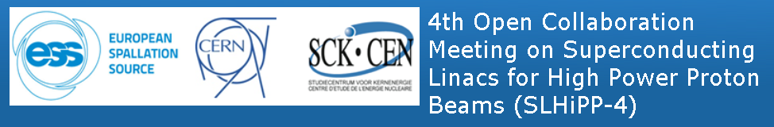
Fermilab elliptical cavities
Slava Yakovlev
4th SLHiPP Meeting
May 15-16, 2014

Slide 2
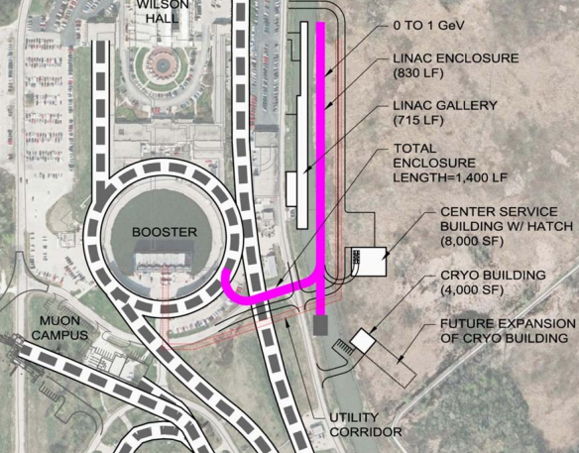
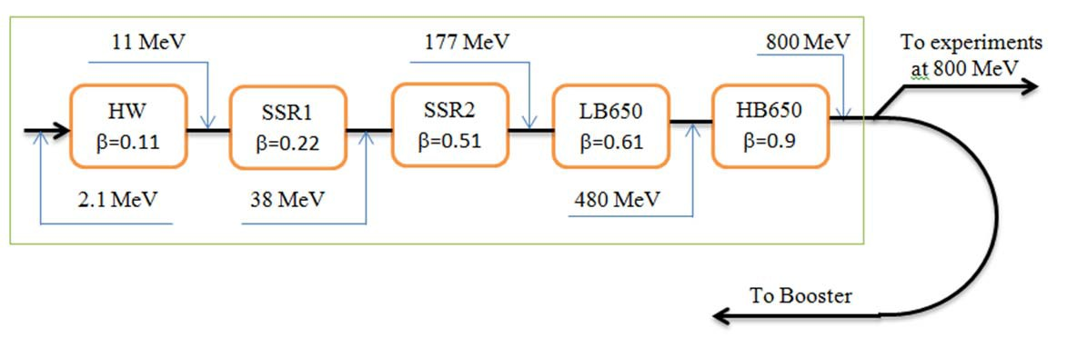
PIP-II Linac :
Linac Beam Energy | 800 | MeV
Linac Beam Current | 2 | mA
Linac Beam Pulse Length | 0.6 | msec
Linac Pulse Repetition Rate | 15 | Hz
Linac Upgrade Potential | CW
Low beam loading;
Long filling time compared to pulse length;
Low efficiency at pulse mode.

Slide 3

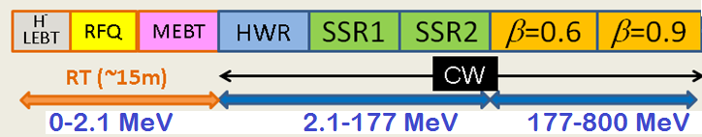
PIP II
SRF Linac Technology Map
SRF Cavity Type | Freq, MHz | Energy (MeV) | Cav/mag/CM | CM type, length
HWR (β_{G}=0.11) | 162.5 | 2.1-11 | 8 /8/1 | scscscscscscscsc, 5.3m
SSR1 (β_{G}=0.22) | 325 | 11-38 | 16 /8/ 2 | csccsccsccsc, 4.8m
SSR2 (β_{G}=0.51) | 325 | 38-177 | 35 /21/ 7 | sccsccsc, 6.5m
LB 650* (β_{G}=0.61) | 650 | 177-480 | 30 /20/5 | cccfdccc, 7.1m
HB 650 (β_{G}=0.9) | 650 | 480-800 | 24 /6/ 4 | cccccc, 9.5m
*3-cavity option is under consideration; CM has no focusing elements.

Slide 4
Accelerating cavity types and
characteristics for the SC linac.
Name | β_{G} | β_{opt} | Freq (MHz) | Type of cavity | B_{peak} (mT) | E_{peak} (MV/m) | E_{acc} (MV/m) | ΔE (MeV)
HWR | 0.094 | 0.112 | 162.5 | Half wave resonator | 41 | 38 | 8.2 | 1.7
SSR1 | 0.186 | 0.222 | 325 | Single‐spoke resonator | 58 | 38 | 10 | 2.05
SSR2 | 0.431 | 0.515 | 325 | Single‐spoke resonator | 70 | 40 | 11.2 | 5.32
LB650 | 0.61 | 0.647 | 650 | Elliptic 5‐cell | 70 | 37.5 | 16.5 | 11.6
HB650 | 0.9 | 0.95 | 650 | Elliptic 5‐cell | 64 | 35.2 | 17.5 | 17.7
E_{peak} ≤ 40 MV/m, for CW (Field emission);
B_{peak} ≤ 75 mT, for CW (medium field Q-slope)

Slide 5
PIP II cavity Issues:
CW option → high Q₀
Low beam loading → microphonics, LFD (pulse regime)
HOMs → “to damp or not to damp?”
Input coupler issues
Design issues:
low EM fields
aperture choice
cavity shape
trapped modes
MP

Slide 6
Single Cell Cavity Tests:
Nitrogen Treatment during vacuum bake
Surface doping: baseline strategy to improve R_{BCS} and allow high Q for LCLS-II at 2K
Current R&D Goal:
Develop a robust surface processing recipe based on Nitrogen Treatment for LCLS-II
Spec Q>2.7e10 at 2K, 1.3 GHz, 16 MeV/m
  and transfer to industry
LCLS-II
*A.Grassellino et al, 2013 Supercond. Sci. Technol. 26 102001
<Q0>(FG) = 4.2e10*

Slide 7
Typical bake cycle – small deviation from standard XFEL degassing cycle*
Gas injection, ~10 min
Standard 800C degassing cycle
*A Grassellino et al 2013 Supercond. Sci. Technol. 26 102001

Slide 8
New FNAL discovery: cooling details matter for bare cavities example for nitrogen doped
~1.8K/min trough Tc
~0.3 K/min trough Tc
*A. Romanenko et al, J. Appl. Phys. 115, 184903 (2014)

Slide 9
Nine cell TB9ACC015 – world record Q nine cell at mid E_{acc}
T=2K
f=1.3GHz
Q
LCLS-II spec
E [MV/m]

Slide 10
Nine cells N doped vs typical 120C bake: comparison at 2K, mid field: 2-3 times higher Q
Q
Eacc [MV/m]

Slide 11
High-Order Modes in Project X cavities
HOM damper is a vulnerable, expensive and complicated part of SC acceleration structure (problems – multipactor, heating, damage of feed-through, etc; additional hardware – cables, feed-through, connectors, loads);
Specifics of Higher Order Mode effects in the PIP II pulsed/CW Linac:
Non-relativistic beam;
Small current and small bunch population;
No feedback (linac);
Complicated beam timing structure
(dense frequency spectrum).
Possible issues:
Resonance excitation of HOMs;
Collective effects;
Cryo-losses;
Emittance dilution (longitudinal and transverse).

Slide 12
Scope of HOM investigations:
Loss factor calculations for non-relativistic beam;
Beam spectrum investigation for different Project X operation options;
Cavity spectrum investigations (simulations and measurements) for all the PIP II sections - HWR, SSR1, SSR2, LB650 and HB650 – impedance and spectrum density versus frequency;
Resonant frequency spread for HOMs estimations and if possible measurements for all the cavities of the PIP II;
Q estimations for different modes;
HOM impedance spread (estimations and measurements) for all the cavities of the Project X;
HOM impedance dependence on the particle velocity over the linac;
Microphonics for different HOMs;
Stability of HOMs versus operation mode tuning/detuning;
Cryogenic loss estimations for different option of the Project X operation (taking into account propagating and non-propagating modes);
Estimation of the beam emittance (longitudinal and transverse) dilution caused by HOMs;
Longitudinal “klystron type” instabilities caused by HOMs;
Transverse instability – BBU;
Comparison to operating accelerators (SNS)

Slide 13
Studies of HOMs in the PX:
“to damp or not to damp?”
Detailed simulations show:
Beam Break Up (BBU) should not be a problem;
“Klystron-type” longitudinal instability does not look to be a problem as well.
Resonance excitation of the dipole modes does not look to be an issue;
Accidental resonance excitation of the 2d monopole band in beta=0.9 section may lead to longitudinal emittance dilution, but probability is very small. However, v.2 of the cavity was designed which is free of this issue.
No HOM dampers!

Slide 14
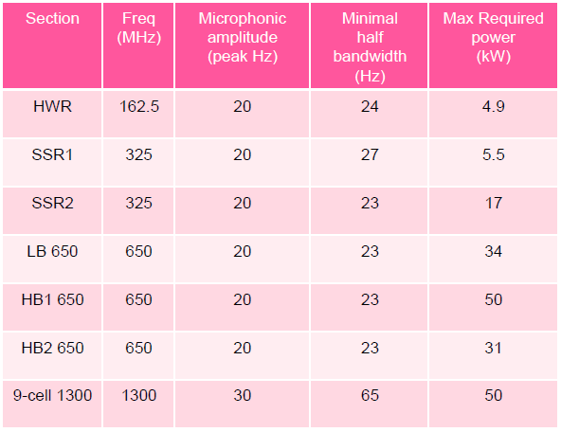
Microphonics in PIP II Cavities
Low beam loading (1-2 mA) → narrow cavity bandwidth → microphonics issues.
Microphonics Control Strategies:
Providing sufficient reserve RF power to compensate for the expected peak detuning levels.
Improving the regulation of the bath pressure to minimize the magnitude of cyclic variations and transients.
Reducing the sensitivity of the cavity resonant frequency to variations in the helium bath pressure (df/dP).
Minimizing the acoustic energy transmitted to the cavity by external vibration sources.
Actively damping cavity vibrations using a fast mechanical or electromagnetic tuner driven by feedback from measurements of the cavity resonant frequency.

Slide 15
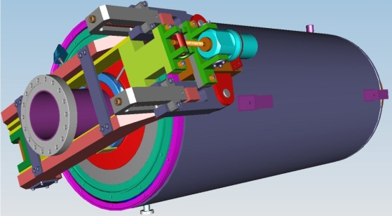
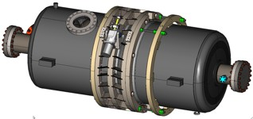
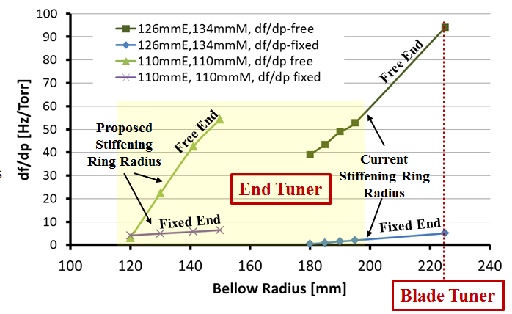
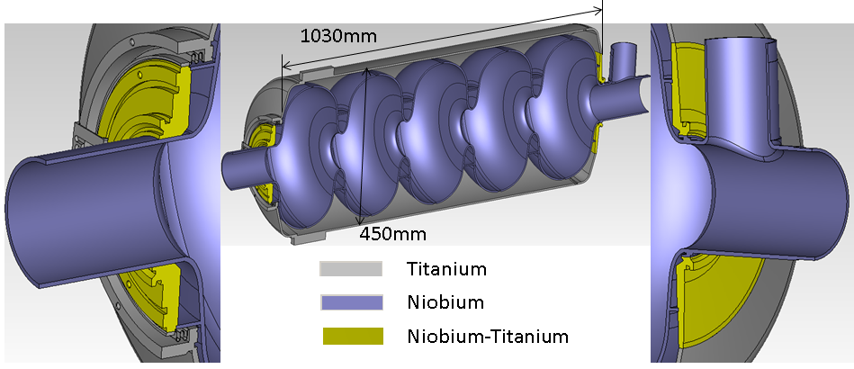
He vessel and tuner design
for 650 MHz cavity
Blade Tuner – scaled ILC:
High df/dP,
Insufficient tuning efficiency;
New End Tuner design:
Low df/dP,
Mechanical resonance s > 60 Hz;
Good tunability;
Less expensive.
Stiffening rings located to minimize df/dP
while maintaining tunability

Slide 16
Requirements to Project X RF couplers
Cavity SSR1 (325MHz):
Max. energy gain - 2 MeV,
Max. power , 1 mA case* - 4 kW,
Max. power , 2 mA case* - 6 kW
Cavity SSR2 (325MHz):
Max. energy gain - 5.3 MeV
Max. power ,1 mA case* - 12 kW,
Max. power , 2 mA case* - 17kW
325 MHz coupler has to provide reliable operation at power level of ~ 30 kW, CW,
taking into account possible operation at higher current in future.
Cavity LB 650 (650MHz):
Max. energy gain - 11.7 MV,
Max. power , 1 mA case* - 30 kW,
Max. power , 2 mA case* - 40 kW
Cavity HB 650 (650MHz):
Max. energy gain - 17.7 MV,
Max. power , 1 mA case* - 30 kW,
Max. power , 2 mA case* - 50 kW
650 MHz coupler has to provide reliable operation at power level of ~ 100 kW, CW.
* Taking into account overhead (losses, control, microphonics).

Slide 17
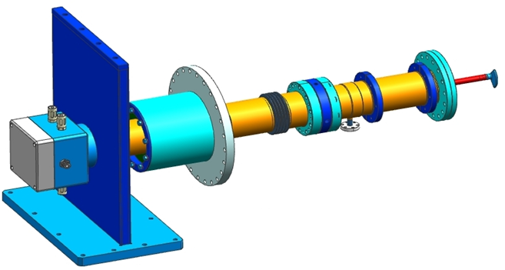
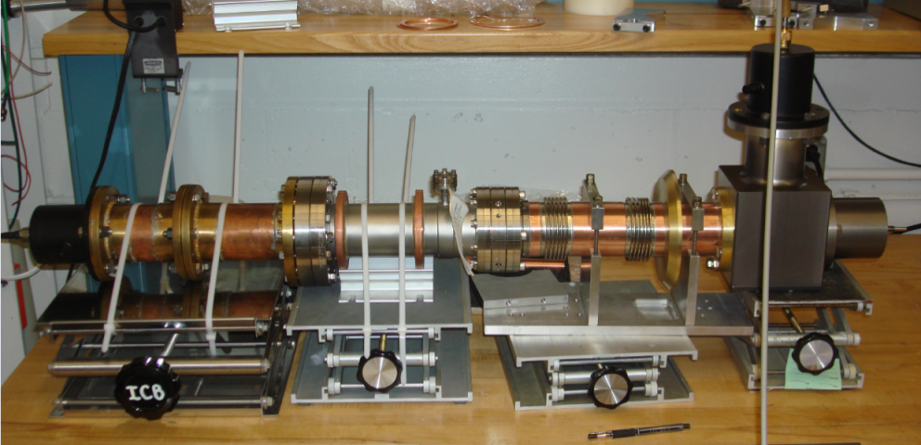
650 MHz, 120 kW CW coupler:
One window;
Air cooling;
Non-adjustable;
Bias is possible.
325 MHz coupler prototype:
Three couplers are manufactured, measured (reflection -22 dB at 325 MHz) and will be tested in few weeks.
The test stand is ready

Slide 18
Cavity design: working assumptions:
  Surface fields.
  Field enhancement factors should be as small as possible in order to provide higher gradient.
B_{pk}≤ 70 mT, E_{pk} ≤ 40 MV/m.
  Coupling coefficient k:
  Smaller k → smaller field enhancement factors;
  Limitation:
field flatness:
δE/E ~ f_{π} /|f_{π}-f_{π(N-1)/N}| ≡ f_{π} /δf ≈ 1/kN² → k~1/N².
For ILC, N=9: δf /f_{π} = 6e-4 (k=1.87%);
We use, N=5: δf /f_{π} = 8e-4 (k=0.75%).

Slide 19
Aperture:
Smaller aperture → smaller field enhancement factors;
Limitations:
beam losses,
field flatness,
mechanical stability,
surface processing.
    SNS (805 MHz): 2a=86mm (β=0.61), 2a/λ = 0.23
2a=98mm (β=0.81), 2a/λ = 0.26
HIPPI (704 MHz): 2a=80mm (β=0.47), 2a/λ = 0.19
We use (650 MHz): 2a=83mm (β=0.61), 2a/λ = 0.18 (FNAL)
2a=100mm (β=0.61), 2a/λ = 0.22 (JLAB)
2a=100 mm (β=0.9), 2a/λ = 0.22 (v.1)
2a=118 mm (β=0.9), 2a/λ = 0.26 (v.2)

Slide 20
Cavity wall slope:
Smaller slope → smaller field enhancement factor;
Limitations :
mechanical stability,
surface processing.
We use:
5 deg for β=0.9 (compared to 7 deg for ILC);
2 deg for β=0.61 (LL has zero slope, Re-entrant has negative).
Should be no trapped modes (optimization of the end cells);
Mechanical stability – under consideration.
Very first impression: β=0.9 is OK,
β=0.61 may need revision.

Slide 21
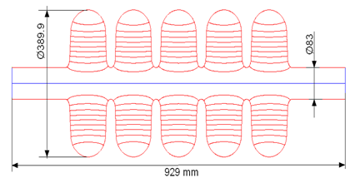
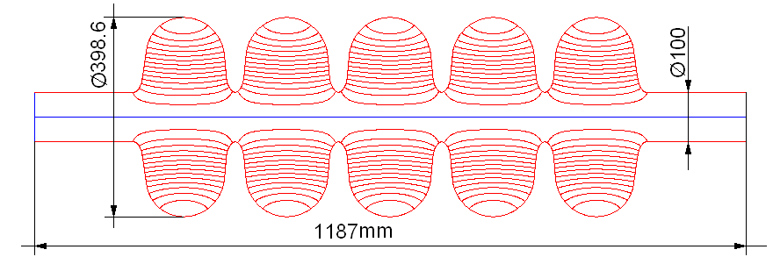
650 MHz, 5-cell cavities
Low-beta
High-beta
Parameter |  | LB650 (FNAL) | HB650(FNAL)
β_{geom} |  | 0.61 | 0.9
Cavity Length = n_{cell}∙β_{geom}λ/2 | mm | 703 | 1038
R/Q | Ohm | 378 | 638
G-factor | Ohm | 191 | 255
Max. Gain/cavity (on crest) | MeV | 11.7 | 17.7
Acc. Gradient | MV/m | 16.6 | 17
Max surf. electric field | MV/m | 37.5 | 34
Max surf. magnetic field, | mT | 70 | 61.5
Q₀ @ 2K | × 10¹⁰ | 1.5 | 2.0
P_{2K} max | [W] | 24 | 24

Slide 22
  LB/ HB 650
  EM design of both LB and HB 650 is ready.
  Two singe-cell LB 650 cavities are manufactured, processed and tested (JLAB);
  Six single-cell cavities HB 650 are manufactured by AES, processed and tested at Fermilab.
  Two HB 650 cavities are processed and tested.
  Four 5-cell HB 650 cavities are manufactured by AES and ready for processing and tests.
  Five additional single cell and five five-cells HB cavities ordered from industry (PAVAC) on ARRA funds
  Design of He vessel for HB 650 with low df/dP and the tuners (slow and fast) are completed.
  Concept design of the CM for HB 650 is ready.

Slide 23
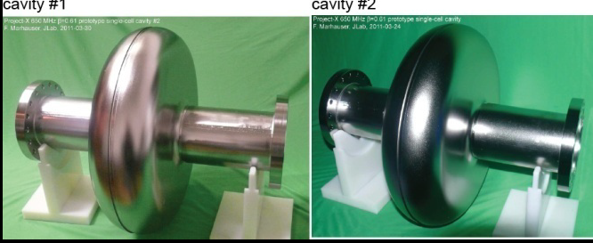
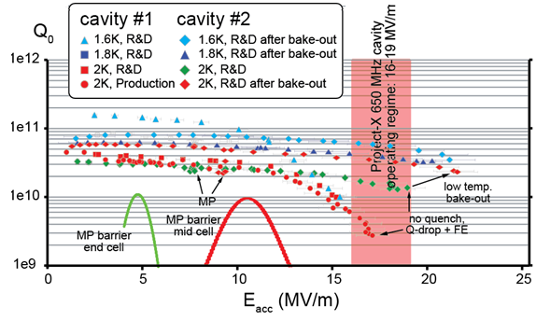
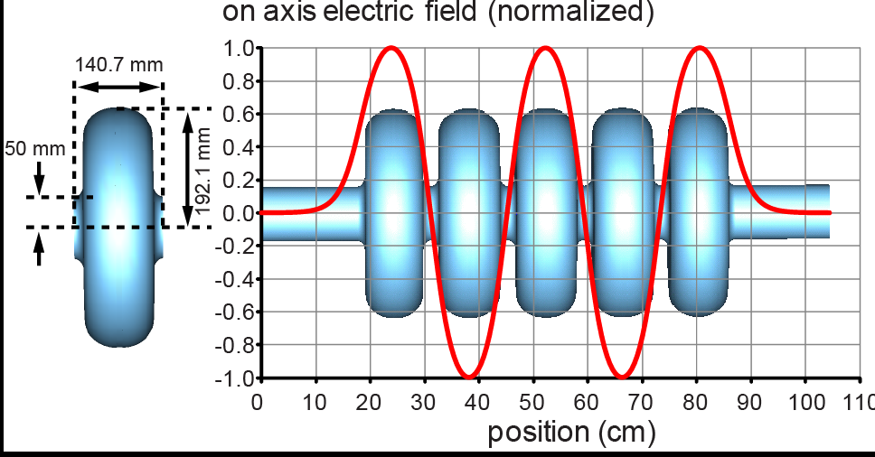
JLAB version of the 650 MHz,
beta=0.61 cavity for the PIP II
For the cavity #2
Q₀ >4e10 @17MeV/m

Slide 24
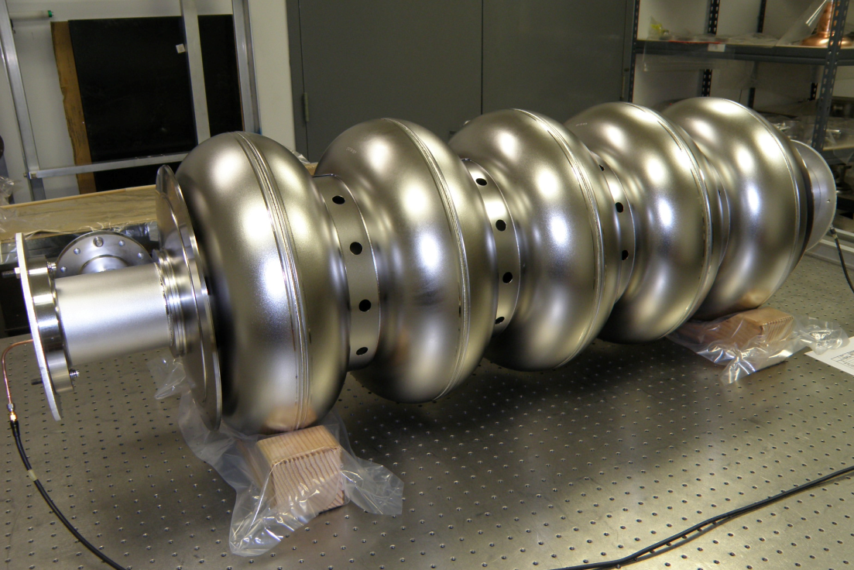
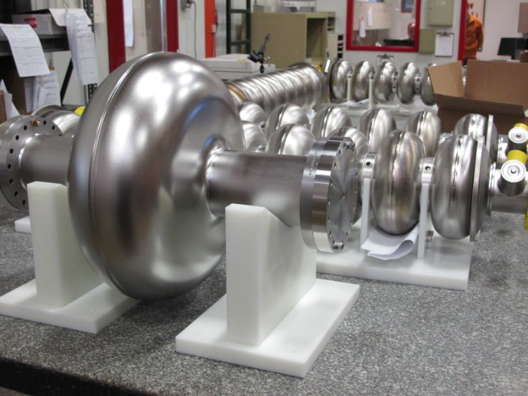
650 HB MHz cavities
Currently Available Cavities:
Expected Cavities:
1-Cell 650 MHz
1. B9AS-AES-001*
2. B9AS-AES-002*
3. B9AS-AES-003
4. B9AS-AES-004
5. B9AS-AES-005
6. B9AS-AES-006
5-Cell 650 MHz
1. B9A-AES-007
2. B9A-AES-008
3. B9A-AES-009
4. B9A-AES-010
1-Cell 650 MHz
Pavac, Inc.
Six to be delivered
late spring 2014.
5-Cell 650 MHz
Pavac, Inc.
Five to be delivered
early summer 2014.
*VTS Tested

Slide 25
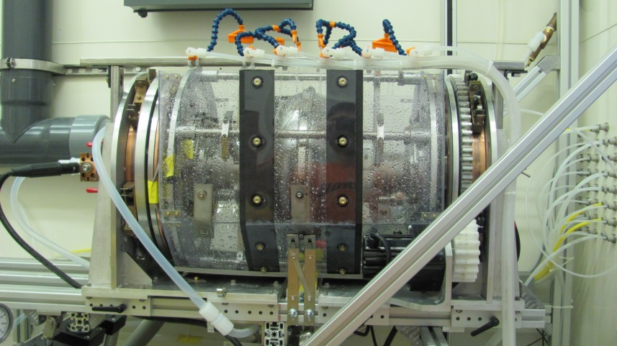
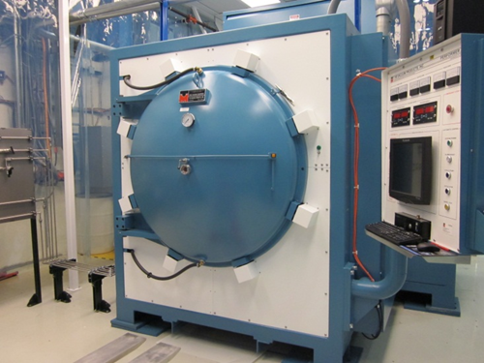
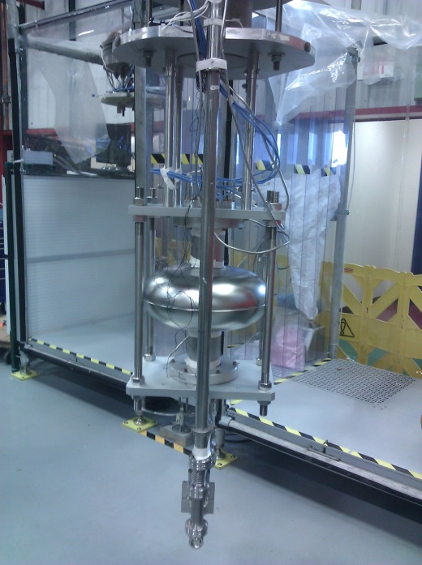
650 MHz testing/processing infrastructure
120-300C ovens--ready
High temperature furnace -- ready
EP, HPR tools, ready for 1-cell, not for 5-cell 650 MHz
VTS1—ready for 1-cell 650 MHz
VTS2,3—not commissioned, needed for 5-cell 650 MHz

Slide 26
Surface processing studies
Explored several different surface processing techniques on 650 MHz single cells
All cases largely exceed the PIP-II specs of Q ~ 2e10 at 17 MV/m

Slide 27
650 MHz 5-cell Infrastructure Prep
EP tool at ANL—new cathode required plus tool testing and evaluation. External cooling implemented.
HPR—requires adapters to accommodate multi-cell cavities.
Transport tooling—requires adapters to accommodate multi-cell cavities.
4-bar frames—designed, need to be procured.
VTS hardware—several sets in-hand. More to be ordered including new RF feethroughs.

Slide 28
650 MHz Testing Plan 2014
2-3 AES 1-cell cavity tests. High Q0 studies in VTS.
2-3 AES 5-cell cavities for baseline processing after VTS2-3 are ready and HPR/cleanroom infrastructure procured. Vendor qualification.
2-3 Pavac single-cell cavities for vendor qualification purposes.
2 Pavac multi-cell cavities for vendor qualification.

Slide 29
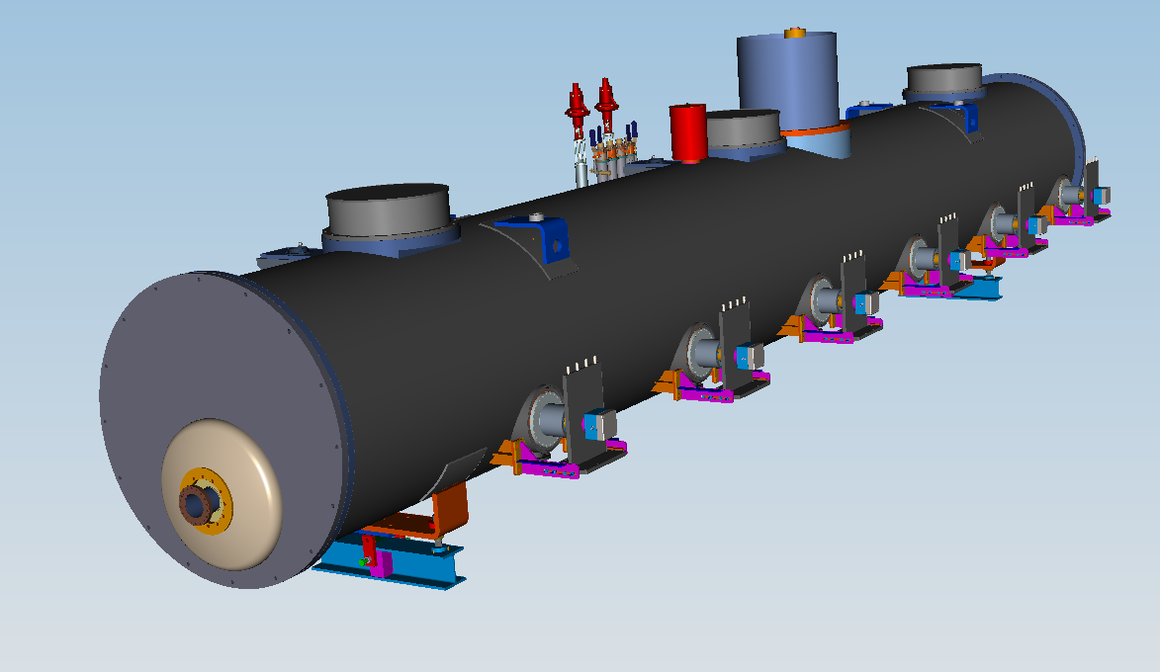
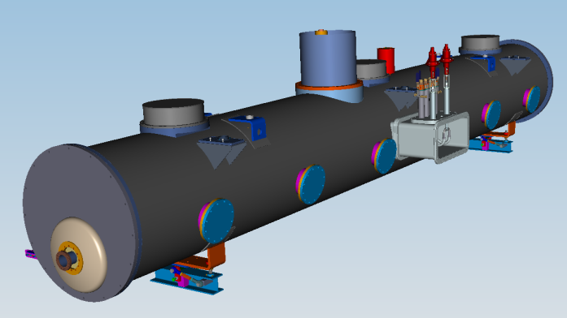
650 MHz Cryomodule.
(6 cavities, β=0.9, DESY Style, stand alone)
-Heat Exchanger
-Cryogenic stuff:
bayonets connections (He supply and
return), Cryogenic valve
control system
-End plates (2)
-Power couplers (6)
-Beam pipe
-CM support (1-fix, 2-sld)
-Vacuum Vessel (pipe: 48”-OD, .375”-wall)
-Ports for access to
Tuner motors (6)

Slide 30
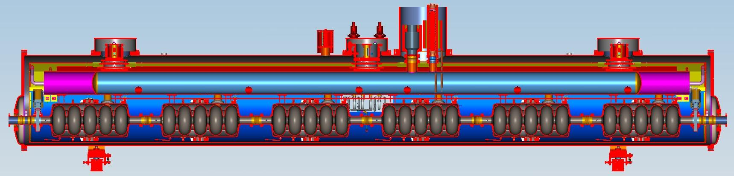
650MHz Cryomodule Layout
(6 cavities, β=0.9, DESY Style-SA)
Overall length (CS-Flange to Flange) ~9480mm
Number of Cavitis-6
Distance between couplers-1468.9mm
Interconnection bellows length ~135.3mm
Beam pipe ID-100mm
1-RF all metal GV for each end of Beam Pipe (cold)
Number of Support posts-3
300mm pipe (concept) serves as strong back, as the 2-phase helium pipe, also providing a large vapor buffer volume.
Heat exchanger
Insulation Vacuum Relief valve

Slide 31
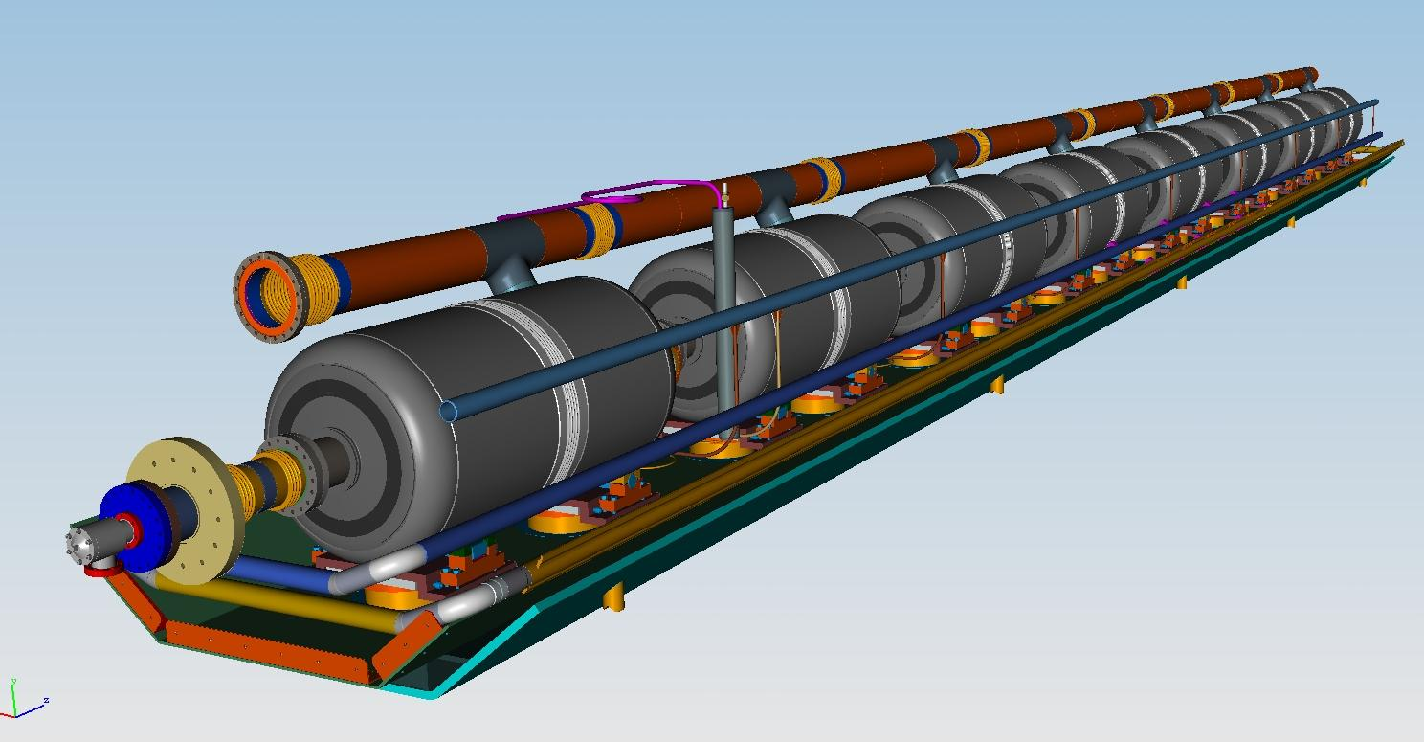
650 MHz Cavity, β=0.9.
String version with strong back
He reservoir
with level sensor
650 Cavity with 2-phase pipe
Warm up cool
down pipe
Strong back
(Tray) with 2
supports for each
cavity
5K circuit (to MC)
70K circuit (shield)
Used scheme of SSR1, by T. Nicol
PIP-II MAC, V. Yakovlev
31

Slide 32
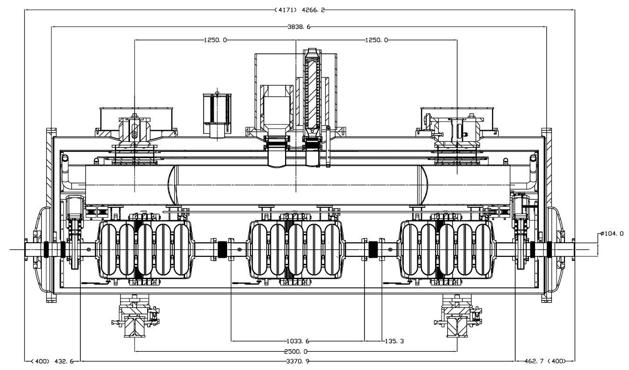
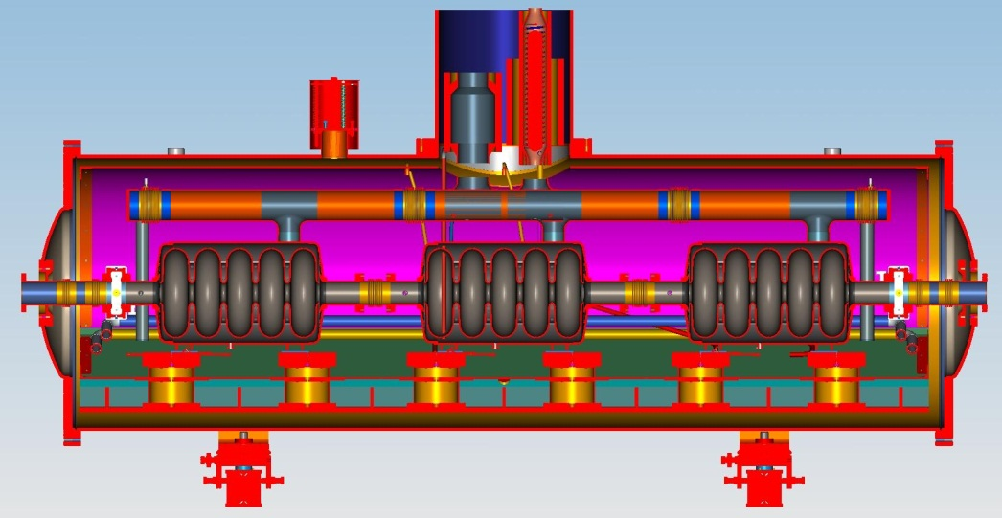
650 MHz 3-cavity Cryomodule, β=0.61.
SSR1 & DESY Style (stand alone)
Overall length (CS-Flange to Flange)~4200mm
Number of Cavitis-3 (shorter approx. 300mm)
Distance between couplers-1468.9mm
Interconnection bellows length-135.3mm
Gate valve (cold) for each end of Beam Pipe (2)
Number of Support posts-2 (1-Fix, 2-Sliding) or 6 (SSR1)
Cavity string support: 300mm pipe serves as strong back, as the 2-phase
helium pipe (DESY St.), or strong back (SSR1 St.)

Slide 33
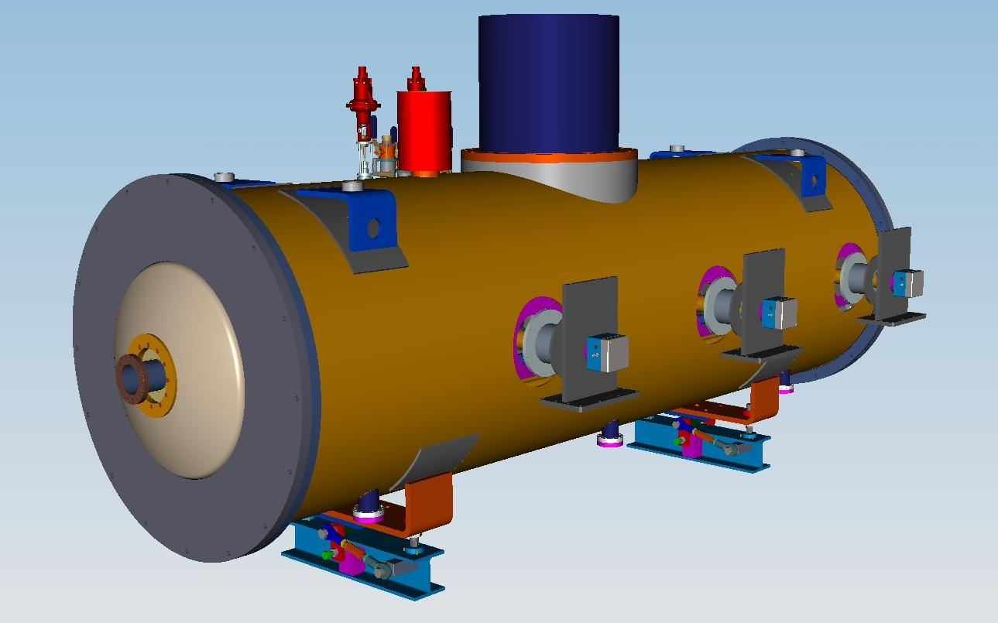
650 MHz Cryomodule, β=0.61.
(SSR1 Style, stand alone)-3 cavity concept
Heat Exchanger
Cryogenic stuff:
bayonets connections (He supply
and return), Cryogenic valve
control system
Power couplers (3)
Beam pipe
Vacuum Vessel
(pipe: 48”-OD, .375”-wall)

Slide 34
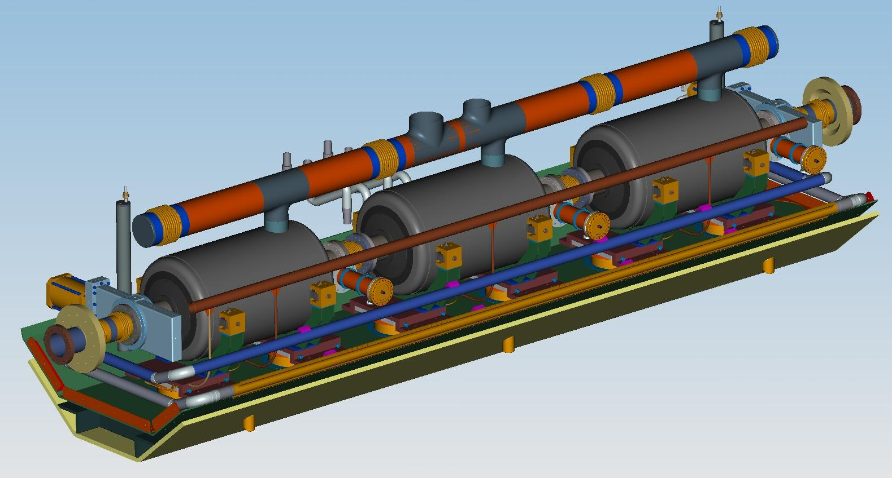
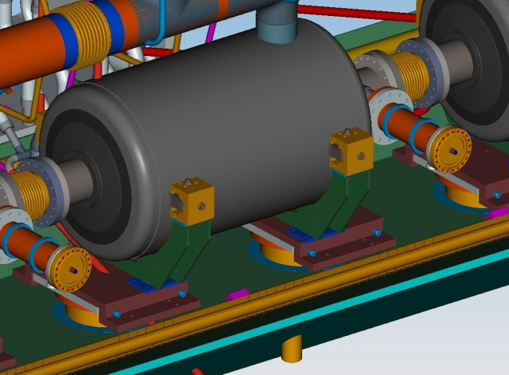
650 MHz Cryomodule, β=0.61.
Cold Mass (SSR1 Style)-3 cavity concept
-650 MHz, β=0.61, cavity with lever tuner (not shown)
-Cavity Bearing supports
-2-phase pipe (ID= 16.3cm)
-He level
-Gate valve
-Strong Back
-Cryogenic piping
-Cavity alignment
supports
-Support posts
(2 per cavity)

Slide 35
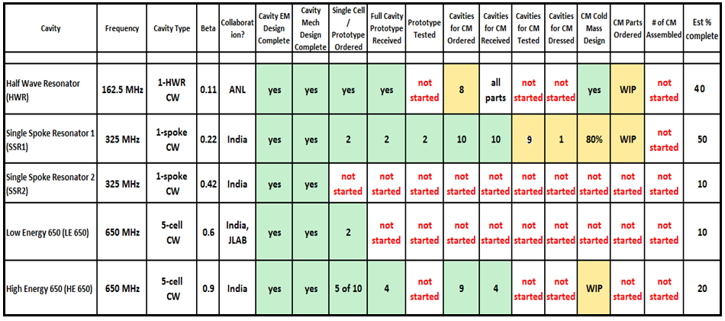
PIP II Cavity and CM development

Slide 36
Conclusions
Design of the cavities, input couplers and cryo-modules for all the sections of the PIP II linac
- SSR1;
- SSR2;
- LB650;
- HB650
is in progress;
Investigations of HOM influence on the accelerator
operation are completed;
“High Q₀ program” is developing;
Microphonics and LFD investigations are in progress.

