Slide 2
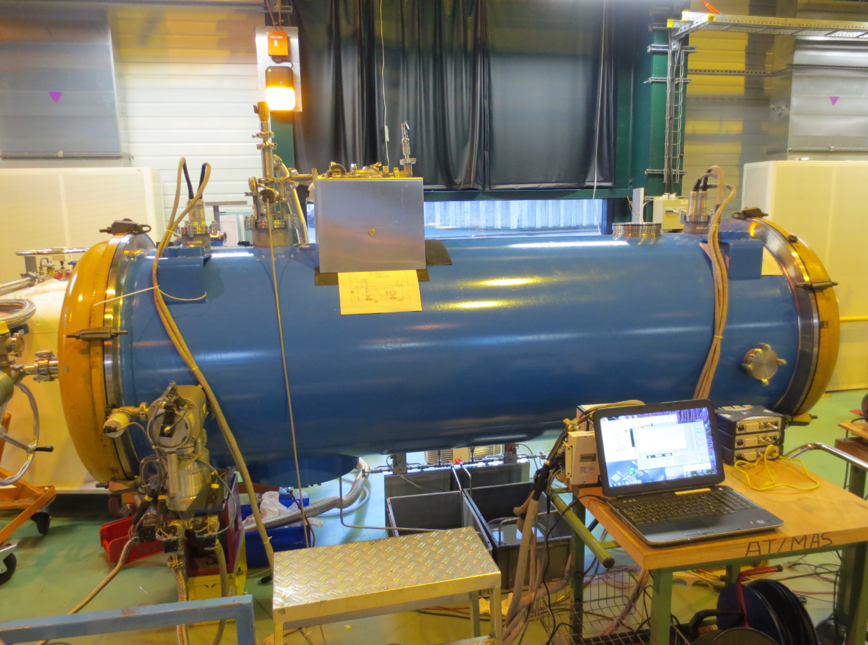
1. Updates on SPL Project
Rossana Bonomi
Rossana.Bonomi@cern.ch

Slide 3
Outline 1.
3
SPL Project
Status Update
R. Bonomi TE-MSC-CMI
SLHiPP-4, CERN 15-16/5/2014

Slide 4
Aim of the SPL SCM study
4
What
Design/construction/test of short version of Superconducting Cryomodule for High Power Proton beam (SCM)
Why
For testing of 704 MHz superconducting cavities
When
SCM is foreseen to be built and tested in 2014-2015
Where
Design/production shared btw CERN, CEA, CNRS and industry
To be tested at CERN, SM18
R. Bonomi TE-MSC-CMI
SLHiPP-4, CERN 15-16/5/2014

Slide 5
Main actors
5
System/Component/Activity | Person(s) in charge | Lab
Cavities/He vessel/tuner construction | O. Brunner O. Capatina T. Renaglia F. Pillon N. Valverde I. Aviles G. Devanz | CERN CERN CERN CERN CERN/ESS CERN/ESS CEA-Saclay
SRF, magnetic shielding, Clean-Room activities, RF test stations (SM18) | T. Junginger K. Shirm J. Chambrillon O. Brunner | CERN CERN CERN (formerly) CERN
RF Power Coupler | E. Montesinos, G. Devanz | CERN CEA-Saclay
Vacuum systems | G. Vandoni | CERN
Cryogenics (cryo infrastructure SM18) | O. Pirotte R. Van Weelderen | CERN CERN
Survey and alignment | P. Bestmann | CERN
Cryo-module conceptual design | R. Bonomi O. Capatina P. Coelho V. Parma D. Perez A. Vande Craen W. Zak | CERN/ESS CERN CERN/ESS (formerly) CERN CERN (formerly) CERN CERN/ESS
Cryo-module detailed design & Integration & Cryostat assembly tooling | P. Dambre P. Duthil P. Duchesne S. Rousselot D. Reynet | CNRS/IPNO-Orsay CNRS/IPNO-Orsay CNRS/IPNO-Orsay CNRS/IPNO-Orsay CNRS/IPNO-Orsay
SPL Machine architecture | F. Gerigk | CERN
ESS Cryomodule developments | C. Darve | ESS
Cryo-module Technical Coordination | V. Parma | CERN
R. Bonomi TE-MSC-CMI
SLHiPP-4, CERN 15-16/5/2014

Slide 6
SPL Short Cryomodule
6
4 MW beam power accelerated up to 5 GeV
Half-length cryomodule (4 cavities) representative of full-length high power S.C. linac
R. Bonomi TE-MSC-CMI
SLHiPP-4, CERN 15-16/5/2014

Slide 7
Status
7
Intercavity supports
Design: CERN
Production: CERN
Test: CERN (N₂)
He tank
Design: CERN
Production: Industry (CEA)
SC Cavities
Design: CERN
Production: 5-cells, 1-cell in Nb and Cu produced by CERN and industry
Mag. Shield
Design: CNRS (CERN spec)
Production: Industry
Tuner
Design: CEA
Production: CEA
RF Power Coupler
Design: CERN (BE-RF, TE-MSC)
Production: CERN
Test: CEA (He, RF); CERN (N₂)
Vacuum vessel
Design: CNRS
Production: Under procurement
(construction before April 2015)
R. Bonomi TE-MSC-CMI
SLHiPP-4, CERN 15-16/5/2014

Slide 8
Time Schedule from Roland’s presentation
8
Cryomodule assembly in 2015
..Test 2015 !
R. Bonomi TE-MSC-CMI
SLHiPP-4, CERN 15-16/5/2014

Slide 9
2. SPL Mock-up: Thermo-Mechanical Measurements
Rossana Bonomi
Rossana.Bonomi@cern.ch

Slide 10
Outline 2.
10
SPL Supporting System
Test: Aim, Implementation
Methodology
Thermal Results: Comparison Test - Theory
Comments on Thermal Results
Mechanical Results
..Towards Helium
R. Bonomi TE-MSC-CMI
SLHiPP-4, CERN 15-16/5/2014
Notes:
The outline of my talk ..

Slide 11
SPL Supporting System
11
Features
External conductors of main RF couplers (DWT)
+ Intercavity-supports (ICS)
=> No space frame, no rods
Requirements
Allow for longitudinal and transverse thermal contractions
Ensure low heat loads to the cold mass => Active gas cooling of DWT
R. Bonomi TE-MSC-CMI
SLHiPP-4, CERN 15-16/5/2014
Notes:
recall on the SPL supporting system:
As seen in the previous presentation, the cavities in the spl machine are not supported by traditional space frames or rods: in order to lower the heat loads, we’ve been used some components which are already existing in the machine meaning the outer conductor of the main couplers and the intercavity supports.
Beyond the the stringent requirements on heat loads, this supporting scheme needs to cope with the unavoidable movements appearing during cool down.

Slide 12
Test
12
Aim of the test
Proof of theoretical studies concerning thermo-mechanical aspects of SPL supporting system
Proof of alignment system
Implementation
Full-size mock-up with “fake” cavities, 2 real DWTs and 1 ICS, inserted in vacuum vessel
Cooled by LN₂ and GN₂
No RF power
R. Bonomi TE-MSC-CMI
SLHiPP-4, CERN 15-16/5/2014
Notes:
What is the test on the mockup for ?
Scope of the test is ..
How has it been implemented ?
Through a full size…..

Slide 13
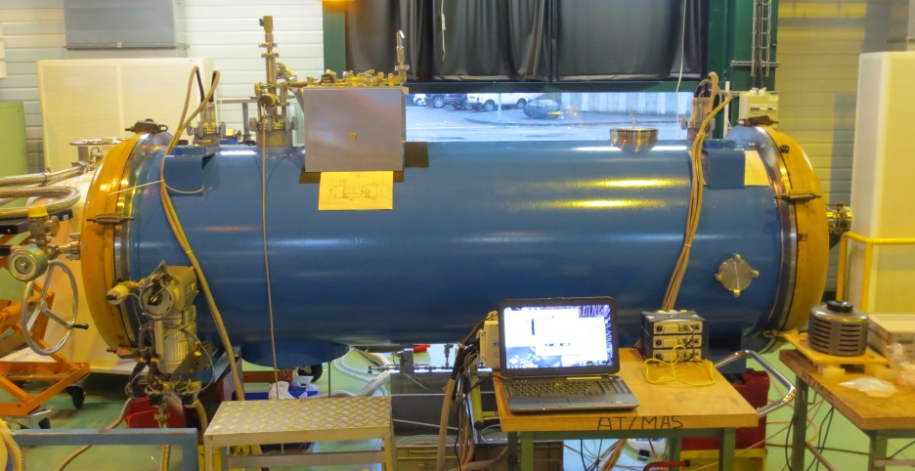
SPL Mock-up
13
.. Rendez-vous at SMI2 (b. 3191) tomorrow !
Sensors
29 Thermal sensors: Pt100 and Thermocouples
(23 Internal + 6 external)
Mechanical sensors: displacements and bending
R. Bonomi TE-MSC-CMI
SLHiPP-4, CERN 15-16/5/2014
Notes:
Nice picture of the installed mockup ..
Thermal and mechanical sensors (Pt100,thermocouples, bending and displacement sensors) have been placed on the mockup for experimental validation of theoretical studies regarding thermal performances and mechanical contractions.
ich you’ll discover tomorrow if you’re coming to the visit in SMI2.
Pt100 (class B) accuracy: <+- 1 deg
TC type E accuracy: < +-2 deg

Slide 14
Methodology
14
Test: measurements * + postprocessing
Semi-analytical model for DWT temperature profiles and exchanged powers
FE thermal analysis (+ fluid dynamics)
Material-GN₂ properties: Cryocomp, Gaspak
* 1 Hz acquisition frequency, 15 weeks of testing from October 2013 (overall).
R. Bonomi TE-MSC-CMI
SLHiPP-4, CERN 15-16/5/2014
Notes:
The approach which has been adopted in general:
Get some measurements from our test by reading out of sensors (so far about overall 15 weeks of testing with 1 Hz acquisition freq).
Compare experimental data to both
analytical models already presented in my previous presentations (not giving here the details)
And to finite elements studies mostly thermal and with fluid dynamics calculations when needed.
Material and gas properties have beeen calculated with the cryocomp and gaspak sotwares.

Slide 15
Mock-up: T Distribution
15
Test results, typical *
No gas flow, steady state, cavities filled with LN₂
77 K
77 K
77 K
77 K
103 K
147 K
93 K
207 K
80 K
256 K
288 K
(10 W)
* Data from April 2014.
R. Bonomi TE-MSC-CMI
SLHiPP-4, CERN 15-16/5/2014
Notes:
Lets start from a typical temp distribution obtained last month during the test:
Cavities were kept cold, whereas dwt were not actively cooled
For example, we can highlight the t distrib obtained for the ics and for the dwt => ..

Slide 16
DWT – No GN₂ Cooling
16
Comparison with analytical and FE models
No gas flow, steady state, fixed boundary temp
-19 deg
-11 deg
-11 deg
-6 deg
+3 deg
+2 deg
Heater power Manually set * :
10 W
Estimated:
~10 W
~10 W
x
147 K
207 K
256 K
x
Temperatures
Good agreement at cold
Heater power
Very good agreement
288 K
(10 W)
* Data from April 2014.
R. Bonomi TE-MSC-CMI
SLHiPP-4, CERN 15-16/5/2014
Notes:
Coming to the dwt, the most delicate component, during similar test conditions we obtained this temp distrib (on the left)
which is compared to that coming from estimations, both semi-analytical and fe models (on the right).
..Remind that no gas cooling is present !
So temp profile along the wall, from the cold bath to the outer flange which is being heated by a resistive wire is shown, and temp differences from test to theory are indicated. Red dots is the test results, blue and green are for fe and semi-anal values.
Despite bigger differences at warm temp, we are able to very well estimate temp profile at cold, which is the most important region as it is directly related to the heat flowing to the bath.
In fact, there is also good agreement f.w.c. heating power (around 10W).

Slide 17
Mock-up: Static Loads
17
Conduction load through DWT is a major concern
Test results
From DWT T profile, estimation of heat load (conduction) to cryogenic bath through each DWT: >10 W
This value is in agreement with analytical estimations
=> For heat load reduction, active gas cooling of DWTs is necessary !
R. Bonomi TE-MSC-CMI
SLHiPP-4, CERN 15-16/5/2014
Notes:
conduction load from the dwt is a driving load.
From the already shown temp profile obtained during the test when dwt is not gas cooled, we can say that more than 10 W are expected to reach the cryogenic bath in each dwt.
Therefore, it is imperative the introduction of gas cooling of dwt if we want to reduce static loads to the machine !

Slide 18
DWT – GN₂ Cooling *
18
CASE 1
CASE 2
20 deg
CASE 3
CASE 4
Temperatures
Good agreement at cold and fully developed steady conditions
* x-axis: x [m]; y-axis: T [K]. Pt100 accuracy: < ±1 deg. Data from various days in April 2014.
R. Bonomi TE-MSC-CMI
SLHiPP-4, CERN 15-16/5/2014
Notes:
Here you have the most representative results obtained with a gas cooled dwt. Also the inlet gas temp has been indicated.
They are plotted together with the theoretical predictions, which are based on fe and analytical studies. Again, in red and dots is the test, blu and green are for semi-analytical and fe results.
..

Slide 19
DWT – Exchanged Powers *
19
Tgas,in = 84 K 114 K 90 K 84 K
TRANSIENT NOT OVER
(cases 2, 3)
Heat to Bath
General good agreement; Small loads already with low flows;
Strongly depends on gas T at inlet
NO GAS COOL
Heater Power
Good agreement for fully developed steady conditions; Increases with flow
* Pt100 accuracy: < ±1 deg; Thermocouple type E accuracy: < ±2 deg. Data from various days in April 2014.
R. Bonomi TE-MSC-CMI
SLHiPP-4, CERN 15-16/5/2014

Slide 20
Comments on Thermal Results
20
General nice agreement when steady state conditions are realized
Discrepancies can be due to
Transients not completely over (DWT, flanges, gas temp)
Limited n. of sensors for DWT temp profile
Not shielded DWT sensors (vessel radiation)
2-phases flow
..
R. Bonomi TE-MSC-CMI
SLHiPP-4, CERN 15-16/5/2014
Notes:
…..

Slide 21
Mechanical Measurements *
21
No constraints appearing on ICS during cool-down
Max displacement between cold cavities: ~4 mm, as expected
Max bending stress measured on DWT: 20 MPa, correspondent to expected friction in ICS
* Measurements from October-November 2013.
R. Bonomi TE-MSC-CMI
SLHiPP-4, CERN 15-16/5/2014

Slide 22
Improvements / Next Steps
22
Improvements already adopted
Improved gas line (insulation, bypass, T sensor)
Separated dewar for GN₂ extraction
Insulated target supports (avoid condensation)
Modifications proposed for next tests
Increase number of thermal sensors on DWTs for better accuracy
Flowmeter on vent line for accurate heat load measurement and direct DWT load estimation
Better insulation for heaters
Better thermalization for masses (to reduce transients)
Phase separator inside the vessel for GN₂
..
R. Bonomi TE-MSC-CMI
SLHiPP-4, CERN 15-16/5/2014

Slide 23
..towards Helium
23
Gas cooling is the most efficient solution
2x electric power of ideal case (self-sustained wall cooling)
this factor is 3x/6x for 2/1 ideal, optimized heat intercepts along the DWT wall
Estimation of mass flow required (100-300 mg/s N₂ => 20-60 mg/s He)
Closed circuit (gas recovery, liquefier)
Easier regulation of gas temperature
..
R. Bonomi TE-MSC-CMI
SLHiPP-4, CERN 15-16/5/2014

Slide 24
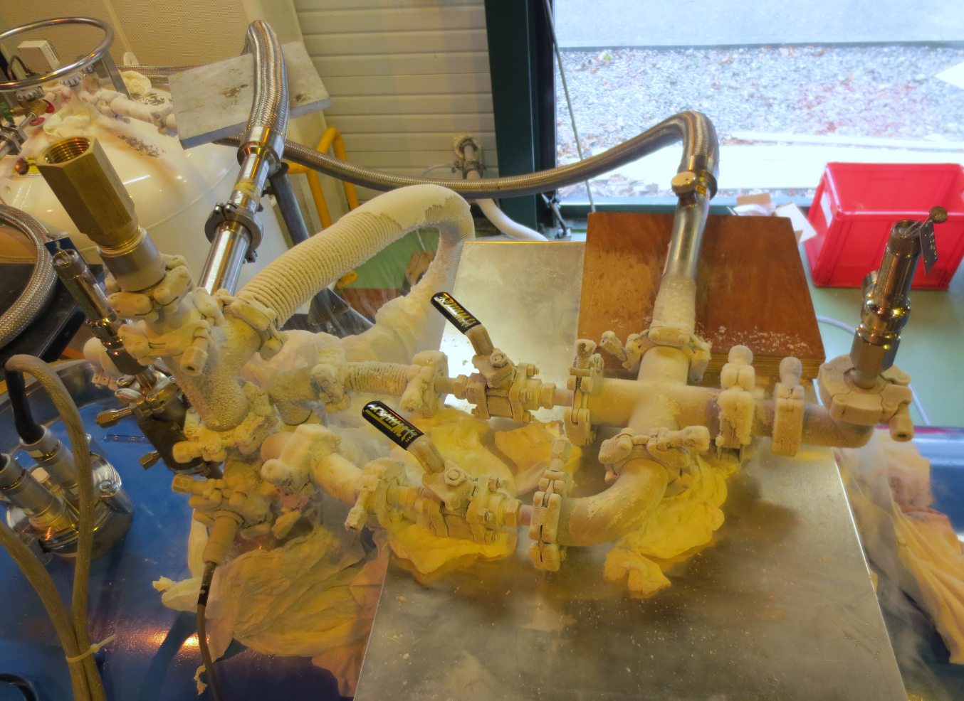
Thank you !
Acknowledgements
Alain Bastard
Patrick Bestmann
Ofelia Capatina
Cedric Charrondiere
Paulo Coelho
Jean-Baptiste Deschamps
Laetitia Dufay
Florian Girardot
Didier Gonnard
Alain Grimaud
Andre Guimet
Michael Guinchard + team
Torsten Koettig
Claudia Parente
Vittorio Parma
Eric Rasoasehno Michel
Michel Souchet
Arnaud Vande Craen
Wojciech Zak
Nicolas Zelko
SPL workspace
https://espace.cern.ch/spl-cryomodule/default.aspx
SPL docs on EDMS
https://edms.cern.ch/nav/P:SLHC-000008:V0/P:SLHC-000076:V0/TAB3
R. Bonomi TE-MSC-CMI
SLHiPP-4, CERN 15-16/5/2014

Slide 26
Thermal Sensors
T6
T7
T9 – T13
T10 – T14
T21
T22
T8 – T12
Int.
T26
T27
Int.
T24
T25
Int.
T11 – T15
T4
T19
T23
T5
T20
T1
T16
T2
T17
T3
T18
R. Bonomi TE-MSC-CMI
SLHiPP-4, CERN 15-16/5/2014
Notes:
Overview of thermal sensors
Only inner ones are shown here and are distributed all over the mock/up
The external ones are those used for the flanges and fluid temperatures

Slide 27
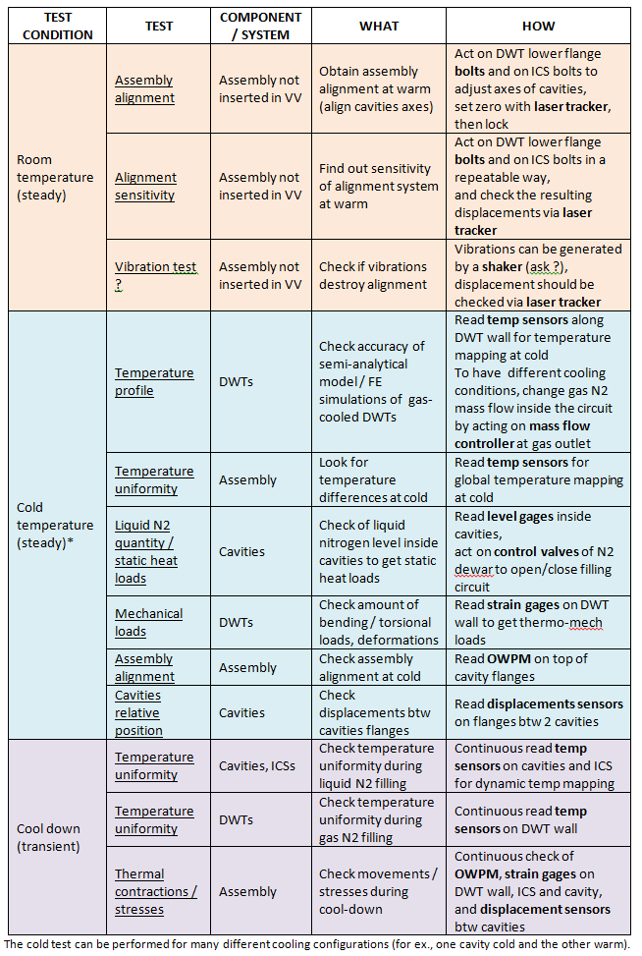
Tests foreseen
Test Program as of 10/2013

Slide 28
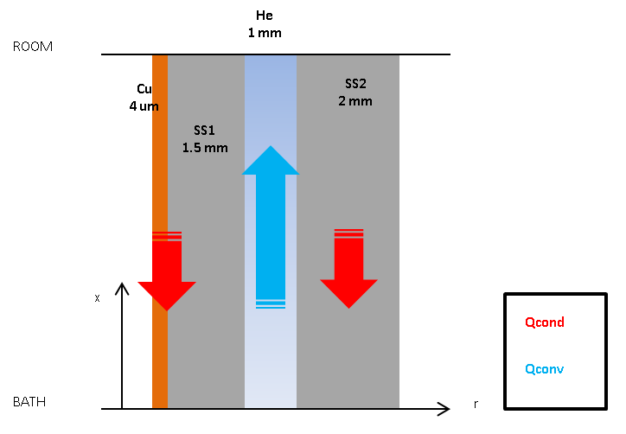
Double-walled tube
Copper layer accounts for 5-7% of tot heat conducted

Slide 29
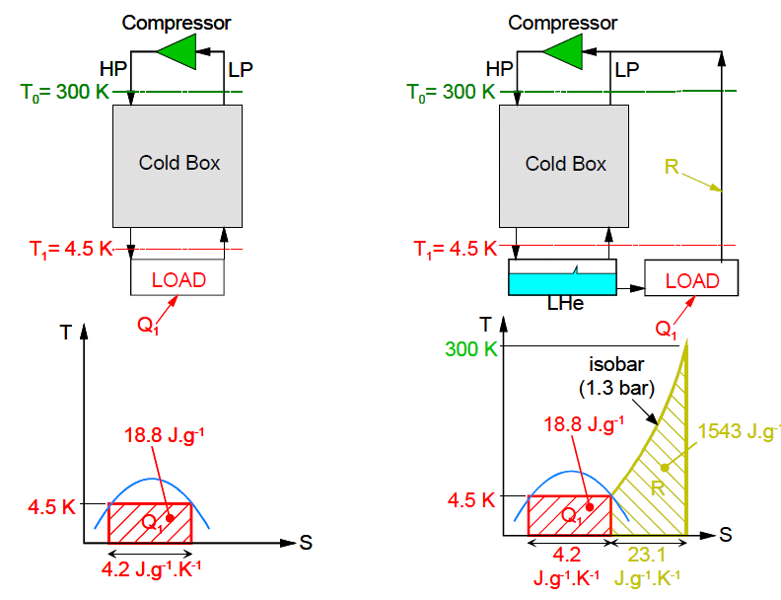
Thermodynamic efficiency of DWT gas cooling
How to compare isothermal and non-isothermal processes ?
Electrical power for liquefaction of 1 g/s helium: 6200 W_{el}
Carnot COP @ 4.5 K: 66 W_{el}/W_{th}
1 g/s liquid helium is equivalent to 100 W_{th} @ 4.5 K *
He refrigeration He Liquefaction
(Figure from: « An Introduction to Cryogenics », Ph.Lebrun, CERN/AT 2007-1)
* U. Wagner s note:
http://cdsweb.cern.ch/record/808372/files/p295.pdf

Slide 30
Thermodynamic efficiency of DWT gas cooling
Comparison with other ways of cooling (heat intercepts, self-sustained cooling)
990 @ 2 K, 220 @ 4.5-9 K, 16 @ 80 K
Case | Q @ 2K [W] | P [W_{el}] | Q @ 9K [W] | P [W_{el}] | Q @ 80K [W] | P [W_{el}] | Flow rate [g/s] | Q equiv. @ 4.5K [W] 1g/s=100W | P [W_{el}] | Total power [Wel]
A) No intercept | 12.6 | 12,375 | - | - |  |  | - | - | - | 12,375 | 26.3
B) 1 optimised intercept @ 80K | 2.2 | 2,178 | - | - | 44.6 | 714 | - | - | - | 2,892 | 6.1
C) 2 optimised intercepts @ 80K & 9K | 0.18 | 178 | 3.2 | 704 | 30.6 | 490 | - | - | - | 1,372 | 2.9
D) 4.5K self-sustained vapour cooling | 0.03 | 30 | - | - | - | - | 0.020 | 2 | 440 | 470 | 1
E) He vapour cooling (4.5K-300K) | 0.10 | 99 | - | - | - | - | 0.040 | 4 | 880 | 979 | 2.1
F) He vapour cooling (4.5K-300K), RF power on | 0.50 | 495 | - | - | - | - | 0.040 | 4 | 880 | 1,375
G) No He vapour cooling, RF power on | 22 | 21,780 | - | - | - | - | 0 | 0 | 0 | 21,780

Slide 31
Mock-up: Static Loads
FE model
No gas flow, steady state, warm MLI surface*
Typical value of radiative heat load on cold cavities (wrapped by 30 layers of MLI) is confirmed: 1-2 W/m²
T_{MLI}* [K] | ε_{MLI} | T_{VV} [K] | ε_{VV} | Q_{RAD,ANALYT} [W/m2] | Q_{RAD,ANSYS} _{simple} [W/m2] | Q_{RAD,ANSYSreal} [W/m2]
290 | 0.02 | 300 | 1.00 | 1.2 | 1.7 | 1.2
290 | 0.02 | 300 | 0.20 | 1.1 | 1.6 | ..
* MLI surface temperature calculated with mli.exe [Chorowski]
R. Bonomi TE-MSC-CMI
SLHiPP-4, CERN 15-16/5/2014

Slide 32
Intercavity Support
Comparison with FE model
No gas flow, steady state, cavities filled with LN₂, radiation with 300K vessel
103 K
93 K
80 K
110 K
100 K
Good agreement with estimations
85 K
R. Bonomi TE-MSC-CMI
SLHiPP-4, CERN 15-16/5/2014

Slide 33
16/4/2014, 21:00 (45000s) -1 hr shift in daq
5 ln/min (104 mg/s) @ 84 K
80 V (27 W)
R. Bonomi TE-MSC-CMI
SLHiPP-4, CERN 15-16/5/2014

Slide 34
16/4/2014, 12:00 (9600s) -1 hr shift in daq
7 ln/min (146 mg/s) @ 114 K
50 V (17 W)
R. Bonomi TE-MSC-CMI
SLHiPP-4, CERN 15-16/5/2014

Slide 35
16/4/2014, 15:00 (20000s) -1 hr shift in daq
10 ln/min (208 mg/s) @ 87 K
80 V (27 W)
R. Bonomi TE-MSC-CMI
SLHiPP-4, CERN 15-16/5/2014

Slide 36
16/4/2014, : (s) -1 hr shift in daq
12 ln/min (250 mg/s) @ 84 K
80 V (27 W)
R. Bonomi TE-MSC-CMI
SLHiPP-4, CERN 15-16/5/2014

Slide 37
16/4/2014
7 ln/min (146 mg/s) @ 114 K
50 V (17 W)
10 ln/min (208 mg/s) @ 87 K
80 V (27 W)
12 ln/min (250 mg/s) @ 84 K
80 V (27 W)
R. Bonomi TE-MSC-CMI
SLHiPP-4, CERN 15-16/5/2014

Slide 38
T_{gas,in} vs Q_{bath}
R. Bonomi TE-MSC-CMI
SLHiPP-4, CERN 15-16/5/2014

