Slide 1
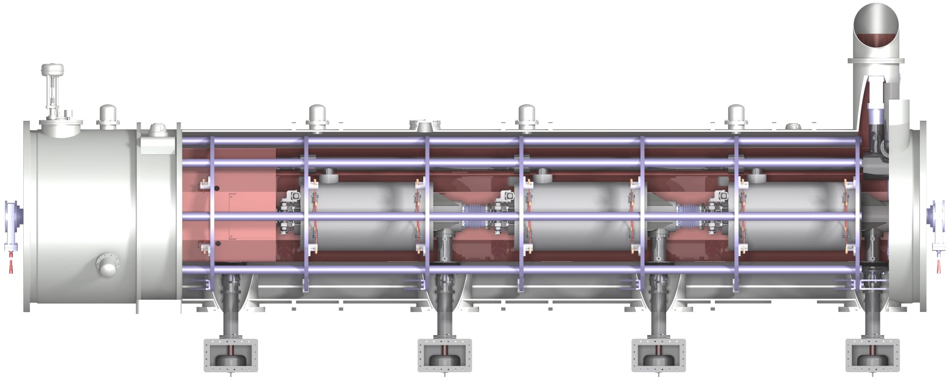
Status of the ESS Cryomodule for Elliptical cavities
M-ECCTD
Unité mixte de recherche
CNRS-IN2P3
Université Paris-Sud 11
91406 Orsay cedex
Tél. : +33 1 69 15 73 40
Fax : +33 1 69 15 64 70
http://ipnweb.in2p3.fr
Gilles OLIVIER
for the CEA/DSM/IRFU and CNRS/IN2P3/IPNO teams

Slide 2
Cryomodule for elliptical Cavities
SUMMARY
Introduction
Medium and high beta cryomodules standardization
General design
Heat balance
Cryogenic circuits
Tooling and assembly process
Assembly and test facilities

Slide 3
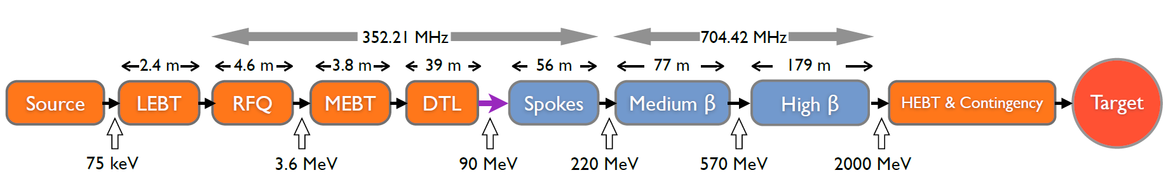
Introduction
Development of a technology demonstrator
with medium beta elliptical cavities (M-ECCTD)
Work done within the FR-SW agreement - collaboration IPNO and IRFU
The design of the cryomodule is compatible with both medium and high beta cavities
CEA SACLAY in charge of of the “cavity package”, the cryomodule assembly and RF power tests
Cavities + helium tank
Power coupler design, manufacturing, RF tests
Piezo tuner
Magnetic shield
Tooling: field flatness, cavity preparation, cryomodule assembling, …
Cryomodule assembly
Tests stand for cryogenic and RF power tests
Tests of the ECCTD cryomodule
IPN ORSAY in charge of the cryostat,
design and fabrication
Vacuum vessel
Space frame – cavity supports
Thermal screen
Superinsulation
Internal cryogenic pipes
Instrumentation

Slide 4
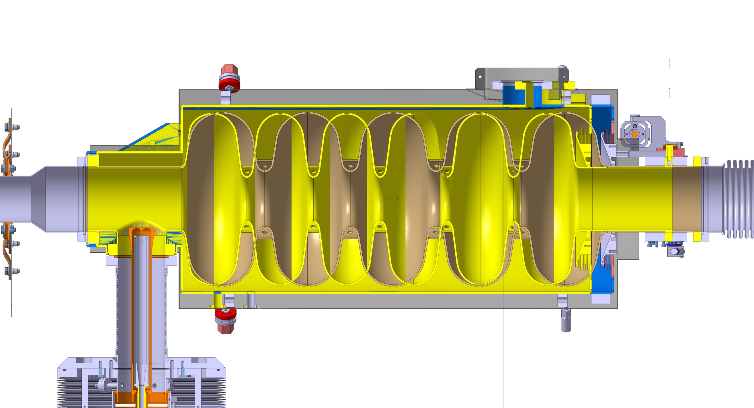
High and medium β cryomodules standardization
High beta (0,86):
5 cells
Length 1316,91mm
Medium beta (0,67):
6 cells
Length 1259,40mm
57,5 mm

Slide 5
High and medium β standardization
1316,91 (HB) / 1259,4 (MB)
900
Blocks for half ring fasteners
794
Position of the nozzle
Main identical dimensions
Main differences
188
20
Identical sub-assemblies:
Vacuum vessel
Spaceframe
Thermal shield
Cryogenics circuits
Ø418
Same mechanical interfaces in the tunnel
Position of the nozzle
180
120,3 (HB)
115,3 (MB)
250
908
Specific components:
Inter cavities bellows
Cold/warm transitions
1500 between couplers

Slide 6
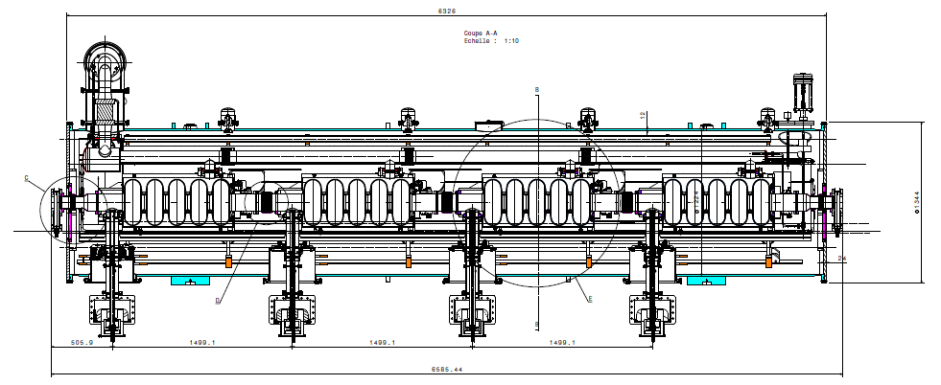
OVERALL DIMENSIONS
6329,6
506,3
1500
1500
1500
450
6587,6
4300 (between supports)

Slide 7
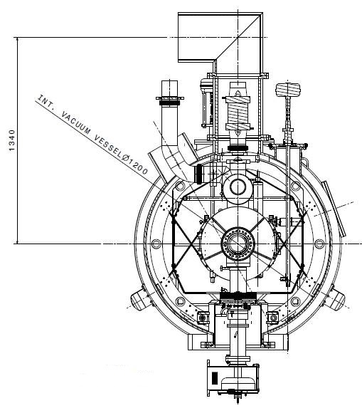
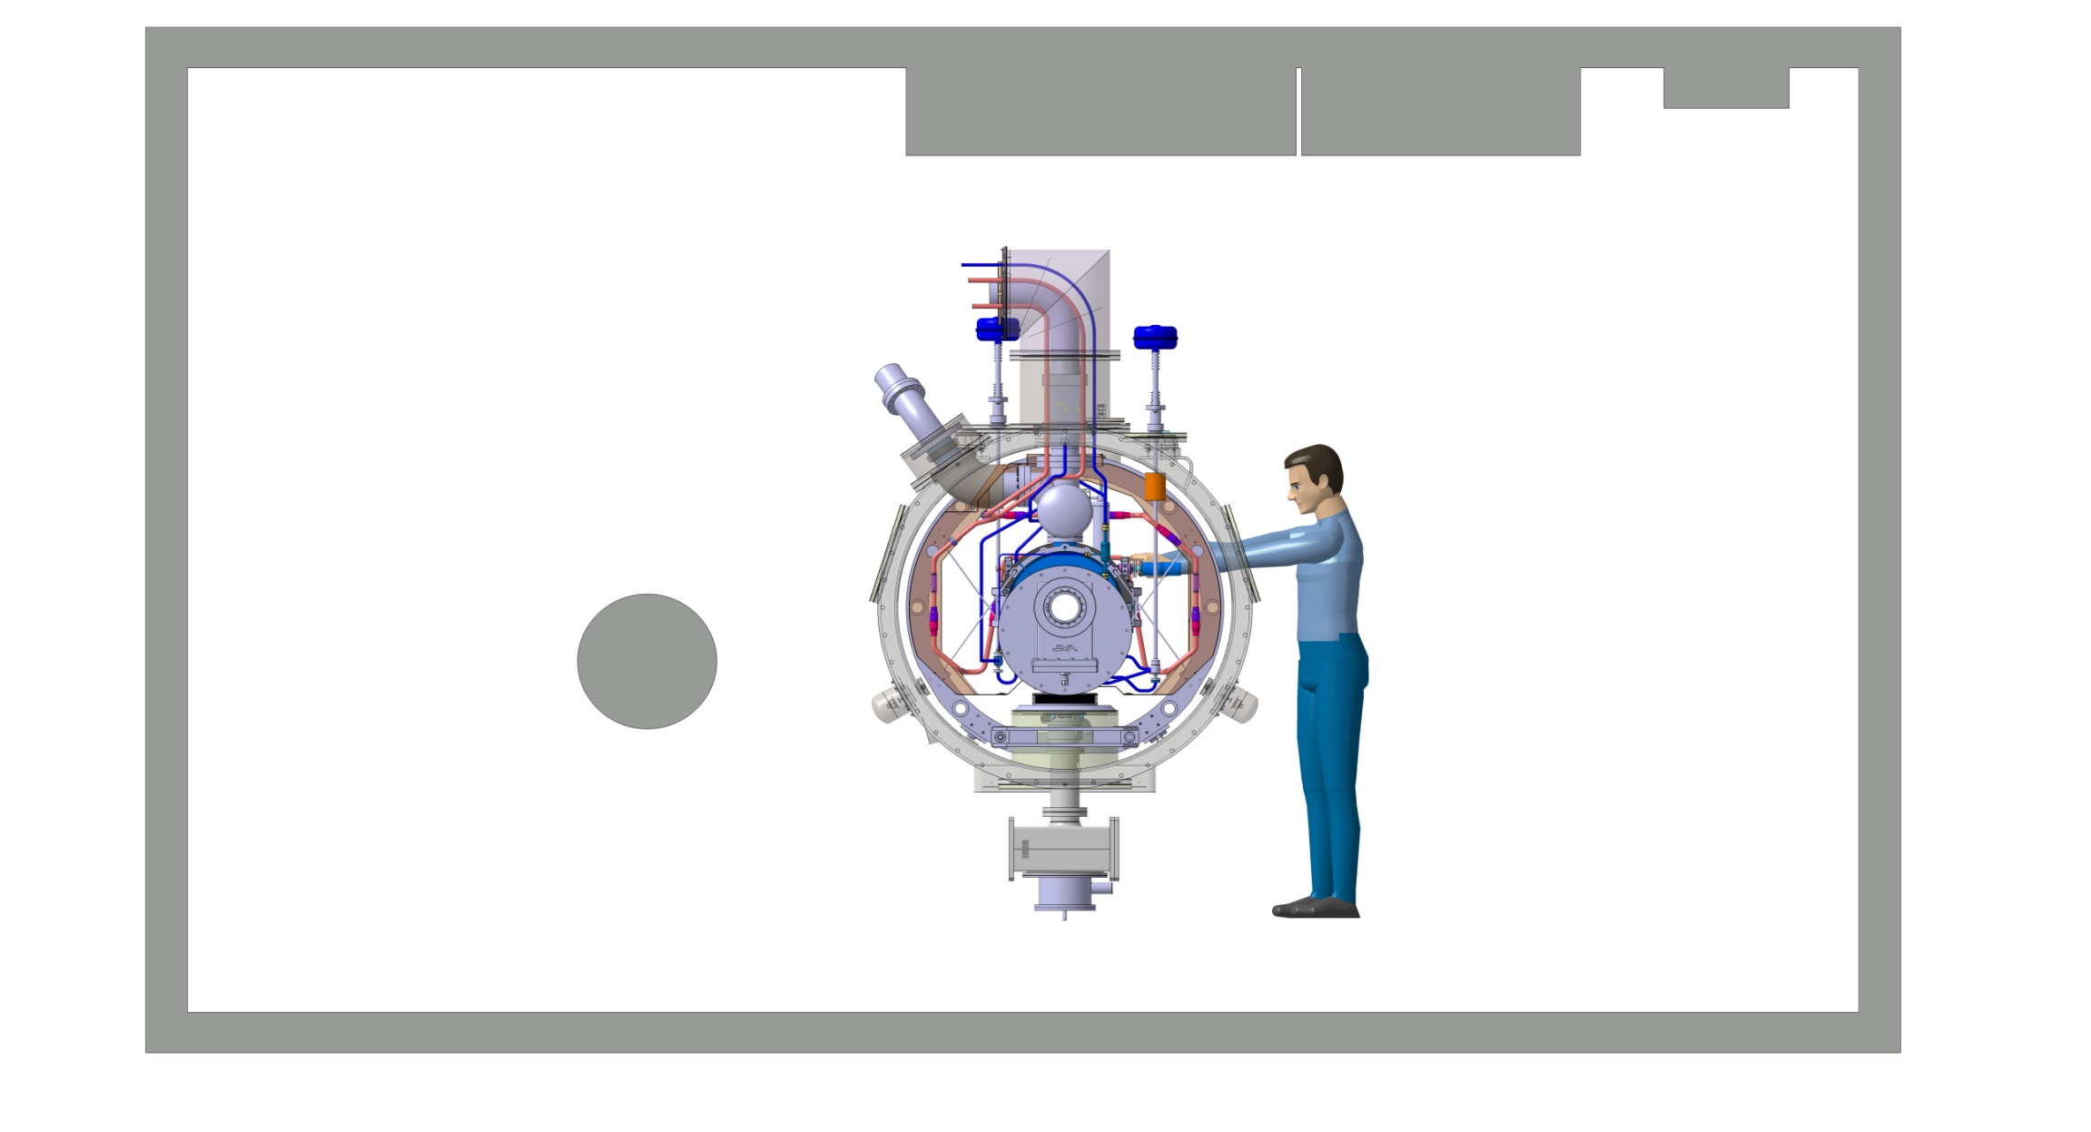
OVERALL DIMENSIONS
Ø324
293
1245
2745
1500
685
604.5
Tunnel
341

Slide 8
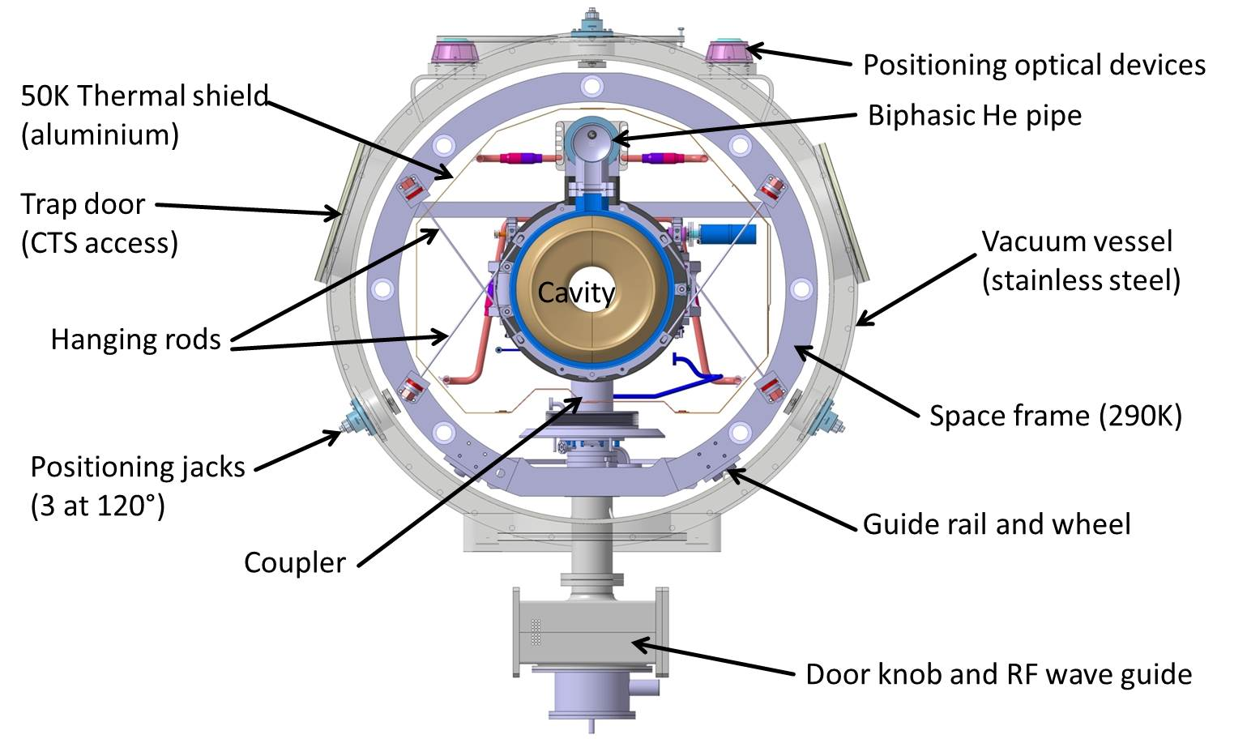
General design

Slide 9
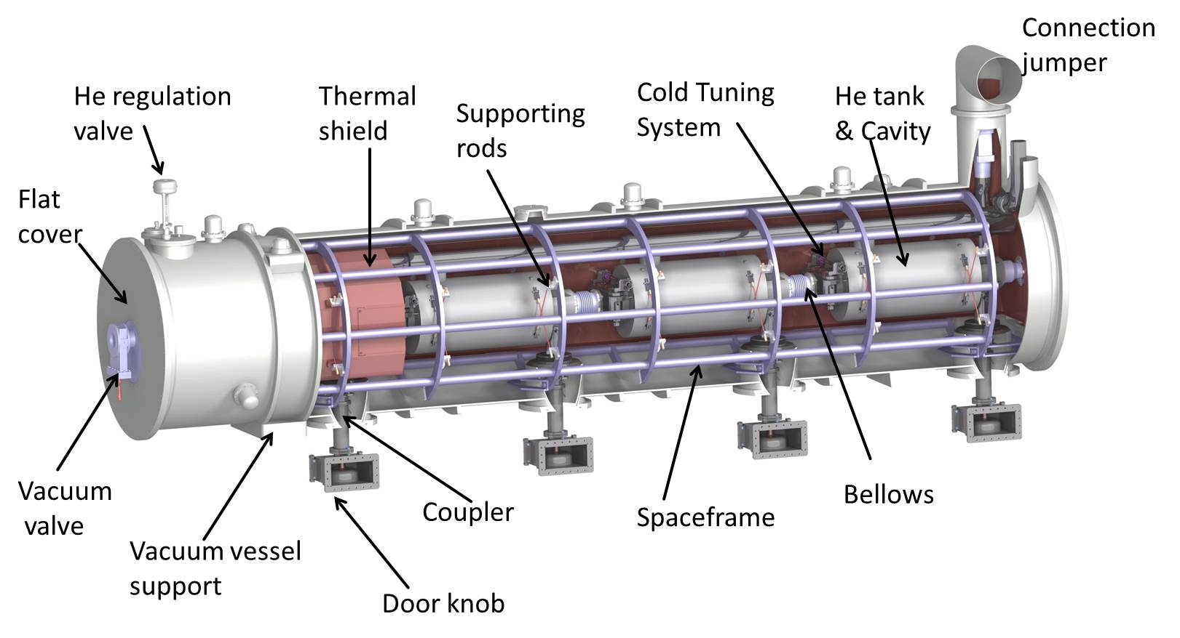
overview
Beam

Slide 10
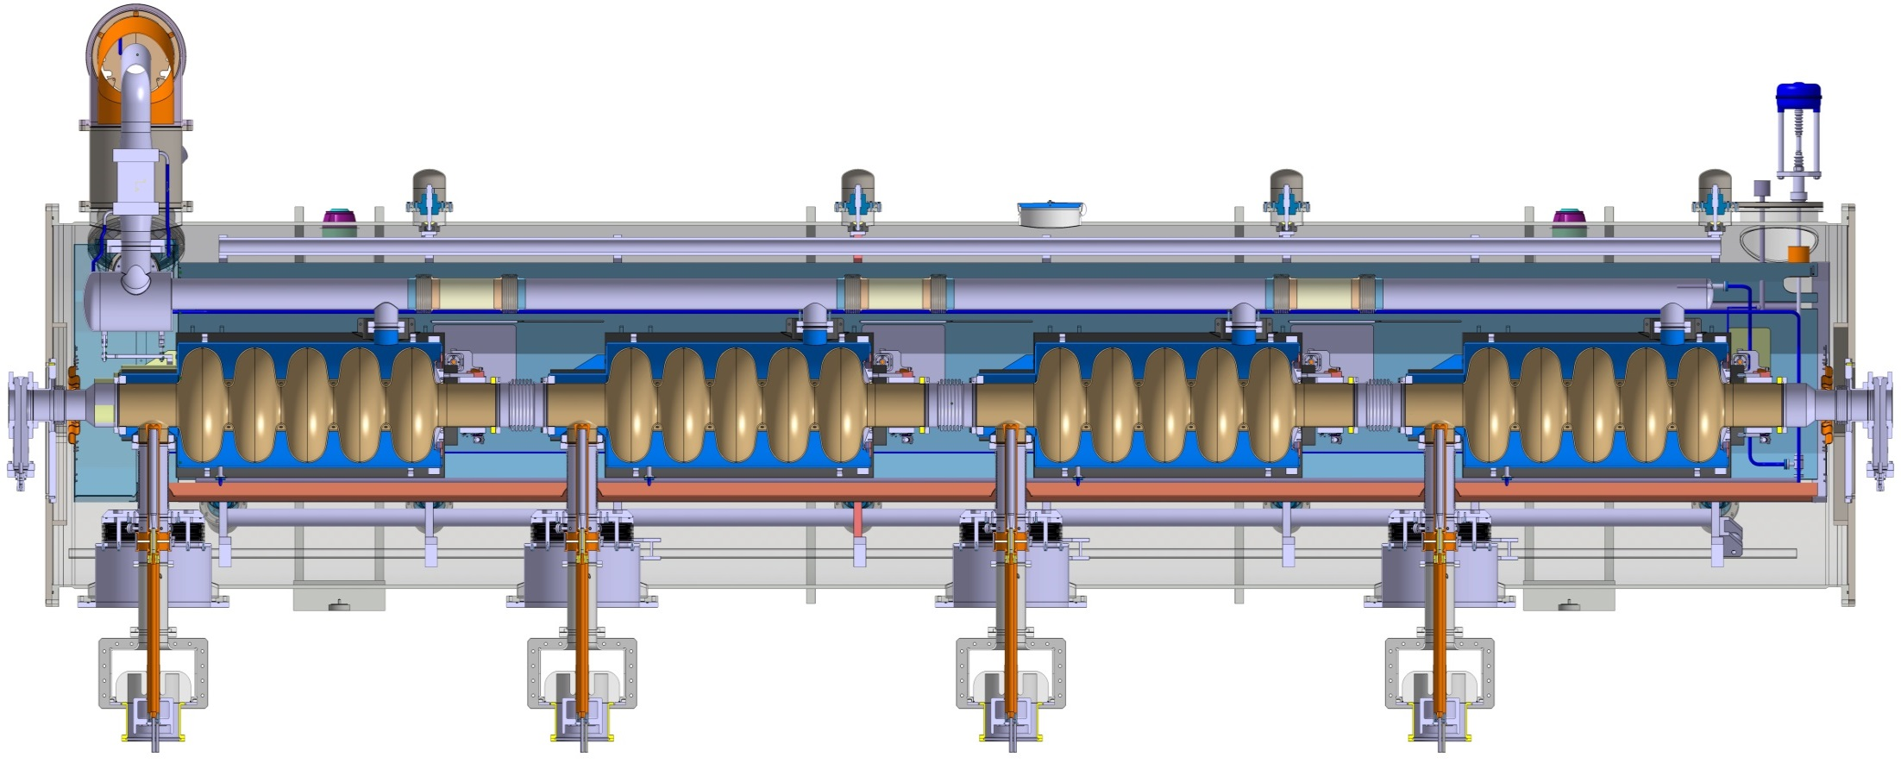
overview
Exchanger
HIGH BETA CRYOMODULE
Low pressure line
Supporting jacks
Spaceframe
Coupler
Vacuum vessel support (x2)
Door knob
Bias system

Slide 11
Heat balance

Slide 12
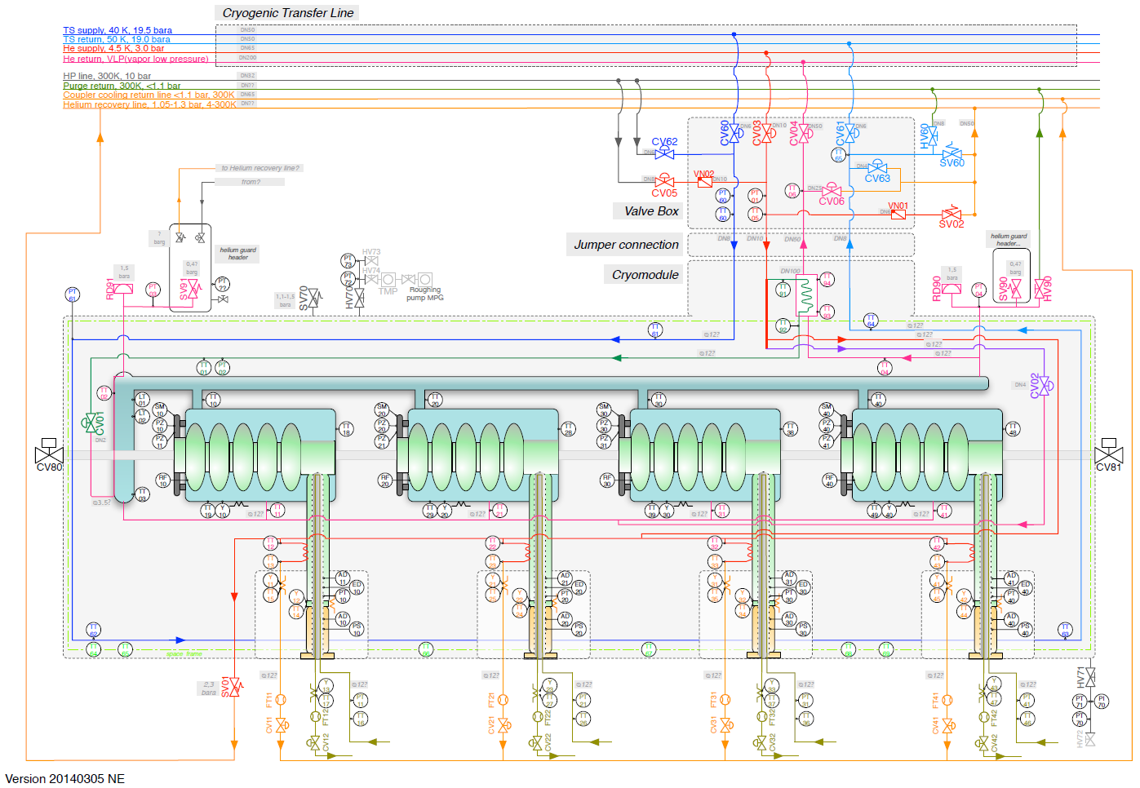
Cryogenic diagram
Nuno ELIAS 2014-03

Slide 13
Helium Pressure relief devices
Cavity mechanical behaviour limit
Safety devices
Maximum allowable overpressure
PS + 10%
+10%
PS
Max. allowable press.
P_{SET} + 50mbar
P_{SET} Set Pressure
Bursting disk
Bursting area
P_{SET} - 50mbar
European rules compliance
(overpressure when opening)
P_{MAX APERTURE} = + 10 % P_{OPENING}
P_{OPENING} = + 5 % P_{SET}
Relief valve
P_{SET}
Opening area
P_{CLOSING} = + 5 % P_{SET}
P_{MIN CLOSING} = - 10 % P_{CLOSING}
(hysteresis before closing)
WP upper limit
WP
Working pressure = nominal pressure
ESS Helium factory, circuits
and operating modes

Slide 14
Pressure vessels European rules
PS<0,5bar
The equipment is not on the scope of the 97/23/CE directive
Vessels
Article 3-3
The equipment must be designed and manufactured according to workmanlike way
Category I
The manufacturing must be more documented, especially with internal production control
Pipes
THE GOAL Article 3-3

Slide 15
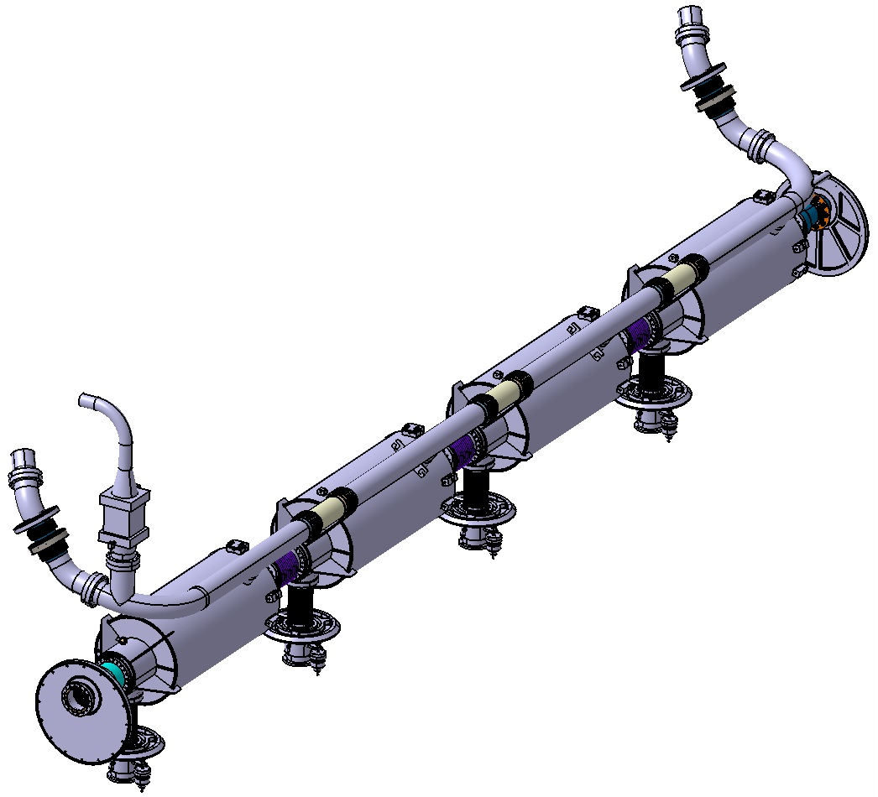
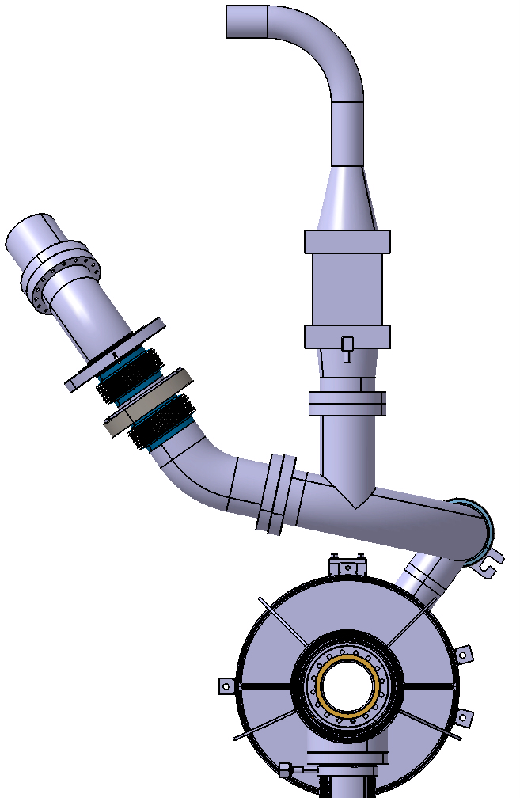
Helium low pressure circuit
2 bursting disk at each tip
+ upstream safety relief valve (with he guard)
A 36° angle is set up for the tank nozzle in order to allow the insertion of the cavity string and the cooling circuit inside the spaceframe
To valve box
Heat exchanger
The circuit is designed to reduce as low as possible the overpressure in case of beam vacuum failure by using a continuous DN100 diameter for the diphasic pipe, large curvatures and 2 DN100 bursting disks at each extremity.
36°
Worst scenario: beam vacuum failure
38KW/m² applied on the cavity wall
Accidental overpressure: 550mbar reduced
to 230mbar after rupture of the disks

Slide 16
Assembly procedure
ASSEMBLY PROCEDURE AND TOOLING FOR THE M-ECCTD
(Medium beta prototype)
Acknowledgments:
Amaury MARTIN (engineer student thesis)
Nicolas BAZIN (CEA)

Slide 17
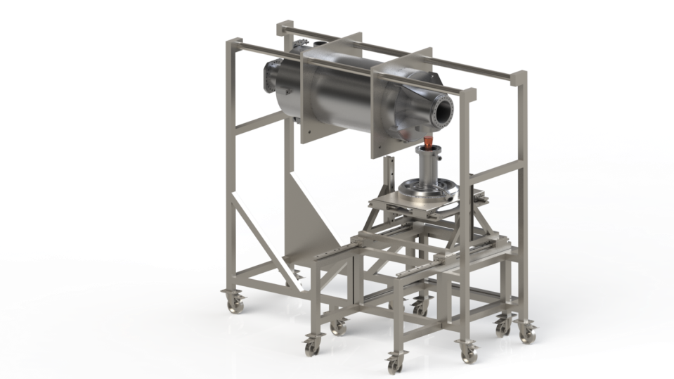
COUPLER Assembly
Choice of the vertical position below the cavity for the coupler during the assembling operation

Slide 18
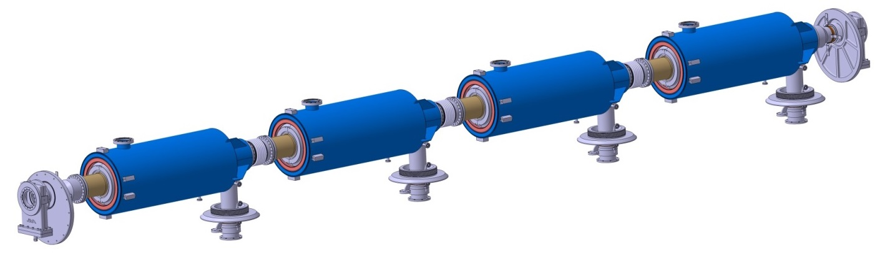
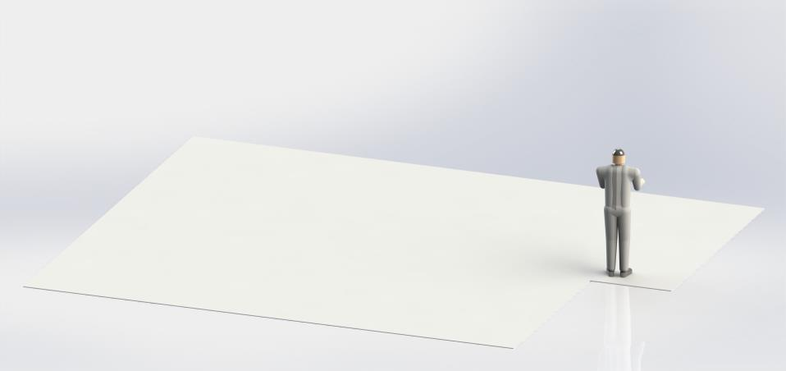
Cavity string assembly
Clean room ISO 5

Slide 19
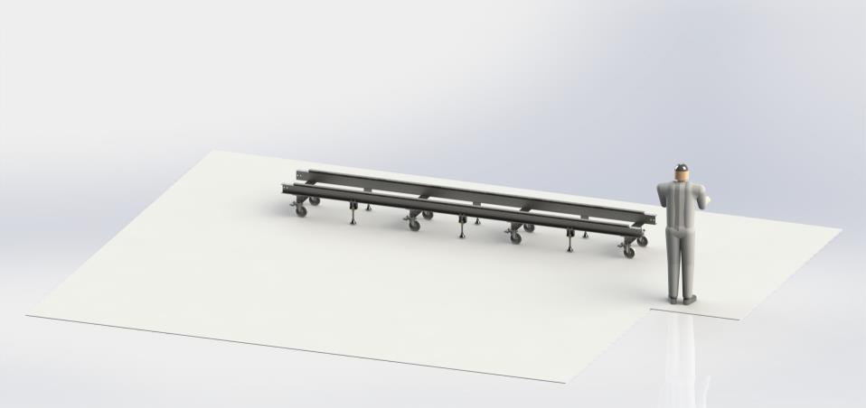
Cavity string assembly
Installation of the central trolley/rail

Slide 20
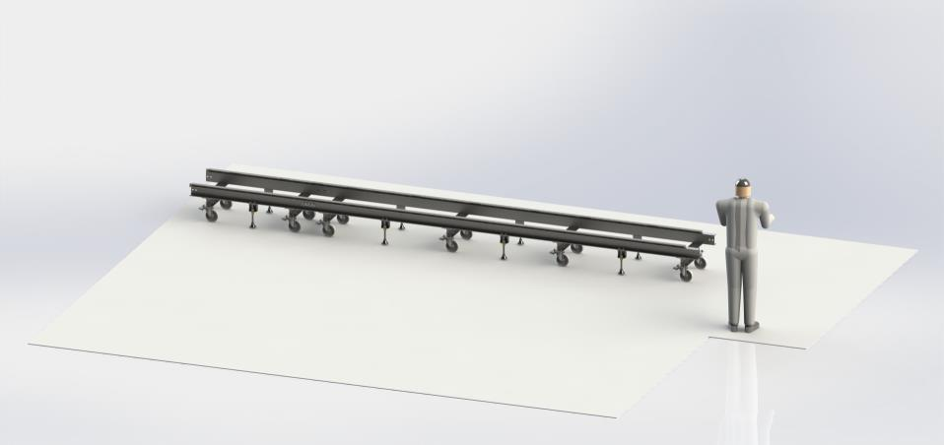
Cavity string assembly
Installation of the extremity trolleys

Slide 21
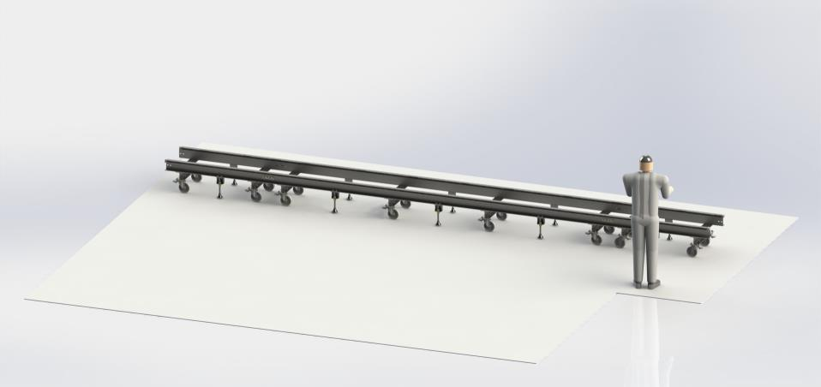
Cavity string Assembly
Installation of the extremity trolleys

Slide 22

Cavity string assembly
Installation of support posts

Slide 23
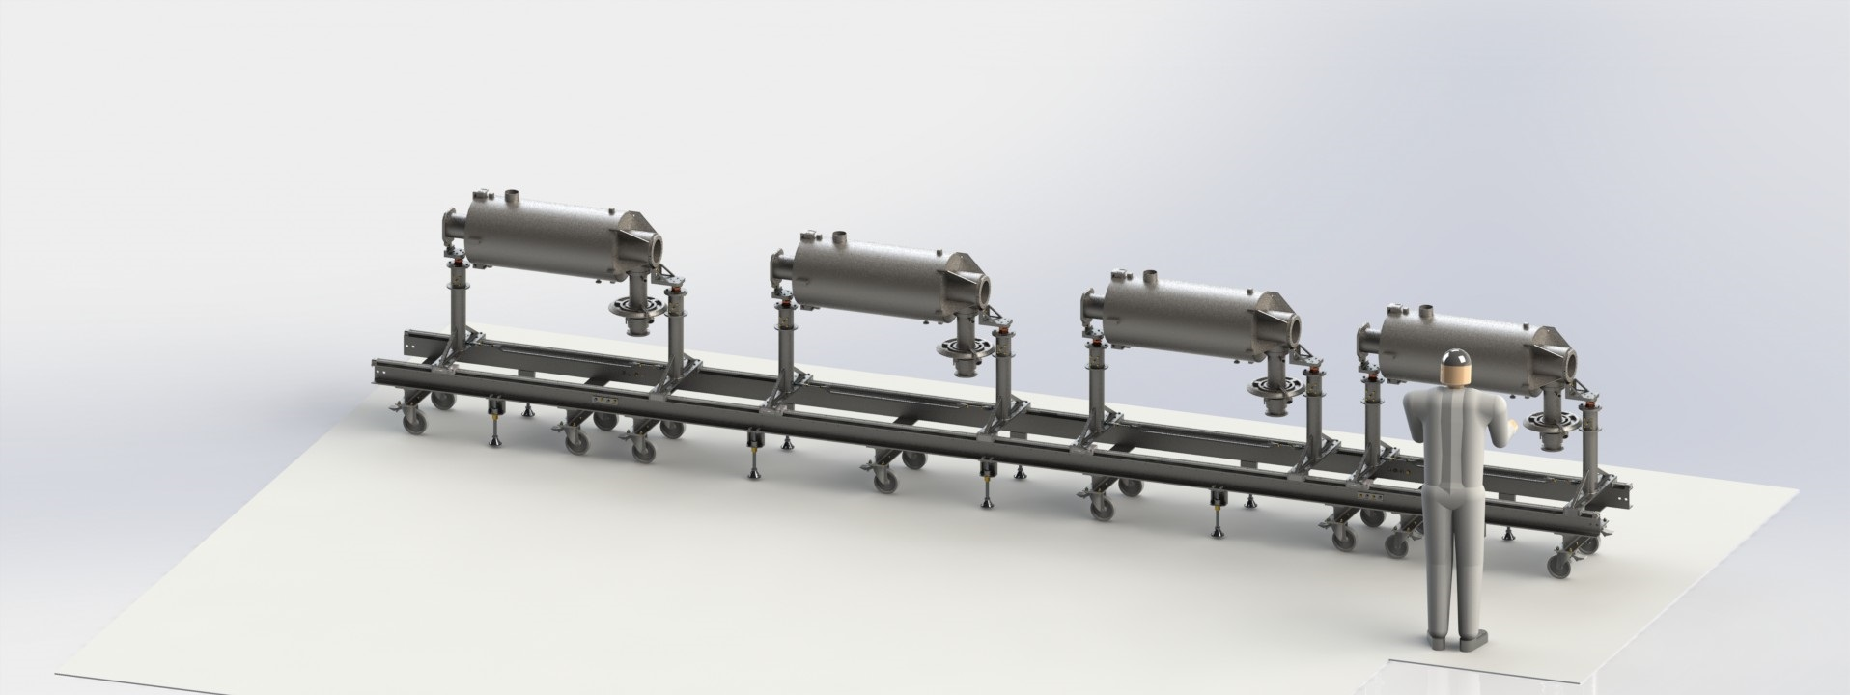
Cavity string assembly
Assembly, positioning and pre-alignment of the cavities

Slide 24
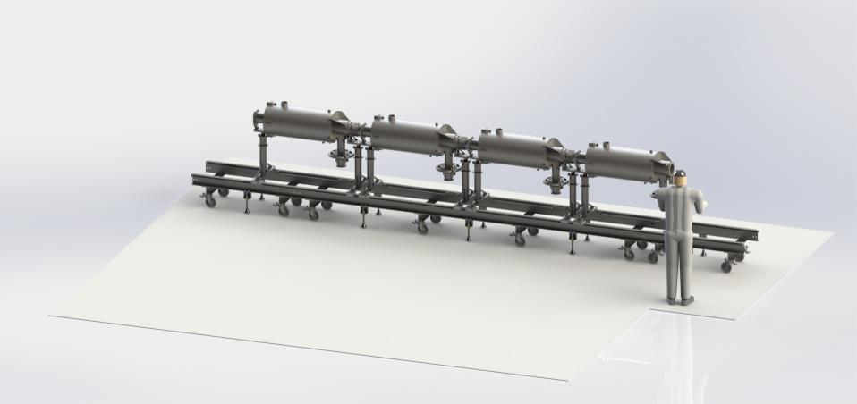
Cavity string assembly
Assembly of the inter-cavity bellows

Slide 25
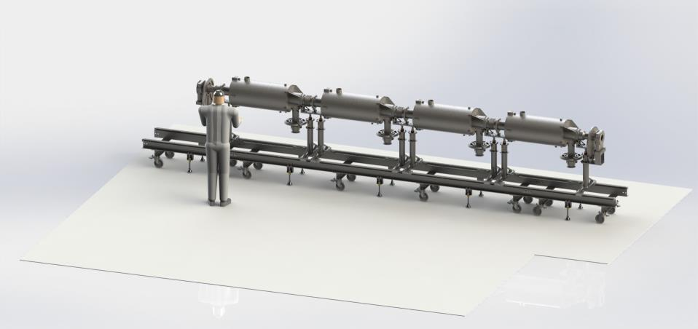
Cavity string assembly
Assembly of the cold to warm transitions

Slide 26
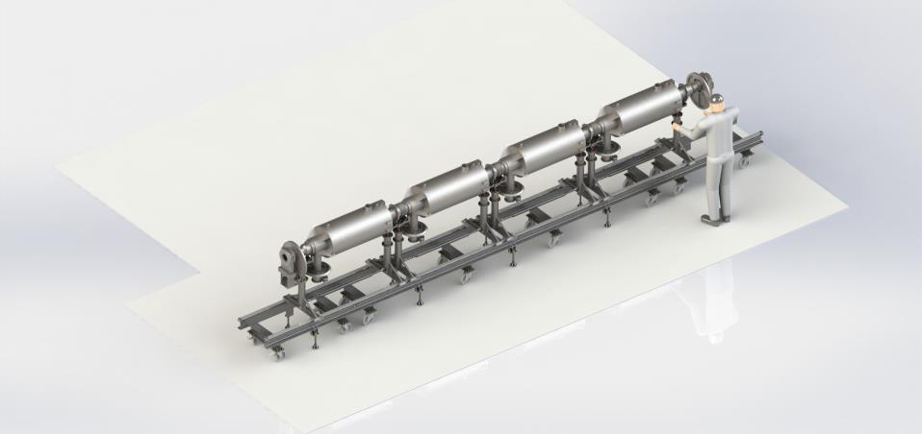
Exit of Clean room

Slide 27
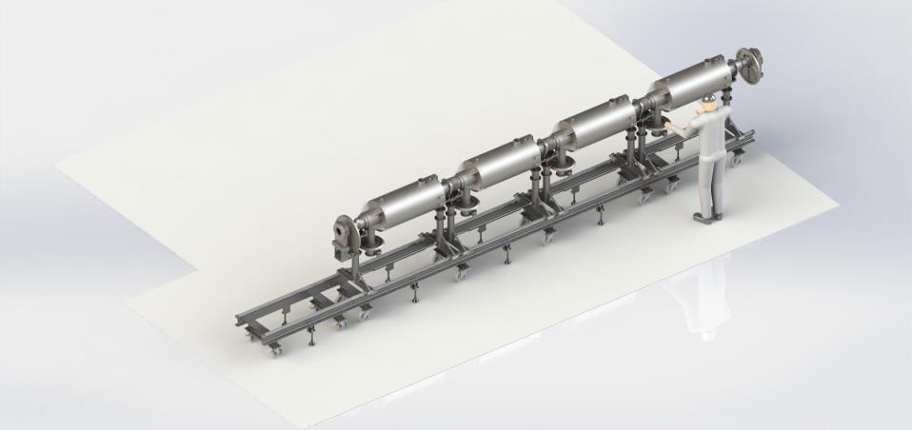
Exit of Clean room

Slide 28
Exit of Clean room
Removing of the extremity trolley

Slide 29
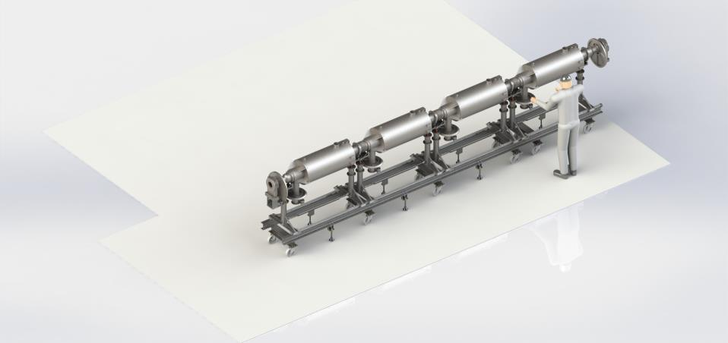
Exit of Clean room
2 m

Slide 30
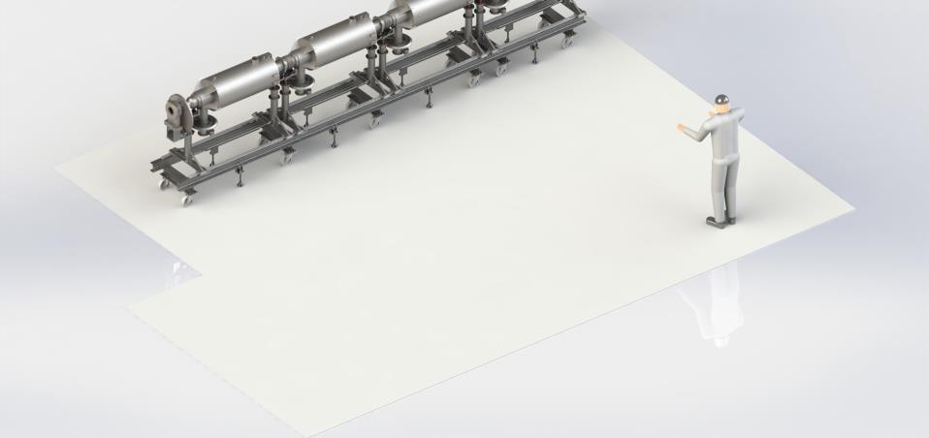
Exit of Clean room
2 m

Slide 31
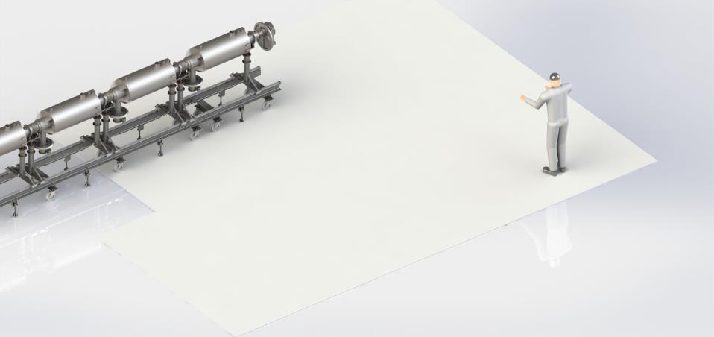
Exit of Clean room

Slide 32
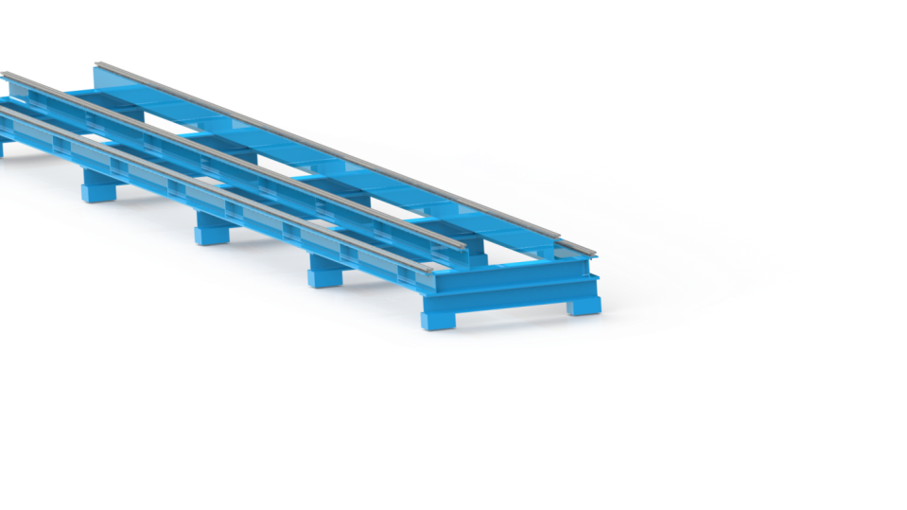
Transfer frame
4 parallel rails
Length about 8m
Gaps: 500 and 900mm

Slide 33
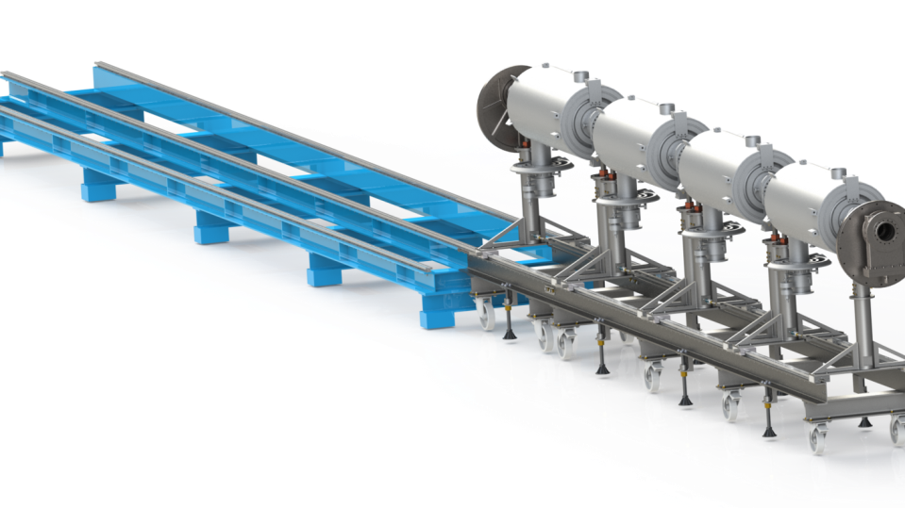
Assembly outside the clean room
Alignment and fixing of the trolley

Slide 34
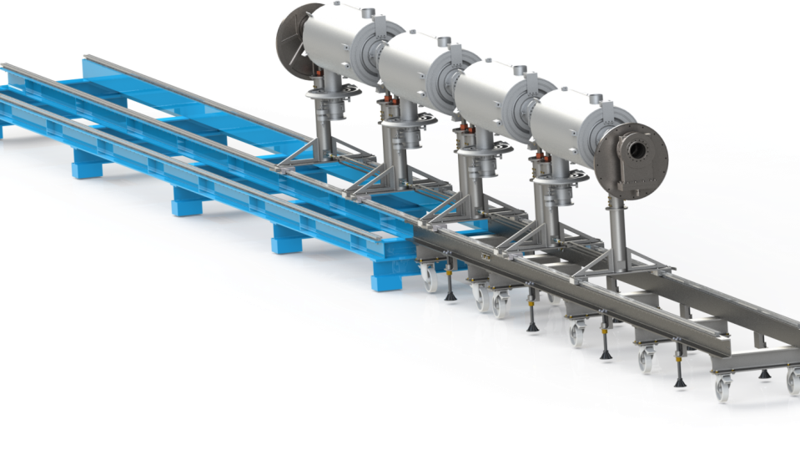
Assembly outside the clean room
Transfer of the cavity string

Slide 35
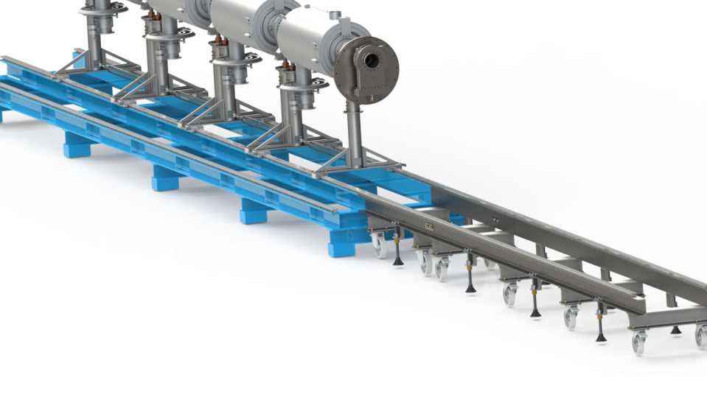
Assembly outside the clean room
End of transfer

Slide 36
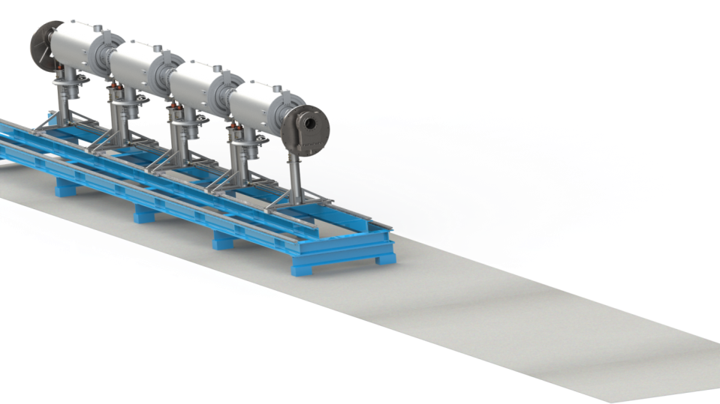
Assembly outside the clean room
Assembly of:
Cold Tuning System
Insulation
Magnetic shield
Cryogenic lines
(not shown)

Slide 37
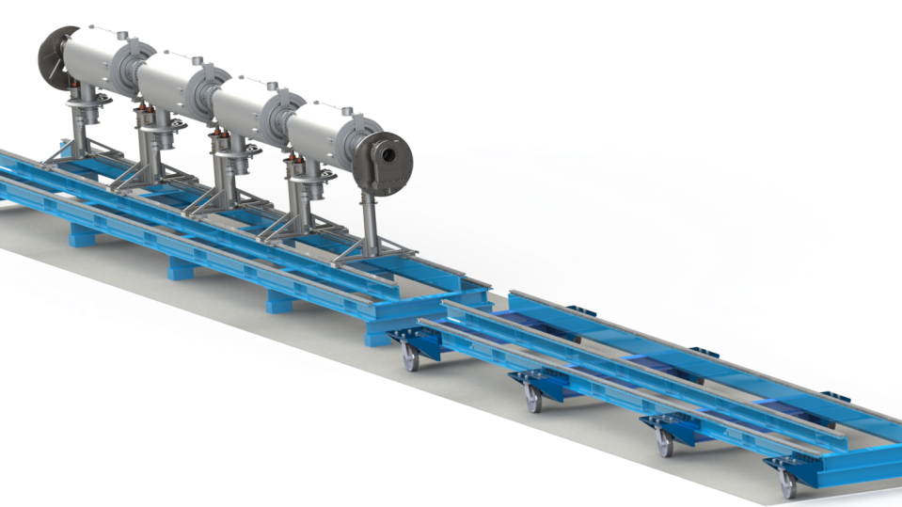
Assembly outside the clean room
Assembly of the spaceframe supporting system

Slide 38
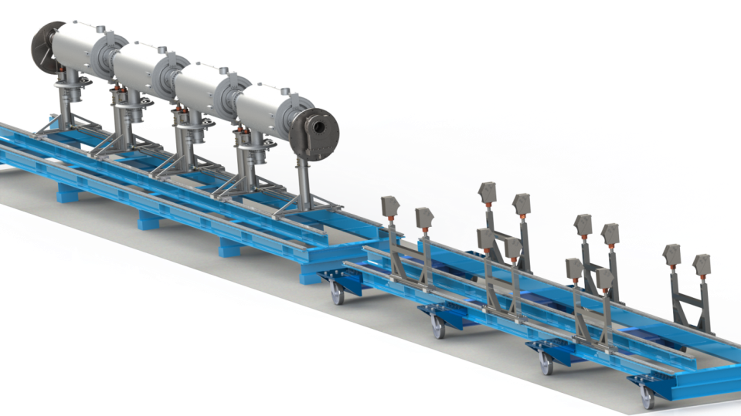
Assembly outside the clean room
Assembly of the spaceframe supporting system

Slide 39
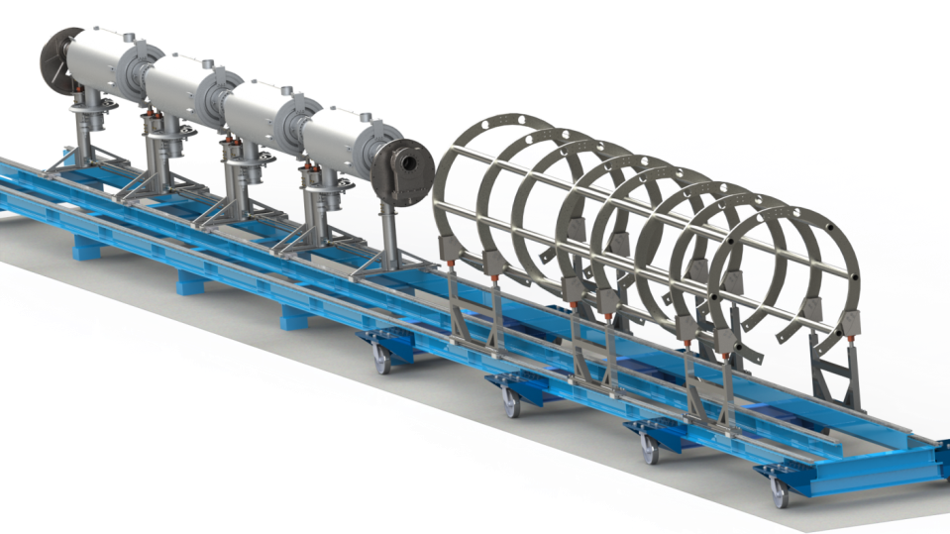
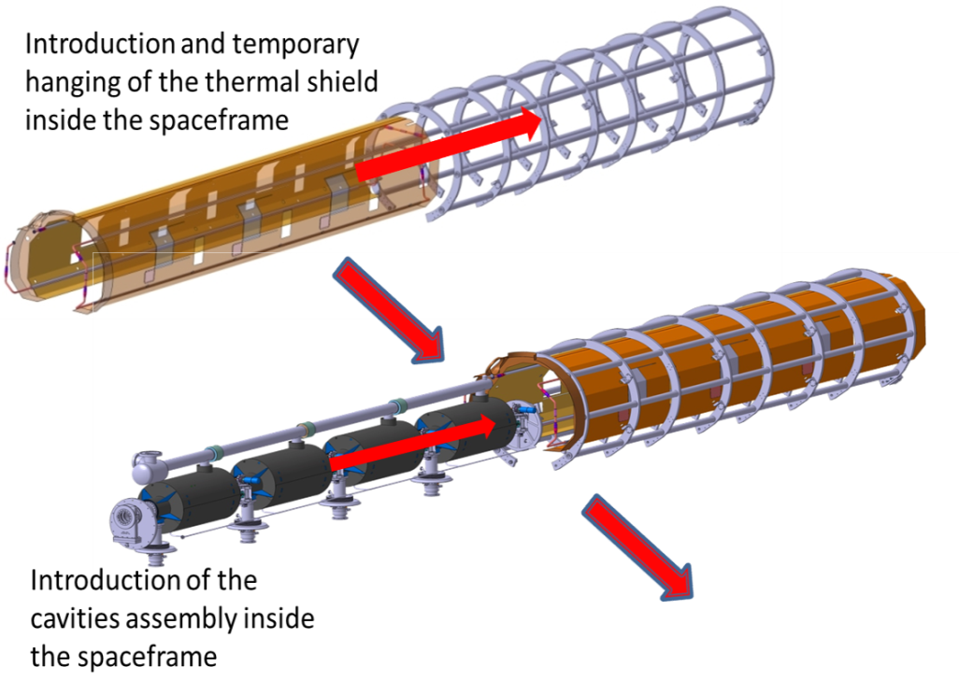
Assembly outside the clean room
Assembly of the spaceframe and the thermal screen (not shown)

Slide 40
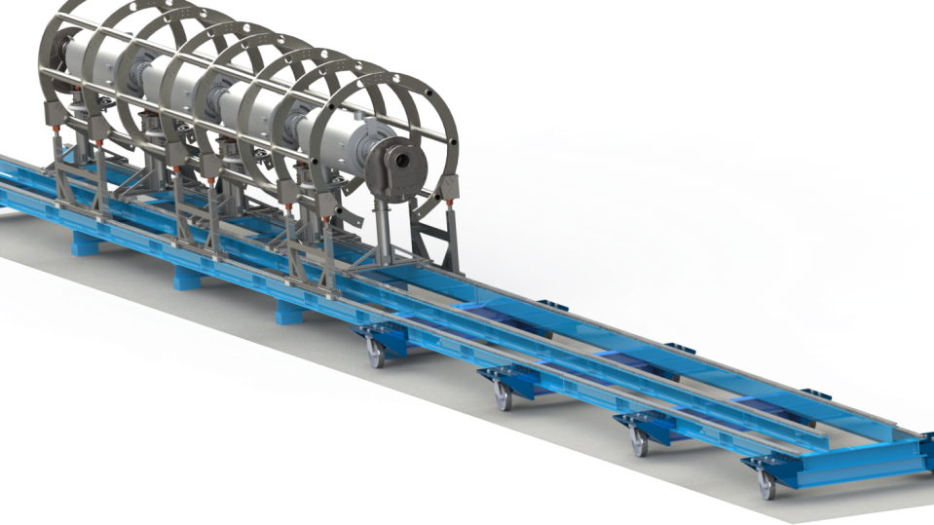
Assembly outside the clean room
Thermal shield not shown
Moving of the spaceframe and the thermal shield around the cavity string
support of the cavity string and the thermal shield inside the spaceframe by means of the supporting system (TA6V rods)

Slide 41
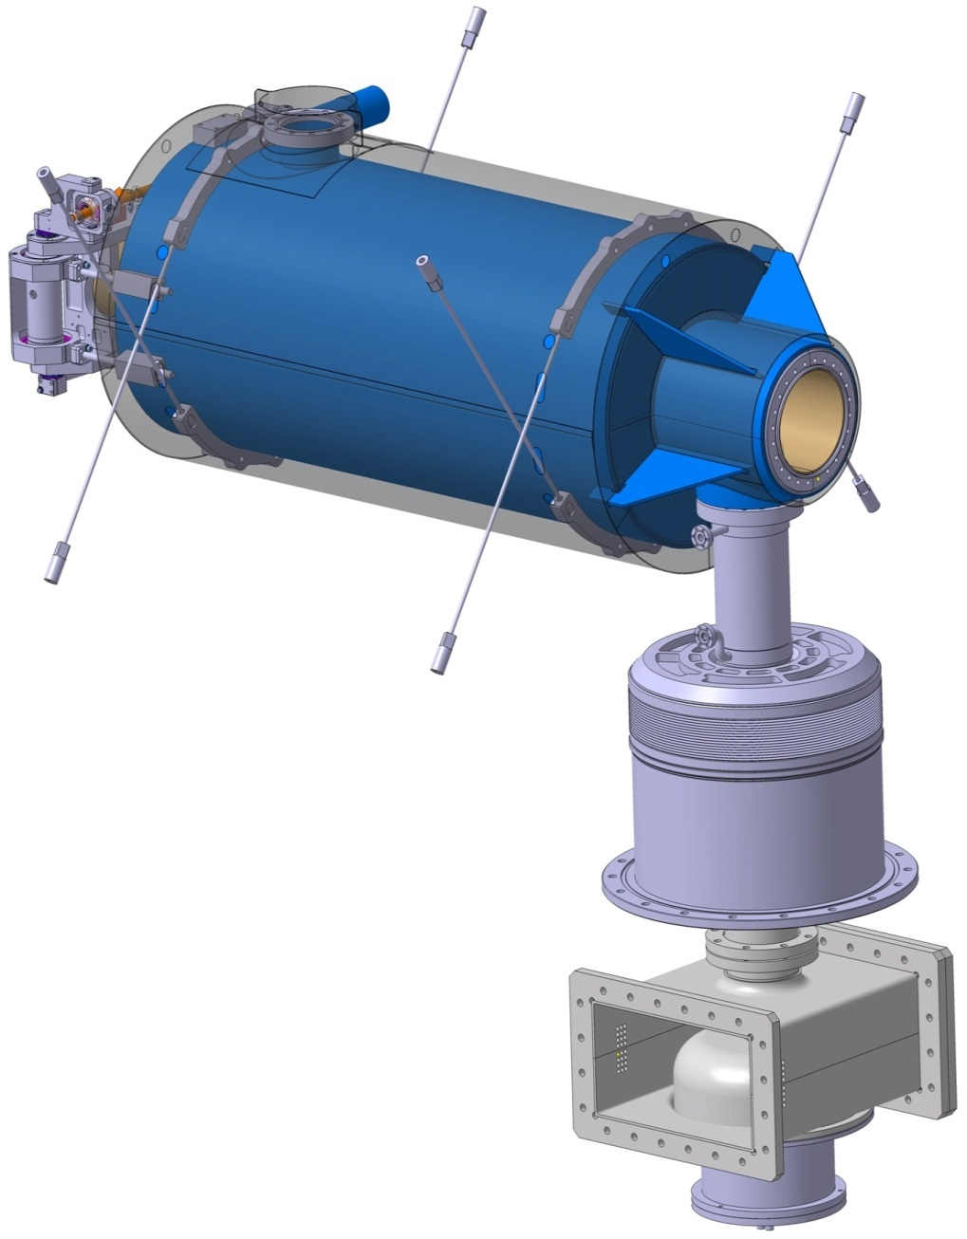
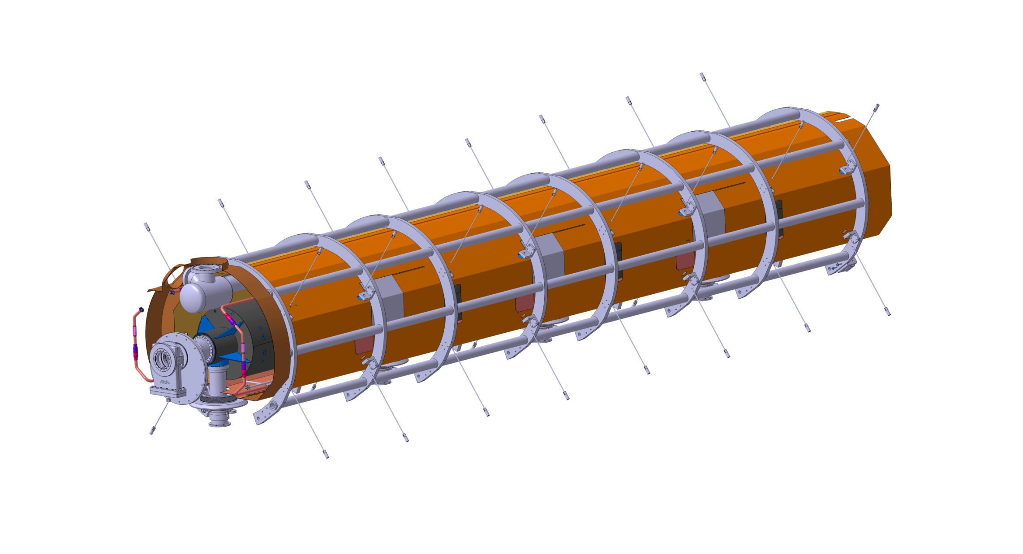
Supporting system
Cross rods fixed
on 2 titanium half rings fastened (on their middle only) to the helium tank on one side
On the spaceframe on the other side
Helium tank
3000N pre-stress applied on the rods
Maximum force 8500N per rod after cooling down
Rods
Magnetic
shield
Half rings linked to the tank (under the magnetic shield)

Slide 42
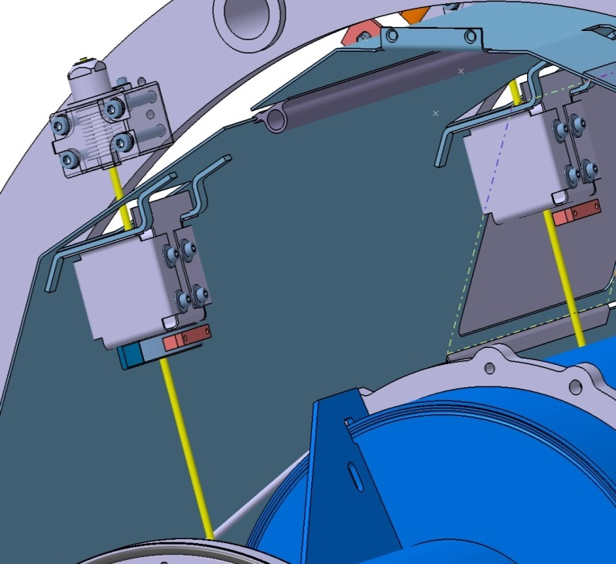
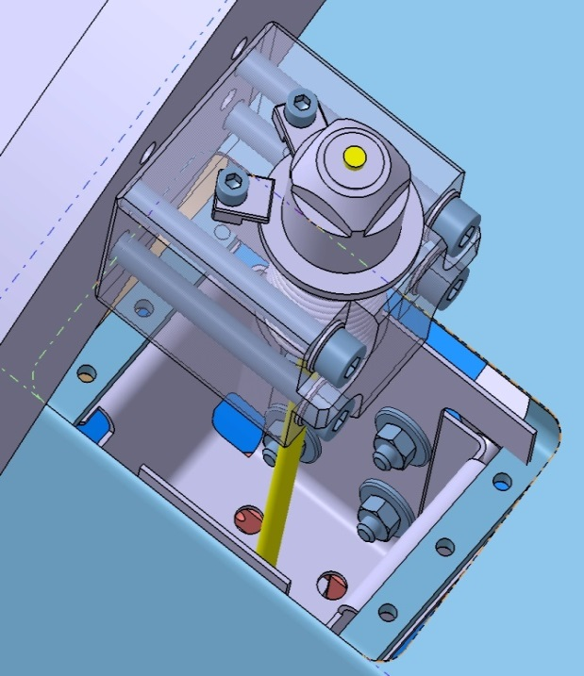
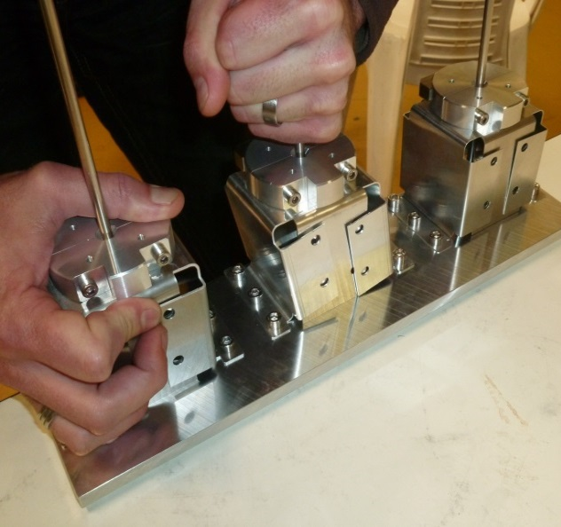
Thermalization of the supporting rods Hanging of the Thermal shield
Thermal shield
Supporting rods
The boxes are blocked only at the fixed point of the thermal shield
Locking jaws and thermalization
Elastic and deformable boxes
FOLDED BOXES ENSURE THE AXIAL MOVING AND THE THERMALIZATION OF THE THERMAL SHIELD.
THEY PERMIT ONLY LOW DISPLACEMENTS ON OTHER DIRECTIONS
3 prototypes have been made (thickness 0,5 , 1 et 1,5mm)

Slide 43
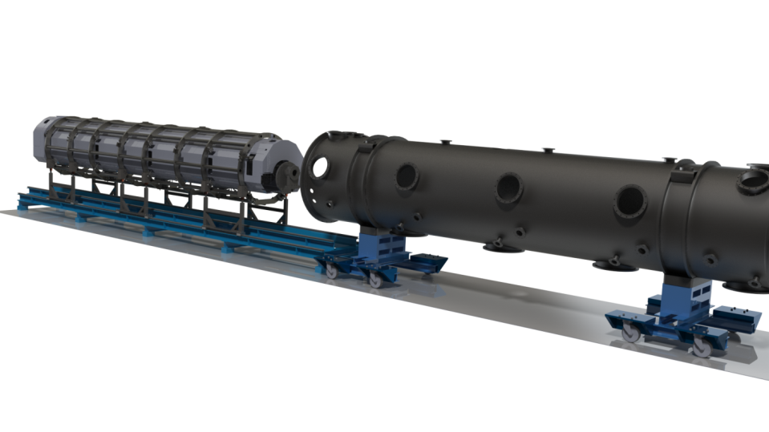
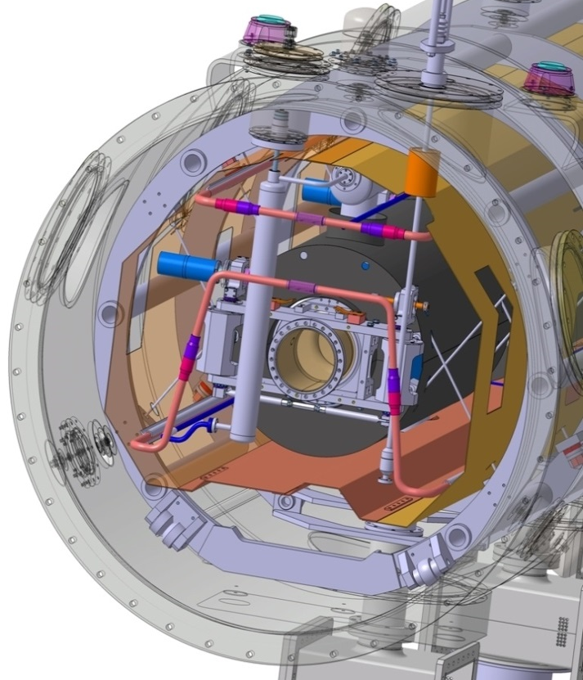
cryostating
Insertion of the whole assembly inside the vacuum vessel
2 wheels are fixed to the spaceframe at each extremity.
The guiding is ensured by two rails welded to the vacuum vessel

Slide 44
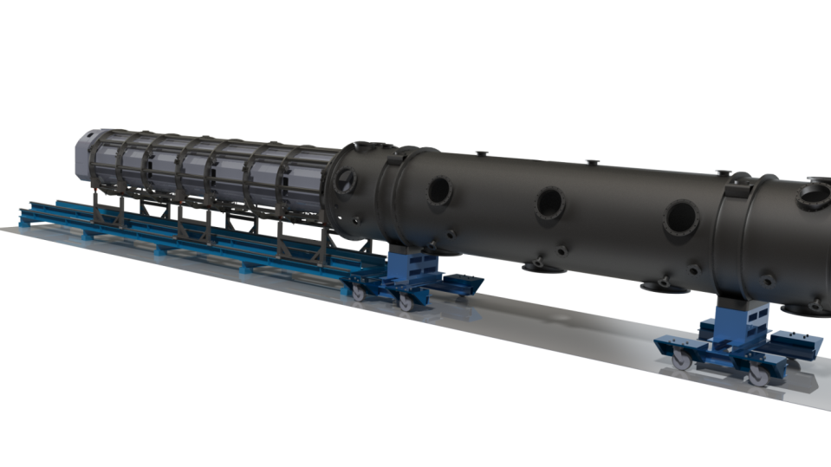
cryostating

Slide 45
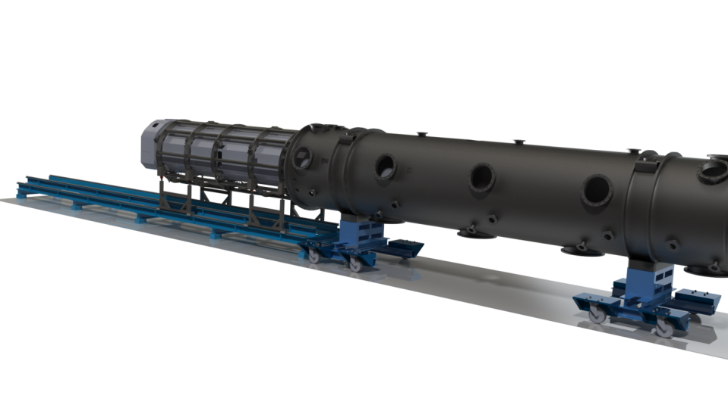
cryostating

Slide 46
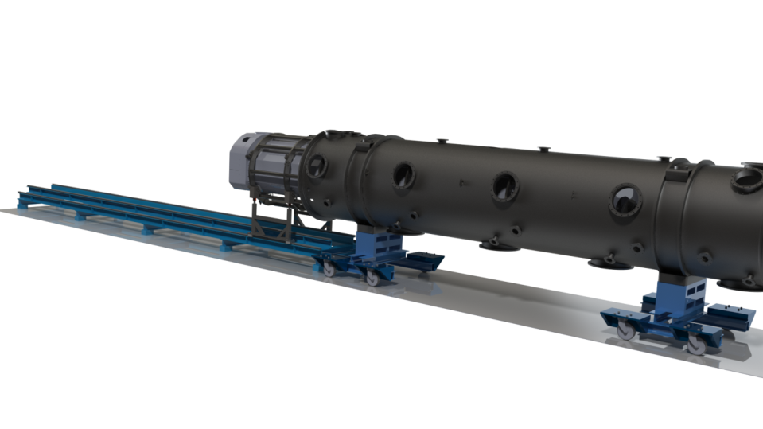
cryostating
End of cryostating.
Finishing operations: final positioning, valves and jumper connections, closing of the cryomodule…

Slide 47
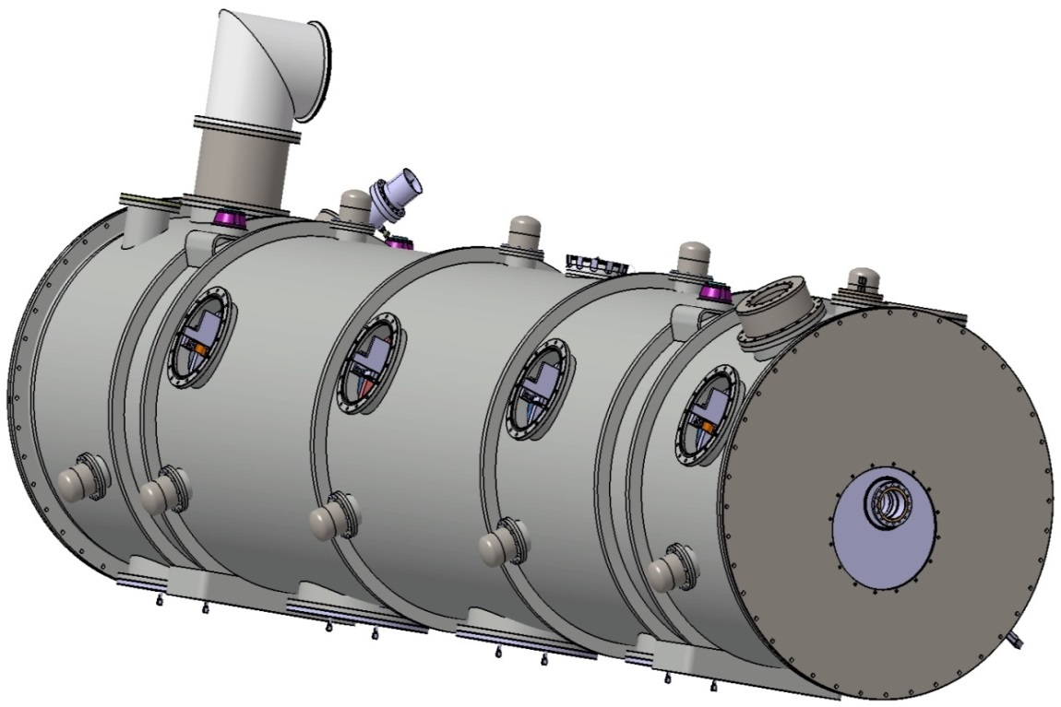
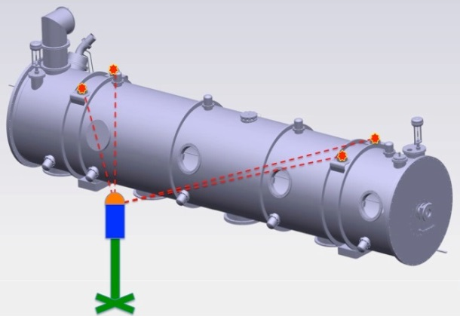
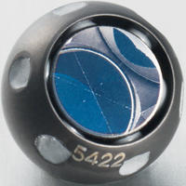
Alignment of the cavity string
Reflector brackets
(vessel alignment)
Alignment of the cavity string within 1,5mm of the beam axis
The same fiducials are available before and after cryostating
Alignment made by laser tracker
Reflector brackets
(cavity flange)
Reflector brackets
(coupler flange)
Alignment of the cryomodule in the tunnel (source ESS)
Additional fiducials will be set up inside the ECCTD cryomodule to check the alignment after cooling down.
1,5" Corner cube reflector
(source ESS)

Slide 48
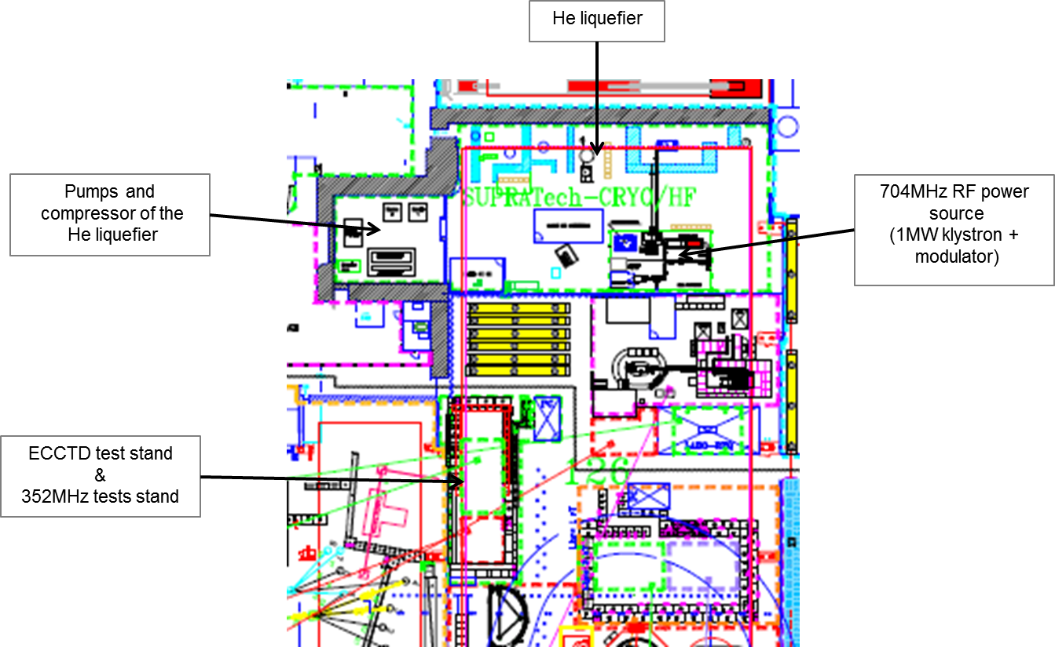
Test facilities at CEA saclay
Development and installation:
Cryogenic lines (L>50m) + Dewar + valves box + jumper line
C/C system
RF wave guide line at 704MHz
Modification of the klystron modulator to increase the pulse length up to ESS requirements (2ms => 3ms)

Slide 49










The new clean room at Saclay
La salle blanche ISO7-ISO5 a été construite pour réaliser les assemblages de cavités supraconductrices dans les conditions de faible empoussièrement.
La salle blanche ISO5 accueillera les montages. Elle est équipée de filtres (FFU - Fan Filter Unit).
Le HPR (rinçage Haute Pression) permet de rincer l’intérieur des cavités. La cavité est fixée sur le plateau monte/baisse. La canne est fixe.
1
4
5
2
4
1
Intérieur de l’ISO5
Dans la salle blanche ISO7, l’extérieur des cavités est nettoyé (SAS humide) et les cavités sont préparées.
3
Local HPR
2
5
La centrale de traitement d’air permet de faire circuler l’air dans la salle blanche à XXXM3/h
Le local d’eau ultra-pure contient
le système de filtration par résine.
3
Centrale de traitement de l’air
Intérieur de l’ISO7
1 | Stéphane BERRY | 4 | Alain PEROLAT
2 | Alain CATALDI | 5 | Richard LE GUENNIC
3 | Fabien EOZENOU | Mardi 13 Mai 2014
Local d’eau Ultra-Pure

Slide 50
Thank you for your attention

