Slide 1
CEA EXPERTISE WITH SRF CAVITY TREATMENT
F. Eozénou
4th SLHiPP Meeting
CERN May 16th 2014

Slide 2
OUTLINE
CHEMICAL (BCP) TREATMENT
ELECTRO-POLISHING
BAKING

Slide 3
CHEMICAL TREATMENTS

Slide 4
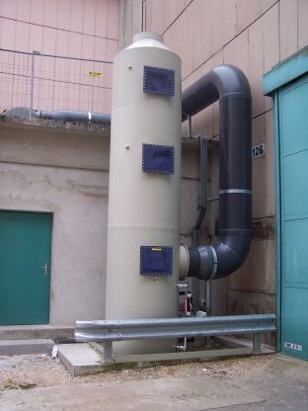

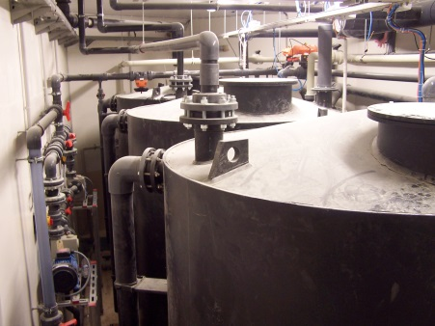
BCP TREATMENT: GENERALITIES
Cavity polished in a mixture of Hydrofluoric, Nitric & Phosphoric acids
(FNP). T<30°C to avoid H contamination
HNO₃: Niobium oxidation
HF: Oxyde removal
H₃PO₄: Buffering of the reaction
By-Products: NOx
Composition until 2007: 1 – 1 – 2 Removal rate 1µm/min
But new QSE constraints: HF < 7%
Mixture changed: 1 – 1 – 2.4 Removal rate 0.8µm/min
Scrubber for gaseous exhausts

Slide 5
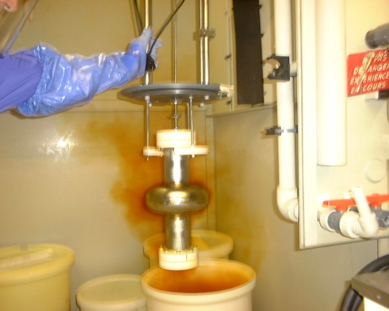
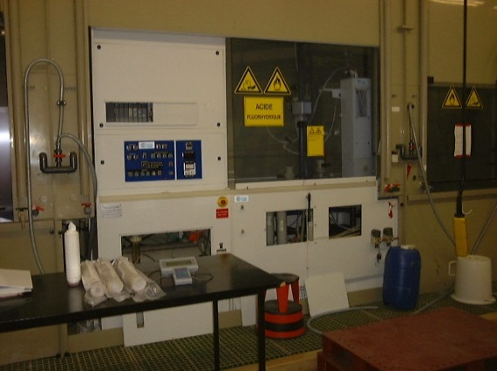
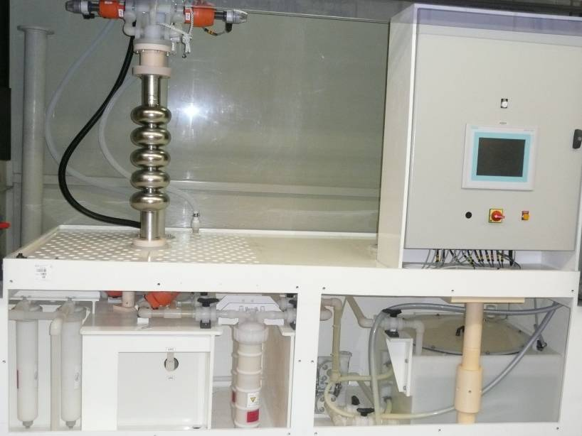
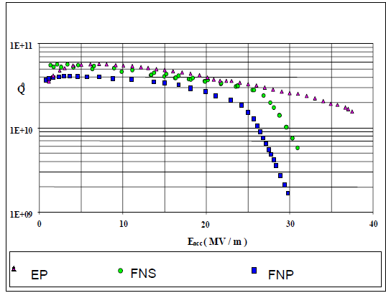
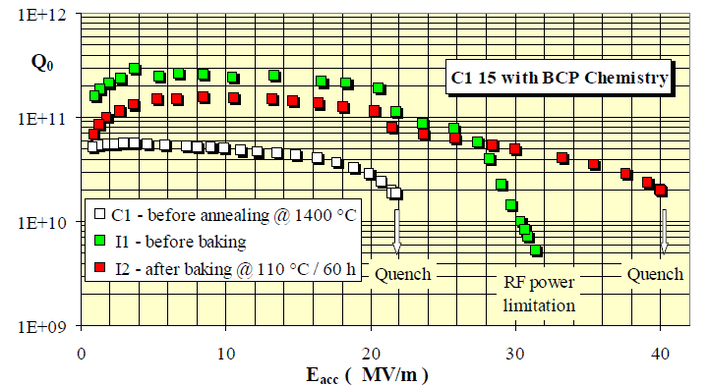
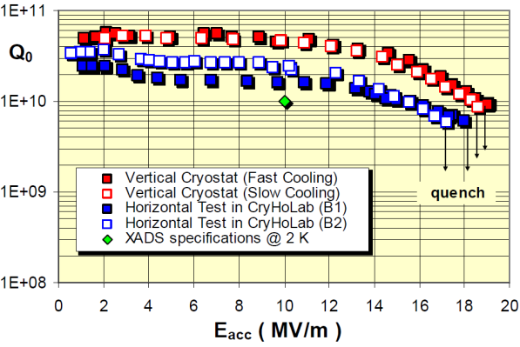
TREATMENT EVOLUTIOn AT CEA SACLAY
RESULTS
Evolution of chemical treatment of elliptical cavities:
Automation and safety improvement
(baked)
Tests with alternative chemistry (FNS)
High gradients achieved after BCP treatment
Results on 5-Cell 700MHz cavity
Visentin et al. LINAC2004
C.Z. Antoine et al. SRF1999
Visentin et al. EPAC2002

Slide 6
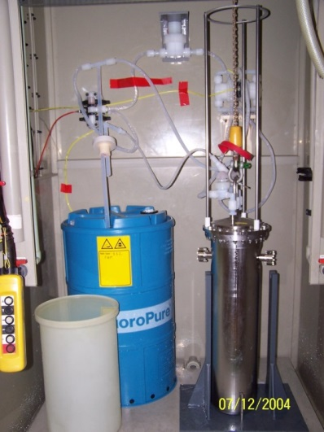
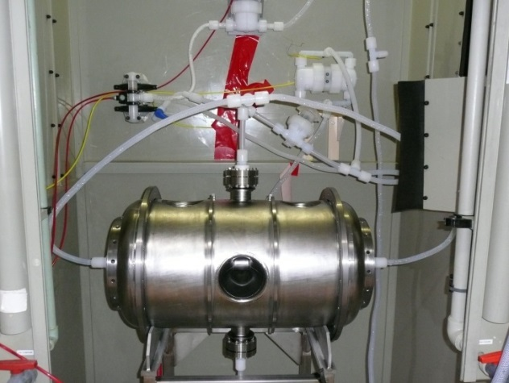


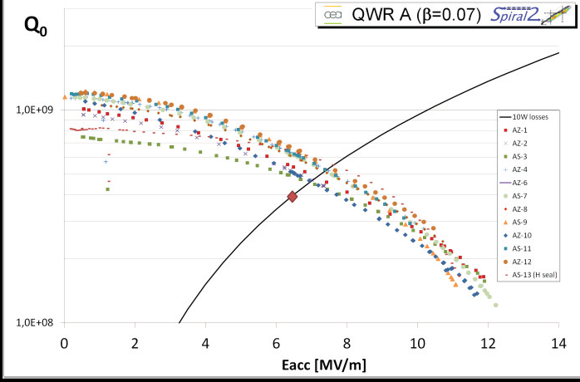
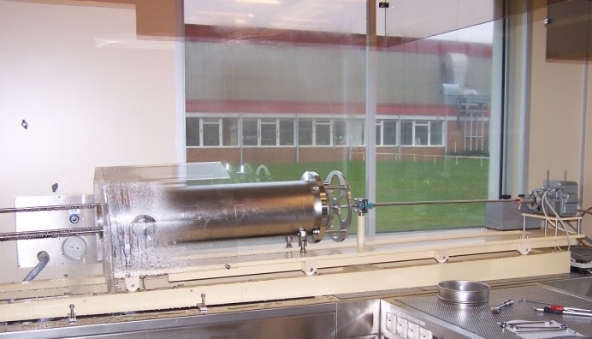
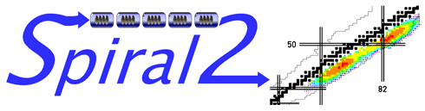
TREATMENT of Quarter WAVE and SPOKE RESONATORS
Treatment of Spiral2 and spoke cavities with circulating acid
High Pressure Rinsing (HPR) of Spiral2 cavity
Qualification of Spiral 2 Cavities after BCP treatment

Slide 7
ELECTROPOLISHING (EP)

Slide 8
GENERALITIES
Process
Nb polished internally with an electrolyte
(concentrated H₂SO₄ - HF mixture) under voltage
Cavity ≡ Anode
Cathode ≡ Al pipe inside the cavity
Chemical reactions
Anode: Niobium oxidation
2 Nb + 5 H₂O ↔ Nb₂O₅ + 10 H⁺ + 10 e⁻
Cathode: H₂ generation
2 H⁺ + 2 e⁻ ↔ H₂
HF: dissolution of oxide Nb₂O₅ layer
H₂SO₄: forming of a viscous layer

Slide 9
GENERALITIES
ELECTROLYTE
Micropolishing smoothens irregularities < 1 µm
Better RF performances due to smoother surface?

Slide 10
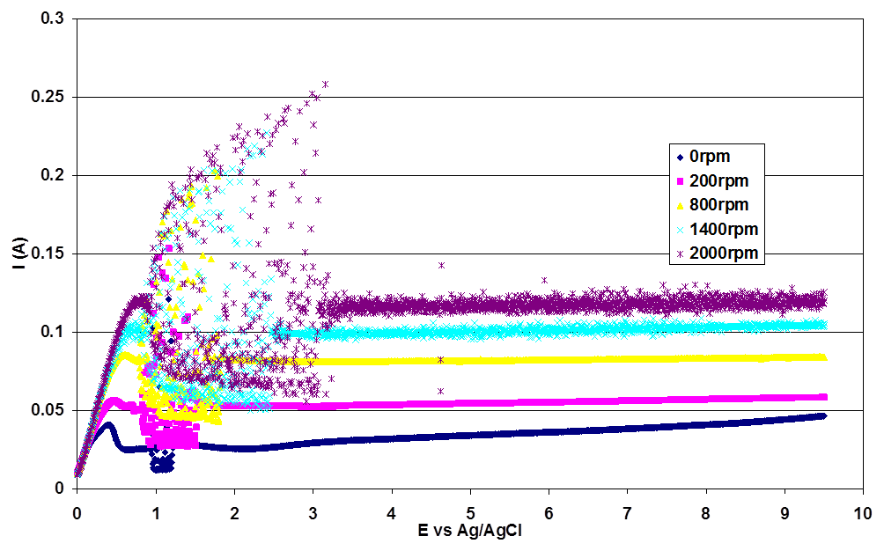
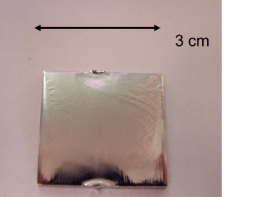

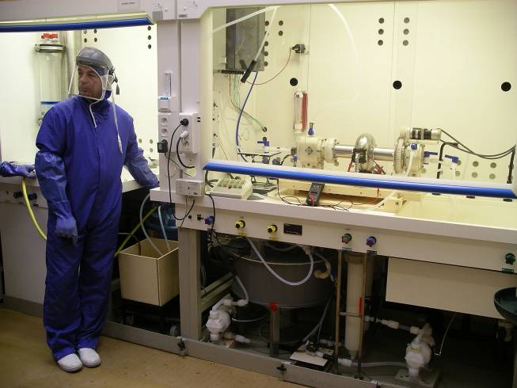

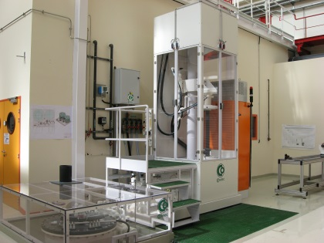
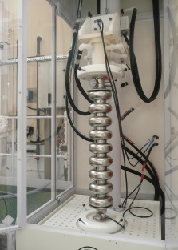


ELECTROPOLISHING AT IRFU: 2004-2014
EP on samples (CARE program): 2004-…
Parameters optimization
Understanding of the process (F⁻ diffusion)
Study of the aging of electrolytes
Sulfur contamination
1-Cell Horizontal EP: 2006-2009
Achievement of high gradients
Alternative recipe tested
Achievement of high Q0
Low voltage EP
Design of a new Vertical EP system: 2009-…
Operating since 2011
Optimization on 1-Cell cavities
Operation with ILC and SPL cavities

Slide 11
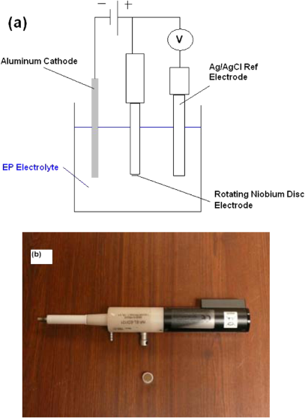
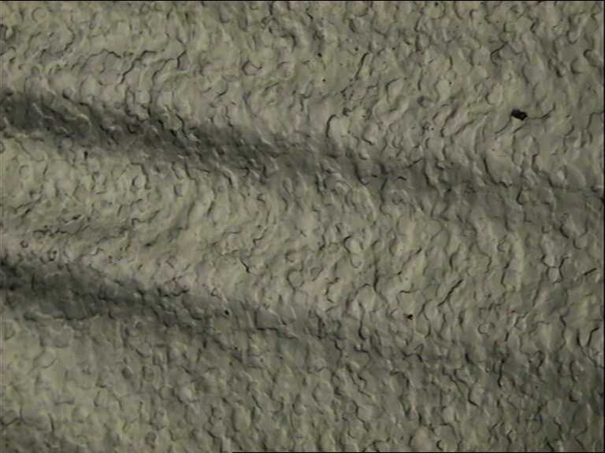
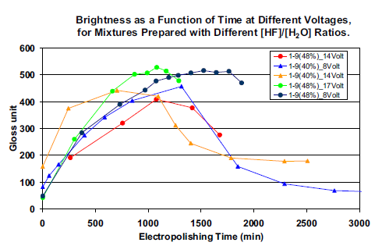
EXAMPLES OF ACHIEVEMENTS ON SAMPLES
Study on samples with rotating electrode:
Intensity limited by diffusion of F- ions to the surface
Evaluation of the diffusion coefficient
Evidence of a viscous layer slipping at the surface
4 mm
Parameters investigation & aging of EP mixtures:
The higher voltage, the lower life time for electrolytes
The higher [HF], the longer lifetime
[HF] is dominant compared to dissolved Nb on aging

Slide 12
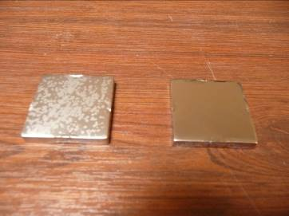
EP AT LOW-VOLTAGE
Motivation for EP at low voltage:
Reduction of parasitical reactions
Lower heating of EP bath
Longer lifetime of the electrolyte
No deterioration of performance
= Theoritical way to reduce Sulfur Contamination
For the same heavy removal on two samples: less visible contamination at lower voltage
Sample electro-polished at 20V
Sample electro-polished at 5V
F. Eozenou, PRST-AB, 13, 083501 (2010)

Slide 13
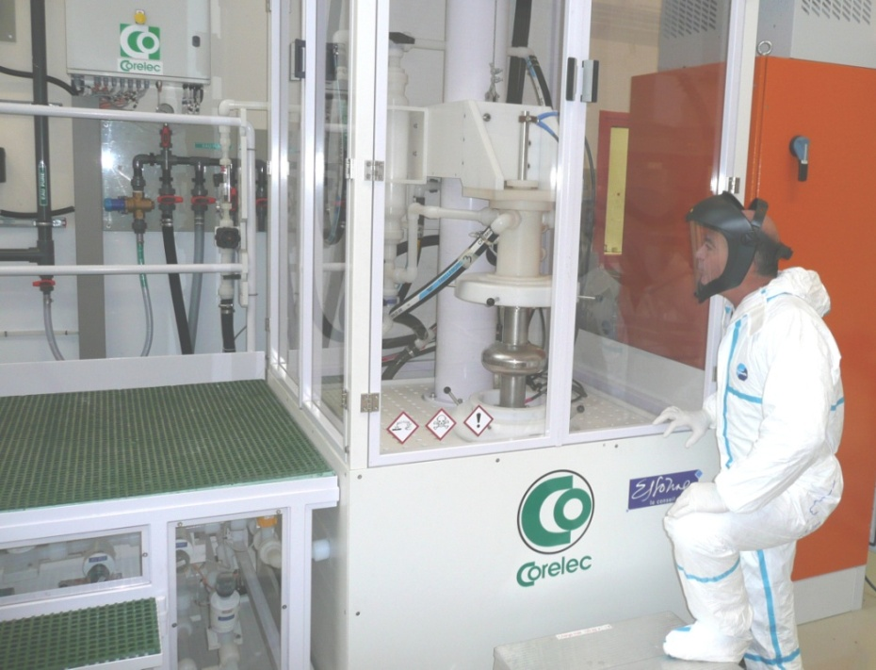
HORIZONTAL Vs VERTICAL EP (VEP)
Pros:
Good evacuation of gases (cavity half filled)
Demonstrated efficiency
Large range of parameters
Pros:
Simple process
Low floor surface
Improved safety
Higher removal rate
Cons:
Complicated process
Rotary seals
Switching of the cavity
Low removal rate
Cons:
Sensitive to fluid dynamics
Proper parameters to be determined…
…Voltage and fluid velocity

Slide 14
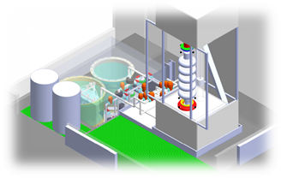
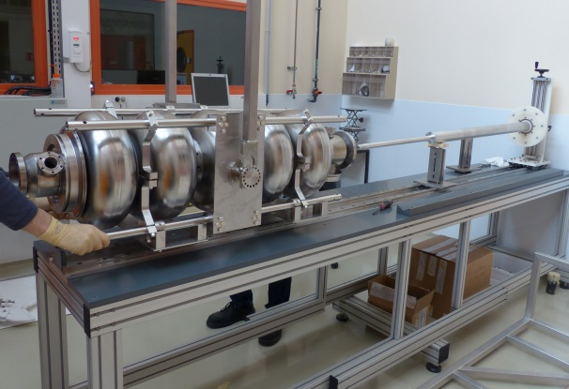
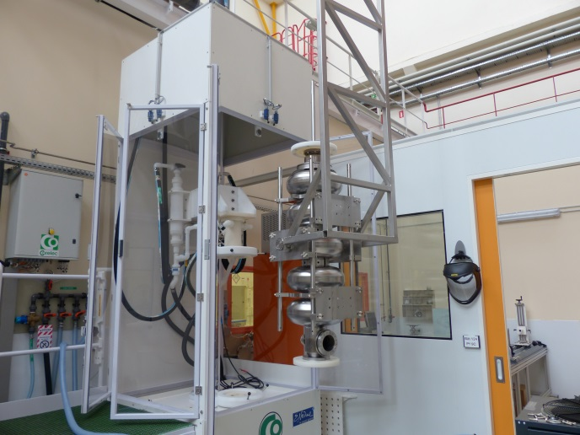
VEP SET-UP AT CEA SACLAY
F. Eozenou. PRST-AB, 15, 083501 (2012)
Designed for large cavities
Circulating acid
Injected from bottom
300L acid capacity
Cooling system (heat exchanger in acid tank)
Emptying by gravity
Nitrogen blowing in top of cavity/acid tank
Cathode inserted in horizontal position
Cathode’s insertion in horizontal position
SPL Cavity insertion in the cabinet

Slide 15
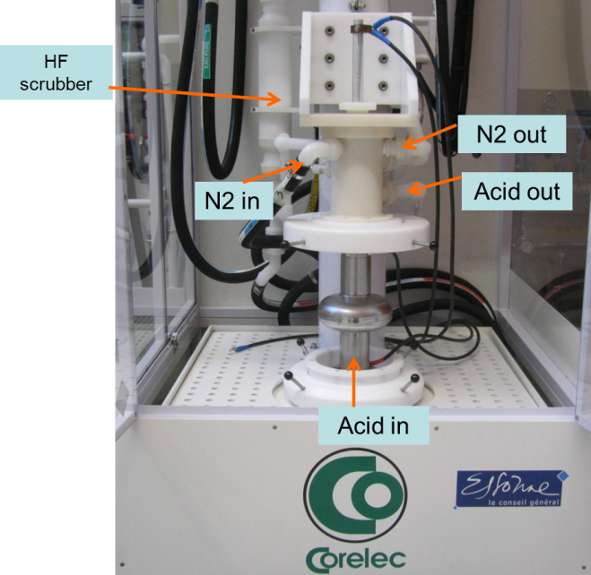
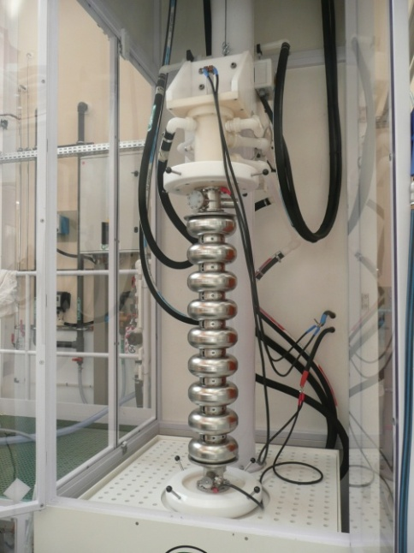

PARAMETERS FOR 1300MHZ VEP
TB9RI025 cavity
Prior to VEP
Circulating acid
Constant voltage
Nitrogen blowing
VEP of 1-Cell and 9-Cell cavities
Focus on parameters: low voltage (~ 6V) – high acid flow (25L/min)
  Improved degassing (H₂ , O₂)
  Lower heating

Slide 16
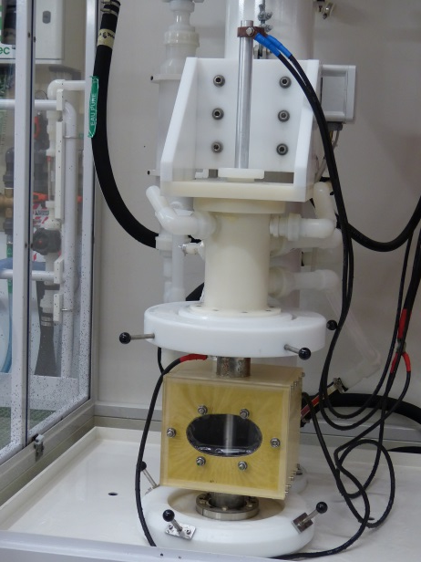
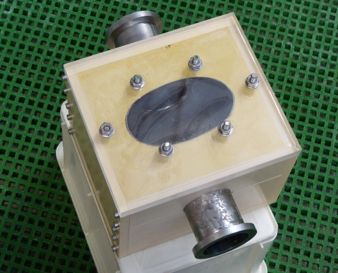
Study of VEP Mechanism (Flows in cavity)
Set-up to investigate inner surface of the cavity during VEP:
1.3 GHz 1C cavity cut and embedded in resin
Goal: investigate the effect of the acid flow, viscous layer during VEP
Explanation for asymmetry?
First test with acid (Ø30mm rod cathode):
Hydrogen bubbles flow alongside the cathode
Air bubbles might be trapped at the cavity surface if the acid flow is too high during filling

Slide 17
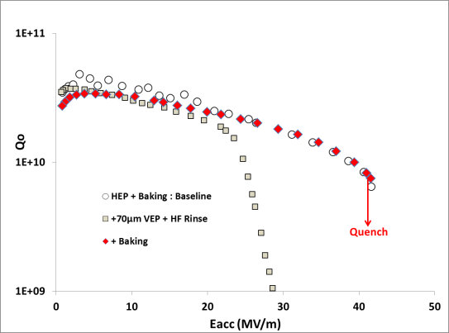
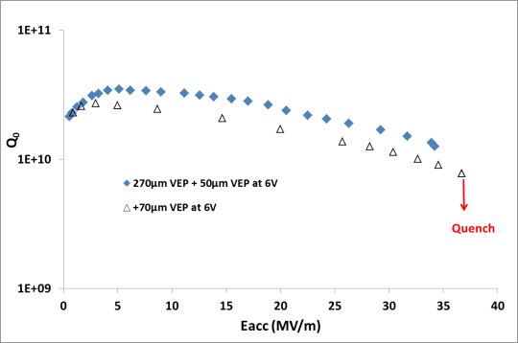

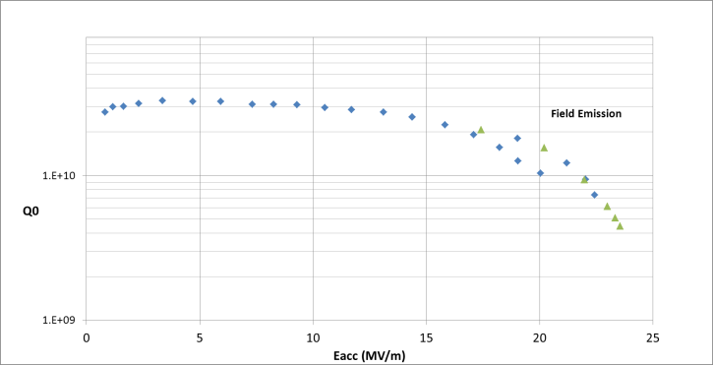
RESULTS ACHIEVED AFTER VEP ON 1300MHz Cavity
F. Eozenou, SRF2013
1DE1 cavity horizontally EP’ed + VEP
Similar performance Vs Horizontal EP
Benefits of baking similar
1AC3 Cavity after heavy VEP
High gradients achieved
9-cell cavity Horizontally EP’ed from
After additionnal VEP, Gradient limited by field emission

Slide 18
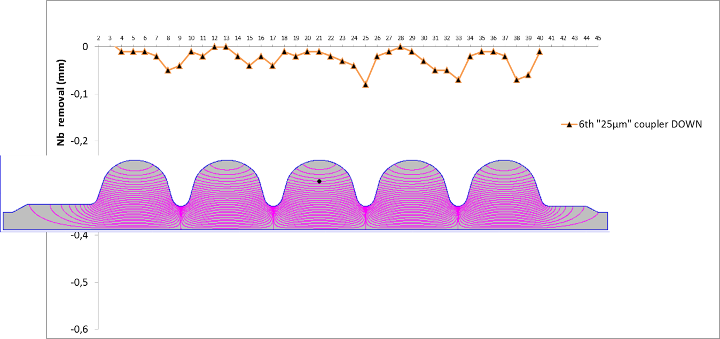
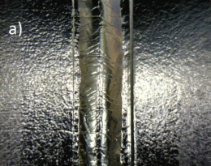
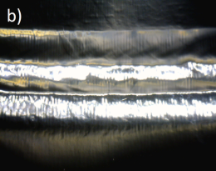
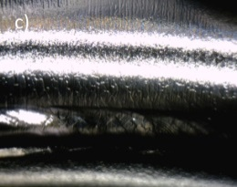
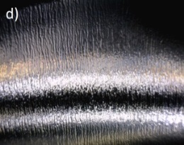
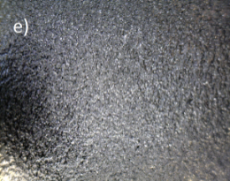
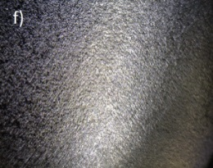
VEP OF SPL cavity. ASSYMETRY OF THE PROCESS
Removal profile after 1seq 25 µm average
Acid Flow
Asymmetry in the cell: higher removal in the upper part of the cells
Asymmetry in the cavity: the higher cell, the faster removal
Achieved surface depends on the location in the cavity
9 mm
Typical surface morphologies after >100µm VEP at different locations. The weldings at a) equators, and b) irises are smooth. Bubbles stripes are observed at the proximity of irises c) and d). In the areas between equators and irises e) and f), the surface is rougher.

Slide 19
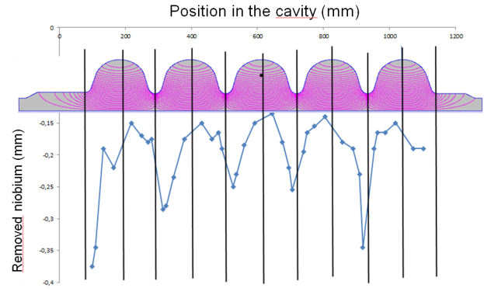
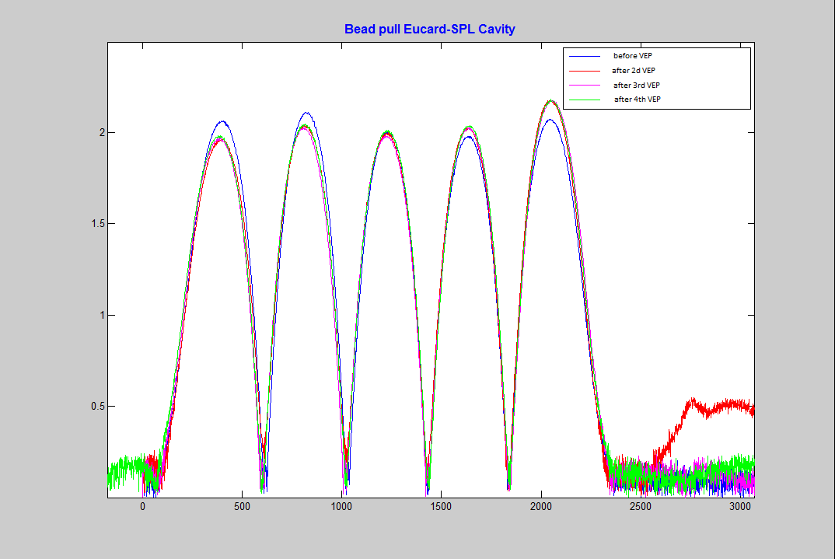

REMOVAL AFTER 200µm VEP
4 sequences with turning of the cavity in between
200 µm average removal
Symmetric removal in the cavity
Ratio iris/equator: 2/1 = similar compared to ILC shape
Strong local attack due to acid condensation in exhaust pipe
Low field deterioration after each VEP sequence sequence
Please refer to J. Plouin’s talk for RF results at 1.7K before/after heat tratment at CERN
(A. Mongelluzzo, S. Calatroni)

Slide 20
BAKING EXPERIMENTS

Slide 21
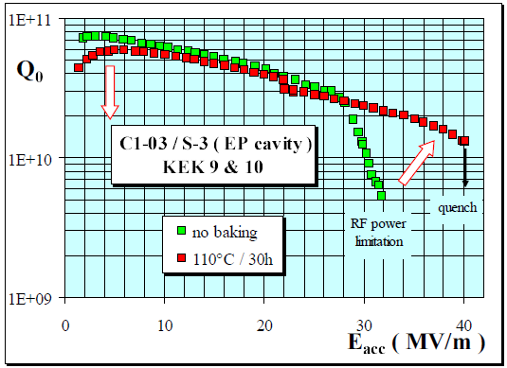
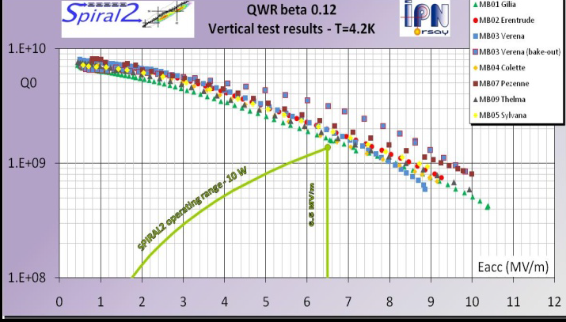
GENERALITIES
Final step in surface treatment in order to reach higher Q₀ / Quench limit
Removal of the standard ‘Qslope’ at high gradient for Tesla-type cavities (gain: +10MV/m on electro-polished cavity)
Q₀ decrease at low field due to an increase in residual resistance Rres
Q₀ increase for quarter wave cavities due to R_{BCS} reduction
Cavity baked at 100-120°C during 30-60h under ultra high vacuum
  → Demanding process
G. Olry et al. SRF2009
Standard Q₀ improvement on Tesla cavity
Improvement of Q₀ at IPN Orsay after Baking 110°C-55h
Losses reduced by 37% at 6.5MV/m

Slide 22
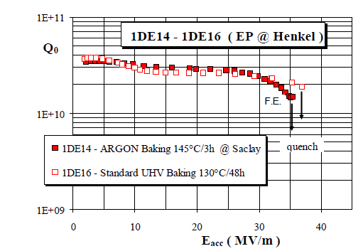
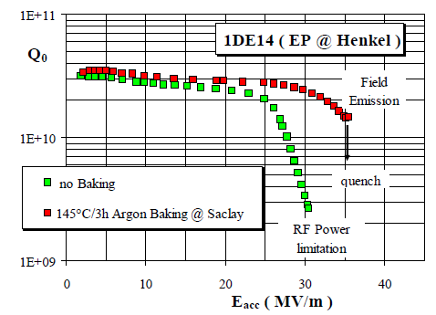
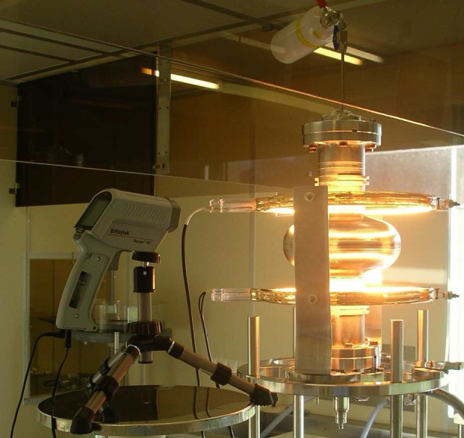
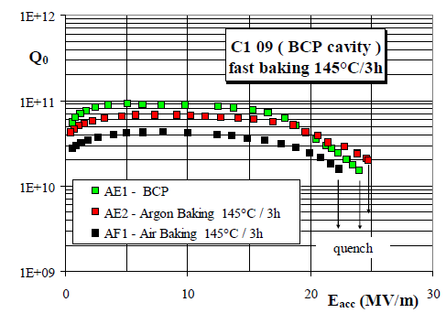
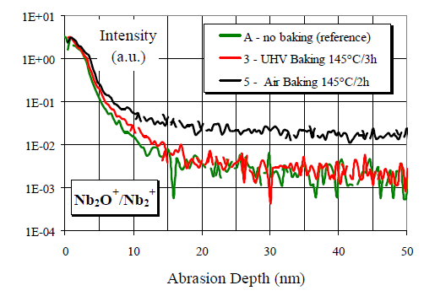
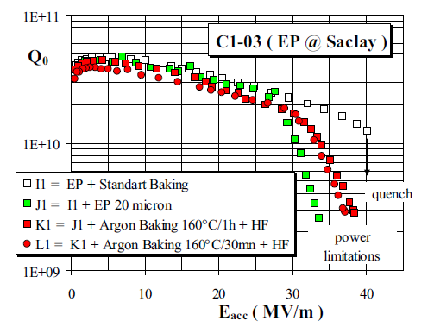
BAKING EXPERIMENTS AT CEA Saclay:
Reduction of baking time
B. Visentin, SRF2007
Cavity baked under argon atmosphere
Baking time decreased down to 3h
Performance similar to standard baking on electropolished cavity
Infrared heater in cleanroom
Air baking deteriorates Q₀
Evidence of Oxygen diffusion in bulk niobium
160°C as baking T: decrease in Q₀

Slide 23
THANK YOU FOR YOUR ATTENTION

