Slide 1
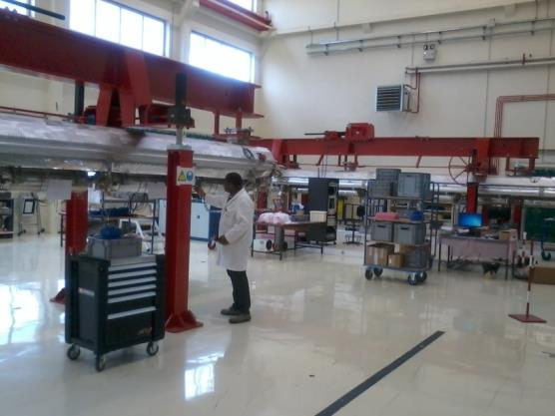
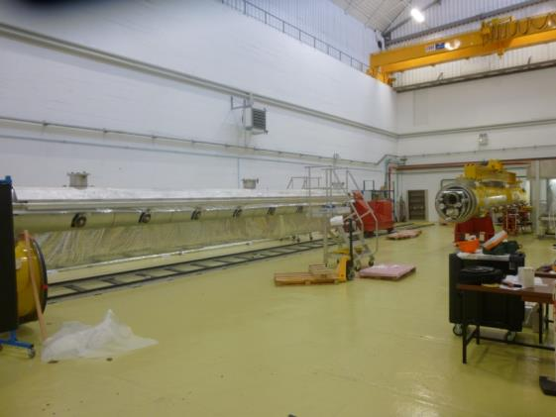
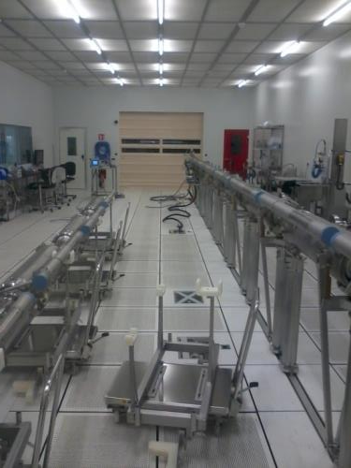
CEA expertise with clean room assembly of XFEL
4th SLHIPP Meeting 2014 May 14-16 at CERN| Stéphane BERRY
Lessons learned during XFEL module assembly
Notes:
Here is picture of the production line loaded with modules on last friday

Slide 2
OUTline
  XFEL project on CEA-Saclay production site
  Cleanliness, leak tightness, venting, alignment
  Lessons learned issues examples from daily work
    on each workstations
  Quality system
    From procedures to assembly report in EDMS
    From traveler to hold points
  Progress
    Pre-series module RF test results

Slide 3




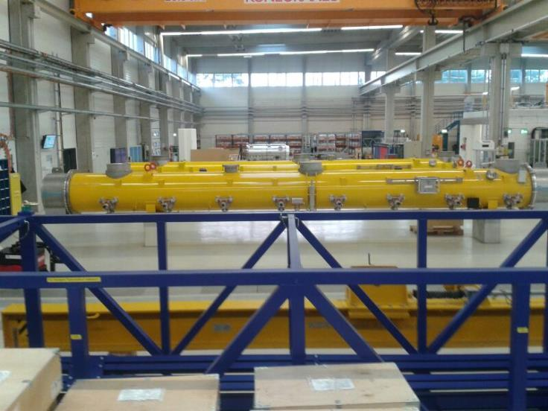


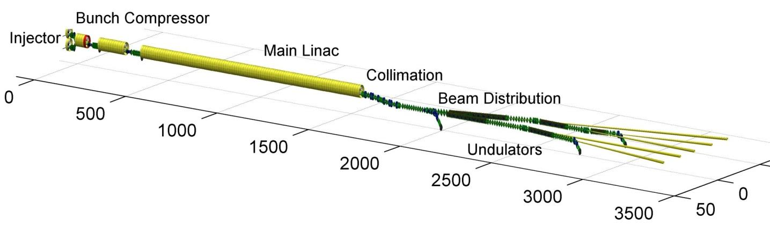











Quick overview
| PAGE 3
Notes:
Talking about contributing to the construction of the E-XFEL superconducting linac with all the other institutes . aiming at producing light in the Xray domain
Linac contains 100 cryomomdules about 12 m long accelerating structure bringing the E- beam to 17;5 GeV
1 CM =12m ; a lot of components among them 400 are being assembled at CEA
An example of the pre-series module we already delivered to DESY

Slide 4
GOAL
To assemble 103 accelerator cryomodules
with a nominal rate of 1 per week
The foreseen production cycle is 7 weeks
The assembly is operated by an industrial contractor ALSYOM
on the Saclay site and infrastructures
under CEA supervision

Slide 5
dedicated ASSEMBLY BUILDINGS
XFel Village
Clean rooms
7
6
4
Bldg 124 North
25x15 m²
CourtYard
3
2
Assembly halls
Bldg 126 North
40x11 m²
5
1
8
Bldg 126 South 30x17 m²
Offices
6
Warehouse
©GoogleMap
Notes:
This is an sky view of the building dedicated to XFEL project in Saclay
The Xfel village is made of clean rooms, assembly halls, officces and warehouse

Slide 6
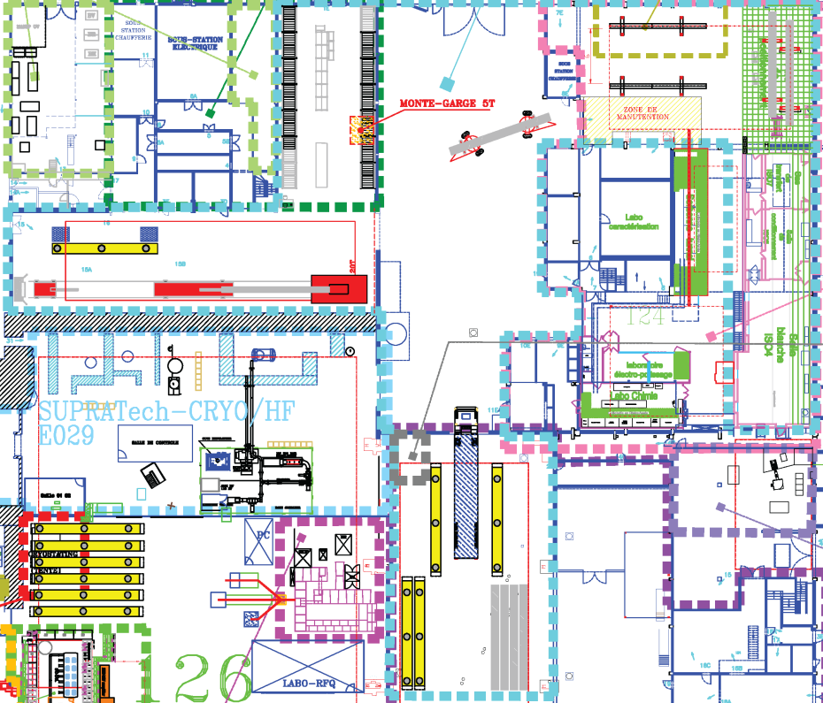
Workstations in assy halls
Reception Area
REC-WS1a
Roll-out Area
RO-WS1 & 2
Alignment Area AL-WS1 & 2
Warehouse
Coupler Area CO-WS1 & 2
Reception Area
REC-WS1b
Clean room Areas
CC-WS1
SA-WS1 & 2
the XFEL Village
Cantilever Area CA-WS1
Shipment Area
SH-WS1 & 2
Notes:
This is the top view scheme of the XFEL village.
One can see the different workstations in the assembly halls.
The workflow is the following
This is the warehouse ;
Parts have to pass through reception tests on this area.
The clean assembly of the most critical compounds occurs in a 100m2 ISO4 clean room.
Pursue assembly by rolling out the cavity string from the CR
The Alignment area is in the same hall
/cross the yard with special truck/
A big cantilever helps to hang the cold mass while sliding the vacuum vessel around it
This workstation is mostly dedicated to warm part of the coupler and its pumping line.
We have to move in another hall to check and prepare the module for shipment.
The RO area is the workstation where the cavity string is dressed with ancillaries
The

Slide 7
Phases of the project
  Preliminary study subcontracted 2007 – 2008
  Preparation of Infrastructure and Tooling 2009 – 2010
  Pre-industrial study and prototyping 2010 – 2012
      Preindustrial study
      Training and Commissioning at Saclay with XFEL Prototype Modules (PXFEL2 and PXFEL3)
      Leading to Restricted Call for Tender signed in July 2012
  4. XFEL module assembly by industry operator 2012 - 2015

Slide 8
Phase 3 : PROTOTYPING
GOAL : to get the « Factory » ready
  Implement the pre-industrial study
  Check the infrastructures
  Check the tools
  Check the procedures
  Train the CEA-IRFU team
  Prepare all the documentation templates
  Set-up the QA/QC and MBOM
  Feedback from the assemblies
  With the support of DESY colleagues

Slide 9


prototyping AND LEARNING PHASE
prototyping phase (~10 CEA persons) :
  the module disassembly of PXFEL2_1 (started 24/08/2010)
  the module re-assembly of PXFEL2_1
  the string and module assembly of PXFEL3_1 (02/05/2011 – 26/10/2011) using DESY cavity posts and clean room tools
  the string and module assembly of PXFEL2_2 (30/01/2012 – 04/09/2012) using CEA cavity posts and clean room tools
  XFEL preseries and series modules
  XM-3: cryomodule assembly demonstration by CEA to Alsyom
  XM-2 and XM-1: pre-series modules by mixed CEA-Alsyom teams (co-activity or transfer of knowledge)
  XM1-100 series modules by Alsyom, under CEA supervision

Slide 10
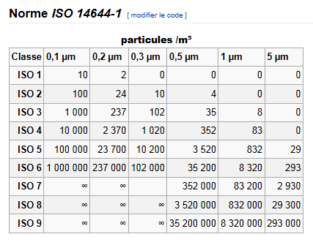
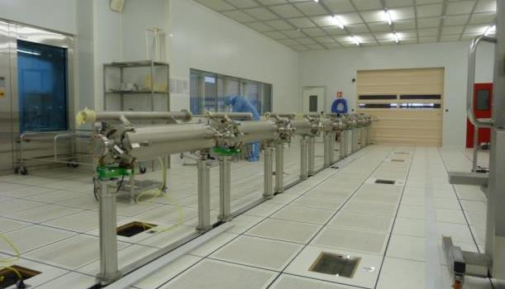
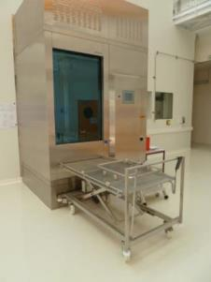
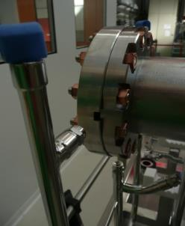
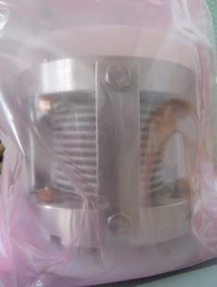
WHY Clean room assembly
  Filed Emission is often a limiting factor for cavities
      Polishing to get smoother surface
      High Pressure Rinsing with UltraPure Water
      Cavity assembly in clean room
  Clean Room
      low dust environment, pressure,
      temperature et humidity monitored
      (ISO4-ISO5-ISO7)
  Remove metallic dust
      outside of component
      Fastening (*new *clean)
      Gasket (*procurment)
  Components clean on outer surface
Class 10

Slide 11
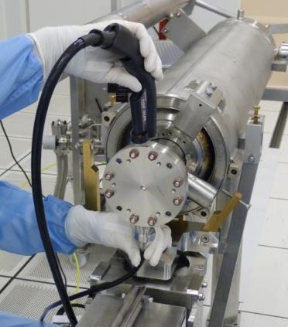
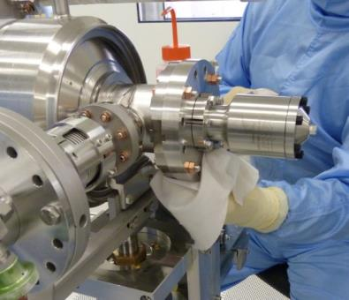
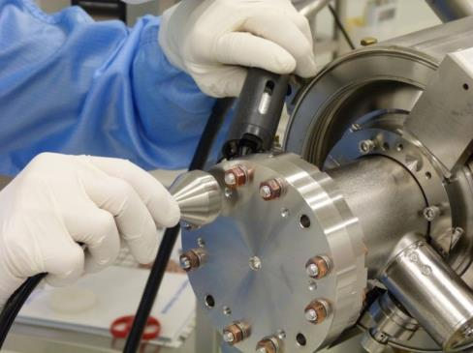
Cleaning of all components, tools
Wiping with clean room tissues and Isopropyl. Alc.
Blowing with ionized nitrogen
control step: counting particles with
airbone particles counter
Counted are below 10 parts (size>0,3 µm) during 1 min
The fastening SS stud /copper nut should be check
Totally degrease tools made of the same material
locked together very easily!! => SS/alu or brass/SS

Slide 12
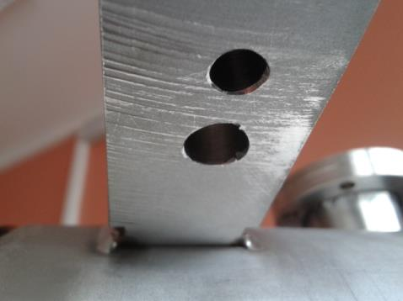
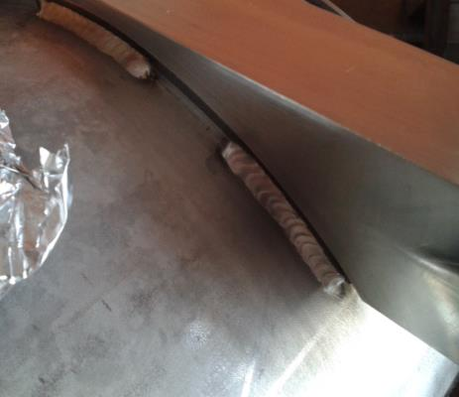
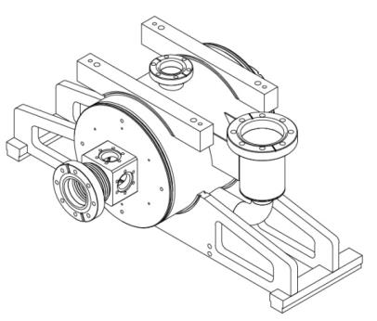
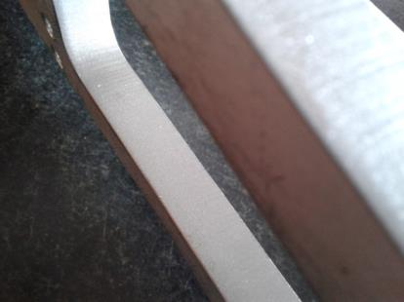
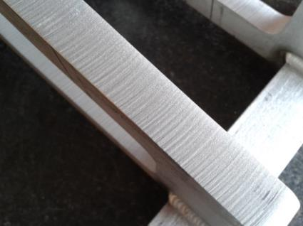
High cleanability of components
“Cleanability” should start with design effort
continues with precise specifications
Ends with reception checks including assembly checks with degreased parts

Slide 13
PUMPING and VENTING Up to AtM.
  Particles should neither move nor be introduced in cavities during venting to Atm. And pumping stages.
  Studies on pipe 10m, 63mm reproducing XFEL module (Ref SRF2009-THPP0104)
      Movement of particles is mainly observed at the position next to the pumping and venting ports. The long tube homogenizes the gas flow and reduces turbulences.
      During pump down the number of particles decreases with decreasing pressure, indicating a reduction of turbulences. In the dirty system particles could be measured down to a pressure of about 100 mbar. If turbulences are again introduced by sudden changes of the throughput of e.g. changing the position of a needle valve, particles had been detected down to pressures of about 1 mbar. Only for pressures < 1 mbar no more particle movement has been observed even when moving valves.
        Use a diffuser to reduce turbulences
        Gauges to mesure precisely 1mbar around Atm
        Venting/pumping: N2 flow (1-1000mbar – Δp(cav-pump) <1mbar) : 50 mbar l/s
        For venting particle filtered gas (N2 or Ar) (particle size ≤ 0.04 mm)
        a gas quality of 99.9999% has to be used: evaporated nitrogen
      as far as possible from components being sensitive to particles
Example: AC150 uncontrolled venting from vacuum to 300mbar
39 to 9MV/m
Manual valves, even needle valves, not well suited to adjust the gas flow
      After venting a system Δp between the vacuum vessel and atmosphere should be Δp < 1 mbar before opening

Slide 14
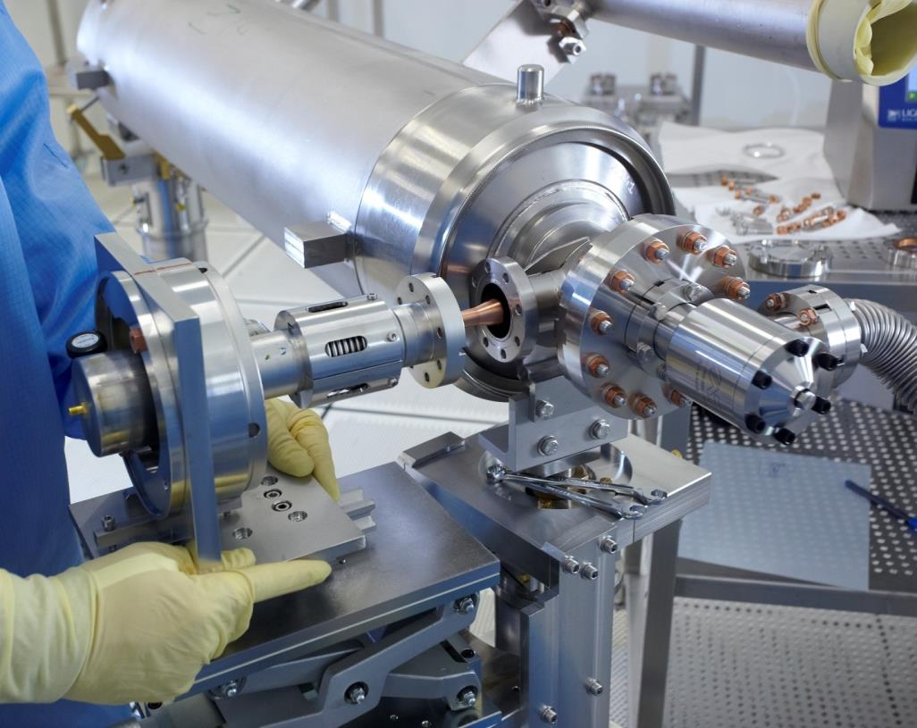
Cold COUPLER ASSEMBLY
Pour insérer une image :
Menu « Insertion / Image »
ou
Cliquer sur l’icône de la zone image
Cold part of coupler, cavity
TTF3 type on XM-2

Slide 15
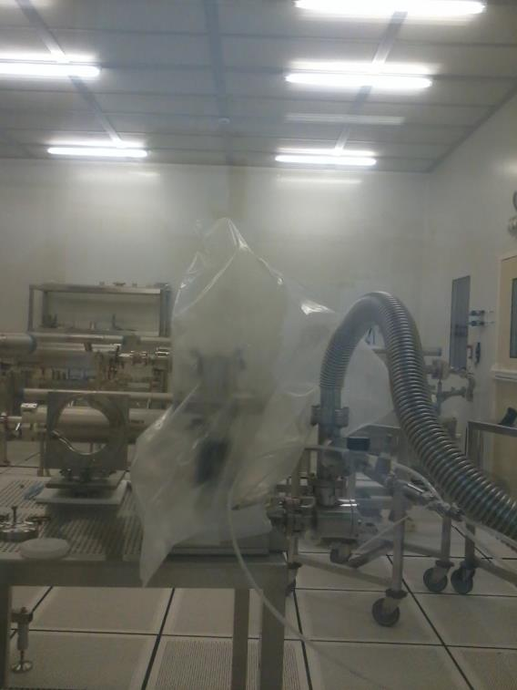
Cold COUPLER ASSEMBLY (leak check issue)
Pour insérer une image :
Menu « Insertion / Image »
ou
Cliquer sur l’icône de la zone image
Coupler pairs first leak check:
  Check: Leak on the coupler itself (TTF3) revealed during cavity string leak test (XM1)
  Admit : Helium spraying method hardly able to detect a leak in the 1 10-10 mbarl/s range in a clean room (air flow spread helium)
  according to NF EN 13185 ind. A09-492. standard
    Helium spray to localise not to quantify.
    Quantify down to 1.10-7 Pa.m3/s
  Plan: to build a simple plastic box for TWG with couplers
  Do: global leak test of pairs of coupler at the 1st leak check (reception or ISO4-CC)
    Global test instead of spraying test (same process time more sensitive)

Slide 16
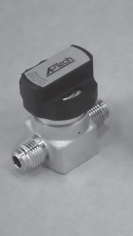
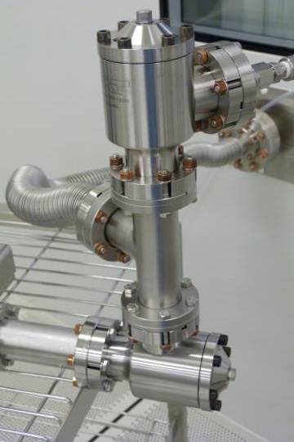
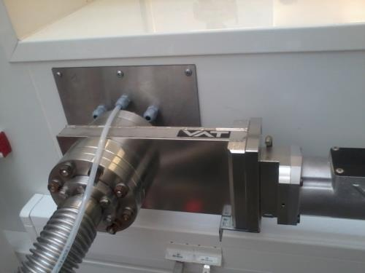
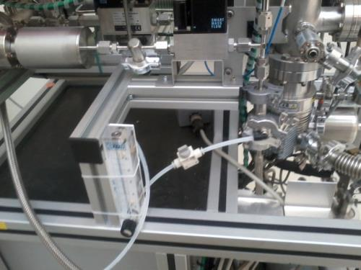
Cold COUPLER ASSEMBLY (flushing issue)
Pour insérer une image :
Menu « Insertion / Image »
ou
Cliquer sur l’icône de la zone image
Assemble parts with N2 flushing
10L/min, dry and filtered
  Cavity and Nitrogen manual valves:
    identical => pump damaged or process delay…
    manual => if forgotten cavity back to HPR…
  Do: different type of manual valves for nitrogen line on each pumping unit
    Aptech springless series AZ30
  2 10-10mbarl/s
  Check: leak tightness and particulates generation : OK
    Ceramic Filter Removal Rating > 99.9999999 % at 0.003 μm
  Analyse: CCC564 out of XM5 (N2 forgotten) !!
  Plan: Next step automated start of nitrogen flushing when opening the object to be assembled (cavity or coupler on its TWG)
    Goal: compensate for human factor

Slide 17
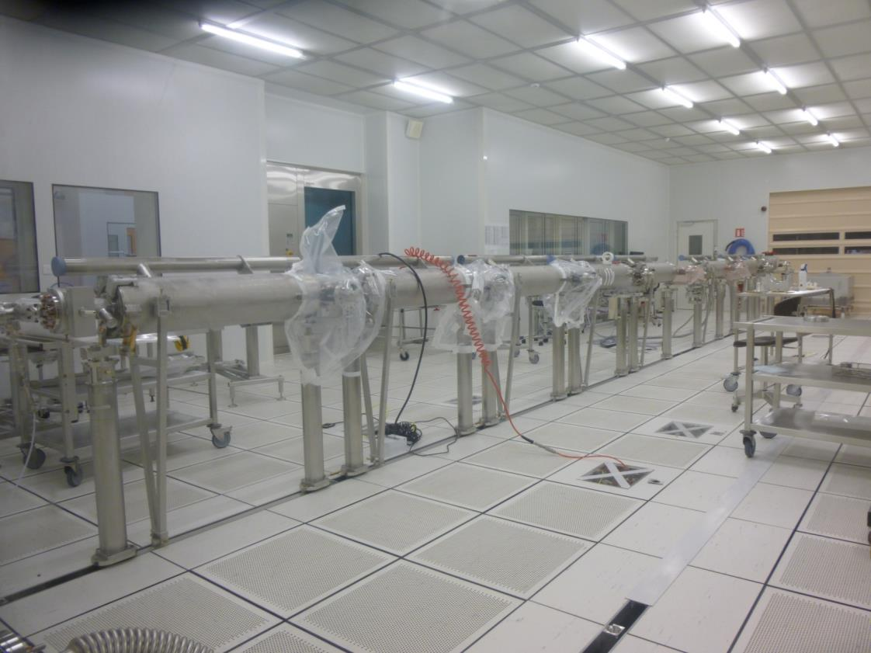
Cavity string ASSEMBLY
Pour insérer une image :
Menu « Insertion / Image »
ou
Cliquer sur l’icône de la zone image
Gate valve, cavity, below, QP package
XM4 (String assembly) on 14/02/2014
Notes:
The basic plan was to have two teams working in parallel on two half-strings, BUT:
- it implies extra connections for flushing
- it is not qualified with prototypes

Slide 18
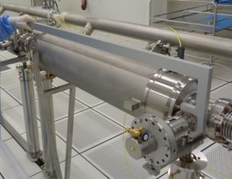
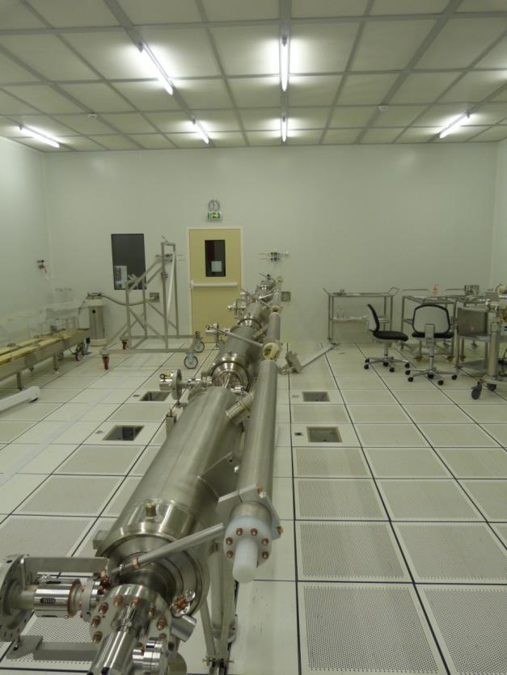
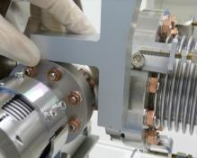
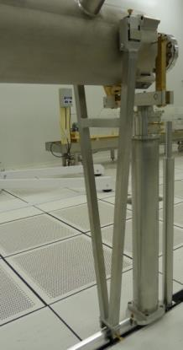
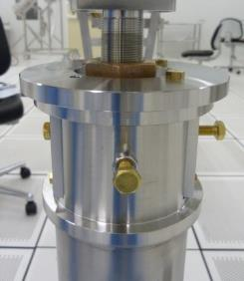
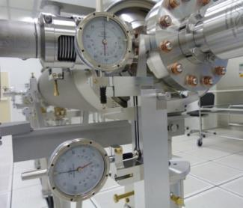
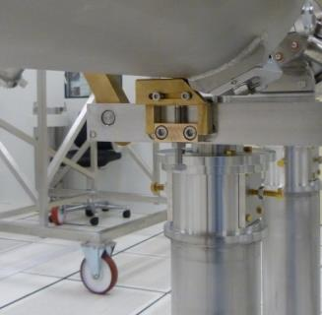
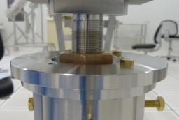
components alignment
SPECS : cavities electrical axis in a concentric circle of 300μm diameter
Need to know the position of electrical axis/ mechanical axis for laser tracking alignment outside of the clean room
in CR
0.1mrad
300μm
~12 m
notice brass/SS assembly for tools

Slide 19
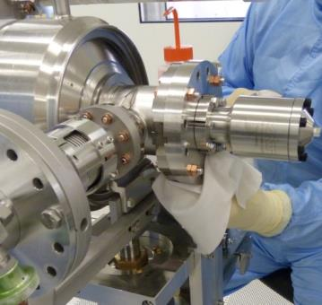
Cavity string ASSEMBLY
Pour insérer une image :
Menu « Insertion / Image »
ou
Cliquer sur l’icône de la zone image
Two cavity bellows connection/day
  Plan: two teams working in parallel on two half-strings
  Do (during XM-2): Pumping system was limited by the capacity of venting cavity Cav n+1 in parallel with connecting Cav n. This is only possible at two locations along the rail.
  Check: which cavity can be addressed from starting the connection to pump until the end of the cavity assembly
  Add: longer multi-utilities pipes from the technical floor to the PTM subsystem (turbo molecular pump and gauges and valves)
  Qualified for XM5
BUT Most of the time is used to clean flange holes by blowing ionized N2.
Notes:
The basic plan was to have two teams working in parallel on two half-strings, BUT:
- it implies extra connections for flushing
- it is not qualified with prototypes

Slide 20
Cavity string ASSEMBLY RAMP-UP
Pour insérer une image :
Menu « Insertion / Image »
ou
Cliquer sur l’icône de la zone image
New schemes have been developed for cavity string and couplers assembly in 6 days in order to have an output of one string per week
  Avoids valve close/open
  Limits the number of venting/pumping
  Speed up production by assembling couplers on the string.
BUT needs to be implemented.
Notes:
The basic plan was to have two teams working in parallel on two half-strings, BUT:
- it implies extra connections for flushing
- it is not qualified with prototypes

Slide 21
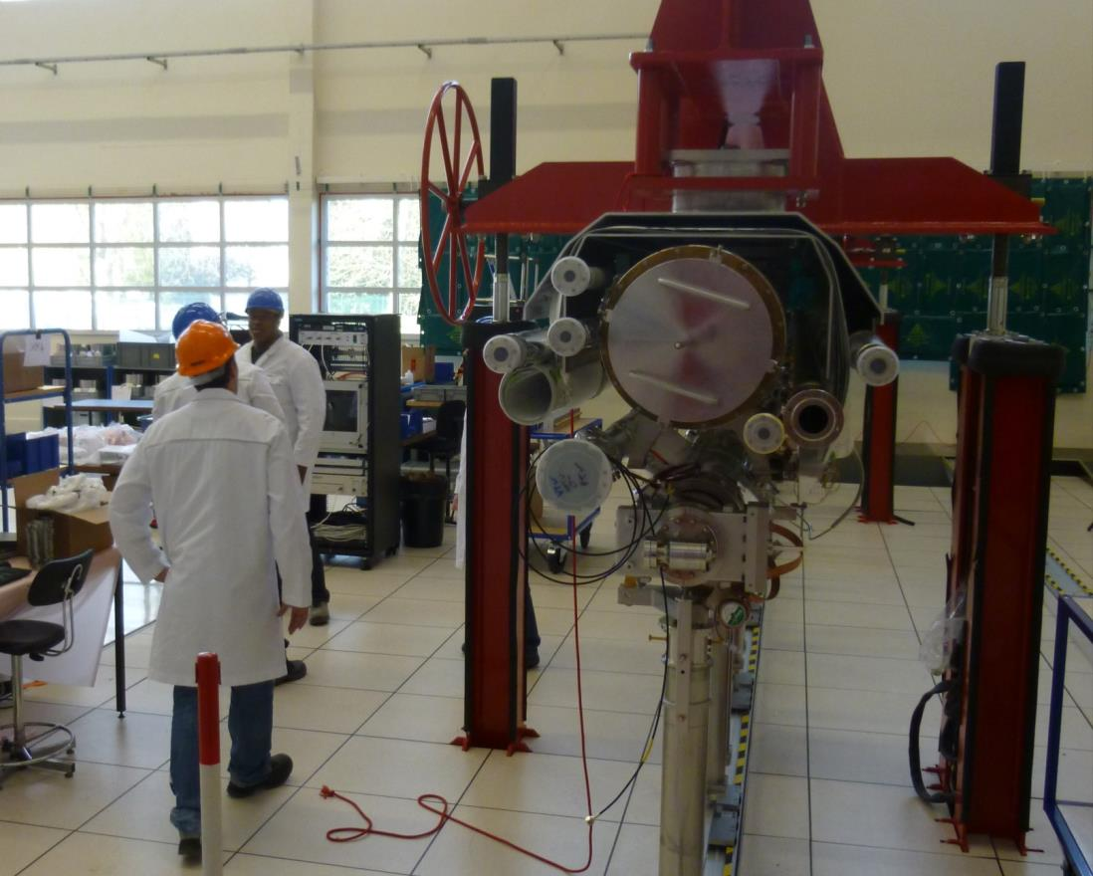
roll-out Area
Pour insérer une image :
Menu « Insertion / Image »
ou
Cliquer sur l’icône de la zone image
Welding, superinsulation, tuner, senors ,magn.shields
XM4 (Roll Out) on 20/03/2014

Slide 22
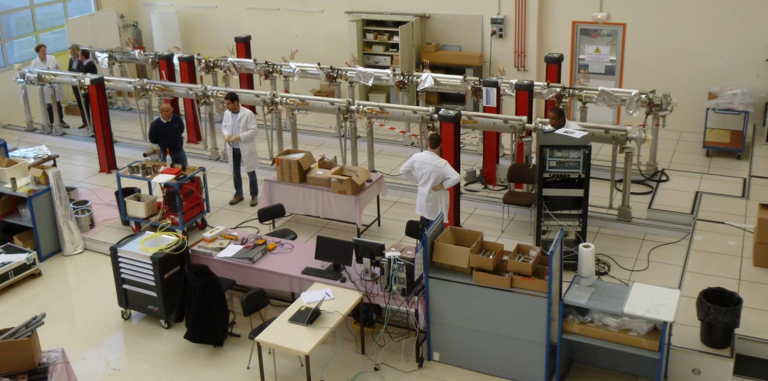
roll-out Area
Pour insérer une image :
Menu « Insertion / Image »
ou
Cliquer sur l’icône de la zone image
XM-1 and XM1 on Roll-Out Area during welding investigations

Slide 23
Welding Issue n°1
1 - Qualifications
PED (TÜV-Nord) request:
Alsyom/SEIV certificate according to EN3834 ‘Quality requirements for fusion welding of metallic materials’
WPQR and WPS for all pipe (orbital) and lip welds (hand), i.e. procedures
welder certificates EN 287-1 (hand welds)
operator certificate EN 1418 (orbital welds)
The last three items have been obtained by Alsyom/SEIV in May 2013.
CEA and Alsyom worked on the EN3834 qualification :
Auditing on 11 March 2014
Certificate expected on 24 March 2014

Slide 24
Welding Issue n°2
2 – Non Destructive Test by Radiography
TÜV-Nord requested systematic Non-Destructive Testing by X-Ray radiography (RT) for all the welds (17 welds) of the Helium 2K two-phase line along cavity string, for all the cryomodules.
These NDT come in addition to the systematic Visual Test (VT) and Leak Test (LT), and Paint Test (PT) for a couple of lip-welds.
Organizing and bringing NDT at Saclay is challenging:
Contract: a call for tender needs to be organized for about 92 campaigns
Safety: CEA-Saclay has very strict safety regulations for implementing X-Ray radiography → today 250 m radius outside area is controlled during the night, mobile lead shields (>6 mm) are under study to prevent outside radiation.

Slide 25
Welding Issue n°3
3 – Execution of NDT and TÜV inspection
Module assembly at two different workstations will need to be synchronized (in the best case) or delayed (in the worst case) with the external action of NDT operators and of TÜV-Nord inspector, on a weekly basis !
The time windows for these two visits is not more than 2 days.
Welding Issue n°4
4 – Get conform Welds ( No pores, or blow-holes)

Slide 26
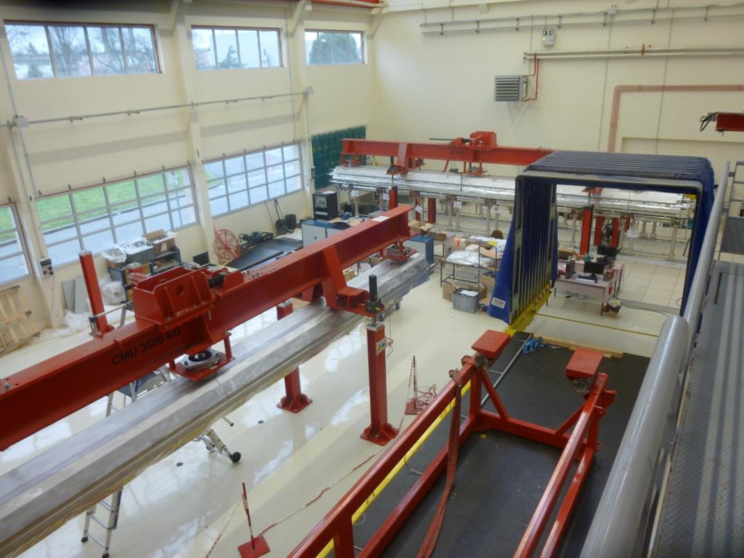
alignment Area
Pour insérer une image :
Menu « Insertion / Image »
ou
Cliquer sur l’icône de la zone image
Alignment, tuner checks, magn.shielding

Slide 27
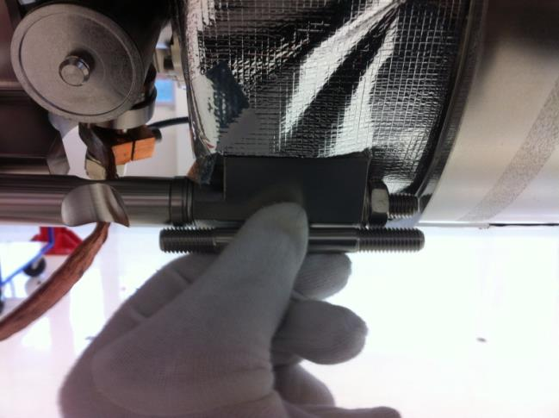
alignment Area
Pour insérer une image :
Menu « Insertion / Image »
ou
Cliquer sur l’icône de la zone image
Software development for automated alignment is ready
  To be checked very soon
Observation of mis-assembly of tuner studs
  check on XM2, correct on XM3&4
(Picture taken on XM3 at AL workstation)
  → Improve qualification of ALSYOM operators !

Slide 28
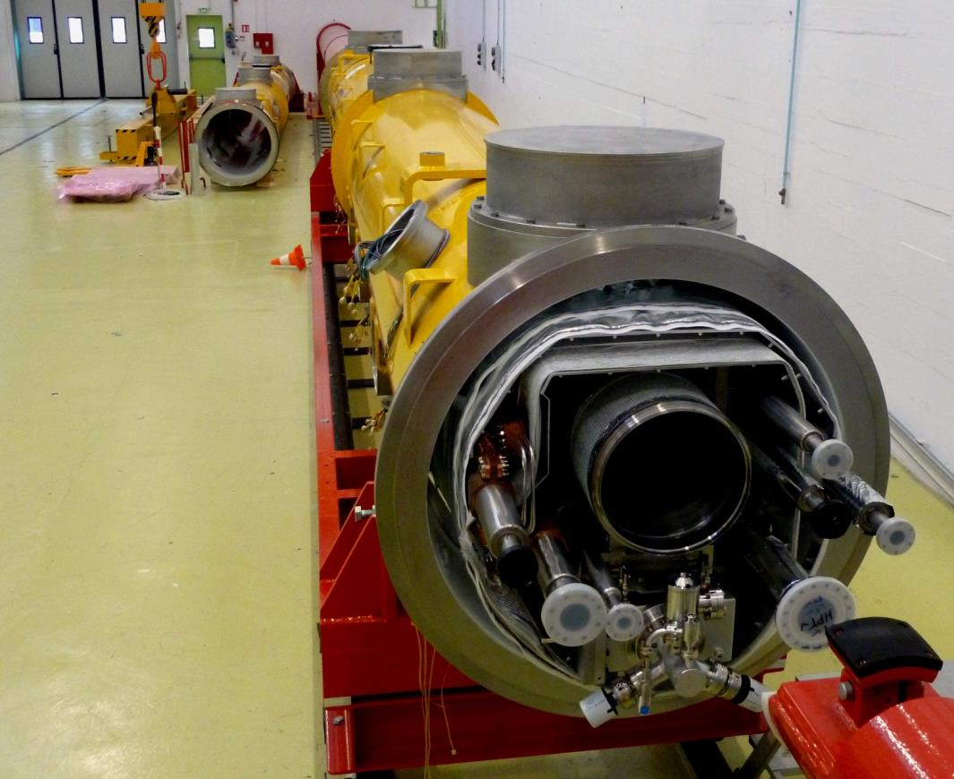
Cantilever Area
Pour insérer une image :
Menu « Insertion / Image »
ou
Cliquer sur l’icône de la zone image
Thermal shields, super insulations, current leads

Slide 29
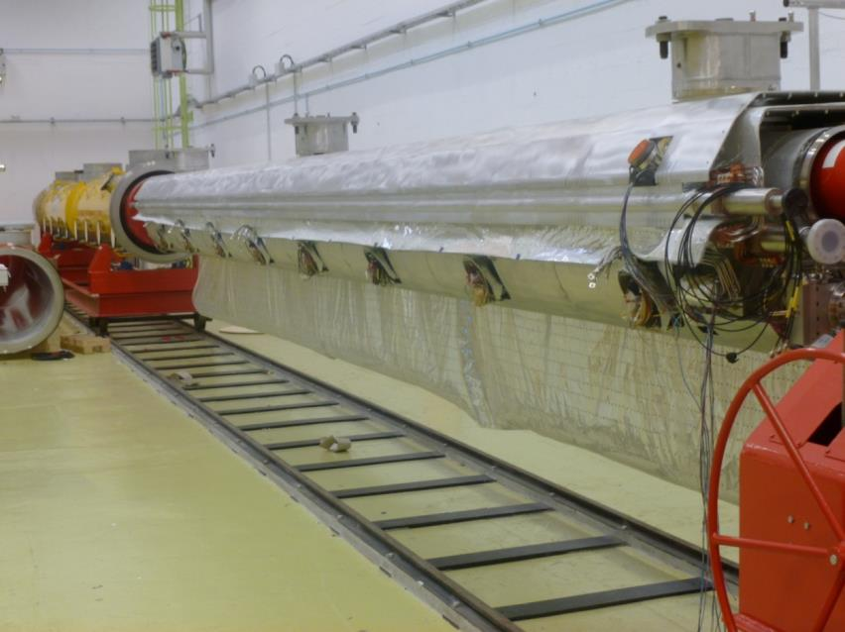
Cantilever Area
Pour insérer une image :
Menu « Insertion / Image »
ou
Cliquer sur l’icône de la zone image
  4K MLI superinsulation
  wrapping of the 4K super insulation is different on Chinese or Italian cold mass
  CX: XM-1 : wrap on coupler side
  EZ: XM-3 XM-2 XM1 : opposite
  Act: Alsyom/cea need to
  develop different methods
  Adaptation to producers differences
XM1 (Cantilever) on 14/02/2014

Slide 30
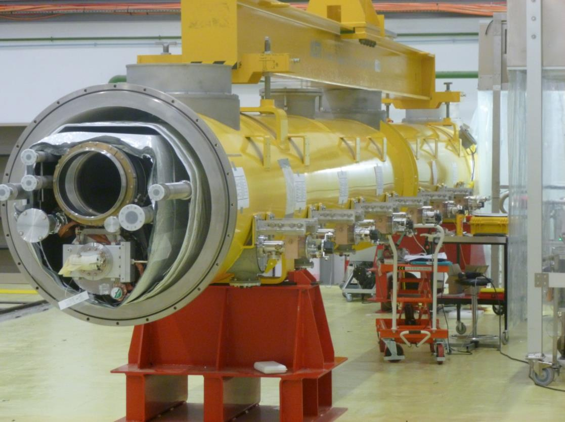
COUPLER Area
Pour insérer une image :
Menu « Insertion / Image »
ou
Cliquer sur l’icône de la zone image
Warm part, wave guide, CP Line
XM-1 (Warm couplers) on 14/02/2014

Slide 31
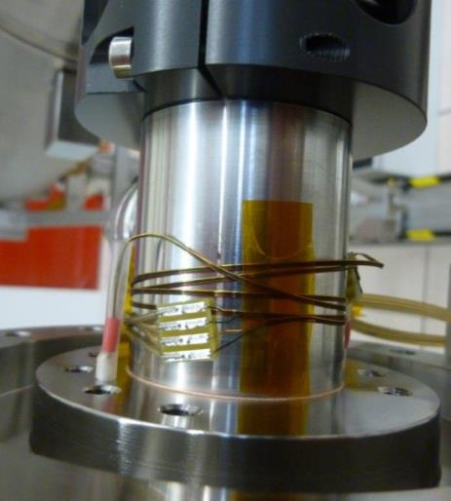
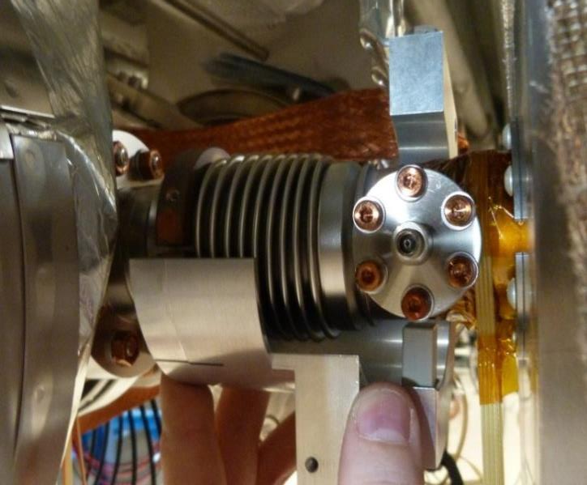
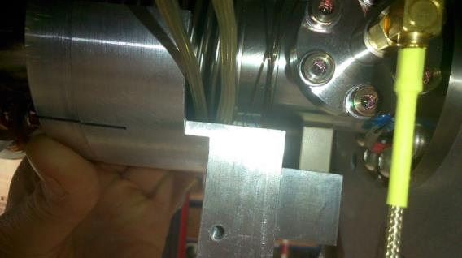
COUPLER Area
Pour insérer une image :
Menu « Insertion / Image »
ou
Cliquer sur l’icône de la zone image
in operation cold window moves !
  Check: New problem discovered during coupler sensor test on XM1 and following modules
  Analyse: same problem with XM-1 on AMTF at DESY: understood a conflict of Peek support and wire of the PT1000
  Plan : new/better thermalization should be applied to XM2,3,4 and the following
  Do: repairing causes delays: operations cannot be fully parallelized because new procedure
  about one week for XM2 (disassemble the XM2 8K shield in order to change the thermalization) and thus two weeks for XM3 and following
  Approval by WP05 is needed
  The problem exists since XM-1!!
XM-3 on January the 17th 2013

Slide 32
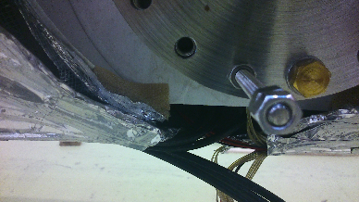
COUPLER Area
Pour insérer une image :
Menu « Insertion / Image »
ou
Cliquer sur l’icône de la zone image
coupler 70K shells and cryomodule 70K thermal shields collision ?
  XM1: Coupler of cavity n°8 stuck : collision between 70 K shields and coupler 70K shells. Problem fixed by better centering of warm part and action on cryostat 70 K shield (cf. picture from XM-1)
  Agreement between WP03/WP05 is needed

Slide 33
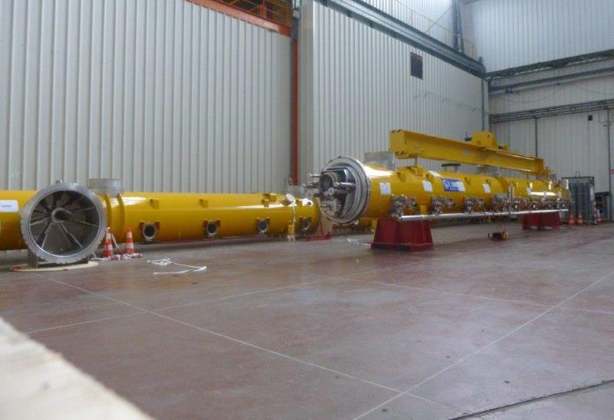
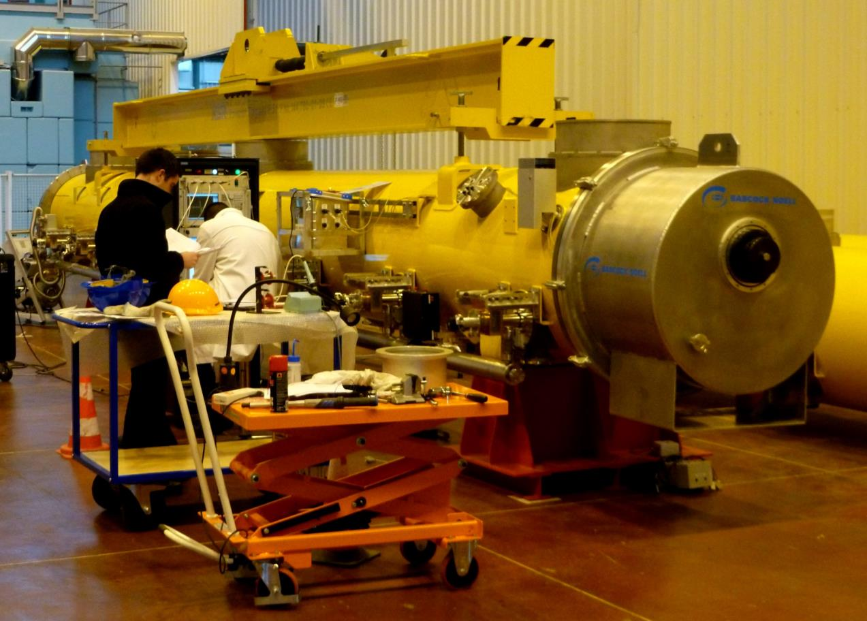
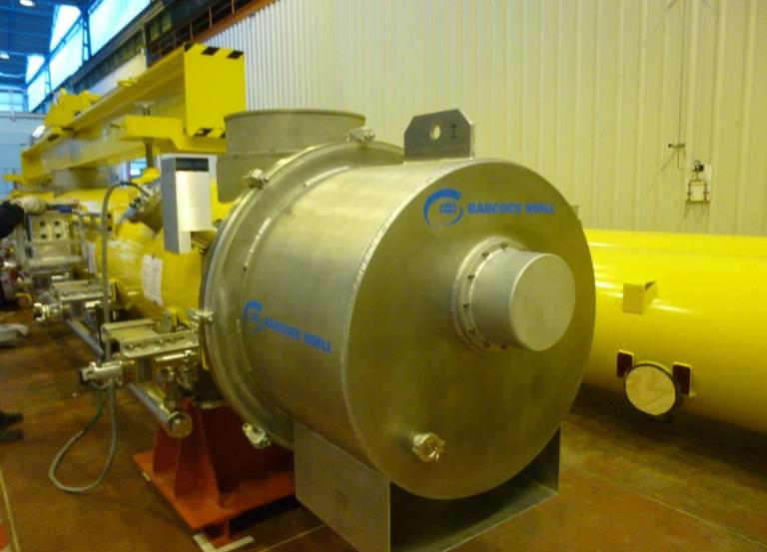
shipment Area
End caps, Final checks, Shipment

Slide 34
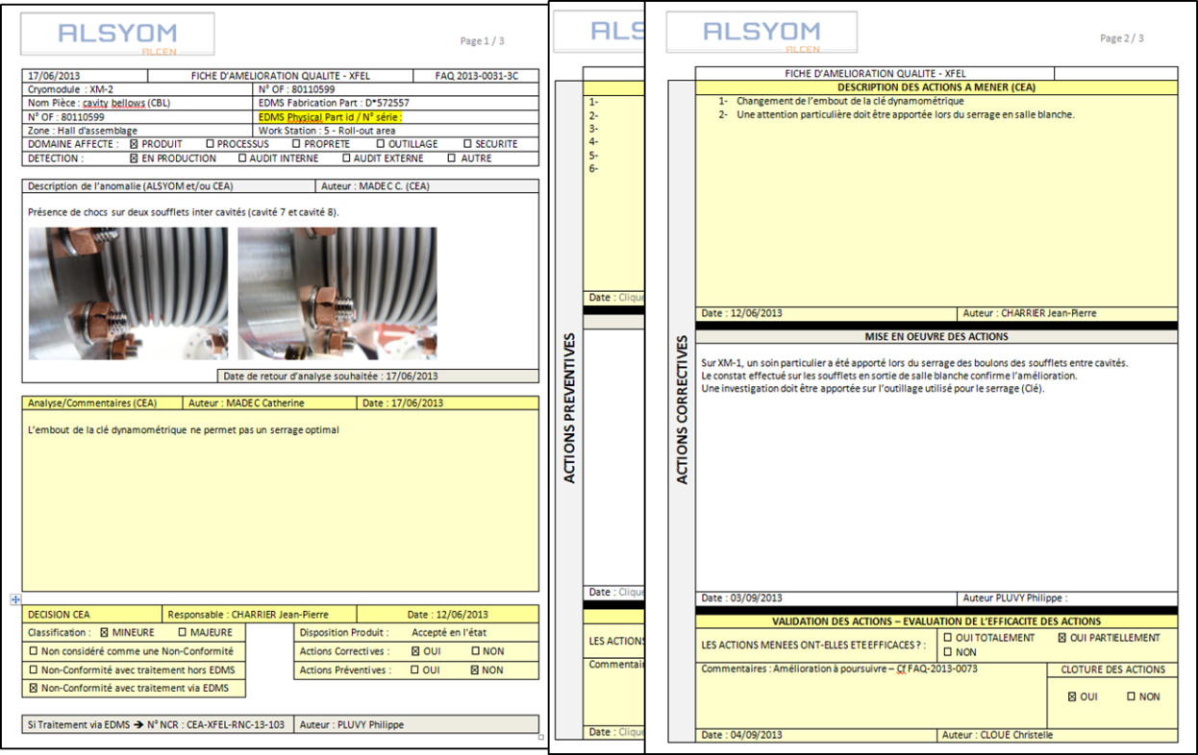


integration of the cryomodule in quality system (Alsyom duty)
Pour insérer une image :
Menu « Insertion / Image »
ou
Cliquer sur l’icône de la zone image
Garanty the conformity of the assembled cryomodules with technical specifications and certification.
Be in a continuous improvement process.
  Correct application of tests and assembly procedures
  Correct use of assembly tools and test equipment
  Any noticed deviation must be write down and Alsyom or CEA must answer or correct
  Save each module configuration, BOM generation
  Save all assembly and test reports and all checks in EDMS

Slide 35

Supervision of the cryomodule integration (cea duty)
  Hold points are defined in the traveler.
  Occurrences : at the end of critical assemblies or tests and between each workstation
  They are carried out by CEA quality representative and technical experts (RF, alignment, vacuum…) with Alsyom quality representative.
  The approbation of an Hold point involves the verification of :
    Visual inspection of the assembly
    Mechanical check if needed
    Control of the tests reports

Slide 36


XM-3 RF Test Results
  A success for the Accelerator Consortium:
    Average individual cavity gradient: 32 MV/m
    Average cavity pair gradient: 29 MV/m
    Three cavities reach gradients above 38 MV/m
    Cryogenics losses are lower than specified.
  A success for WP03+WP09: 230MV
    Seven cavities are reproducing VT gradient
    Cavity 1 is degraded from 31 down to 23 MV/m useable gradient: gate valve/cav1 connection not for training !
  A success for CEA:
    XM-3 is the assembly demonstration cryomodule of CEA w.r.t. ALSYOM contract.

Slide 37

module XM-2 RF test results
Pour insérer une image :
Menu « Insertion / Image »
ou
Cliquer sur l’icône de la zone image
Successful RF test for XM-2
  Vert. Test average: 25,8 MV/m
  Module test Average: 24,5 MV/m
  XFEL specification: 23,6 MV/m
  The cryomodule reaches 196 MV
    10MV decrease vs. Vert. Tests
    Due to cavities in position 1 2 3 4 8
    Qualifies CEA pumping unit even if
    uncontrolled venting up to 2-7 hPa
    Corrective action realized.

Slide 38
Conclusion
Pour insérer une image :
Menu « Insertion / Image »
ou
Cliquer sur l’icône de la zone image
  LESSONS LEARN:
  High tech components procurement: from spec to cleaning
  Tools design in particular for the CR
  Able to process improvement
  Quality System development
  Know-how transfer to industry
  Welding certification
  RESULTS
  XM-3 and XM-2 are a success, XM-1 is on specs
    Preliminary results XM-1 mean Eacc= 25,6 >23,6 MV/m
  CHALLENGES:
  Continue to guaranty the conformity of the cryomodules
  Schedule of 1 module / week in one shift after ramp-up
  KEY ISSUE
  qualified and well trained people

Slide 39



DSM
Irfu
SACM
LIDC2
Thanks CEA colleagues, Alsyom staff and DESY INFN LAL collaborators
Commissariat à l’énergie atomique et aux énergies alternatives
Centre de Saclay | 91191 Gif-sur-Yvette Cedex
T. +33 (0)1 69 08 69 39
  Etablissement public à caractère industriel et commercial | RCS Paris B 775 685 019

Slide 40
Conclusion
Pour insérer une image :
Menu « Insertion / Image »
ou
Cliquer sur l’icône de la zone image
  n°1 problem: cope with the industrialization equation « parts + procedures = cryomodule on specs »
XM-3 and XM-2 are a success, XM-1 is on specs
XM-1 revealed the challenges and difficulties of the Helium tank welding: qualification, radiography, conformity
following modules: welding control and its organization is an issue
n°2 problem: schedule of 1 module / week in one shift after ramp-up String Assembly still needs some work
n°3 problem: fast ramp-up schedule Not OK yet
qualified and well trained people is the issue
n°4 problem : fastening hardware, procurement and cleaning under control now

Slide 41
CEA ORGANISATION
Project Leader
10 FTE
Quality Engineer
System Engineer
Experts:
Survey
RF
Vacuum
ALSYOM
Fabrication Manager
Workshop manager
Clean Rooms
Area Manager
Assembly Halls
Area Manager

Slide 42

ALSYOM ORGANISATION on 28/04
Off site
28(27) ALSYOM
2 SEIV (welding)
On site
actual / foreseen
1
1
1
1
1
1
2
1
21/20

Slide 43

Planning of Technical Specifcations

Slide 44


Progress Report (1) on 21/03/2014
Notes:
All components are in house until XM7
Module delivered
5 module are in the production line

Slide 45

ALSYOM Staff EVOLUTION & Planning
XM6
XM5
17/03
XM4
24/02
Start of production phase
ALSYOM Staff only
SEIV not incl.
XM3
06/01
21/11
Start of training phase
XM2
23/09
XM1
04/09
Start of observation phase
XM-1
XM-2
01/07
27/02
02/04
07/08
XM-3
17/09
24/04
w38
w1
w11
w21
w31
w41
w51
Project Weeks
2012
2013
2014

Slide 46
Progress Report (2)
MODULE Shipment
XM-3 successful RF acceptance test at DESY
    Large grain cavities, TTF3 couplers
XM-2 successful RF acceptance test at DESY
    Series cavity, qualifying CEA pumping system in clean room
XM-1 delivered to DESY now at AMTF 27/02/2014
    revealed the difficulties of the Helium tank welding:
  XM1 on the Shipment Area Week n°13.
    revealed the coupler thermal sensor collision with PEEK holder
  XM2 on the Cantilever Area Week n°15
  XM3 on the Alignment Area Week n°17
    first XFEL module with no repair welds needed
XM4 on the Roll-out Area Week n°18
XM5 under string assembly (8 cavities connected) Week n°19
XM6 under cold coupler (2 couplers connected) Week n°20
  Transition to 1 module/week foreseen on Week n°15 when Alsyom staff is complete.

Slide 47


Clean Room Layout
ISO 7
(class 10 000)
28 m²
5.92 m x 4.72 m
ISO 5
(class 100)
38 m²
7.72 m x 4.72 m
ISO4 (Class 10)
112 m²
7.8 m x (6.6+7.8) m
15.6 m
May 2012
PXFEL2_2
December 2012
XM-3, with Alsyom

Slide 48

One-week throughput at String Assembly
The key it to be able to work out two cavity conections per day.
To achieve this CEA and Alsyom are working on 2 solutions:
Bringing more venting connection services from the three underground CEA vacuum systems (primary + mass spectrometer)
Avoiding the cavity venting before the connection
Solution n°1 is being implemented
Solution n°2 is being tested: it is superior
because it avoids 8 valve close/open per
module, but it requires a different arrangement
filter and valve for the flushing.
Pumping through the filter has been
successfuly achieved with the Swagelock
filter reference: SS-SCF3-VR4-P-30
HIGH PURITY FILTER, 1/4" MALE VCR
ELEMENT FILTRANT CERAMIQUE MEMBRALOX - 10 CM2
Vacuum process time/module
reduction of operator time:8H
178 H
25H

Slide 49

Réparation des cavités XM5-XM100

Slide 50




2 K Blankets:
Prototype by Jehier for XM-2

Slide 51



Magnetic Shieldings
Prototype by MecaMagnetic for PXFEL configuration
(warm-up tube with flange)
Pre-series by MecaMagnetic for XFEL configuration
(warm-up tube with Ti/SS transition): benchmarking XM-3 cavities !

Slide 52

Super-insulation Blankets
Super-insulation blankets have been qualified (PXFEL2_1 and PXFEL3_1).
The 40/80 K super-insulation blanket (2x15 layers):
costs about 4 k€
saves 1 day on cantilever and about 7 p.day (balance at ~600 € / day)
saves about 30 W @ 40 K with respect to multilayers (30 + 29 separators).
Cryo loss at | PXFEL 3 | PXFEL 3_1 cooldown Dec 2011 | PXFEL 3_1 cooldown Feb 2012 | PXFEL 2_3 cooldown March 2013
40 / 80 K | 134 W | 96 W | 97-102 W | 95 W
Negotiations with Jehier allowed about 10% reduction / CfT offer, through:
more flexible (rapid) delivery rate
simplification of 2K blankets fabrication
70 K blankets ordered in advance for XM-3, XM-2, XM-1 (delivered in June 2012)

Slide 53



70 K Blankets:
Prototype by Jehier for PXFEL2_2

Slide 54



Cold Re-entrant Cavity BPM
31 XFEL cryomodules will be equipped with a cold BPM of the re-entrant type, designed, fabricated and equipped with FE electronics by CEA and industry.
These BPM will be attached to the quadripole (upstream) and to the gate valve into a so-called BPM-Quadripole Unit (BQU) cleaned and assembled at DESY ISO4 clean room and later shipped to CEA/Saclay.
Although the specified XFEL resolution is 50 µm, the re-entrant cavity BPM has the potential for 1 µm resolution. In the FLASH warm beam line, 8 µm resolution was mearured in the past with prototype BPM.
This is a broadband BPM, although of the cavity type, the time resolution is 40 ns.
Two such BPM have been included in XM-1 and XM1
PXFEL2

Slide 55




Cold Re-entrant Cavity BPM
Copper coating and fabrication status
Cleaning of the copper coating led to a tarnishing problem once.
The production of SS bodies is underway

Slide 56

Electronics Status
  RFFE electronics prototype received
  All functions are incremented
  RFFE under laboratory tests

