Slide 1
SNS Lessons Learned from Design, Integration, and Operation
Presented at the
4th Open Collaboration Meeting
on Superconducting Linacs for High Power Proton Beams (SLHiPP-4), CERN
May 15-16, 2014
Sang-ho Kim
Spallation Neutron Source
Research Accelerator Division, ORNL

Slide 2
Outline
Design
Commissioning/Operation
Maintenance history
Lessons learn
Summary

Slide 3
First trials and challenges at SNS design and construction period
1.4 MW, pulsed spallation neutron source; about 7~8 times bigger beam power than ISIS
Superconducting RF technology for the pulsed operational proton machine (relatively high duty + high current)
IGBT based compact High Voltage Convertor Modulator
>1 MW beam accumulation (1.5e14 ppp) in the ring including stripper foil
Liquid mercury target
Beam loss management at 1.44 MW operation for hand-on maintenance
Machine availability goal >90 %
Many aspects of the SNS machine contain R&D nature, like any other machines

Slide 4
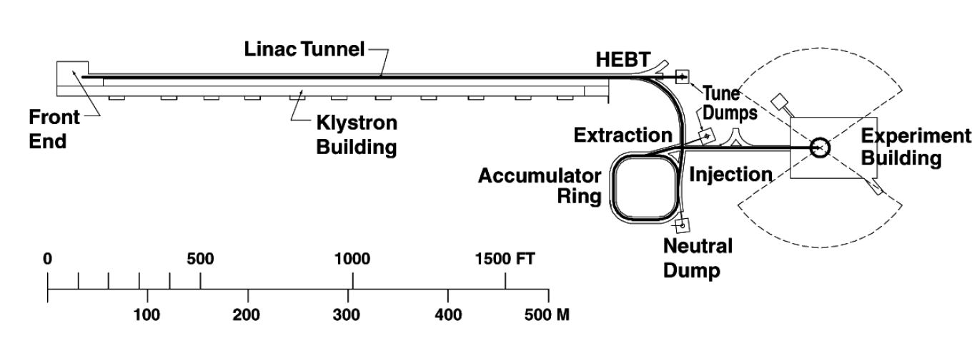
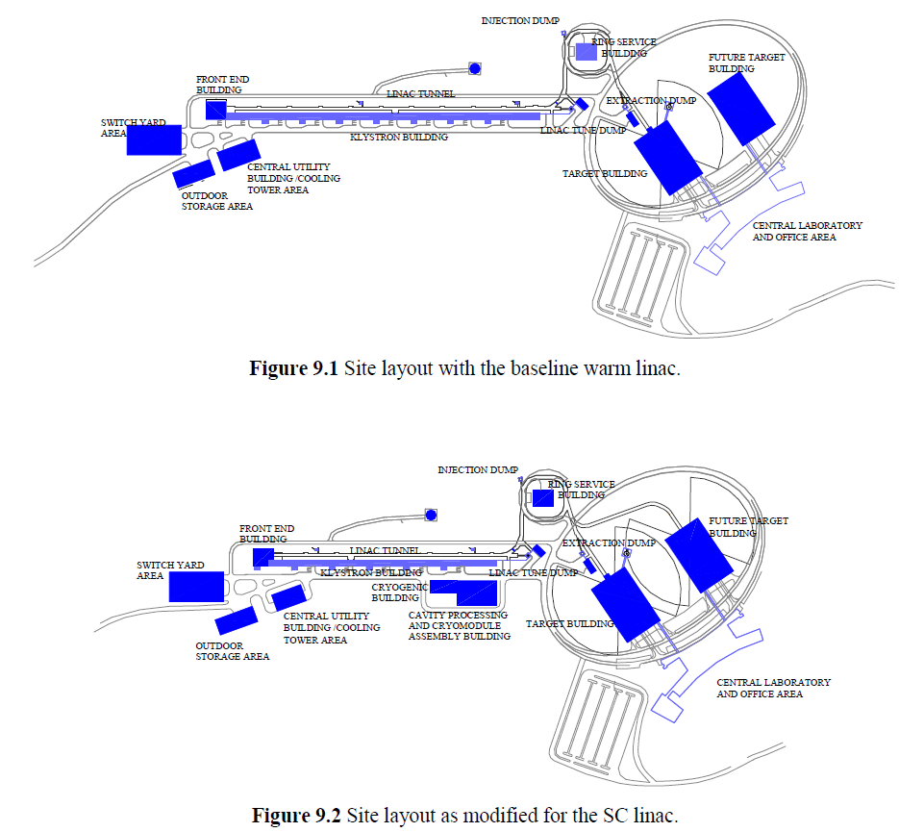
Evolution of SNS
NSNS (1997)
SNS (1999)
Linac length: ~465m
All warm linac

Slide 5
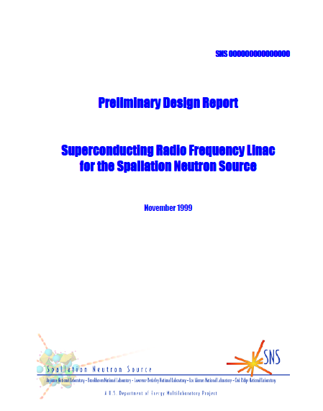
SNS Superconducting linac
Preliminary Design Report for SCL option (Nov. 1999)
Linac length: ~330m

Slide 6
SNS SCL initial design basis
SNS baseline change from NC to SC in 2000, relatively late in the project
RF frequency; followed that of the NC CCL (from LANSCE)
SRF Cavity designs were mainly driven by two constraints
  Power coupler; maximum 350 kW (later increased to 550 kW)
  Cavity peak surface field; 27.5 MV/m field emission concerns
    Later increase to 35 MV/m for HB cavities by adapting EP but only a few cavities were EP processed
With one FPC to cavity; HB cavity → 6 cell
Long. Phase slip at low energy; MB cavity → 6 cell
And then usual optimization process
  TTF, peak surface field balancing, raise the resonant mechanical frequency, LFD, HOM, etc

Slide 7
SNS SCL Components
Cryomodule; similar construction arrangement employed in CEBAF
Power coupler; scaled from KEK 508 MHz coupler
HOM coupler; scaled from TTF HOM coupler
Mechanical tuner; adapted from Saclay-TTF design for TESLA cavities
Piezo tuner; adapted later on. Incorporated into one of legs for unexpected large LFD
Cavity end group; Reactor grade Nb

Slide 8
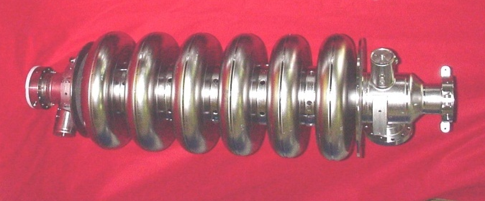
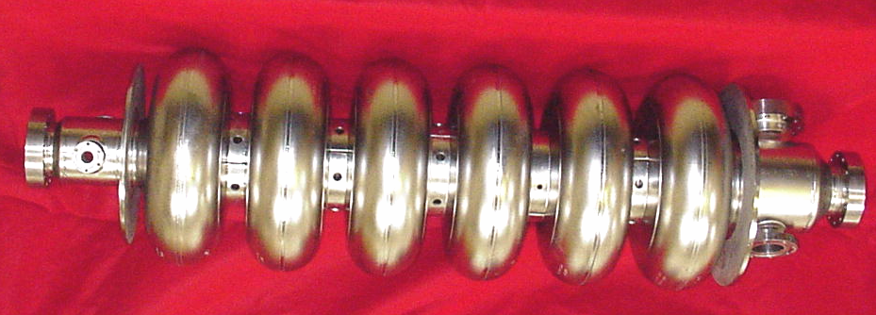
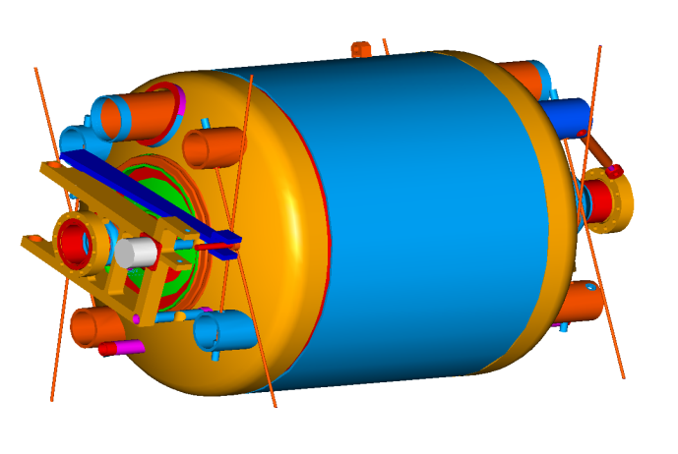
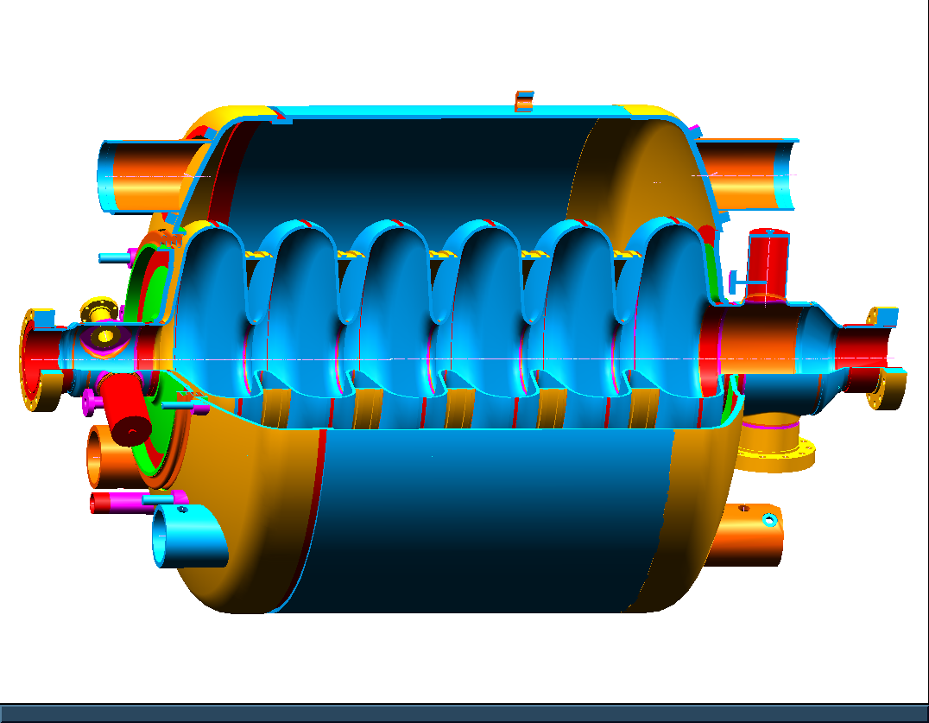
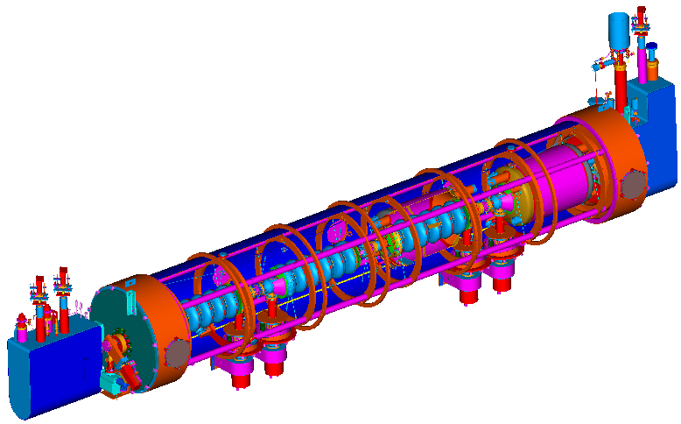
SNS Cavities and Cryomodules design;
β=0.61 Specifications:
E_{a}=10.1 MV/m, Q_{o}> 5E9 at 2.1 K
β=0.81 Specifications:
E_{a}=15.8 MV/m, Q_{o}> 5E9 at 2.1 K
Medium beta (β=0.61) cavity
High beta (β=0.81) cavity
Helium Vessel
Field Probe
HOM Coupler
Fast
Tuner
HOM Coupler
Slow
Tuner
Fundamental Power Coupler
11 CMs
12 CMs

Slide 9
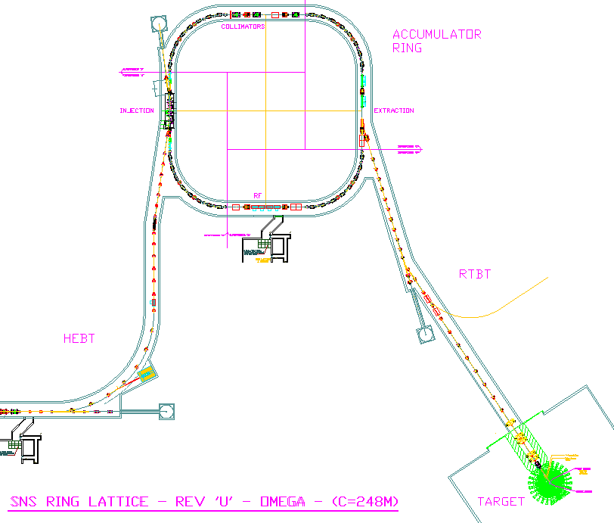


SNS Machine layout
Accumulator Ring: Compress 1 msec long pulse to 700 nsec
Front-End: Produce
a 1-msec long, chopped, H-beam
H- stripped to p
Linac; 1 GeV acceleration
402.5 MHz
805 MHz
DTL
CCL
SRF, β=0.61
SRF, β=0.81
upgrade
Liquid Hg Target
2.5
86.8
186
259 m
387
1000 MeV
157 m
71 m
Chopper system makes gaps
945 ns
mini-pulse
Current
Current
1 ms macropulse
1ms

Slide 10
Limiting gradients of both types of cavities at low and high duty factor
Electrons from one cavity can affect other cavities in the cryomodule
At low repetition rate the limiting gradients between individual and collective are about same. (longer gap between pulses)
At higher duty factor (>30 Hz) collective effect decreases achievable gradients
Number of Cavities
Eacc

Slide 11
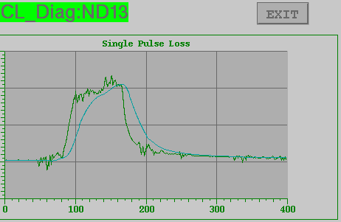
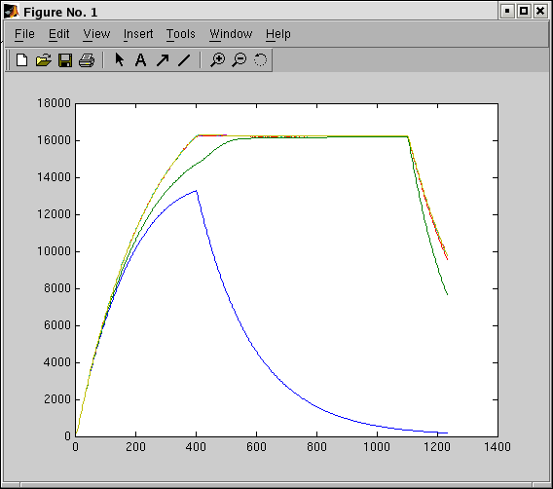
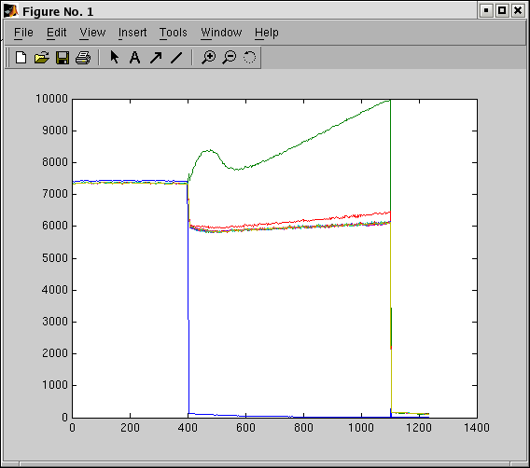
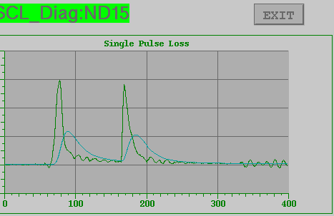
End Group Heating & Partial quench
Electron activity induces heating mostly at end group, and ends up with partial quench at the end groups.
At partial Quench
Radiation Signals
13a; 14.5 MV/m
13b; 15 MV/m
13c; 15 MV/m
13d; 10.5 MV/m
Radiation (arb. unit)
Majority of CMs
15a; 19 MV/m
15b; 17 MV/m
15c; 21.5 MV/m
Cavity Field
Forward P
A few CMs
(1 unit=10 us)

Slide 12
SNS SCL commissioning and operations
Completed CM installation (April-June 2005)
SCL commissioning with beam (Aug.-Sep. 2005)
Formal production run (since Oct. 2006: FY07) 4K operation
2 K transition; 30 Hz production run (June 2007)
60 Hz production run at 2.1 K (Since Nov. 2007)
Present run; 1.25MW beam on target at 60 Hz, ~940 MeV (+13MeV energy margin), 80 cavities in service
Presently SCL is running very reliably

Slide 13
High availability for high power beam
Matured operational experience of pulsed proton SCL as a user facility
Learned a lot in the last 10 years about operation of pulsed SCL:
  Operating temperature, Heating by electron loadings (cavity, FPC, beam pipes), Multipacting & DC bias, Turn-on difficulties, HOM coupler, RF Control, Tuner, Beam loss, interlocks/MPS, alarms, monitoring, …
Current operating parameters are providing very stable and reliable SCL operation
  Average trip (downtime): < 1 trip/day (<5 min./day)
  Availability last 3 years:
    Whole SCL system including RF, HVCM, Control, Vacuum, etc.: 98 %
    SCL cavities/cryomodules/CHL: 99.5 %
  Operational flexibility is the major contributor for high availability of SCL
    Almost every run several cavities have problems in sustaining the nominal operating gradients in various reasons: lower Eacc or turn-off to minimize downtime
    Overall no major performance degradation so far in long term, but requires many actions to keep performance/integrity

Slide 14
Status of components and parts
FPC; reasonably stable/robust. had two mild leaks at about 10⁻⁶ torr l/s from errant beam/discharge events (very slowly developed~ Over year). Not catastrophic failure
HOM coupler; vulnerable component especially during conditioning, MP (relatively dirty surface), decide to take out.
Cavity
  MP; about 25 cavities show MP, not a showstopper
  Field emission; not much changed, main limiting factor
  Errant beam/beam halo → could degrade cavity performance
Tuner; vulnerable component (both piezo and mech.).
  Large beam loading, low Qex, reasonable LFD, pretty good field regulation by LLRF→ does not require Piezo tuner (decide to take out)

Slide 15
Turn-on and High power commissioning
First turn on must be closely watched and controlled (possible irreversible damage)
  Initial (the first) powering-up, pushing limits, increasing rep. rate (extreme care, close attention)
    Aggressive MP, burst of FE → possibly damage weak components
    Similar situation after thermal cycle (and after long shut down too) → behavior of the same cavity can be considerably different from one run to another (gas redistribution)
Cryomodules/strings must be removed and rebuilt if vented/damaged

Slide 16
SCL tuning
Beam Energy
  Have operated with output energies ranges from 550 MeV to 1070 MeV
  Routine operation at 60 Hz, full duty factor has been near 900-940 MeV + energy margin
Tune-up
  SCL scaling time: took a few days in early days (machine trips during scan, learning process of staffs, software development) AP continuously improves application software→ Now 30 min.
  It is much faster to establish 81 phase/amplitude setpoints in SCL than for the 10 normal conducting setpoints
•Flexibility
  One of the main benefits of a superconducting linac for proton beams is operational flexibility
  We have taken advantage of the flexibility of individually powered superconducting cavities to “tune around” cavities with reduced gradients, etc.
  Have operated with as many as 20 cavities turned off in initial tuneup.

Slide 17
Activation: Beam Power Frontier for ion beam accelerators
IFMIF
IPHI
LEDA
10 MW
1 MW
ADS
100 kW
EFIT
SARAF-2
MYRHHA
SPIRAL-2
FRIB
RISP
PSI
ESS
SNS
PEFP
LANSCE
SPL
MMF
Prj-X
Central challenge at the beam power frontier is controlling beam loss to minimize residual activation
NF/MC
TRIUMF
ISIS
JPARC RCS
PSR
CSNS
JPARC MR
Prj-X MR
1 W/m at 1 GeV proton beam for hands-on maintenance
AGS
NOVA
NUMI
CNGS

Slide 18
High beam intensity/power in SCL
Activation for hands-on maintenance
  In design/simulation for SNS: No losses were predicted but we have
  It turned out that ‘intra-beam stripping’ is the main contributor (H- beam case)
  Beam loss in SCL: ~50 W during normal operating condition at 1.2 MW operation
  May not be linear but we estimate that there will be no major issue up to 3MW in SNS for this concern
√
Machine performance sustainability with high availability

Slide 19
High power/high intensity
Once cavity limiting gradients and stable operating gradients in cryomodules are identified, will cavity be stable in long term and/or at any levels of beam current?
What could be the specific concerns with high intensity beam?
  Errant condition, uncontrolled condition with high intensity beam?

Slide 20
Experience with High Intensity Beam in errant condition & with uncontrolled beam
Affection on SRF cavities (so far about 10 cavities)
  Beam Halo
  Errant Beam
  Both are enhancing gas dynamics
    Redistribution of gas, desorb gas, and could create hot spots or conditions for local discharge, Arcing
  Could be very slow process → gradual performance degradation → less stability margin and then quench
  Or could be fast if power density from beam loss is large enough and local discharge is triggered→ interaction with RF power (beam triggers event and discharge/arc with RF is the main event)
  The stable operating gradients are initially set based on RF only operation

Slide 21
Dedicated diagnostics, more careful operation for FE/NC structure, Dedicated MPS line
Errant beam BLM trips have been reduced by > 2x
Continuing to mitigate errant beams
  Ion source/LEBT high voltage and RF conditioning
  Routine maintenance of vacuum systems
  Operational experience with DTL and CCL cavities
Cavity degradation continues
  Lowering gradients helps reduce downtime
  Cavity warm up and conditioning during long shutdowns
Reduction in MPS beam turn off time coming in this year (5-6 us)
Protection of the SCL against performance degradation is much more challenging than initially expected

Slide 22
Thermal cycling
Recover SRF cavity performance from gaseous contamination
Mostly successful except two cavities (seems to have particulate contaminant or defect were created)
Warm-up up to room temperature
Several CMs are waiting for thermal cycling, but thermal cycling would create leak or make an existing leak bigger

Slide 23
CM repair history since FY07
Instruments (PT, CCG, TC, TD) ~100
Leaks in helium line ~10
Valve actuator ~20
Thermal cycling to remove gaseous contamination ~10
Tuner repair >20
Insulating vacuum repair/upgrade (10 CMs require pumping)
RF component (water condensation at coupler air side, loosen connection in CM) ~3
Power supply/electrical (window heater, cavity heater) ~10
HOM coupler issue: removed feedthroughs from 4CMs
Coupler window: 2
Coupler cooling issues (valves, fans)

Slide 24
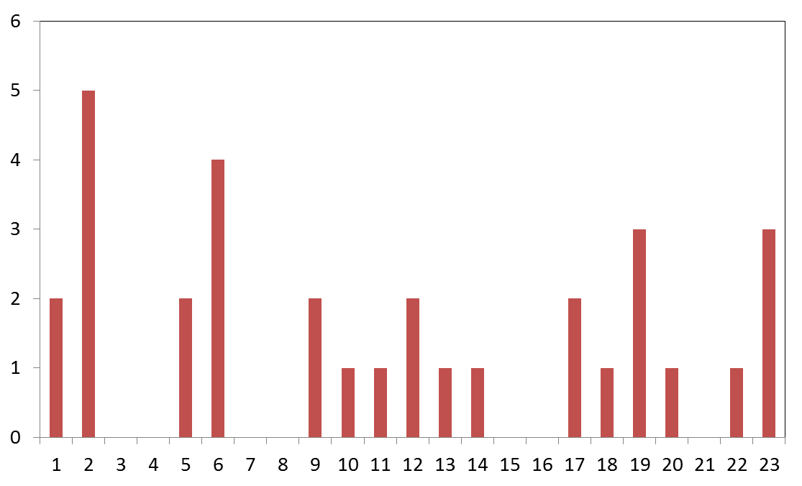
Thermal cycle in the tunnel
Total 34 times since FY07
No of thermal cycle
CM slot number

Slide 25
Cryomodule repair out of tunnel in SNS
Large helium leak (5CMs before or during commissioing, 1CM in 08)
Non-operational cavity due to large Fundamental coupling to HOM (1CM repaired, 1CM still in the tunnel )
Air to beam line leak (coupler window) (2 CMs)
Low performer replaced with spare cryomodule (1CM)

Slide 26
Lesson learned
Some of operational limits, difficulties, nuisances are design dependent
  Known/expected issues or
  Unknowns from knowns (unexpected degradation/interactions)
But there will be always limits/difficulties/nuisances
  Machine specific, and/or general
  More complex→ more limits/difficulties/nuisances
Design should focus on system operations as a whole
  Simplification
  Reasonably enough margins (too much is OK as long as a project can support)
  Robustness
  Room for expected/unexpected unknowns/failures

Slide 27
Summary
High performance, reliability, availability
  Balanced performances lead to the most efficient system
    Overdesign for something while overlooking something else
    Limited by the weakest link; Law of the minimum)
  Continuous development of dedicated diagnostics/protection
Assuming a machine is designed and configured in a proper way, protecting a machine against errant/uncontrolled conditions will be one of the major concerns
  It may not be just lowering the gradient or having larger bore radius (it will help but may not be enough)
  Should include adequate MPS, diagnostics, beam scraping, etc.
  There would not be a general solution since every machine has its own specifics.

Slide 28
Backup slide

Slide 29
Historical background of SNS
In 1984, the Seitz-Eastman committee appointed by the National Research Council called for two new national facilities, an intense X-ray source (the Advanced Photon Source, now operating at Argonne National Laboratory) and an "advanced steady-state neutron source facility" designed to have a neutron flux 5 to 10 times that of the Institut Laue-Langevin reactor.
When the fiscal year 1987 congressional appropriations bill passed, DOE received funds for the time for an "advanced neutron source.“ The money was earmarked for ORNL's Center for Neutron Research Project (originally called HFIR-II), which changed its name to the Advanced Neutron Source Project to reflect the language of the appropriations bill. (~$3B)
In 1991 DOE set up the Kohn committee to revisit the question of whether a reactor or spallation source would make the best neutron source.
In 1992 the committee concluded that both were needed, but gave the ANS higher priority for rapid construction.
"Because the ANS was initially designed to use highly enriched uranium, there was concern that the government would have a credibility problem as it urged other nations to refrain from using nuclear materials that could be turned into weapons." DOE then asked ORNL to lead a team of national laboratories to design a spallation source that would cost $1 billion or less, about a third as much as the ANS. 1995
Although greatly disappointed about the ANS cancellation after eight years of hard work, ORNL staff quickly shifted gears.

Slide 30
SNS cavity limiting factors
Mainly due to electron activities
  Field emission induced heating (major limiting factor for both types of cavities).
  Electron accelerating in high beta cavity is much more efficient
    In average, individual cavity limiting gradient (powering one cavity at a time in a cryomodule) is higher than design value.
    Collective limiting gradient (powering all cavities in a cryomodule) is lower than design value in higher beta cavities.
  Multipacting (MP) behaviors between medium and high beta cavities are about same. But the consequence is different.
    HOM coupler has two multipacting locations ranges from 3 MV/m to 16 MV/m.
    MP induced radiation → radiation onset is very low especially in high beta cavities. Field emission onset is higher than radiation onset gradient.
    Mostly MP can be processed out but not always. Severe MP could damage HOM couplers/feedthrough/cables, etc. (also burst of field emitter could damage HOM couplers)

Slide 31
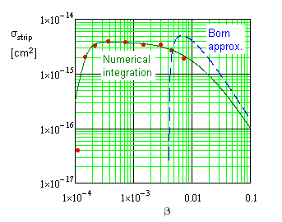
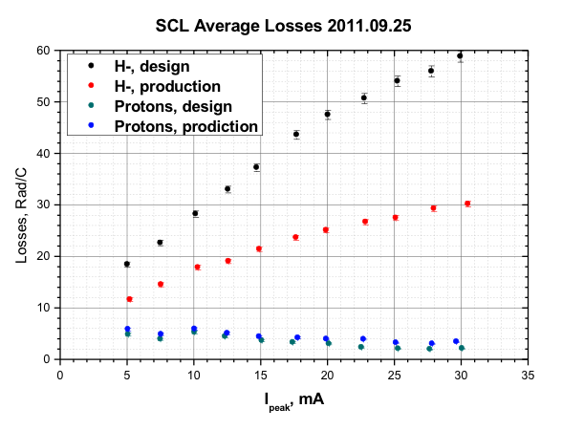
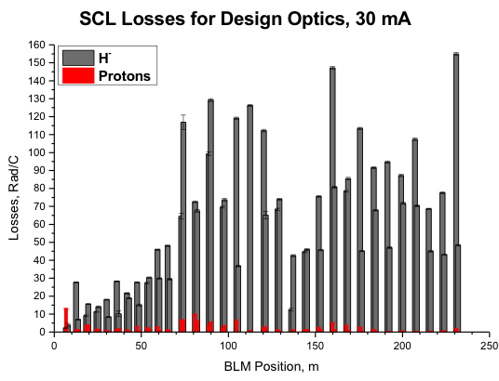
Beam loss in SCL (activation level is not an issue for hands-on maintenance, but it was a mystery)
Intra beam scattering (IBS) ?
Performed experiment with proton beam
IBS is the main contributor to beam loss in SNS SCL
Beam loss in SCL at SNS: ~50W at 1MW
Proton beam accelerators will have much less concern for activation
SNS range
b_{com}
30 mA, design lattice (strong focusing)
A. Shishlo, et al
Normalized Beam Loss (Rad/C)
Distance along SCL (m)
Peak beam current (mA)

Slide 32
Beam Halo
Some of cavity performance degradation may come from beam halo.
But it is difficult to verify since it is a very slow process.
  Statistically when beam loss is relatively lower in normal conducting cavity, more SCL cavity trips/degradations in upstream part and transition part between medium and high beta sections
  After degradation occurs, in some cases cavity trips without beam too.
  Diagnostics is difficult to set a absolute threshold. Just after having an event,
    Beam pipe temperature increment with beam was relatively higher but not that much
    Beam loss was relatively higher but again very little
Degradation seems to be developed for a long time, and then a cavity became very sensitive to small changes

Slide 33
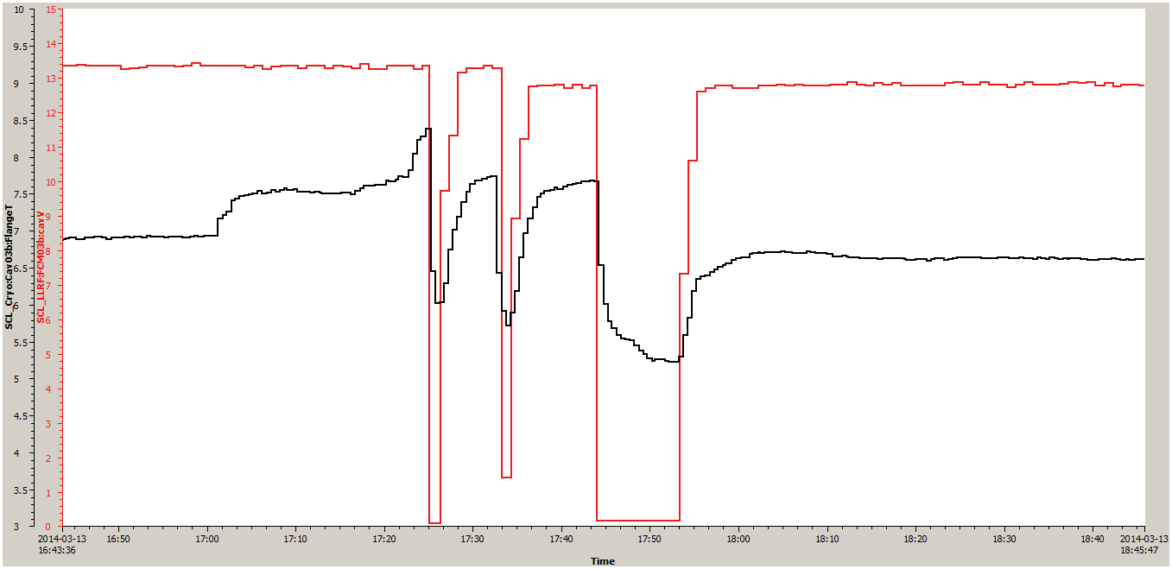
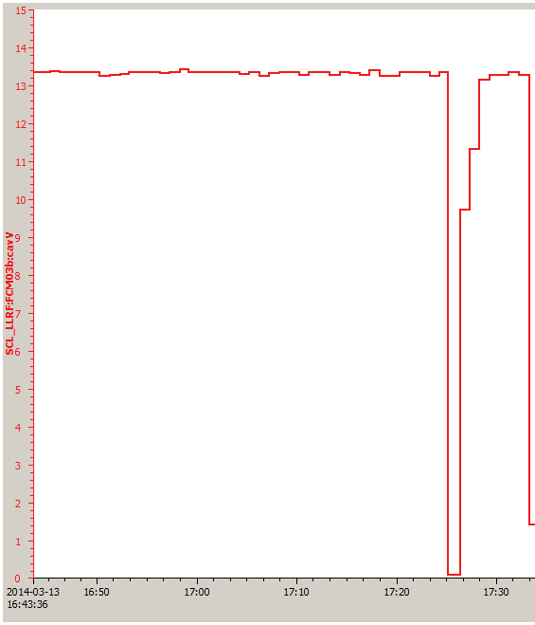
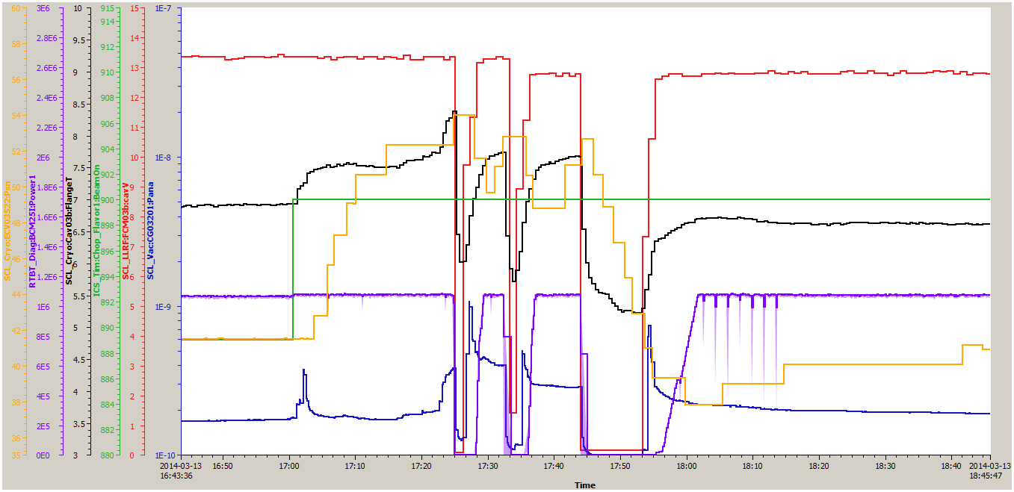
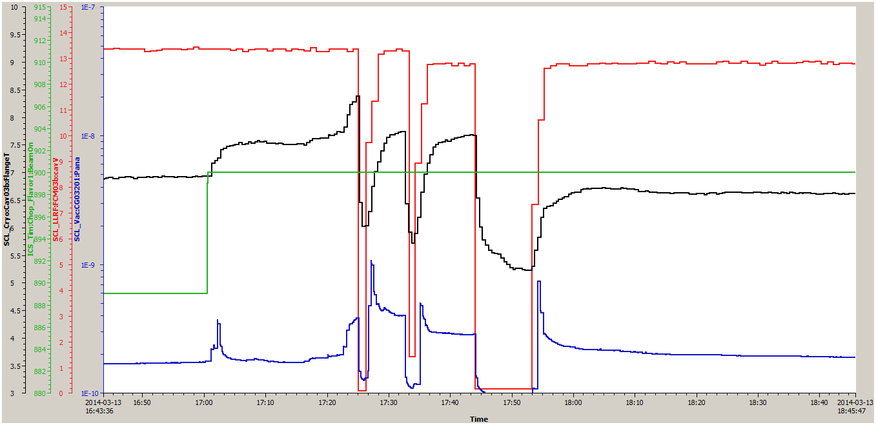
Primary JT opened more by 14% (cavity dynamic power increased by 70-80 W, which is average power at 7 % duty operation).
Beam pulse length was increased from 890 turns to 900 turns (~1%) .. I turn ~ I us
There was a hot spot in somewhere in the end group, a few minutes was not enough to cool-down. Waited for about 10 min. and recovered.
Lowered cavity field
Lowered cavity field
Cavity field
Lowered cavity field
Cavity field
Primary JT
position
1.5 K
1.5 K
1.5 K
1.5 K
10 min.
900 turns
Cavity end group
Temperature
(indirect indication but
only one that indicates
temperature increment)
A SCL cavity (3b) kept tripping.
RF waveform diagnostic buffer indicated partial quench
But tripped due to
Partial quench
890 turns
What happened
at this time?
10 min.
10 min.
10 min.

Slide 34
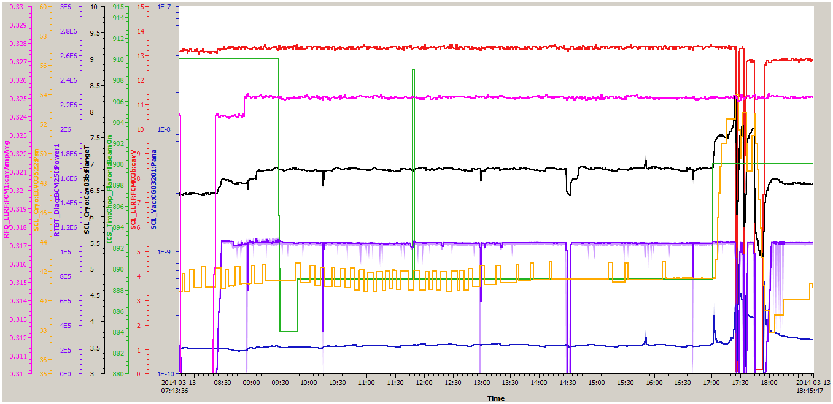
RFQ amplitude was increased
Ion source was tuned
Explained
in previous pages
8 hours

Slide 35
Errant beam during high intensity beam operation (I)
Errant beam: off-energy beam generated anywhere in the accelerator and transported to the downstream in a fault condition
  Since the errant beam is off-energy beam, it is mostly lost while transported through the linac, which results in beam trips caused by excessive beam loss.
SCL Beam Loss Monitors (BLM) are the primary indication of errant beam
MPS detects errant condition from RF system/BLM → MPS system truncates ion source and RFQ (SNS MPS system has about 25 us MPS delay. Was much longer before 2010)

Slide 36
Errant beam during high intensity beam operation (II)
  Errant beam hitting cavity surface: desorbs gas or particulates creating an environment for arcing/discharge (creating non-zero chance)
    Mostly nothing but creating non-zero chance for cavity performance degradation and/or part failures
    Because of its nature, purely statistical: to minimize the dangerous events → less errant beam events, short duration
~10% of BLM trips were due to the Ion source/LEBT
  Most ion source induced BLM trips occur during the first week of a new source installation
    High voltage arcing in LEBT, unstable plasma, etc.
~ 90% of BLM trips were due to Warm Linac RF faults
  RF faults occur at different times during the pulse
    Faults during the RF fill had reproducible times
    Faults during the RF flattop were random
  Focused on improving warm linac operation

Slide 37
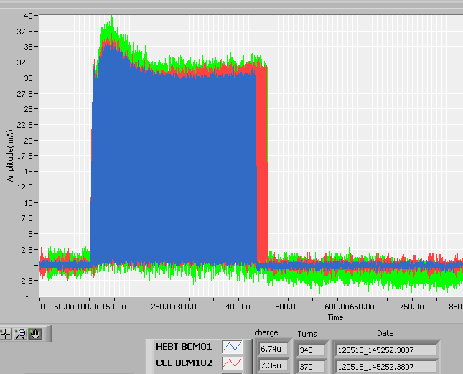
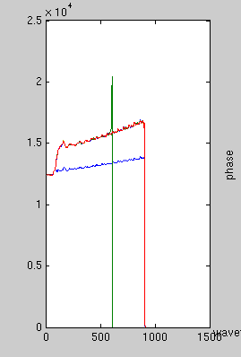
RF Truncation in NC structure
Abnormal RF pulse with beam
Normal RF pulse with beam
LLRF output
370 useconds in
CCL
LLRF Drive
22 us full beam lost in the SCL
348 useconds in HEBT
Normal RF pulse with no beam

Slide 38
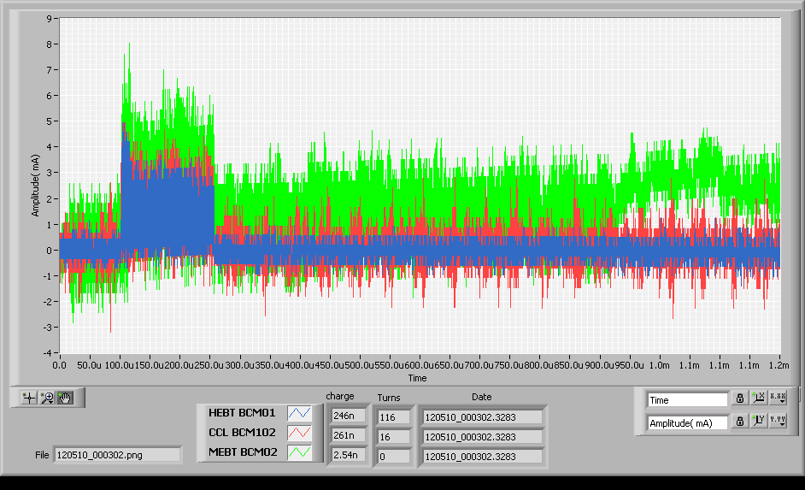
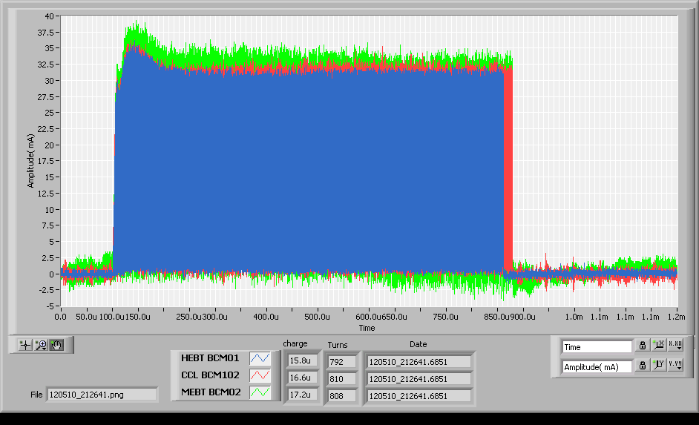


Ion source/LEBT is one cause of errant beams
Low current pulse causes beam loss in SCL
Normal
Normal ion source pulse
~ 33 mA
Abnormal

Slide 39
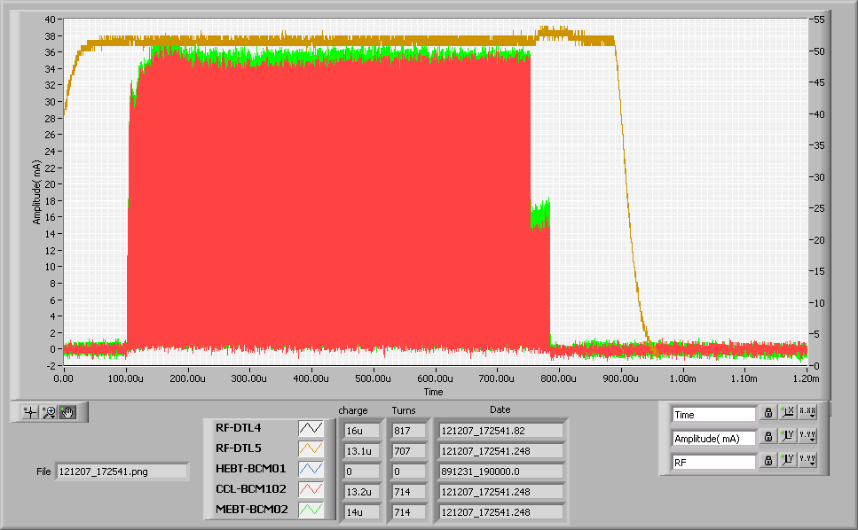
Ion source/LEBT errant beam example
DTL4 RF waveform
Drop in beam current beginning in the MEBT
HEBT BCM01 was not working for this case

Slide 40
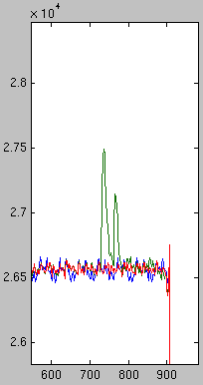
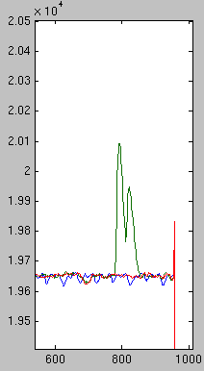
Warm Linac cavity response with beam current drop
CCL
Beam current drop
DTL
SCL BLM trip
Field
Field
SEQUENCE
Beam current drops
RF field jumps and LLRF corrects
SCL BLMs trip
RF field jumps and LLRF corrects
Time (usec)
Time (usec)

Slide 41
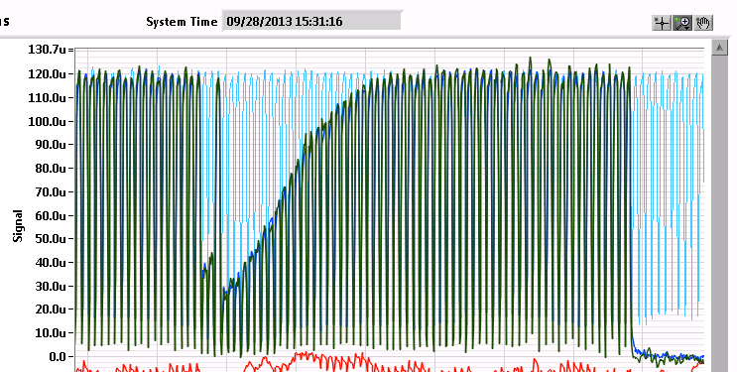
Example: Odd beam from front end

Slide 42
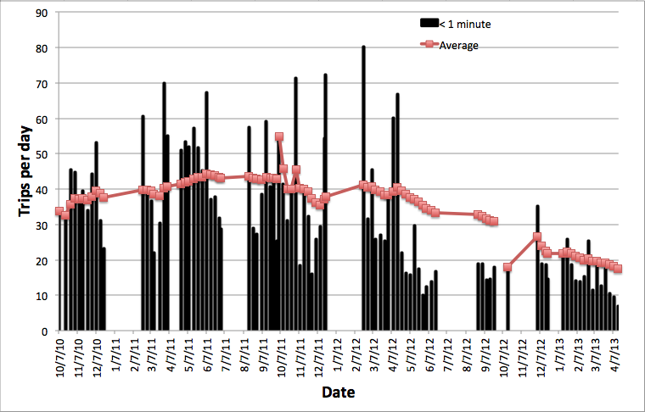
Errant beam trips reduced by careful NC conditioning/operation
75 % of ‘less than 1min trip’ comes from ‘errant beam’
  FY12 or before: 30-40 times/day
  FY13: about 15 time/day
FY12-1
FY12-2
FY13-1

Slide 43
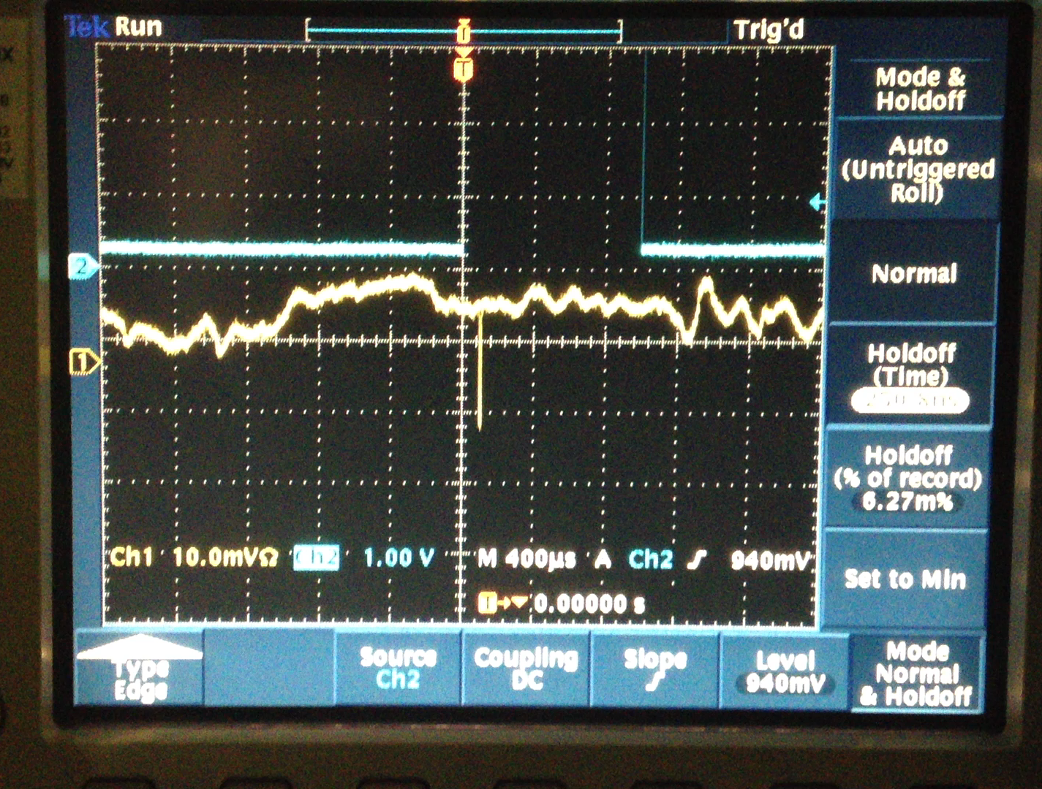
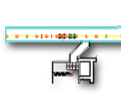
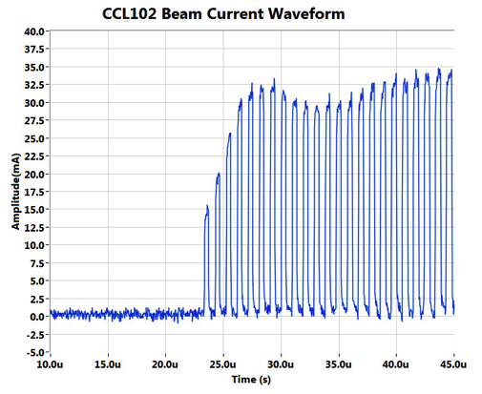

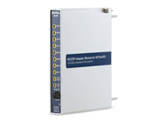
Layout of dedicated MPS
HEBT BCM01 Waveform
Wideband current transformers:
  1 GHz with 1 ms droop time constant
  Nearest one before and after SCL
  Long cable lengths (500-1200ft)
SNS Linac
~1.3µs →
~1.2µs →
CCL102
HEBT01
RFQ
DTL
CCL
SRF, β=0.61
SRF, β=0.81
Source
MEBT
Electronics
Buildings
Attenuators
Amplifier
~.4µs →
Amplifier
← ~1.3µs
Digitizer
← ~1.1µs
~1µs
Amplifiers and attenuators to counter induced noise on long cables

Slide 44
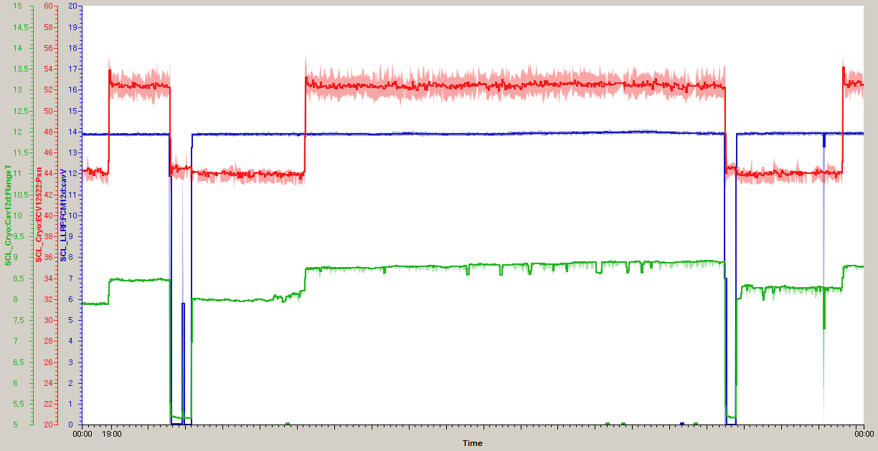
Some cavities become meta-stable condition at the same gradient
JT valve position (10% more: 50-60 W)
Cavity gradient
Coupler flange temperature
(indirect indication)
Some part in the end group (must be very low field region) became normal conducting but still operable
Additional cryogenic load at 2K is about 50W more from one cavity (in CW 800W)

Slide 45
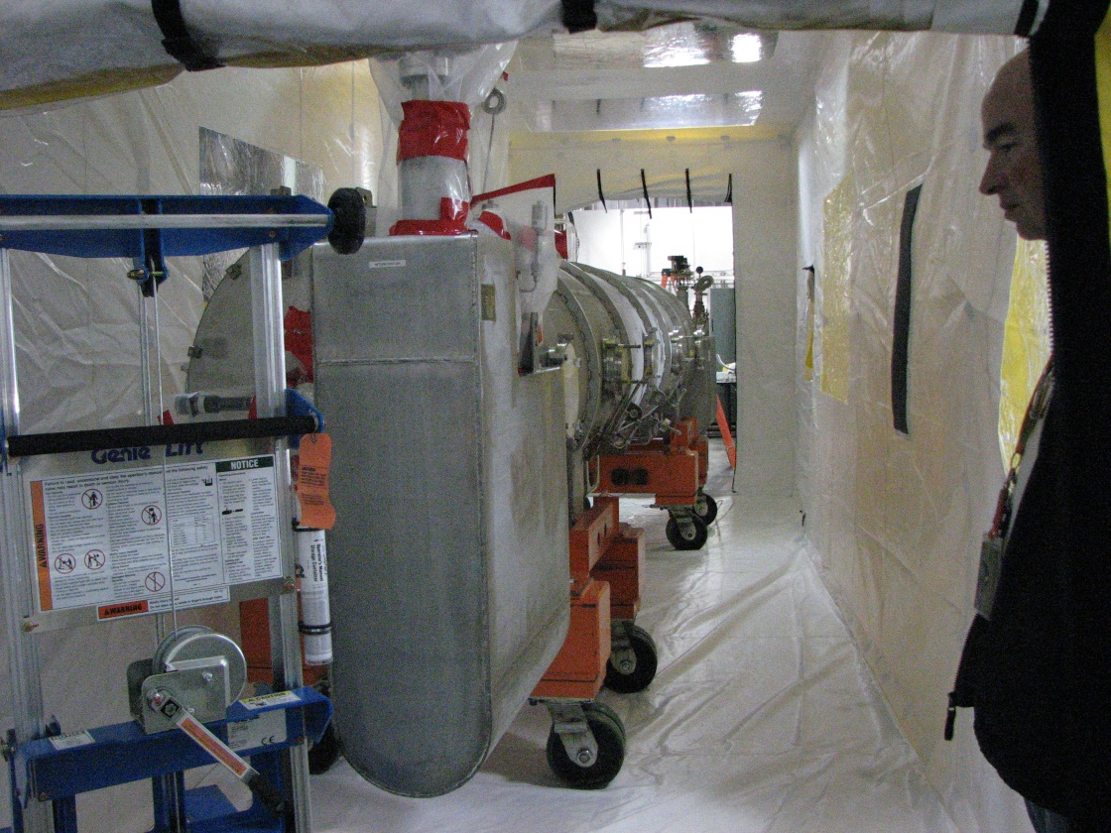
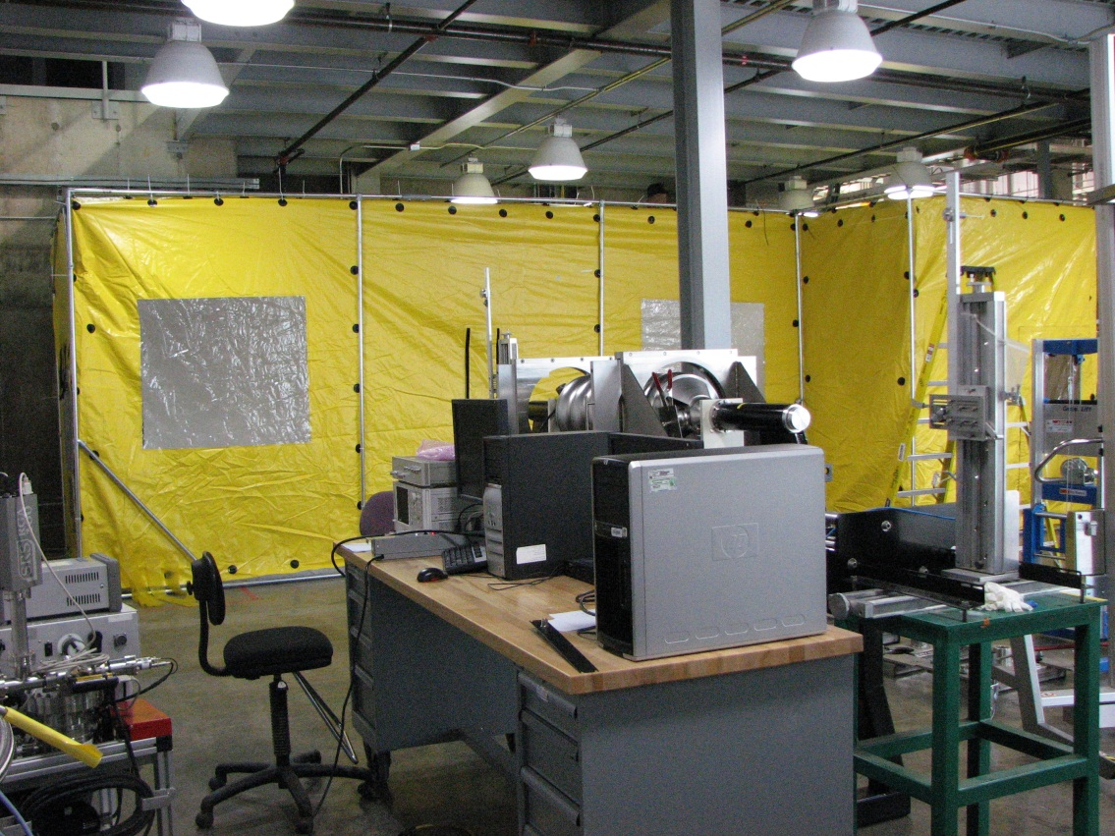
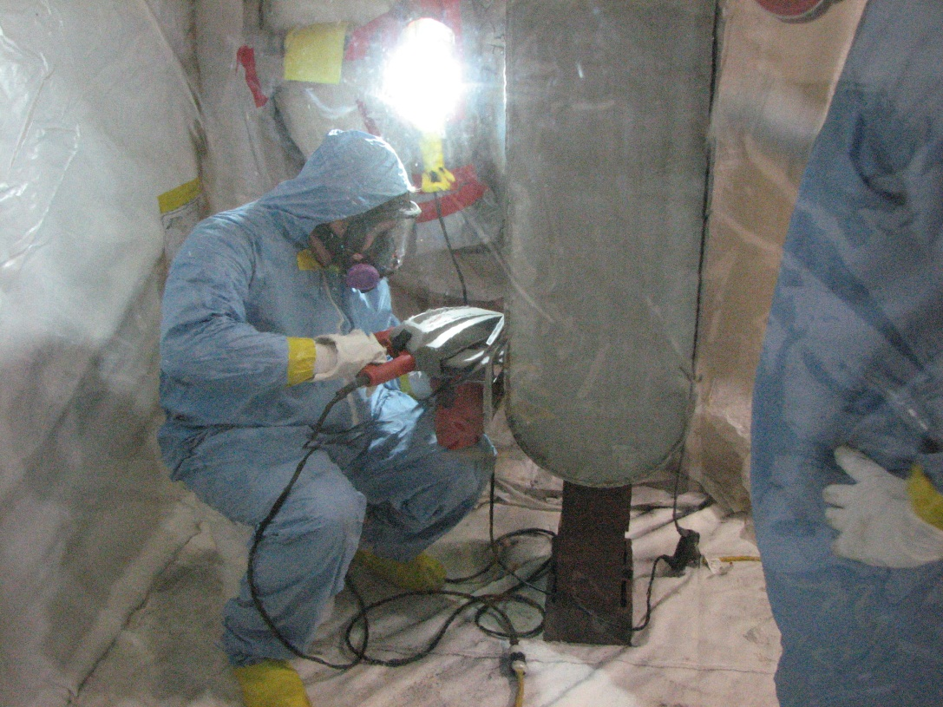
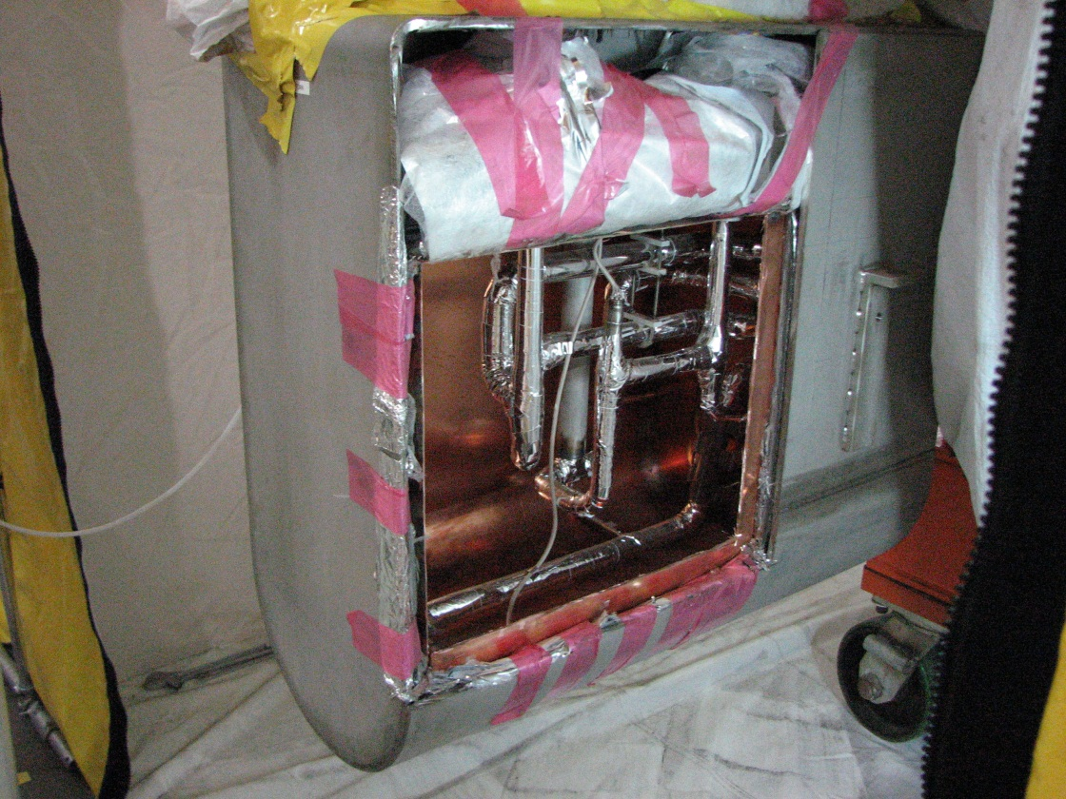
CM12 (H01) Repair
Decontamination Test for CM Repair
Leak in the helium line
Cutting Into End Can
Removal of Internal Diodes

Slide 46
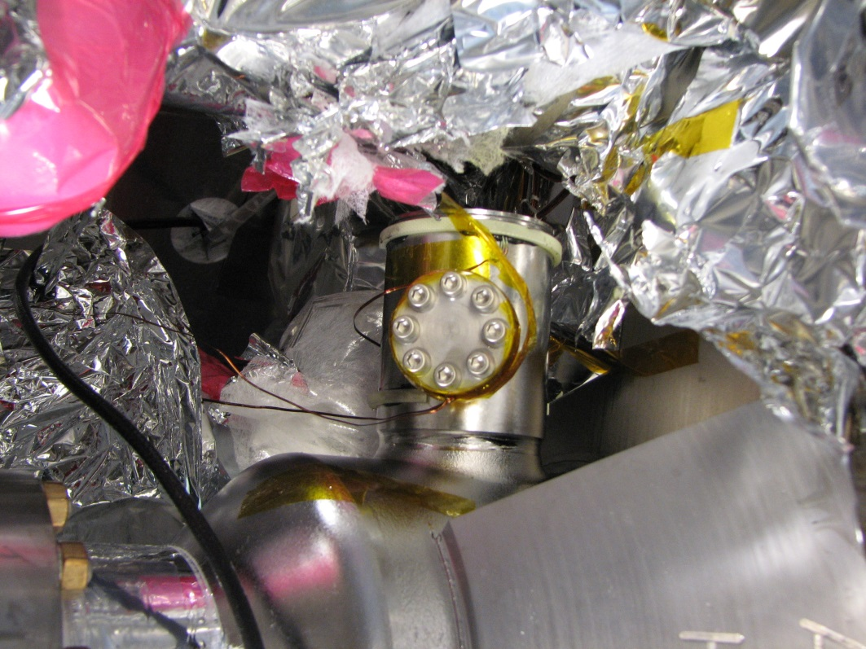
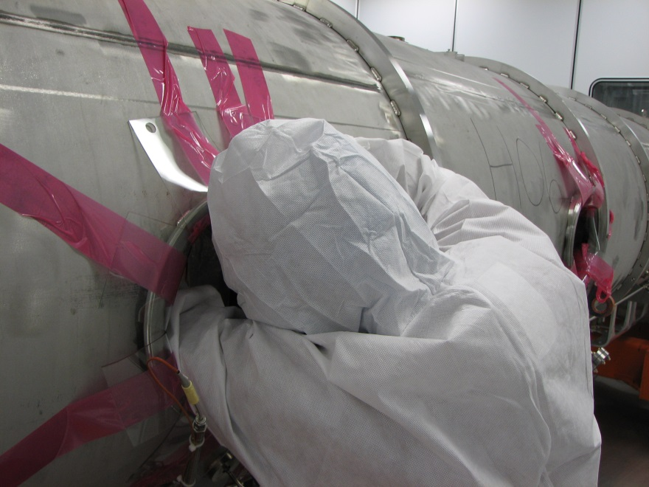
HOM
Reevaluated the requirement of HOM coupler in 2007 and decided to remove feedthroughs as needed
Two cavities were non-operational due to large fundamental power coupling to HOM coupler (one repaired)
Feedthroughs from 4CMs were removed. Half of them showed leak
Blank off

Slide 47
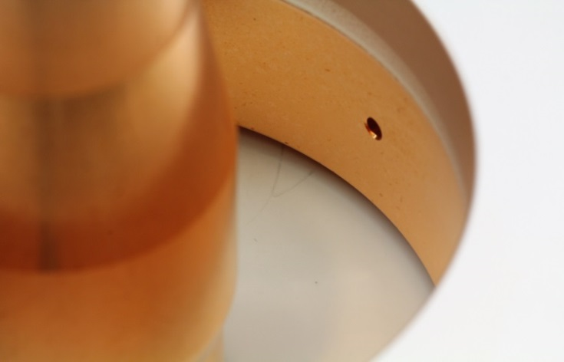
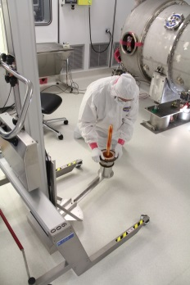
Coupler window leak
So far two cavities had leak at the coupler window (6c, 20d)
  Presumably from errant beam event in 2009 (arcing accompanied)
Did not results in catastrophic failures
  Vacuum at the coupler window: between 1e-10 torr 1e-8 torr and after 2 years it had stayed 1e-8 torr
  Leak rate: about mid 10^-6 torr l/s
Out of service in the tunnel during operation and took out both CMs in 2012 and repaired in the SNS test facility

