Slide 1
The ESS Cryomodule Test Stand in Lund
Wolfgang Hees
WP leader Test Stands
www.europeanspallationsource.se
2014-05-15

Slide 2
The ‘career’ of a Cryomodule
cryomodules are built ‘somewhere in Europe’
factory tests at their place of assembly
transport to Lund
site acceptance tests on ESS test stand
preparation for installation
storage or installation in tunnel
commissioning
operation
eventually … repair inhouse at ESS
elliptical cavity CM

Slide 3
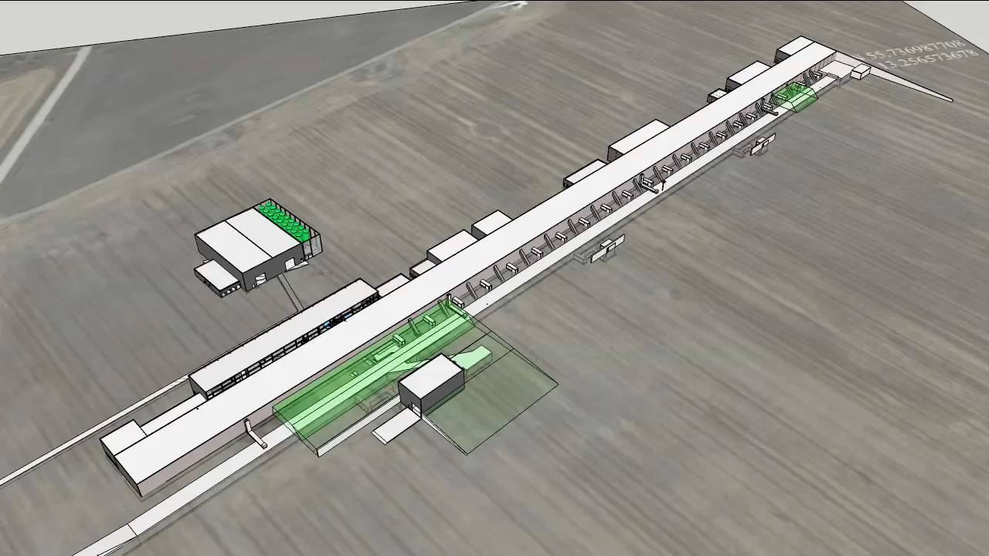
Test Stand location in Klystron Gallery

Slide 4
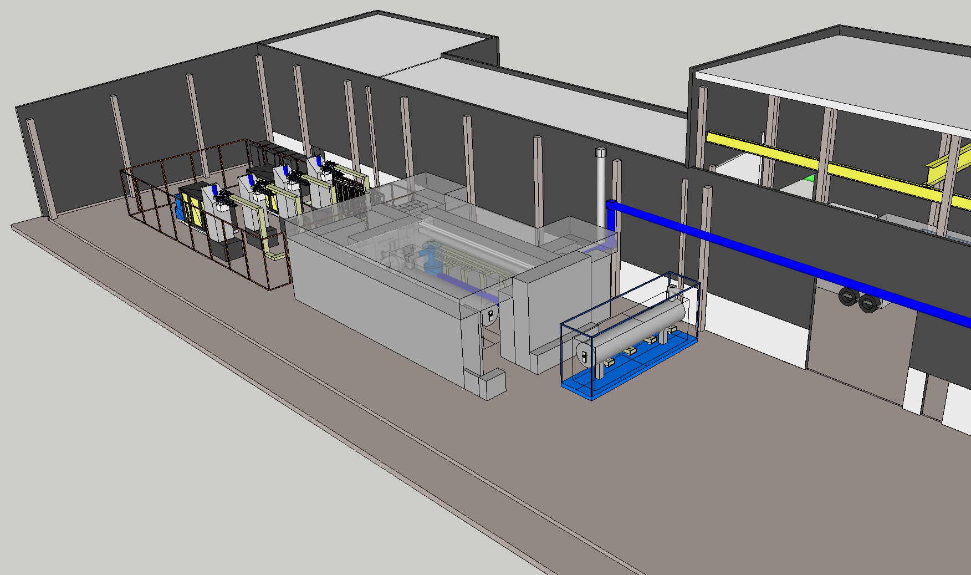
Test Stand area
cryogenic
transfer line
2 modulators
4 klystrons
equipment access
door
cryomodule
loading area
test stand
bunker

Slide 5
Schedule

Slide 6
Test Stand Cryo-system
warm compression
purification
comp. bldg
≈ 100 m
sub atmospheric warm compression
coldbox
coldbox bldg
≈ 100 m
cryomodule
test stand bldg

Slide 7
Layout and flow scheme of the Test Stand CDS
Test stand
cryoplant
Cryogenic Transfer Line (80 m)
Valve box
Jumper connection
Cryomodule
Valve box
courtesy Jarek Fydrych
Cryomodule

Slide 8
Test Stand Cryoplant
Heat load contributions at different temperature levels
and consequently installed capacities:
 | 2 K | 4.5 K | 40 K
 | static & dynamic | liquef. | static
 | [W] | g/s | [W]
1 high-β CM | 41 | 0.092 | 46.5
distribution line | -- | -- | 188
total | 41 | 0.092 | 234.5
installed power | 76 | 0.2 | 422
same plant will later deliver 5000 l/month LHe to experiments,
required combined capacity @4.5Keq.: ~ 400 W

Slide 9
RF equipment
modulators: 1x 660 kVA or 2x 330 kVA (baseline)
4 klystrons
LLRF controls
waveguides, circulators, loads etc …
provided by WP8 (RF)
decision on modulators depending on ongoing investigation and R&D

Slide 10
Site Acceptance Test
transport from manufacturer
reception: unpacking, inspection
preparation for test bench
installation in bunker & connection to cryo & RF
initial testing
warm coupler conditioning
warm RF tests
cool down & cold coupler conditioning
cold LLRF tests, cold HPRF tests
heat load measurements
warm up & disconnection
preparation for tunnel
transport to storage or tunnel
total: 3-4 weeks

Slide 11
Requirements for the CM test stand
specification of material (CMs) to be tested
test plans & schedules
preparatory work to be done on CMs (coupler conditioning etc …)
not yet finalized
will come from WP5, with approval from LE
details to be developed together with IKC partners
(IFJ-PAN, DESY, Uppsala)
are expected to align with current plans

Slide 12
beyond 2020
cryomodule tests finished by 2022
test stand needed for repair / maintenance
available for R&D
has to be moved from the contingency space
crucial future infrastructure*: clean room, vertical cavity test stand, cavity treatment facility
-- because availability of third party labs can not be guaranteed in the long term
* disclaimer: such an ESS SRF R&D facility is at this point
neither planned nor financed

Slide 13
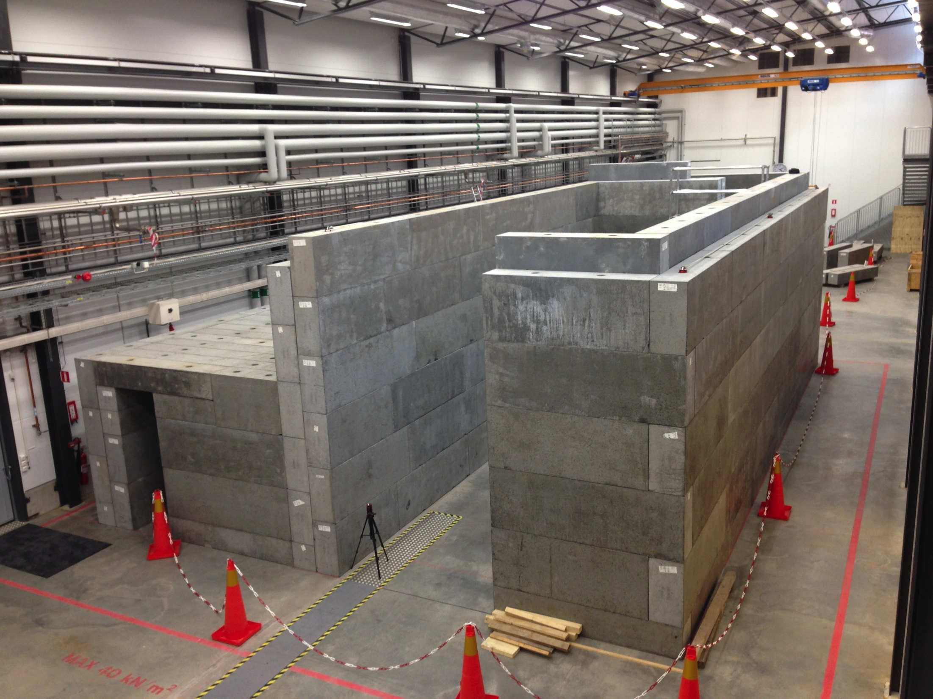
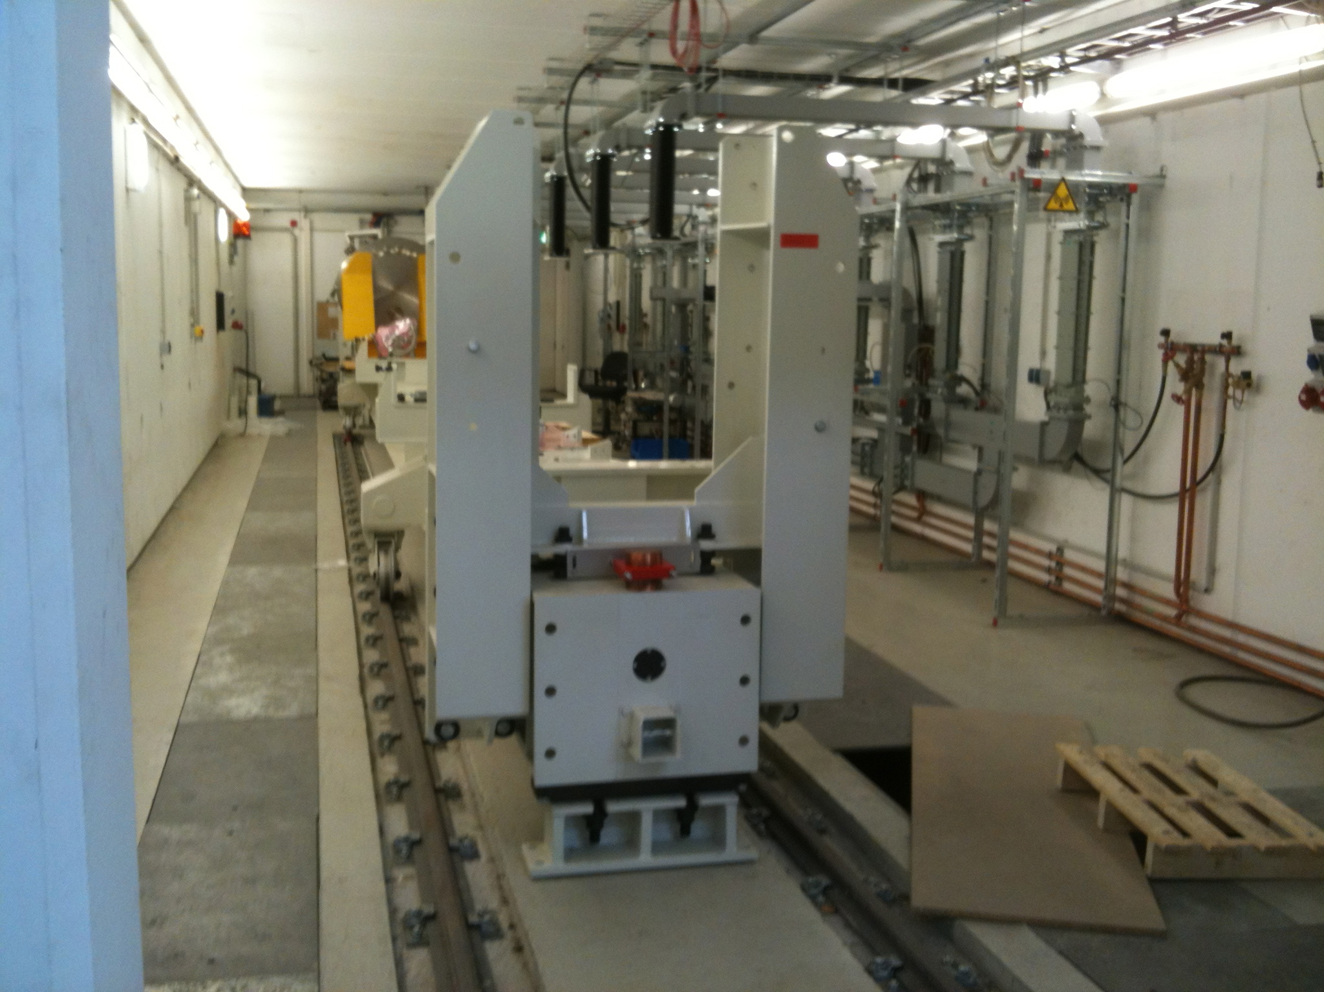
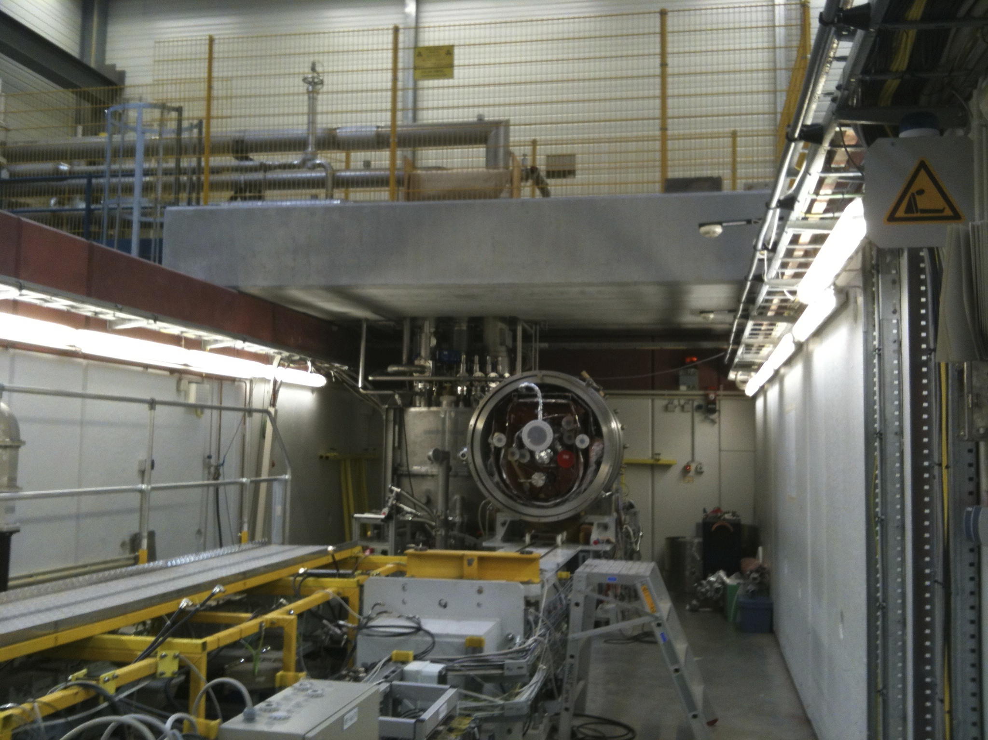
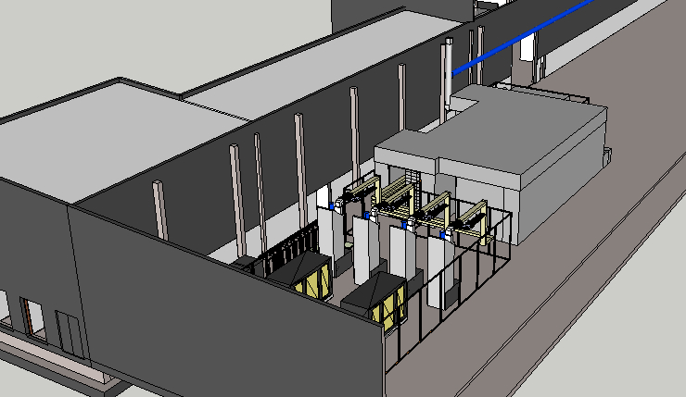
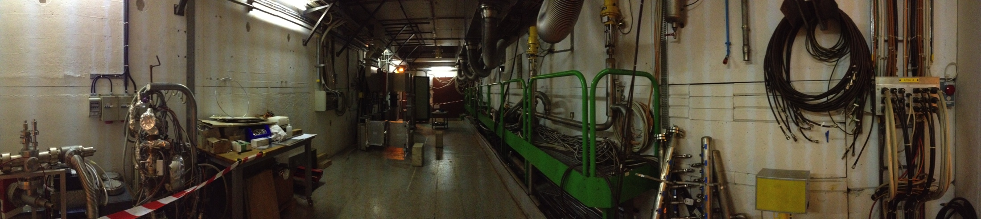
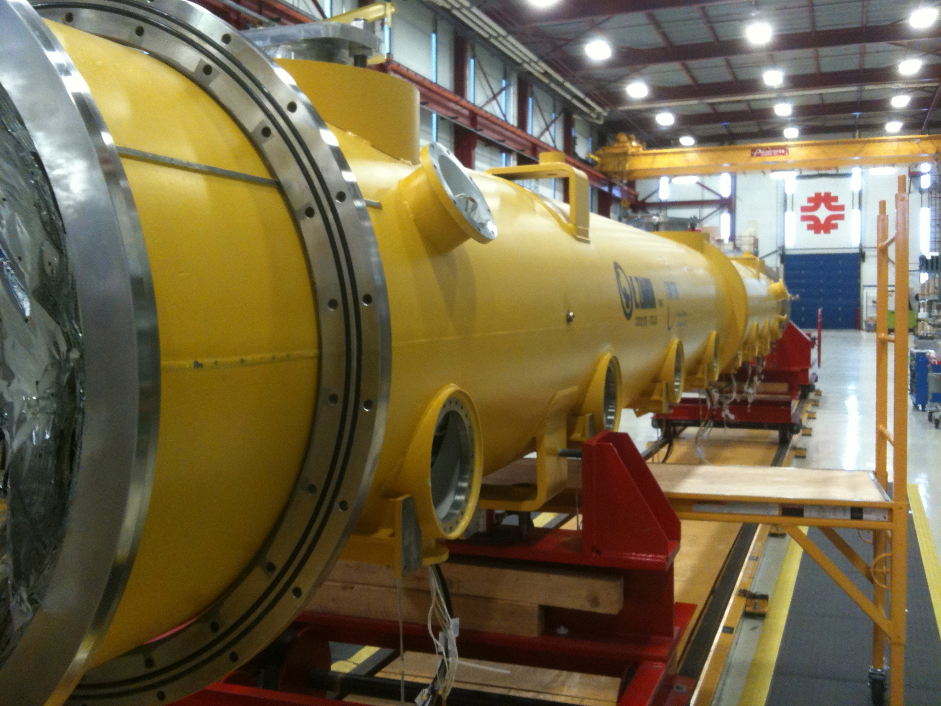
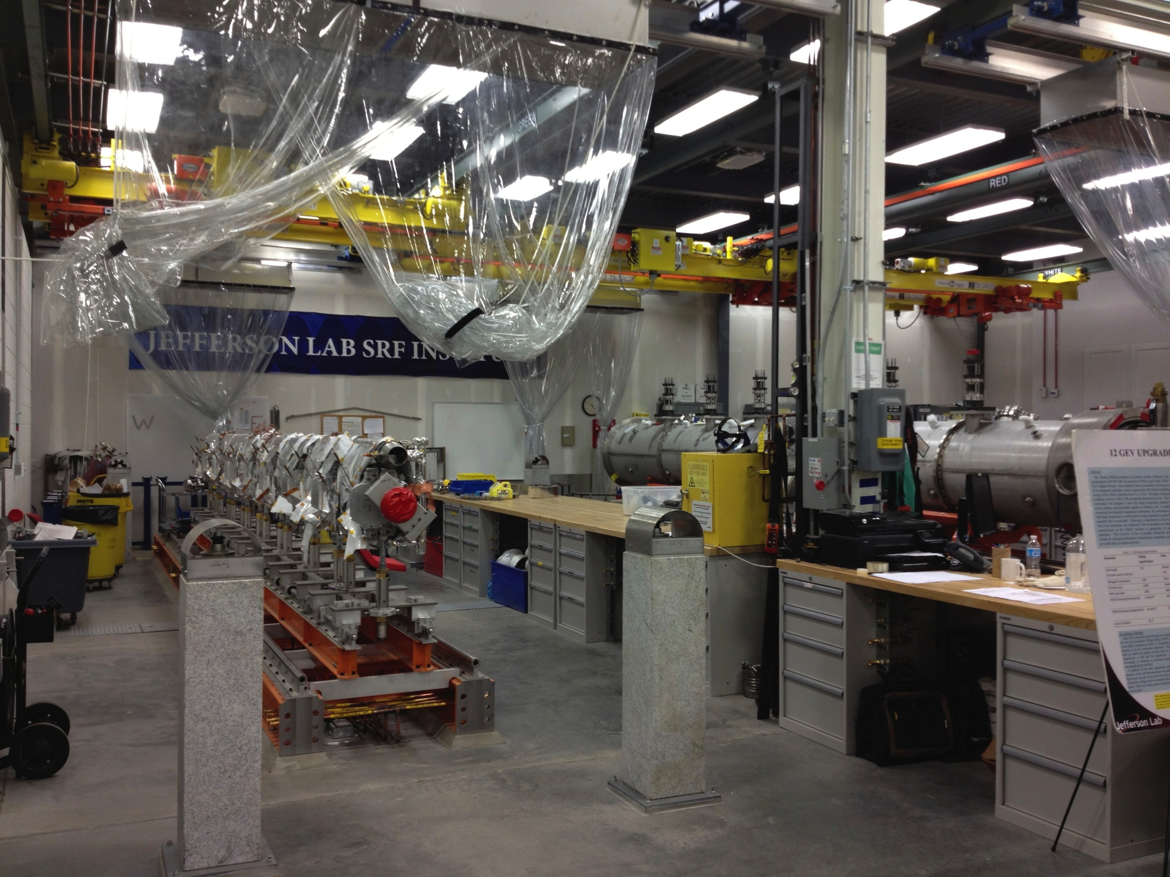
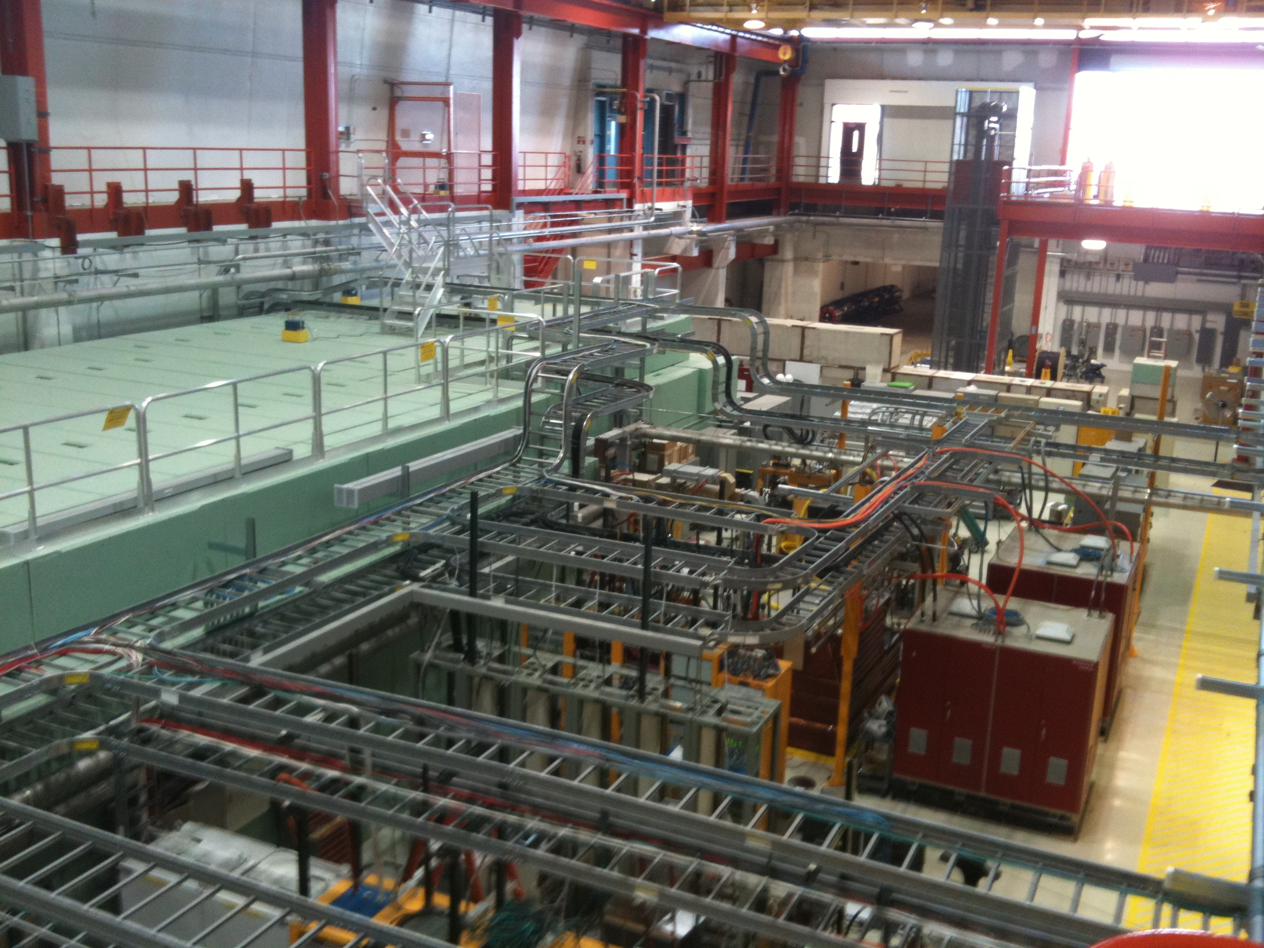
DESY
Uppsala
ESS
CERN
FNAL
JLab

