Slide 1
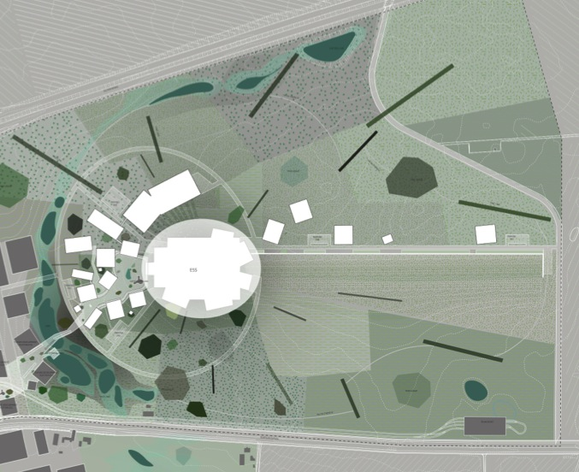
An ESS Based Super Beam for Lepton CP violation discovery
ν
accumulator
target/horn station
1

Slide 2
Linac Work Package
Front end
Source
RFQ design
Chopping
Beam physics
H- Losses
Transport
RF sources and Cooling
RF amplifiers and modulators
cooling
Electronics
Control system
Diagnostics
Energy Upgrade
Safety
Costing
Participants: ESS, CERN, Uppsala

Slide 3
https://indico.in2p3.fr/conferenceTimeTable.py?confId=10090

