Slide 1
HWR and Test Cryomodule for China ADS
SLHiPP-4, 15th May, 2014 CERN
Weiming Yue
On behalf of Linac Center
Institute of Modern Physics
Chinese Academy of Sciences

Slide 2
Contents
Introduction
HWRs for C-ADS at IMP
  EM Parameters
  Procedures of fabrication
  Preparation and VTA results
  Stiffening ribs
Performance of test Cryomodule
Design of CM6

Slide 3
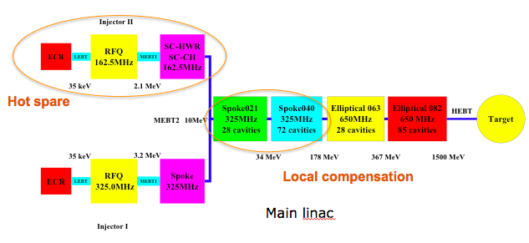
Layout of C-ADS
IMP is in charge of Injector II and prototypes R&D of spoke021 and spoke040 in 2011 to 2015.

Slide 4
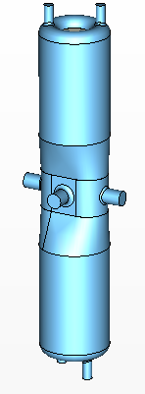
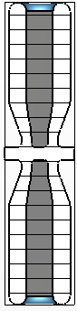
EM Parameters of IMP-HWR010
f (MHz) | 162.5
β_{opt} | 0.101
Epeak / Eacc | 5.9
Bpeak / Eacc | 12.1
G = Rs×Q0 (Ω) | 28.4
R / Q0 | 153
Q0 (4.4K, Rs=71.4 nΩ) | 4E8
Vacc (MV) | 0.78
Epeak (MV/m) | 25
Bpeak (mT) | 50
Pdiss(W) (4.4K, Rs=71.4nΩ) | 10
※ Eacc=Vacc/(β_{opt}×λ)

Slide 5
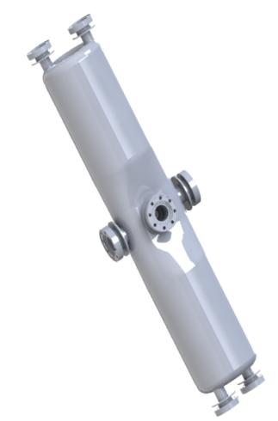
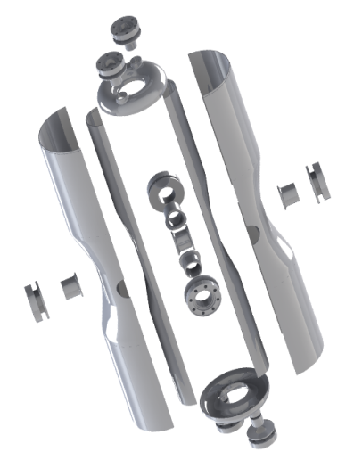
Drawing, Machining, and EBW
Material
  OTIC，RRR>300，partly RRR>380
Drawing, machining and BCP
  Punching die，Al 7075
  Surface survey before every step of fabrication
  BCP (65%HNO₃:40%HF:85%H₃PO₄=1:1:2) 10um, resin by UPW, drying in cleanroom of class 100
  Polishing every seam and BCP 10um before EBW
E-beam welding
  EWB by two different parameters:
    #01, #02;
    #03, #04, #05.

Slide 6
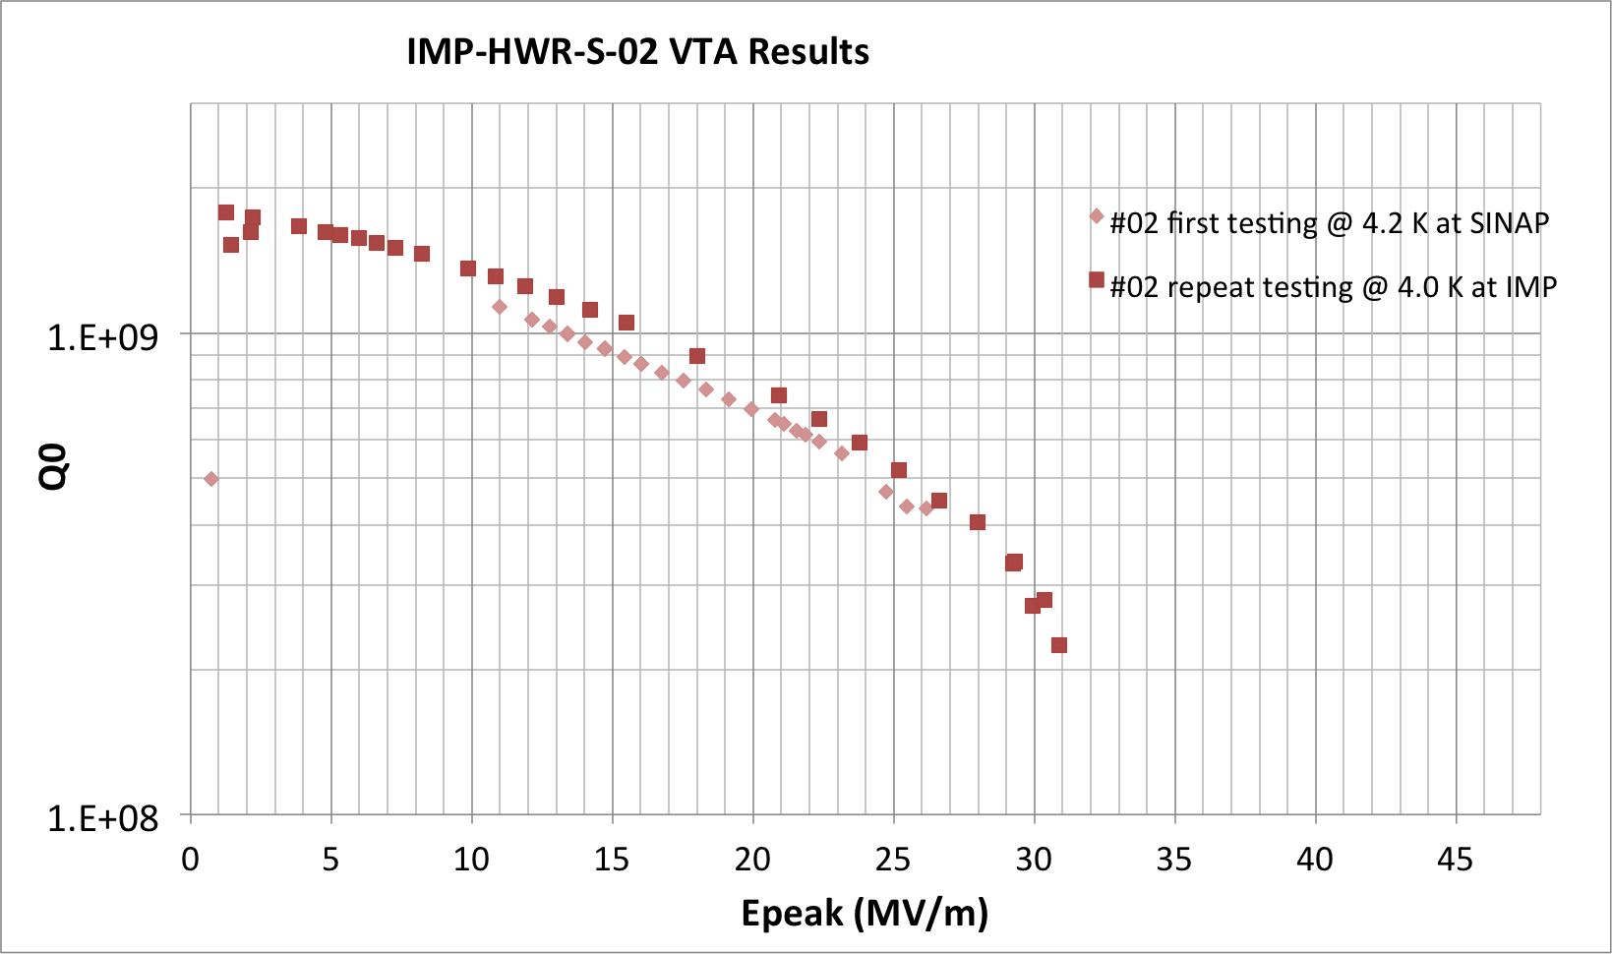
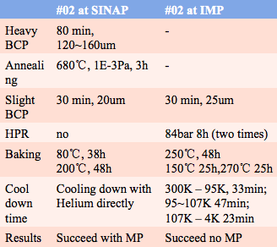
Preparation and test of #02 HWR
29/01/2013
Multipacting
01/12/2012
Quench

Slide 7
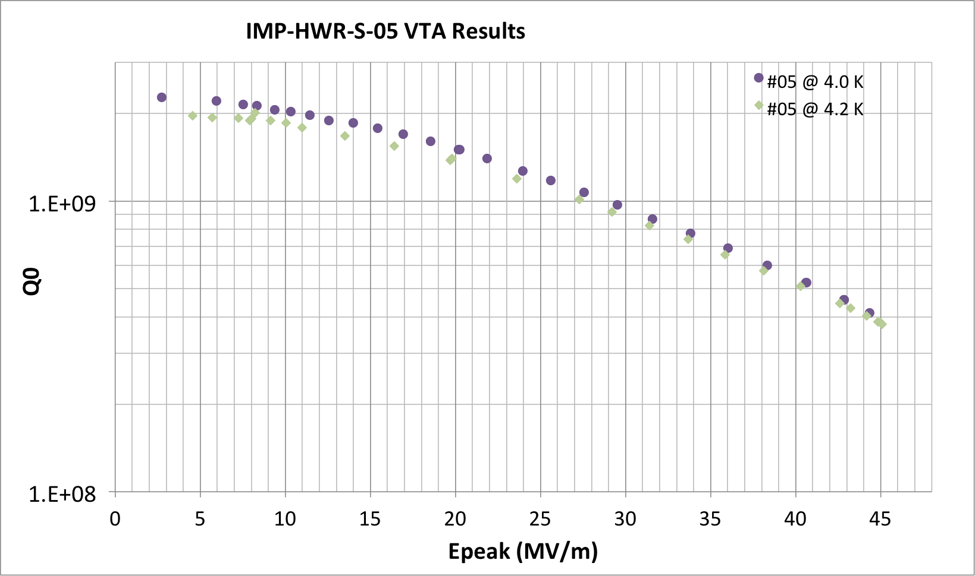
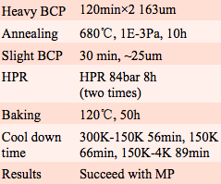
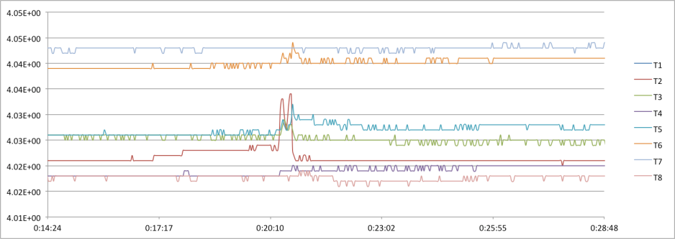
Preparation and test of #05 HWR
23/03/2013
Quench

Slide 8
Preparation and test of #03 HWR
18/05/2013
 | #3 1st | #3 2nd
heavy BCP | 1:1:1.5 150min 136.7um
Annealing | 680℃，1E-3Pa，10h， leak | 850℃ 3h
Slight BCP | 30 min(3 times),75um | 30um
HPR | 84bar 8h(3 times)
Baking | 120℃，52h | 120℃，48h
Cool down time | 300K-150K 100min, 150K-130K 76min， 130K-4K 80min | 300K-150K 48min, 150K-130K 74min， 130K-4K 100min
results | Failed due to FE or MP | Succeed with FE or MP
Field Emission
Quench
Multipacting

Slide 9
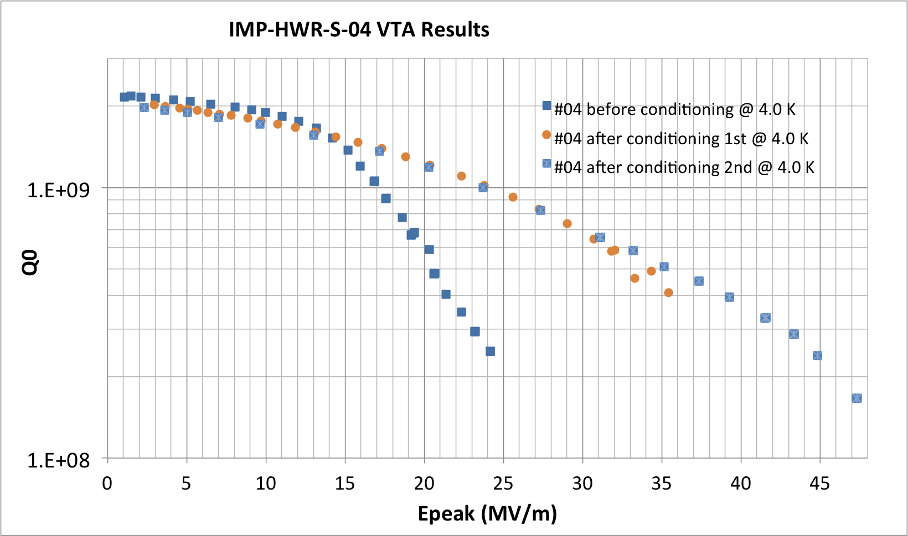
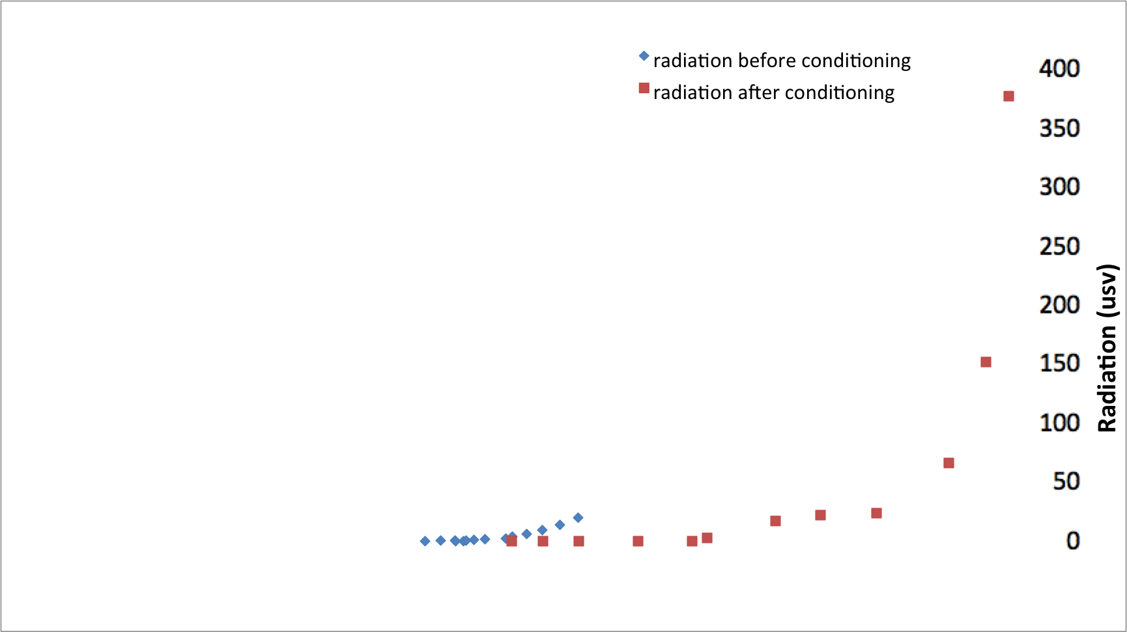
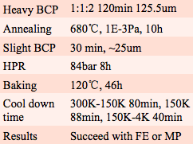
Preparation and test of #04 HWR
08/06/2013
Field Emission
Quench

Slide 10
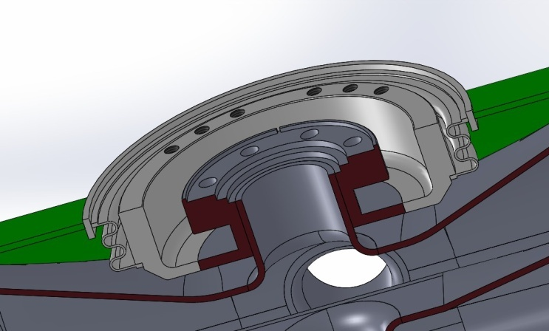
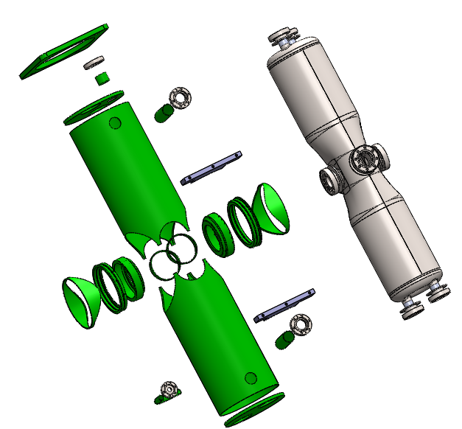
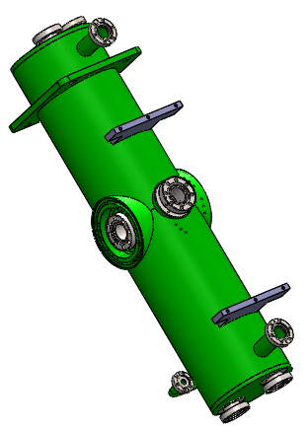
HWR Helium Vessel Structures
NbTi transition
Ti Tuning bellows
HWR cavity
Helium space
Helium Vessel
Beam port
Enlarged View
Exhaust Port
Subassembly
Helium inlet
Subassembly
3D model
Exploded View

Slide 11
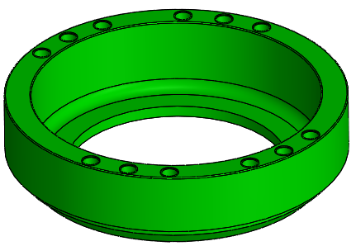
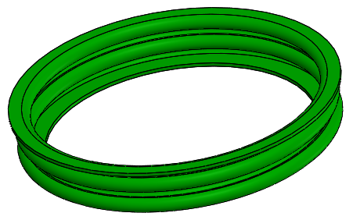
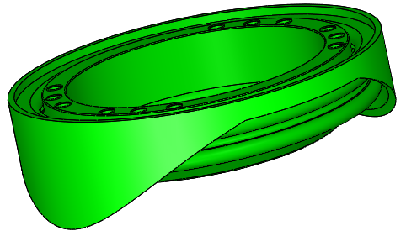
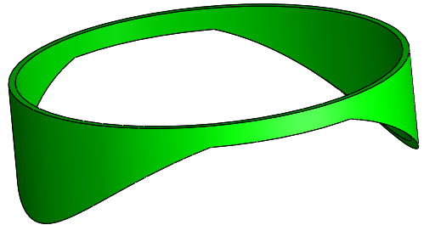
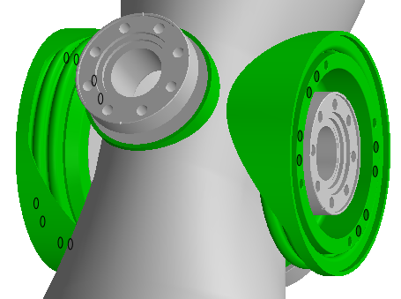
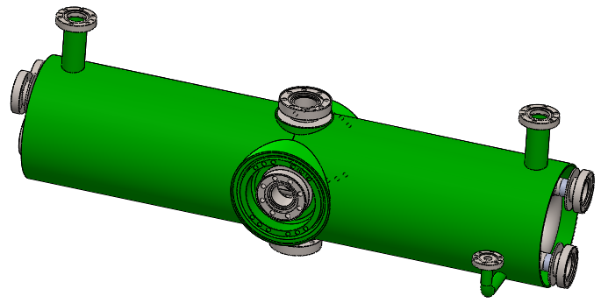



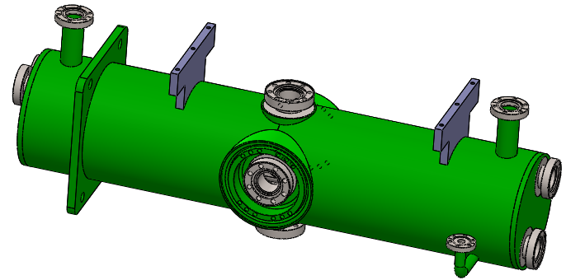
The welding process 2
Tuner connecting ring
Ti Tuning bellows
Beam transition Port
Beam transition Port
Subassembly
Tack & Stitch weld
RF transition Port
Tack & Stitch weld Top and Bottom Tubes
Naked HWR cavity with transition Port
Tuner Mount Blocks
Titanium Plate
Tack & Stitch weld End Cap to
Top and Bottom Tubes
End Cap 1
End Cap 2

Slide 12
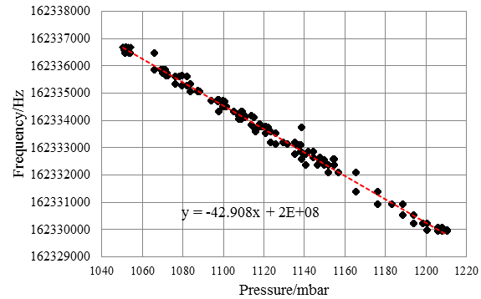
Df/dp without Stiffening ribs
Df/dp=-42Hz/mbar
Bandwith 230 Hz
The HWR is too soft!

Slide 13
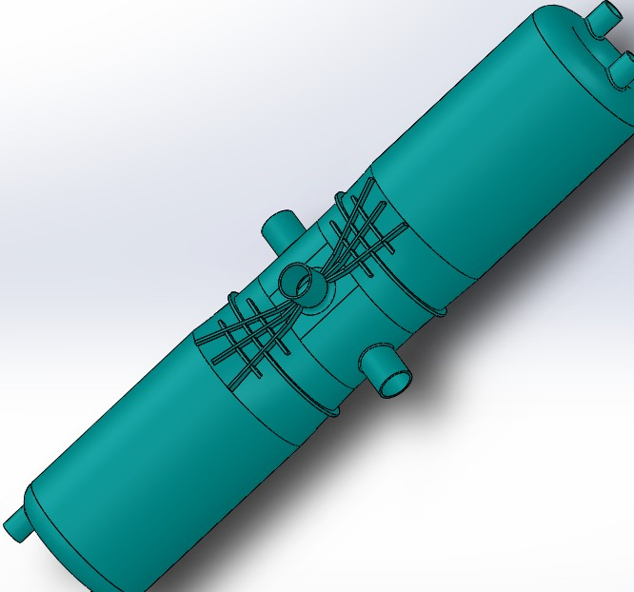
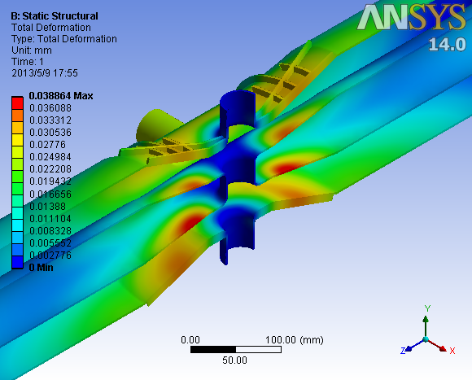
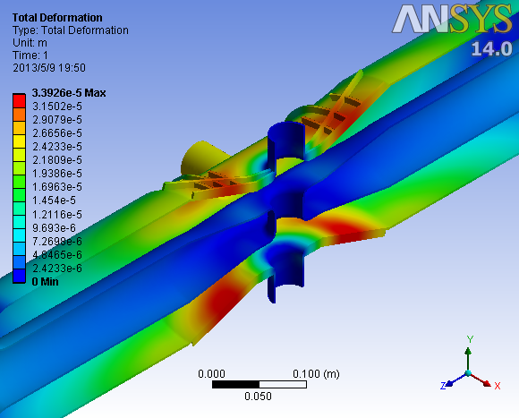
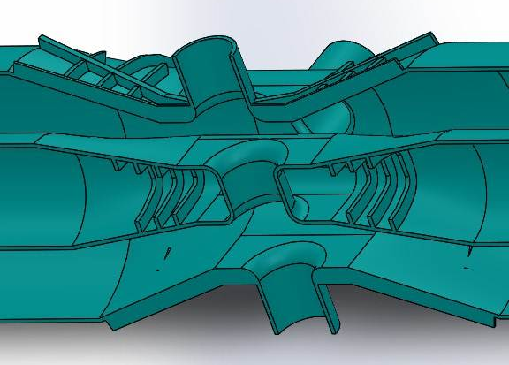
Stiffening ribs Design
Ribs on out conductor
df/dp < 5.6 Hz/mbar
Ribs on both surfaces
df/dp < 1 Hz/mbar

Slide 14
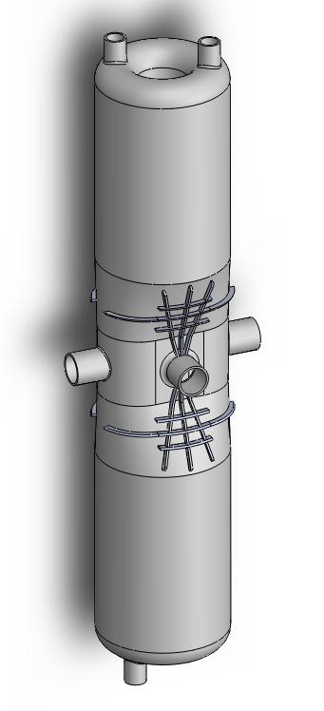
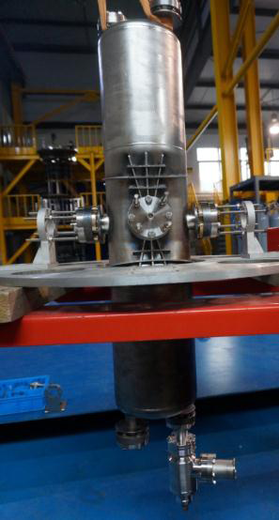
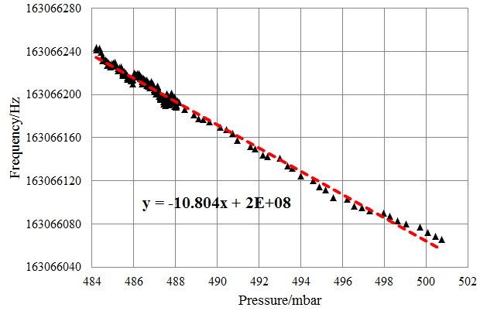
Df/dp with Stiffening ribs
Ribs on out conductor
df/dp =10Hz/mbar

Slide 15
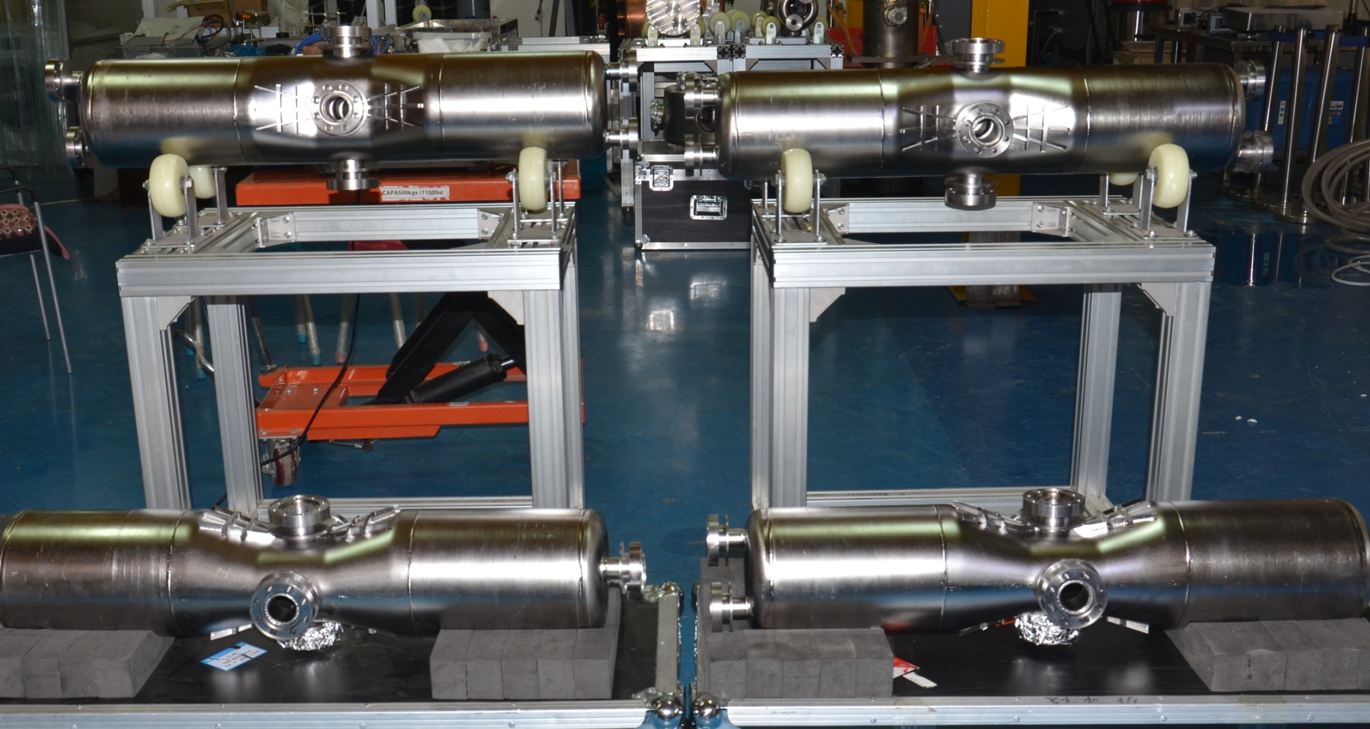
Mass production of HWRs
Four HWRs with ribs on both surfaces has been fabricated

Slide 16
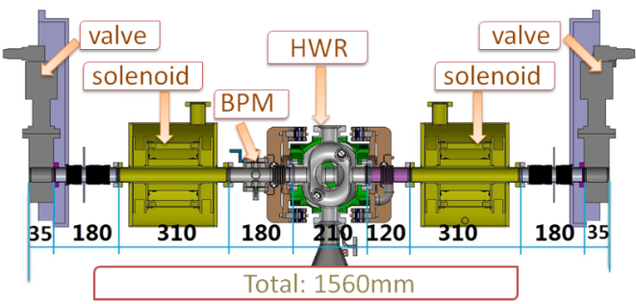
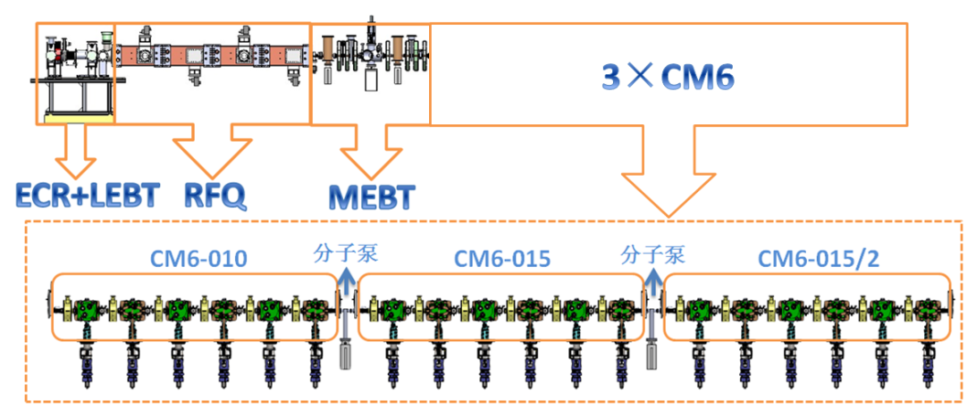
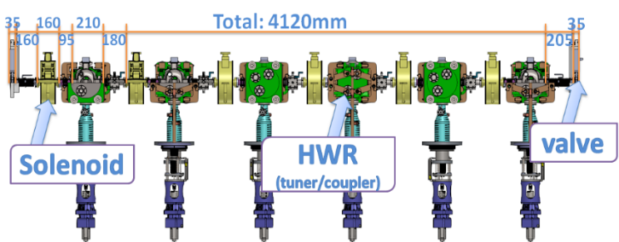
Introduction of CM for injector II
ADS InjectorⅡLinac contains 3 Cryomodules.
Cryomodules containing 162.5MHz, beta = 0.1 dressed HWR cavities and associated components, SC solenoids , Cold BPM
Operation Temperature: 4.4K
Operation Pressure: 1.05bar
Total length:4120mm
We had done the single cavity test cryomodule –TCM1 firstly.
TCM1

Slide 17
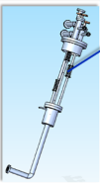
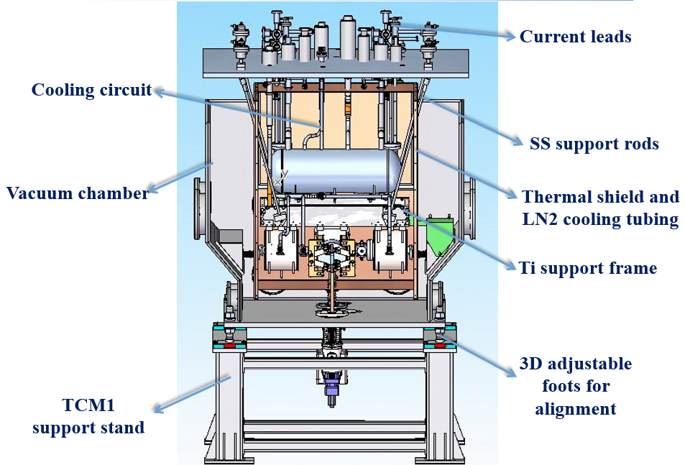
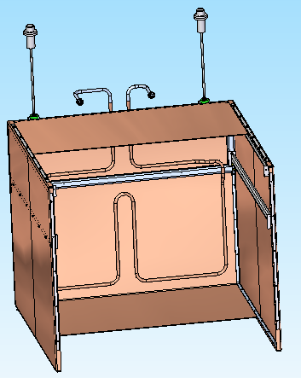
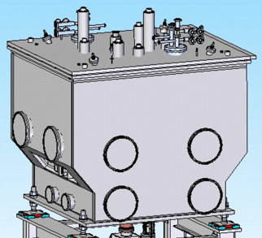
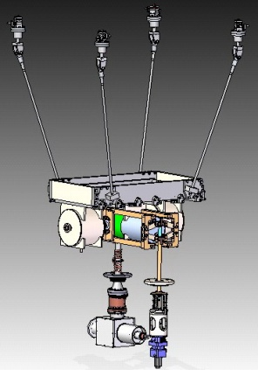
Design of TCM1
Single HWR cavity, two solenoids, one Cold BPM
LN₂ thermal radiation shield-copper
Titanium frame support for cold mass
Cooling circuits for HWR cavity and SC solenoids
vacuum

Slide 18
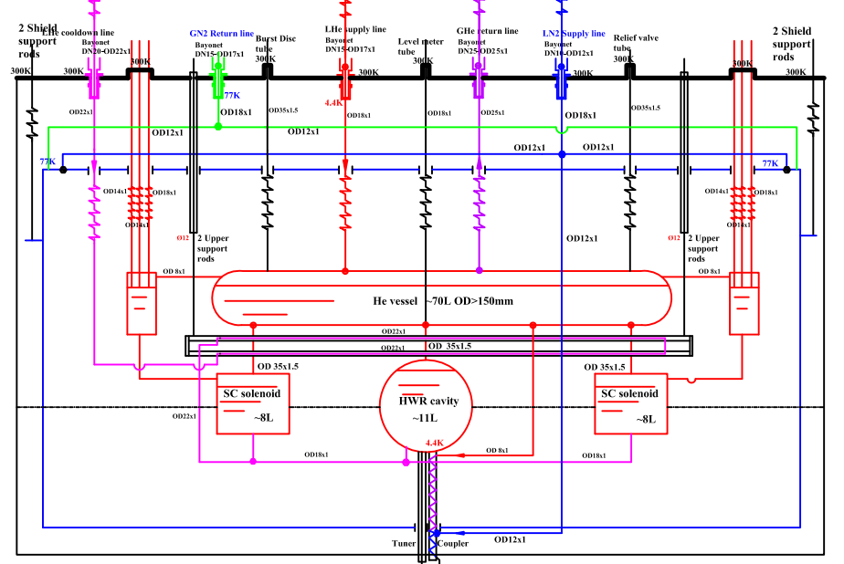
Cooling scheme of TCM1
4.4K heat load/W
HWR | 12.9
solenoids | 1.3
Cooling pipes | 3.8
others | 0.5
total | 18.5
80K heat load/W
total | 37
Precooling mode
supply from the bottom of cavities
Operation cooling mode
supply from the top of cavities
Coupler and Current leads cooling
LN2 supply and return pipes for
thermal shield

Slide 19
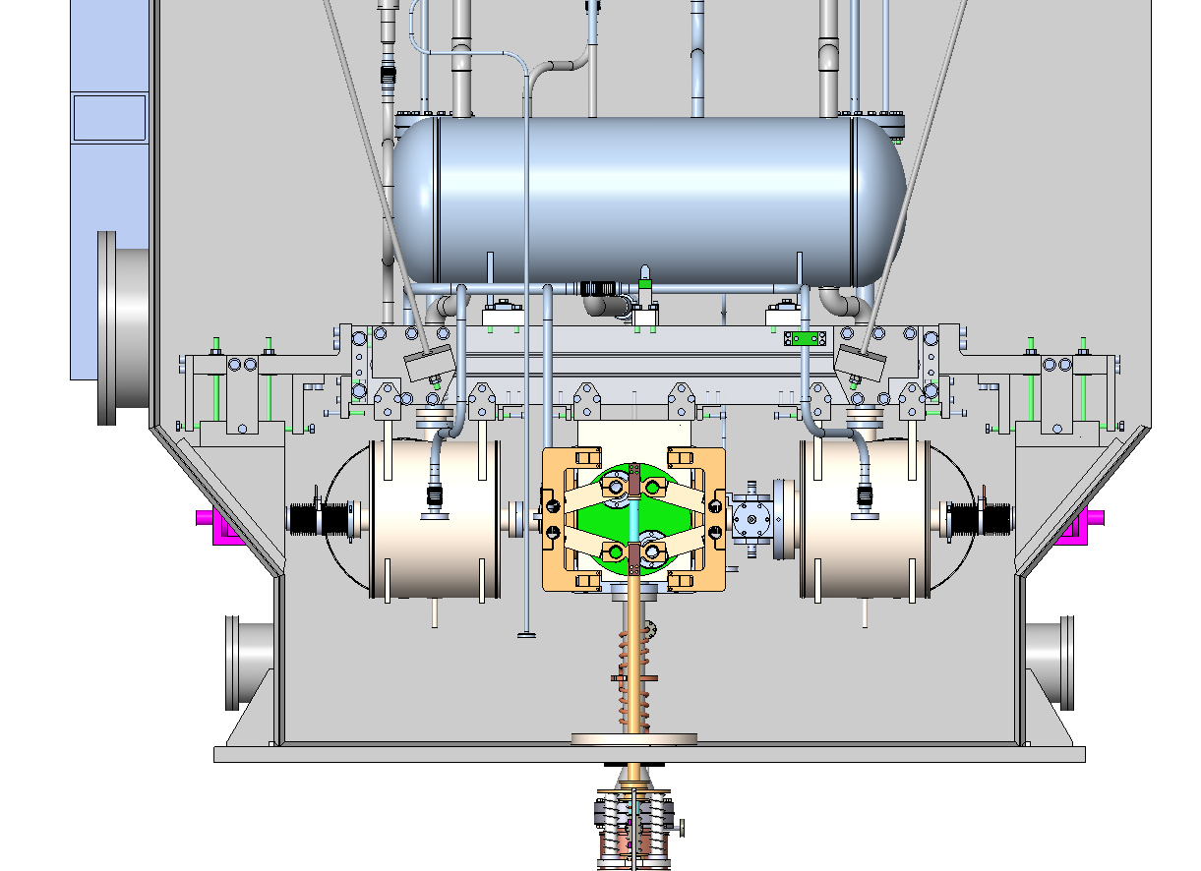
Cavity, coupler and tuner in TCM1
All components were cleaned in class100.
Coupler was bumped in vacuum and valve seal for 3 month.
120 C baking was not done.
Coupler conditioned up to 4kW in room temperature.
High power was feed in cavity up to 2kW in room temperature.
Solenoids were not exited.
Notes:
Fixation location

Slide 20
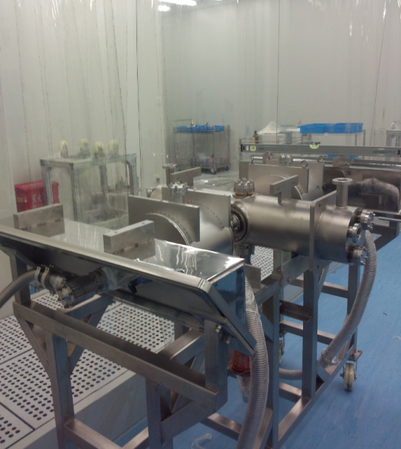
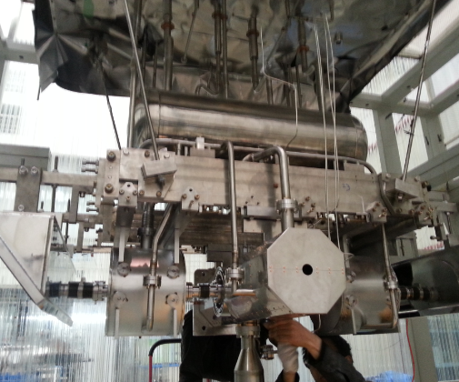
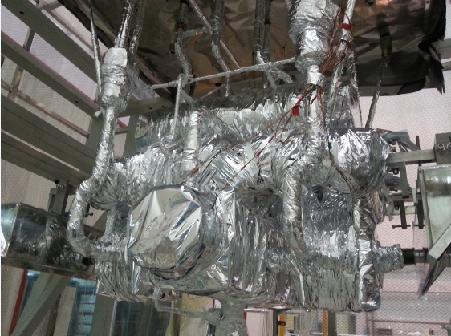
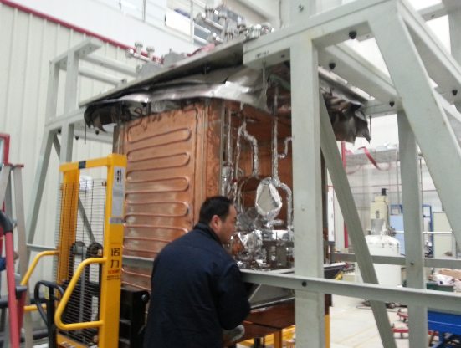
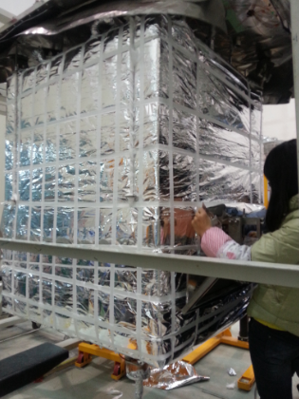
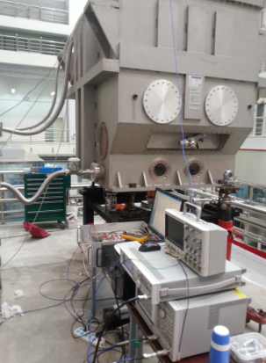
TCM1 assembling
Cavity string with
vacuum in clean room
Cold mass covered with
Muti-layer insulation
Cavity assembled with Ti support
Thermal shield
covered with
Muti-layer insulation
Thermal shield assemble
finished

Slide 21
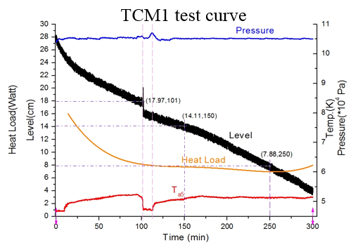
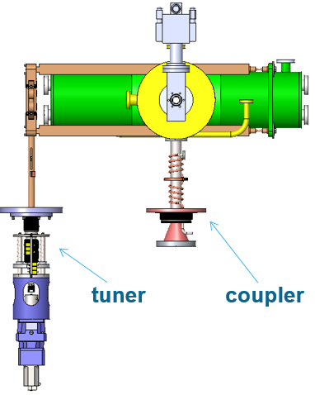
TCM1 horizontal test
Ta5
Use level meter to test the heat load and it fluctuate strongly.
Ta5 located on the top corner of the cavity, there have bubbles which make Ta5 up and down in a cycle.
Pressure can controlled at 500Pa at static situation.
The test static heat load is about 8W.

Slide 22


Temperature at Different Places
Ta5

Slide 23

Cool-down curve
Temperature of Cavity
Vacuum in Cavity

Slide 24


Epeak vs Q0 from VT to HT
Qt=1.1E11
Ke=12.5

Slide 25
Lessons learned from horizontal testing
No Helium flux meter, liquid level meter is not enough for a stable measurement.
Precooling pipes have closed spaces in which GHe get more and more. It can cause the level and pressure fluctuate.
Titanium frame support is instability. This is hard to alignment.
120 C baking is necessary, coupler vacuum is not good.
Frequency control is a key point in mass production.
Additional work to reduce backslash. Piezzo tuner may be necessary.
A commercial Ti bellow to improve tuner performance.
The heat load of cryogenic transmission line is too high.
The heat load of valve box is too high.
Bayonet have no universality.

Slide 26



Cryomodule components-CM6
Cold mass
- HWR cavity, tuner, coupler, SC solenoid, Cold BPM.
- An interface with the room temperature
-Design currents of solenoid: 80A, 80A, 200A
- Storage energy:4.8kJ
Thermal radiation shield
- Aluminum plate and Muti-layer insulation(40 layers)
- 80K LN₂ cooling
Vacuum vessel
- Outer dimension: 4.2m×1.5m×1.6
- Material: 316L SUS
- Connection between cryomodules:
vacuum bellow and pump
- insulating vacuum: 10⁻⁴Pa
- beam vacuum: 10⁻⁷Pa

Slide 27


Cryomodule components-CM6
G10 post support
- Supporting the cold mass in the vacuum
vessel
- Material：FRP(G-10)
- 2 fixed post
- bear more then 5 ton
Magnetic shielding
- room temperature
located in the vacuum chamber inwall
- low temperature
located out of the cavity but in its vessel
Cavity
Magnetic shield
Cavity vessel

Slide 28
Summary
The fabrication and treatment of HWRs have been qualified by Vertical and horizontal testing.
The test cryomodule with one HWR and two solenoids have been commissioned three times. The maximum Epeak reached 32 MV/m. And the dynamic heat load is less than 5 Watt at 25 MV/m.
The df/dp of HWRs has reduced to less than 10 Hz/mbar by employing the ribs on the surface of high electric field.
Mass production of HWRs is continuing. The first batch of 4 cavities arrived at IMP. 15 HWRs will be done by the end of the year.
The cryomodule for 6-cacity finished design base on the experience of Test Cryomodule. It will be fabricated in the year.

Slide 29
Thanks for your attention!

