Slide 1
Upgrade of CERN SM18
Infrastructure
P. Maesen on behalf of
BE/RF-SRF section
Following :
1. J. Chambrillon, M. Therasse, O. Brunner, P. Maesen, O. Pirotte, B. Vullierme and W. Weingarten, "CERN SRF Assembling and Test Facilities", Proceedings of SRF2011, Chicago, IL USA,
2. O. Pirotte, V. Benda, O. Brunner, V. Inglese, T. Koettig, P. Maesen, and B. Vullierme
“Upgrade of the Cryogenic CERN RF Test Facility”, Cryogenic Engineering Conference & International Cryogenic Materials Conference 2013, Anchorage, United States

Slide 2
Contents
New cryogenic distribution in CERN SM18 RF
  Vertical test stand V3
  Horizontal bunker M7
Ultra pure water production
Wave guides
New Clean Room and HPR
Status and timescale

Slide 3
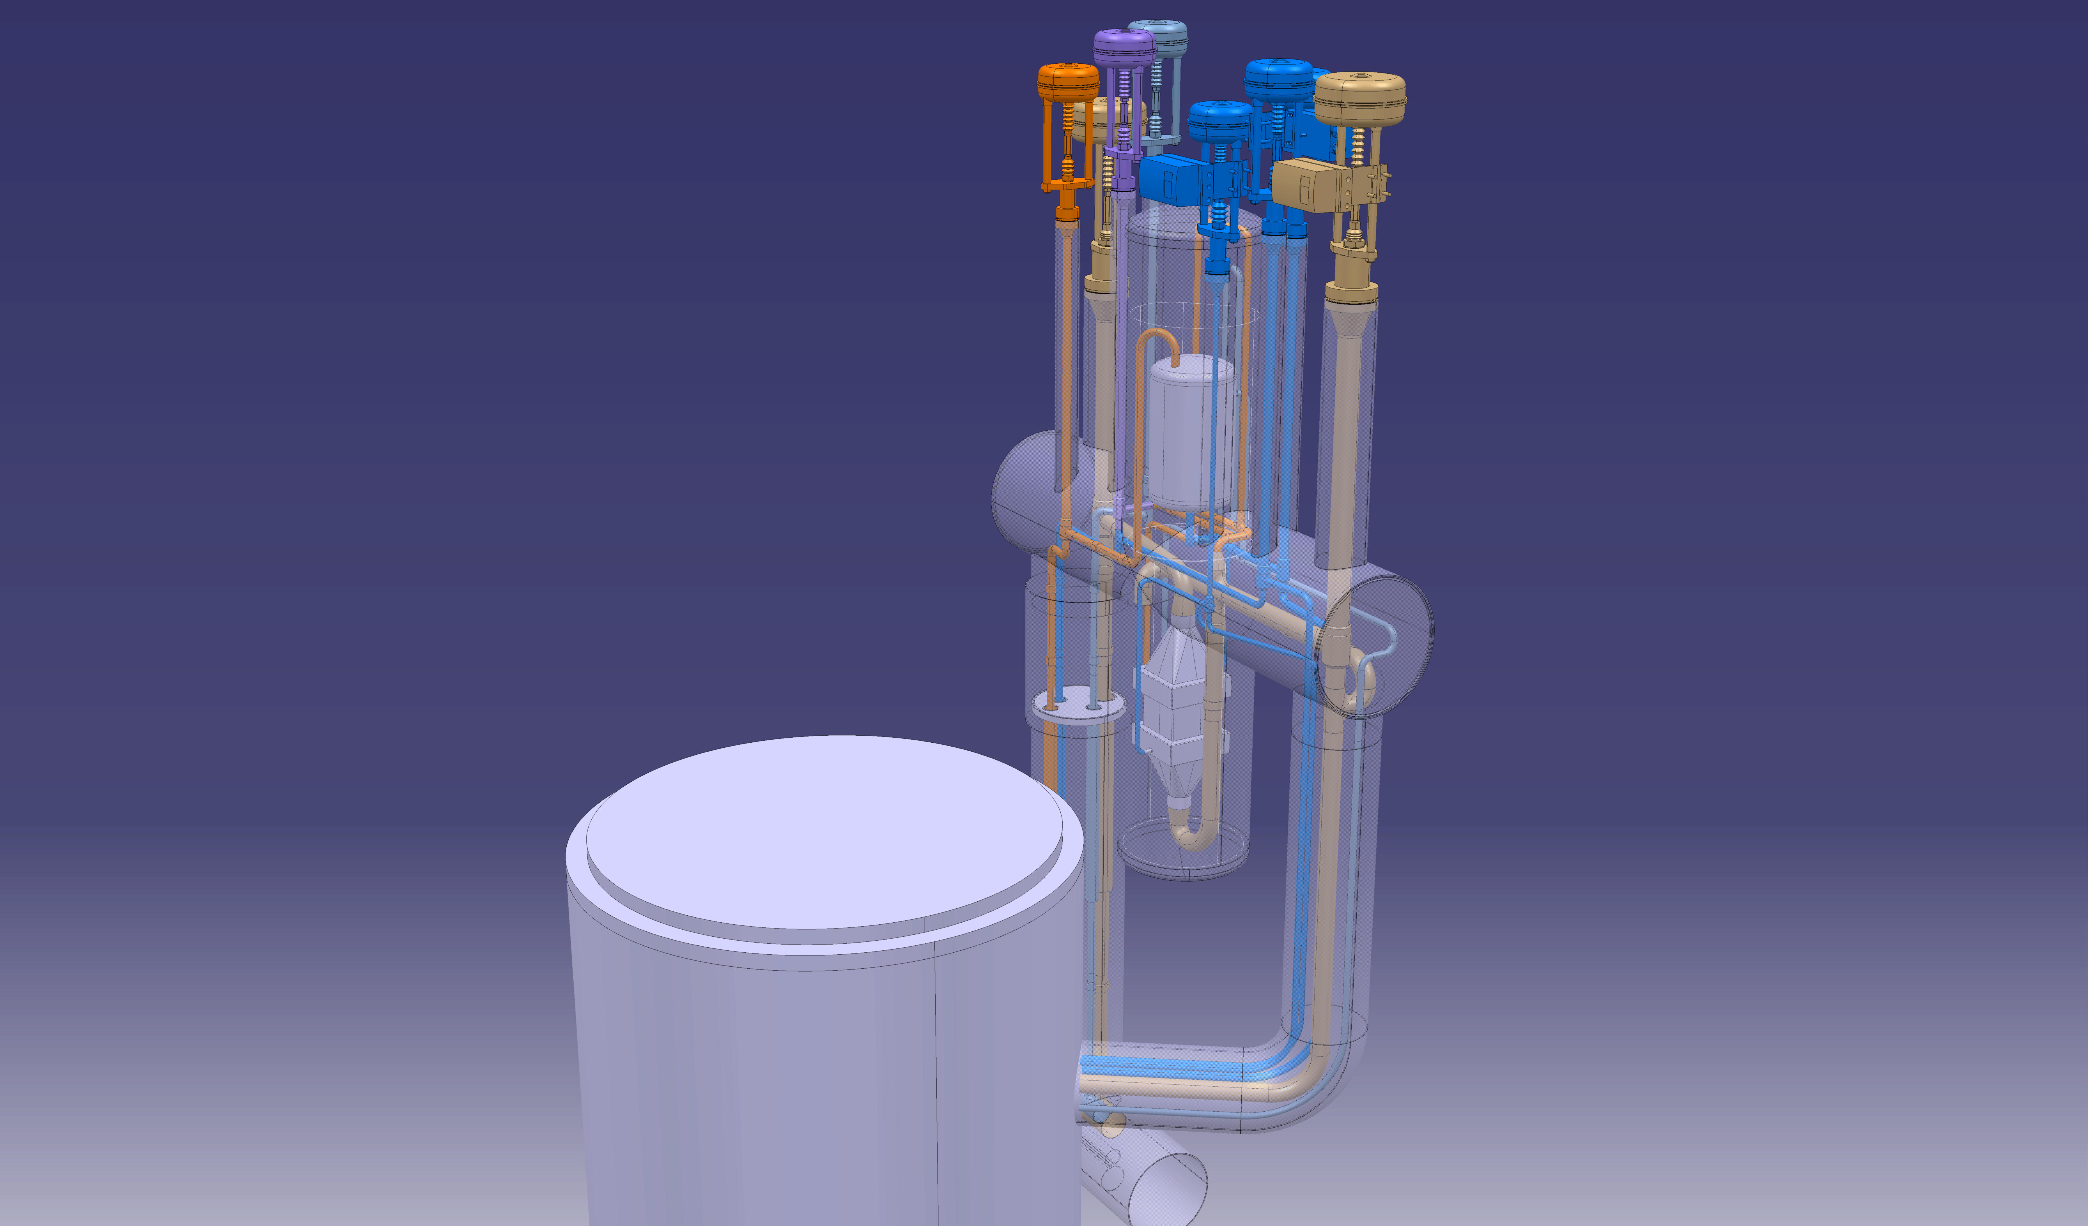
New cryogenic distribution in CERN SM18 RF
Cryo service module x6
V3 or V4 Cryostat
Rigid connection

Slide 4
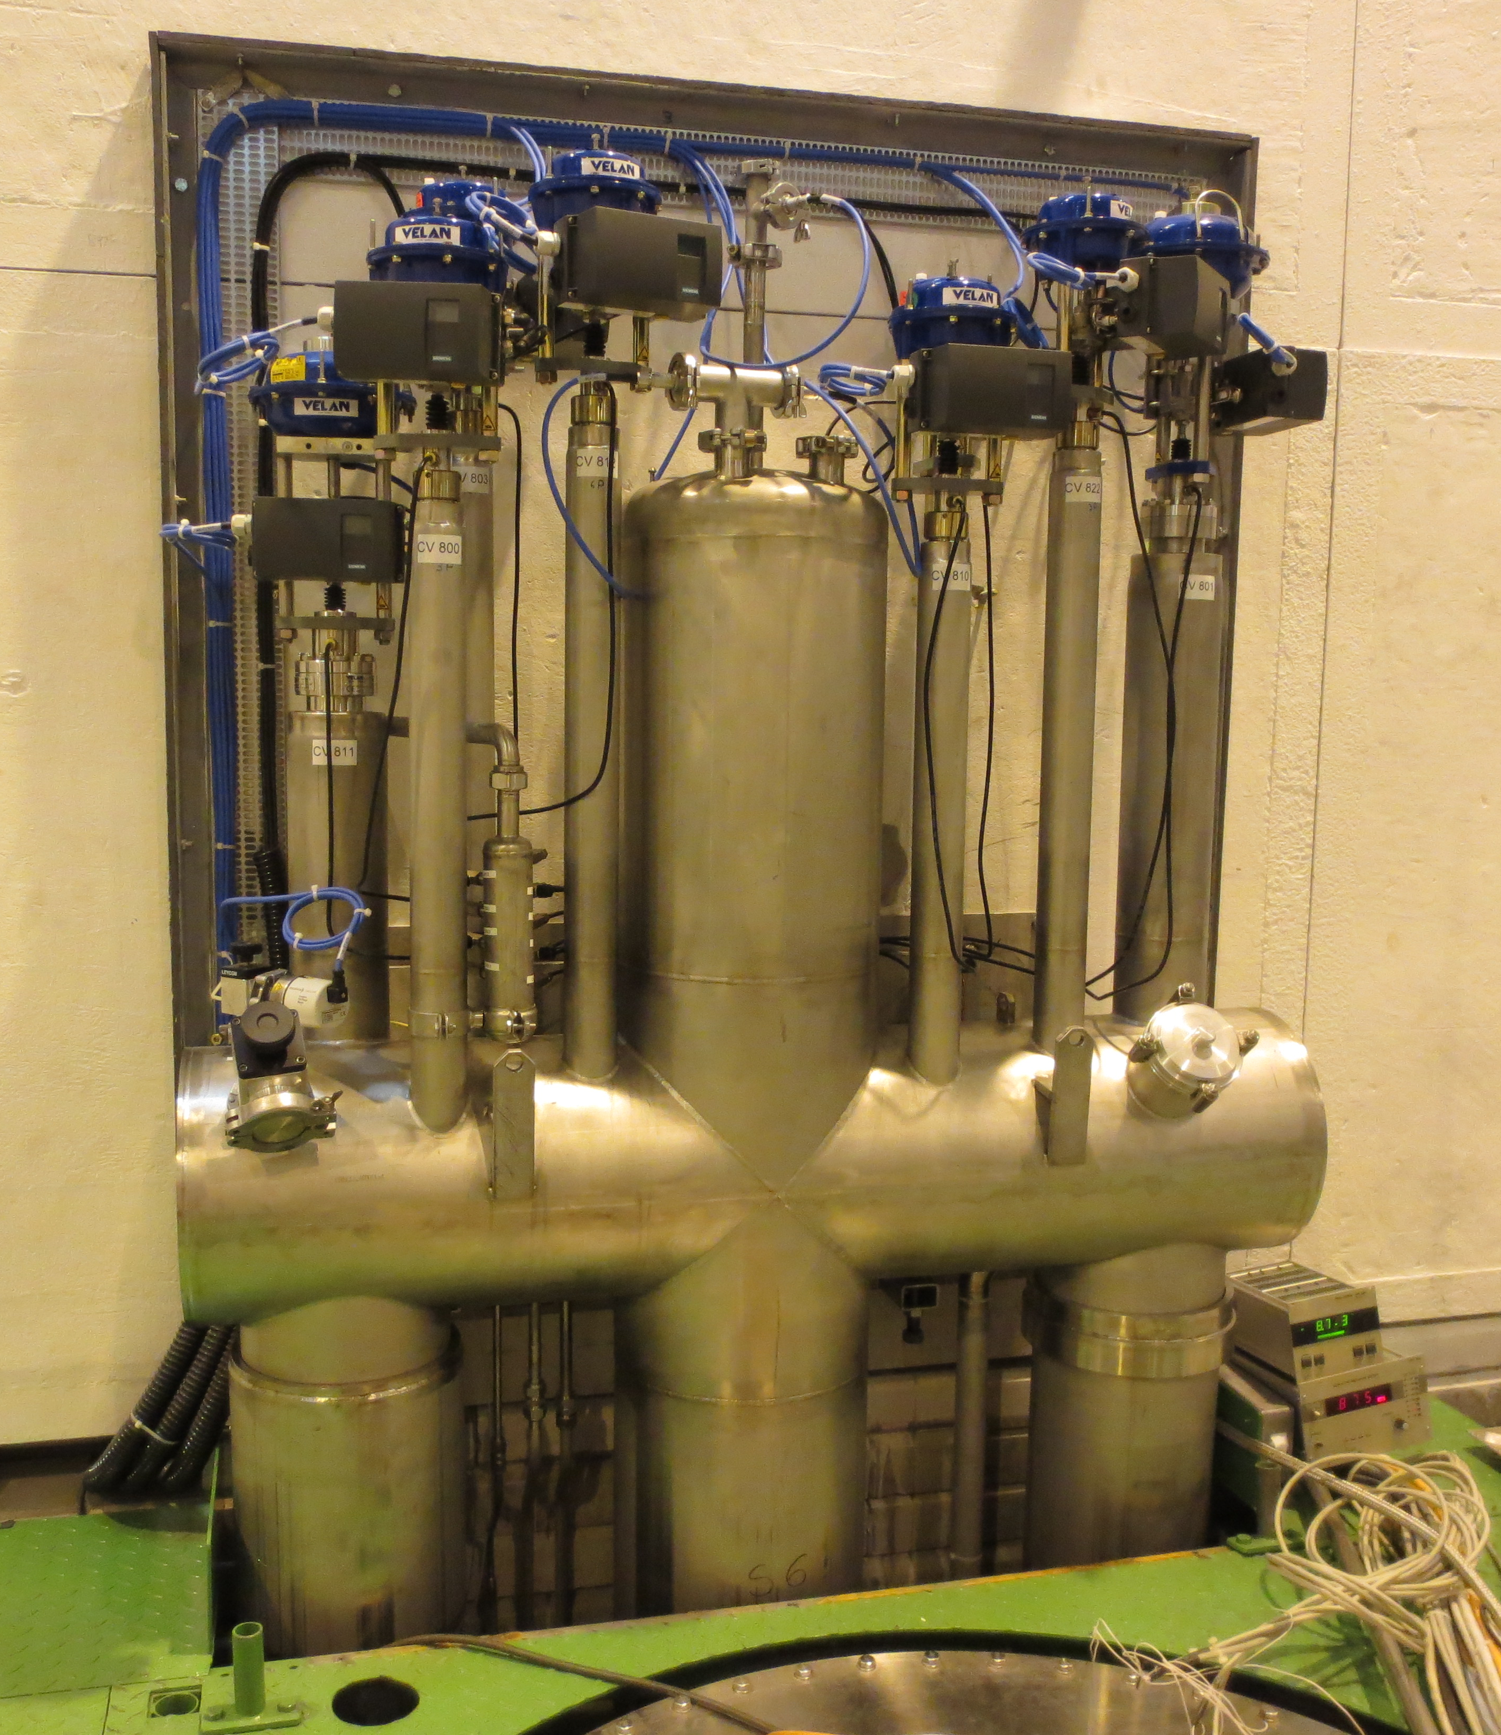
Vertical test stand V3
Commissioned in mid 2013
With He guard
Cryostat with active screening
Very efficient

Slide 5
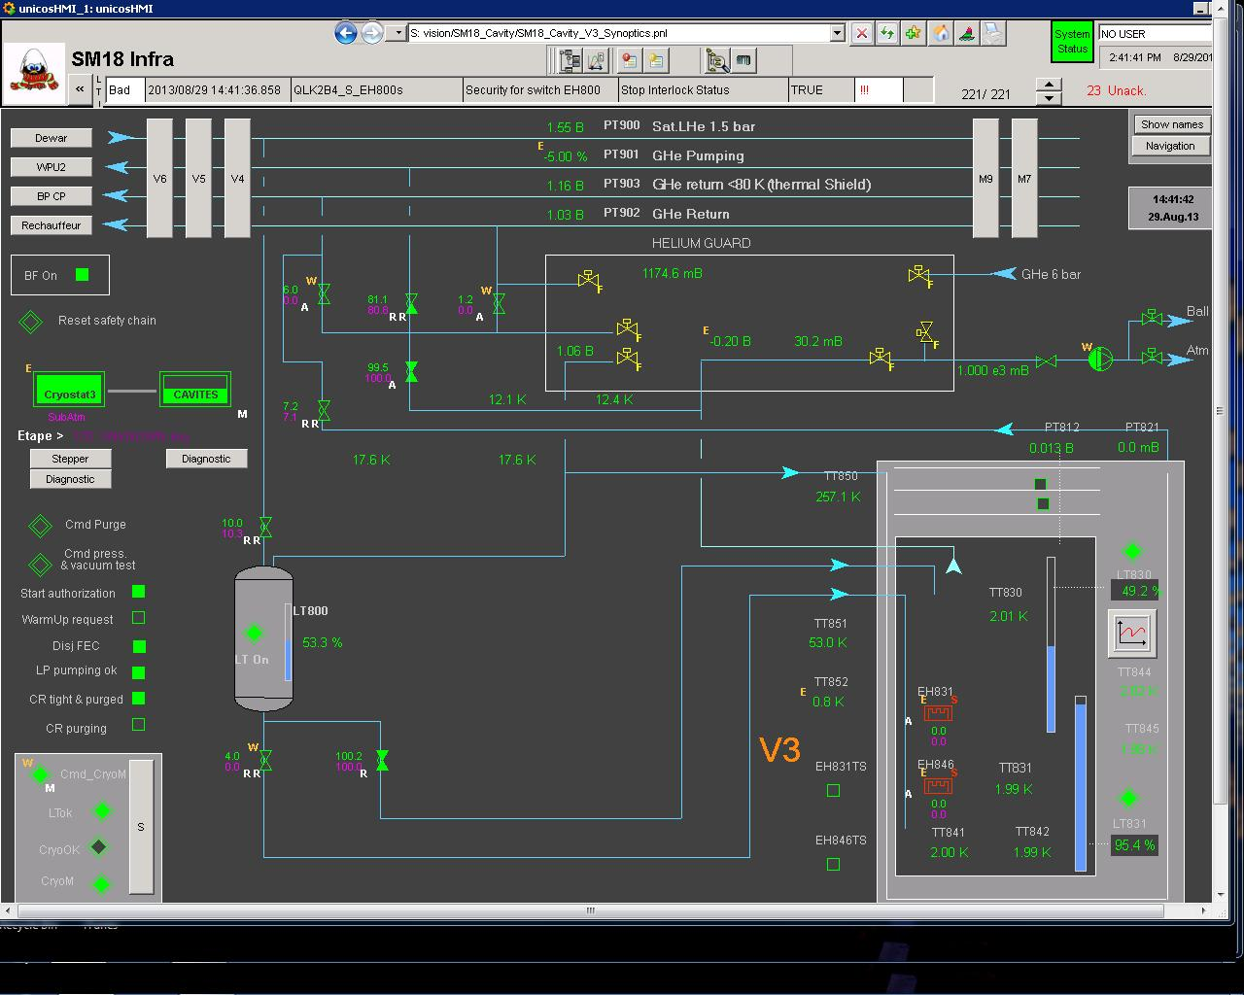
V3 Operated at 2k since August ‘13

Slide 6
Vertical test stands V3,V4,V5 and V6

Slide 7
  Horizontal bunker M7
V3
M7
V4
V5
V6
M9

Slide 8
  Horizontal bunker M7
New long term decision
As M9 will be used for :
  LHC cryomodule
  HIE-ISOLDE cryomodule
  And later FCC 400 MHz project
M7 will be used for :
  SPL half cryomodule
  CRAB cryomodule
  And later new LHC 800 MHz project
  -------> Need to redesign a multipurpose cryo box !!

Slide 9
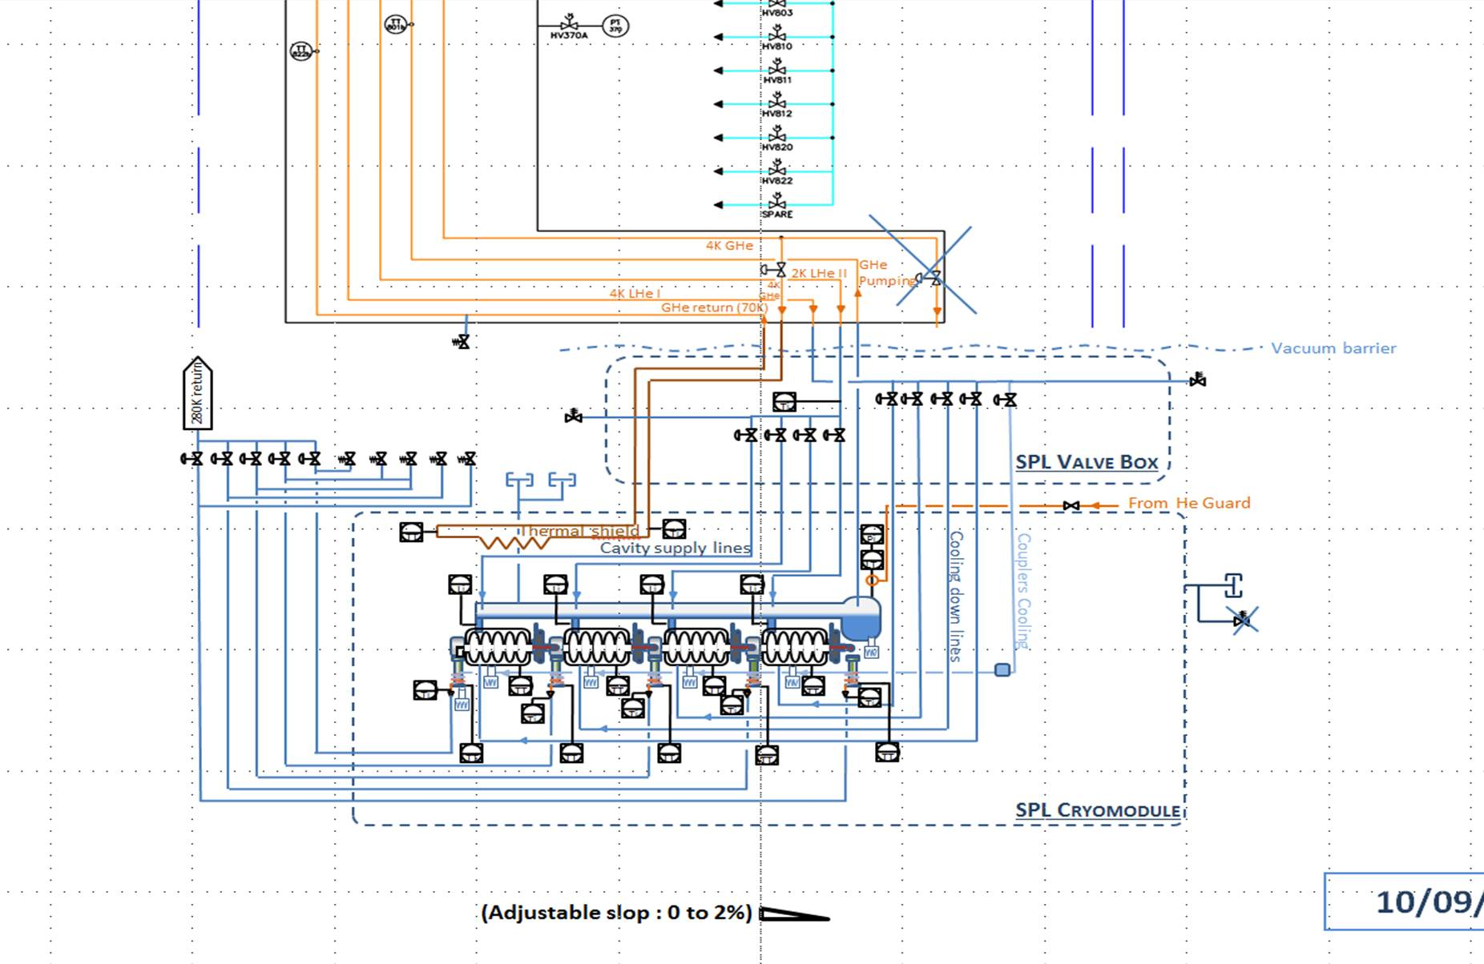
!!! To be redesigned !!!

Slide 10
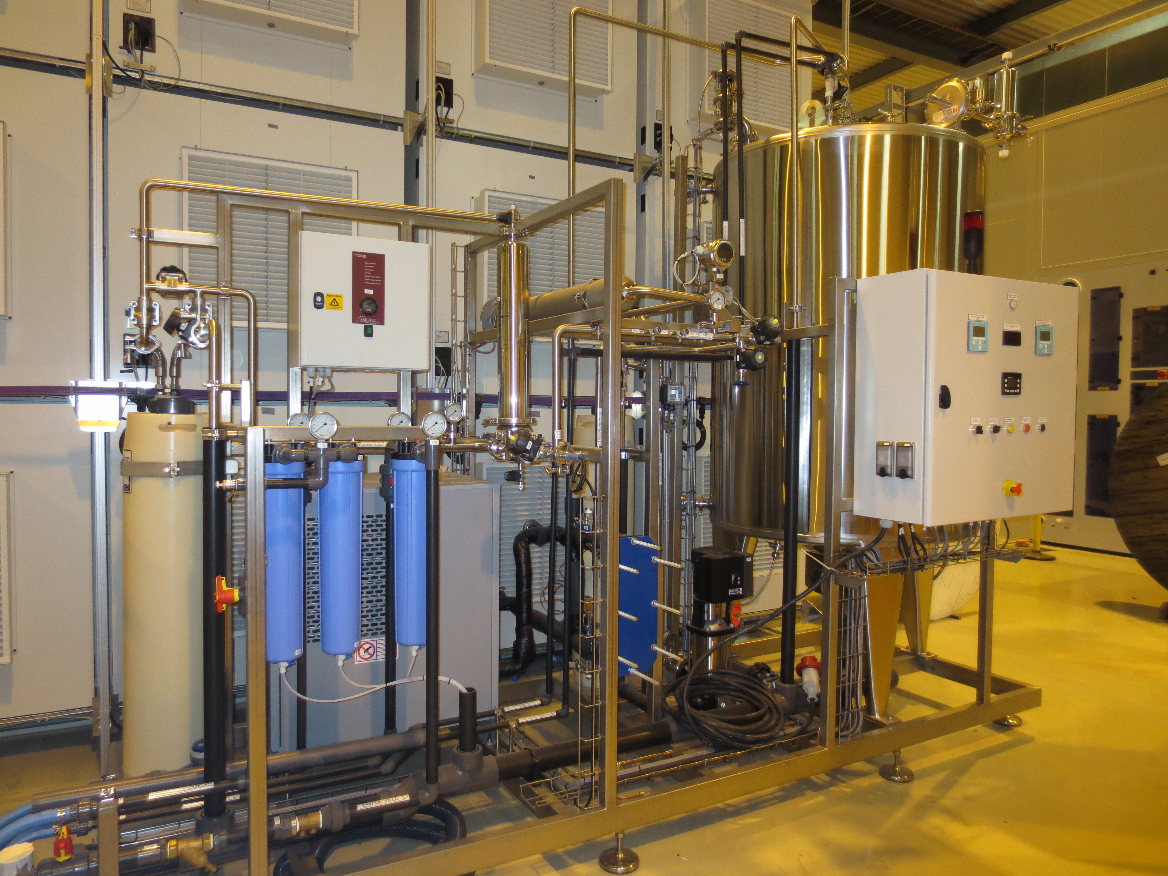
Ultra pure water production
Delivered and commissioned in Oct’13
Emptied and displaced for site
To be placed in final position and restarted…

Slide 11
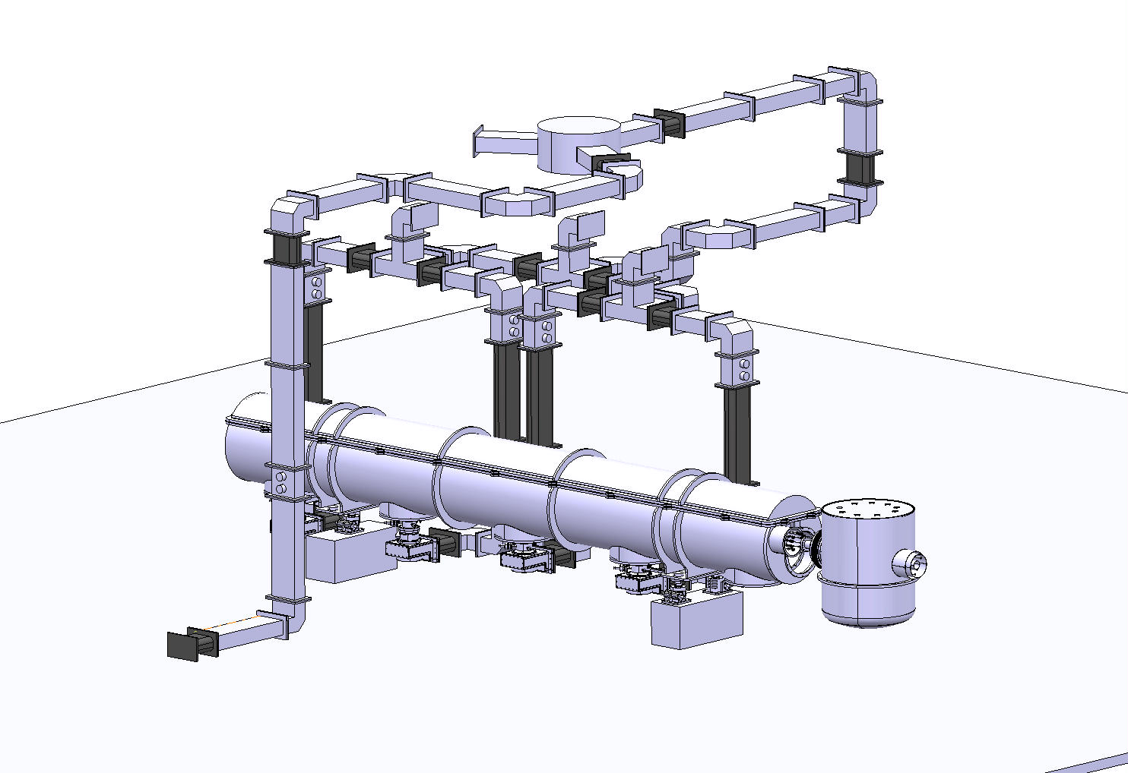
Wave Guides
Integration in M7 well advanced (BE/RF, EN/MME (drawing office))
  Power distribution
  Cryomodule (incl. slope)
  New standard 2 kelvin service module
Still to be done:
  Detailed integration of cryomodule repair scenarios
    (i.e. how to lift the top cover of the CM?)
  Cabling (RF and Cryo)
  SPL valve box to design & build

Slide 12
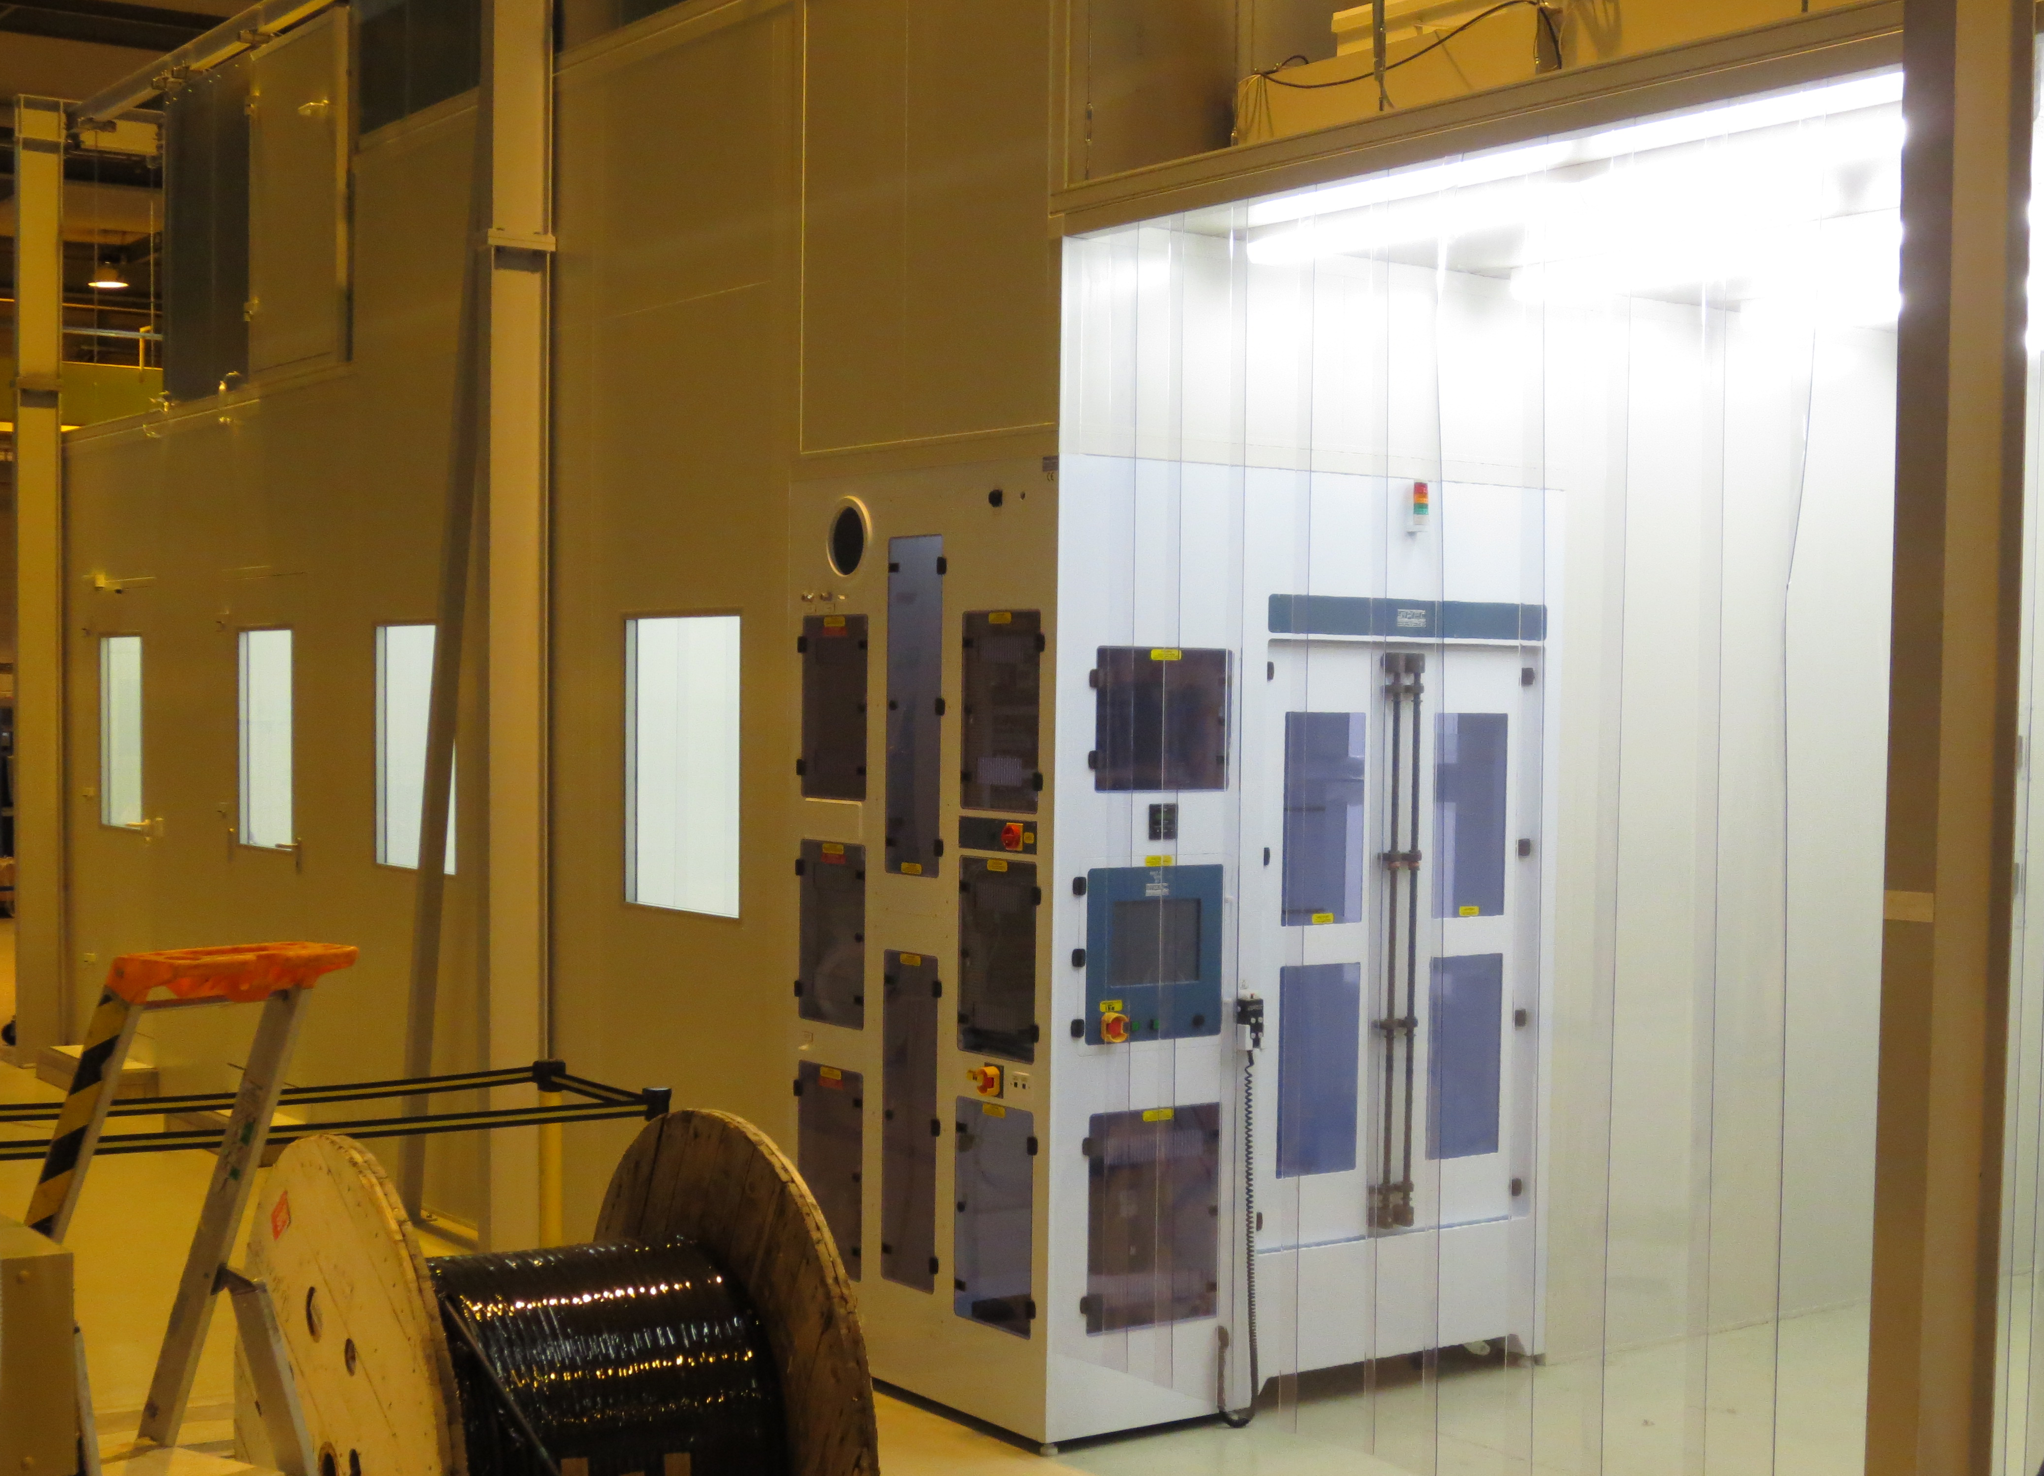
New Clean Rooms & HPR just coming to reality

Slide 13
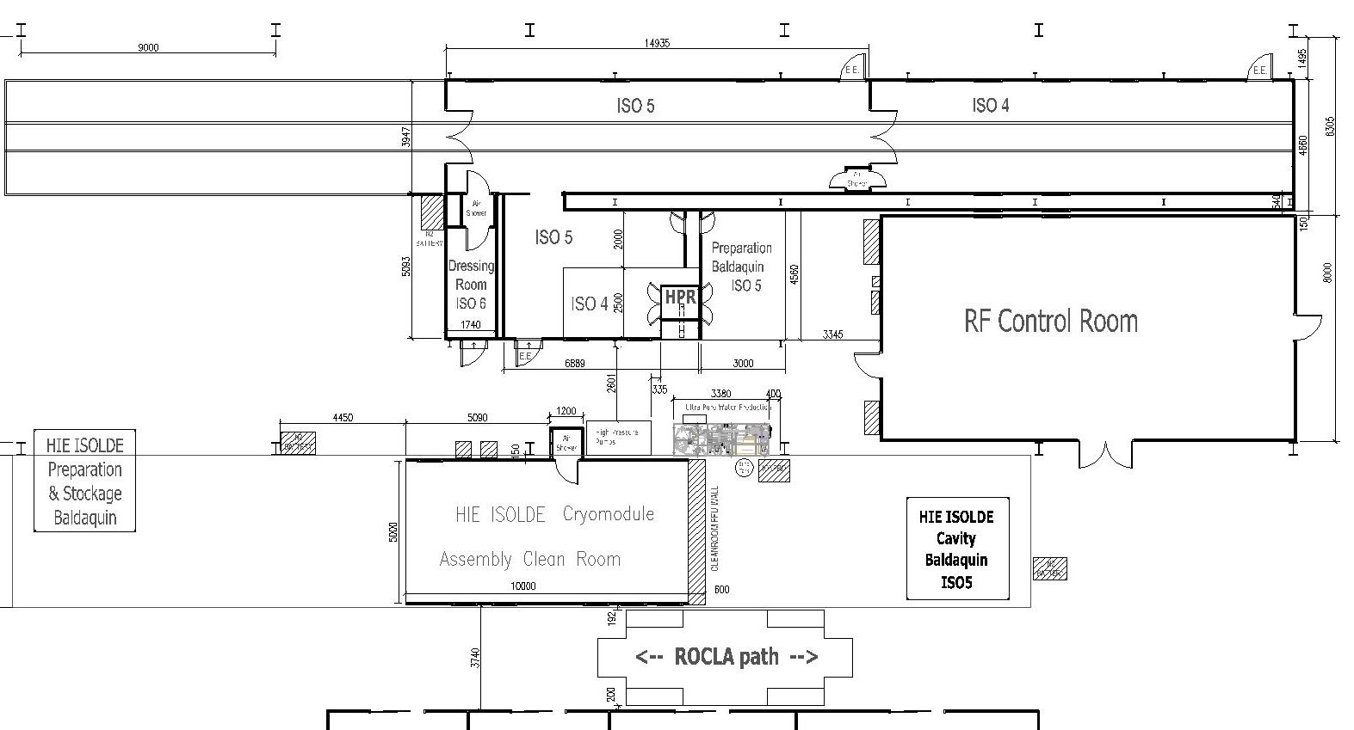
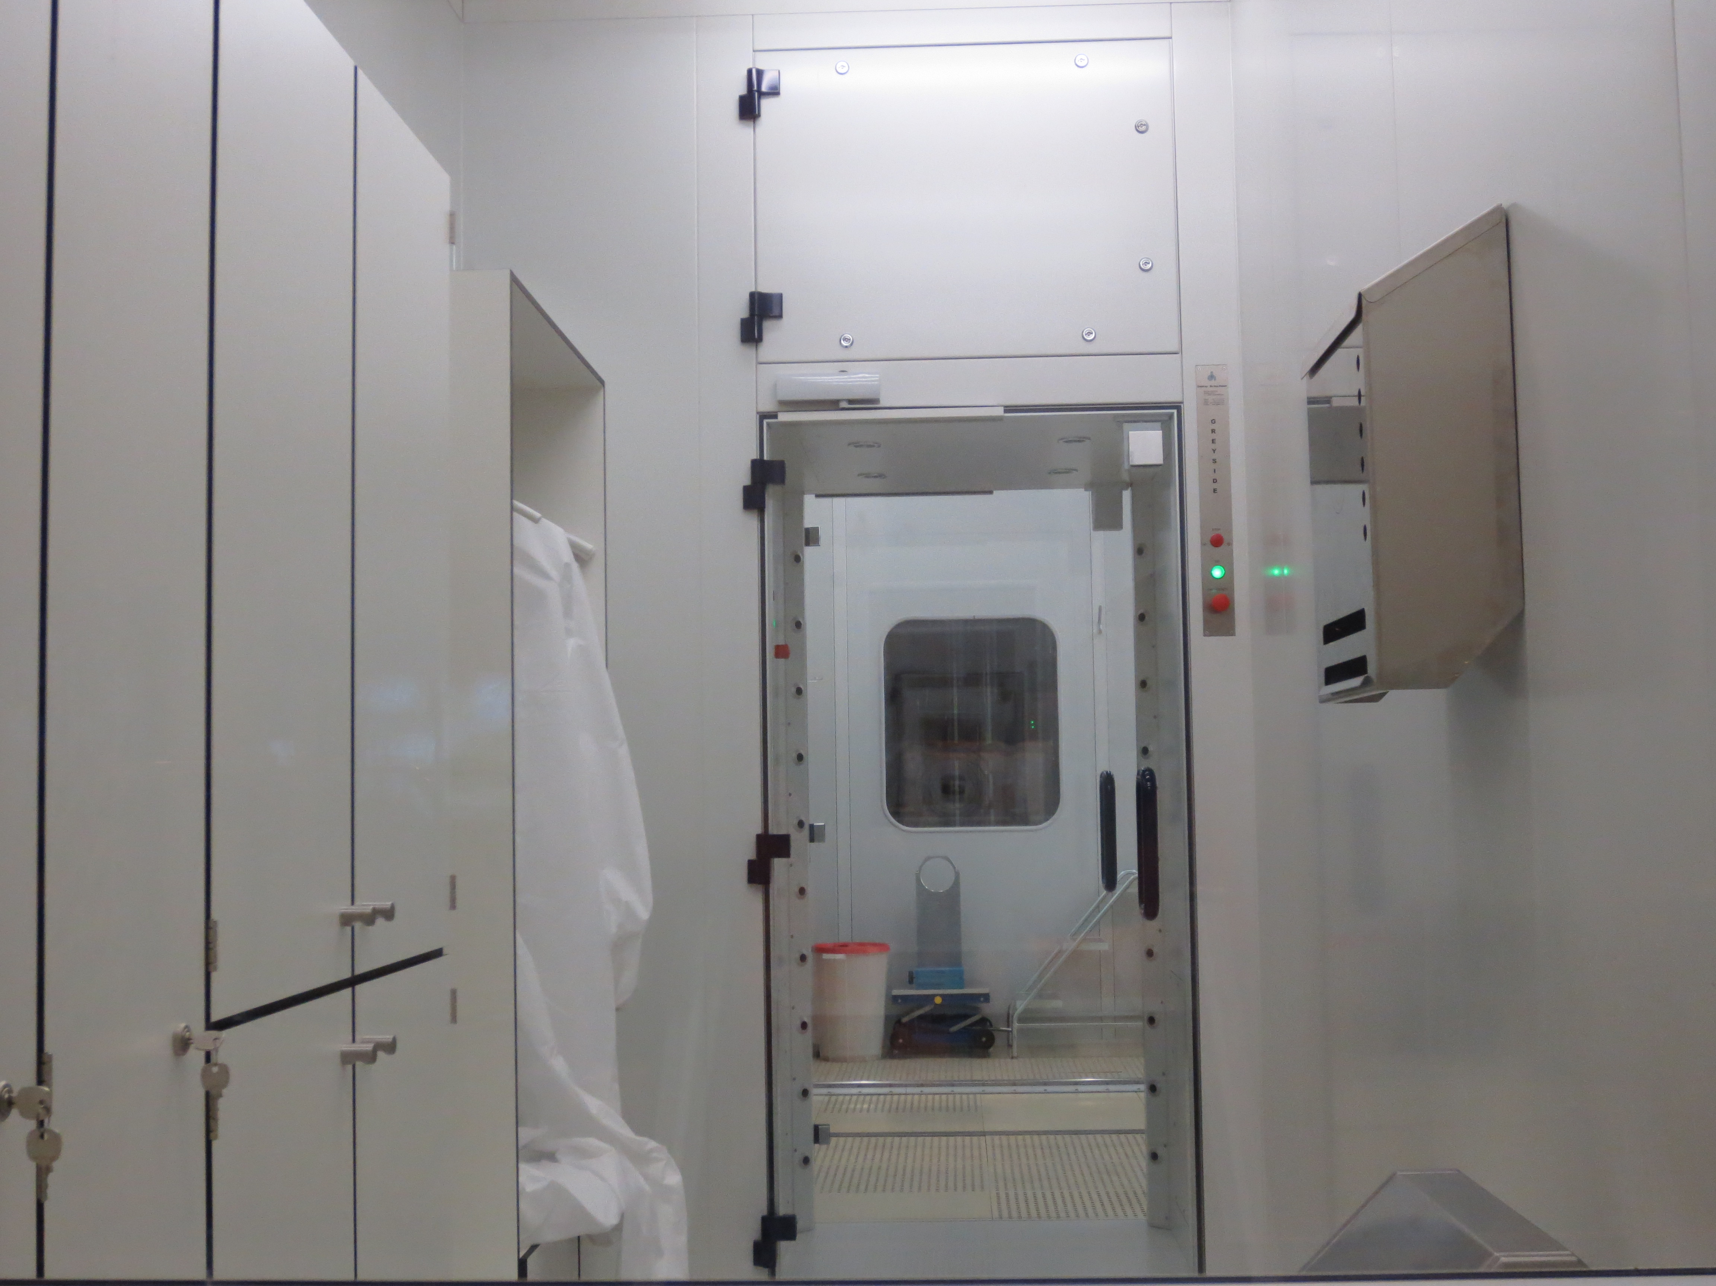
New Clean Rooms & HPR
15m long grey room for cryomodule preparation
15m long Cleanroom for cryomodule assembly
Cavity HPR & drying
Personnel entrance

Slide 14
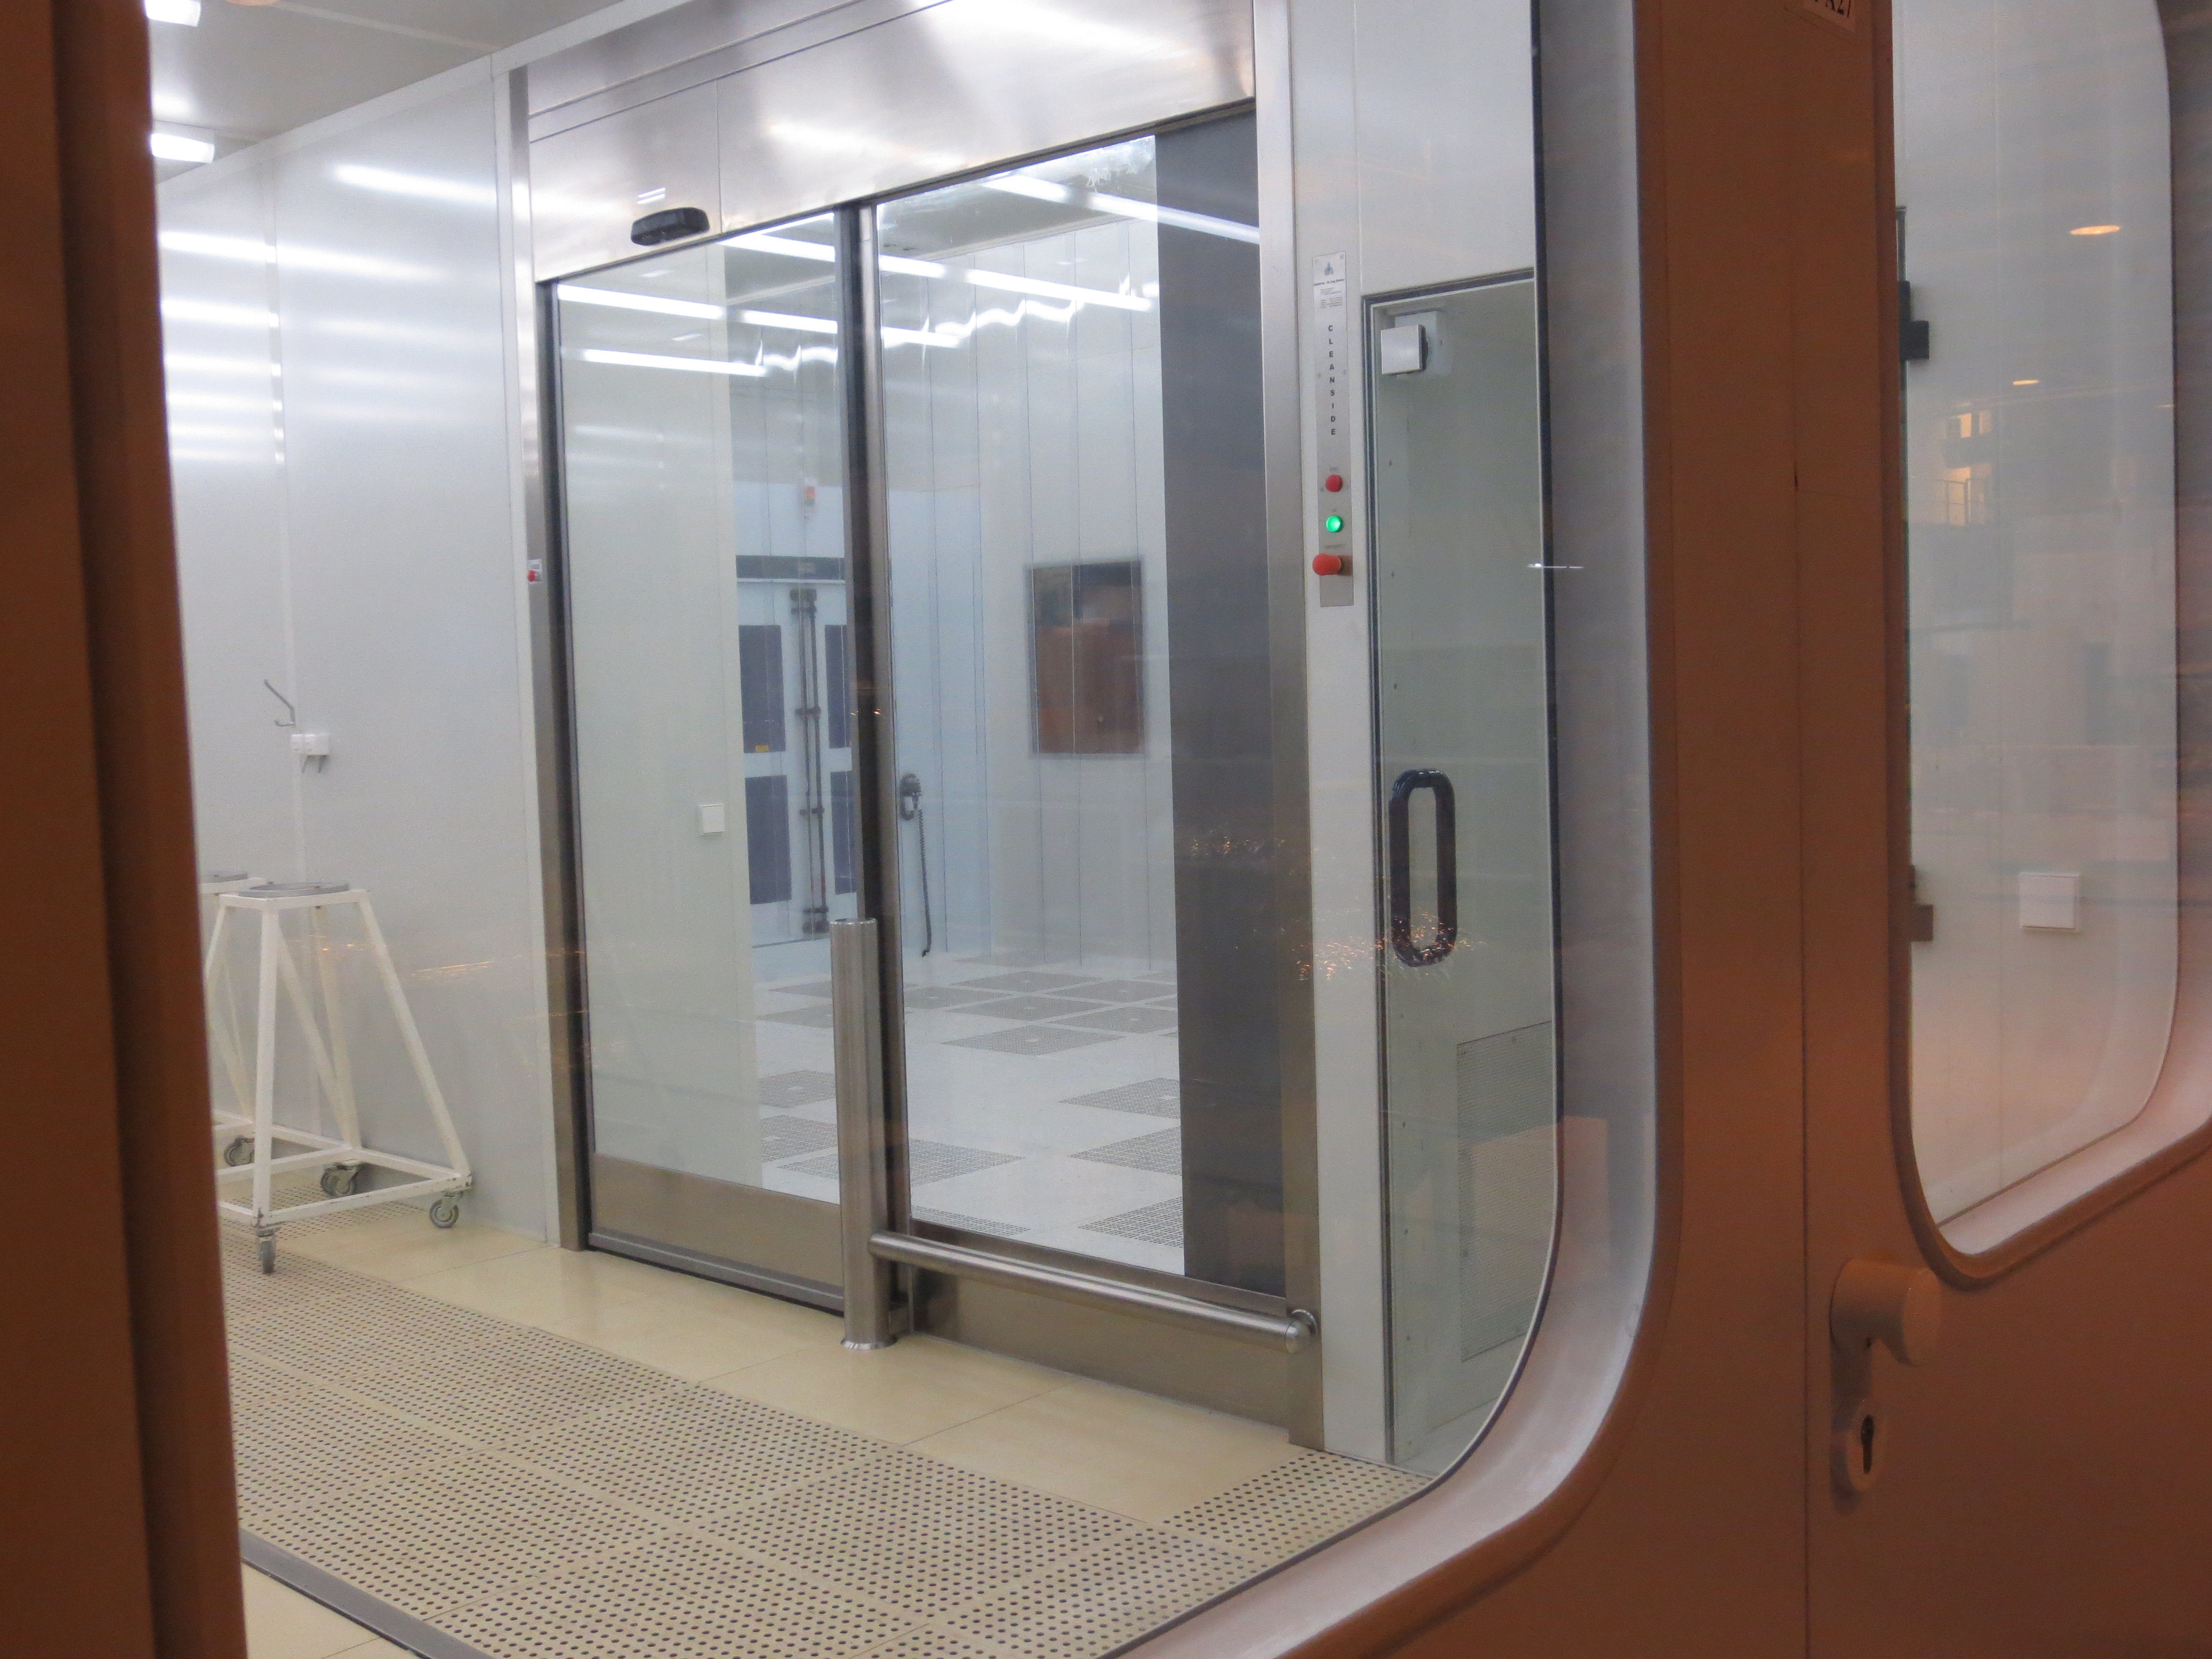
New Clean Rooms & HPR

Slide 15
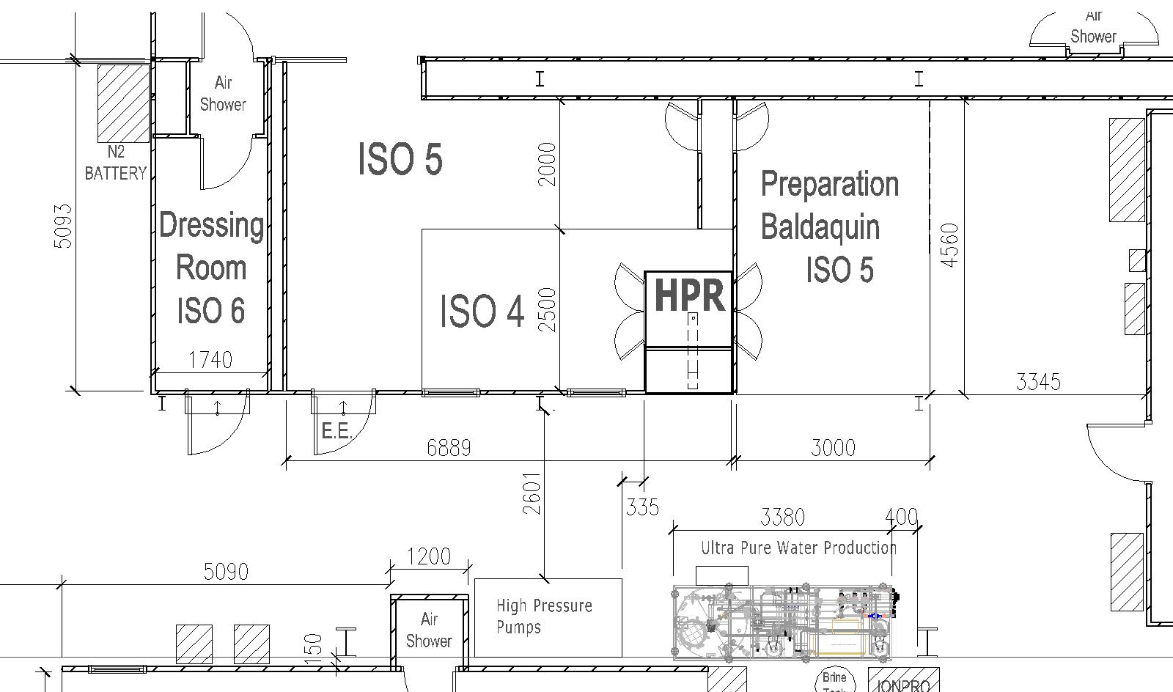
Cavity rinsing almost in operation
Accessories Preparation
High Pressure Rinsing
High Pressure Rinsing
Drying and flanges mounting
Possible warm N2 drying
Rinsing

Slide 16
Status & timescale (1)
Procurement of equipment:
  Klystron (1x): 1.5 MWp ordered, tested at Thales, ceramic window problem…
  Circulator (1x): ordered, delivery Summer ’14
  RF loads (3x): 1.5MWp ordered, delivery January ’13 OK
  Waveguides: special pieces (magic tees, bends, bellows) ordered at Mega Industries (USA) all straight parts from Spain delivered OK
  Modulator: delivery expected by mid 14 (tbc by D. Nisbet)
  Electrical power: 3*400V 300A reserved with 400A upgrade on ERD2/M18, cables pulled OK

Slide 17
Status & timescale (2)
Key dates:
  June ’14: First High Pressure Rinsing
  -> End Summer ‘14: CCDTL tests (Linac 4)
  September -> December ’14: SPL HPRF system installation : Modulator, klystron ?
    Providing the L4 RF tests are moved in Bld150 (3 MeV test stand)? (tbc by F. Gehrig)
Controls:
  HPRF controls: re-use the PLC system developed and installed for L4 test stand
  Cryomodule:
    RF controls expected to be ready by 2015 ( L. Arnaudon )
    Cryo controls to be defined ( TE/CRG ) Attention : New multipurpose cryo box !
  Low level ?

Slide 18
Thanks for your attention
Live visit of SM18 tomorrow afternoon
Questions ?

