Slide 1
Bolted joints and bolt calculator To torque or not to torque?
Dawid Patrzalek
European Spallation Source ERIC
22.10.2019

Slide 2
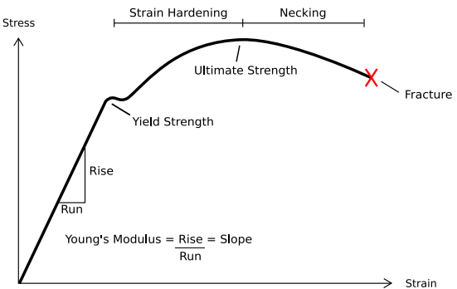
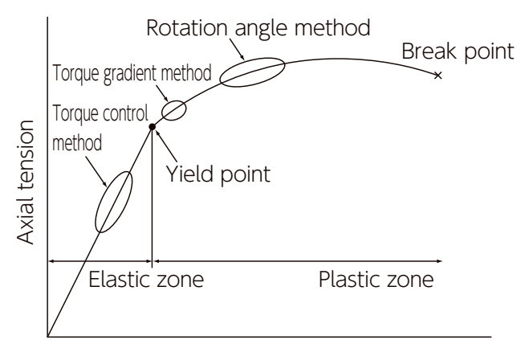
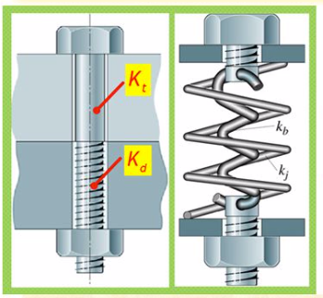
Why is it so important to accurately torque a bolted joints?
Not enough torque:
Bolted joints can be compared to springs: if a spring is not tensioned enough, it will not hold a connection as desired and it the worst case scenario can detach/ slip off on its own.
That same rule applies to bolts: if not torqued enough, the connection will not be stiff enough and there is a risk of bolts undoing themselves.
Too much torque:
Again, let’s compare bolted joints to springs: if a spring is elongated too much, it will plastify and loose its tensioning properties.
That same with bolts: if over-torqued, a bolt will elongate too much and plastify.

Slide 3
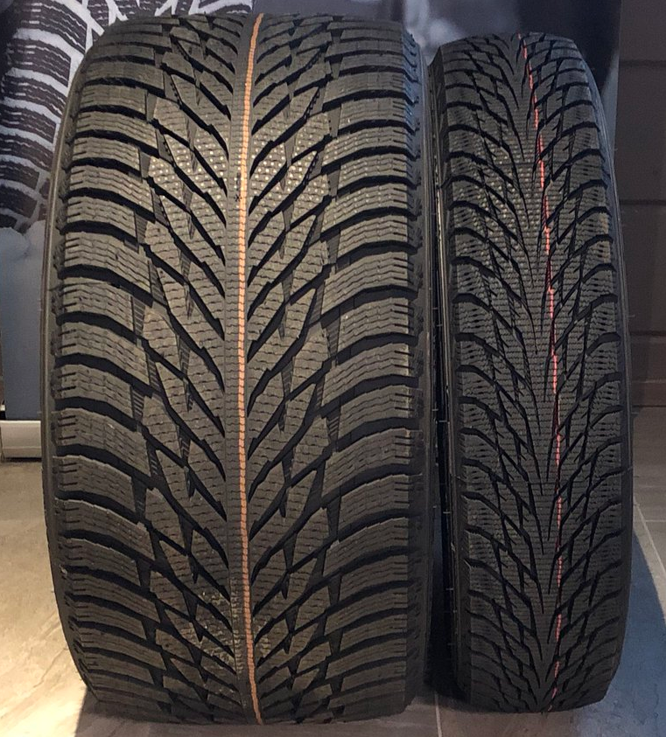
Understanding friction
Why do more powerful cars have wider tyres compared to weaker cars?
Notes:
Tire load sensitivity

Slide 4
Understanding friction
F_{f=}μ*N [N], where:
μ – coefficient of friction
N – normal force [N]
Surface has nothing to do with friction!

Slide 5
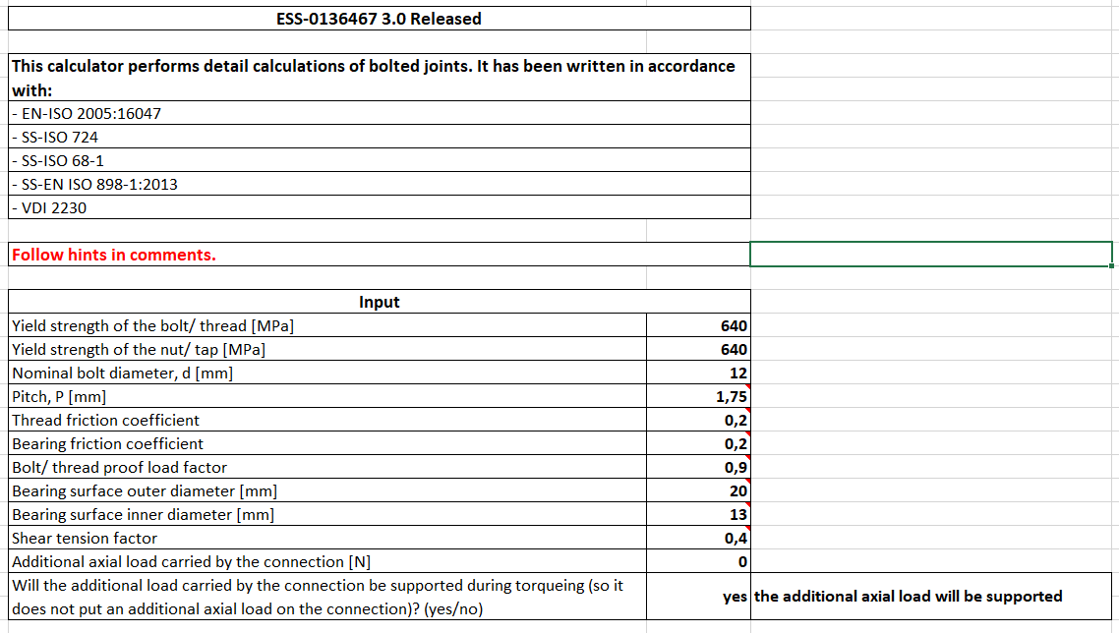
Switching to the calculator
ESS-0136467

Slide 6
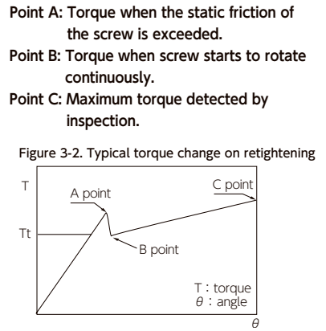
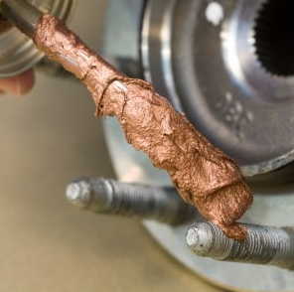
Understanding friction
Remember - static coefficient of friction is higher than kinetic!
So what, why does a static and kinetic coefficient of friction matter for torqueing?
Lubricate or not to lubricate?

Slide 7
Tightening procedures
Tohnichi Torque Handbook
Source: Tohnichi Torque Handbook

Slide 8
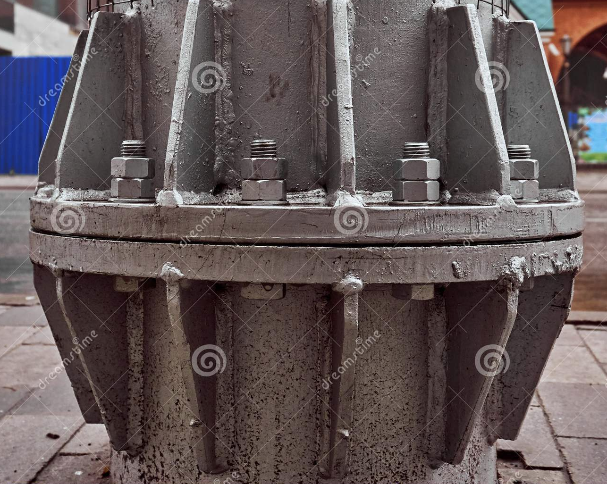
Tips and trics
Design bolts as long as possible – it is easier to control torque and loosening possibility is lower
Require lubrication of bolts – it protects agains corrosion/ seize and torqueing is more accurate
Head down, nut up!

