Slide 1
Catia Macros for PBI
Thomas Grandsaert
Development Engineer – MET/Diagnostics
European Spallation Source ERIC

Slide 2
Problem #1
Identifying BLE locations in the ESS EPL model

Slide 3
Demo #1
Identifying BLE locations in the model
DEMO #1
Function: Search for all parts with a specific title within an entire assembly tree
Link to script:
script #1

Slide 4
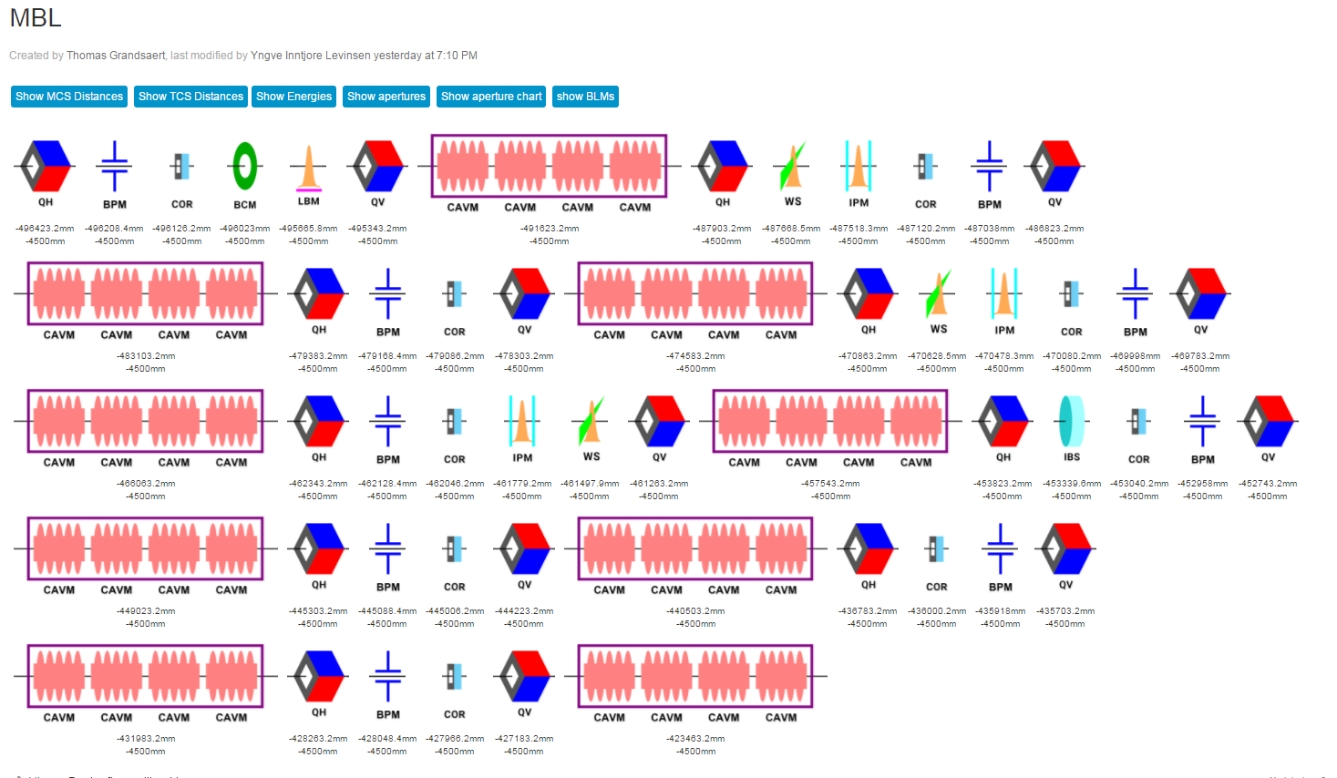
Problem #2
Generating the ESS Skeleton from the ESS BP Tracewin Lattice

Slide 5
Demo #2
Generating the ESS Skeleton from the ESS BP Tracewin Lattice
DEMO #2
Function: Generate axis systems and design table from excel file (csv)
Link to scripts:
script #1
script #2
Note: names must
be the same in Catia VBA!

Slide 6
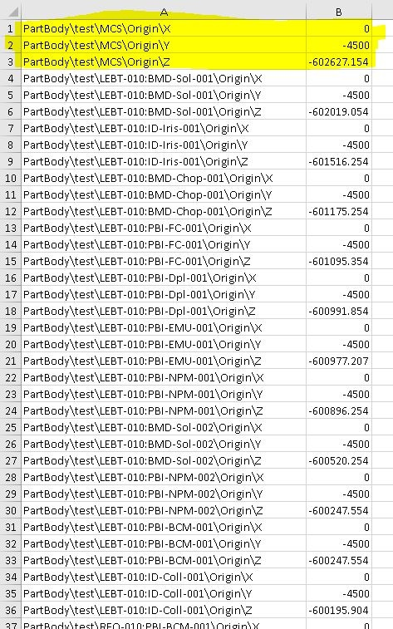
Problem #2
Generating the ESS Skeleton from the ESS BP Tracewin Lattice
ESS-0485335 – Approved 12/12/2018

Slide 7
Questions/Finale
Thank you!
^^;

