Slide 1
European Spallation Source CATIA FORUM Feedback from a user…
Nicolas BRETON
Design engineer
European Spallation Source ERIC
2019-10-17

Slide 2
SUMMARY
1- Design Workflow
2- Productive functionnalities
3- Problems solved

Slide 3
DESIGN WORKFLOW
Initial Release workflow : 20 steps
Drawing change Release workflow : 25 steps + 1 per drawings
Material change Release workflow : 33 steps + 2 per parts + 4 per assembly
CAD & Drawing change release workflows : 34 steps + 2 per parts + 4 per assembly
Small project : 10-15 parts / 2-3 Assemblies
Drawing change => 37-43 steps
CAD & Drawing change => 62-76 steps
Medium sized project : 50-100 parts / 6-10 assemblies
Drawing change => 81-135 steps
CAD & Drawing change => 158-274 steps
Large project : 100-500 parts / 10-20 assemblies
Drawing change => 135-545 steps
CAD & Drawing change => 274-1112 steps
Indicative numbers :
Std User does 1000clicks/hour
5-6 hours of computer/day
5000-6000 click per day
2-30 clicks per steps
2000-4000 click for medium sized project for each change

Slide 4
DESIGN WORKFLOW
Initial Release workflow : 20 steps
Drawing change Release workflow : 25 steps + 1 per drawings
Material change Release workflow : 33 steps + 2 per parts + 4 per assembly
CAD & Drawing change release workflows : 34 steps + 2 per parts + 4 per assembly
Practical example :
Conceptual design - review before PDR (LoM A)
Geometry change
Material update
Conceptual designed - approved during PDR (LoM A-B)
Detailed design - send for review before IDR
Geometry change
Material update
Detailed design - released for IDR (LoM C)
Drawing production - send for review before CDR
Geometry change
Material update
Drawings update
Detailed design and Drawings - released for CDR (LoM P)
Typical scenario
Well managed / Lucky project => 200 steps
Small project => 150 steps
Small unlucky project => 300-400 steps
Possible interferences :
If I forgot to change one Level of maturity =>15 steps
If one of the parts is not in the right Maturity state => 10steps
If I forgot to update the title block => 25 steps + 1 per drawing
If I forgot to update the computed weight => 34 steps + 2 per parts + 4 per assemblies
If I called the wrong revision in one of the assemblies => 34 steps + 4 per assemblies
If one balloon is wrong on my drawing => 25 Steps
Practical example :
Conceptual design is done and send for review before PDR (LoM A)
Request to change material -> Material update
Interference problem -> Geometry adjustment
Technical solution change -> Geometry adjustment
Conceptual designed is approved during PDR (LoM A-B)
Detailed design is done and send for review before IDR
Request for material change -> Material update
Geometry optimization
Optimization for manufacturing
Detailed design are released for IDR (LoM C)
Drawing production is done and send for review before CDR
Drawing review -> Updated and modification
Geometry changes -> Drawing updates
Request to change material -> Material update
Interference problem -> Geometry adjustment
Communication with manufacturer -> Geometry change / Drawing update
Detailed design and Drawings are released for CDR (LoM P)

Slide 5
DESIGN WORKFLOW
Improve our workflow :
Material update to include into the workflow process
Title block update included in the workflow process
Drawing update in CATIA after CHESS Release
Workflow functionalities :
Possibility to create revision on a drawing only ( Not his product / part)?
Level of Maturity could be defined ONLY by CHESS in the workflow to avoid any LoM Mistake or back and forth?
Why do we need to select all inner components within a assembly in CHESS ( Change Order) if it is a requirement to release all ? Can it be automatized ?
Forbid changes when a components is none editable ( Released – Review – Approved)?

Slide 6
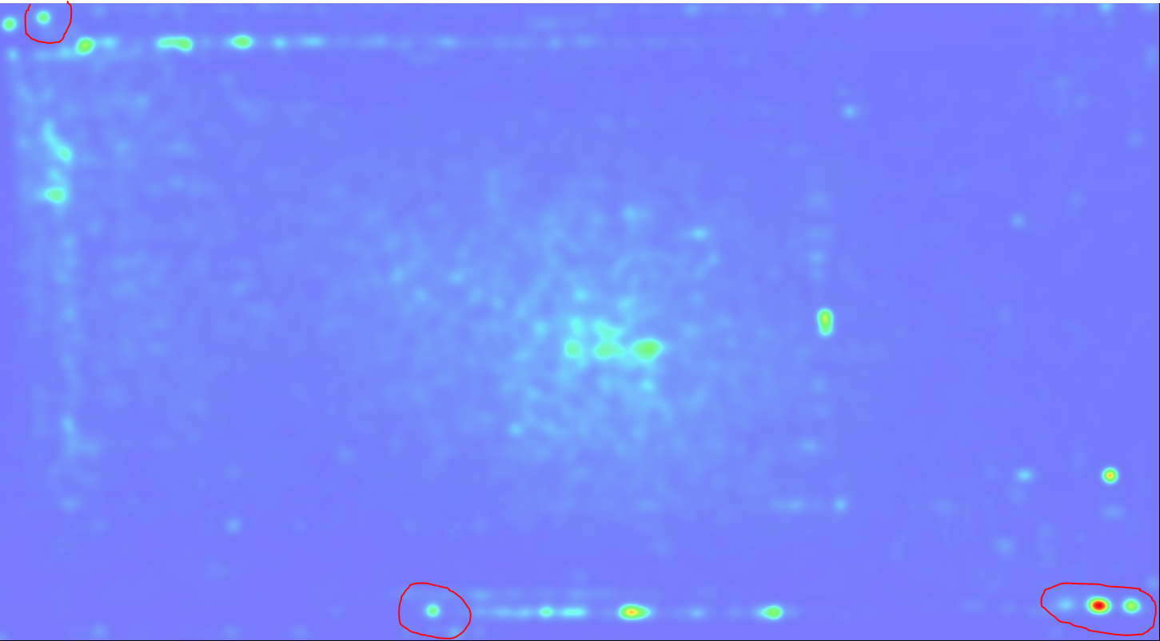
DESIGN ENVIRONEMENT… Soon
Click Heatmap Analysis :
70 000 Clicks
2 weeks time
CATIA Filtered
Application switch
Confirm click of
pop up windows
( Enter doesn’t work)
Update

Slide 7
PRODUCTIVE FUNCTIONALITIES
Suggestions :
Export STEP without having to save
Batch printing in Catia ( multi-selection to investigate)
No connection between balloons and BOM
BOM Export in csv, xls, txt, …
Exploded view module…
“Continuous "Update mode ( do not interrupt at error etc)
Center of gravity Creation

Slide 8
PROBLEM SOLVED
Create a revision on a modified document (Unload/Reload the document)
Difficulties deleting drawings from assemblies (Action sequence to be carefull)
Material connection lost ( reload materials ATTENTION)
Importation of STEP / CGR and few others ( clear cache etc)
When selecting overloaded view ( going to 3D is allowed) update confluence method
Material connection lost ( reload materials)
Batch application of materials (By clicking on each before validatation=

Slide 9
DESIGN WORKFLOW
Initial Release workflow : 20 steps
Open With Product Finder
Switch to the Lifecycle app
Expand all
Select all with filter
Open Sheet editor
Change level of maturity where appropriate
Select all with filter
Change the Maturity to Review
Change the maturity to Approved
Collaborate the EBOM
Open Chess
Create a change Order & Change action
Attach to the change order products to release
Enter structures
Expand to all levels
Select all to release with filter
Add to the CA
Enter Workflow
Create the Workflow template
Start the workflow

Slide 10
DESIGN WORKFLOW
CAD & Drawing change release workflows : 34 steps
Open with product finder
Switch to lifecycle app
Expand all
Select all with filter
Change the Maturity to Review
Change the maturity to Preliminary
Open in assembly app
Apply changes where needed
Open BI essential
Select complete assembly
Recalculate general weight
Select and open all drawings
Apply changes where needed
For parts : Title Block update
For assemblies : Open the Title block update Update the title block
Open the Title block update Update the title block
Delete existing BOM
Create new BOM
Edit Columns
Reorder if ordering was made ( WARNING BALLOONS)
Update Hatching on various views
Open With Product Finder
Swith to the Lifecycle app
Expand all
Select all with filter
Open Sheet editor
Change level of maturity where appropriate
Select all with filter
Change the Maturity to Review
Change the maturity to Approved
Collaborate the EBOM
Open Chess
Update the Structure and item fields ( Check and control)
Start the workflow

