Slide 1
MAX IV War Stories
or
Experiences from the commissioning of MAX IV beamlines
Paul Bell (KITs)
JACC II Tuesday March 10th 2020

Slide 2
Basic parameters
Linac, 1.5GeV and 3GeV accelerators
16 funded beamlines
Approx 10 controls software engineers
  => approx 2 “activities” per person
Until 2014 focus was mainly the accelerator control system, since 2015 it has been commissioning of beamlines, more recently a move from (slow) controls into (fast) DAQ for the beamline endstations.

Slide 3
Very Approximate Commissioning Timeline
NanoMAX
MaxPEEM
FemtoMAX
BioMAX
FlexPES
CoSAXS
HIPPIE
Balder
FinEST
Species
Bloch
Veritas
2015
Commissioning
2016
Operation
2017
2018
2019

Slide 4
Very Approximate Commissioning Timeline
NanoMAX
MaxPEEM
FemtoMAX
BioMAX
FlexPES
CoSAXS
HIPPIE
Balder
FinEST
Species
Bloch
Veritas
2015
As of December 2019
- 7 beamlines in user operation
- 5 in commissioning
- “lucky” not everything in parallel
(KITS one of many constraints)
2016
2017
2018
2019

Slide 5
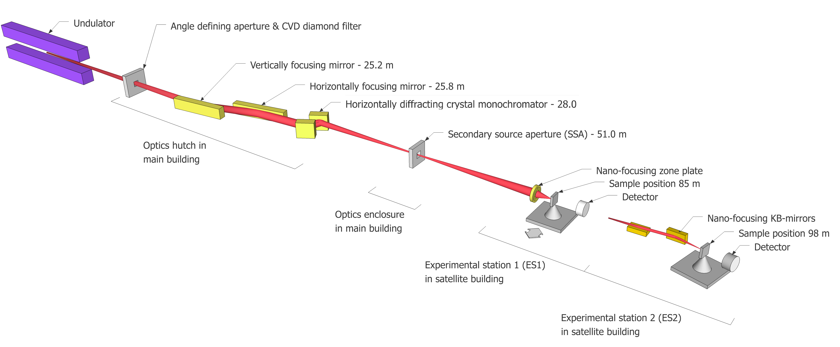
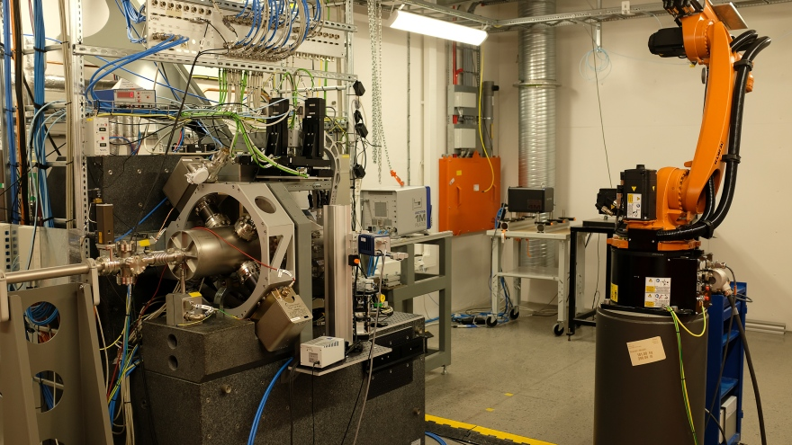
KITS timeline
Users
- Give support in early days
- Ongoing development
- new equipment
- more advanced use cases
Users – 2y = preparation
- create control system
- vacuum, optics...
- “standard elements”
=> mainly configuration
Users – 1y = commissioning
- end station control + DAQ
- specialist equipment e.g. detectors
- development and testing

Slide 6
NanoMAX - background
One of the first beamlines to enter commissioning & receive users (with BioMAX)
  Very long commissioning time, expert users as early as 2015, > 1 year before first real users
  A lot of controls system development in that time (“flyscan” motion of sample + trigger)
A classic MAX IV beamline from control system POV, technically & organisationally:
  Make use of existing standard tools to achieve basic day 1 functionality:
    Sardana for orchestration of Tango devices
    Lima for detector control and data acquisition
  No dedicated controls system developer at the beamline: a KITS contact with shared work in the team
Complex in terms of detectors and data rates:
  Multiple detectors: 4 pixel area detectors, 1 SDD and 1 Ge with Digital Pulse Processor
  Aim for hardware sync of detectors and flyscanning, continuous motion of the sample on a stage while detectors triggered in time, 100Hz frame rate

Slide 7
NanoMAX – evaluation of approach
Use of existing tools/frameworks can provide for day 1 operation with minimal development effort but may not give best performance
  Can be inefficient if these tools end up taking a lot of resources to adapt to specific use case e.g. Lima for detectors. At some point, doing something custom becomes better value.
No dedicated controls expertise at beamline
  - a lot of work for KITS
  + we retain understanding and control, keep to standards, easier to support in long term
  - may not address all of the beamline needs
  => more recently, BL staff get both more autonomous with standard tools (develop Tango devices) and also start their own developments

Slide 8
NanoMAX – testing (lack of)
Before users in 2017 and 2018 very little system wide testing done
  Still adding features in days before users arrived!
  Multiple feature requests from different scientists
  No test protocols
  Tests by KITS not sufficient or realistic – need involvement of scientists for realistic tests. Often wanted behaviour that was not specified (e.g. stressed how fast a scan should be, not how slow)
  Compare to LHC experiments: ran with cosmic rays for > year before recording LHC collisions to fully test all sub-systems, readout, storage, full chain as if running for real (opposite extreme)
  Better in 2019: worked more closely with scientists, envisaged actual user behaviour.

Slide 9
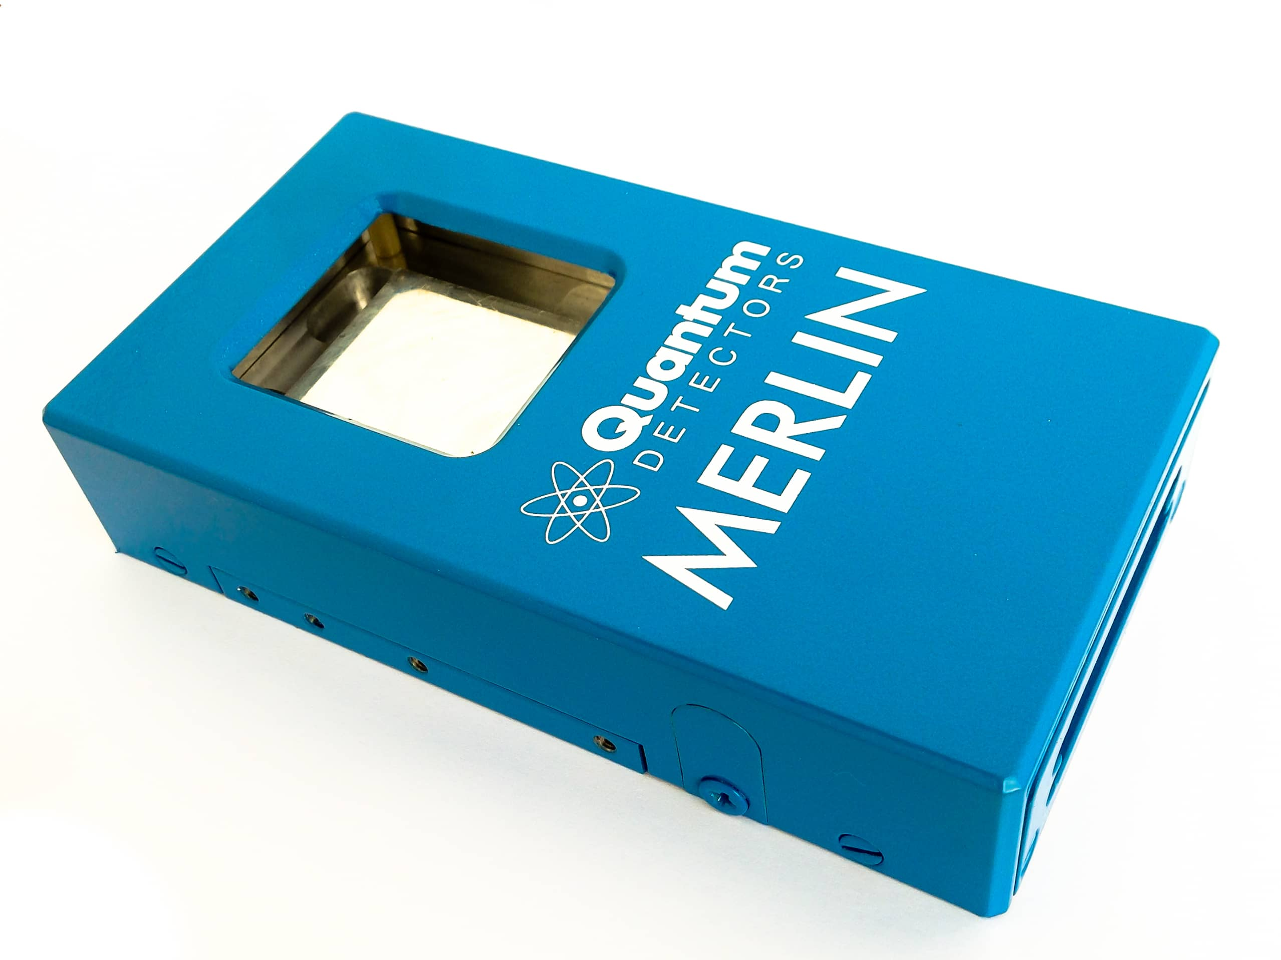
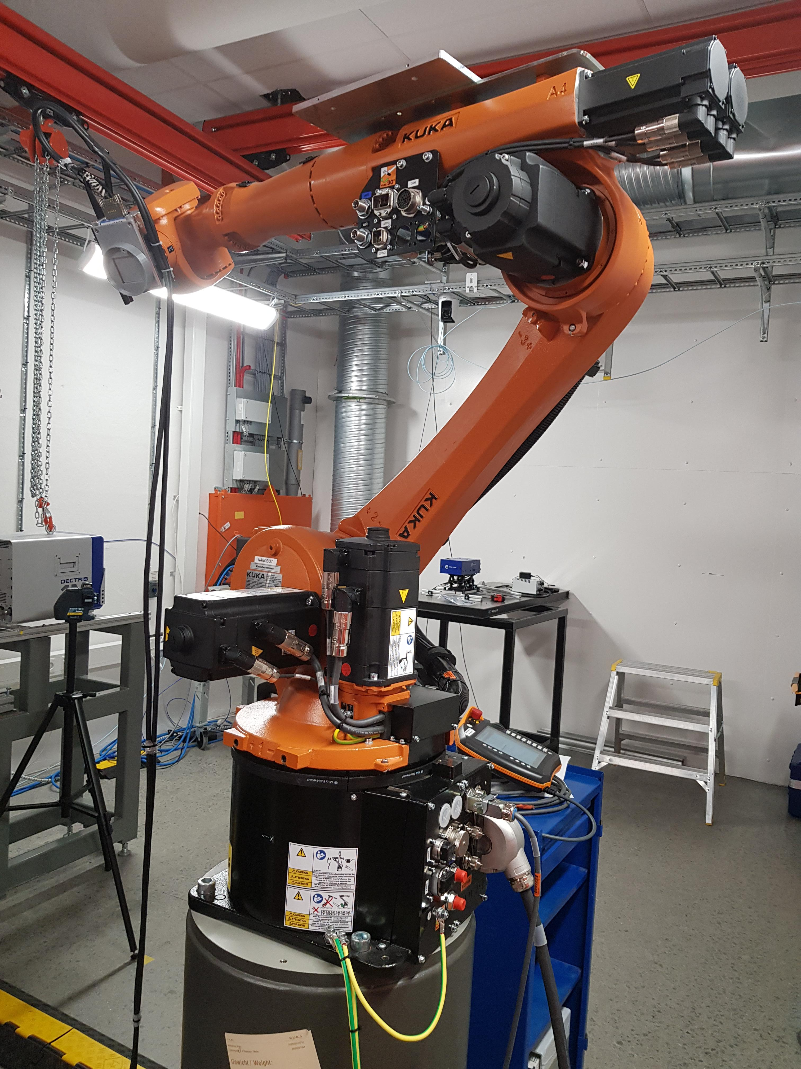
NanoMAX – a bad detector experience
Quantum Detectors Merlin Hybrid Photon Counting detector based on Medipix chip
System supplied had NI crate with embedded Windows PC running Labview interface, limited to below 100Hz frame rate data transfer
Well proven in 2017, painless Lima deployment
Aiming for higher rates, in 2018 NanoMAX swapped NI crate for separate PC with 10Gbe interface, control system unchanged. No validation before users arrived. “Its the same”.
=> Frequent, random crashes with users in 2018
Non reproducible memory leak eventually found on vendor supplied PC, never resolved (machine itself or its environment), cannot debug during user operation
BL could not use 100Hz anyway, so reverted to old system, not before whole user period disrupted
Would have been caught with system tests
Note: company gave extensive support!

Slide 10
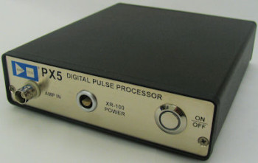
NanoMAX – a bad detector experience 2
Simple digital pulse processor
“It has an ethernet connection, it must be easy to integrate”
“There’s even an existing Tango device”
Reality:
    Existing Tango device hard to compile in linux due to external dependencies and Windows env.
    UDP communication unreliable, so scans continually interrupted by lost packets; huge development effort to improve robustness
Believing what a manual claims is no substitute for actual experience.
  Can be better to have something that covers 90% of the requirements with proven reliability that 100% of requirements with unknown reliability, especially when requirements not certain
Saying something can be controlled remotely might mean its satisfactory for an undergraduate lab application reading once per minute lab but not for our demands.
Note – company were very helpful in supporting us to get it working!

Slide 11
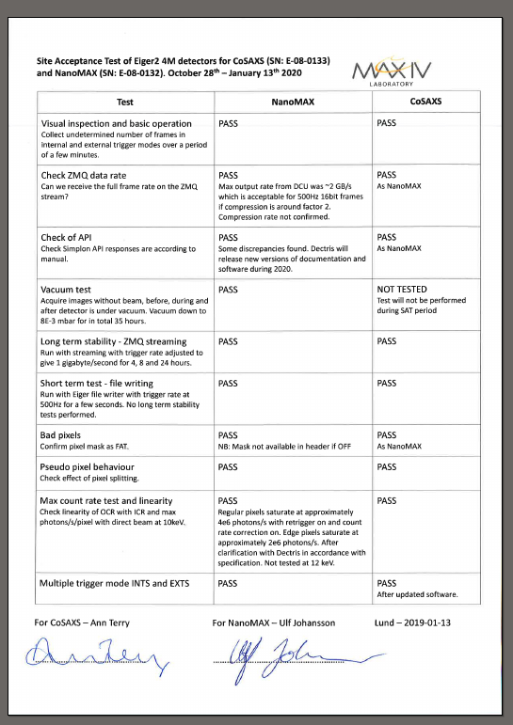
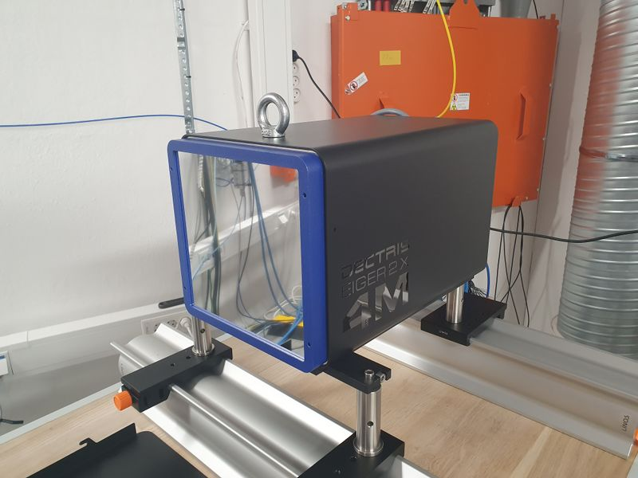
NanoMAX – a lesson learnt
  We need dedicated detector support!
  Test thoroughly on arrival
  One person to liaise with company for support if needed
  For new detectors:
  Define a SAT with the scientists
  Allow dedicated testing time
  Document test protocol
  Not promised to users until robust
SAT

Slide 12
BioMAX
One of the first beamlines to enter commissioning & receive users (with NanoMAX)
Typical MX beamline: high throughput, highly automated…
Main challenges are the integration and synchronization of equipment
  complex scanning is done by the diffractometer, a black box
  → Less dependant on Sardana than Nanomax for both low level control and UI, since MxCUBE web app is the core application, the only tool seen by users
Different to other MAX IV beamlines, but have support of wider MxCUBE community
Dedicated beamline resource on general controls and MxCUBE development ~3 FTE during installation, embedded in KITS team (not anymore)
User operation since spring 2017

Slide 13
BioMAX - MxCUBE experience
Web app developed from scratch: started Sep. 2015, first experiment in June 2016 (commissioning)
Part of a collaboration where milestones and a master plan was agreed
  Not all milestones were met, but software was delivered in time for users and matched to actual beamline capabilities
But:
  CI and unit testing not in place from the beginning (and little today)
  Unstable situations suffered by users MxCUBE and/or underlying communication, authentication…), the app was not displaying useful message to the user…
  Staff not fully engaged in testing until not long ago

Slide 14
BioMAX – Equipment Integration
MD3 diffractometer and robot
  Initial user operation without robot!
  Tango devices working from early stages, followed by additions after equipment testing and usage
  Many issues with the synchronization between them (h/w signal, internal waits for signals needed fine tuning, vendor bugs…)
  MxCUBE had also bugs and missing functionality in regards to these systems
Eiger detector (16 megapixel photon counting detector, few GB/s data rate – not for Lima control.)
  Had some bugs that needed workaround in MAX IV systems, some of those still there
  New Tango device for control and DAQ (file writing) -> bad idea, we are moving away from this now
    Running in one dedicated h/w server at the beamline (no other alternative in 2016)
          A failure here compromises the operation
          Want to move data operations to DAQ cluster (already happening in other beamlines, was no DAQ cluster in 2015)
  Equipment is not very communicative if the detector head goes off (not a common issue any more)
Remote Operation - introduced recently, main issues:
  Safety (safety key mechanisms for exp hutch motors and robot)
  Internal procedures like sample delivery, etc.
  Few additions in controls for improved usability

Slide 15
BioMAX – Final Thoughts
Beamline is continuously evolving and in high use:
  Very little time for testing new developments in controls & MxCUBE
  Still some last minute requests from scientists/users
Highly affected by changes in infrastructure or MAX IV systems, issue solving easily eats a big chunk of users’ beamtime
The Sardana development was not given enough importance in the beginning, later staff started asking for new virtual motors, macros. This should have been planned from the beginning, the main focus was MxCUBE
During last year some of the beamline staff started developing more and more
When staff report issues, it is very difficult to get priorities from (all is super mega critical for user operation)

Slide 16
FinESTbeAMS
Funded by an Estonian and Finnish consortium, supported by the EU through the European Regional Development Fund and the Academy of Finland
Staff also funded from outside
Attempt to keep to MAX IV standards for hardware and software
  Controls engineer placed in KITs group and fully integrated to team, though worked mainly on FinEST tasks
  Knowledge share, keep to standards for new developments
  Lots of non-standard legacy equipment – retain for use on day 1, programme to adapt and replace with MAX IV standard. e.g. old physical IOCs replaced, custom code replaced by Tango devices...

Slide 17
FinESTbeAMS
Once development phase over KITS support it like any other beamline (hence vital it adheres to standards)
Communication important from early phase (before construction began) so that Finnish-Estonian colleagues knew what to expect from us and v.v
Outcome
    Dedicated/ring fenced resources is a good way to get things done quickly!
    Embedding those resources in KITS team did result in standards being applied and knowledge shared
    Successful initial operation, parts of DAQ still running legacy system with minimal integration, but this will be reimplemented.

Slide 18
FemtoMAX
A random story:
- Started with a fake deadline: “beamline should be ready for commissioning in 2014”
(before the linac that serves it)
- Good high level specification but devil is in the details:
  Bad specification of the DAQ system:
      2013: no scanning, only event based
      → 2019: Mix of scanning + event based
      2013: “we will record all data”
      → 2019: We have too much data, can we filter some out?
  Non standard hardware chosen by beamline: not reliable, not suitable
  Last minute integration: Pilatus detector delivery on Friday, users on Monday
- No extra resource allocated although foreseen as complex project.
  Although a lot of budget but keep buying equipment to integrate
- No priority until 2019

Slide 19
FemtoMAX
Another random story:
- Want a user-friendly beamline
- automate everything since the beamline staff cannot fill the gap.
- Keep being in expert user commissioning. Blaming the control system for being ready (joke)

Slide 20
Conclusions: Classic theme
Not involving controls group in early stages causes problems later
    Buying hardware without considering its integration – false economy if it generates a huge development effort, in worse case impossible
    Buying hardware that is unknown instead of using proven solutions can be risky – cannot believe what manuals say, proven performance and prior experience is worth a lot
    KITs must plan resources, no headroom for last minute big requests

Slide 21
Conclusions: relying on existing software
Notably: Lima for detector control/acquisition, Sardana for orchestration of motion/triggering and DAQ
One size fits all approach, can be very smooth and allow you to get started without knowing the details, might not cover all use cases in natural way to frustration of users
If it goes wrong fixing it can be hard exactly because you do not have a deep understanding (code itself very complex, many layers of inheritance, etc)
Can hide interesting physics problem “how does my detector perform” below layers of IT problems “why can’t I compile this plugin”, where there is more value addressing the first point. Value negated if too much time spent on the second type of issue.
Can mask underlying problems with e.g. detectors & triggers. Need expertise to decipher error messages and understand failure modes. Was unwise of us to assume we could get by without investing in deeper understanding from the outset.
In best case can be up and running on day 1 with minimal investment, but must gain expertise for inevitable trouble shooting and eventually will encounter use cases that are not provided for.
My feeling: embarrassing to be unable to explain behaviour of something I have provided

Slide 22
Conclusions – testing and delivery
Controls people cannot do realistic tests alone, need input of scientists
    (however many unit tests you have, field tests are irreplaceable)
Must start early, not develop up to last minute
Dedicated testing time must be forced into the scientists’ planning
Big pieces of equipment need dedicated tests, whole ensemble must have system tests with realistic conditions.

