Slide 1

Data Management and Software Centre
Mark Hagen
Head of DMSC
Mark.Hagen@esss.se
www.europeanspallationsource.se
IKON6, February 27th 2014

Slide 2
What is DMSC ?
Data Management and Software Centre (DMSC)
A Division of ESS Science Directorate…
  Just like Instrument Technologies, Neutron Instruments etc.
  Two campuses: ESS Lund & ESS Copenhagen
  (Universitetsparken, Københavns Universitet)
  DMSC building to be constructed in Copenhagen
Responsibility: design, develop & implement for the ESS instruments:
  Software (user control interfaces, data acquisition, reduction & analysis)
  Hardware (servers, networks, workstations, clusters, disks, pfs etc.)

Slide 3
Organization
DMSC
Data Systems
& Technologies
Inst. Control, Data
Acq. & Reduction
Data
Management
Data Analysis
& Modeling
User Office
Software
Copenhagen Data Centre
DMSC servers in Lund
Clusters, Workstations
Disks, Parallel File System
Networks (inc. Lund – CPH)
Data transfer & Back-Up
External Servers
Instrument Control User
Interfaces
EPICS read/write
Streaming data (ADARA)
Data reduction (MANTID)
File writers (ADARA)
Data Catalogues
Workflow Management
Post-Processing………….
---- Reduction
---- Analysis
Messaging Services
Web Interfaces
MCSTAS support + dev.
Instrument Integrators
Analysis codes (e.g.
SANSview, Rietveld,…)
MD + DFT Framework
User Database
Proposal System
Training Database
Publications Database
Initially one work package (2 work units)

Slide 4
Mission
ESS is an experimental facility – users will come here to do neutron scattering experiments:
  Collect the most (appropriate) data during their beam time
  Understand that data as much as possible/practical
DMSC’s mission is to create a computational infrastructure that gives ESS users:
  The ability to acquire (capture) neutron & associated data & control the instrument
  The ability to reduce, and analyze, the data (as it is being acquired)
  Data files created instantly after acquisition (no matter how big)
  The ability to reduce a data set post-acquisition (could be 1 min, 1 month, 1 year later) in ~1 minute
  Archival, and cataloguing, of the data
  Access to the resources (software/hardware) for users to do post-acquisition reduction, analysis, visualization, modeling
How do we make it happen?

Slide 5
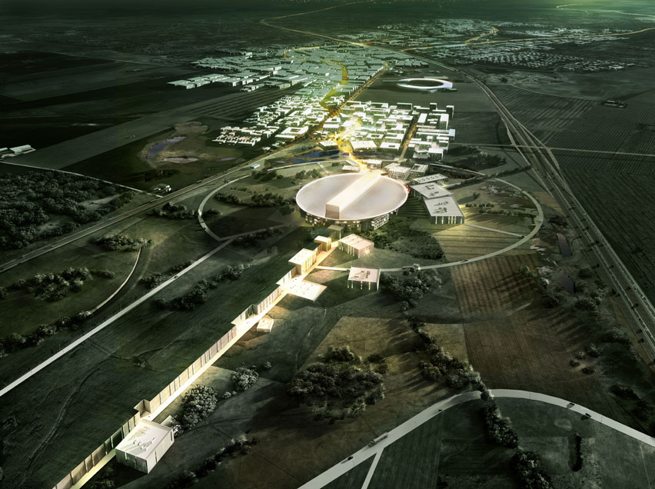
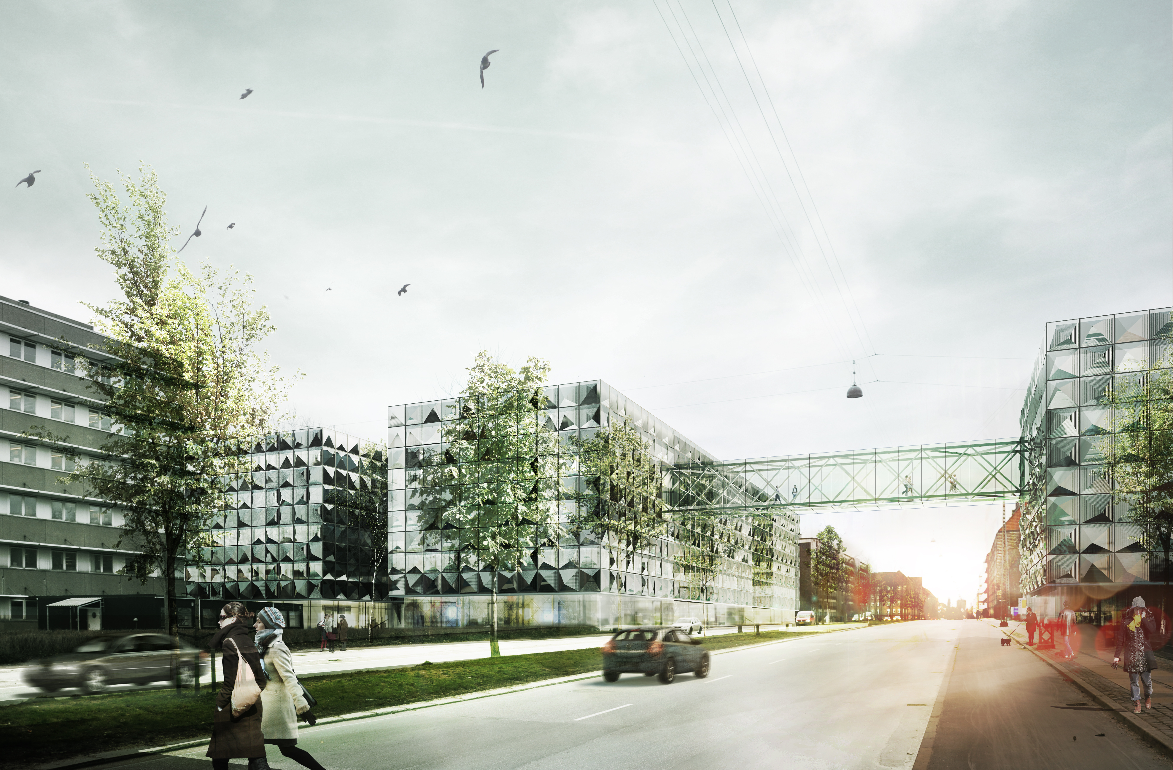
General Framework + Customization
Generic Data Framework
Event mode data for later reprocessing/filtering
Stream the data ➔ on the fly data processing (live view)
➔ on the fly file creation
➔ to a location where appropriate
post-acq. resources are available
Create standard HDF5 data files (NeXus or other)
(Where possible) Automate data reduction & analysis
Catalogue the data & meta-data for fast processing
Don’t re-invent the wheel
Existing projects: ICAT, MANTID, ADARA – Join these
Customize for ESS Instruments
User Control Interface, detector type, IOC’s for sample environment etc.

Slide 6
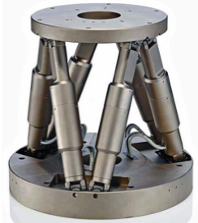
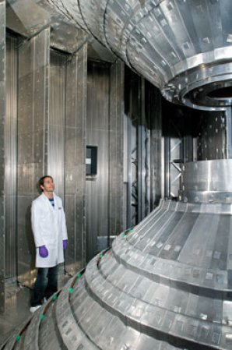
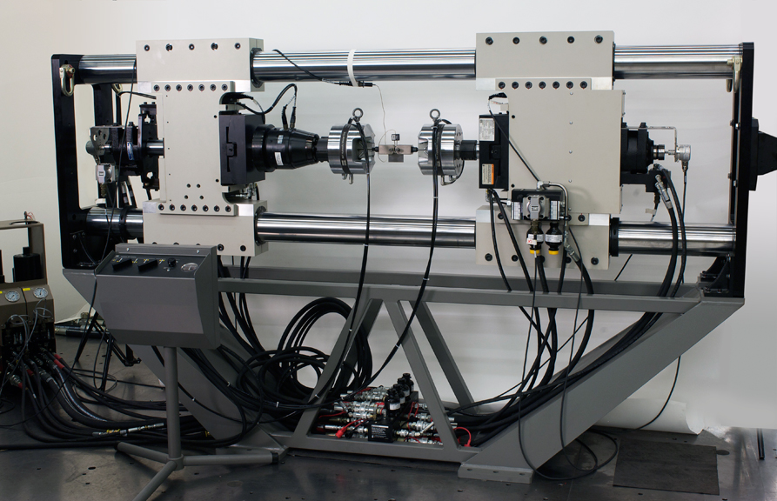
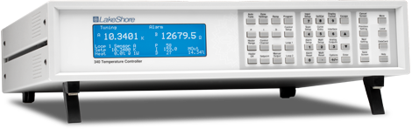
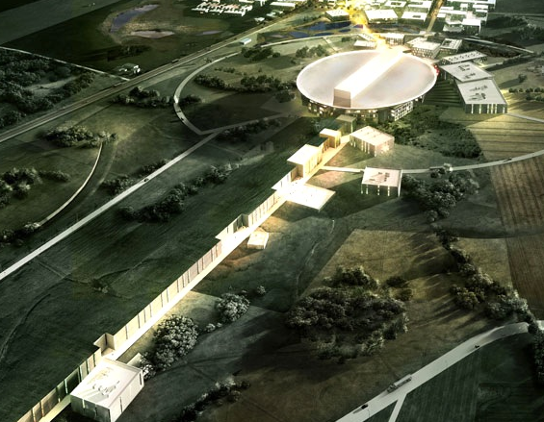
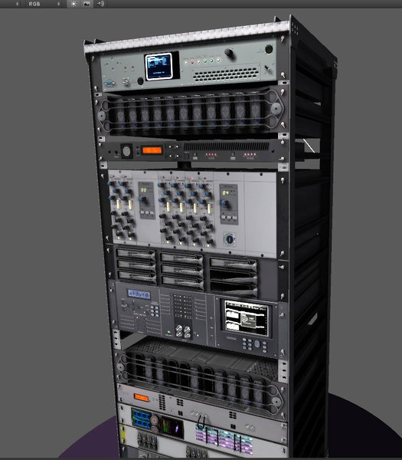



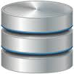
Data Acquisition, Reduction & Control
Generic Framework
Instrument Control
Data Acquisition
Data Reduction &
Visualization
NEUTRON TECHNOLOGIES
Choppers
Motion Control
Sample Environment
Fast Sample
Environment
Detectors
& Monitors
Timing
Bulk Data Readout
(Detector Group)
DATA MANAGEMENT &
SOFTWARE CENTRE
Data Aggregator
& Streamer
( )
INTEGRATED
CONTROL SYSTEMS
Control Box
User Control
Interface
Live, Local & Remote
Data Reduction
Automated
Data Reduction
Automated
Data Reduction
Data Analysis Interfaces
Lund Server Room
Copenhagen Server Room
Instrument Control Room

Slide 7


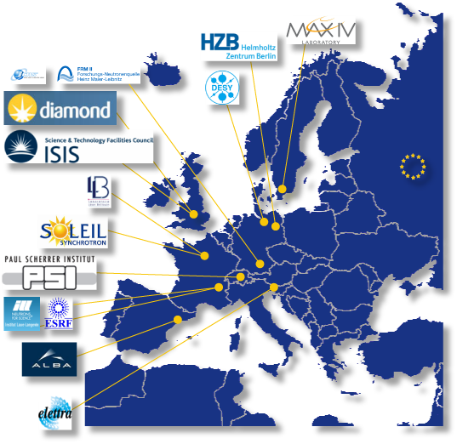

Potential Collaborations
Data Acquisition, Streaming & Reduction
Used by ESS accelerator/target,
SLS, Diamond, US light sources,
to be used by ISIS & SNS
Publish/subscribe software & protocol
for streaming data (neutron + meta)
Data reduction framework in Python
& C++ developed by ISIS & SNS
ICAT data cataloguing software
developed under NMI3 by PanData
collaboration of 19 European
facilities (+ SNS in US)
Data Management

Slide 8
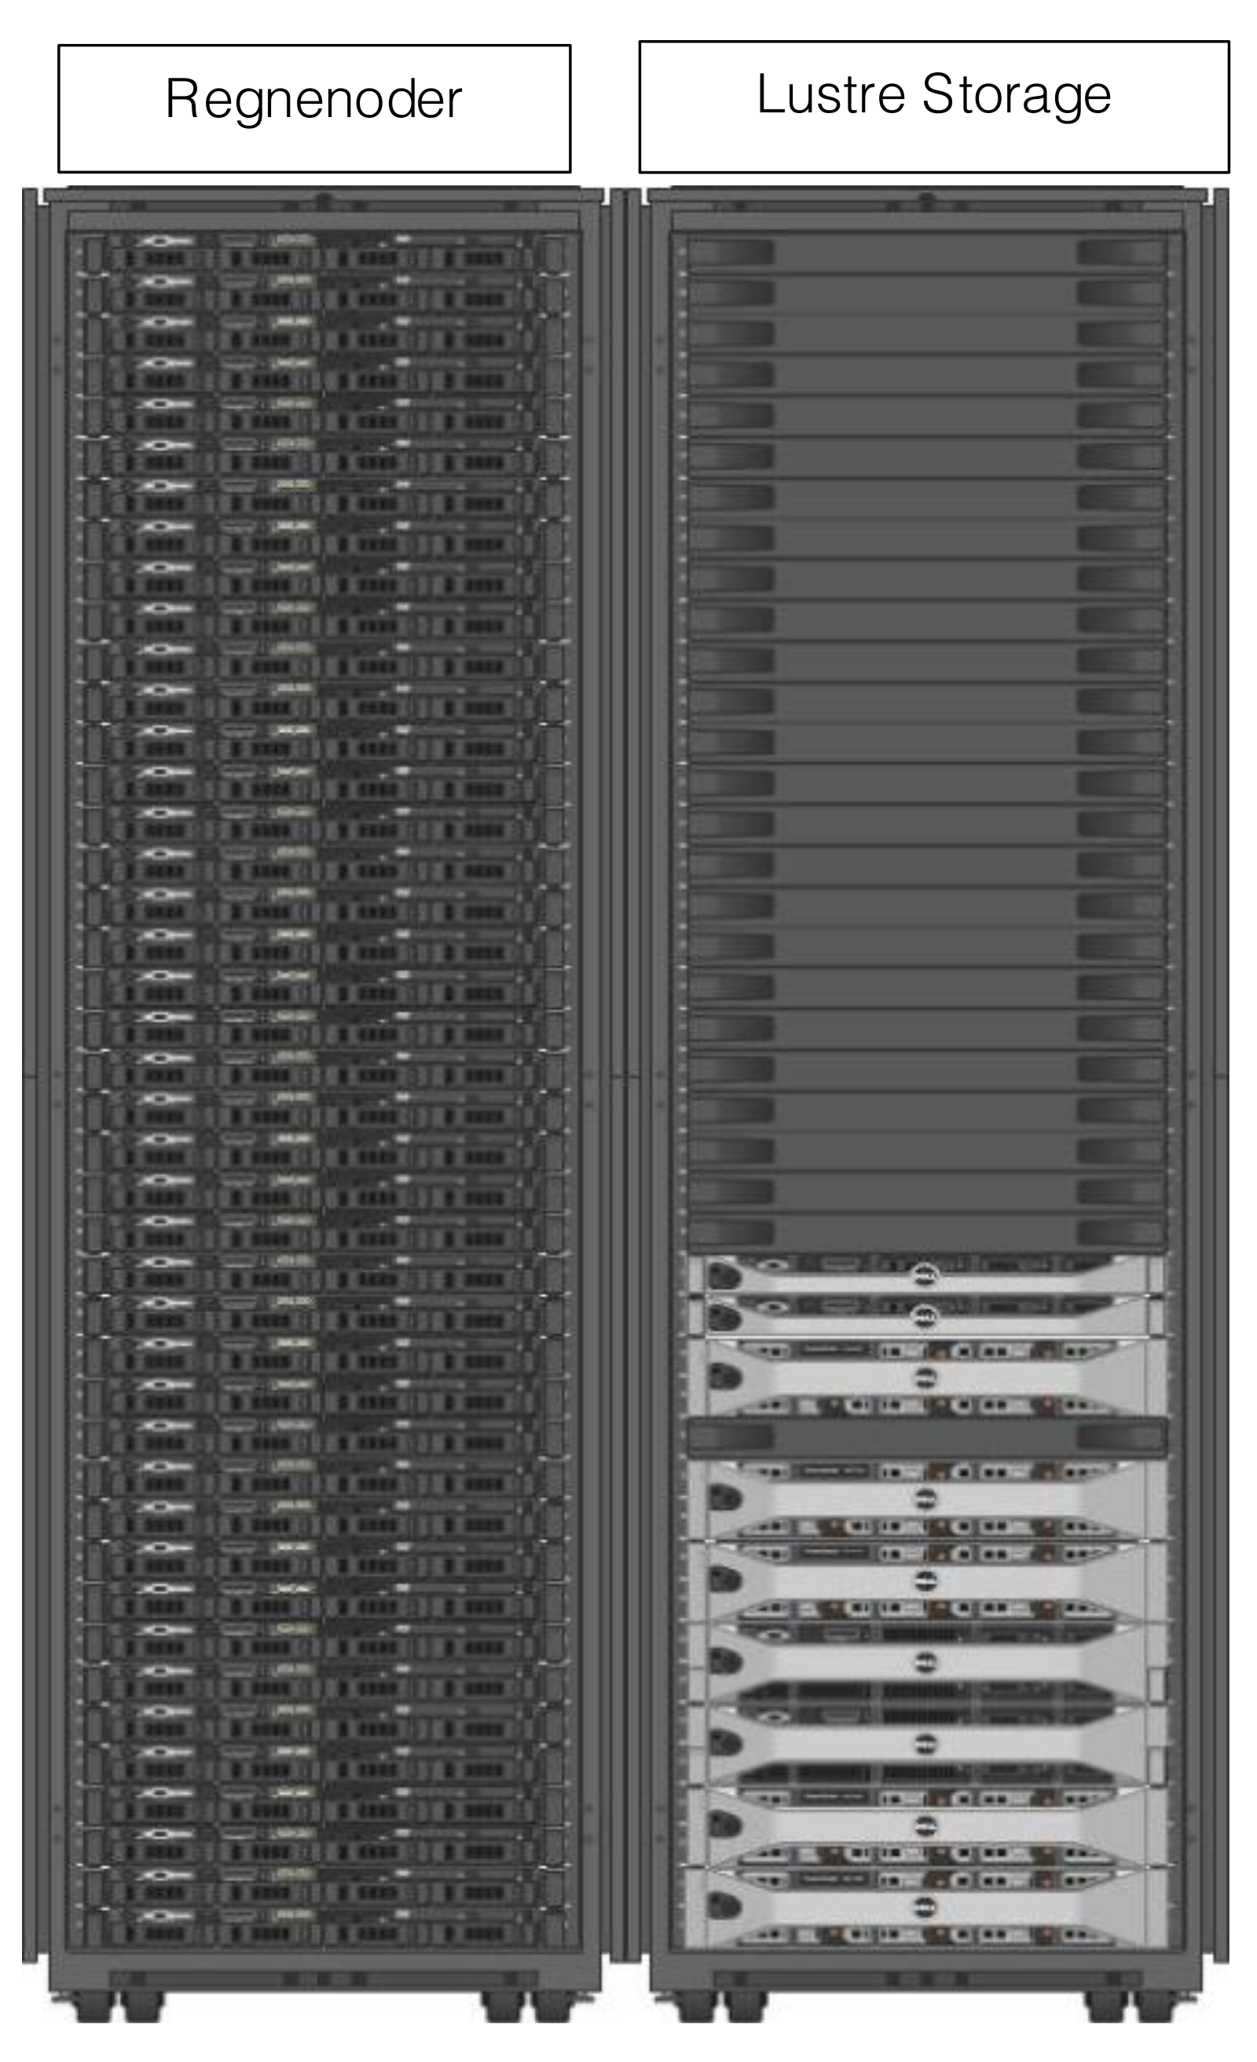
Data Systems & Technologies
DMSC will not be running a “supercomputer” centre!
Data (disk) storage:
  Back of the envelope ➔ 2 – 3 PBytes/yr
  Spectrum of file sizes ~100MByte - ~10’s GByte – ~1TByte
  Fast disk (200MByte/s) & Parallel File System (10GByte/s)
Cluster(s) for data reduction & (modest) data
analysis - ~2048 cores
Architecture – CPU, GPU… visualization cluster/server
Interim Data Centre (funded by Denmark in pre-construction)
888 core cluster + ~100TByte Parallel File System
Used by neutronics (target), instrument concepts, optics group

Slide 9
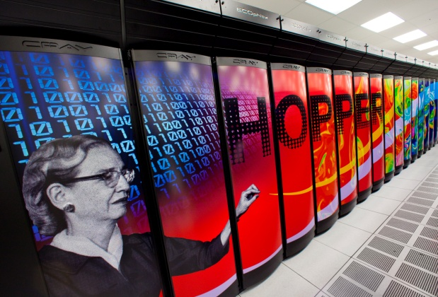
Data Systems & Technologies
Archive – 2yrs on fast disk – 5yrs on disk - > 5yrs slow or ??
Back-up – somewhere else – supercomputer centre – commercial??
Data download servers – sftp & gridftp
Remote login capability for ESS users:
  Re-reduce data using cluster
  Data analysis software available for users
Software development servers – repositories, bug trackers, build servers
DMSC could obtain a grant of supercomputer time
for use by ESS users who need it for modeling

Slide 10
Potential Collaborations
Data analysis – surely all facilities need data analysis software ?
  Talking with ILL, ISIS, SINQ/PSI, JCNS
  Interoperability of software
  Modularization, file formats/converters…
  Economies of scale
Could enable new developments
  Automated analysis
  Streaming analysis
  Feedback from analysis to data acquisition…
Surely every facility needs “User Office Software”
  Are there opportunities for development of existing software (don’t re-invent the wheel)

Slide 11
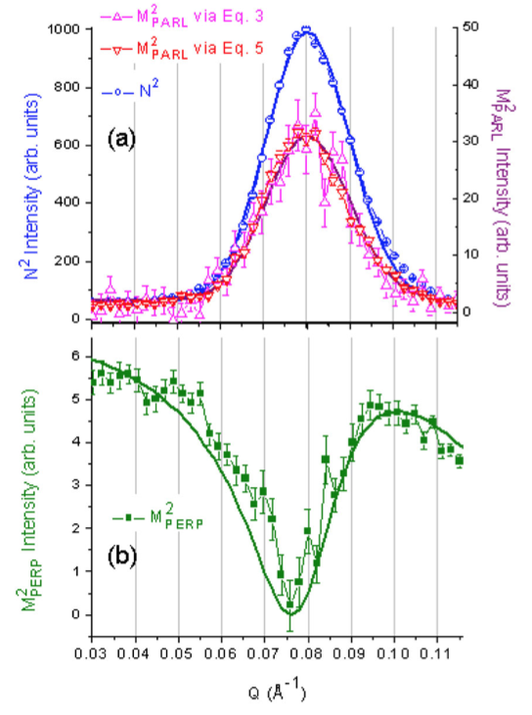
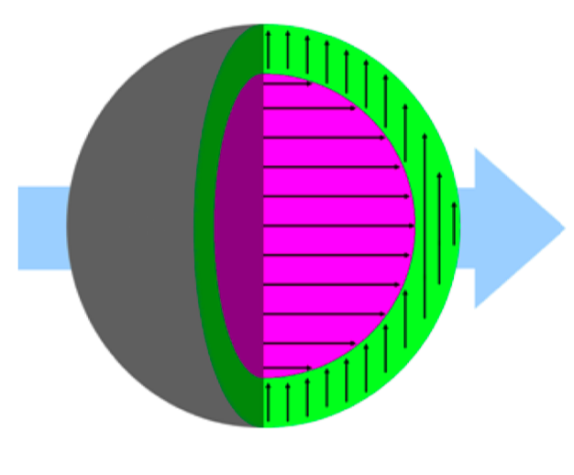
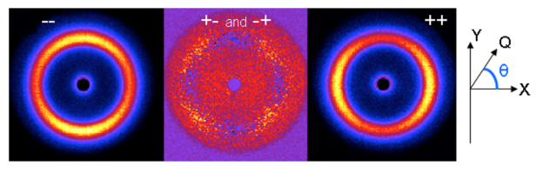
Data Analysis
Data on disk is useless!
  It is published results from the
  data that makes progress
Need to ensure that ESS users have
access to
  appropriate software packages
  for data analysis
  the necessary computational resources to exploit the software
  to obtain those results
  analysis software during experiment to influence the data taking strategies
Roll out in-sync with instruments
Structure of Nanomaterials
K. L. Krycka et al. Core Shell Magnetic Morphology of Structurally Uniform Magnetite Nanoparticles PRL 104, 207203 (2010)
Polarized SANS demonstrated that these nanoparticles have uniform nuclear structure but core-shell magnetic structure.
Required development of both data reduction and data analysis methods and tools.

Slide 12
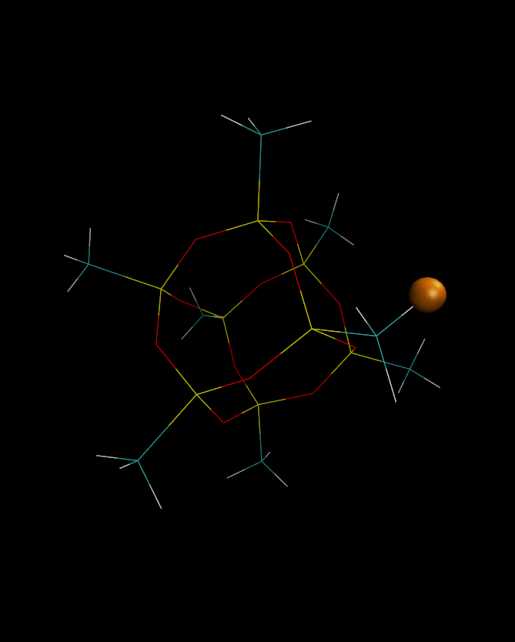
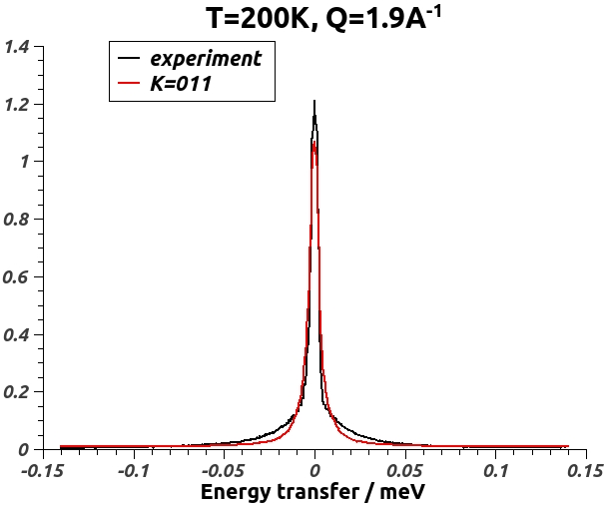
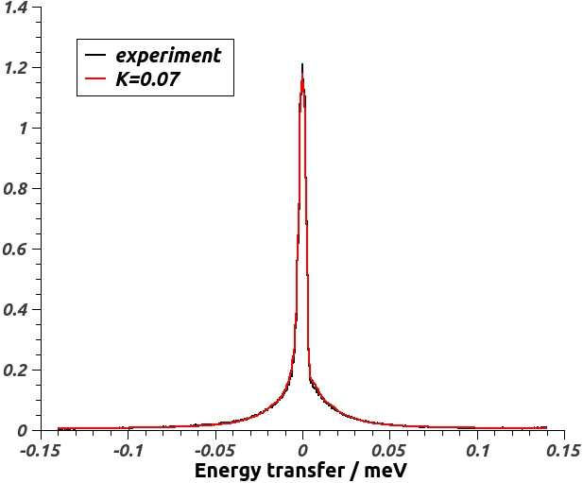
Data Analysis Development
Integration of Analysis with Advanced Modeling Techniques
Molecular Dynamics & Density Functional Theory (DFT) Techniques
Jose Borreguero (SNS/NDAV) Mike Crawford (Dupont) & Niina Jalarvo (Julich): BASIS experiment / MD simulation studies of Methyl rotations in methyl-Polyhedral oligomeric silsesquioxanes (POSS)
Optimization of dihedral potential governing the rotational jumps in methyl hydrogens. Preliminary simulations indicate that the dihedral potential barrier must be decreased ~37% in order to match experimental data
Original
force-field
Optimized
force-field

Slide 13
During the construction years
Primary goal: To be ready for hot commissioning of first ESS instruments in 2020.
Includes significant amount of NRE (Non-Recurrent Engineering) for subsequent ESS instruments.
Establish the basic facilities at both campuses.
Front loaded with instrument-centric work + scope to grow analysis in an integrated way

Slide 14
Conclusion
DMSC’s mission is the computational (software/hardware) infrastructure for
the ESS data chain - instrument control, data acquisition, reduction & analysis
Generic framework customized for each of the instruments – utilizes data streaming
to account for large data files/live processing
Don’t re-invent the wheel – work with collaborators ISIS, SNS, PanData (+ others?) to
develop/customize existing software – EPICS, ADARA, MANTID, ICAT…
Customize for each of the ESS instruments in-sync as they roll out
In-sync with instrument roll out work with instrument teams to ensure analysis
software is available (doesn’t necessarily mean develop)
Longer term goal to develop new data analysis methods for ESS instruments

Slide 15
Questions
QUESTIONS

