Slide 1

Optimization of
Moderators and Instruments
Ken Andersen
IKON6 meeting
27 February 2014

Slide 2
Flattened Moderators
Baseline
Flattened

Slide 3
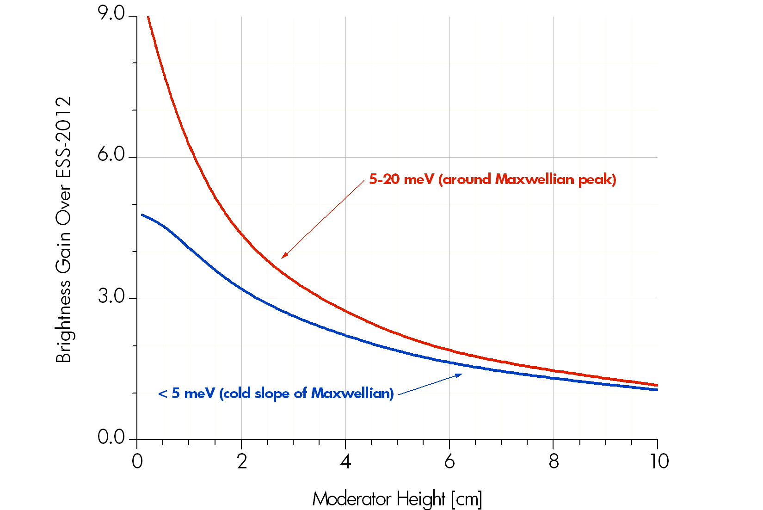
Flattened Moderators

Slide 4
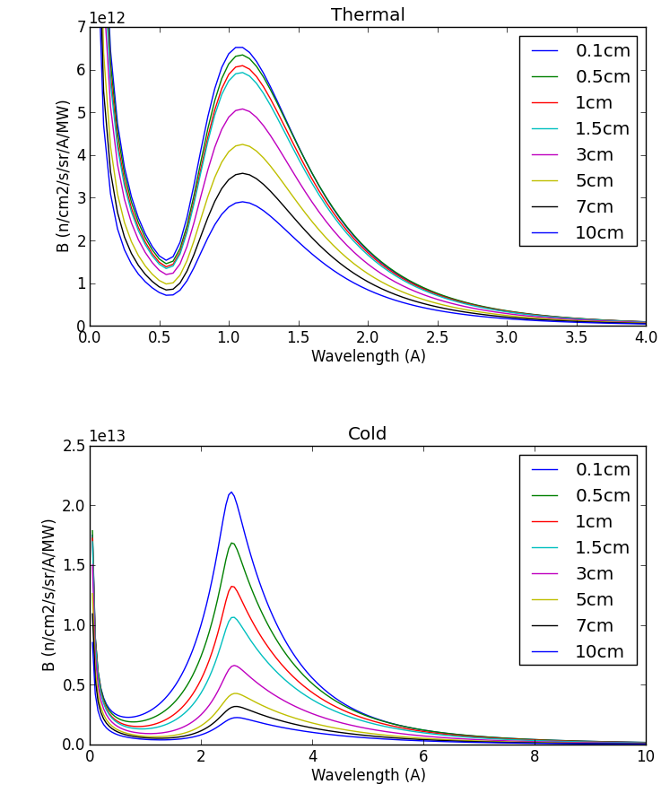
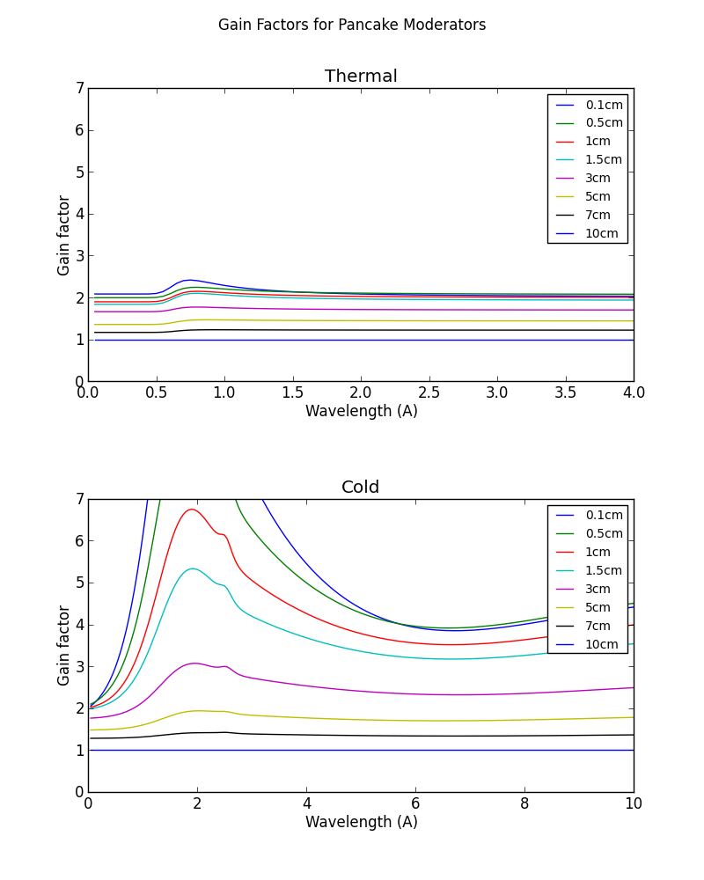
Brightness Gains
Thermal
Thermal
Brightness
Brightness Gain
Cold
Cold

Slide 5
Guide_Bot McStas Optimisation
Mads Bertelsen (Kim Lefmann)
Copenhagen University

Slide 6
Guide_Bot McStas Optimisation

Slide 7
The Reference Instrument Suite

Slide 8
Instrument Optimisations (1/3)
Large-Scale Structure Instruments

Slide 9
Instrument Optimisations (2/3)
Diffraction Instruments

Slide 10
Instrument Optimisations (3/3)
Inelastic & Fundamental Physics Instruments

Slide 11
Example: Thermal Chopper Spectrometer
Jan Saroun, NPI, Řez

Slide 12
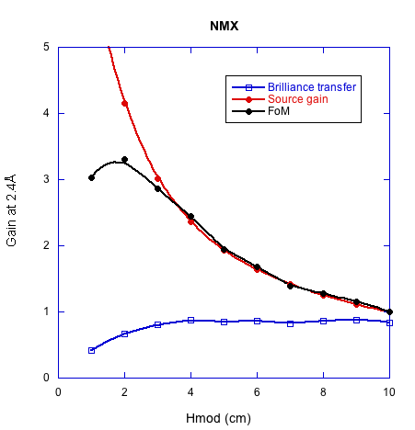
Example: NMX Macromolecular Crystallography
Esko Oksanen, ESS
variable
m=1
4.3m
30mm
150m

Slide 13

Plan of action for instrument optimization
FoM
N
22 x
A
B
h
h
Instrument results by 28th of January
  update reference suite
Big coordination meeting 12th of February
  agree on remaining work
  finish instrument optimisation work by 7th of March
Freeze moderator design by end-April
  arrive at global optimum for all instruments
  arrive at new reference suite layout

Slide 14
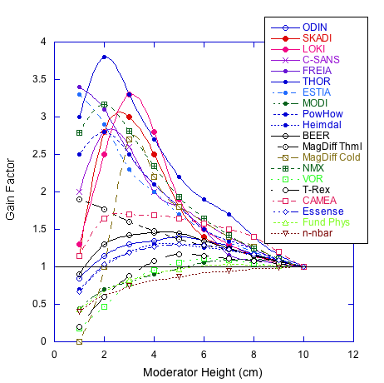
Current Results
20 instruments so far:

Slide 15
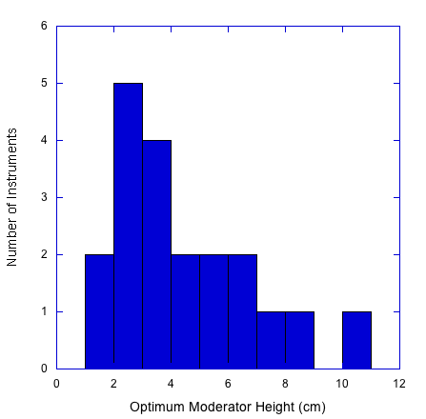
Current Results

Slide 16
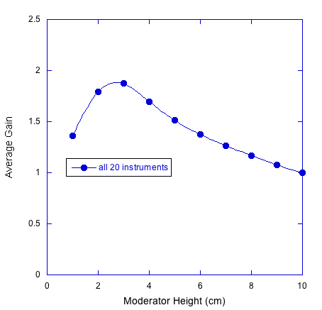
Current Results

Slide 17
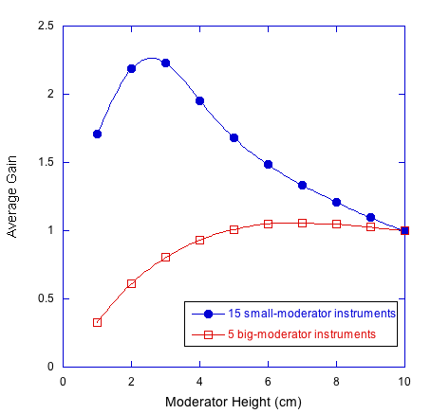
Current Results

Slide 18
Current Results

Slide 19
Current Results
MODI, VOR, T-REX
Fundamental Physics
n-nbar

Slide 20
Instruments missing from analysis so far:
Thermal Chopper Spectrometer
Miracles Backscattering Spectrometer
Wide-Angle Spin-Echo
MODI, VOR, T-REX
Fundamental Physics
n-nbar

Slide 21
Optimising Reference Suite layout:
- constrained by building layout

Slide 22
Baseline layout
12cm height
12cm height

Slide 23
Possible layout with 1 moderator
3cm height
3cm height

Slide 24
Possible layout with 1 moderator
2cm height
5cm height

Slide 25
Possible layout with 2 moderators
3cm height
6cm height

