Slide 1

Labs and Facilities
Scientific Activities Division
Michelle Everett
IKON6 2014-02-27

Slide 2
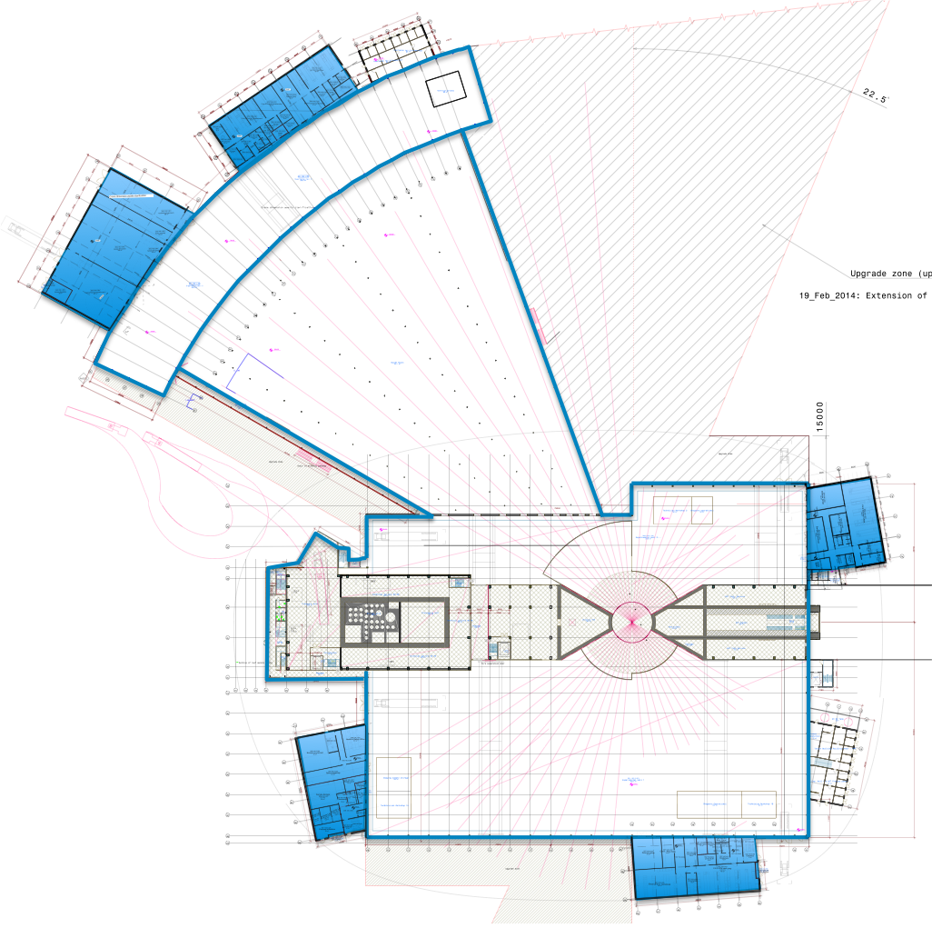
Instrument
Halls and
Target
Building
Hall 3
Guide Hall
Hall 2
Main Entrance
Proton beam
Hall 1

Slide 3
Buildings
3B
Hall 3
3A
Upgrade Area
Guide Hall
Upgrade Area
2
Hall 2
Hall 1
1A
Upgrade Area
1B

Slide 4
50 meters
155 m – 175 m
NMX
100 meters
LoKI
200 meters
ODIN

Slide 5
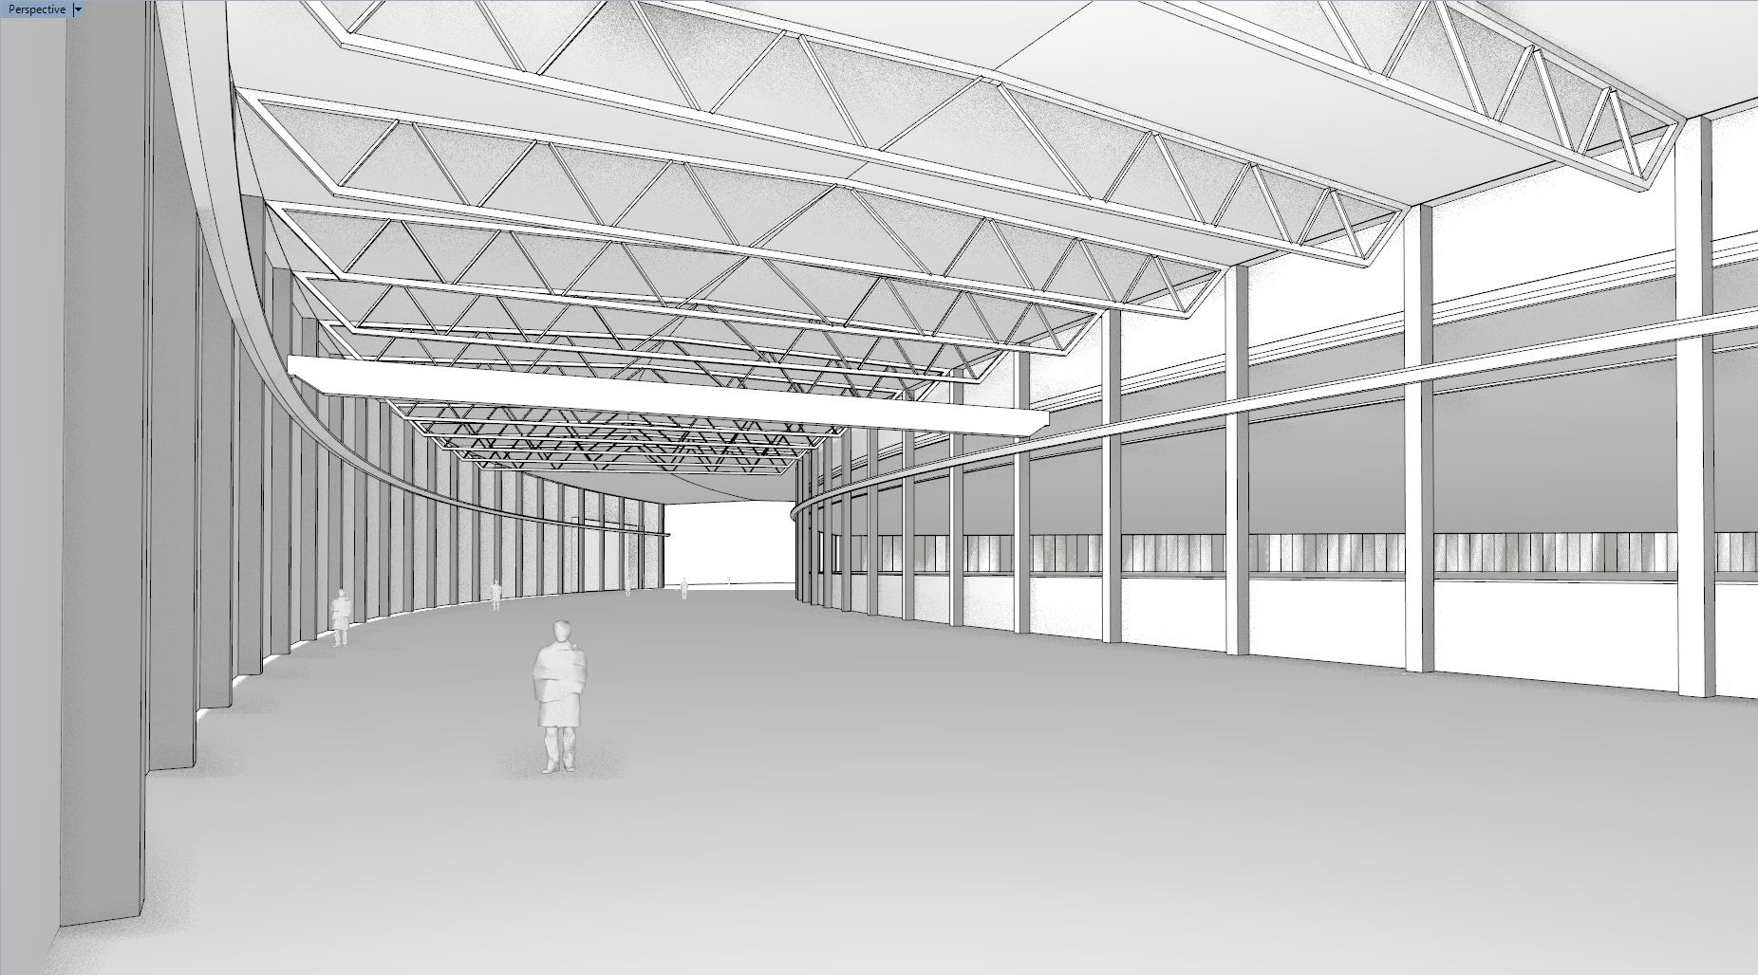

Slide 6
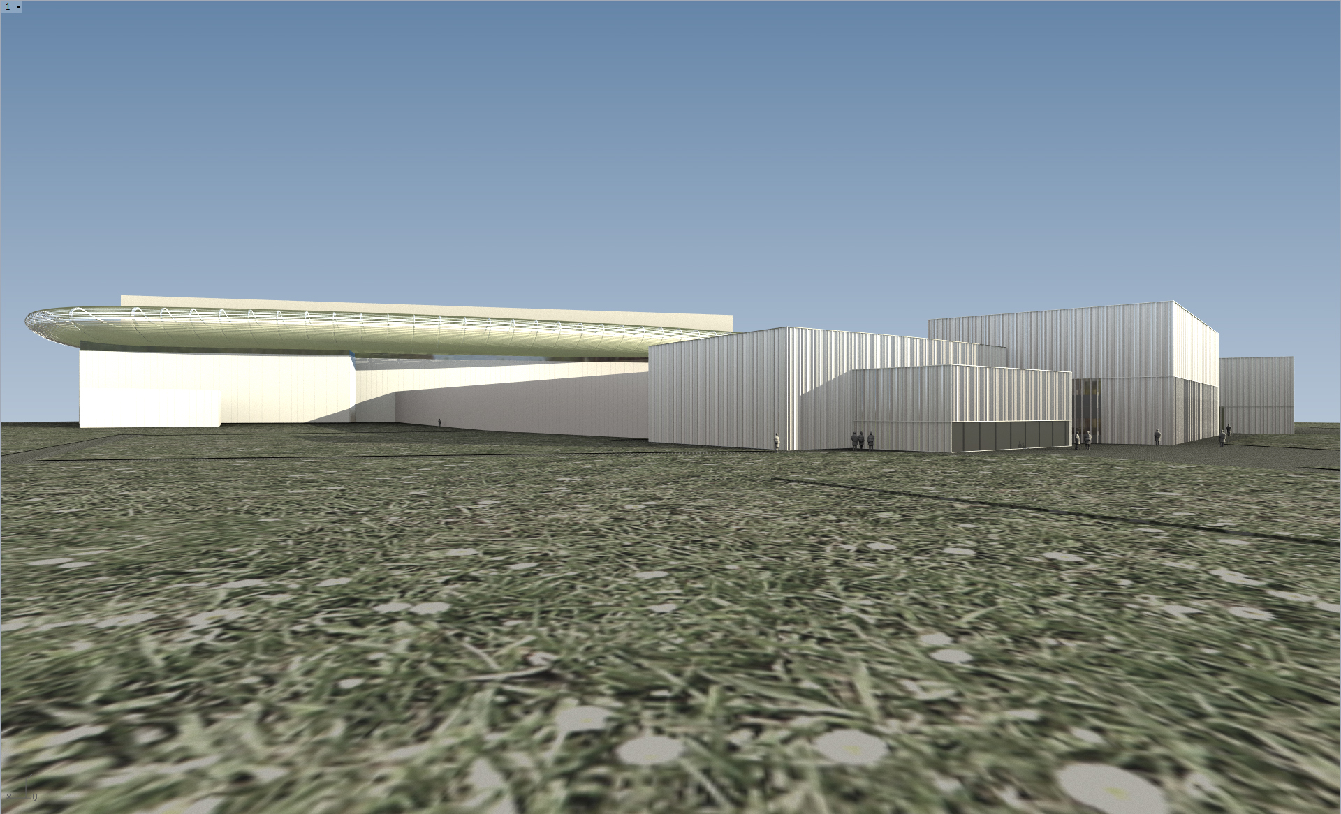

Slide 7
Science Drivers for the Reference Suite

Slide 8
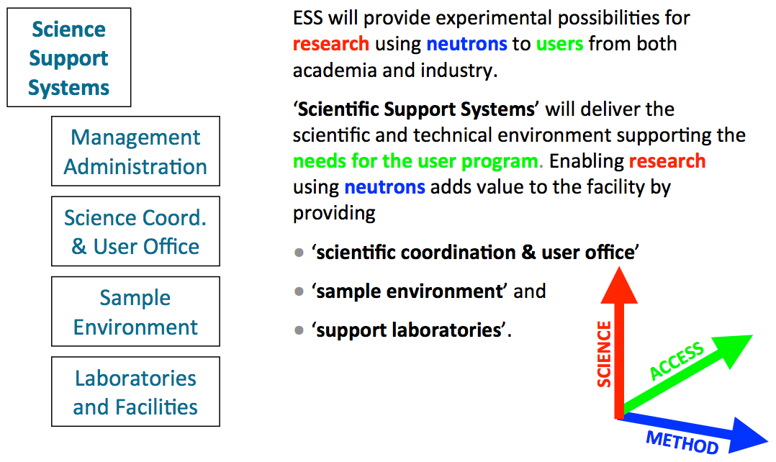
Scope and Requirements

Slide 9
User Labs
100 m²
Chemistry &
Physics
Furnace room
Sealing and encapsulation
Thin film prep
Cutting, orienting, co-aligning, and sample mounting
100 m²
280 m²
Notes:
Ex situ sample conditioning as well as supporting in situ equipment for the instruments

Slide 10
User Labs
100 m²
Life Science & Soft Condensed Matter
SAXS & x-ray reflectometer
Light scattering
DSC
Cold rooms
Centrifuge rooms
UV-VIS and FTIR
CD spectrometers
200 m²
200 m²

Slide 11
User Labs
Radioactive
Materials
Radioactive materials storage
Glove boxes
Leak testing and encapsulation
45 m²

Slide 12
User Labs
200 m²
Engineering
Ability to handle bulky real world samples
Overhead crane
Bay door access to the outside and to the hall

Slide 13
User Labs
300 m²
Physical
Characterization
NMR
Powder X-ray
Single crystal x-ray
Laue crystal alignment
SQUID
RAMAN

Slide 14

User Labs
Imaging &
Cultural Heritage
Secure storage for precious samples such as works of art and archaeological artifacts
Microfocusing x-ray
100 m²

Slide 15
Sample
Environment
Main Hub
700 m²
2 levels
Offices
Over head crane
Machine shop
60 m²
100 m²

Slide 16
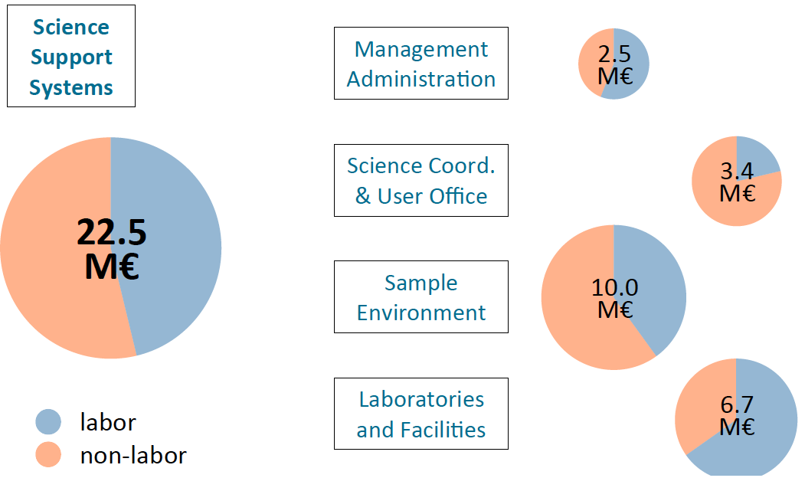
Construction Budget

Slide 17

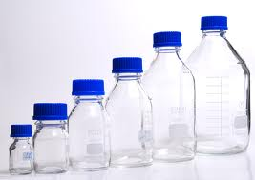

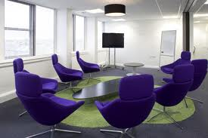
Other needs to be met:
Coffee rooms
User lounges
Conference rooms
Sample receiving
Dishwashing
Health & safety
Hall coordinators
Lab managers
Toilets

Slide 18
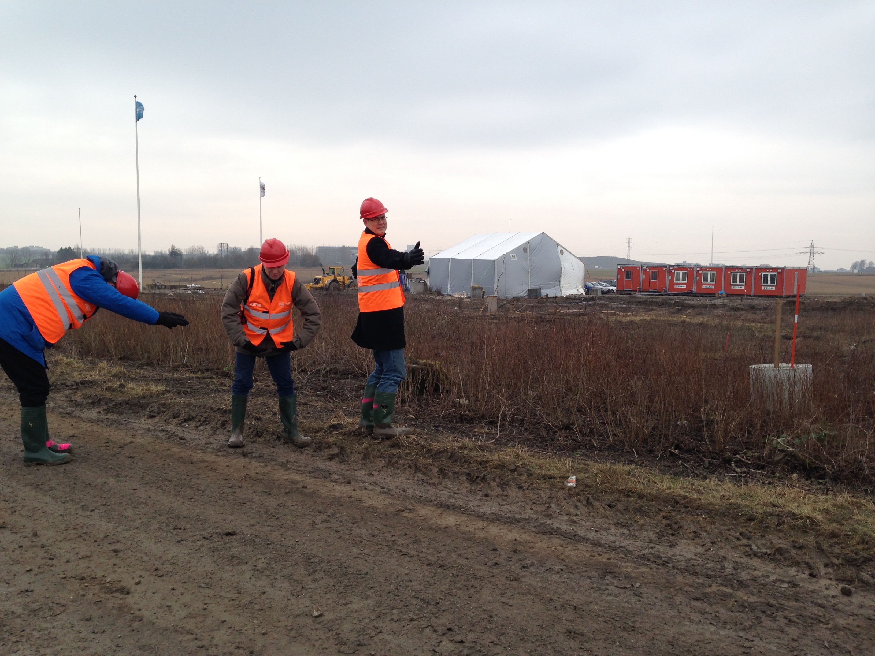
Monolith
Guide
Target
Chopper
ESS will be what we make of it!

