Slide 1
Site & Conventional Facilities
IKON 6
Magnus Eneroth
Construction Manager
Conventional Facilities
www.europeanspallationsource.se
February 27, 2014

Slide 2
Organization
Infrastructure Directorate
Örjan Larsson
Personal Assistant Inger Persson
Conventional Facilities (CF) Division Kent Hedin
Environment, Safety & Health (ESH) Division Peter Jacobsson
Energy Division
Thomas Parker
CF Planning Anders Thonäng
CF Estimation/Cost Control Karin Wennerholm
Ulrika Agnvik
Gitte Myhré
Erica Lindström
CF Admin Ulrika Hammarlund
Fredrik Indebetou
Thomas Hansson
Daniel Skölde
Fredrik Jörud
CF Design Jan Molander
CF Construction Magnus Eneroth
Overall Design Coordination
CF Support
Construction Management
Architectural
Helle Basse Larsen Boris Kildetoft
Structural
Magnus Jakobsson Emma Segerstedt Karin Svedin
Environment/OHS
Malin Åberg
Emma Segerstedt
Magnus Jakobsson
System Installation Ronny Sjöholm
Fredrik Bergstedt Jan Lundgren Jörgen Mattsson
Test & Commissioning Jörgen Mattsson
Earth Works/Geotechnical
Björn Hedén
Quality Assurance
Lars Persson
SE/BIM/Risk
Fredrik Österberg
Design Project Accelerator K Svedin
Design Project Target Bldg F Bergstedt
Design Project Instruments J Lundgren
Design Project Aux Bldgs R Sjöholm
Design Project Earth Works B Hedén
Design Project CUB R Sjöholm
Site & Logistics K Sjöstrand
Installation Coordination L Hedenklo
Installation Coordination J Lundgren
Construction Coordination B Hedén
A
S
I
A
S
I
A
S
I
A
S
I
A
S
I
A
S
I
Installation Coordination NN
Installation CoordinationNN
Installation CoordinationNN
Installation CoordinationNN

Slide 3
Conventional Facilities - Schedule
2013
2014
2015
2016
2017
2018
2019
 | 2011 | 2012 | 2013 | 2014
Building Program
Architectural Competition
Feasibility Study
Baselining/ Scrubbing
Preliminary Design
Detailed Design
Procurement Contractor
Construction Start

Slide 4
Design Phases
The development of all required documents and data for the Project is divided into 3 stages.
Feasibility Study
Development of concepts and viable options taking into account stakeholder needs, time and budget constraints. Resulted in a CF Baseline for Accelerator, Target & Experimental Halls in August 2013.
Preliminary Design An Assessment of the Feasibility Study and alternative part solutions resulting in a main proposal for fulfillment of the project goals.
Detailed Design
The Detailed Design encompasses and implements the Preliminary Design decisions. All drawings and documents necessary for construction will be reviewed and collected in appropriate sub-projects.

Slide 5
Status Conventional Facilities
Start Detailed Design
Completing test piling on site
Start collaboration with construction Contractor
Building permits
Environmental monitoring program
Planning for the construction start

Slide 6
2013 |  |  |  |  |  |  |  |  |  |  |  | 2014
Jan | Feb | Mar | Apr | Maj | Jun | Jul | Aug | Sep | Okt | Nov | Dec | Jan | Feb
Procurement Strategy Approved
Procurement Legal Advisor
Developing Contract
Developing PQQ
Developing ITT
Prequalification
Tender period
Tender Evaluation
Contract Award

Slide 7
Collaboration Contractor
One of the world's ten largest construction companies.
57,000 employees
Home markets in Europe (Sweden, Norway, Finland and Estonia, Poland, Czech Republic, Slovakia, Hungary, the UK), the U.S. and Latin America.
Largest home market is the U.S., followed by Sweden.
Revenue € 15 billion

Slide 8
Collaboration Organization – C101
Installation Coordination
Project
Manager
Ass.
Project
Manager
Cost Control
Site Facility Team
= Contractor Resource
Supporting resources from CF to the Project
Planning
Sustainability
Quality
Installation Support
System Engineering/BIM
Risk
BREEAM Coordination
Planning
Administration
= ESS Resource
Installation Coordination
Purchasing
Sustainability
Procurement
Site Engineer
Site Engineer
Design
Design Coordinator 1
Design Coordinator 2
Design Coordinator 3
QA
Installation Coordination
Installation Coordination
Construction Coordinator
Installation Coordination
* Some resources may work less than 100%.
Coordinating Bas-U
Production
Manager
Part 1
Site Engineer
Block Manager
Block Manager
Block Manager Early Earth Works
Notes:
Assumed Collaboration Organization – C101 – phase 1, part 1, month 2

Slide 9
Month -1 |  | Month 1 | Month 2 | Month 3 | Month 4 | Month 5 | Month 6
CF PREP WORKS
Team Building & Contract review
Common office @ ESS
Collaboration activities, create a common view on collaboration
Organization Phase 1
Scope Phase 1
Workshops for Design, OHS, QA, Schedule etc.
Design Development
Common Design Org. Update Design Mgmt. Plan, describe in Performance Plan
Total Works Cost Estimation Part 1
Set Target Cost 1
Detailed Schedule Part 1 & Main Schedule Part 2
Performance Plan
Finalize Performance Plan & Schedule
Procurement of Subcontracts
Preparation for Construction Start June 2
Start of Construction

Slide 10
Contract schedule
Environmental Court Verdict
Preliminary Design
Detailed Design
Construction
Part 1
Phase 1
Phase 2
Option 1
Planning
YES
Option 2A
NO
Option 2B
Contract signed
Target Cost
Incentive
Part 2
Phase 1
Phase 2
Option 3
Planning
YES
Option 4A
NO
Option 4B
Call off Option 3
Target Cost
Incentive

Slide 11
1 Collaboration Contract
1.1 Special Conditions Phase 1
Phase 1
Phase 2
Part 1
1.2 Construction Contract Part 1 with Target Cost
1.3 Construction Contract Cost Plus Part 1
Target Cost
Target Cost
Part 2
1.4 Construction Contract Part 1 and Part 2 with Target Cost
1.5 Construction Contract Cost Plus Part 2
Target Cost
Target Cost

Slide 12
Governance & Reporting
Client’s representative
Contractor’s representative
Responsibility
Steering Group (2+2)
Reporting
Project Organization
Project Management Team
Project Managers (1+1)

Slide 13
Target cost
Target Cost
Phase 1 costs
Phase 1 costs = The Contractors costs invoiced for the Phase 1 works performed
Risk Reserve = Construction Risks
Design Cost = The Clients design cost from March 1, 2014 to completion
Total Works Cost = The Production estimate
Risks reserve
Design Cost
Total Works Cost

Slide 14
Incentive
Target Cost
Incentive
Project cost < Target Cost
50/50
Contractor gets 50% of the savings
Project cost > Target Cost
70/30
Contractor paid 70% of verified costs above TC
Capped at 10% of TC
Project Cost

Slide 15
Design consultants
Originally Framework agreements with
Sweco
WSP
ÅF
Tyréns
New Public procurement late 2013 => Framework agreements
Sweco, WSP, ÅF, Tyréns
Cowi, Fojab, Gronmij, Hifab, Reijlers, Arup
Architect Henning Larsen procured early 2013
Notes:
10-15 in 6-9 mon => 0,5 M – 1,25 M

Slide 16
Conventional Facilities - Detailed Schedule
2013
2014
2015
2016
2017
2018
2019
Design Phases
MASTERPLAN GENERAL ARCH.
PRELIMINARY DESIGN
ACCELERATOR BLDG
DETAILED DESIGN
TARGET BLDG + EXP HALLS 1,2
EXP HALL 3 + GUIDE HALLS
AUX. BLDGS
AUX. BLDGS
MAIN UTIL.(GROUND)
EARTH WORKS
CONTRACT SIGNED
Construction Phase
START OF CONSTRUCTION
CUB OPERATIONAL
PART 1 FINAL INSPECTION
FULL ACCESS EXP. HALL 1 & 2
EARLY ACCESS COLD BOX & COMPRESSOR BLDG
FULL ACCESS ACCELERATOR
FULL ACCESS EXP. HALL 3
EARLY ACCESS KLYSTRON GALLERY
EARLY ACCESS EXP HALL 1
FULL ACCESS TARGET BLDG
EARLY ACCESS EXP HALL 2
FULL INSPECTION
EARLY ACCESS EXP HALL 3

Slide 17
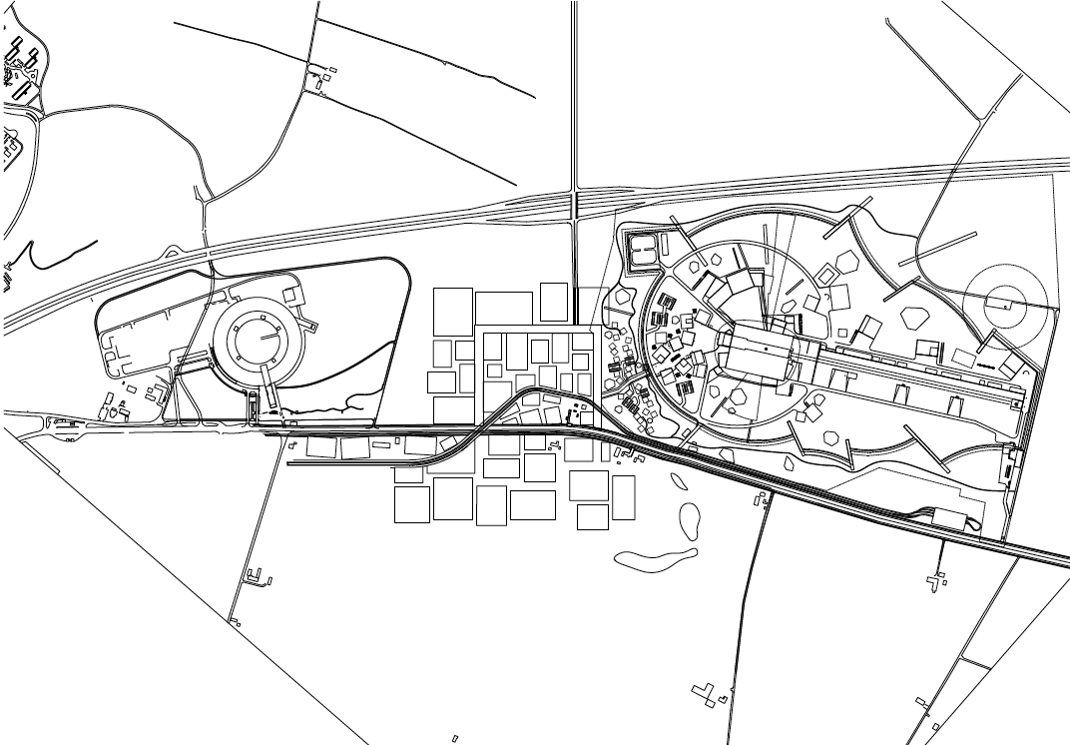
ESS is co-located with Max IV and Science Village in close proximity to Lund
Lund
E22 Highway
ESS
Max IV
Science Village

Slide 18
The architecture of ESS
Architectural design competition Five architect consortia was preselected in an international architect competition and competed to design the ESS exterior. In February 2013 the winner was announced by the ESS jury: Henning Larsen Architects was selected to develop the final architectural design together with the ESS team.

Slide 19
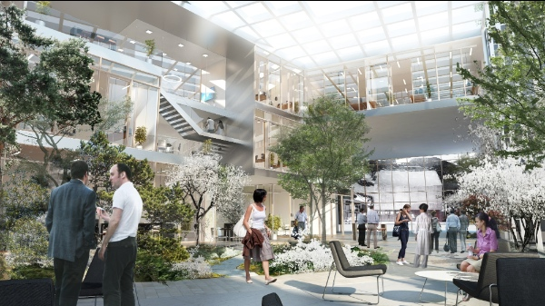
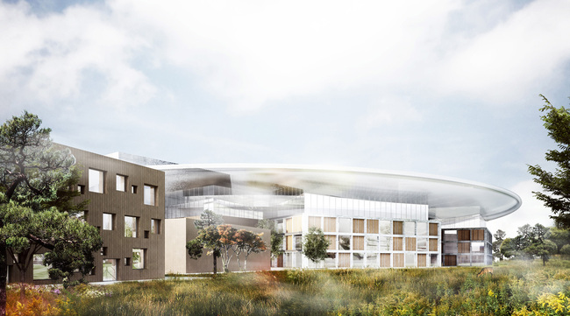
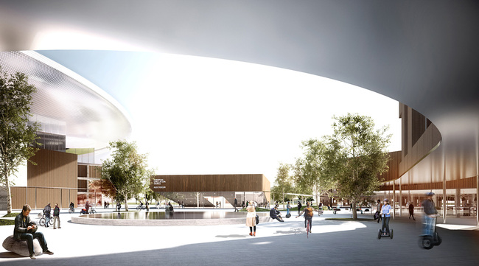
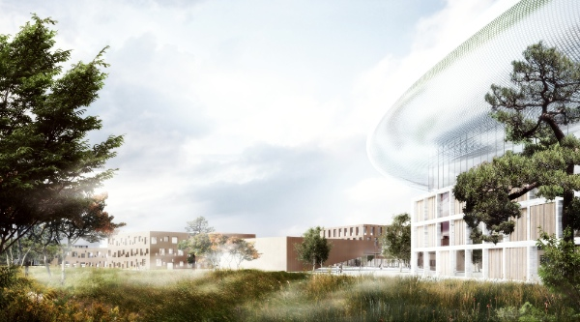
Architectural Concepts

Slide 20
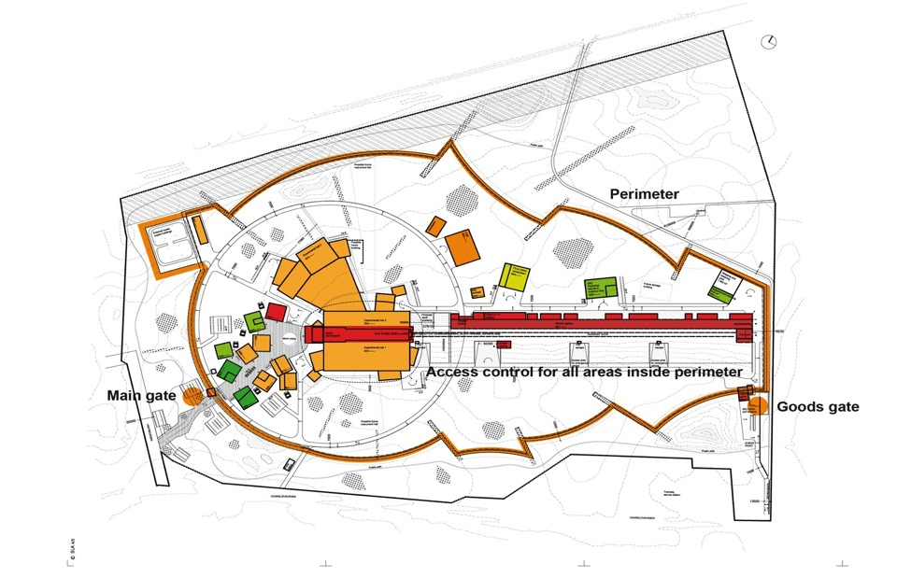
The ESS Site covers 75 hectares
~ 1,2 km

Slide 21
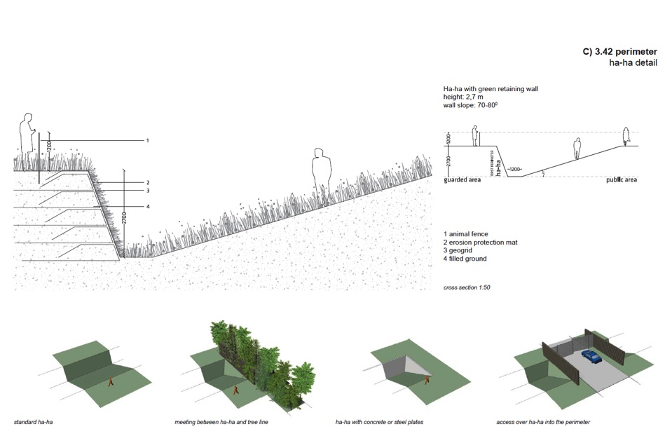
Perimeter detail 2013-10-25
Conventional facilities | EPG 2013-10-28 | Masterplan Baseline

Slide 22
Accelerator Buildings without berm

Slide 23
Section through Tunnel

Slide 24
Gallery and Tunnel Colored volumes represent the machine

Slide 25
Section through A2T

Slide 26
HVAC and A2T

Slide 28
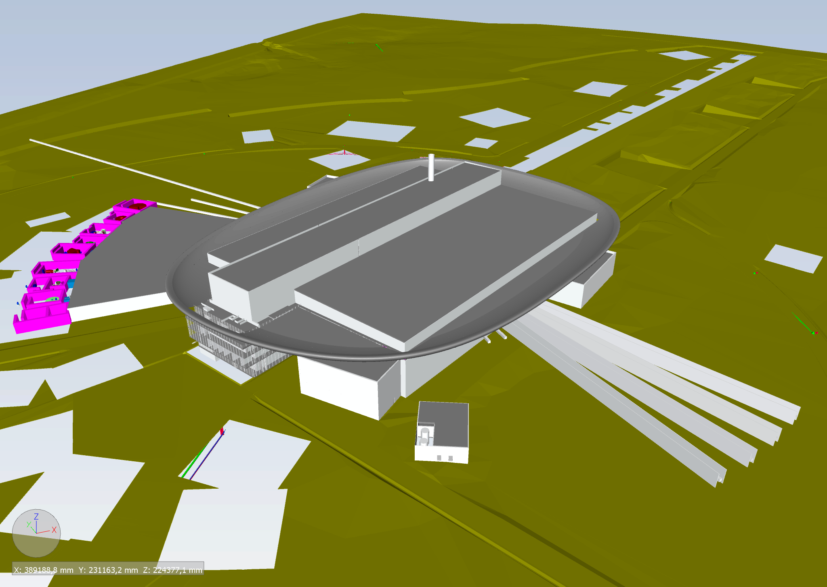

Slide 55
