Slide 1

IKON6
Lund, February 26th 2014
Jim Yeck
CEO & Director General

Slide 2
Outline
Technical Progress, Funding, and 2014 Milestones
Licensing and Civil Construction
Construction Preparations and In-kind Goals
1st Annual Review Results
Planning for Initial Operations and Ramp-up Phase
Status of Instrument Proposals (if time allows)

Slide 3


















Largest European science project
Sweden,
Denmark and Norway:
50% of construction
15-20% of operations
European partners:
50% of construction

Slide 4
ESS organization for construction phase

Slide 5
ESS transition from ESS AB to an ERIC
Member countries will submit a formal application to establish a European Research Infrastructure Consortium (ERIC) for ESS. The ESS ERIC will be in place in early 2015.

Slide 6
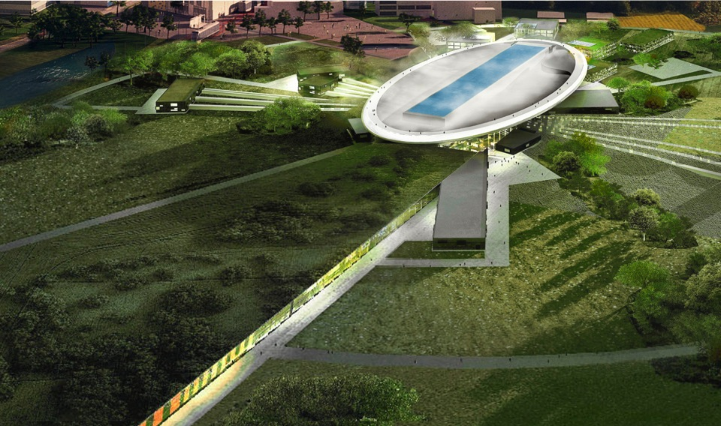
Road to realizing the world’s leading facility for research using neutrons
2025
ESS construction complete
2014
Construction work starts on the site
2023
ESS starts
user program
2009
Decision: ESS will be built in Lund
2019
First neutrons on instruments
2012
ESS Design Update phase complete
2003
First European design effort of ESS completed

Slide 7
Preparing the project performance baseline
Deliver on TDR performance and STC commitments
  5 MW accelerator capability
  Construction cost of 1,843 B€
  Operations cost target of 140 M€ per year
  22 “public” instruments
Start w/ unconstrained resources (technically limited schedule) and develop credible project execution plans
Comprehensive review of project baseline and execution plans
Secure funding and resources and align schedules with the available resources

Slide 8
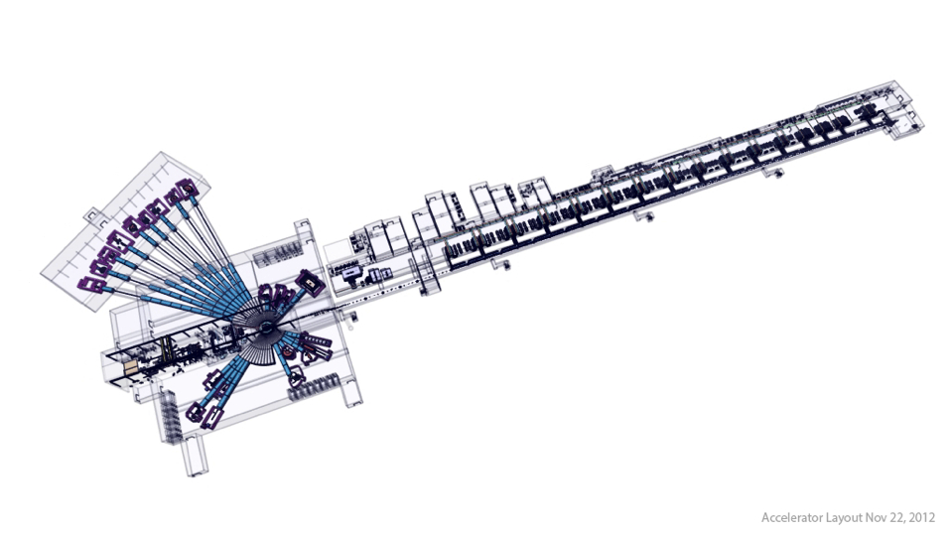
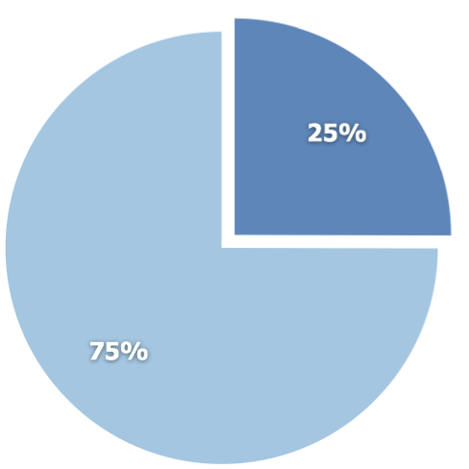
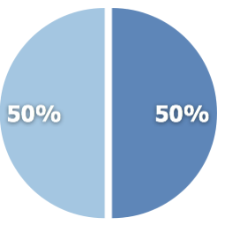
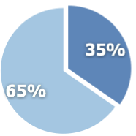
ESS In-kind contributions potential
Total construction cost:
€ 1,84 billion
Target station
€ 154M
Accelerator
€ 510M
In-kind
NSS/Instruments
€ 350M
Cash
Potential In-kind identified is ~36%. Working to increase potential above 40%.

Slide 9
Critical Path
Licencing
Accelerator Buildings
Licensing
ConvF
Spoke & Medium Beta CM
(Prod&Inst&Comm)
AccSys
NSS
High Beta CM
(Prod&Inst&Comm)
Instrument Construction
Ground break
First installations
on-site (ACCSYS)
First Beam
on Target (570 MeV)
Machine installed
for 2.0 GeV
Last of Instr Const
Instr HO to Op

Slide 10
2014 top level milestones
ID | Name | Proj | Planned | Forecast | Actual
G1500 | Start of Concept Design for instrument 1-3 | NSS | 7 Jan | 7 Jan | 7 Jan
G5220 | Start of Detail Design Accelerator Building | Convf | 7 Jan | 18 Feb
G5180 | Contract C101 Signed | Convf | 18 Feb | 18 Feb
 | First in-kind contracts presented to IKRC | Accsys | 7 Mar | 7 Mar
G8000 | Establish the ES&H Advisory Committee | Admin | 31 Mar | 31 Mar
G28900 | SSM Permit | Licens | 30 Apr | 31 July
G63640 | Moderator Concept Finalized | Target | 30 Apr | 30 Apr
G5040 | Environmental Court Verdict | Licens | 14 May | 30 May
G8010 | Annual Review update | Admin | 26 May | 26 May
G5060 | Ground Break | Convf | 2 Jun | 2 Jun
G1665 | Decision on 2013 Instrument proposals (instr. 4 plus ) | NSS | 1 Oct* | 1 Oct
G36450 | Lattice database version 2 available | ICS | 30 Jun | 30 Jun
G63720 | Preliminary design review of beam extraction | Target & NSS | 10 Jul | 10 Jul
G36460 | ICS Hardware Platform freeze | ICS | 30 Sep | 30 Sep
G36470 | Audit on MPS technical design specification finished | ICS | 1 Oct | 28 Nov
G31210 | Cryogenic transfer line ordered | Accsys | 8 Oct | 8 Oct
G31250 | Spoke Cavity Prototype available For Uppsala test stand | Accsys | 3 Nov | 3 Nov
G148900 | Start construction of Tunnel G01 | Convf | 18 Nov | 18 Nov
G1460 | Define and implement the In-kind collaboration model for the construction of the neutron instruments | NSS | 19 Dec | 19 Dec
*) The decision on 2013 instrument proposals will be taken at the September STC meeting

Slide 11
Licensing – status and plans
2014
Jan | Feb | Mar | Apr | May | Jun | Jul | Aug | Sep | Oct | Nov | Dec
Environmental Court
SSM Opinion to Court
Main Hearing April 25th
Court ruling and permit
Ground break June 2nd
Radiation Safety Authority (SSM)
Public announcement: Info from ESS complete for construction permit
Reviews and reports
Assessment
Issue of permit to construct
Start of concrete works
EU Notification, Euratom art 37
~6 month process
EU Opinion needed before permit for
testing and operations
Swedish Environmental Court requires EU Opinion before main hearing. ESS, with support of SSM and EU, is appealing this position. Decision 10 March 2014.

Slide 12
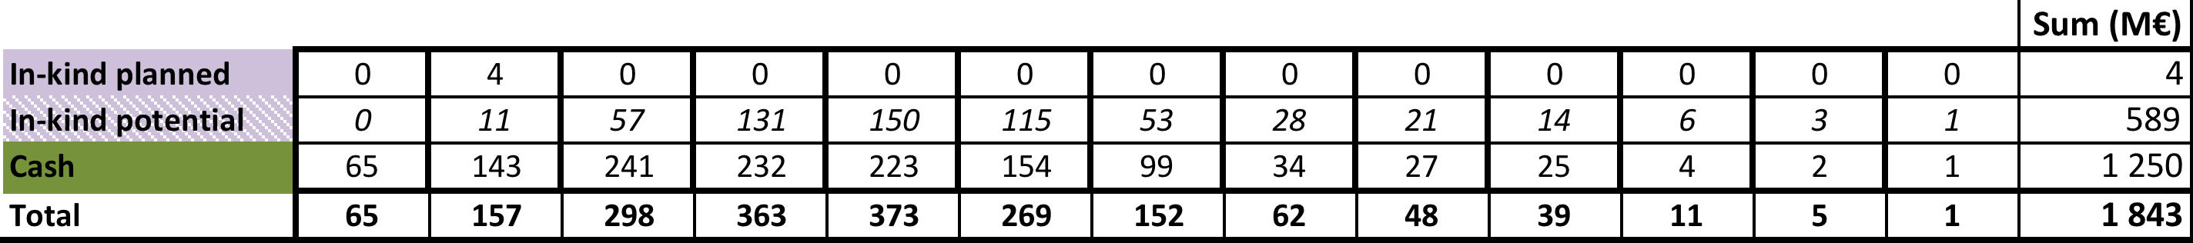
Cash vs. In-kind

Slide 13
November review charge
∗ A Performance Measurement Baseline (PMB) is an integrated work plan made up of a sequence of activities which cover the complete scope, cost and schedule of a project. Once the PMB established and approved, the PMB can be used to evaluate actual cost and schedule performance to determine whether the project is meeting its planned scope, cost and schedule objectives.

Slide 15
First impressions
The first ESS annual review took place at LUND the 12th-14th November 2013
Present : ESS project team, 33 members of the review team organized in 7 subcommittees and 7 observers (see next slide for details)
First impressions:
The review committee congratulates the ESS team and its management for the quality of the material and presentations submitted to the reviewers
The ESS is now a real project from all points of view, well shaped and well organized. ESS is now managing to the established baseline.
A big effort was made in the last 10 months to build up an organization structure with names and clear responsibilities attached to it
The management of the project is strong, well determined, motivated and success oriented. The ESS overall schedule foresees first protons on target in December 2019. The cost cap has been fixed to 1.843 Beuro (year 2013).
ESS will start real construction work in June 2014 (ground break)

Slide 16
TOP 10 recommendations
Appoint a technical manager of the entire project, as a direct report to the CEO/DG (deputy DG?).
Develop a plan to maximize the in-kind contributions to NSS
Establish a clear process for freezing and enforcing controls to changes to interface requirements to contain cost and schedule impacts. CF is particularly urgent.
Reassess the entire staffing procedure and schedule. Come up with a realistic plan.
Put in place the necessary manpower and procedures for the procurements planned in 2014.
Solve the HR contract problems related to short, long time visitors and in-kind manpower.
Relook at the assumption of beam line losses of 1W/m and establish consequences if different.
Prepare a project plan for the ICS personnel safety system by April 2014.
Get the LOI process for in-kind ready before April 2014.
Confirm the exact responsibility of the host countries on CF procurements and contracts. Ensure that the process for selecting the contractor is robust to limit the possibility of challenges that might cause unnecessary delays.

Slide 17
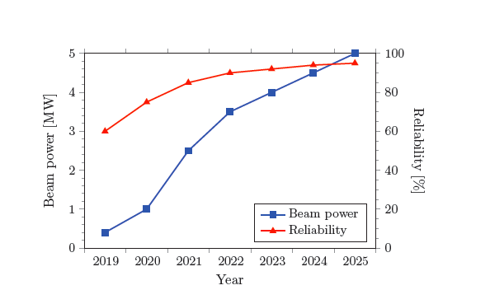
Commissioning and operations
Criteria for start of Initial Operations:
Deliver a measurable number of moderated neutrons to an instrument.
TDR Performance Goals
Strategy
Initially keep radioactivity
and doses low to allow
hands on maintenance.
Ramp up power quickly
to find limitations and
increase reliability
before user operations
start.
Initial User Ops

Slide 18
Initial Operations planning & budget
Status of activity and resource planning for transition to operations

Slide 19
1st six months of 2014
1st Annual Review action plans
Letters of Intent or Agreements with Member countries ☑☑☐☐☐….
Demonstrate accelerator and target station technology readiness
– key interfaces resolved for a civil construction start
Continue engagement of the scientific user community and
select initial instruments for engineering development
– first three instruments in 2013, additional instruments in 2014
Select conventional facilities partner company/start final design in Feb 2014 ☑
Secure license and permits for facility construction and establish Project Performance Measurement Baseline by May 2014
Start facility construction!

Slide 20
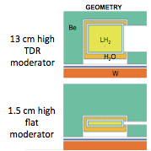
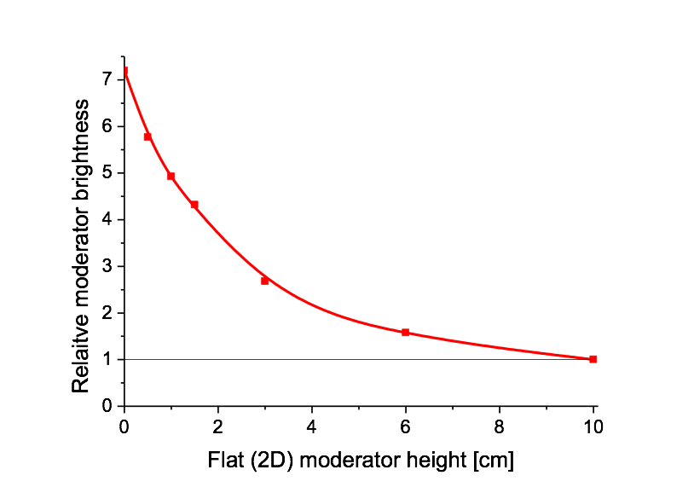
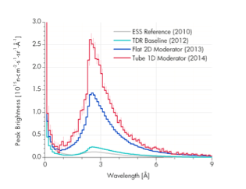
Enhanced flux neutron moderators
New moderator concept
  Mechanism understood
  Works for all neutron sources, including reactors
Harmonization with instrument suite
  Complex optimization is in progress for the potential instrument suite and sample sizes
  Collaboration within ESS (Instruments and Target) and with the Instrument Consortia from our partners
Timeline and milestones
  Feb. 12: 1st moderator workshop, refine parameter space for further optimization
  March, second half: 2nd moderator workshop
  April 30: New moderator configuration to CCB

Slide 21
~100 external experts advise on the development of the ESS instrument suite
STAP: Scientific and Technical Advisory Panel. One for each instrument class.
Powder Diffraction
Chair: Bo Brummerstedt Iversen, Aarhus University, DK.
10 members.
Imaging
Chair: Muhammad Arif, NIST, US.
5 members.
Scientific Advisory Committee (SAC)
Chair: Aleksandar Matic, Chalmers University of Technology, SE.
Co-chair:
Peter Böni, Technische Universität München, DE.
23 members.
Small-Angle Neutron Scattering
Chair: Richard Heenan, ISIS, UK.
11 members.
Single-Crystal Diffraction
Chair: tbd.
7 members.
Direct-Geometry Spectroscopy
Chair: Tobias Unruh, U. of Erlangen, DE.
7 members.
Europe’s Spallation Source
Macromolecular Diffraction
Chair: John Helliwell, U. of Manchester, UK.
5 members.
Materials and Engineering Diffraction
Chair: Michael Preuss, U. of Manchester, UK.
7 members.
Indirect-Geometry Spectroscopy
Chair: Philippe Bourges, LLB, FR.
6 members.
Reflectometry
Chair: Robert Dalgliesh, ISIS, UK.
11 members.
Fundamental and Particle Physics
Chair: W. Michael Snow, U. of Indiana, US.
8 members.
Neutron Spin-Echo Spectroscopy
Chair: Bela Farago, ILL, FR.
8 members.
The STAPs consist of 85 expert scientists from the international community
Each STAP advises ESS management and informs SAC.
SAC advises ESS management, who proposes to STC.

Slide 22
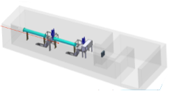



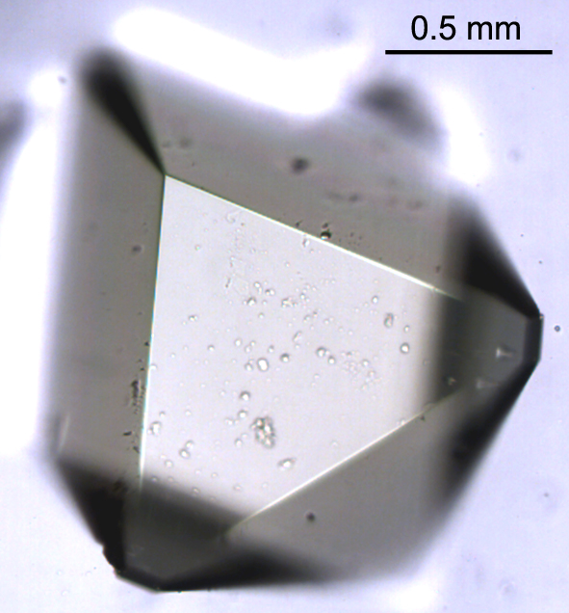
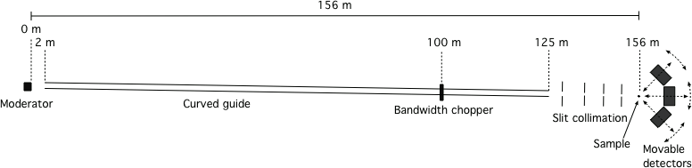


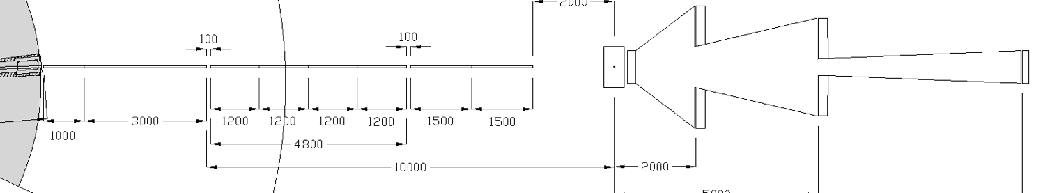

4 Instrument Concept Proposals in the 2012-2013 Round
Endorsed for development
ODIN - Optical and Diffraction Imaging with Neutrons
Endorsed for development
NMX Macromolecular Diffractometer
Compact SANS
~20m
SAC wished to see role within a wider suite of SANS and ESS instruments. Resubmitted.
Endorsed for development
LoKI - A Broad-Band SANS Instrument
Geo & engineering
Heritage
Magnetism
Soft matter
Life science
Chemistry

Slide 23

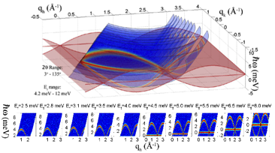
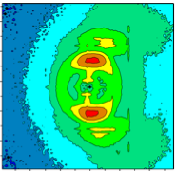
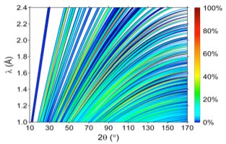
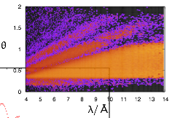
16 new instrument concept proposals in 2013-2014
Spectroscopy
VOR Wide Bandwidth Spectrometer
T-REX Bi-Spectral Spectrometer
ESS-CCS Cold Chopper Spectrometer
Tempus Fugit Time-Focusing Spectrometer
CAMEA Indirect Geometry Spectrometer
ESS-NSE Spin Echo Spectrometer
SKADI High Intensity SANS
Compact-SANS SANS Biology & Materials Science
ESS-ENG Engineering Diffractometer
MODI Monochromatic Diffractometer
HEIMDAL Thermal Powder Diffractometer
POWHOW Bi-Spectral Powder Diffractometer
FREIA Reflectometer for liquid interfaces
THOR Horizontal Reflectometer
ESS-PAREF Polarised Reflectometer
ESTIA Focusing Reflectometer
SANS
Diffraction
Reflectometry

Slide 24
ESS is ready for commitments
Commitment to share in support of ESS project phases: construction, initial operations and ramp-up, and steady state operations
Commitment to start construction!
  Each member’s share of total construction investment (LoI)
  Development of cash flow and In-kind plans
Commitment to work with the ESS organization to deliver 22 public instruments and the funding necessary for facility operations

