Slide 1
NSS Update and Instrument Construction
Rob Connatser
Head, Scientific Projects Division
www.europeanspallationsource.se
November 12, 2013

Slide 2
Introduction
NSS Status Update
In-kind Contributions
Annual Review Feedback
Instrument Construction: Phase 1
Instrument Construction: current status
WBS/PBS

Slide 3
Organisation
PSI
LLB
JCNS
European Spallation Source
Neutron Scattering Systems
Project Director
Instrument Concepts
Instrument Construction
Science Support Systems
DMSC
Instrument Technologies
Detector Systems
Chopper Systems
Neutron Opt. & Shielding
Electrical Engineering
Instruments 1-n
HZG
FRM-II
ILL
CNR
ISIS
TU Delft
SNS
Sample Environment
Project structure closely aligned with the structure of the ‘Line Organisation’
Replace circles with logos
Notes:
Planner starting 6. November, Seconded Engineer from ANSTO starting 25. November. Total number of staff in Science Directorate: 46

Slide 4
Neutron Scattering Systems Status
Building Core Teams in all Divisions and Groups
Working to implement Annual Review Recommendations
Supporting the three instrument projects in Phase 1
Continuing to work with other parts of ESS
Operations planning
Providing requirements and coordinating space and infrastructure needs to Conventional Facilities
Interfacing with Target Systems

Slide 5
In-kind and Design Update
The NSS project managed a total of 47 in-kind contributions that are part of the “ESS Design Update Phase”. The last ones were recently presented to the Preliminary In-Kind Review Committee (PIKRC).
1
7
Lessons learnt
Negotiating deliverables
Experiencing in-kind framework
9
4
1
3
Identified potential in-kind partners and interact with them…one-to-one, EoI’s or IKON meetings…
22

Slide 6
In-kind and Procurement
PSI
TU Delft
LLB
FRM-II
HZG
JCNS
CNR
ILL
ISIS
SNS
Potential for in-kind contributions
Instrument Concepts WU
≥50%
Science Support Systems
≥30%
Instrument Construction (per instrument ≥70%)
Total ~70%
Instrument Technologies
≥16%
DMSC
≥50%
Current estimate of in-kind potential is about 50% of the NSS total budget (~175 Mio€)
Opportunity to access expertise, knowledge and skills that ESS as a “Green Field” site does not yet have Note: Not a complete list of partners

Slide 7
Annual Review Charge for NSS
• To review the technical design and specifications of the NSS
• To assess the maturity of scope definition, cost, schedule and risk of the NSS
• To assess the readiness of the NSS management team and adequacy of staffing for move to construction phase
• To assess the appropriateness of the plans for managing in kind contributions

Slide 8
Review Summary
Provide an independent assessment and recommendations on NSS Status and Brief Description of Present Achievements The NSS project team has done a commendable job in the establishment and implementation of a process for engaging the EU community in the instrument selection process
Neutron technologies division has identified key competencies required to be managed in-house and recruited competent leaders in all those areas Progress towards initiation of construction of the first three instruments is well advanced
Concept development and design of essential neutron beam infrastructure (transport systems, detection, automation, DAE etc.) is progressing in timely manner

Slide 9
Annual Review Recommendations
8 Recommendations
Conduct a project level review of the NSS budget to reduce the risk of delivering less than 16 instruments to an acceptable level
Establish an acceptable scope for NSS, consistent with budgetary constraints and seek endorsement of stakeholders
Establish agreements with in-kind partners for implementation of instrument development and construction, and for bringing those instruments to full potential
Reassess instrument construction costs, with due consideration of the impact of a high proportion of in kind contributions
Focus existing personnel on attracting in-kind contributions and establishing interfaces /standards to accommodate those
Maximize consolidation of procurements for key components with other subprojects (e.g. steel, concrete...)
Establish a detailed work program for the Data Management and Software Centre including a time-line for recruiting staff
Conduct an independent assessment of instrument construction cost, with 1st level cost differentiation (e.g. low, medium and high cost prototypes)
Notes:
Internal workshops, reassessment of all work packages, internal follow up on Chopper & Detector systems & TAPs: Objective to update project plan by 31 March 2014
Scope: Construction budget of 350 M€ consistent with 16 public instruments and supporting infrastructure; 6 final public instruments to be financed out of pre-ops and ops money; instrument 22 construction ends in 2028.
Workshop with partners previous two days. Follow on activities are being planned.
Workshop at end of March with partners on developing a consistent model for instrument costs, revisions to cost book.
Connect personnel at all levels within NSS with partners for finding areas of interest for in-kind partnerships.
On-going- see Mark’s talk tomorrow.

Slide 10
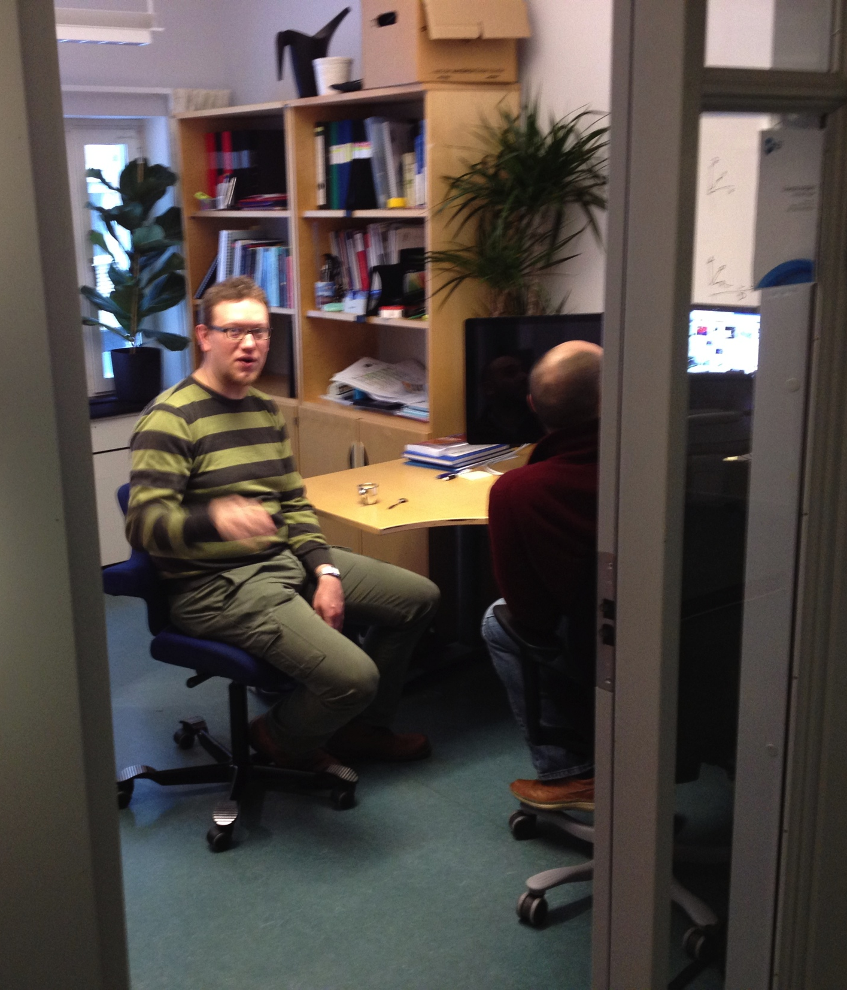
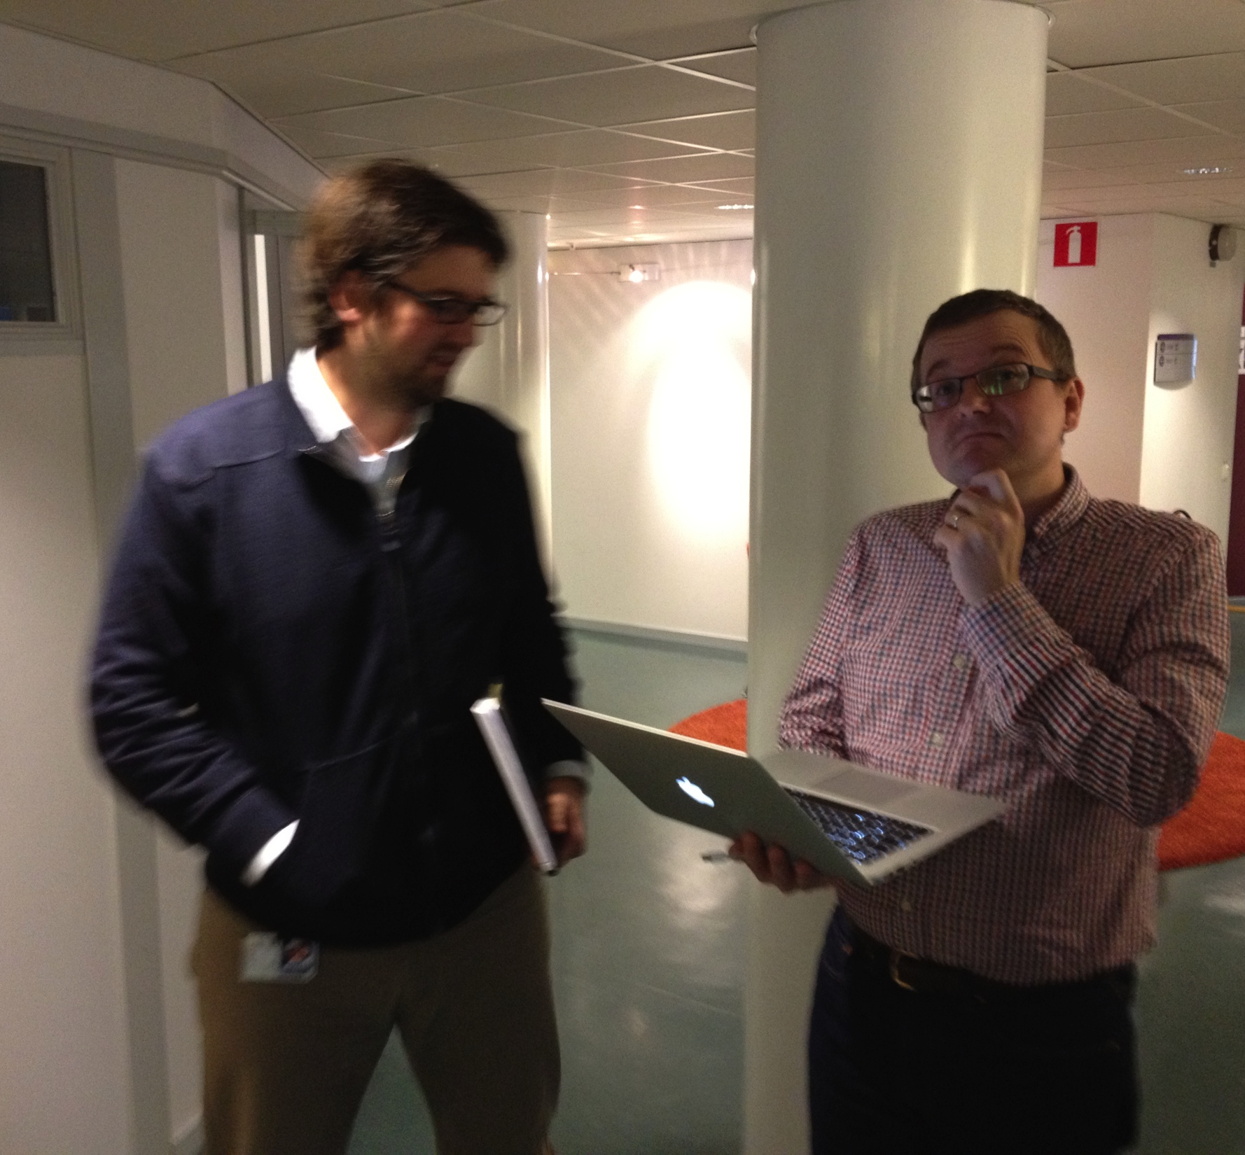
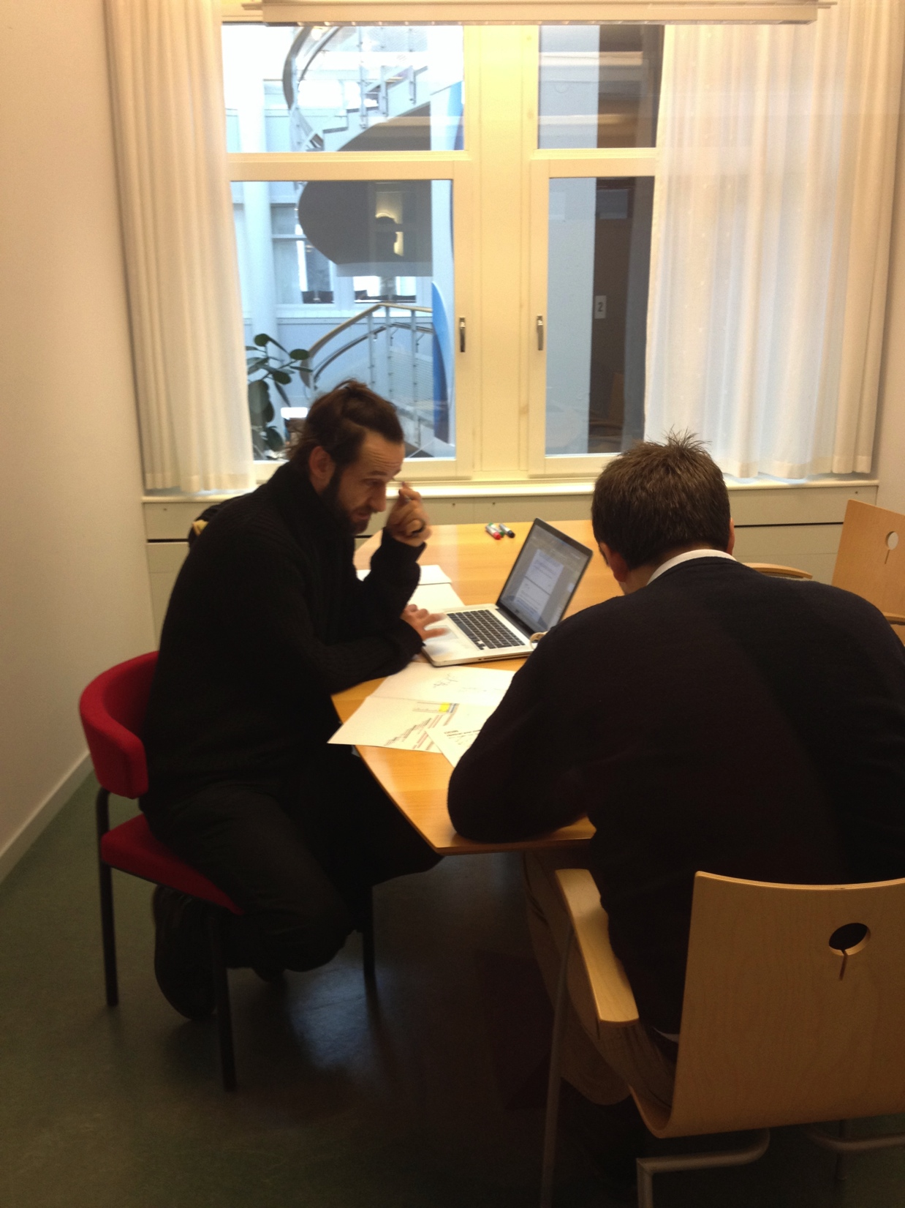
Instrument Construction Update
Work beginning on first instrument projects

Slide 11
Instrument Construction Update
Three instrument in Phase 1
Bunker engineering and shielding modeling underway
Continuing to develop processes, focusing on incorporation of in-kind resources and institutions
Meet and connect with partners

Slide 12
STC
Approval
Phase 1 – Preliminary Engineering
Design and Baseline
Decision
to move forward
Approved
Baseline
Design,
Cost
and Schedule
Phase 2 – Final Engineering
Design and Installation Plan
Engineering
Review
Phase 3 – Construction
and Installation
Safety Systems
Review
Readiness for
“Hot”
Commissioning
“Hot”
Commissioning
and Operations
Phase 4 – Beam Testing
and cold Commissioning

Slide 13
Phase 1 – Preliminary Engineering Design
Accepted Instrument Concept
Refine technical requirements
Develop designs and requirements of technical components.
Baseline
Instrument Scientist
Scientific Partners
Partner Institutions
Lead Engineer
Technical Groups
Planner
Prepare 3D model
Refine costs and estimates
Develop budget, schedule, plans with partners
Make a plan
Notes:
WHAT is going on?

Slide 14
Phase 1 Resources
Resources Person-years/value Funding Source
Instrument Scientist 0.8 Instrument WP
Instrument Engineer 1.0 Instrument WP
Planner 0.33 Programme Office
Chopper Team Member 0.25 Instrument WP
Detector Team Member 0.5 Instrument WP
Electr. Eng. Team Member 0.25 Instrument WP
Optics Team Member 0.5 Instrument WP
DMSC Team Member 0.1 DMSC SP
Travel budget 10k€ Instrument WP
Equipment budget 10k€ Instrument WP
STAP mid-year meeting 6k€ Instrument Concepts WP
STAP Review 1 6k€ Instrument Concepts WP
Engineering Review 1 8k€ Instrument WP
Notes:
What resources do I have?

Slide 15
Baseline Documents
Baseline Documents:
Instrument Work Package Specification
P&ID of Instrument
Requirements & Interface documentation
Schedule
Budget
Work unit documentation describing in-kind partner agreements
3D CAD model of instrument envelope
Technical Group design documents
Draft Commissioning Plan
Notes:
What do I have to make?

Slide 16
Functional Requirements Overview for LoKI
The Neutron guide system should deliver to the sample neutrons within the wavelength band 2-22Å (1).
The Neutron Guide System should be optimized to maximize transport of neutrons in the wavelength band 2-22Å (2)
The Neutron Guide System should be optimized to minimize transport of neutrons outside the wavelength band 2-22Å (3)
The Neutron guide system should not permit prompt Pulse noise to interfere with the scatter signal, noise from prompt pulse should be below 1% of signal (8)
The Neutron Guide system should deliver a flux to sample no less than 1X10⁹ N/cm²/sec. (4)
The collimation system should provide variable collimation up to ±0.6° (9)
The neutron optics system should collimate the beam prior to sample to have a divergence no greater than ±0.6° (7)
The neutron guide system should be optimized to maximize the transport of neutrons with divergence less than ±0.6° (5)
The neutron guide system should be optimized to minimize the transport of neutrons with divergence greater than ±0.6° (6)
The collimation system should provide collimation lengths of 2, 5, 10m (10)
The collimation system should not produce additional background signal (11)
The collimation system should provide for variable beam geometries at the sample 1mm² to 3mm². (12)
Wavelength bandwidth (Δλ) should be selectable between 0.4 to 20Å (15)
The selected wavelength band should be delivered from the full source pulse (18)
The neutron pulse frequency should be 7hz and 14Hz (16)
Frame overlap should be prevented (14)
Transmission of choppers when closed should be less than 1X10⁻⁶ (17)
The chopper system should accommodate maximum guide dimensions of 30X30mm (19)
The available Q range should be 1X10⁻³Å⁻¹ to 1Å⁻¹ (20)
….
Partial DRAFT

Slide 17
Tollgate 2 Review
AKA “Decision to move forward”
Two major components:
Scientific
Engineering & Project

Slide 18
Tollgate 2 Scientific Review
Does the instrument meet its stated performance parameters?
Has the science case evolved and how does that impact the instrument design?
Does the instrument meet the needs of its science case?
Does the layout of the instrument support the operation and use of the instrument?
Does this instrument meet the users’ needs for infrastructure, sample handling, sample manipulation, etc. ?
Can it be operated safely?
Do the proposed sample environments and user support facilities meet the needs of the users and match the science case for the instrument?
Does the draft commissioning plan sufficiently evaluate the instrument and prove that the instrument works as proposed?

Slide 19
Tollgate 2 Engineering & Project Review
Is the proposal feasible to build?
Do the partners have the resources and expertise needed?
Has the team identified all of the appropriate interfaces?
Has the team followed the ESS engineering and technical standards?
Can it be operated safely?
Are the cost and duration estimates reasonable?
Has the team planned appropriately for the risks, both technical and otherwise?
More or less?

Slide 20
WBS & PBS
Work Breakdown Structure
Section 01: Phase 1
Section 02: Project Management, Integrated Design, & System Integration
Section 03: Design
Section 04: Procurement, Fabrication, & Validation
Section 05: Installation & Verification
Section 06: Cold Commissioning

Slide 21
WBS & PBS
Work Breakdown Structure
Section 01: Phase 1
Section 02: Project Management, Integrated Design, & System Integration [Scientist & Engineer]
Section 03: Design
Section 04: Procurement, Fabrication, & Validation
Section 05: Installation & Verification
Section 06: Cold Commissioning [personnel]

Slide 22
WBS & PBS
Work Breakdown Structure
Section 01: Phase 1
Section 02: Project Management, Integrated Design, & System Integration
Section 03: Design
Section 04: Procurement, Fabrication, & Validation
Section 05: Installation & Verification
Section 06: Cold Commissioning

Slide 23
WBS & PBS
Work Breakdown Structure
Section 01: Phase 1
Section 02: Project Management, Integrated Design, & System Integration
Section 03: Design
PBS
Section 04: Procurement, Fabrication, & Validation
PBS
Section 05: Installation & Verification
PBS
Section 06: Cold Commissioning

Slide 24
PBS

Slide 25
Partnerships with Instrument Teams
As the WBS & PBS are developed, Instrument Teams are looking for partners to work with for realizing the instrument.
Work Units will be developed with these partners specifying deliverables.

Slide 26
Thank you!

