Slide 1
Science Directorate Instrument Technologies division Neutron Chopper Group Update IKON6
Iain Sutton
Neutron Chopper Group Leader
www.europeanspallationsource.se
February 26, 2014
Notes:
Good morning
My name is Iain Sutton
I am currently the Group leader for Neutron choppers
And In the following 10mn I will attempt to present the Status and strategy of NG Tech work package

Slide 2
The story so far….

Slide 3
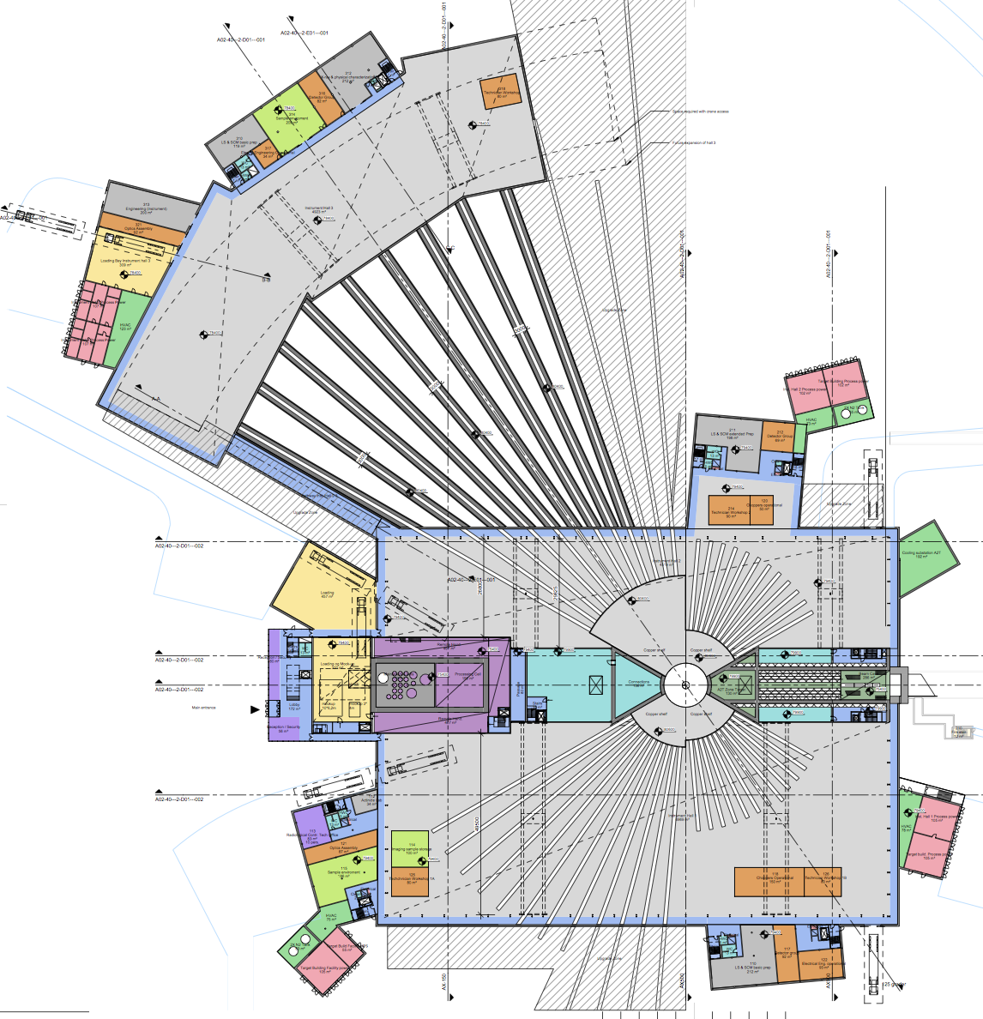

Slide 4
Spallation source instruments
BEAM SHUTTER
-HEAVY
DETECTOR
-BEAM MONITOR
Cut away of LET on TS2
Courtesy of ISIS
NEUTRON OPTICS
- IN MONOLITH GUIDE
BEAM LINE SHIELDING
PHOTO ISIS Instrument
- overlay schematic components
CHOPPER 1
CHOPPER 2
DETECTOR
-BEAM MONITOR
BEAM SHUTTER
-LIGHT
NEUTRON OPTICS
- GUIDE
NEUTRON OPTICS
- COLLIMATION
NEUTRON OPTICS
- POLARIZER
FLIGHT TANK
SAMPLE
ENVIRONMENT
CHOPPER 3
DETECTOR
-BEAM MONITOR
DETECTOR
-ARRAY
Notes:
----- Meeting Notes (2/26/14 12:36) -----
The basic anatomy of a neutron spectrometer at a spalation source
Suffice to say that choppers are one of the principal components of most of them and that is unlikely to change at ESS

Slide 5
Bunker – Preliminary view
Notes:
What we may me doing a little differently that at other facilities is our approach to shielding
A highly intergrated approach between beamlines which currently supposes a common bunker housing the instruments fornt end
Including around 2 thirds of all the facilities choppers

Slide 6
Chopper cavities in Common shielding concept – side view
Bulk shield
- Access plug –
Steel (?)
Bulk shield
- upper –
Heavy concrete
Neutrons
Bulk shield
Mid section
Bulk shield
- lower -
R6m
R10m
Notes:
Bulk shielding – heavy concrete – grey
Removable sections for acces in green. (in steel)
Chopper and other equipment will be housed in cavities
Current thinking is to design and install as modules to aid removal
Removable sections less than 10.

Slide 7
Beam line separation < 10 deg Complicated chopper installation
Notes:
For this reason the installation of choppers within the shielding has come in for a lot of thought.
Particularly with respect to a decision on beamline separation
with an angular separations in multiples of 5 degrees seem probable.
Short and medium length instruments will likely be separated by 10 or 15 degrees
Long Instruments situated in Hall 3 would be separated by as little as 5
As one might imagine, close to the monolith this limits the space available for the all important 1st choppers and compromises will have to be made

Slide 8
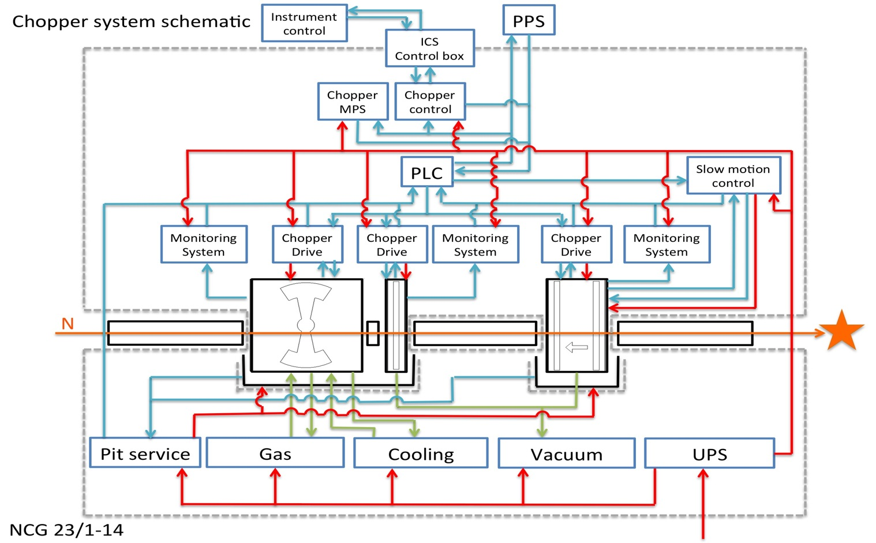
Intergrated Systems
NCG / E&E / DMSC
NCG / E& E / Integrated Control Systems
NCG / E & E Group
Neutron Chopper System
N0&S Group
N0&S Group
N0&S Group
Notes:
Choppers are not only tighly integrated with shielding
But also within the other systems composing and supporting an instrument
Much of this equipment is the responsibility of other groups within the company an the issues have to be worked out together …

Slide 9
Chopper Interfaces & Stake holders
DMSC
ICS
Detectors
Instrument
control Software
Control Network
HW / SW
Time stamping
Data acquisition
Software
Chopper
Hi level Control algorithms
Communication
protocols
Timing
signals
Data Veto
Instrument #1
Chopper
Control
HW/SW
Control
Box
Instrument specific control parameters
Control box
Software
(device driver)
E &E Group
Chopper Integrated Slow motion
Control
Electronic
Hardware &
Middleware
Instrument specific installations
Neutron Chopper Systems
Instrument #2
Servo Control
Electronics & Parameters
Motion control
Software
Instrument specific components
Instrument availability
Sample
Environment
Instrument # 22
Chopper
Mechanic
systems
Chopper
Support
Systems
Guide-Chopper Interface
Crane access & capacity
Alignment
Personnel Safety
Systems
Integrated
Beamline
shielding
Vacuum systems
Neutron optics
Machine Protection Systems
Operating schedule
Cooling /
heat recovery
Containment
Optics &
Shielding
Electrical Power & UPS
Facility
Target
Contamination
Safe working
practices
Ventilation
Health &
Safety
Monolith / instrument interface
Building Services
Notes:
In fact if you just try to identify the primary stakeholders and proximate issues concerning choppers you come up with something like this
I think you will agree it’s quiet a bundle
Establishing interfaces and tying up the loose end is currently proving quiet a challenge
But it’s a vital building block to enable the design and operation of instruments
Lets look at just one of these interfaces …

Slide 10
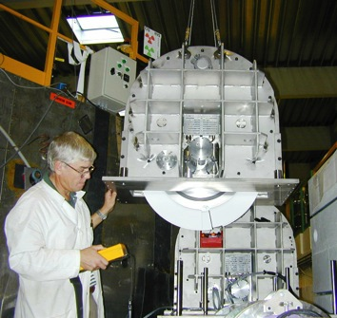
Interfaces: Chopper-Optics-Shielding
Key Objectives
Highest neutronic performance for instruments
Low back ground @ Detector
Highest instruments availability
Lowest lifetime costs
Input to instrument construction projects
Interface definitions
Chopper-Optics
Guidelines for design
Installation
Access / Serviceability
Integration of shielding
Policies
Alignment /Vacuum /Access /Activation
Equipment standards for procurement
Common housing strategies
Vertical split
Guide removed with Choppers
Horizontal split
Guide remains in lower housing
Notes:
Very obvious and real interface Choppers / Guides
With the increased complexity of ESS choppers systems the numer of these interfaces is increased
Intergration
with guides
with shielding
Ensuring serviceability within shielding…
The list goes on…
The result of this effort will be condensed into a number of documents – many in the form of guidelines for instruments
Its important to the design of each instrument
But equally to the operation of the instrument as a whole
We do …. so you do not have to.

Slide 11
A preliminary review of chopper systems included in current proposals
Proposal round 2013
Notes:
Turning aside from the current preparations for construction I would like to share with you a brief look at some of chopper systems might look like

Slide 12
NMX
Chopper system schematic
Status: P1-P.Design
EQUIP ACCESS ZONE
CLASS : BLACK
EQUIP ACCESS ZONE
CLASS : GREEN
Sector: W
Beam-port: W12
2PA-02 (FTF)
2PA-02 (FTF)
BEAM PORT
GUIDE
GUIDE
GUIDE
L 20 50 156
# 1-2 3-4
FUNCTION
BW SELECTION
BW SELECTION
NOTES
14Hz, D700
14Hz, D700
Notes:
Wide range of designs and system complexities
Ranging from No choppers to more than 20
These are simple ‘stick representations’ and I do not propose to analyse them at length
But flick though a number to give you an over view
Source on the left
Sample on the right

Slide 13
CS/ VOR
Sector: Beam port: NA
Schematic
Phase 0: Proposal
COMMON SHIELDING
2PA-01-M-350 (CR)
2PA-01-M-!$) (FTF)
2PA-01-M-400(CR)
2PA-01-M-350 (CR)
PA-02 (-M-14)
SHUTTER
GUIDE
BEAM PORT
SHUTTER
GUIDE
GUIDE
# 1-2 3-4 5 6-7 8-9
L 8 16-16.05
POSSIBLE SHUTTER POSITION
POSSIBLE SHUTTER POSITION
FUNCTION
PULSE SHAPING
RRM
PHASE(D) / CO
MONOCHROMATOR
BAND WIDTH
NOTES

Slide 14
RF/ FREIA v2.0
Schematic
Sector: E/N Beam-port: ?
Status: P0-Proposal
EQUIPT ACCESS CLASS : ORANGE
EQUIPT ACCESS CLASS : GREEN
2PA-02 (FTF)
PA-02 (DC)
2PA-02 (FTF)
PA-02 (DC)
PA-02 (DC)
2PA-02 (FTF)
GUIDE
2PA-02 (UO)
BEAM PORT
GUIDE
GUIDE
GUIDE
GUIDE
GUIDE
GUIDE
L 6.5/6.6 7.1/7.5 8,5 10/10.1 11.1 15 15,6 25
# 1-2 3 -4 5 6-7 8 9-10 11
WAVELENGTH BAND DEFINING
WAVELENGTH BAND DEFINING
WAVELENGTH BAND DEFINING
FUNCTION
PULSE SHAPING
FRAME OVERLAP
FRAME OVERLAP
FRAME OVERLAP
NOTES
56Hz, D1300
7-14Hz, D1300
7-14Hz, D1300
7-14Hz, D700
56Hz, D1300
42Hz, D1300
28Hz, D1500

Slide 15
PD/ HEIMDAL
Schematic
Status: P0-Proposal
EQUIPT ACCESS CLASS : BLACK
EQUIPT ACCESS CLASS : TBD
PA-02 (DC)
2PA-02 (FTF)
PA-02 (DC)
BEAM PORT
GUIDE
GUIDE
GUIDE
PA-02 (DC)
PA-02 (DC)
PA-02 (DC)
L 6,5 7 9 13 78 78,6 S = 169m
# 1 2 3 4 5 6 7
PULSE SELECTION (CT2)
BAND DEFINITION (CC1)
FRAME OVERLAP (CC3)
FRAME OVERLAP (CC3)
FRAME OVERLAP (CT3)
PULSE SHAPING (CT1)
FUNCTION
NOTES
280Hz, D700
14Hz, D1360
14Hz, D1280
14Hz, D1280
14Hz, D1280
14Hz, D700
Notes:
The typical number of choppers on a concept is 7.5
This figure is 3 time higher than the average of instruments at reactor sources and twice that of short pulse spallation sources
The is nothing surprising in this, it is a result of techniques required to get the most out of a long pulse

Slide 16
Schematic
Status: P1-P.Design
Sector: S
Beam-port: S12
IM-ODIN
EQUIP ACCESS ZONE
CLASS : BLACK
2PA-02 (FTF)
EQUIP ACCESS ZONE
CLASS : GREEN
2PA-02 (FTF)
2PA-02 (FTF)
2PA-02 (FTF)
2PA-02 (FTF)
2PA-02 (UO)
2PA-02 (UO)
2PA-02 (FTF)
2PA-02 (FTF)
BEAM PORT
GUIDE
GUIDE
GUIDE
GUIDE
GUIDE
GUIDE
GUIDE
PA-10 (PPSc)
GUIDE
L 6,5 7 9,25 10 11 12 16 20 30 40 60
# 1-2 3-4 5 6-7 8-9 10-11 12-13 14-15 16-17 18-19
FUNCTION
SUB FRAME OVERLAP
SUB FRAME OVERLAP
BAND WIDTH
SUB FRAME OVERLAP
PULSE SHAPING
SUB FRAME OVERLAP
SUB FRAME OVERLAP
PULSE SHAPING
PPS
BAND WIDTH
NOTES
56Hz, D700
56Hz, D700
28Hz, D700
3,5-14Hz, D700
3,5-14Hz, D700
14-42Hz, D700-2000
14-42Hz, D700-2000
14-42Hz, D700-2000
14-42Hz, D700-2000
14-42Hz, D700-2000

Slide 17
A Summary of Choppers for 22 Instruments, based on 3+16 instrument concepts
LOW
SPEED
INTERMEDIATE
SPEED
HIGH
SPEED
LARGE
ROTOR
FAN
PPSc
(15-35)
(27)
(30)
(3 -5)
(4-8)
(50-70)
2PA-02 (FTF)
2PA-02 (UO)
PA-02 (-M-14)
PA-02 (-M-14)
PA-10 (PPSc)
22 Instruments = 150 – 160 axis in 6 ‘platforms’
Notes:
Average choppers 7.5
Which 22 inst 150 -160 axis
By configuration, performance and requirements can be sub divided into 6 broad families
Small rotored disc chopper
Low / intermediate / high speed
Large rotored choppers

Slide 18
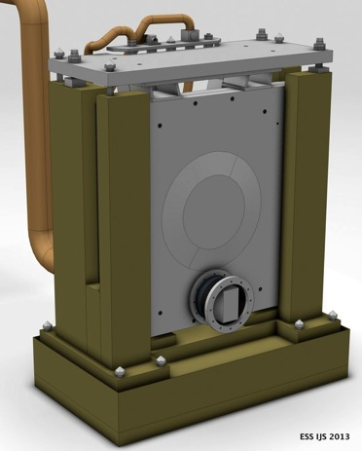
Platform 1 Disc chopper – Small rotor – Low speed
Key requirements
Rotation speed: Low ( 7 - 96 Hz)
Openings: Large
Attenuation at short wavelengths
High reliability in radiation environment
Low lifetime cost
Principal characteristics
Type: PA-1-H- (horizontal axis disc)
Rotors : Simple + Robust
Diameter: 600-800mm
Enabling Technologies .
Rotors materials: Metallic
Bearings: Magnetic
DC-SR
(50-70)

Slide 19
Platform 2 Disc chopper – Small rotor – Intermediate speed
Key requirements
Rotation speed: (96-192 Hz)
Openings: (Multiple) Small or Large
High reliability in radiation environment
Principal characteristics
Type: PA-1-H- (horizontal axis disc chopper)
Rotors: Simple or Optimized
Diameter: 600-800mm
Enabling Technologies .
Rotor material: CFRP / Alu
Bearings: Magnetic
DC-SR
(15-35)

Slide 20
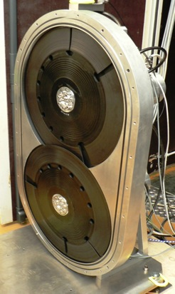
Platform 3: Disc chopper – Small rotor – High speed
Key requirements
Rotation speed: 192- 400+ Hz
Openings: (Multiple) Small
Minimal guide interruption
High reliability in radiation environment
Principal characteristics
Type : PA-1-H- (horizontal axis disc)
Rotors design: Optimised
Diameter : 600-700mm
Enabling Technologies .
Rotor material: CFRP / Ti / MMC
Bearings: Magnetic
DC-SR-HP
(25-35)
2.PA-1-H-M

Slide 21
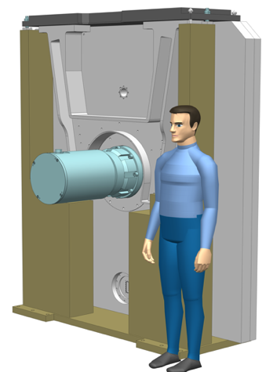
Platform 4: Disc chopper – Large rotor
Key requirements
Rotation speed: (7 - 56 Hz)
Openings: Multiple V.Large, Asymmetric
High closing speed
High reliability in radiation environment
Principal characteristics
Type: PA-1-H- (horizontal axis disc chopper)
Rotors: Optimized
Diameter: 1200 - 2000mm
Enabling Technologies .
Rotor material: CFRP / Alu
Bearings: Magnetic or Contact
DC-LR
(25-35)

Slide 22
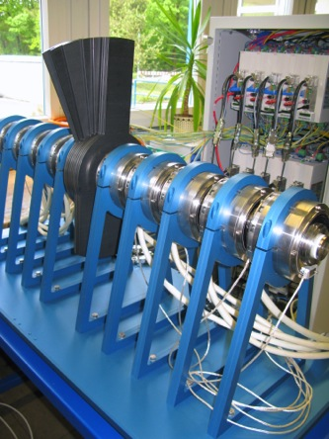
Platform 5: Disc chopper – Fan
Key requirements
Rotation speed: (7 - 56 Hz)
Openings: Variable width, Asymmetric
Principal characteristics
Type: XPA-1-H- (horizontal axis disc chopper)
Rotors: multiple concentric ‘Fan’
Diameter: 500 - 800mm
Enabling Technologies .
Rotor material: Aluminium
Bearings: Contact
DC-SR-FAN
(3-5)

Slide 23
Platform 6: Prompt pulse suppression chopper PPSc
Key requirements
Rotation speed: (7 - 56 Hz)
Closure: 3ms, Symmetric or Asymmetric
Attenuation : 90% @ Prompt pulse energies
Extreme radiation resistance
Principal characteristics
Type: PA-10-H- (horizontal axis chopper)
Rotors: 300 – 400 thick , single or double
Diameter: 500 - 600mm
Enabling Technologies .
Rotor material: Nickel alloy / Tungsten
Bearings: Magnetic
PPSc
(4-8)
PA-10 (PPSc)

Slide 24
approach
Objectives
Maximize instrument performance by considering the needs of the instrument suite and that of the facility globally and not case by case.
Increase the effectiveness of collaborations by matching partner competence and capacity to equipment needs.
Reduce development costs by avoiding duplication of effort and sharing equipment across several instruments
Ensure high serviceability to achieve highest standard of support to instruments in operation.
Notes:
Identify the common requirements of Science & the facility Serviceability, maintainability, instrument availability, and even cost effectiveness…
Increase serviceability and reduce costs through parts commonality.
Explore the potential for solutions which can meet ‘sub sets’ of requirements
Explore the potential for providing solutions within a family of choppers.
Match build partners technical & supply potential to family groups.

Slide 25
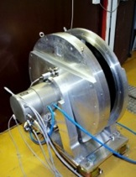
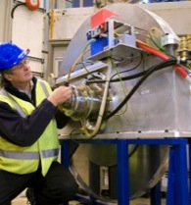
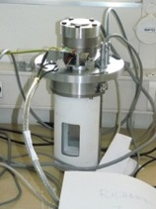
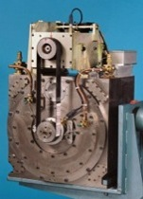
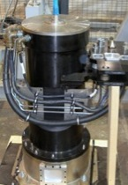
Procurement - Some options : for ‘standard’ systems
SYSTEMS
SYSTEMS INTERGRATORS
TECHNOLOGY PROVIDERS
Notes:
Despite the fact that ESS unique many of the systems may be constructed for existing industry standard or ‘near standard’ components
Typical disc choppers / fermi
Commercial suppliers

Slide 26
Procurement options - some ideas for ‘long pulse specific’ systems ?
SYSTEMS INTERGRATORS
Notes:
ESS unique requirements
Unique Long pulse will require some equally unique solutions
Special PPSc choppers adapted to the long pulse and higher energies
Completely unique large rotor choppers
Diameters 2 or more meters
Critical to employing the WFM and (RRM ?) techniques an harnessing the potential of the long pulse
No european commercial suppliers for complete systems
Current spallation sources design own
Suppliers of critical subsystems are known and we propose to work with them in much the same manner

Slide 27
Development & Build partners the discussion is open …
LOW
SPEED
INTERMEDIATE
SPEED
HIGH
SPEED
LARGE
ROTOR
FAN
PPSc
BUILD PARTNER ‘D’
BUILD PARTNER ‘E’
BUILD PARTNER ‘B’
BUILD PARTNER ‘F’
BUILD PARTNERS ‘A+H’
BUILD PARTNER ‘C+G’
POSSIBLE BUILD PARTNERS ?

Slide 28
Chopper system breakdown
Procurement value ~70 % of total
Procurement value ~20%
Predominantly Instrument specific
Neutron Chopper System
Mechanical systems
Control systems
Support systems
Pit systems
Chopper 1-2 Low speed
Chopper 3-4 Low speed
Rack & Cabling
Control Hardware
Software
Vacuum
Power supply
Cooling
Monitoring
Pit 1 module
Pit 2 module
Extraction tooling
Service pack
Tooling
Critical Spares
Chopper 5 PPsc
Chopper 6–7 Hi-Speed
Procurement value ~10%
Predominantly generic systems
Notes:
The facilities goals of performance, cost and quality are attained by the retaining of high level control over design and procurement parameters and the selection of equipment on and ‘Instrument suite wide basis’.
Establish Standards, Guidelines
Manage development & procurement through technical groups via the delegation of instrument work units.
An optimal match to build partners and a maximal use of in-kind potential.
Facility does not benefit from the ‘Fruit cake’ model of building instruments.
Commonality is lost
Cost advantages of scale are lost
Duplication of effort

Slide 29
Instrument projects overview
 | 2014 | 2015 | 2016 | 2017 | 2018 | 2019 | 2020 | 2021 | 2022 | 2023 | 2024 | 2025 | 2026 | 2027 | 2028
Operations Schedule
#1
#2
#3
#4
#5
#6
#7
#8
#9
#10
#11
#12
#13
#14
#15
#16
1st Neutrons
Initial Design | Final Design | Procurement & Fabrication | Construction | Installation | Cold Commissioning | Hot Commissioning

Slide 30
Chopper & Instruments
Target Operations Schedule
T-60m T-48m T-36m T-24m T-12m T0
#1
#2
#3
Development
Delivery, Integration & Test
1st Neutrons
On site Installation
Commissioning Interventions
Procurement
Initial Design | Final Design | Procurement & Fabrication | Construction | Installation | Cold Commissioning | Hot Commissioning

Slide 31
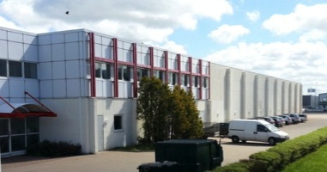
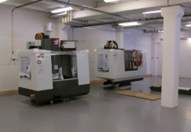
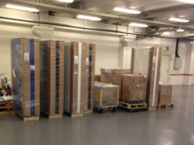
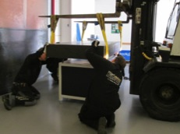
Science directorate / Neutron technologies division - Interim mechanical workshops -
CURRENT STATUS
Skiffervagen 26, 224 78 ,Lund
Tools
Equipment
Space
Building ESS’s capacity to innovate….

Slide 32
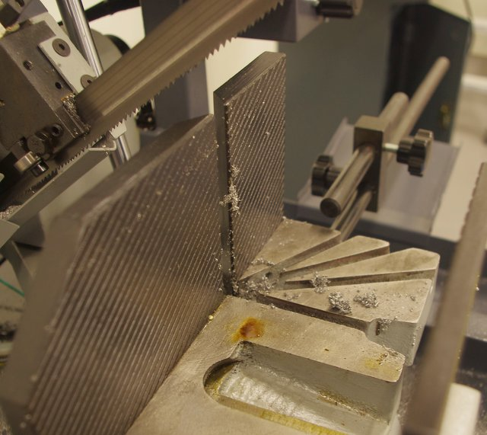
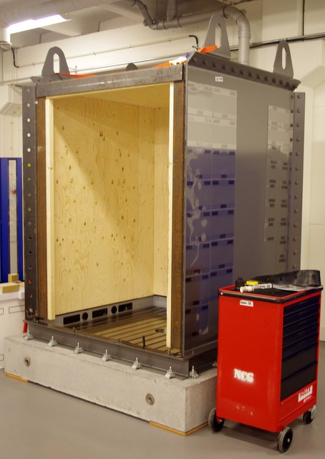
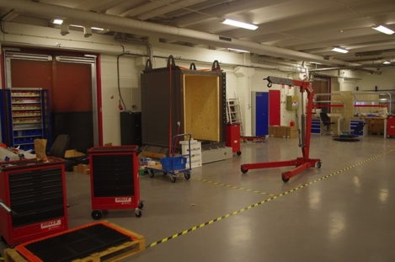
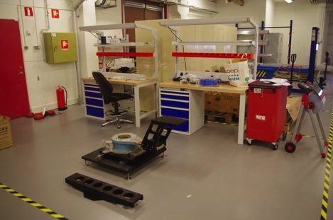
Neutron technologies workshops
Real work is commencing!
Basic machine shop
Optics group test station
Chopper test cell
Electronic assembly area
Prototype assembly area

Slide 33
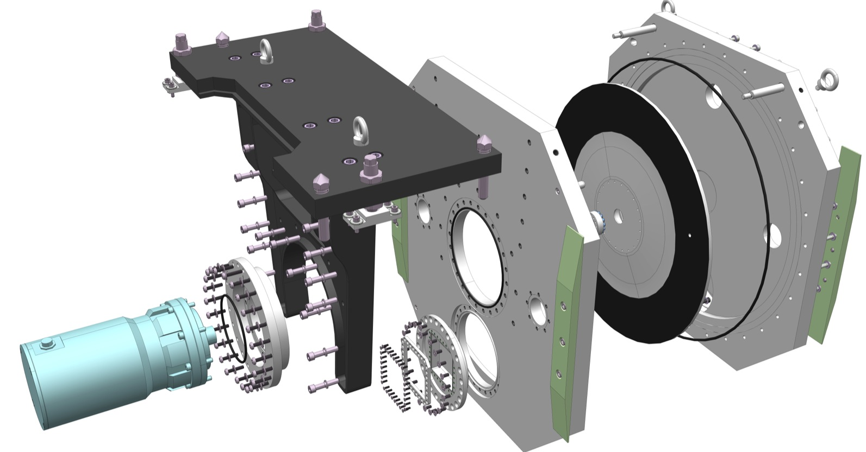
THE END
Thank you for you attention

Slide 34
A chopper extraction concept

Slide 35
The End

