Slide 1
Electrical Engineering for NSS -Status and Planning-
Thomas Gahl
Electrical Engineering Group Leader
www.europeanspallationsource.se
February 26, 2014

Slide 2
Overview
EE scope: Evaluation of technologies
Support instruments construction
Building up competences and facilities
Evaluation of motion control components
Hardware harmonisation
In-kind possibilities
Staff plan / Lab space
To do in 2014
Summary

Slide 3
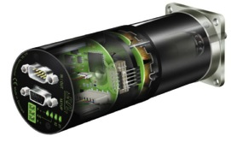
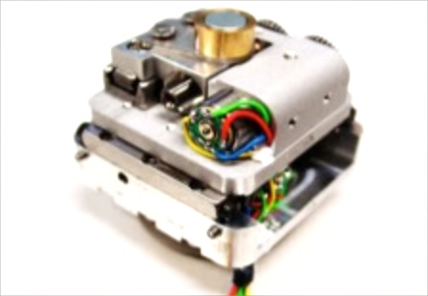
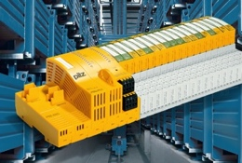
Scope: Evaluation of Technologies
Motion control unit
Motion control components (motor, encoder, sensors)
Components for harsh environment (radiation, magnetic field, vacuum)
PLCs
Personal safety / interlock systems
Racks, cabinets, cable trays
Cables, connectors
Shielding, EMC
Documentation: Drawings, schemes, naming conventions

Slide 4
Scope: Support Instruments Construction
Feasibility study: Motion control list, cabling layout
Support instruments design
Develop and deliver delegated work packages
Guide and supervise the electrical installation process
Commissioning of supported technologies
Transfer to operations phase: Documentation, maintenance plan, spare parts

Slide 5
Scope: Build up competences and facilities
Building a core team of Electrical Engineering competences
Continuous responsibility of the same core team from development to construction and operation
Ensures that only a technology is chosen that the team later is willing and able to maintain
Preliminary workshops to build prototypes and demonstrators
Workshops and labs on the final site (instruments halls and development space)

Slide 6
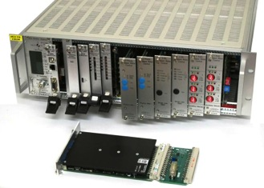
Evaluation of Motion Control Units
Collecting requirements and compiling catalog (March-Dec 2014)
Market survey (March-May 2014)
Selection of 3 candidates for evaluation (May 2014)
Development of integration concepts for candidates (June 2014)
Set-up and test of candidates (June-Dec 2014)
Final evaluation and decision (Jan-March 2015)
Building of prototype (April-June 2015)

Slide 7
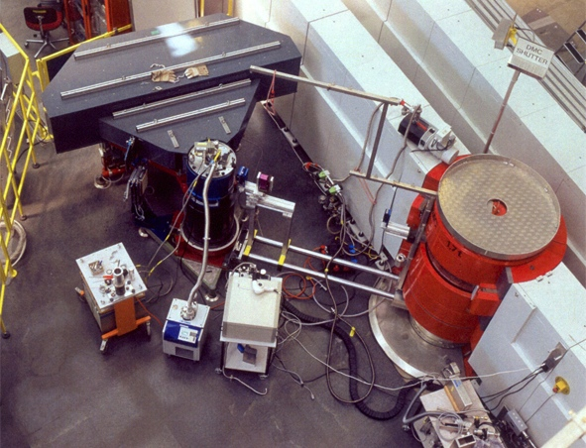
Components for Harsh Environment
Radiation
Primary Instrument
Monochromator
Chopper
Collimator
Vacuum
Detector
Sample Position
Magnetic Field
Sample Position
Guide Fields
Temperature
Sample Position
No classical Harsh Environment !
Dust, Dirt, Moisture, Chemicals, Seawater, Hazardous (Ex-Proof), Intrinsically Safe, EMI etc.

Slide 8
ESS Control System Layers
DMSC
Instruments Graphical User Interface (GUI)
ICS
Signal flow
DMSC
Instruments Human Machine Interface (HMI)
HMI Control Room
ICS
Device Layer (EPICS)
ICS
Input / Output System (Control-Box)
ICS
Input / Output System (Control-Box)
IT
Instruments Hardware (Motion Control, DAQ etc.)
ACC,
TAR
Hardware Accelerator, Target

Slide 9
Hardware Harmonisation - Why?
Ensure consistent technologies over the whole neutron instruments suite to facilitate commissioning and maintenance
Relate the solutions closely to the ones used in ESS accelerator and target
Exploit technological synergies with collaborators and partners in and outside ESS
Develop joint competences with the in-kind partners giving them an occasion to upgrade to latest technologies
Ensure the compliance of the solutions to the ESS facility wide installations, like the control system EPICS

Slide 10
Harmonisation Stakeholder (intern)
Accelerator
ICS
Electrical Engineering Group
Target

Slide 11
Harmonisation Stakeholder (extern)
Accelerator
Collaborators
ICS
Electrical Engineering Group
In-kind partners
Target
Suppliers

Slide 12
Hardware Harmonisation: Motion Control
Identify internal and external stakeholders
Establish work group for Motion Control within the Hardware Harmonisation Committee at ESS
Distribute responsibilities for collecting requirements and evaluate technical solutions
Issue a preliminary standard components list
Define a preliminary control unit for tests and prototypes
Open an on-line requirements document (software “Doors”) for review and completion by the stakeholders
Selection of the solution according to the requirements

Slide 13
In-kind possibilities
Prototype development of the final motion control unit (2015)
Identify and test motion control components for high magnetic field (2016 - 2017)
Identify and test radiation proof components (2015 – 2016)
Secondment of technical personnel to ESS for cabling and commissioning of motion control equipment (2017 – 2020)
Equipment for ESS labs and workshops (tools, instruments etc.) (2017 – 2020)
First contacts with ISIS and DIAMOND, who are in the same situation looking for a new generation of motion controller with advanced features and connected to EPICS.

Slide 14
Staff Plan
Core Team (ESS staff)
1. Group Leader Sen. Engineer Thomas Gahl Dec. 2012
2. Project Engineer Engineer NN Jan. 2015
3. HW-Engineer 1 Engineer Anders Sandström Oct. 2013
4. HW-Engineer 2 Engineer Paul Barron March 2014
5. SW-Engineer (50% ICS) Engineer Torsten Bögershausen April 2014
6. Sen. Technician Sen. Technician Hiring process ongoing June 2014
7. Mechatronics Techn. Technician NN Aug. 2014
8. Electrics Techn. Technician NN Aug. 2015
===============================================================
Extended Project Team
9. Instruments Install. Technician/Engineer temporary (3.5y) Jan. 2017
10. Instruments Install. Technician temporary (3y) Jan. 2018
11. Instruments Install. Technician temporary (1.5y) Aug. 2019

Slide 15
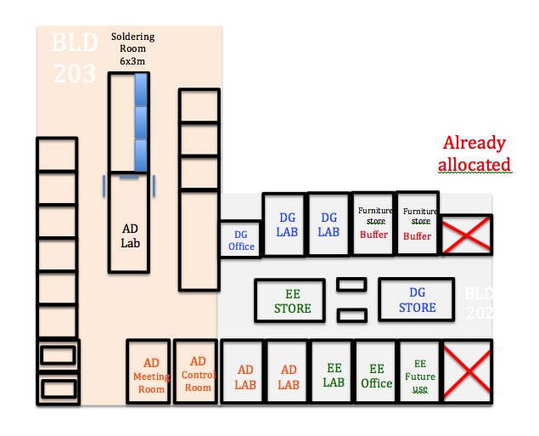
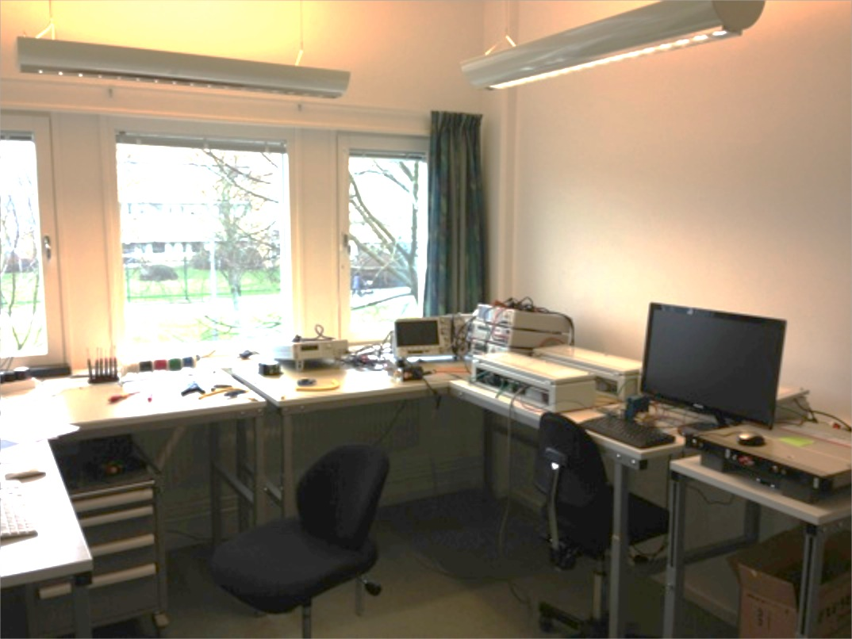
Lab and Workshop space
Cluster with ICS: Motion Control Lab, Automation Lab, Soldering Workshop, Small Mechanical Workshop
Presently in office building but outsourcing of the cluster is planned
Small share in the Mechanical Workshop Skiffervägen

Slide 16
To do in 2014
Identify Electrical Engineering competences in partner institutes and facilities
= stakeholders for technology evaluation
Establish standardisation work groups composed of internal and external partners
Work together on the requirements documents
Identify in-kind partners and define possible projects
Set-up a TAP for Electrical Engineering
Continue recruitment for core competence team

Slide 17
Summary
EE at ESS is well defined and started already with first evaluation and instruments support activities
Hardware harmonisation process has started internally and external partners have to be included as well
Staff and workshop space is in place
First in-kind partners have been identified and projects have to be defined in detail
.
.
.

Slide 18
Summary
EE at ESS is well defined and started already with first evaluation and instruments support activities
Hardware harmonisation process has started internally and external partners have to be included as well
Staff and workshop space is in place
First in-kind partners have been identified and projects have to be defined in detail
We still need talented and committed technical staff either
permanent for the core team or
contracted/seconded for a limited time

Slide 19
Thank You !

Slide 20
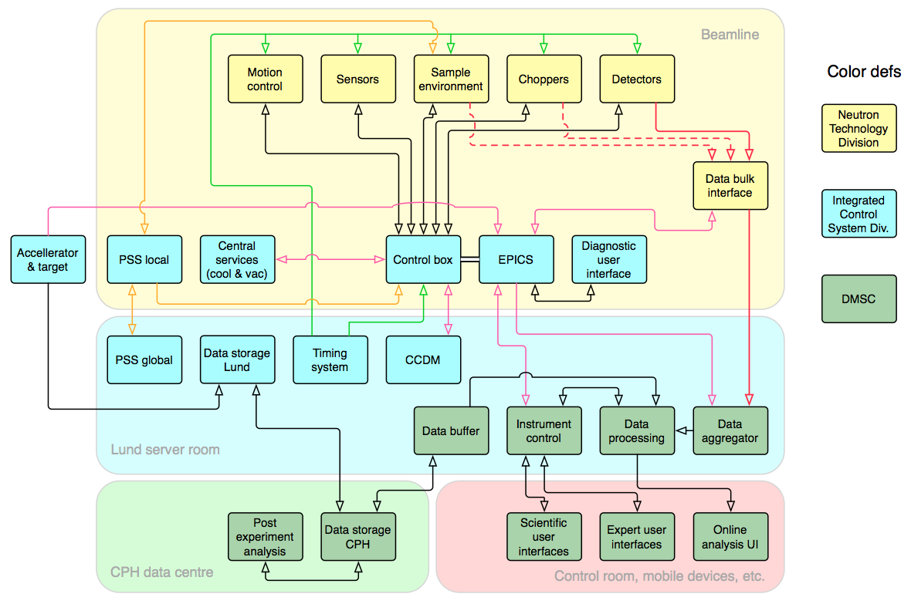
Control Software within Neutron Scattering Instruments

Slide 21
Resulting Staff plan (already in Primavera)
Yellow/orange = possible in-kind

Slide 22
Staff Plan (EE competencies on site)

