Slide 1

ESS
Flat moderators at ESS
IKON6, Lund, Sweden
Luca Zanini – 26 February 2014
ESS 2014-02-27

Slide 2
ESS moderator team
Neutronics Group
  K. Batkov, N. Borghi, E. Klinkby, T. Schönfeldt, A. Takibayev, L. Zanini
Plus
  F. Mezei, G. Mührer, E. Pitcher
Recent published work
K. Batkov, A. Takibayev, L. Zanini, F. Mezei, Unperturbed moderator brightness in pulsed neutron sources, Nuclear Instruments and Methods in Physics Research A729 (2013) 500–505
F. Mezei, L. Zanini, A. Takibayev, K. Batkov, E. Klinkby, E. Pitcher, T. Schönfeldt, Low dimensional neutron moderators for enhanced source brightness, In press, Journal Neutr. Research, 2014. See also arXiv:1311.2474
E. Klinkby et al., Voluminous D2 source for intense cold neutron beam production at the ESS, 23 Jan 2014, arXiv:1401.6003
2

Slide 3
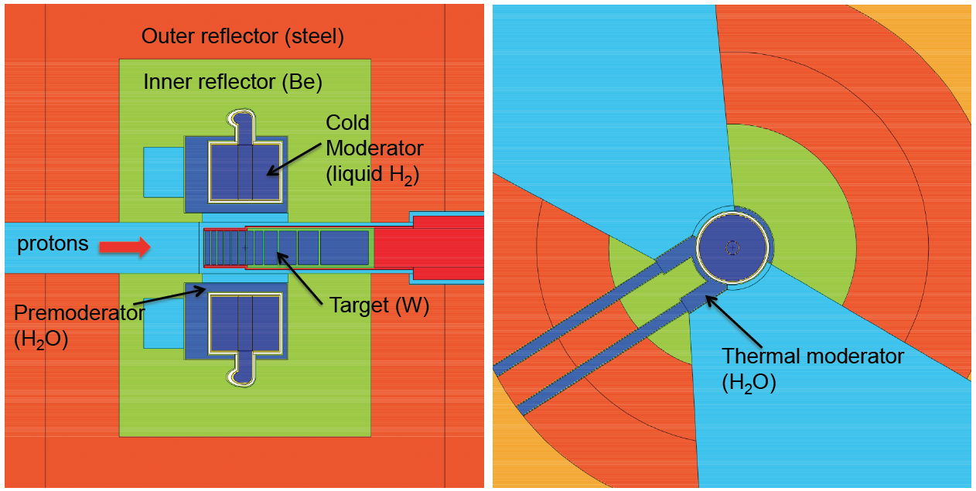
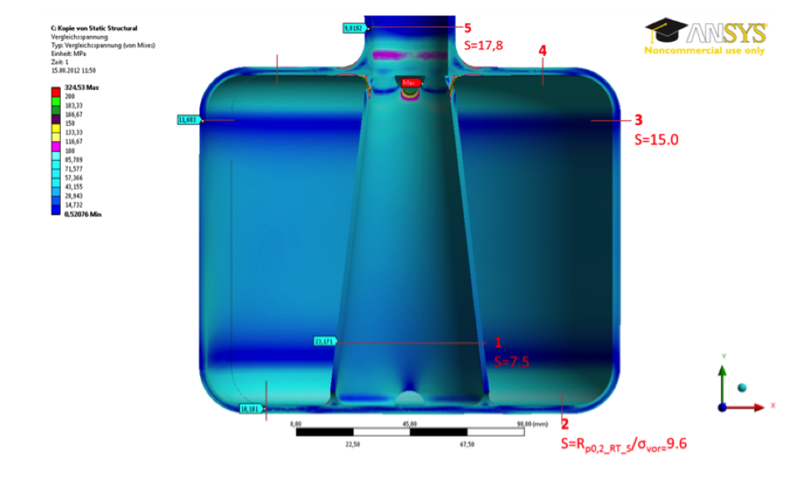
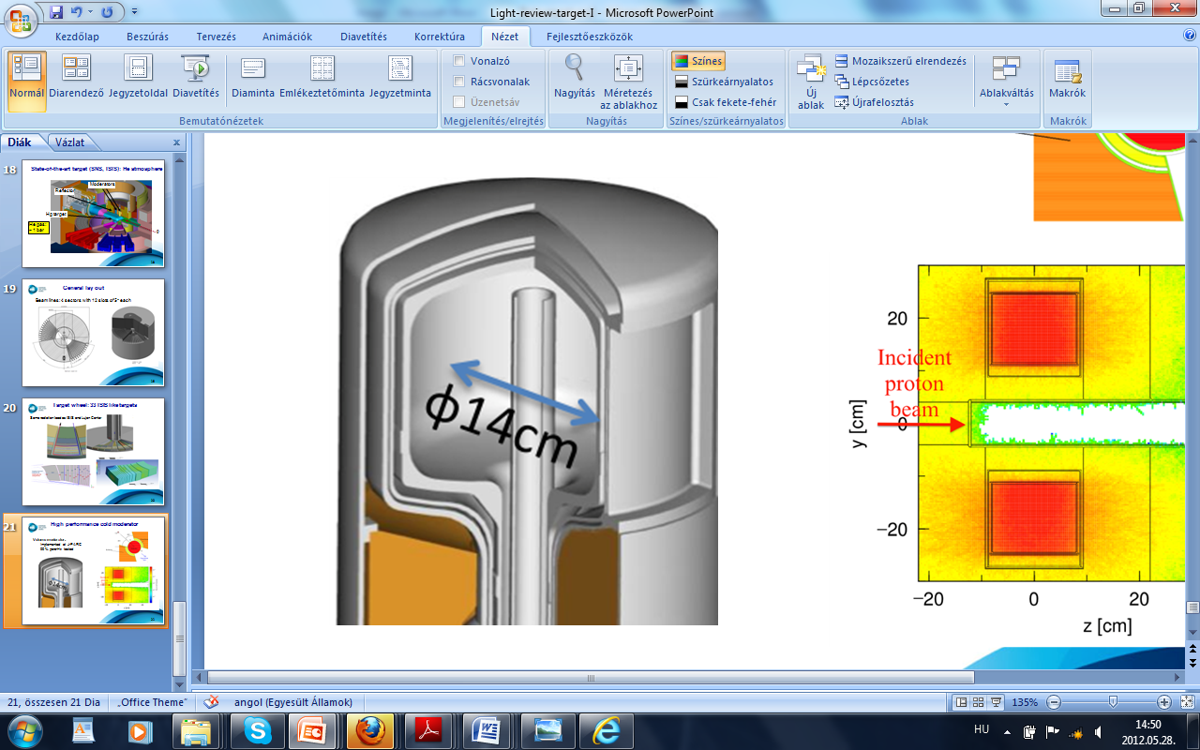
The TDR baseline design is a volume para-hydrogen moderator (13 cm high x 16 cm ø)
Thermal wings provide a bi-spectral source.
3

Slide 4
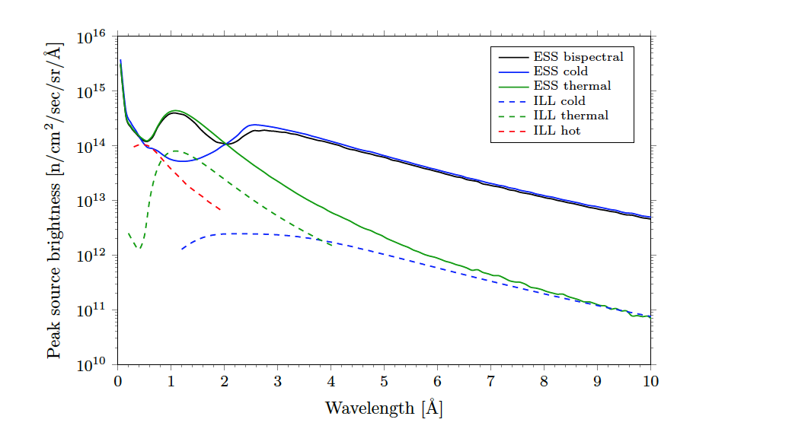
Excellent performance from the TDR moderator
Volume moderator:
implemented at J-PARC
99 % para-H₂ tested
(ESS Technical Design Report)
4

Slide 5
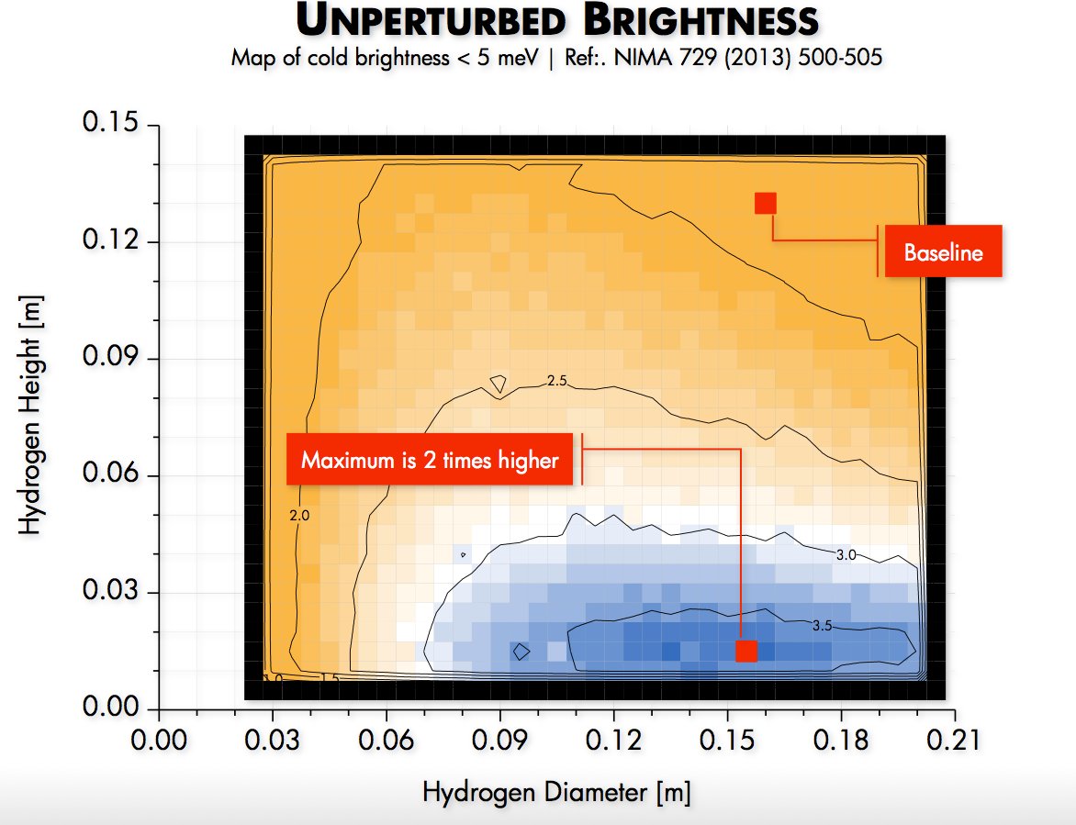
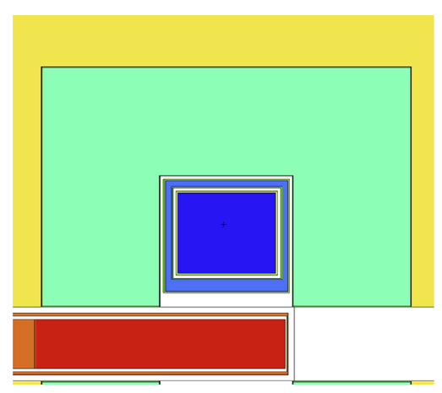
After TDR: Unperturbed moderator brightness
5

Slide 6
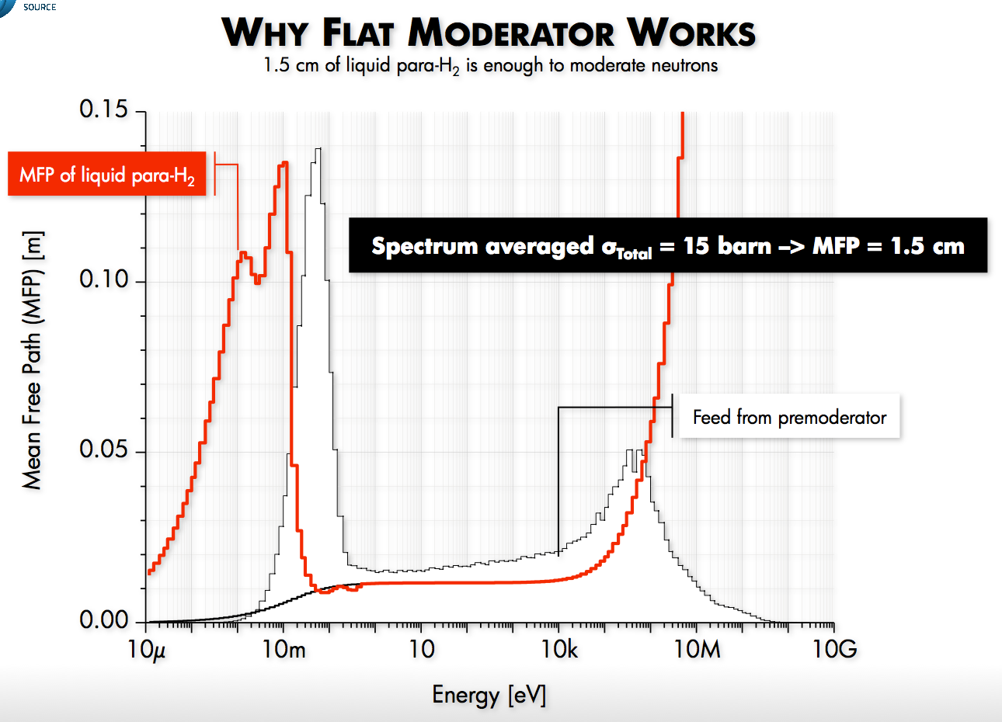
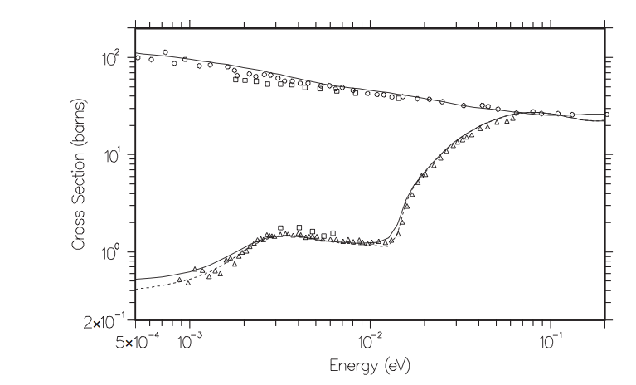
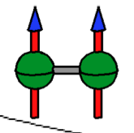
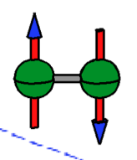
Why flat moderators work
1. the physics
MFP in liquid para-H₂ of the order of 1 cm for thermal neutrons and 10 cm for cold neutrons
premoderator used to tailor the neutron spectrum entering the cold moderator
ortho
para
6
6

Slide 7
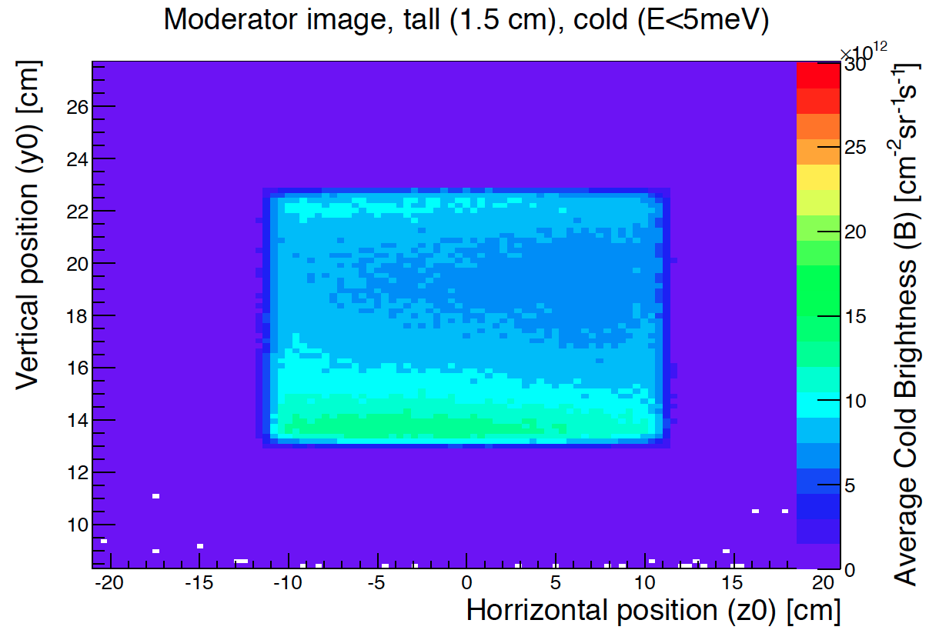
Why flat moderators work
1. the physics
Quiet spot
Cold hotspot
thermal neutrons arriving from the surroundings are transformed into cold ones within about 1 cm of the walls of the moderator vessel
7

Slide 8
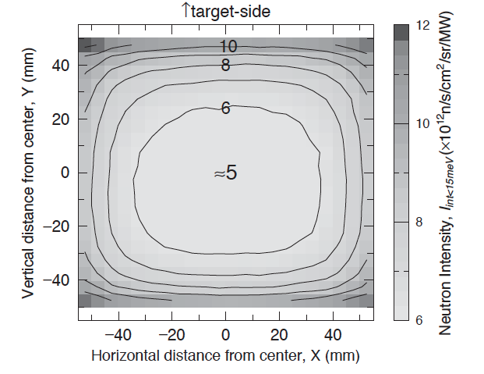
Why flat moderators work
1. the physics
(Kai, 2004)
behaviour used at JPARC,
reflectometer points at the bottom
thermal neutrons arriving from the surroundings are transformed into cold ones within about 1 cm of the walls of the moderator vessel
8

Slide 9
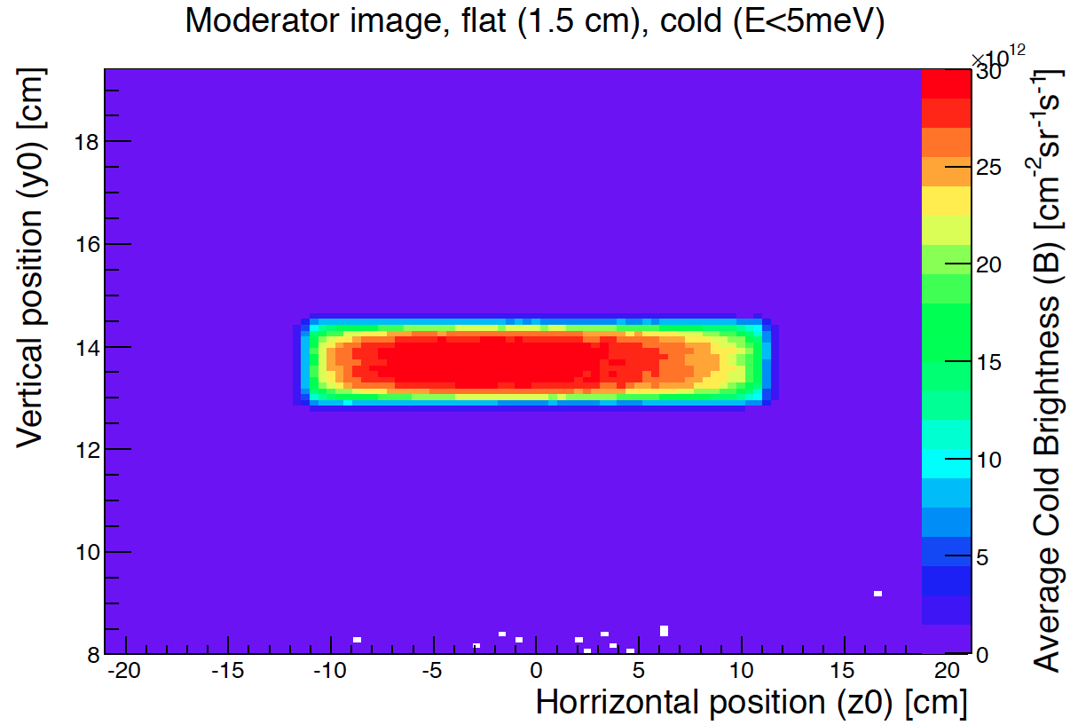
Why flat moderators work
1. the physics
thermal neutrons arriving from the surroundings are transformed into cold ones within about 1 cm of the walls of the moderator vessel
along the direction of these walls this intense layer of cold neutrons can be seen from the outside into depths comparable to 10 cm.
Directional effect
9

Slide 10
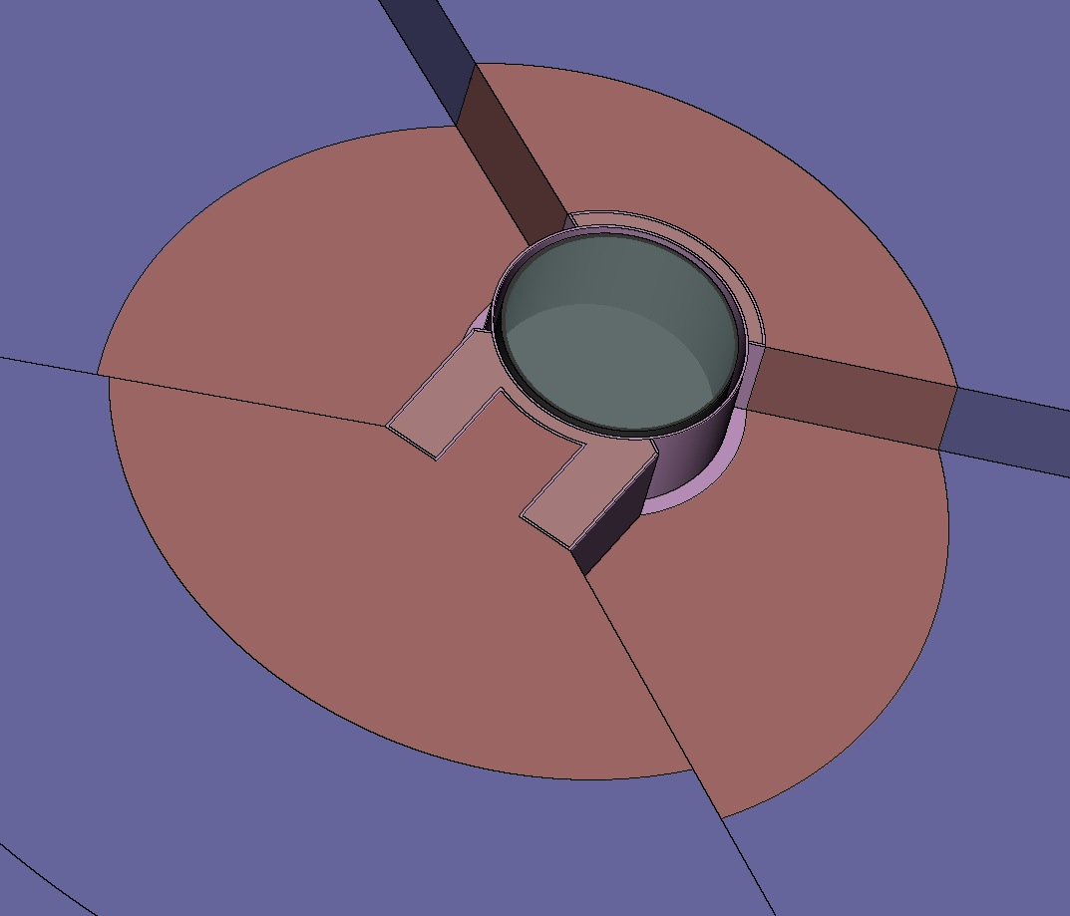
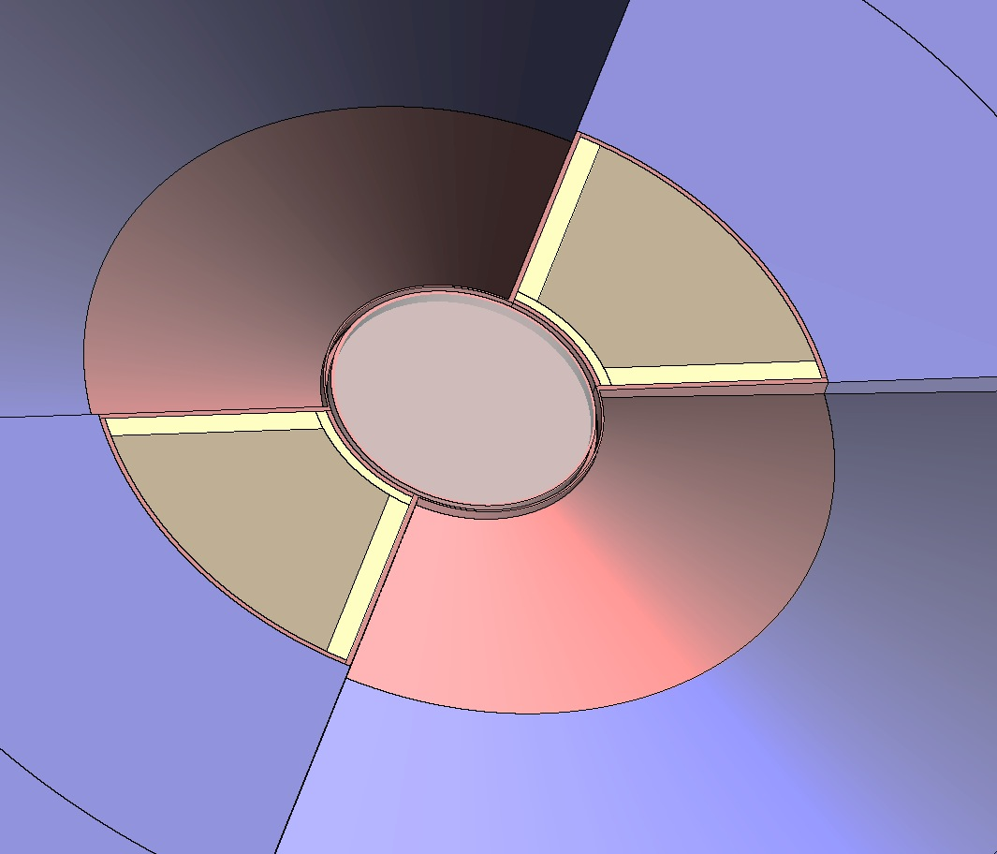
Why flat moderators work
2. the perturbation effect
Very close performance as two flat moderators with 60° openings:
No need for two flat moderators
Smaller moderator surfaces lead to removing smaller amount of reflector material around the moderator for openings for beam extraction.

Slide 11
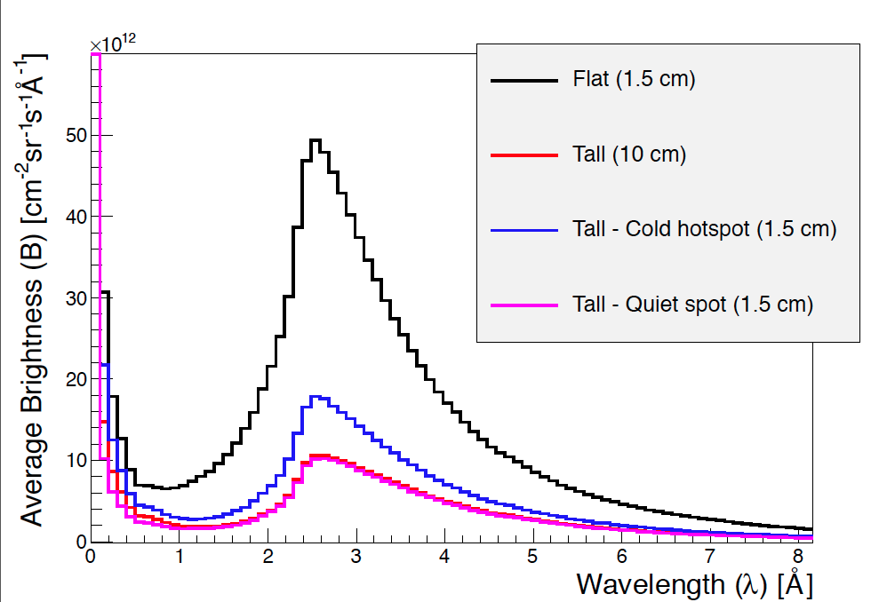
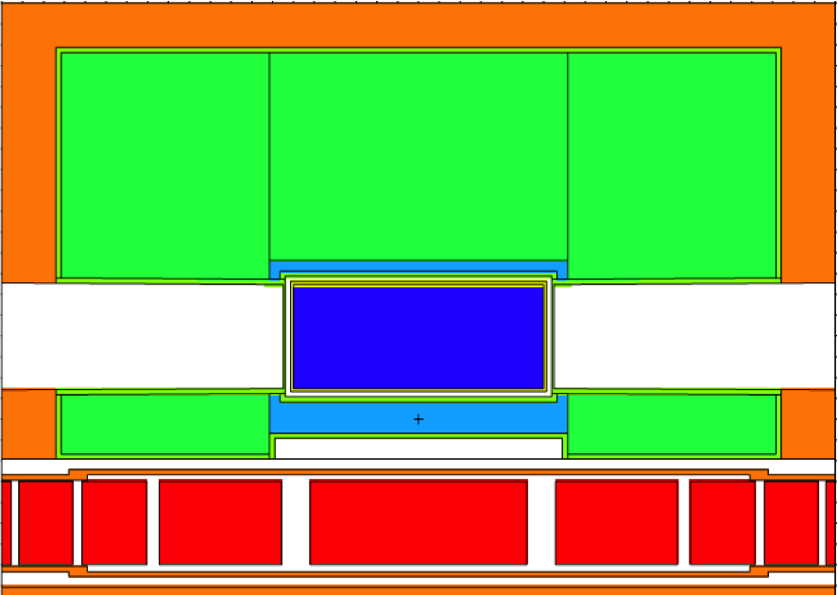
Higher brightness
Quiet spot
Cold hotspot
11

Slide 12
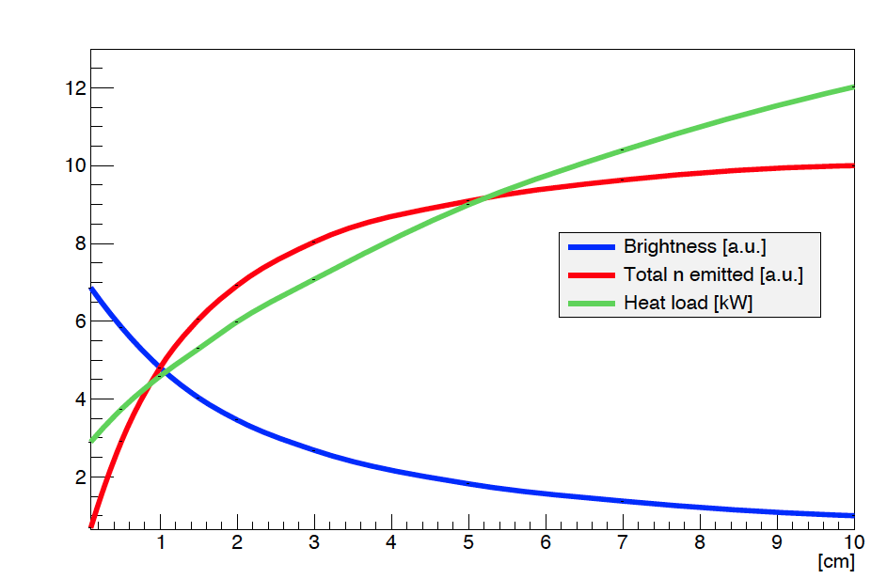
Higher brightness, lower heat load
At 3 cm 80% of total number of neutrons emitted compared to maximum
Moderator height [cm]

Slide 13
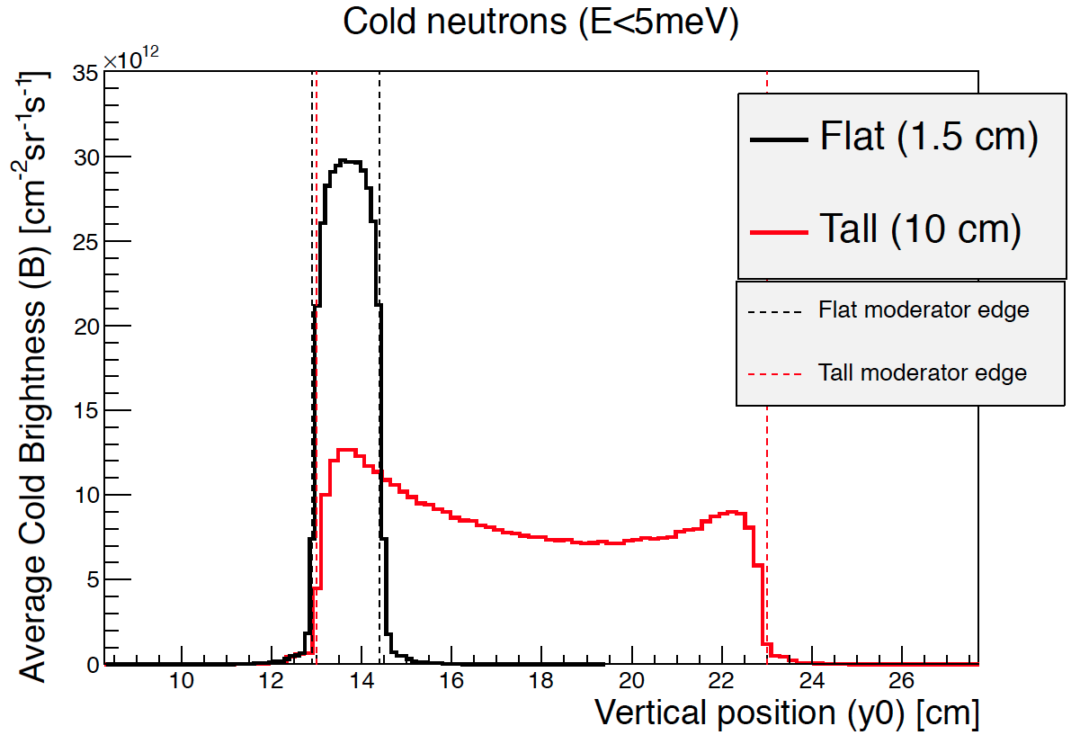
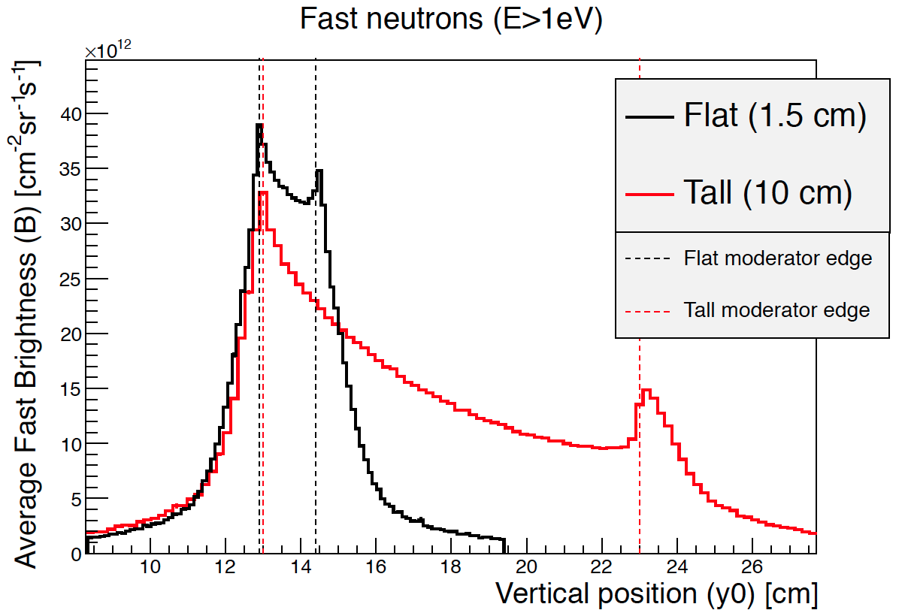
Higher brightness, better signal/noise
Less diffuse fast neutron background with the flat moderators: smaller opening for beams, more shielding up front.
13

Slide 14
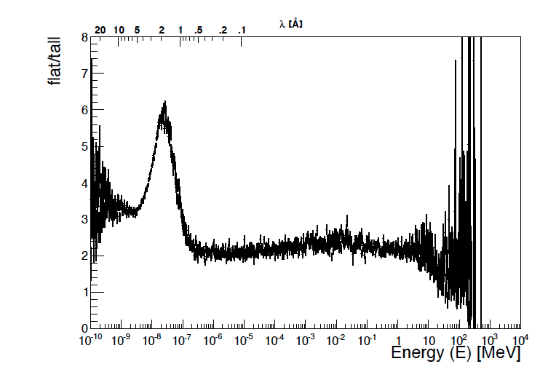
Background
ordinary wavelength spectra, divided by the integral of neutrons above 1eV - which is a measure somewhat proportional to signal/background.
14
Notes:
THANK YOU

Slide 15
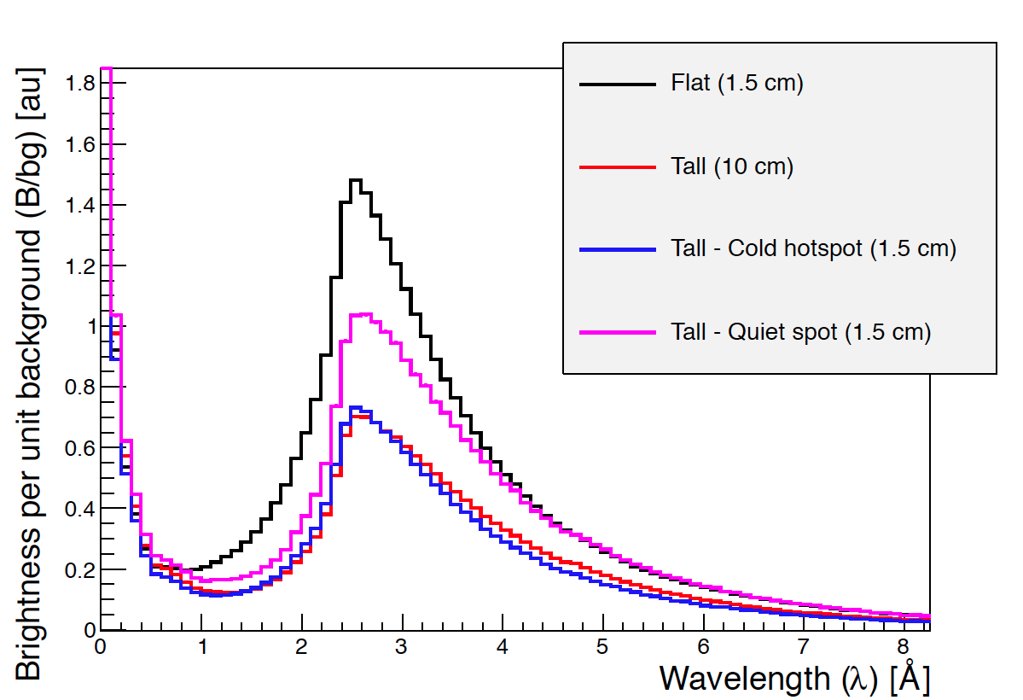
Background
ordinary wavelength spectra, divided by the integral of neutrons above 1eV - which is a measure somewhat proportional to signal/background.
15
Notes:
THANK YOU

Slide 16
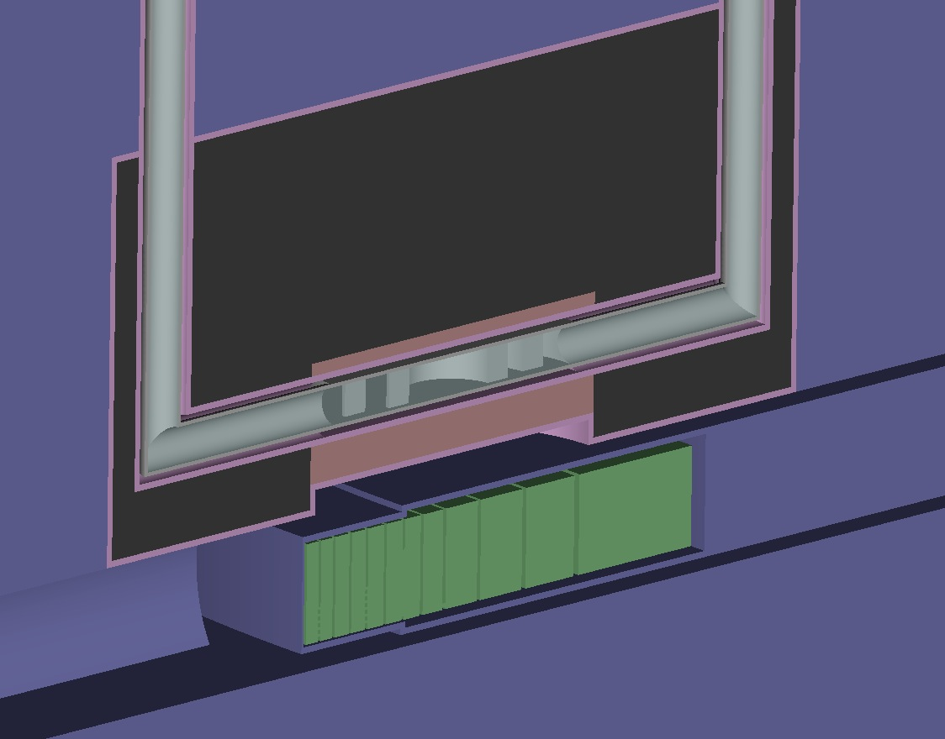
Engineering considerations
  Conventional moderators are 2.5-5 cm thick.
  Adapting moderator engineering to higher beam power is more straightforward for conventional size (flat) moderators than for the larger volume moderators
16

Slide 17
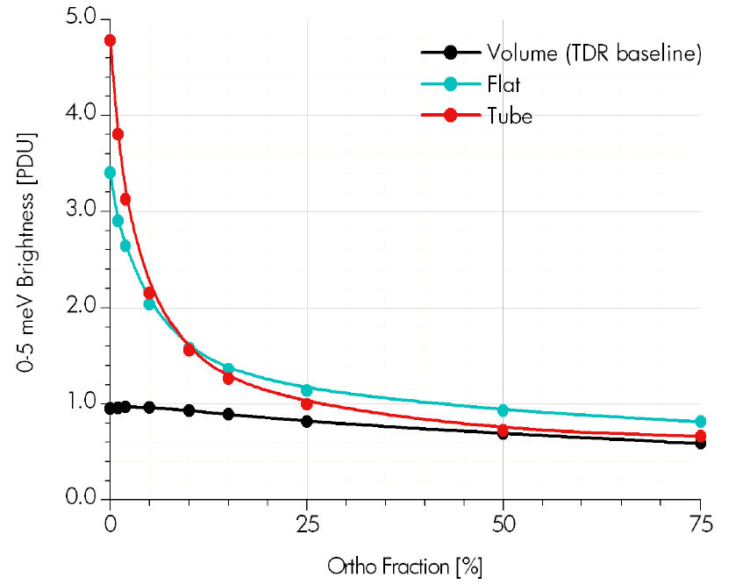
Pure para-H₂ needed
  Conventional moderators are 2.5-5 cm thick.
  Adapting moderator engineering to higher beam power is more straightforward for conventional size (flat) moderators than for the larger volume moderators
Extreme dependency of the brightness on the purity of para-H₂
Importance of catalyst
More than 99% measured at J-PARC
17

Slide 18
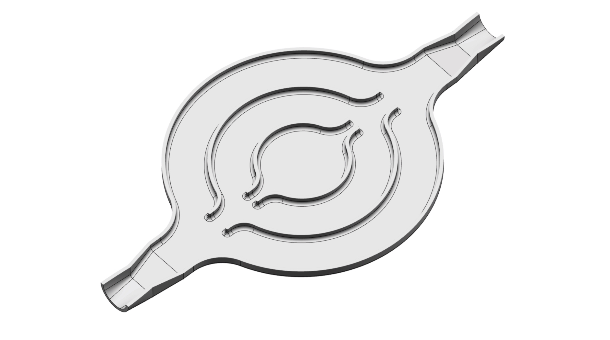
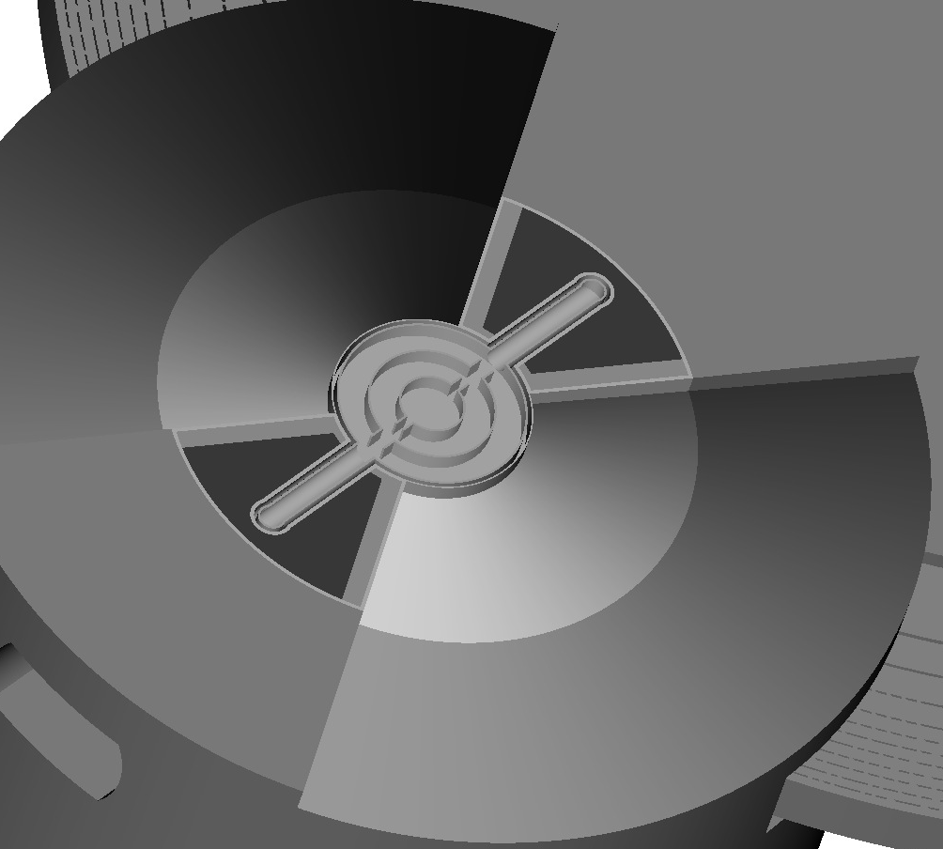
Effect of engineering details is taken into account in the model
Same effect on brightness for flat and tall moderator from engineering details
Overall absolute uncertainties within 15%.
(5% from pipings)
(N. de la Cour)
18
Notes:
THANK YOU

Slide 19
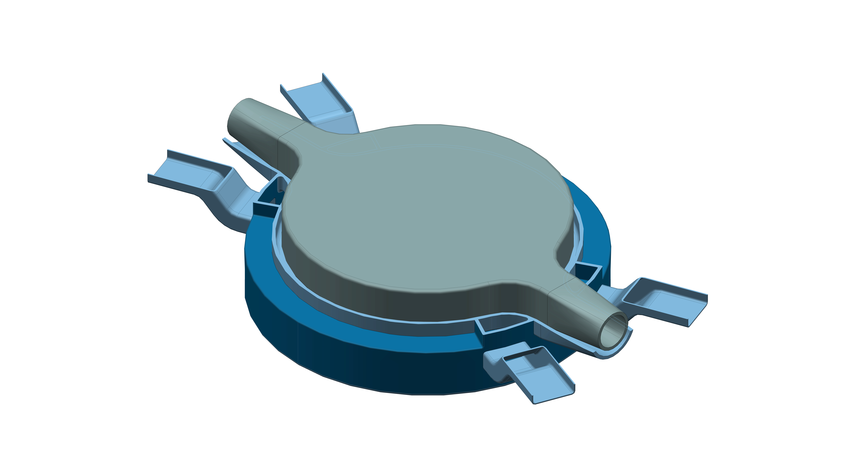
Conceptual design of flat H₂ moderator and H₂O premoderator
(R. Linander, N. de la Cour)
19

Slide 20
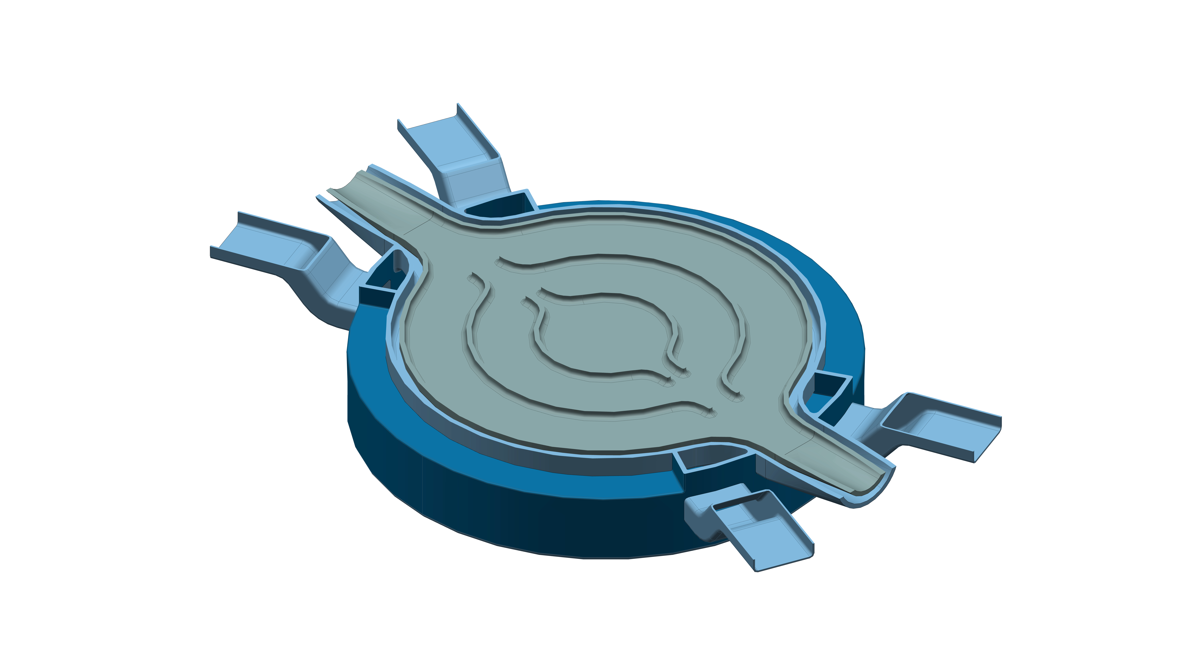
Conceptual design of flat H₂ moderator and H₂O premoderator
20

Slide 21
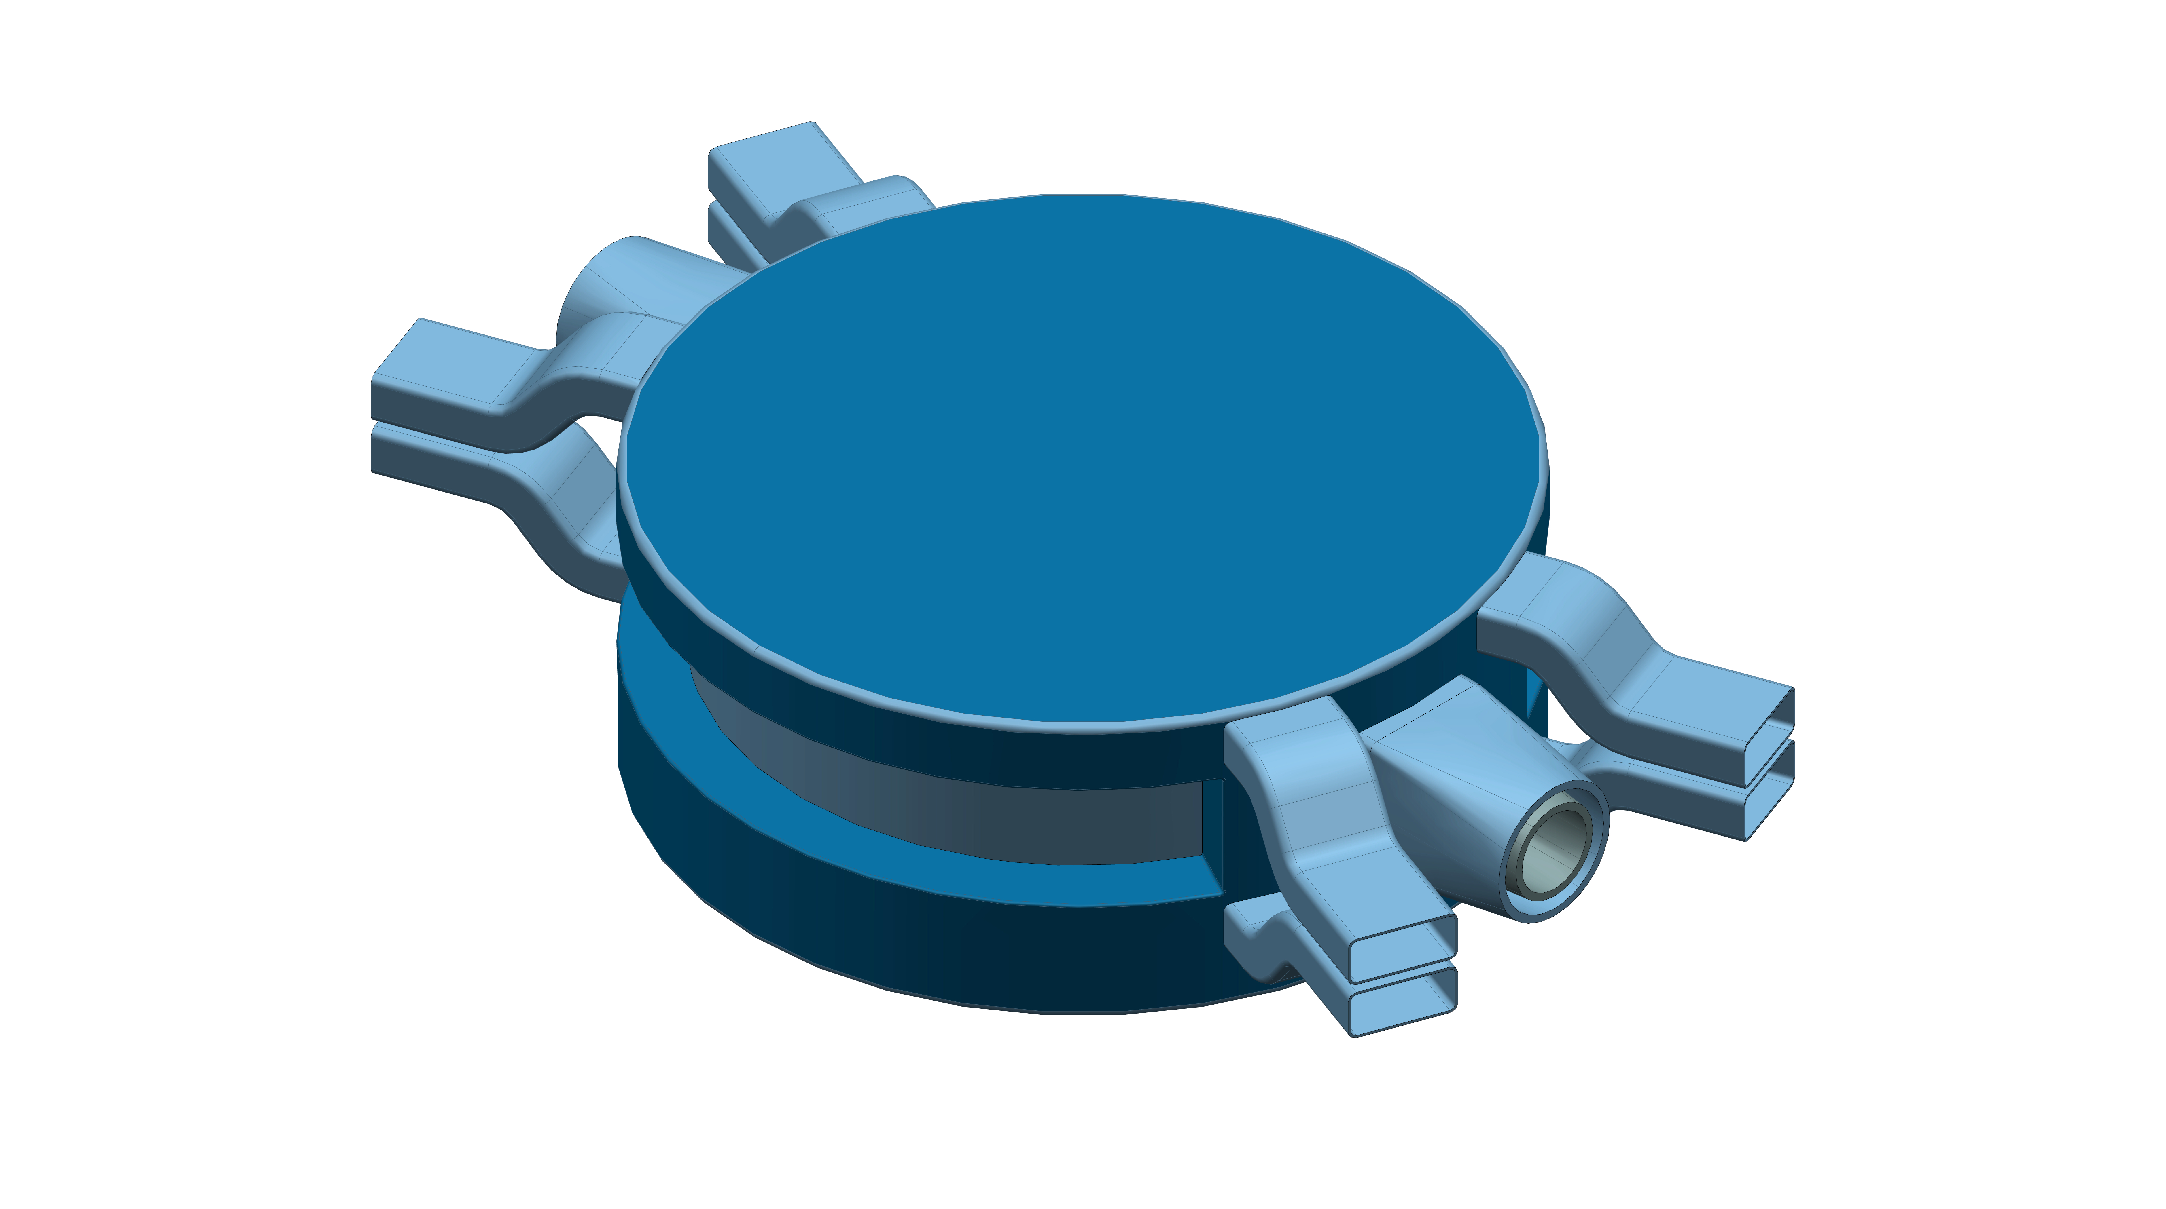
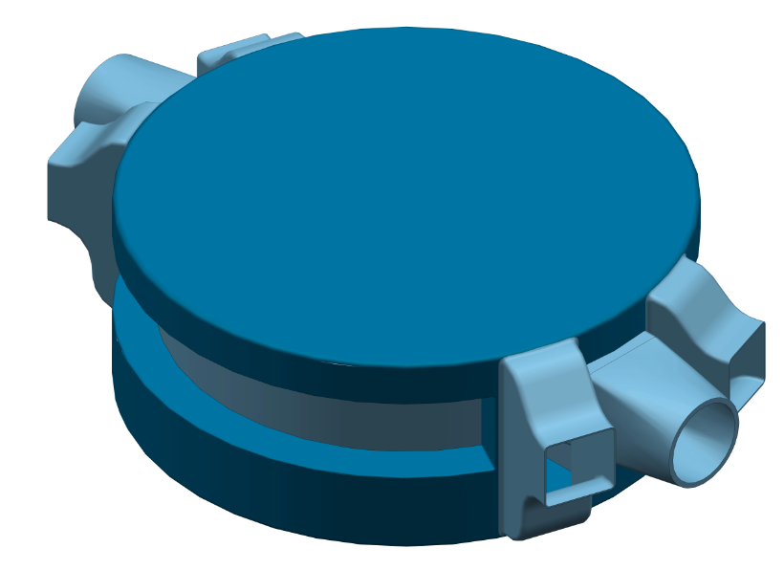
Conceptual design of flat H₂ moderator and H₂O premoderator
variant
Possibility to extract thermal neutron from water pipes
Grooving may improve the thermal brightness (60% in Dubna)
21

Slide 22
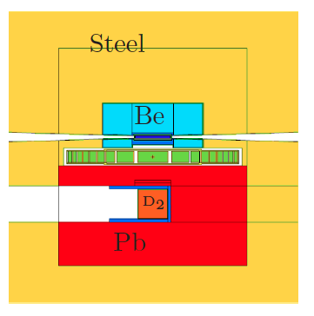
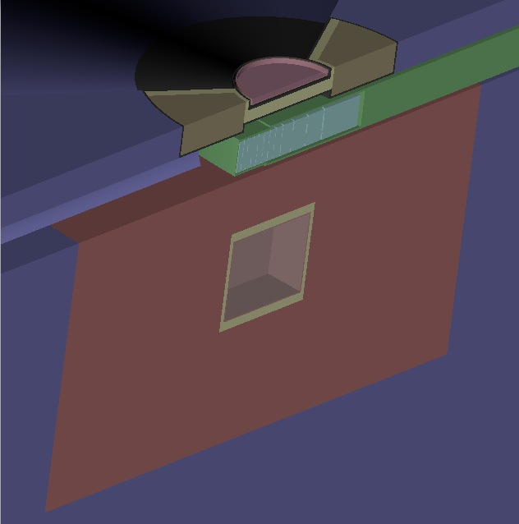
A possible scenario for maximum moderators performance
(or Pb)
One (flat) moderator on the top
Pb fast neutron reflector at the bottom (and outer reflector)
  15% brightness increase
easier extraction of MR plug and less Be.
A large through-going tube at the bottom with a D₂ moderator for high-intensity flux for fundamental physics studies:
  Factor of 3 in neutron emission
22

Slide 23
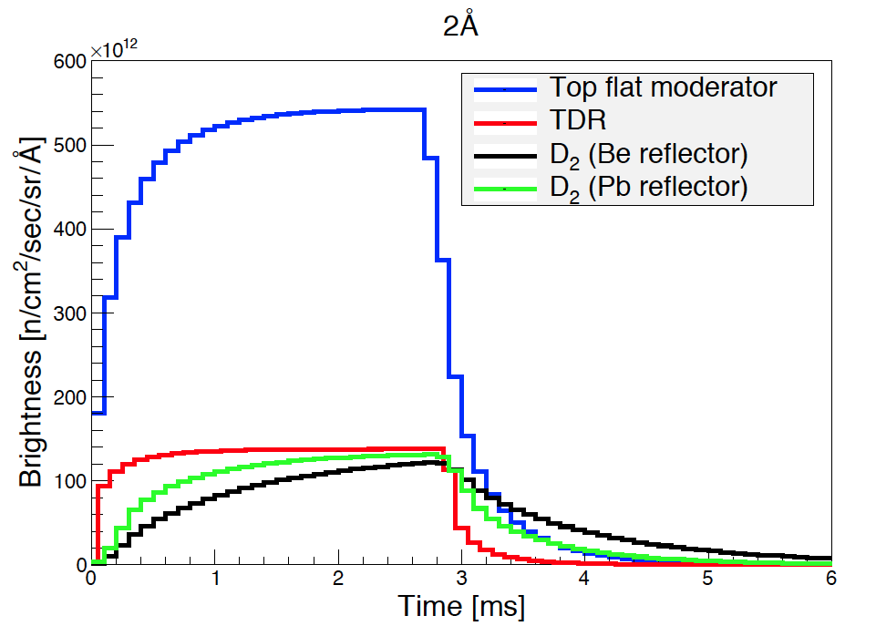
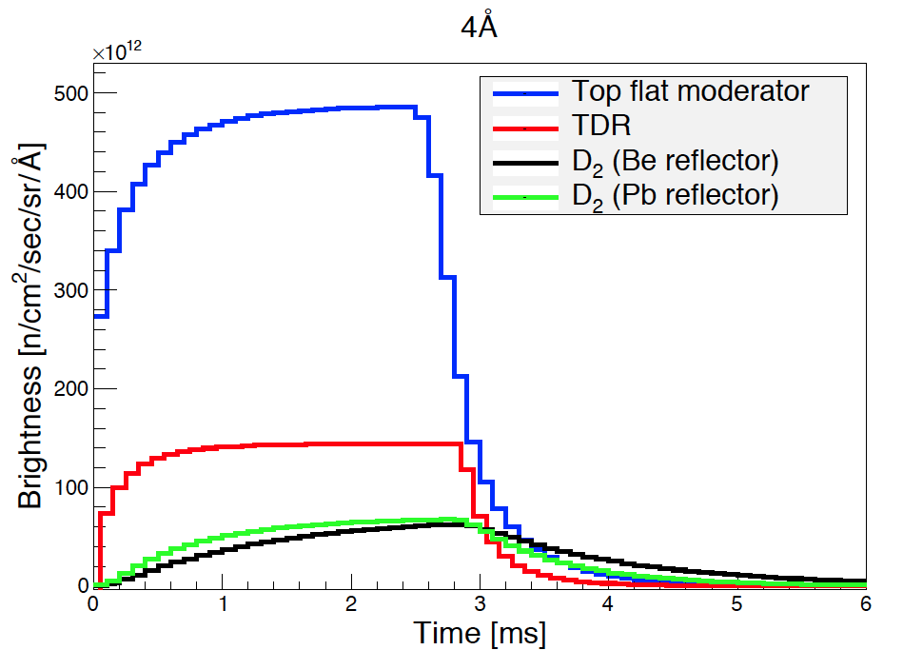
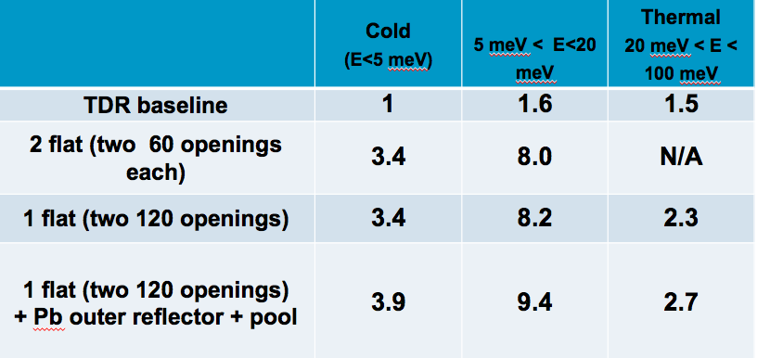
Summary performance
(FLAT: H= 1.5 cm, D=24 cm)
23
(numbers in absolute units of 5.6 10⁻⁴ n/cm²/sr/proton)

Slide 24
Main Conclusions & Outlook
Low-dimensional moderators provide significant increase in brightness with respect to conventional volume moderator
No penalty in relative performance due to engineering
Best option to accommodate different needs for instruments
  Two moderators (big and small)
  One moderator (different heights in a single moderator)
Harmonisation with Instrument Suite
Deadline April 30
24

