Slide 1
Target Update
John Haines
Head of Target Division
www.europeanspallationsource.se
February 27, 2014

Slide 2
Outline
Target Station scope, organization, status and plans
Cost, schedule, and staffing needs
Summary of 2014 goals
Target
Neutron instruments
Linear proton accelerator

Slide 3
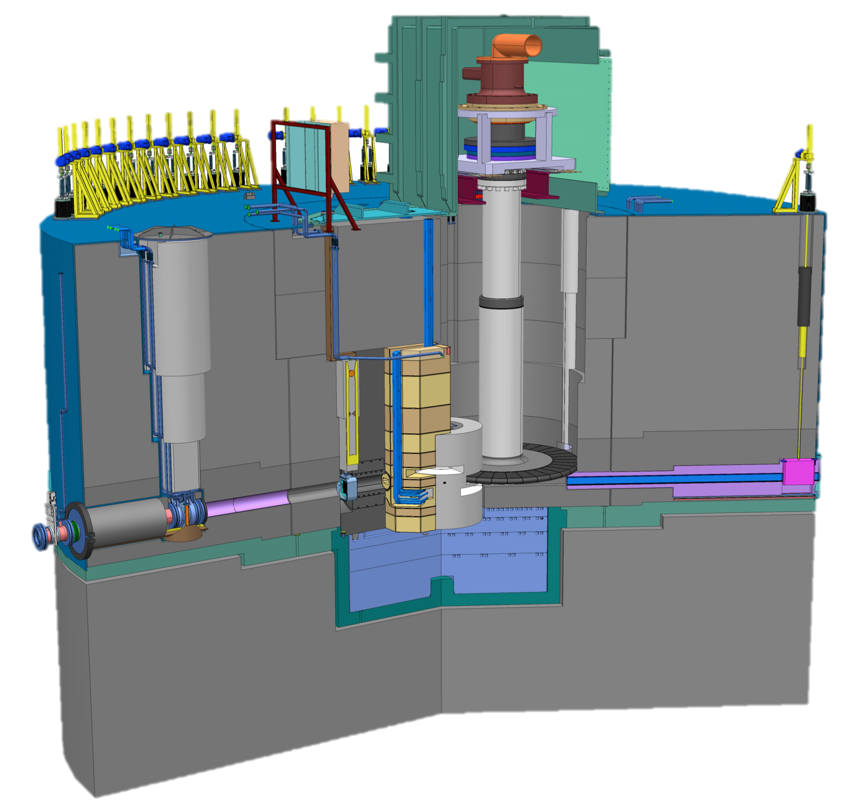
Target Station Scope – Monolith
Target drive housing
Requirements:
Convert protons to neutrons
Peak brightness (E < 10 meV) at 5 MW: 2x10¹⁴ n/cm²/s/sr (30 x ILL)
Heat removal - 5 MW proton beam
Confinement and shielding
Unique features:
Rotating target
He-cooled W target
Monolith
liner
Steel
shielding
Neutron beam extraction
Proton beam window
Target wheel
Moderator and reflector plug
Neutron beam window

Slide 4
Target Station Layout
High bay
Active cells
Utilities block
Target monolith
Accelerator – Target interface area

Slide 5
Target Organization Aligned with Project Execution
TARGET DIVISION
J. Haines
HEAD OF DIVISION
E. Pitcher
DEPUTY HEAD OF DIVISION
F. Plewinski
C. Blixt
Administrative Assistant
NEUTRONICS
L. Zanini
GROUP LEADER
TARGET PHYSICS
G. Muhrer
GROUP LEADER
FLUID SYSTEMS
J. Haines (A)
GROUP LEADER
MONOLITH & HANDLING
R. Linander
GROUP LEADER
TARGET CONTROLS
L. Coney
GROUP LEADER
MATERIALS
Y. J. Lee
GROUP LEADER
12.1 Management & Administration
12.5 Fluid Systems
12.7 Controls
12.8 Physics
12.2 Target Systems
12.3 Moderator & Reflector Systems
12.4 Monolith Systems
12.6 Remote Handling Systems

Slide 6
General Comments on ESS Target Station Project Status and Plans
Design concepts for all Target Station systems have advanced from the TDR (issued in April 2013), but many remain to be fully optimized as part of the completion of Preliminary Design in 2014
Cost and schedule baseline established
Logically driven, resource loaded schedule used to establish funding needs, staffing plan, delivery dates, integrate with other parts of ESS, …
Focused on achieving beam-on-target by the end of 2019 with high confidence (adequate schedule float)
Two biggest challenges for Target in 2014 are establishing in-kind partnerships and hiring needed staff
These two items are closely coupled

Slide 7
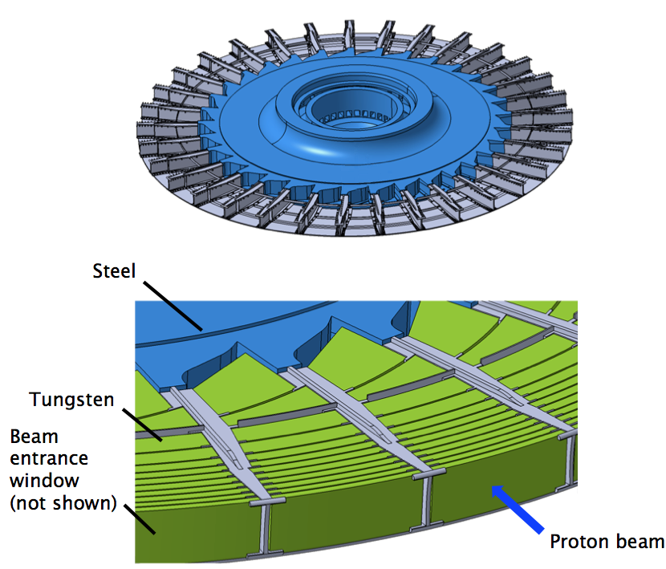
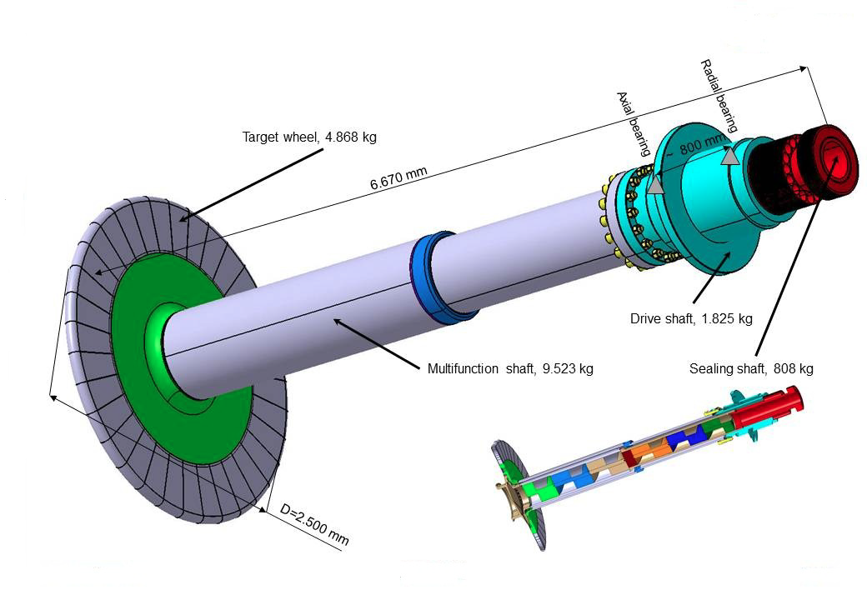
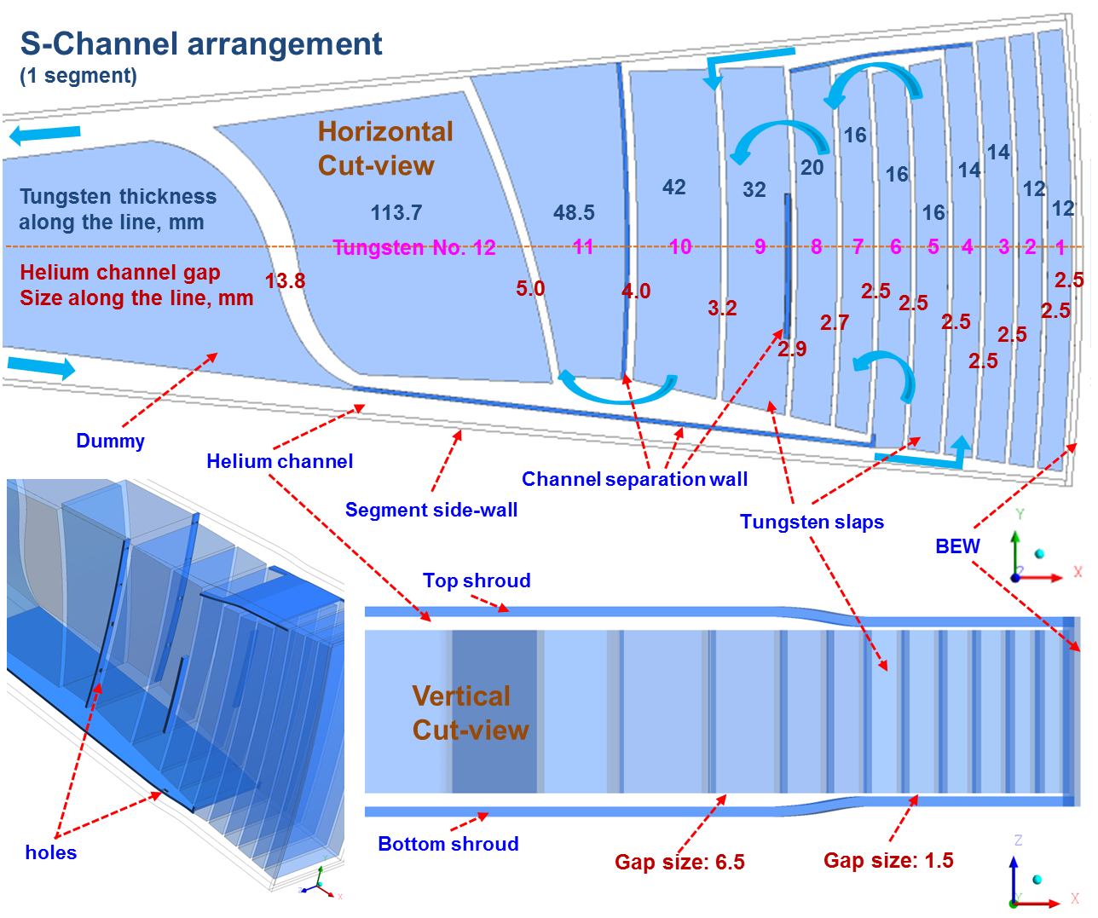
He-cooled, rotating W target has a long-lifetime and is passively safe
Tungsten slabs in 33 sectors
Helium coolant
Mass flow 3 kg/s
Pressure 0.3 MPa
Inlet/outlet temperatures: 20 °C/220 °C
Rotational speed 25.5 rpm
Wheel diameter 2.5 m
Shaft length > 5 m
Lifetime ~ 5 years (@ 5 MW)
Key issues for optimization studies:
He pressure, flow rate, and flow passage configuration
He seals
Finalize water-cooled backup work by determining power limit based on need for emergency cooling

Slide 8
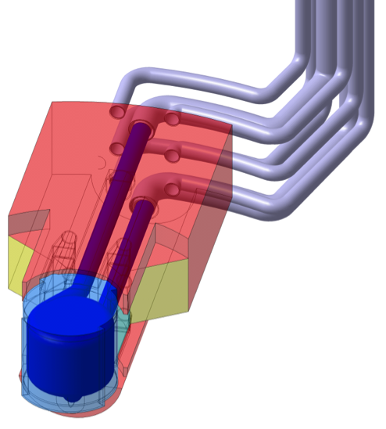
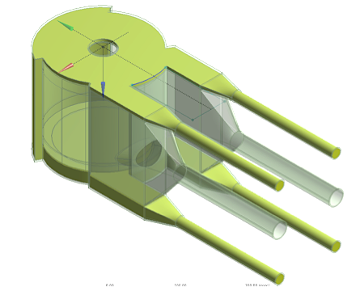
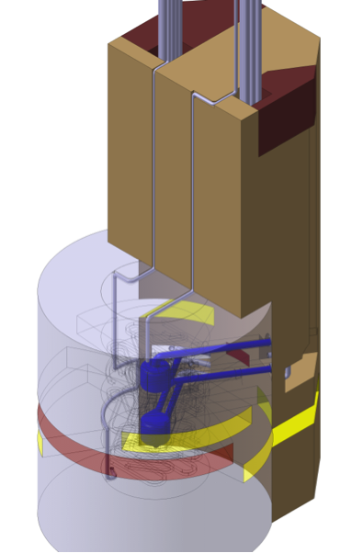
Moderator and reflector plug integrates two LH₂ moderators within a Be reflector
Inner reflector
Beryllium
Complex “cylindrical” aluminium vessel
Water cooled
Outer reflector
Steel
Water cooled
Cold moderators
Super-critical hydrogen at 20 K and 1.5 MPa
Aluminium alloy vessel
Expected lifetime ~ 1 year @ 5 MW
Vacuum jacket for insulation
Water moderator assemblies
Thermal water
Pre-moderator surrounding the cold moderator vessel
Extended wings facilitate thermal or bi-spectral beam extraction
Expected lifetime ~ 1 year @ 5 MW

Slide 9
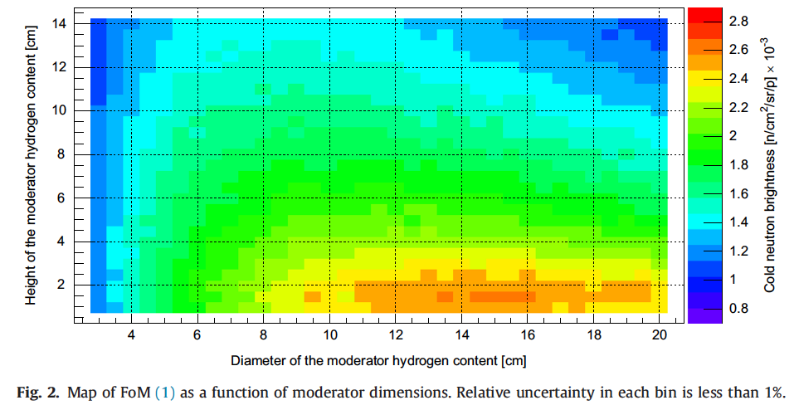
Moderator optimization studies have identified a potential opportunity for huge increase in neutron brightness
a
TDR (baseline) design
Key issues for optimization studies:
Moderator configuration – shape, size, number
Instrument performance, operational and maintenance issues, cost, schedule, …
Remote handling concept
K. Batkov, et al., NIM A 729 (2013) 500.

Slide 10
Monolith Systems serve shielding and confinement functions and facilitate neutron beam extraction
Shielding systems
Internal monolith structures
Monolith bulk shielding
Monolith removable shielding
Confinement systems
Proton beam window
Monolith vessel
Neutron beam windows
Covers and penetrations
Helium atmosphere system
Enabling systems
Target monitoring plug
Proton beam instrumentation plug
Irradiation module
Neutron beam extraction system
Tuning beam dump
Key issues for optimization studies:
Beam extraction configuration – number of beamlines/spacing, beam guide inserts, shutter configuration
Remote handling concepts for proton beam window, instrumentation plugs, and beam extraction
Containment of He environment/allowable leak rate
Details of interface with CF and Instruments
Diameter ~ 12 m
Height ~ 8 m
Mass ~ 7000 tonnes (mainly steel)

Slide 11
Fluid Systems provide primary and secondary cooling and process/confine radioactive fluids
Primary Water Cooling:
Water Moderators 50 kW
Reflectors 300 kW
Shielding and Plugs 1.6 MW
Intermediate Water Cooling:
for Target System 3.8 MW
for Gas Systems 90 kW
for Water Systems 2.2 MW
Rad. Gas Effluent & Confinement (RGEC):
Target Station Ventilation 110 000 m³/h
Separation Gas for Primary Water
Radioactivity Monitoring
Active storage
Water storage
Helium storage
Auxiliary Helium Systems
PBW Cooling 5 kW, 200 g/s
Target Helium Purification 3 g/s
Monolith Helium Purification 7 g/s
Vacuum, gas and water supplies
Key issues for optimization studies:
Optimizing cooling system requirements, e.g. temperature ranges to improve energy recovery
He environment control – throughput and filtering requirements

Slide 12
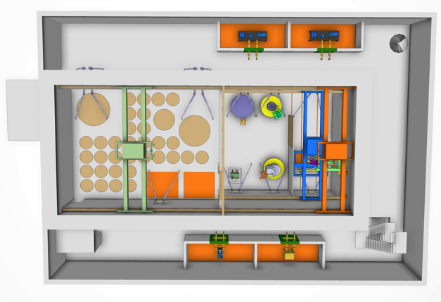
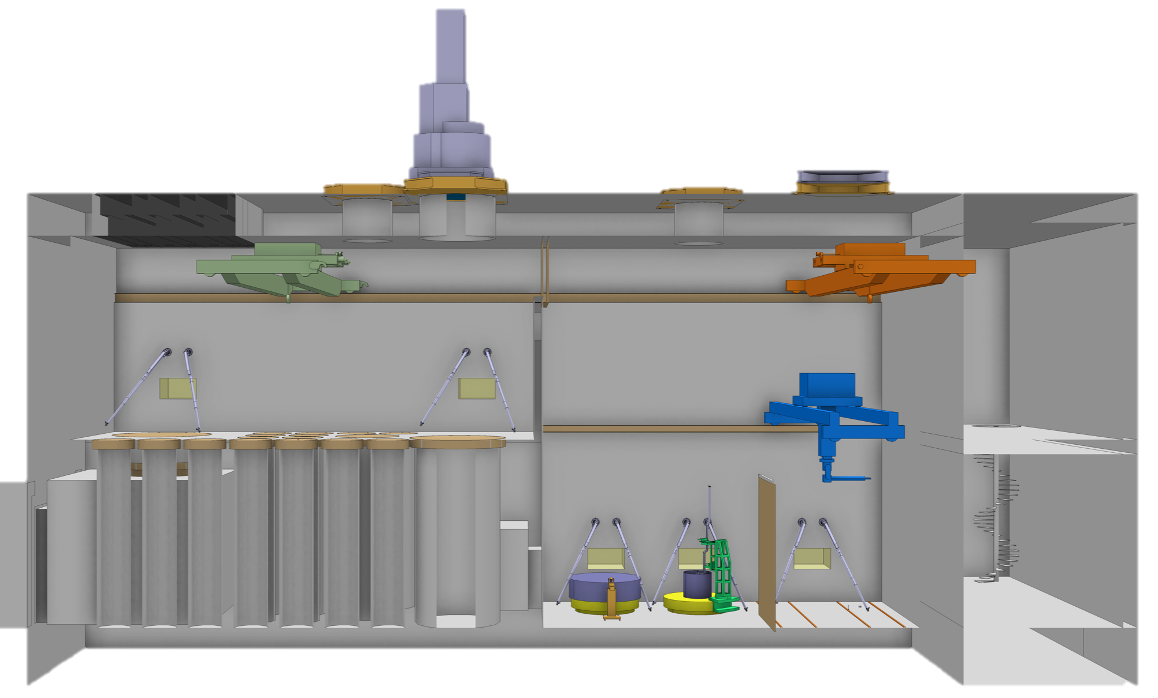
Remote Handling Systems maintain target equipment and package and process waste
Active Cells: Top View
Active Cells: Hot Cells with connected infrastructure and tooling
Internal casks and associated handling devices: Radioactive component transport between monolith and active cells
Mock-ups, test and training facility
Transfer hatch
Maintenance cell
Storage pits
Transfer zone
Internal Cask
Active Cells: Side View
Air lock
Technical galleries
Processing cell
Key issues for optimization studies:
Remote handling concepts
Identification of required hot cell operations/equipment
Interface with Target Building and Instrument Halls

Slide 13
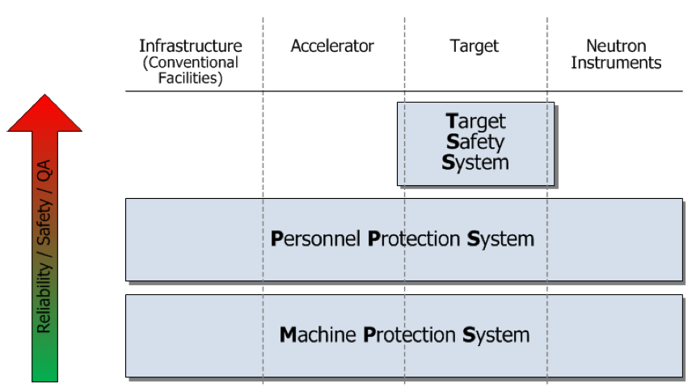
Target Safety System protects public and environment from radioactive hazard
Target Safety System
Active controls credited with a safety function; namely
Protect workers, public, and environment from radioactive contamination hazard
Interface/point-of-contact between other parts of TS and Integrated Control System
Key issues for optimization studies:
Hazards analysis leading to identification of safety credited controls

Slide 14
Target Station Cost Estimate Breakdown by Work Package

Slide 15
Major Procurement and In-Kind Contributions
Top 10 Target Procurements (61 M€)
Monolith shielding
He cryoplant for cold moderators
Radioactive gas effluent & confinement system
Target Safety System
Helium gas purification system
Tele Manipulators
Moderator-Reflector plug
In-cell cranes
Light shutters
Helium compressor
More than 60 major procurements, representing 109 M€ (71 % of total)
Largest cost items are relatively conventional, but cost for steel monolith shielding is volatile
Potential in-kind contributions worth 101 M€ (65 % of total) identified
Working with potential partners to develop in-kind agreements --- close to establishing agreement on a few items, but many items still under discussion

Slide 16
Target Station Project Plan Shows Completion by End of 2019
2014 2015 2016 2017 2018 2019
Moderator concept finalized
Target critical path goes through Moderator-Reflector System
Moderator-Reflector Assembly – Critical Design Review
Moderator-Reflector Plug Fabrication Contract Awarded
Access to Target Building for Monolith Installation
Moderator-Reflector Assembly Delivered to ESS Site
3 months float to First Beam-on-Target commitment of Dec 2019
Target Station Ready for Beam
Target Station Construction Complete

Slide 17
Staffing Required for On-Time Execution of Target Station
Some of these positions will be covered by in-kind agreements, but
Which ones?
How many?
When?
Head count = 36
Now
starting from head count of 27
at end of 1013

Slide 18
Closing Remarks: Major Activities and Goals for 2014
Hiring, hiring, hiring
Work with Science Directorate to finalize strategy for moderator configuration
Finalize detailed requirements and key design features (He pressure in target loop, MR plug extraction scheme, monolith diameter, neutron beam extraction, …)
Conduct Preliminary Design Reviews for critical components and subsystems
Target wheel and drive systems
Target helium cooling system
Moderator and Reflector plug
Neutron beam extraction system
Target monolith shielding
Work towards establishing agreements with in-kind partners

