Slide 1
LoKI – A SANS Instrument for Materials Science
and Soft Matter
LoKI Kickoff Meeting, ESS
Andrew Jackson
www.europeanspallationsource.se
January 29, 2014

Slide 2
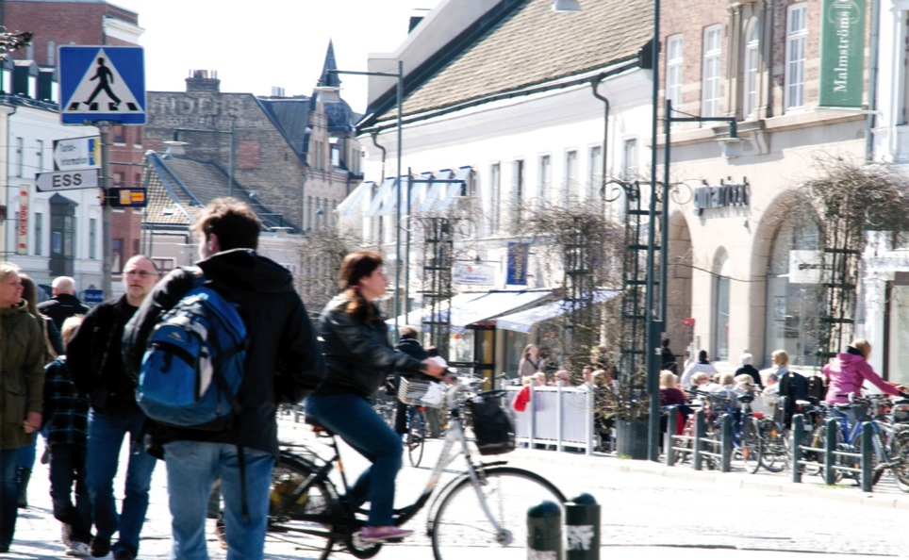
What is “Materials Science”?
Materials Science Shapes Our Daily Lives
LIGHTING
CONSTRUCTION
MATERIALS
NEW
MATERIALS
SOLAR
ENERGY
FUNCTIONAL
FOOD
MEDICINE
PACE- MAKERS
FUNCTIONAL
FABRIC
COSMETICS
MOBILE PHONES
BIO FUEL
TRANSPORT
IMPLANTS
GEO SCIENCE

Slide 3
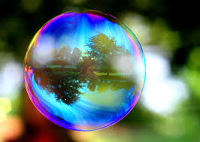
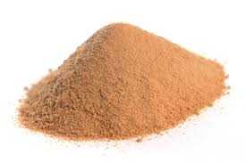
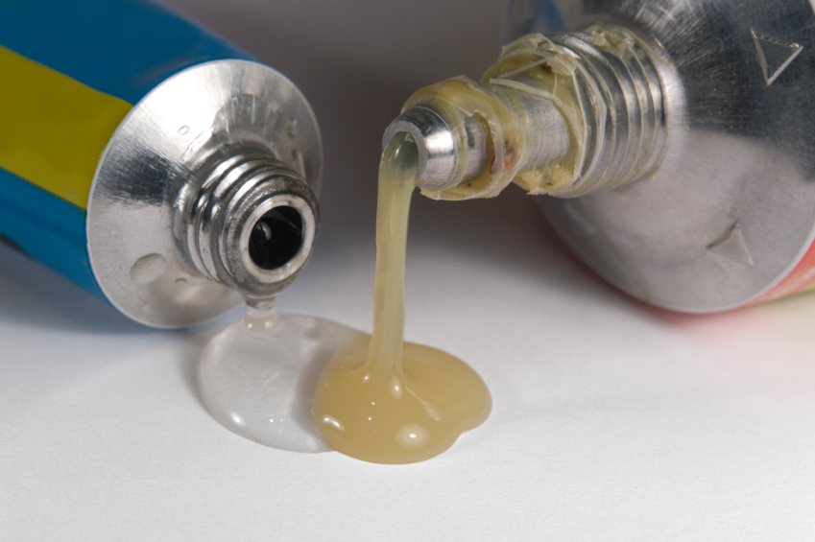
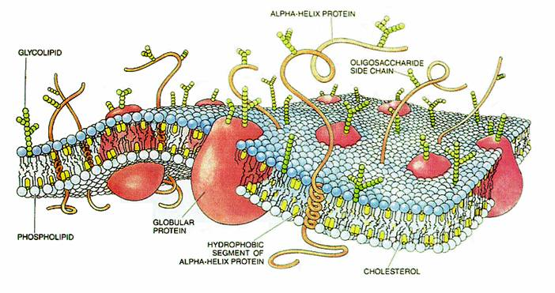
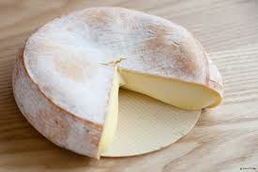
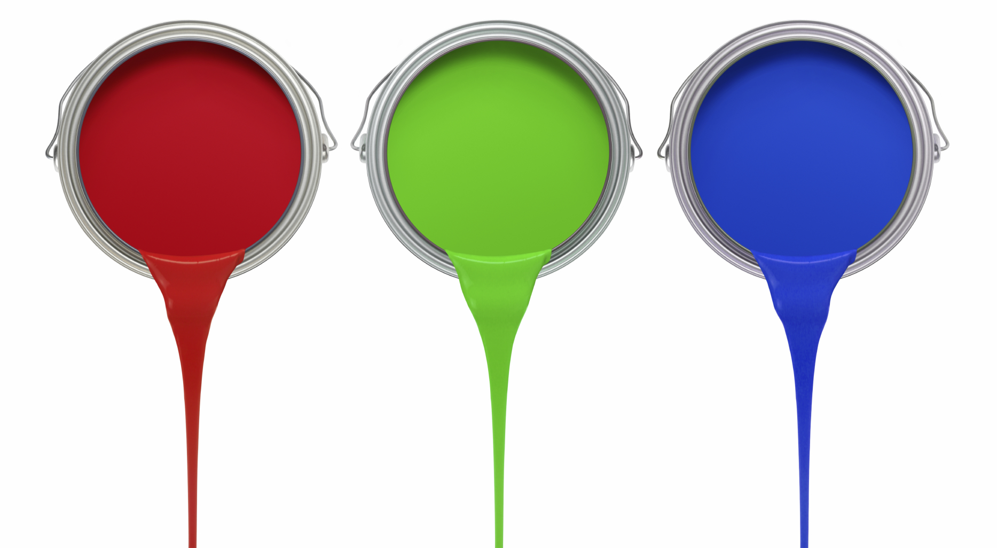
What is Soft Matter?
Wikipedia says...
Soft matter is a subfield of condensed matter comprising a variety of physical states that are easily deformed by thermal stresses or thermal fluctuations. They include liquids, colloids, polymers, foams, gels, granular materials, and a number of biological materials.
page

Slide 4
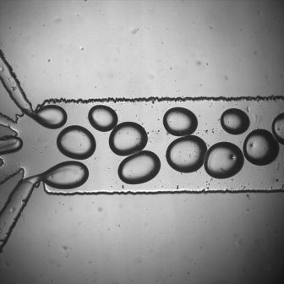
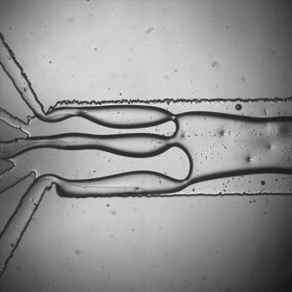
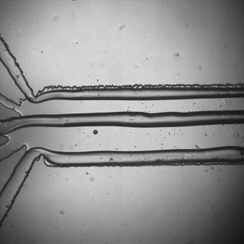
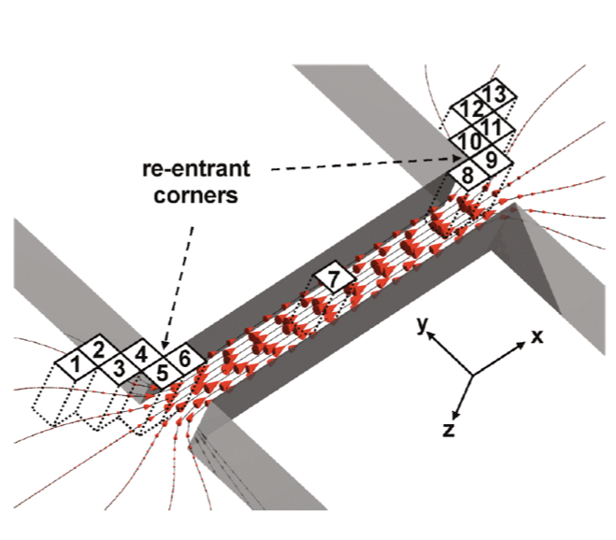
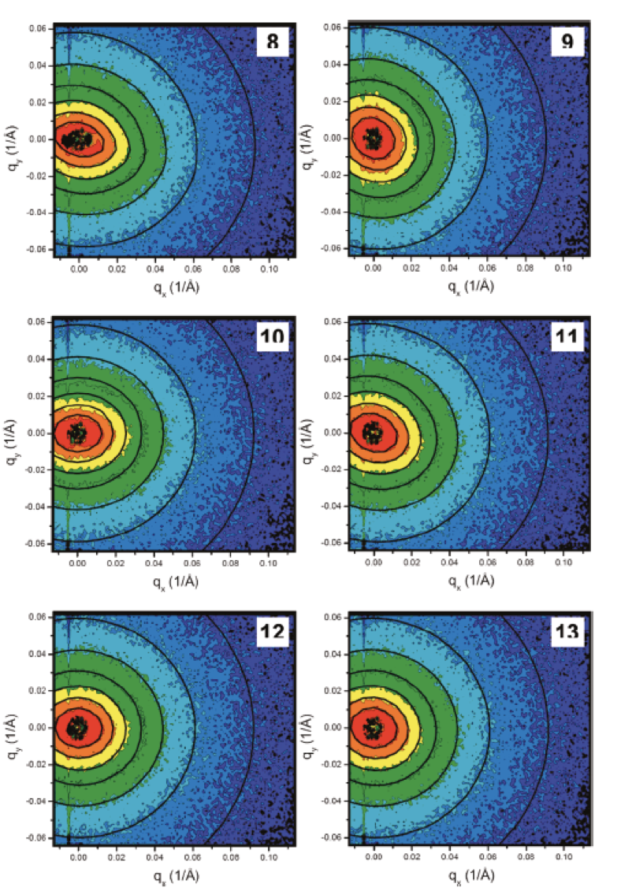
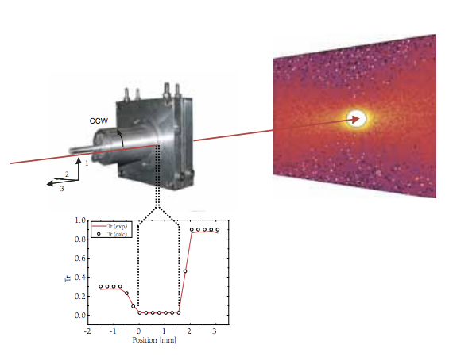
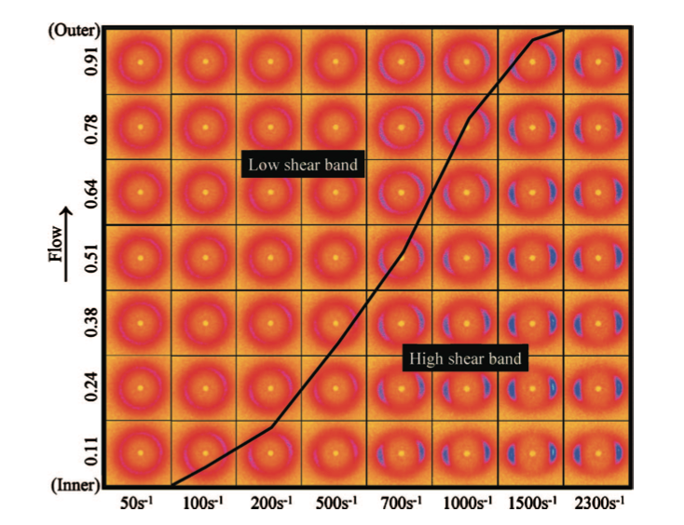
Fluid Flow
The flow of complex fluids through complex geometries is relevant to many industrical processes including polymer processing and oil recovery.
Microfluidic devices are increasingly used for chemical and pharmaceutical discovery, production and processing.
There is a need to understand structural effects of flow both for practical puroposes and to compare with fluid flow models.
Fluid thread breakup under microfluidic confinement (Cabral group, Imperial College)
Measuring the deformation of polymer chains allowing development of new models of polymer flow (Clarke et al. (2010) Macromolecules 43, 1539)
Shear Banding in CTAB wormlike micelles providing confirmation of rheological model. (Helgeson et al. (2009) J. Rheol 53, 727)

Slide 5
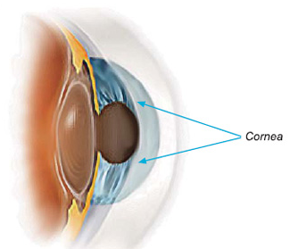
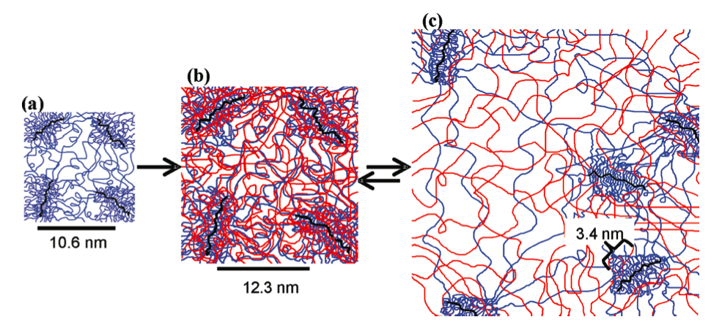
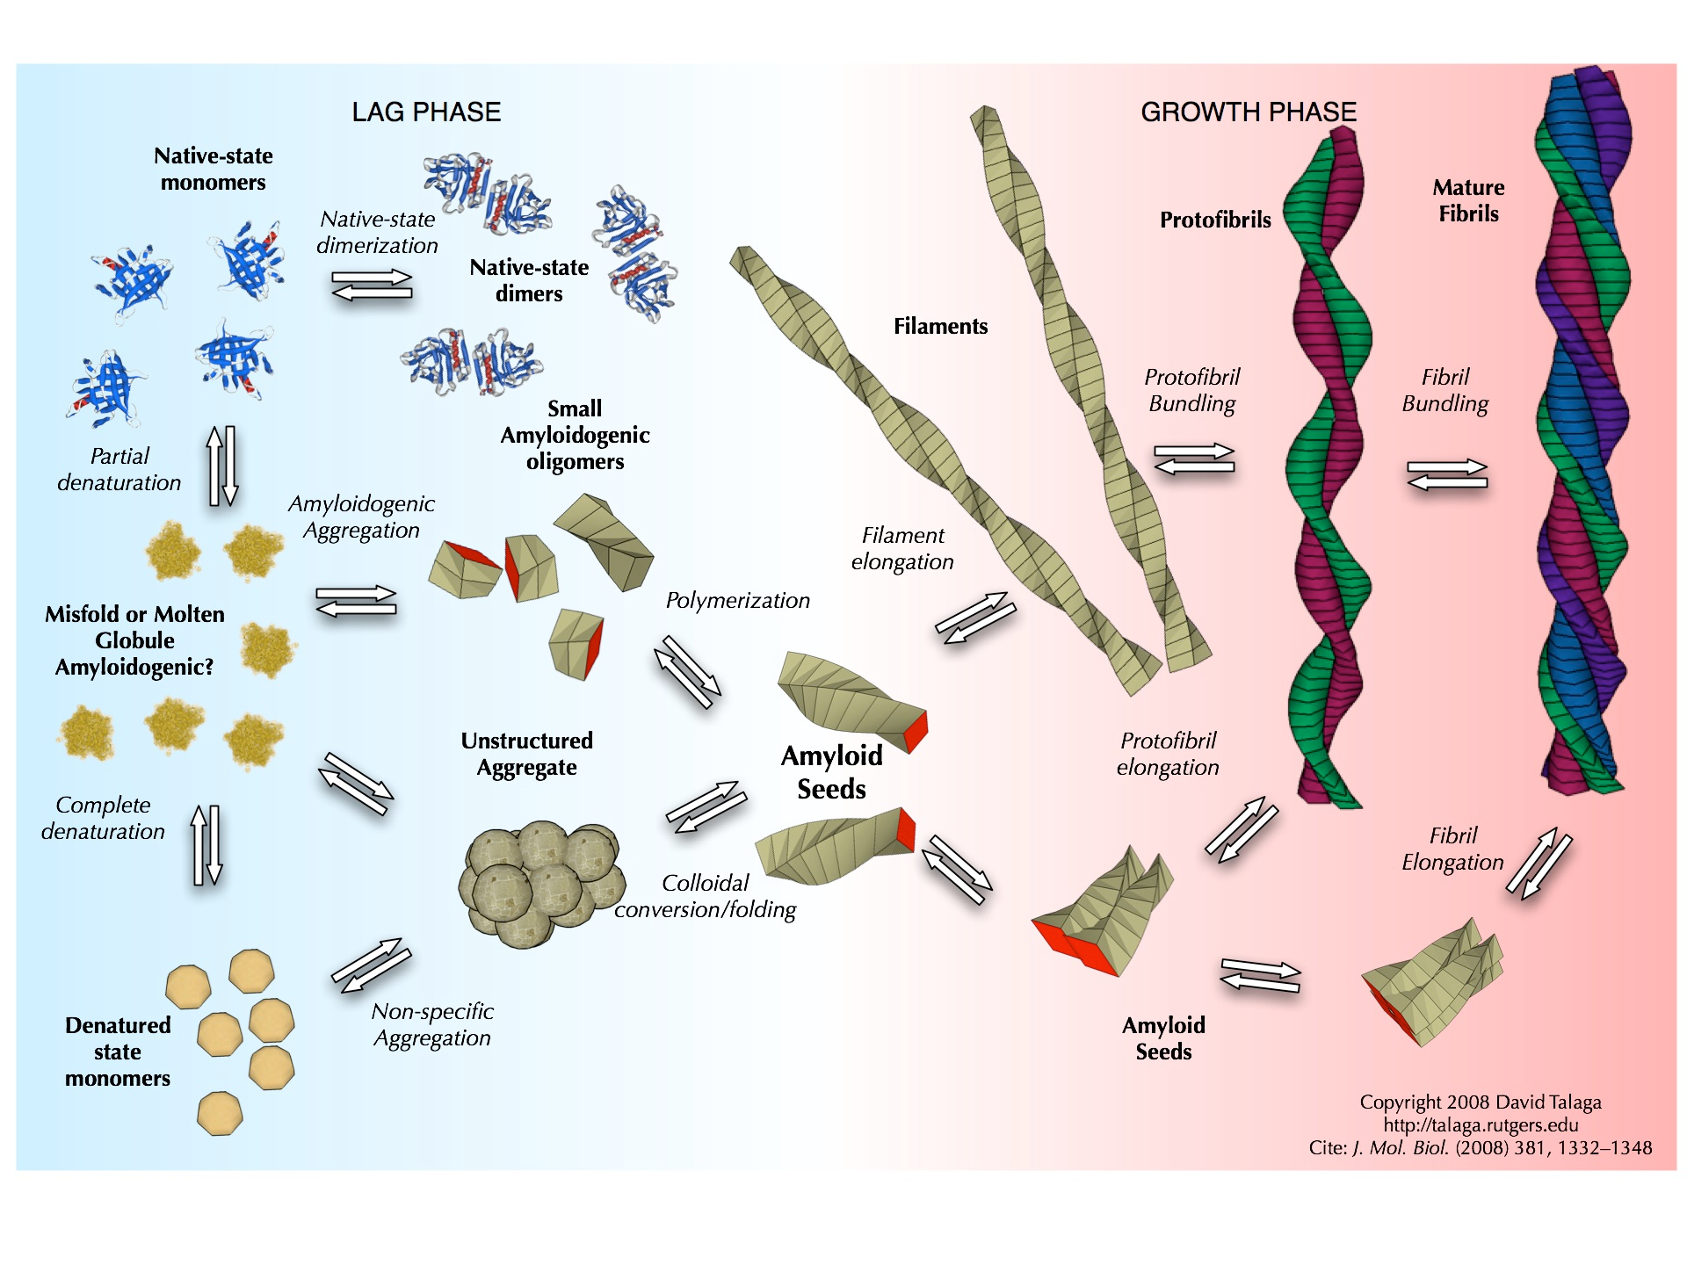
Multiple Length Scales & Kinetics
Double network hydrogels provide strength and resiliance together with high water content.
Gel structure forms over multiple length scales.
Kinetics of gelation can be rapid needing sub-second time resolution.
Neutrons provide the structure of each component in the presence of the other.
Swelling of a double network hydrogel designed for use as a cornea replacement. (Frank Group, Stanford)
Amyloid fibrils have been associated with more than 20 human diseases including Alzheimer’s and Parkinson’s diseases and rheumatoid arthritis.
Fibril formation and growth is a multi-length scale problem and to understand methods of formation and inhibition the structural evolution must be observed.

Slide 6
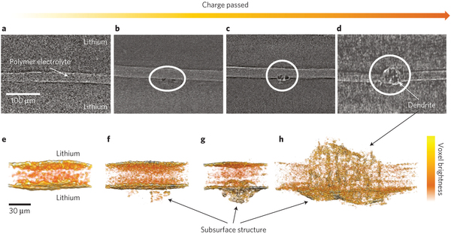
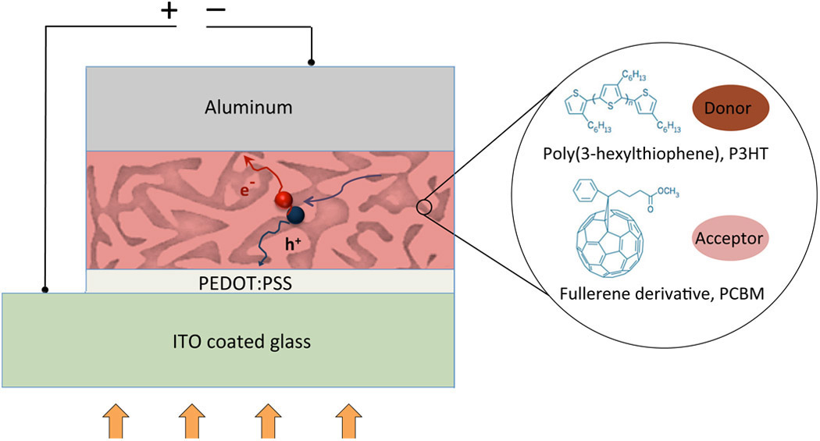
In-Operando Behaviour
Lithium Ion Batteries are a crucial technology for the expansion of electric vehicle use and for mobile computing.
Higher energy densities could be achieved with alternative anode materials and new electrolytes.
Analysis of operating devices allows the monitoring of nano- and micro-structural change.
Dendrite growth in lithium metal anode batteries observed by x-ray microtomography. (Harry et al. (2013) Nature Materials 13, 69)
Organic Solar Cells promise to provide cheap and accessible solar energy.
The lifespan and efficiency of the devices depends on the nano-structure of the bulk heterojunction polymer mixture.
Understanding the structural evolution under operation guides development of new devices.

Slide 7
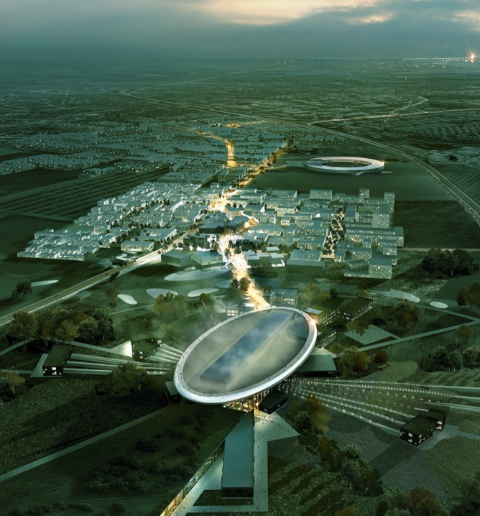
The Source
17 Countries
Brightest neutron source
5MW
2.86 ms
14 Hz
First neutrons 2019
22 instruments by 2028
1.843 B€

Slide 8
Goals
A broad Q range, high flux SANS instrument for materials science and soft matter
Science Based Goals
Rapid data collection / short counting times to enable kinetics
Probe broad size range to examine hierarchical structures
Small sample volumes for scanning, biological and complex samples
Integrated flexible sample environment for non-equilibrium studies
Integration of complementary techniques experimentally and in data analysis
Simplicity of operation to allow users to focus on science
Notes:
non-equilib *and* complementary measures e.g. ir, nmr, dsc etc

Slide 9
Goals
A broad Q range, high flux SANS instrument for materials science and soft matter
Technological Goals
Broad simultaneous Q range with Q_{max}/Q_{min} = 1000
Good Q resolution over the whole Q range
High flux making best use of ESS source
Single pulse scattering measurements
Optimized use of new detector technologies

Slide 10
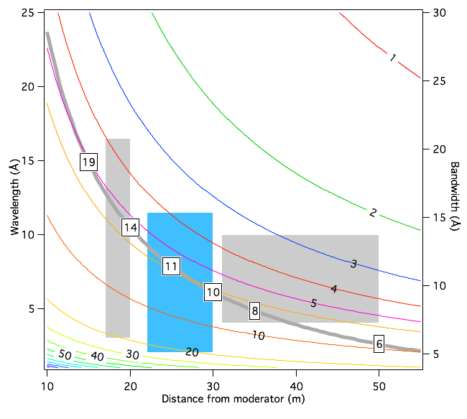
Goals
A broad Q range, high flux SANS instrument for materials, soft matter and bio-science.
Design Constraints
Avoid line-of-sight (background)
Bandwidth vs Time Resolution (Q resolution)
Space (sample environment)
Conclusion
Detectors between 20 m and 30 m
Wavelength-Distance Space used by LoKI

Slide 11
Goals
A broad Q range, high flux SANS instrument for materials science and soft matter
Require good Q resolution across whole Q range - high angle to reach high Q with long wavelengths.
Need broad Q range - large solid angle of detectors and broad wavelength band.
High spatial resolution at low angles to reach low Q
Wavelength-Distance Space used by LoKI

Slide 12
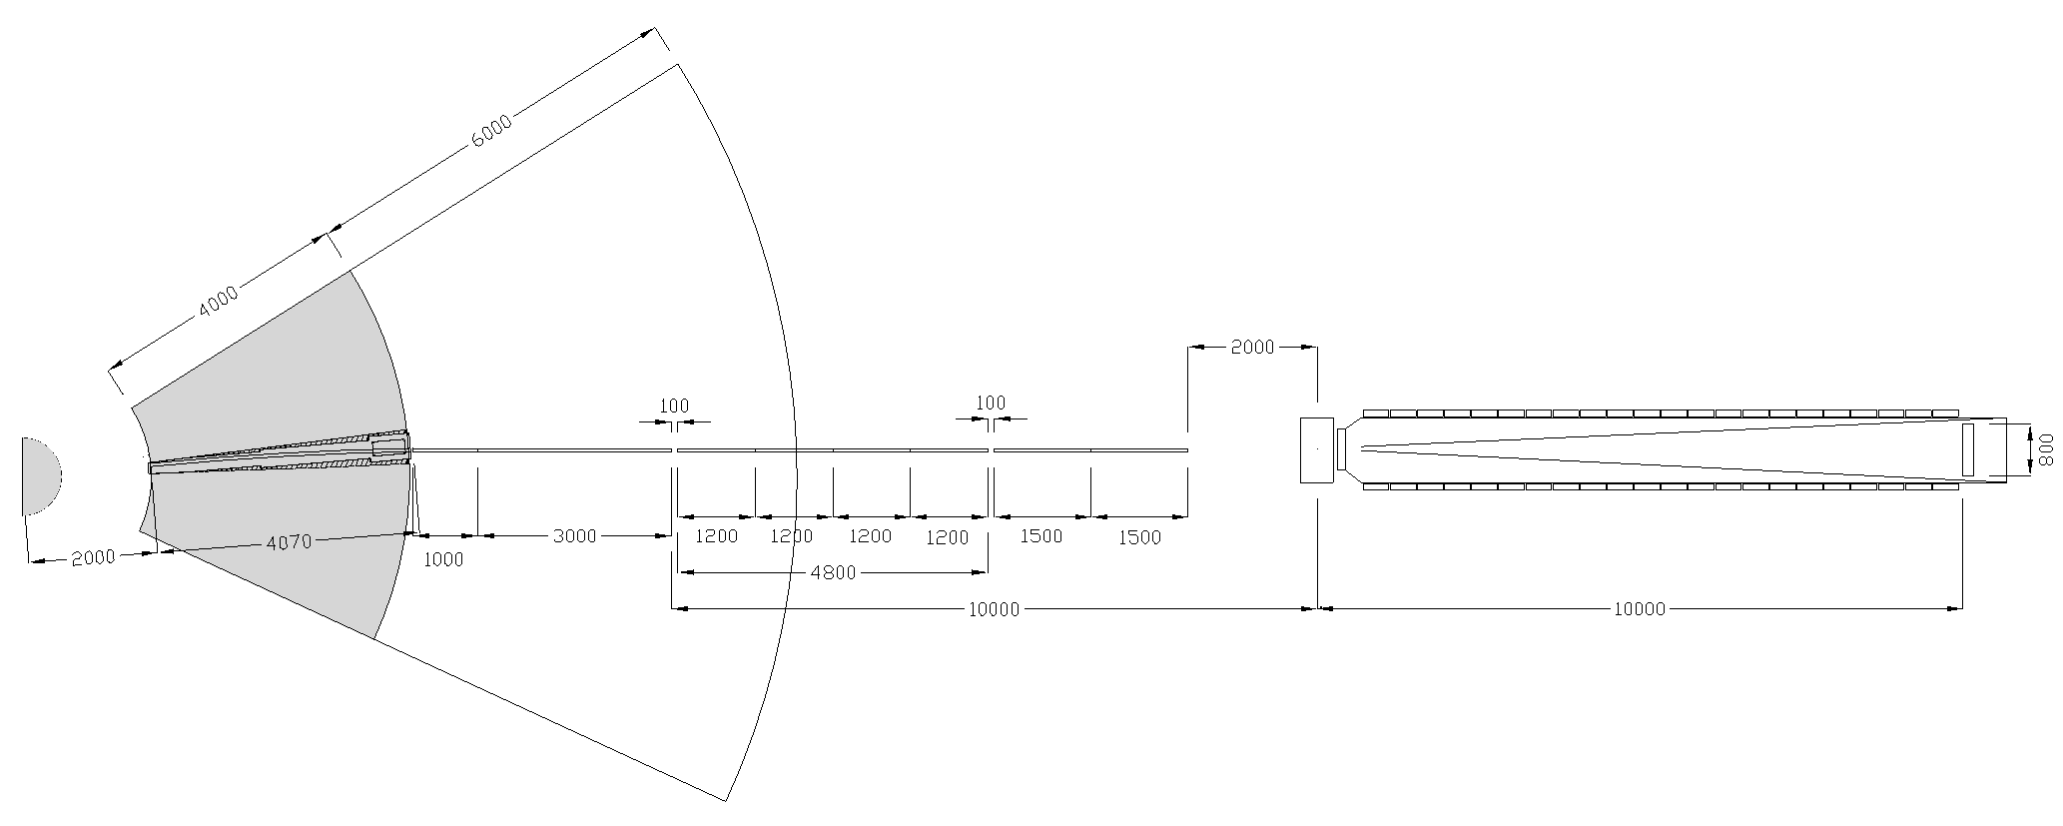
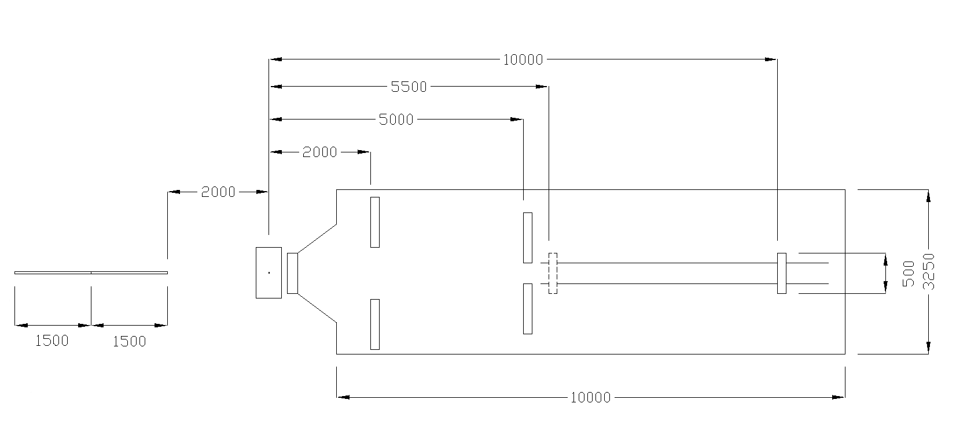
Overview
Bender: r = 78 m
l = 4 m
4 channels
m = 3
Variable Opening Choppers
Guide: 3 cm x 3 cm
m=1
Collimation: Up to 10 m
A1 = 20 mm, 10 mm, 8 mm, 4 mm
Optional Focussing Optics
SDD: ~1 - 10 m
SDD: 2m, 5m, 10m

Slide 13
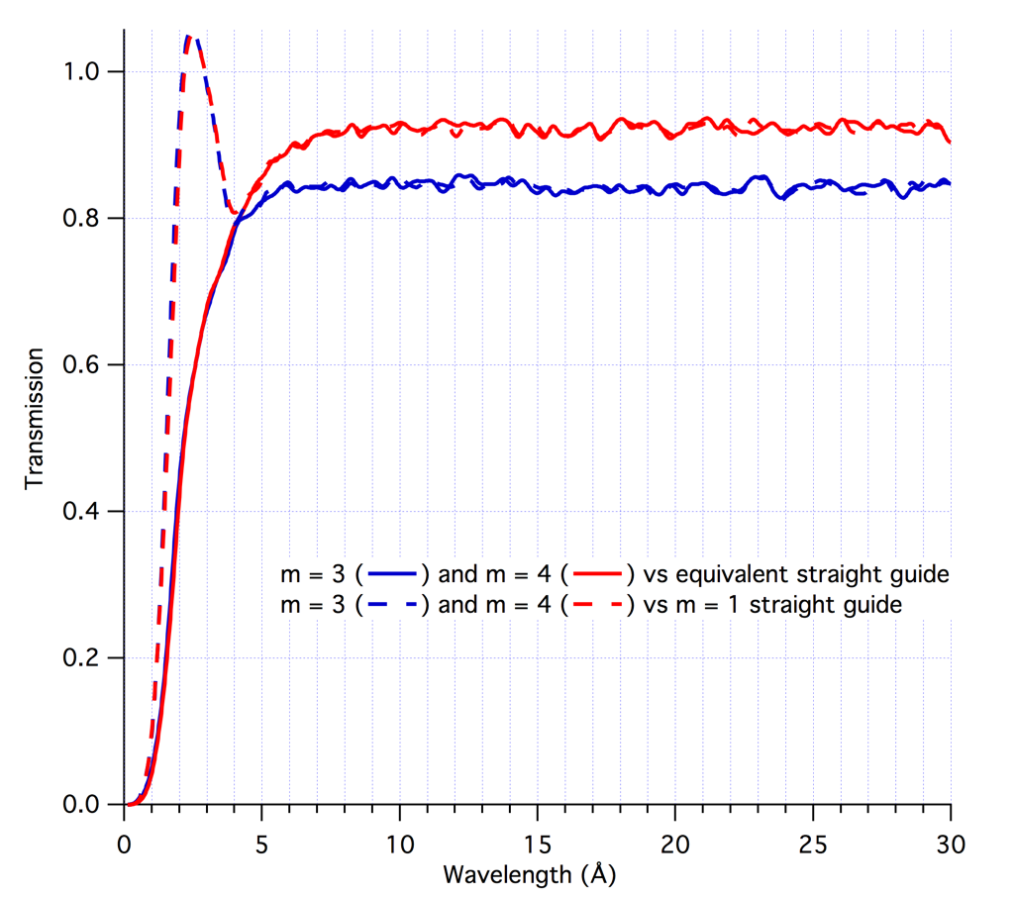
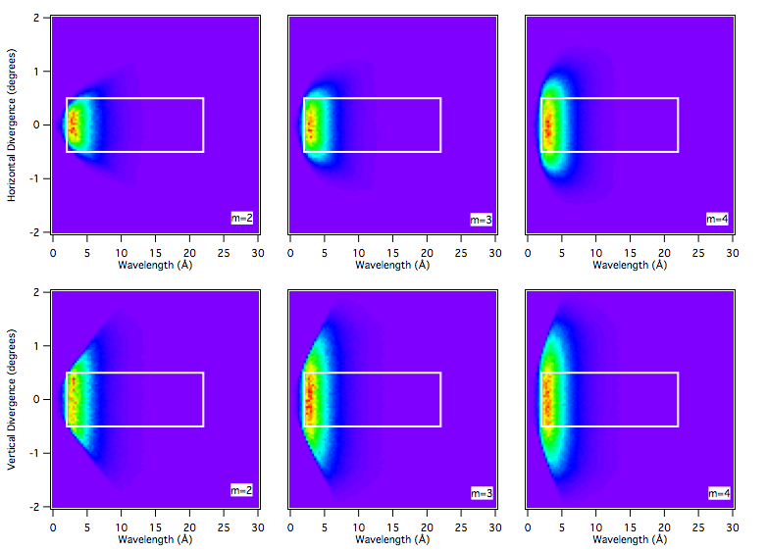
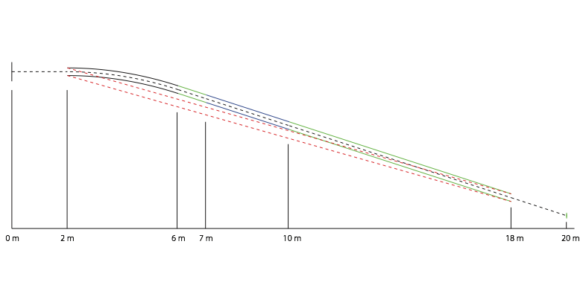
Bender Performance
78 m radius
4 m length
3 cm x 3 cm
4 channels
m = 4
Avoid line of sight before start of collimation
Bender
Chopper 1
Chopper 2
Collimation
Guide

Slide 14
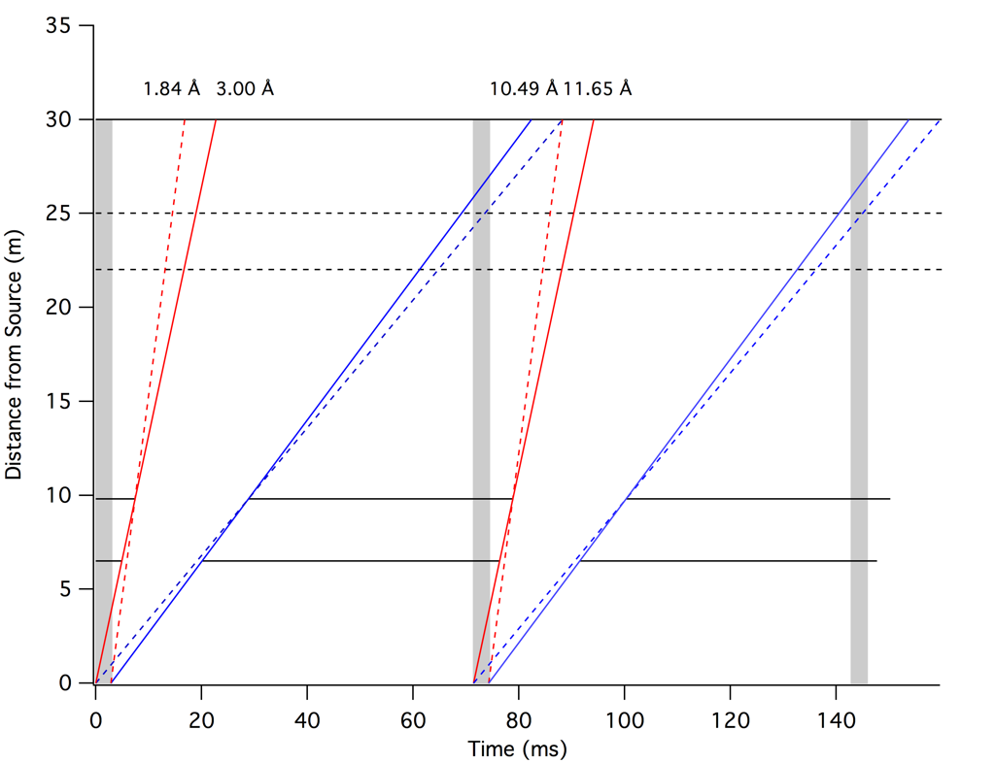
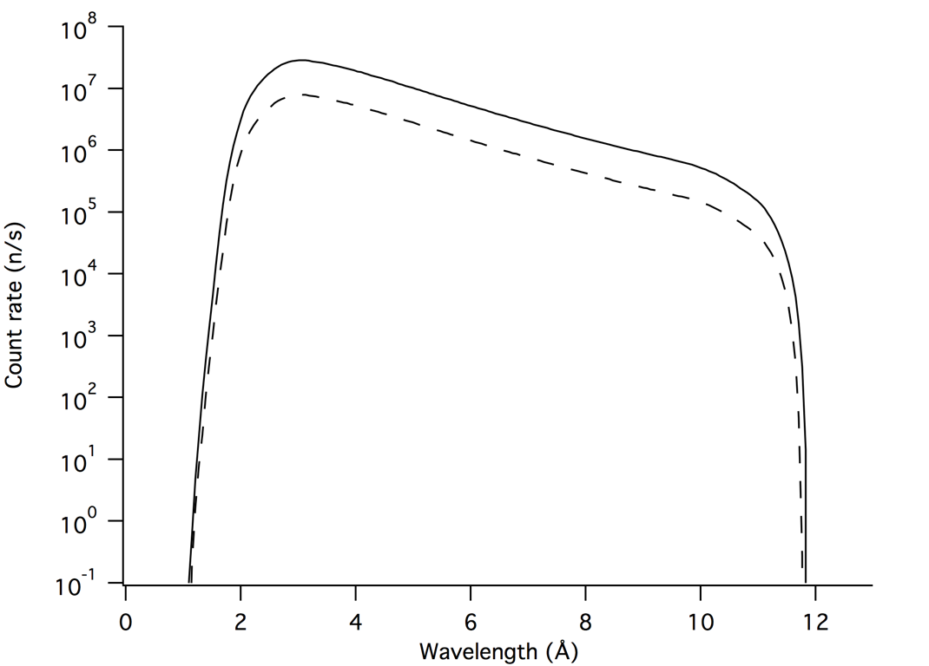
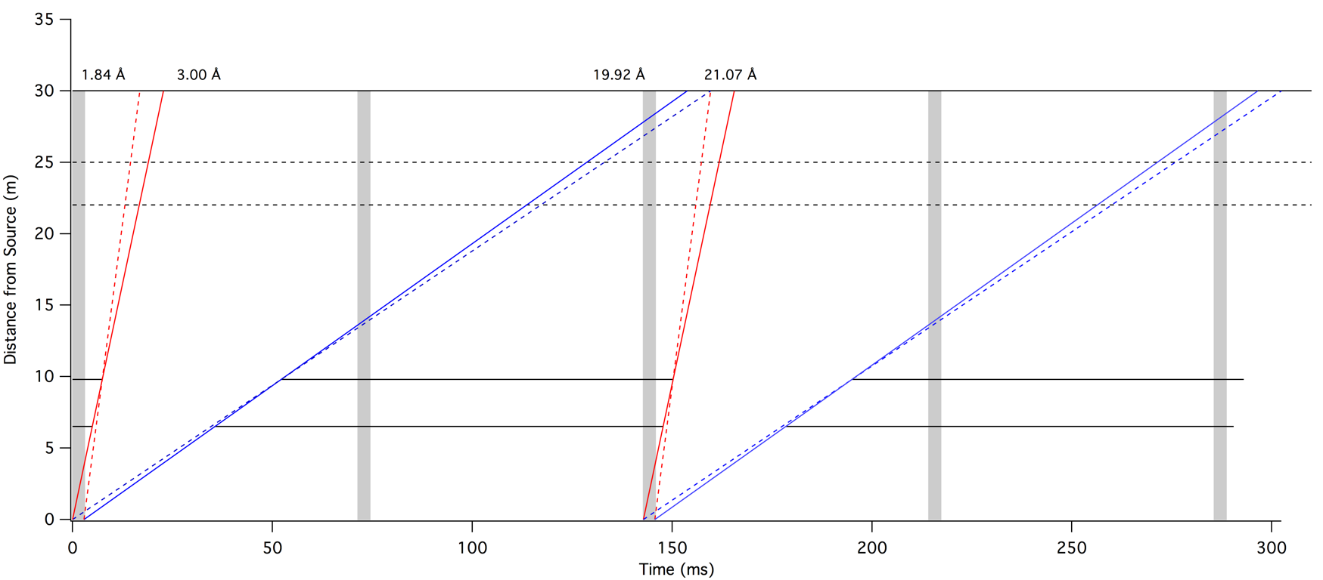
Wavelength Selection
Variable opening double disc choppers at 6.5 m and 9.8 m
14 Hz
3 - 10.5 Å
7 Hz
3 - 20 Å

Slide 15
Sample Position
A flexible space with 2.5 m along the beam and 3 m perpendicular to the beam
A system of sample environment pallets that can be quickly interchanged allowing offline setup of equipment
Space for magnets, rheometers and shear cells, pressure cells, sample changers, auto-sampling robots, flow-through cells ... whatever the user can think of!
Space for complementary measurement techniques

Slide 16
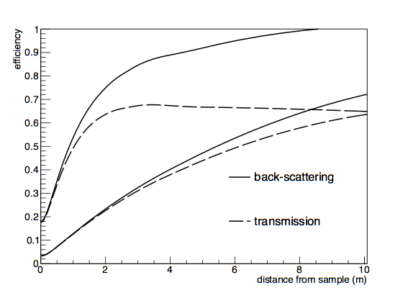
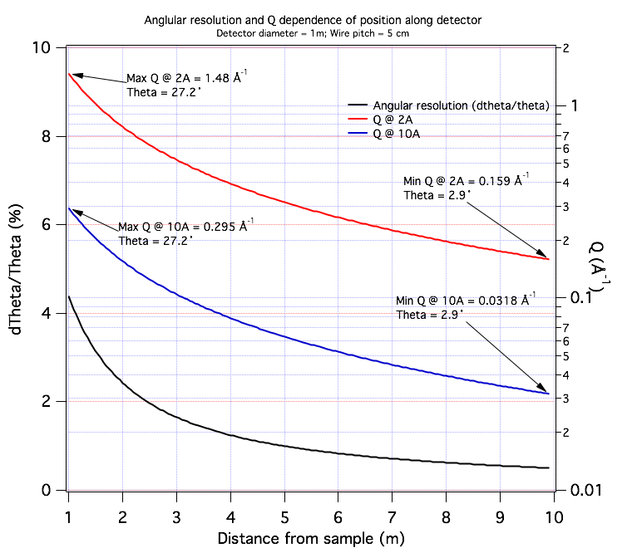
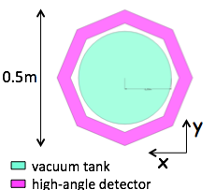
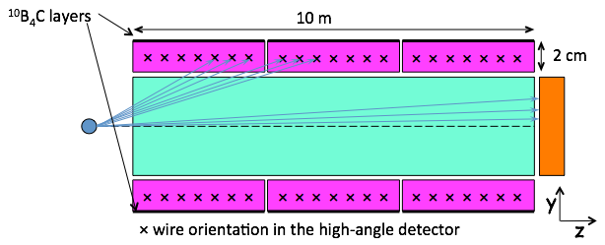
“Lined Tube” Detectors
Q range of 1m diameter high angle detector
0.03 Å⁻¹ < 1.0 Å⁻¹
^{using 3Å - 10.5 Å neutrons}
12 Å
2 Å

Slide 17
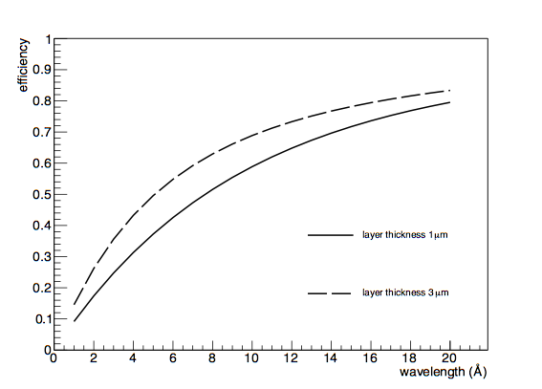
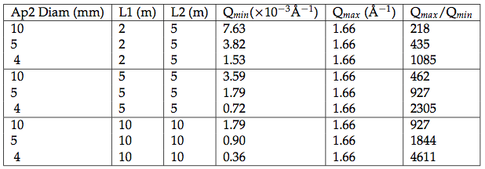
“Window Frame” Detectors
Front: 3 m x 3 m with 1 m x 1m hole
Middle: 2.4 m x 2.4 m with 0.5 m x 0.5 m hole
Back: 0.5 m x 0.5 m
Accessible Q ranges with 3 Å - 10.5 Å neutrons

Slide 18
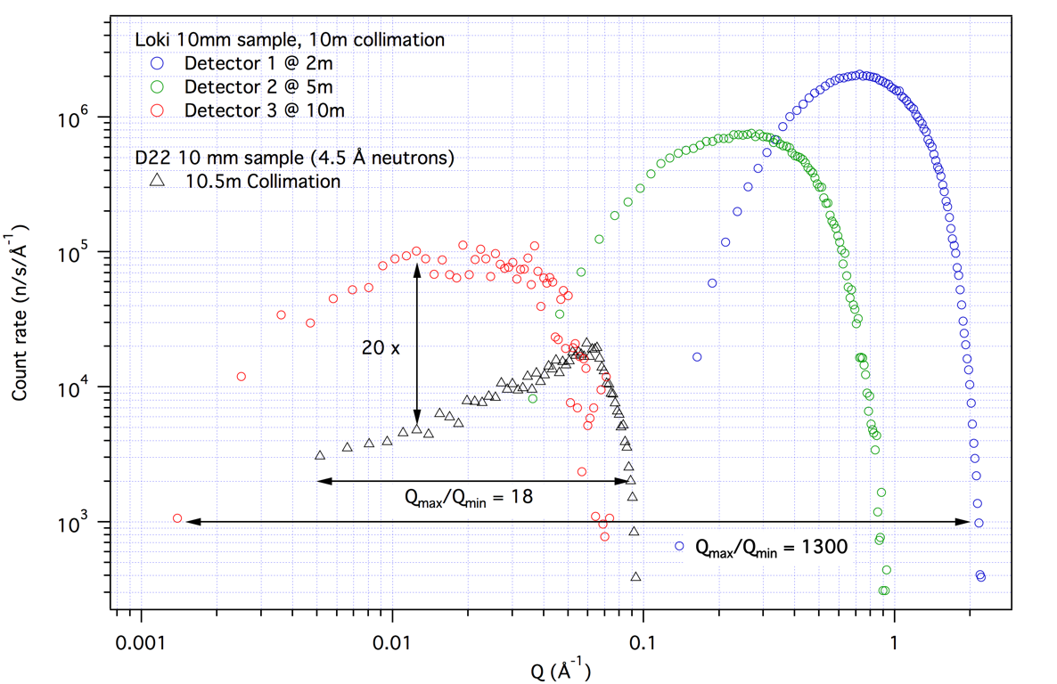
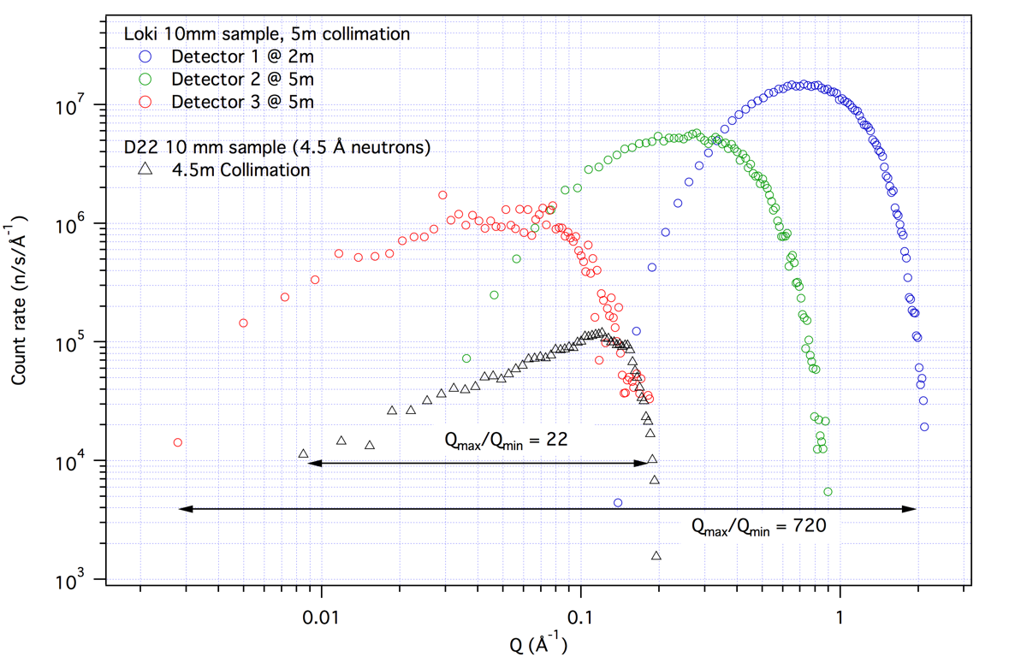
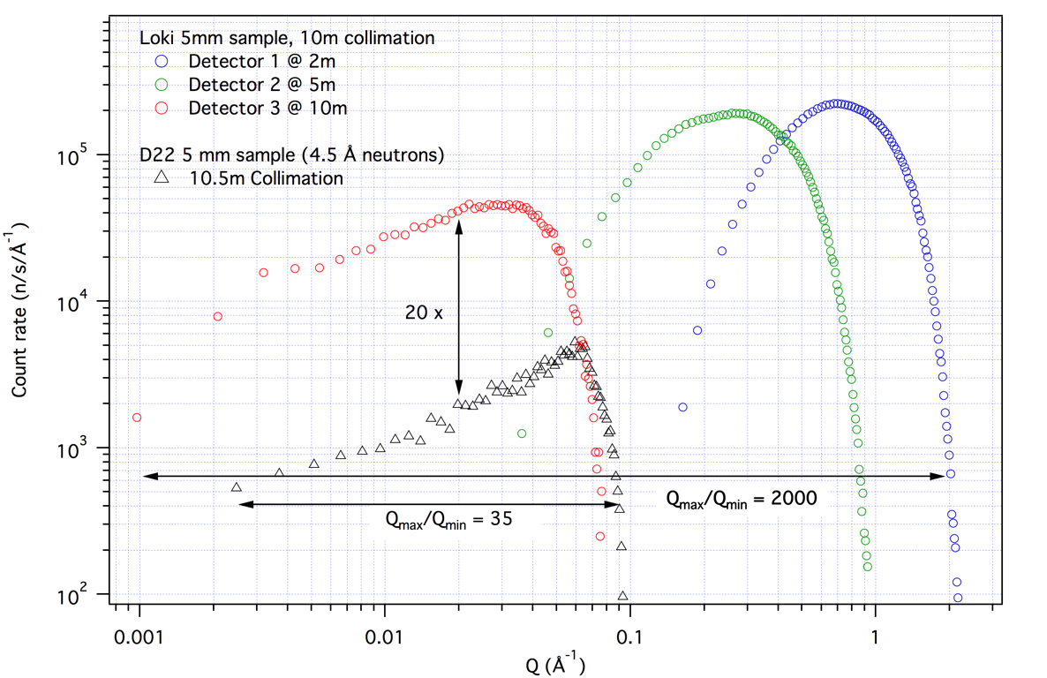
Performance
Scattering from 1mm H2O using “Window Frame” detector layout
Notes:
20 x flux gain means we can measure 20x smaller samples at the same stats. So 10 mm diameter becomes 2 mm diameter

Slide 19
Risk Management
Risk : Detectors will not be available.
Mitigation :
This is a common risk for all ESS instruments that require large areas of detector given the lack of 3He options (availability, count rate). As such it is a high priority for ESS to develop such systems and current progress is good.
In the case of LoKI, the initial design phase will progress with multiple possible detector layouts and the final technology choices can be made 18 - 24 months after the start of the construction project. This should provide sufficient opportunity for detector developments to be advanced to a stage where that decision is possible.
Risk : Shielding will not be sufficient to provide a low enough instrumental background
Mitigation :
This is again a common risk for all the short (< 60 m) instruments at ESS and the optics group is already working to address it. During the engineering design phase we will work closely with the optics group to determine exact requirements and design the shielding solution.

Slide 20
Costing
3He Detectors in Window Frame layout
20 M€
10B Detectors in Window Frame layout
14.5 M€
10B Detectors in Lined Tube layout
12 M€
Notes:
Costing for 10B detectors assumes production pricing i.e. R&D costs are borne by detector group
Costs are higher than in proposal based on increase in chopper cost as advised during review

Slide 21
Summary
LoKI will provide
A world leading SANS instrument for the ESS with high flux, wide simultaneous Q range, a flexible sample area and opportunity for enhancement with focussing optics.
Beam sizes as small as 2mm will be routinely accessible allowing small sample volumes and scanning experiments.
The ability to perform “single-shot” kinetic measurements on sub-second time scales
The ability to perform stroboscopic measurements with a time resolution of the pulse length.

