Slide 1

LoKI – Project Planning and Engineering
LoKI Kickoff Meeting, ESS
Stewart Pullen
www.europeanspallationsource.se
January 29, 2014

Slide 2
Introduction
Project Phasing
Project Scheduling
Requirements for LoKI
CAD Work – Skeleton of LoKI.
Integration of components

Slide 3
Project Phasing
The project has 4 major phases with Toll Gate Reviews at the end of each.
  Phase One – Preliminary Engineering Design & Baseline
  Phase Two – Final Engineering Design & Installation Plan
  Phase Three – Construction & Installation
  Phase Four – Beam Testing & Cold Commissioning
This year will see the completion of Phase 1
Notes:
The project will follow a 4 phase process.
Phase 1 = 1 year
Phase 2 approximately 2 years
Phase 3 approximately 2 years
Phase 4 approximately 1 year
Phases 2 & 3 and 3&4 will have some overlap

Slide 4
Project Phasing
Notes:
Review 1 (Decision to move forward) will require SANS STAP members to be involved, to review the scientific and feasibility of the Instrument and its proposed tech packages.
Review 2 will be an internal review focused on the Engineering and operational details of the instrument design.
Review 3 will look at the instruments readiness for Cold commissioning, this will largely look at the safety systems readiness for operation of the instrument without spallation neutrons.
Review 4 will look at the instruments readiness for Hot commissioning, this will largely look at the results of the cold commissioning and review any changes that were necessary prior to hot commissioning.

Slide 5
At the end of Phase 1
We plan to have:
Final Design Document
  The Requirements Baseline
  Technology group options to meet requirements
  Preferred options
Process and Instrument Diagram (P&ID)
Systems Engineering documents
CAD File containing Instrument Skeleton and Instrument Envelopes
Schedule & Budget
Draft Commisioning Plan
Notes:
These will be the documents that will be presented for review at Review 1.

Slide 6
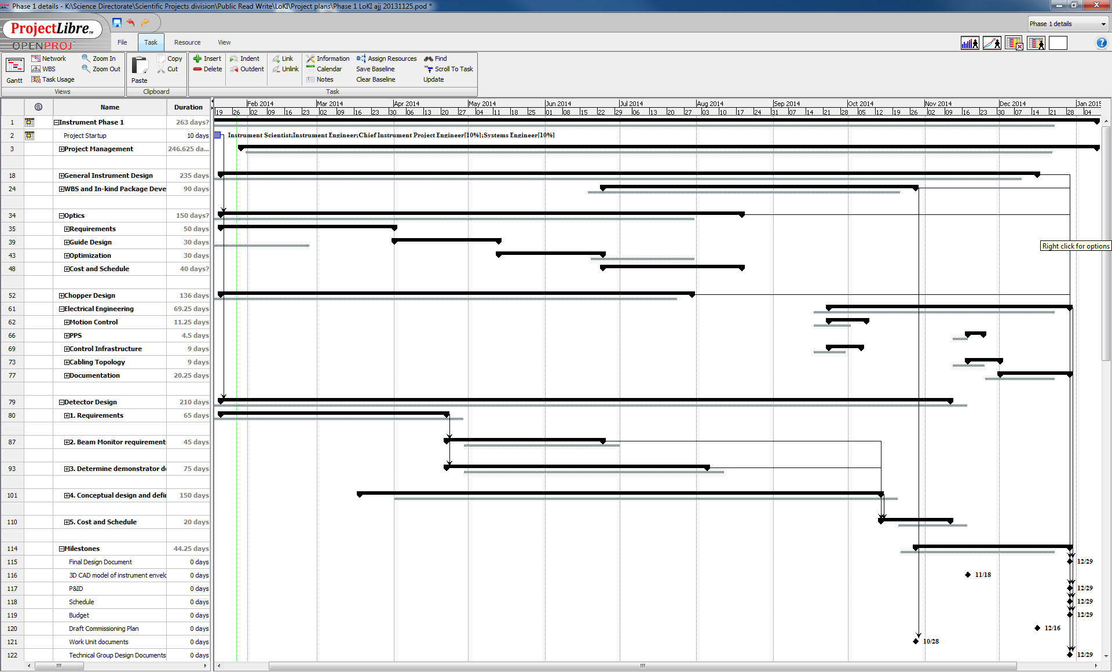
Phase 1 Project Plan
Notes:
The requirements should be well in hand by the end of April.
This will lead to the development of technical options to fulfil the requirements which should be ready by October in most cases (Elec. Eng. December).

Slide 7
The Instrument’s Requirements
High level list of functions that LoKI should perform.
These are then discussed with the relevant Technical Groups.
The Technical Groups in conjunction with the Instrument Team will explore various options and configurations to find the best fit for LoKI and its users.
This should then be baselined at the end of Phase 1, ready for detailed design in Phase 2.
Notes:
The requirements should be traceable, unambiguous, obtainable, verifiable.
The technical groups will extract the sub-requirements that will lead to a specification (with the help of the Instrument team offcourse).
Once the options are determined, associated price and schedule data should also then be available, which will feed into the Review at the end of Phase 1.

Slide 8
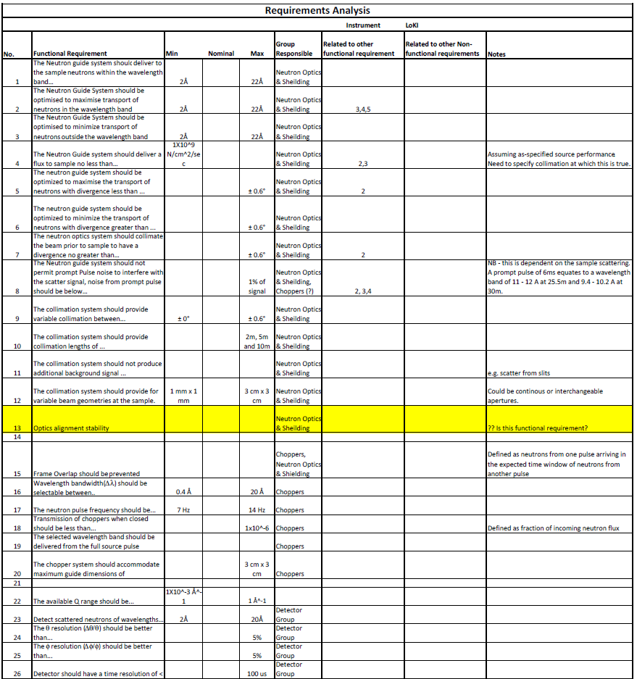
Requirements Analysis
Work is in progress
We are discussing these with the Technical Groups now to better define them.
It can be seen that some requirements impact more than one technical group. These need to be managed closely
This is just the first
half of our first pass
of LoKI’s requirements
Notes:
To manage the interface components good communication between the Instrument Team and the Technical groups is paramount as is good communication among the technical groups.

Slide 9

CAD : Instrument Skeleton and Envelope
The Instrument Skeleton is a basic geometric representation of the instruments key features.
This will reflect the McStas model and sheilding calculation so that all models reflect the same key instrument features.
This should be performed by an agreement in the parameters used in all.
The skeleton will allow for easy integration into the wider facility CAD.
Notes:
Into which more detail is added as the project moves through the phases.
This is important to ensure consistency in the models and make sure that the impacts of any changes can be assessed across the board.
.
It can be added to the accelerator and target facility CADs once the instruments port location is decided. This will provide a fully integrated high level CAD document of the Instrument, Target and surroundings.

Slide 10
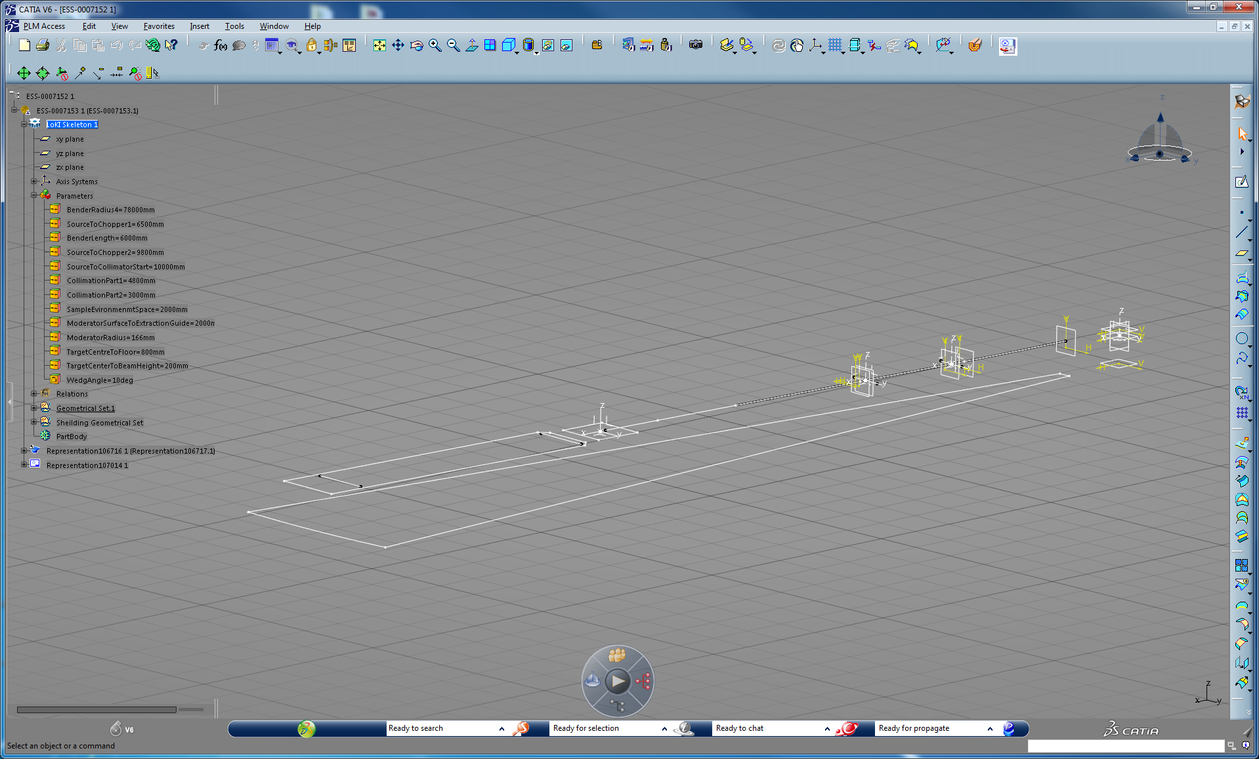
Preliminary Skeleton Work
Notes:
Iso. of a preliminary skeleton showing coordinate systems for choppers and sample.
The dimensions are driven by parameters to make alteration of the skeleton simple.
We can quickly configure the instrument in a variety of ways. These are the parameters that must be correlated to the McStas simulation and shielding calculations.

Slide 11
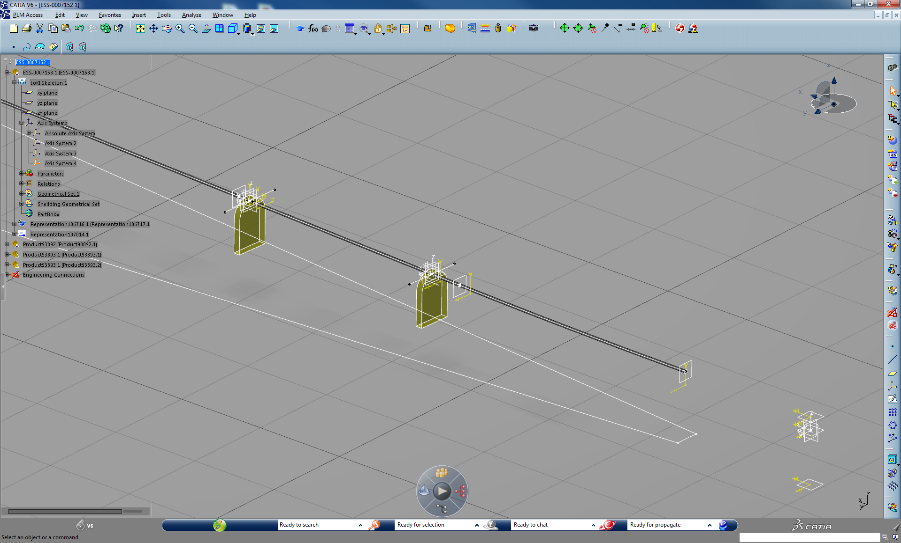
Example of an envelope integration
Notes:
This is an example of the some chopper envelopes and how they might be integrated into the skeleton.
The key to making this work is ensuring that there are guidelines that are agreed to that dictate where coordinate systems will locate to (i.e. the centre of the guide slot in the chopper).

Slide 12
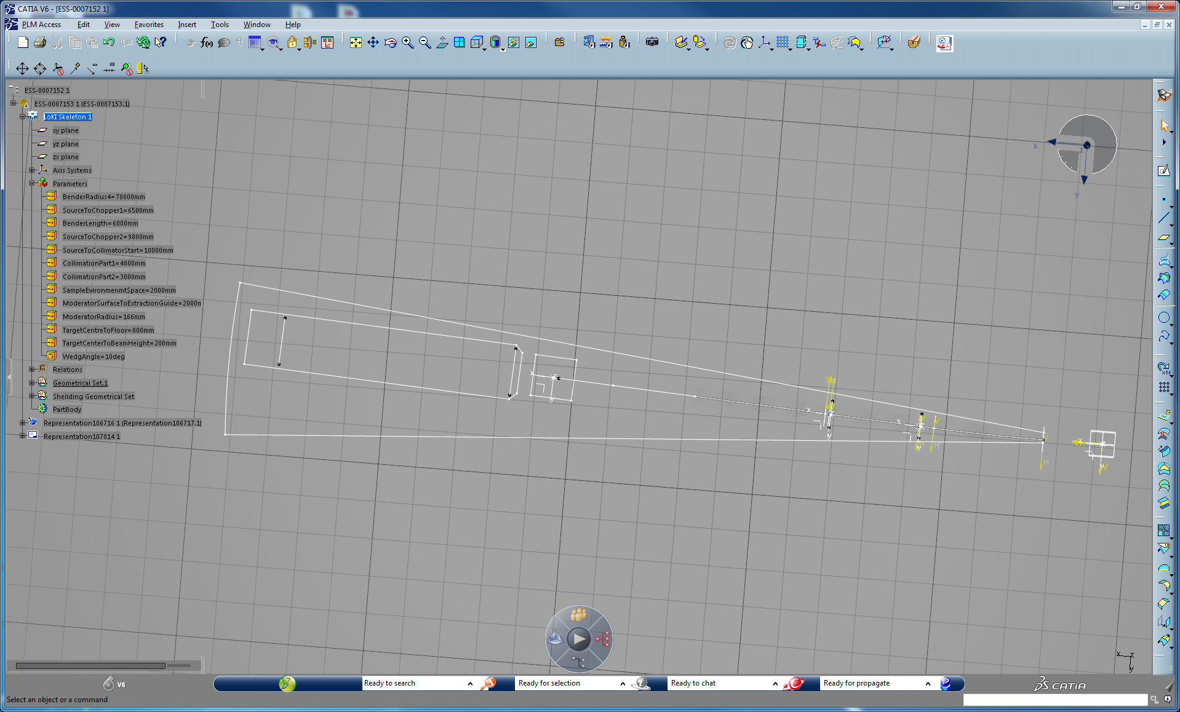
Example of a Plan view showing LoKI layout.
Notes:
Plan view, these views will assist in checking the layout when parameters are changed. It also show the instruments fit within its confines.
This example shows a 10deg. Wedge offset 7deg. to 3deg.
At the moment this has removed the influence of having instruments either side, this would have to be addressed.

Slide 13
Summary
Phase one has begun and should be completed in 1 year.
We are formalising the requirements so they can be baselined.
This is being done in consultation with the Technical Groups.
We are producing a CAD system that will prove useful for the entire duration of the project.
Thank You

