Slide 1
Detector possibilities for LoKI
Kalliopi Kanaki

Slide 2
Topics to be addressed
Detector options for LoKI
Related detector group R&D activities
Highlights of results
Instrument phase 1

Slide 3
Making decisions
What should we take into account?
Requirements matching
Cost
Technology availability
Technology readiness level (TRL)
NASA TRL (wikipedia)

Slide 4
LoKI options
Zero angle detector
Low angle
  Anger cameras
  MultiBlade
  MultiGrid
  bGEM
High angle
  ¹⁰B tube
Zero angle detector
Low angle
  Anger cameras
  bGEM
  MultiBlade
Mid-angle
  Anger cameras
  bGEM
  MultiBlade
High-angle
  Macrostructures
  MultiGrid
Rate & resolution limitations make ³He an unrealistic option

Slide 5
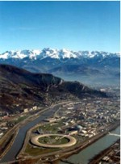
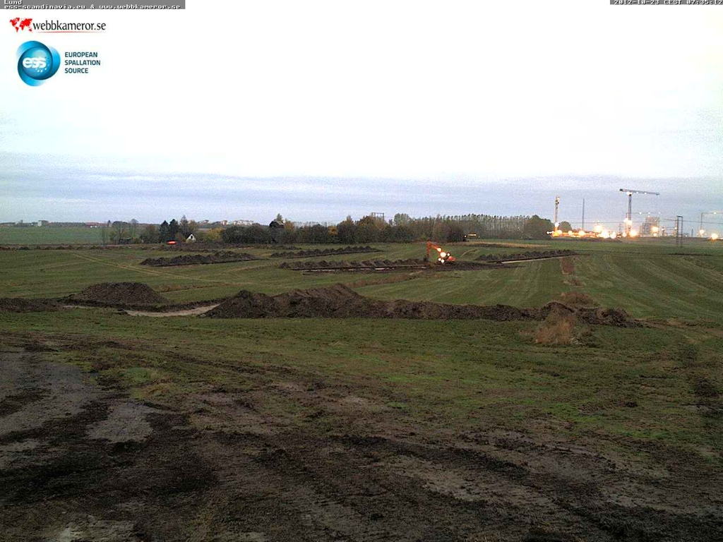
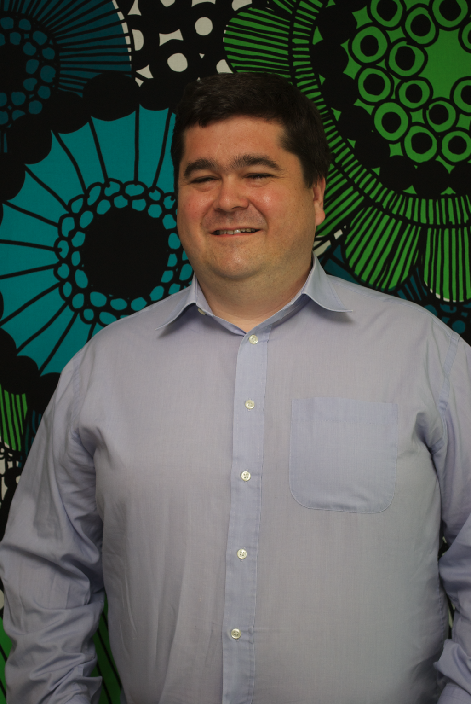
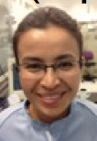
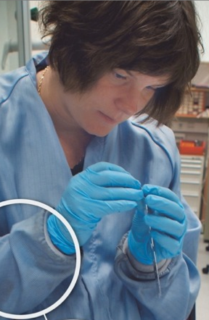
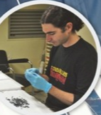
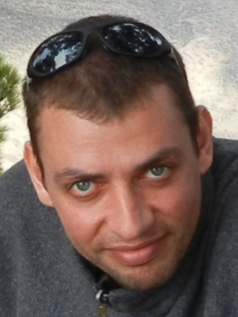


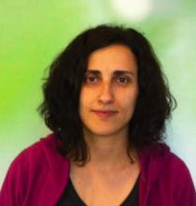
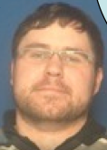
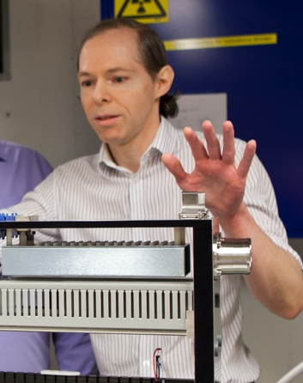
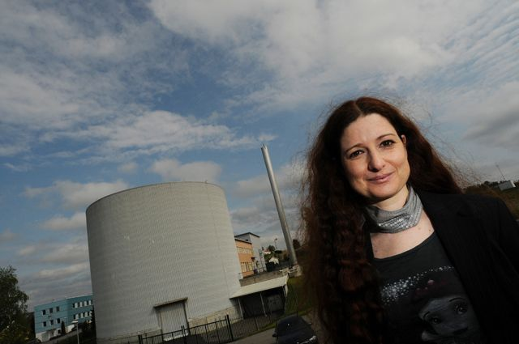

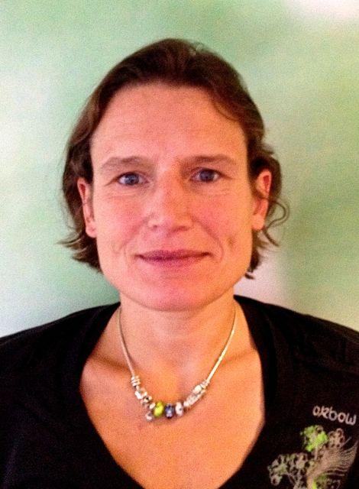
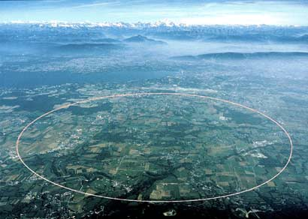
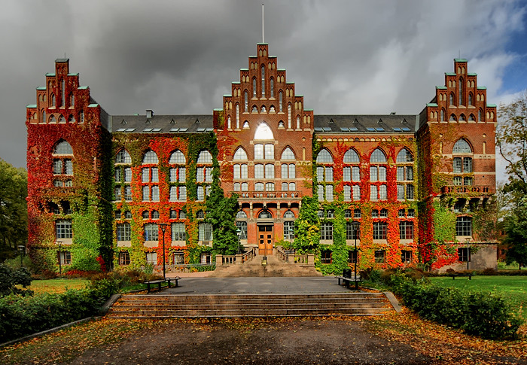
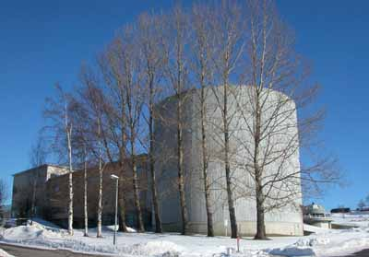
The ESS Detector Group
Richard Hall-Wilton
Kalliopi Kanaki
Thomas Kittelmann
Scott Kolya
Luis Ortega
Linkoping
ILL
(31 Dec 2010, detector group comprised of ... Carina!)
ESS
Anton Khaplanov
Carina Höglund
Mewlude Imam*
Isabel Llamas
Xiao Xiao Cai
Thomas Haraldsen
Kevin Fissum
Björn Nilsson
Julius Scherzinger*
Vladimir Pastukov*
3 PhD Students (*)
(+5 bachelors/Masters Projects+2 interns)
IFE
Dorothea Pfeiffer
5
CERN
Lund U, LTH, MAXlab
reorganization of the group & work breakdown structure to change focus
from R&D to instrument classes and construction

Slide 6
LoKI related ESS R&D activities
¹⁰B technology (ILL/ESS/FRM-II/Linköping)
  Multi-Grid detector (multiple converter layers)
  Macrostructures (multiple converter layers)
  Tube detector (single converter layer)
  B₄C coatings
bGEM (Italy/CERN)
Simulation framework
Neutron energy determination

Slide 7
Technology strategies
No ³He developments internally
Expect a need of ca. 2000 bar-litres of ³He
Do not buy ³He directly, secured by in-kind partners
B⁴C coatings can be mass produced very cheaply
New deposition machine at Linköping will provide 100-300% of expected ESS needs
Production will be partly by ESS, partly by in-kind partners
Act as centre of excellence for the technology: i.e. simulation, standards, expertise concentrated at ESS
Numerous groups already working on scintillator technologies: ISIS, SNS, Jülich, JPARC
Resources not available: ESS should be a client for scintillator technologies
In-kind ISIS (WLS), Jülich (WLS, Anger cameras)

Slide 8
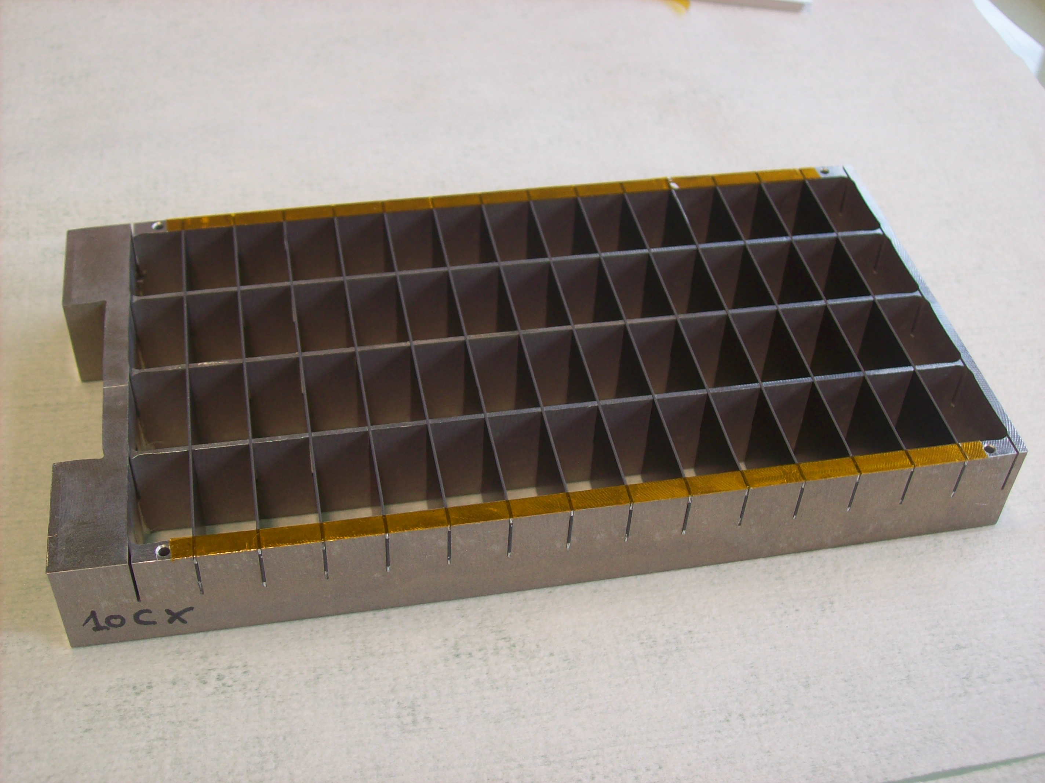
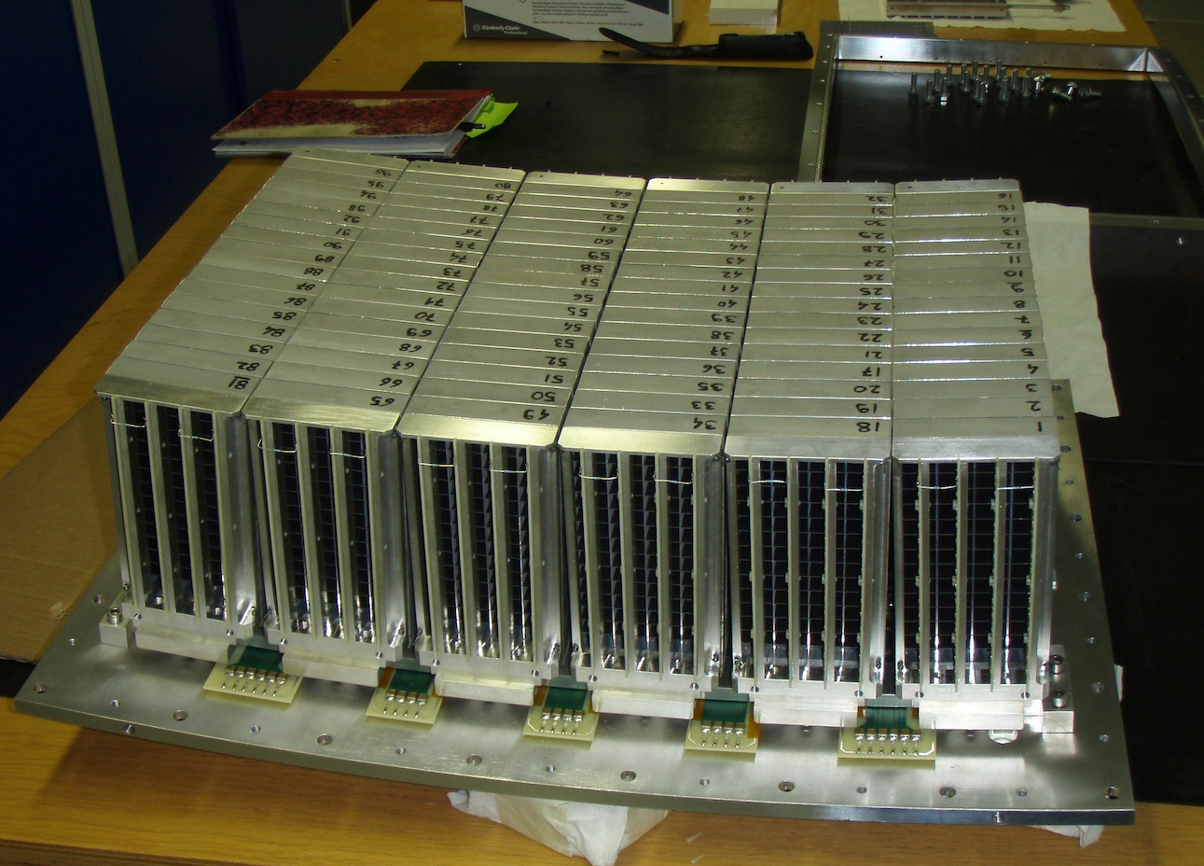
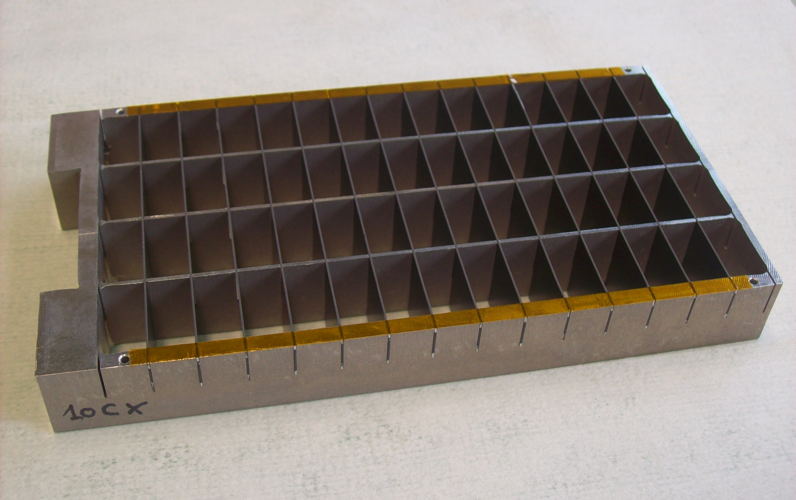

Multi-Grid design (ILL/ESS/Linköping)
Multiple conversion layers (30)
MWPC concept
neutron efficiency: analytically calculated, simulated,
measured, understood
γ efficiency comparable to ³He
scattering understood
detector induced background understood
large scale IN5 detector to be produced
by October 2014, 3m x 0.8m
working on definition of detector standards
for reliable comparisons
A. Khaplanov et al., Nucl Instr. & Meth. in Phys. Res. A, 720, 116-121 (2012)
A. Khaplanov et al., JINST 8, P10025 (2013)
F. Piscitelli and P. van Esch, JINST 8, P04020 (2013)
F. Piscitelli, Ph.D. thesis, University of Perugia (2013)

Slide 9
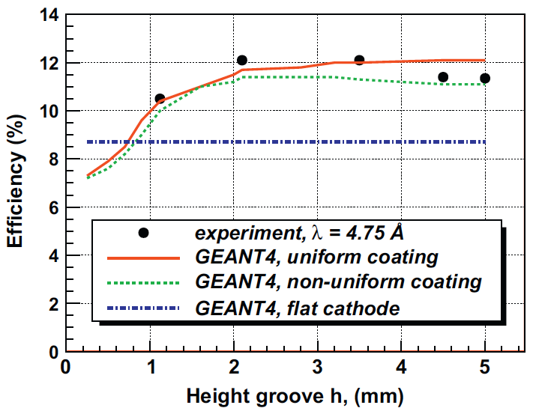
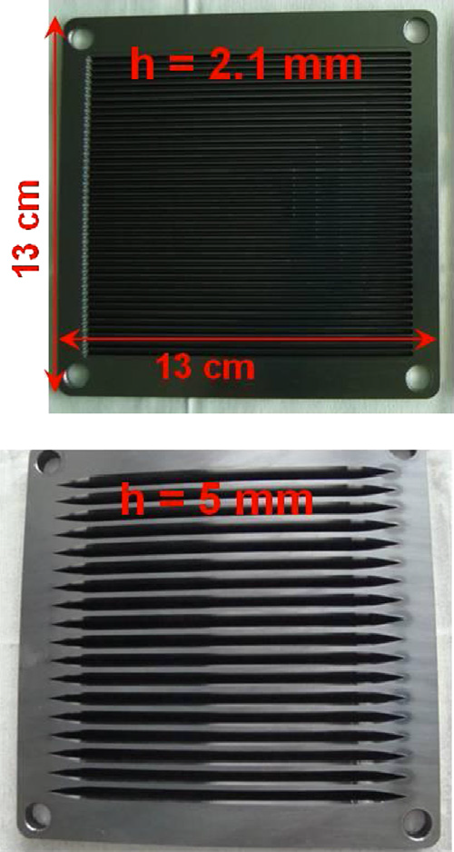
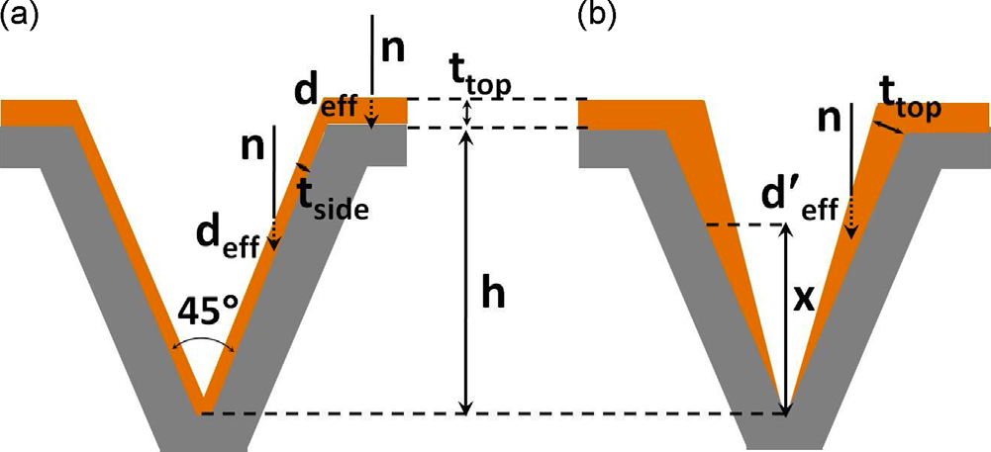
Macrostructures design (FRM-II/ESS)
Multiple conversion layers (5)
MWPC concept
Uniform coating performs better
Macrostructures increase (layer) efficiency by a factor 1.5
Performance simulated, measured, understood
I. Stefanescu et al., Nucl. Instr. Meth & Phys. Res. A, 727, 109-125 (2013)
I. Stefanescu et al 2013 JINST 8 P12003

Slide 10
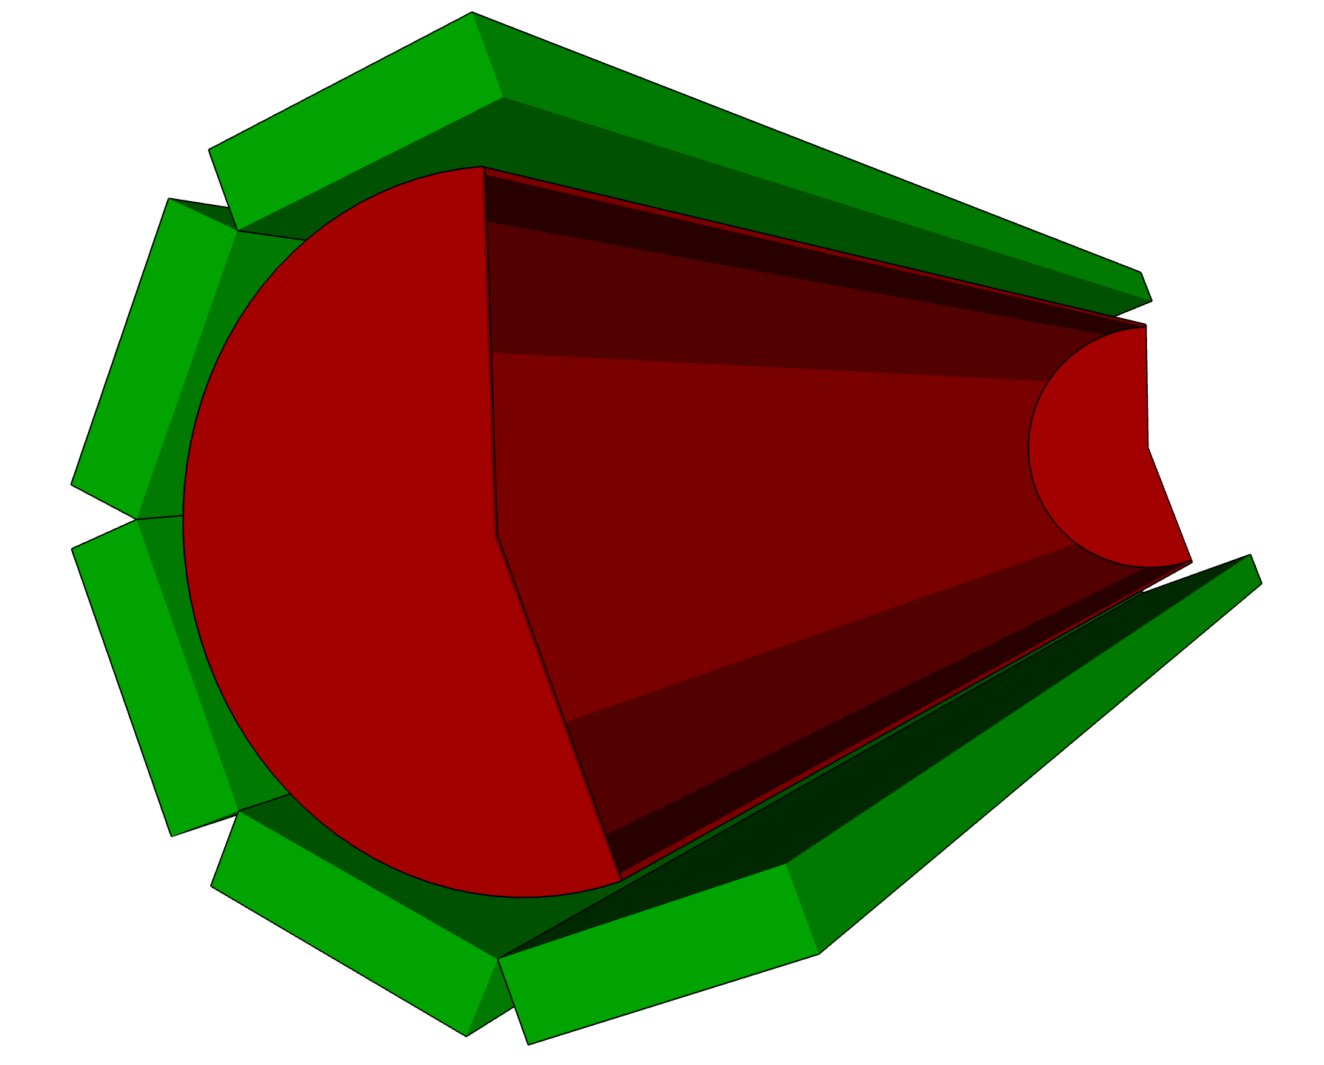
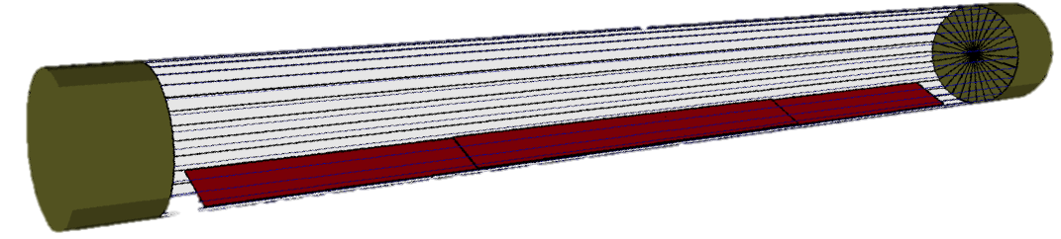
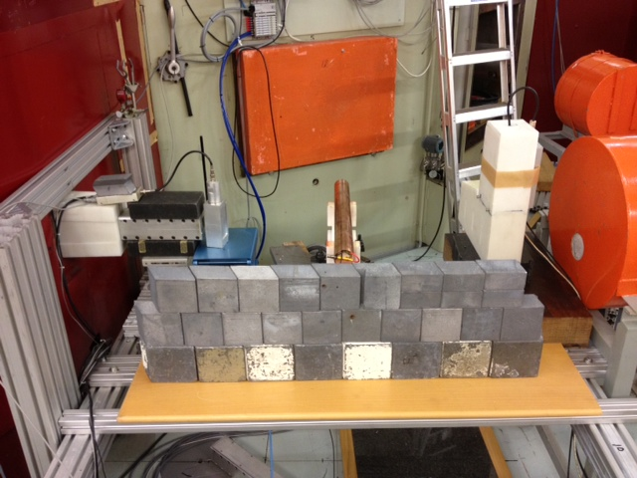
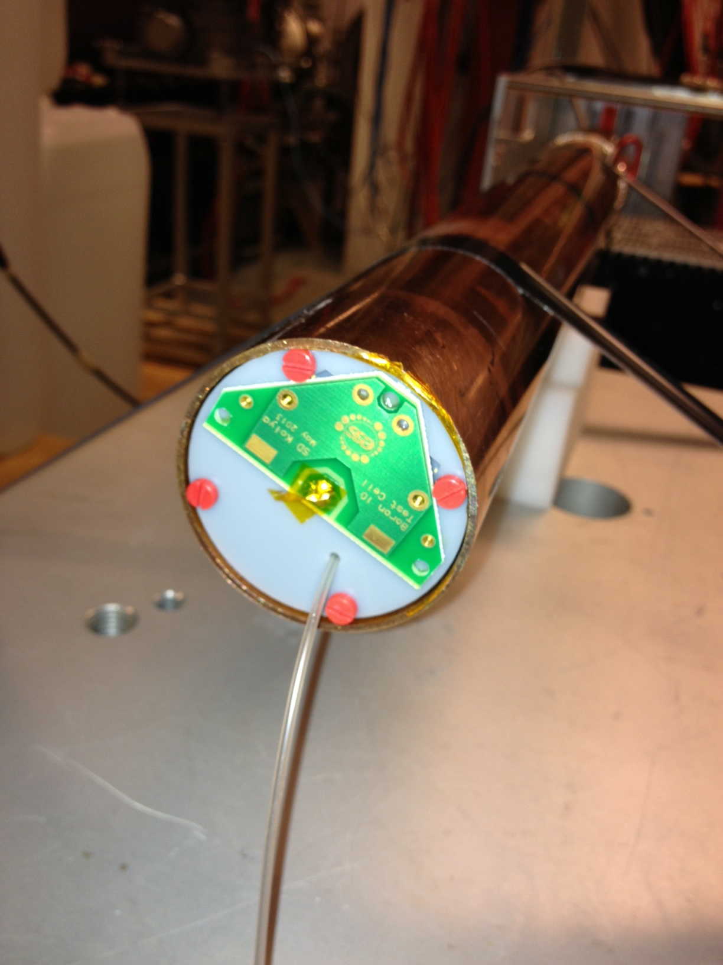
Tube detector
detector banks
Analytical calculations in place
Detailed simulations in progress
Prototyping phase (proportional counter)
Tests with AmBe source and beam in progress
vacuum tank
0.5m
10m
¹⁰B₄C coating
0.5m

Slide 11
Analytical evaluation I: Efficiency
back-scattering
Capture and ion escape included in the calculations
Back-scattering efficiency higher than transmission -> working choice
Room for optimization by
  further increasing the neutron incident angle
  varying the boron layer thickness
  additional converting layers
K.Kanaki et al., J. Appl. Cryst. 46, 1031–1037 (2013)
F. Piscitelli and P. van Esch, JINST 8, P04020 (2013)
F. Piscitelli, Ph.D. thesis, University of Perugia (2013)

Slide 12
Analytical evaluation II: Resolution
polar angle resolution
wavelength resolution
pitch = 5cm
δθ = | θ_{n}-θ_{n-1}|
δθ/θ < 10% at the detector area with highest occupancy, far better than what required
λ and Q resolutions are detector-specific
Impact of azimuthal angle negligible
Resistive wires or segmented cathodes can be used for 2D resolution
Q resolution
pitch = 5cm
12

Slide 13
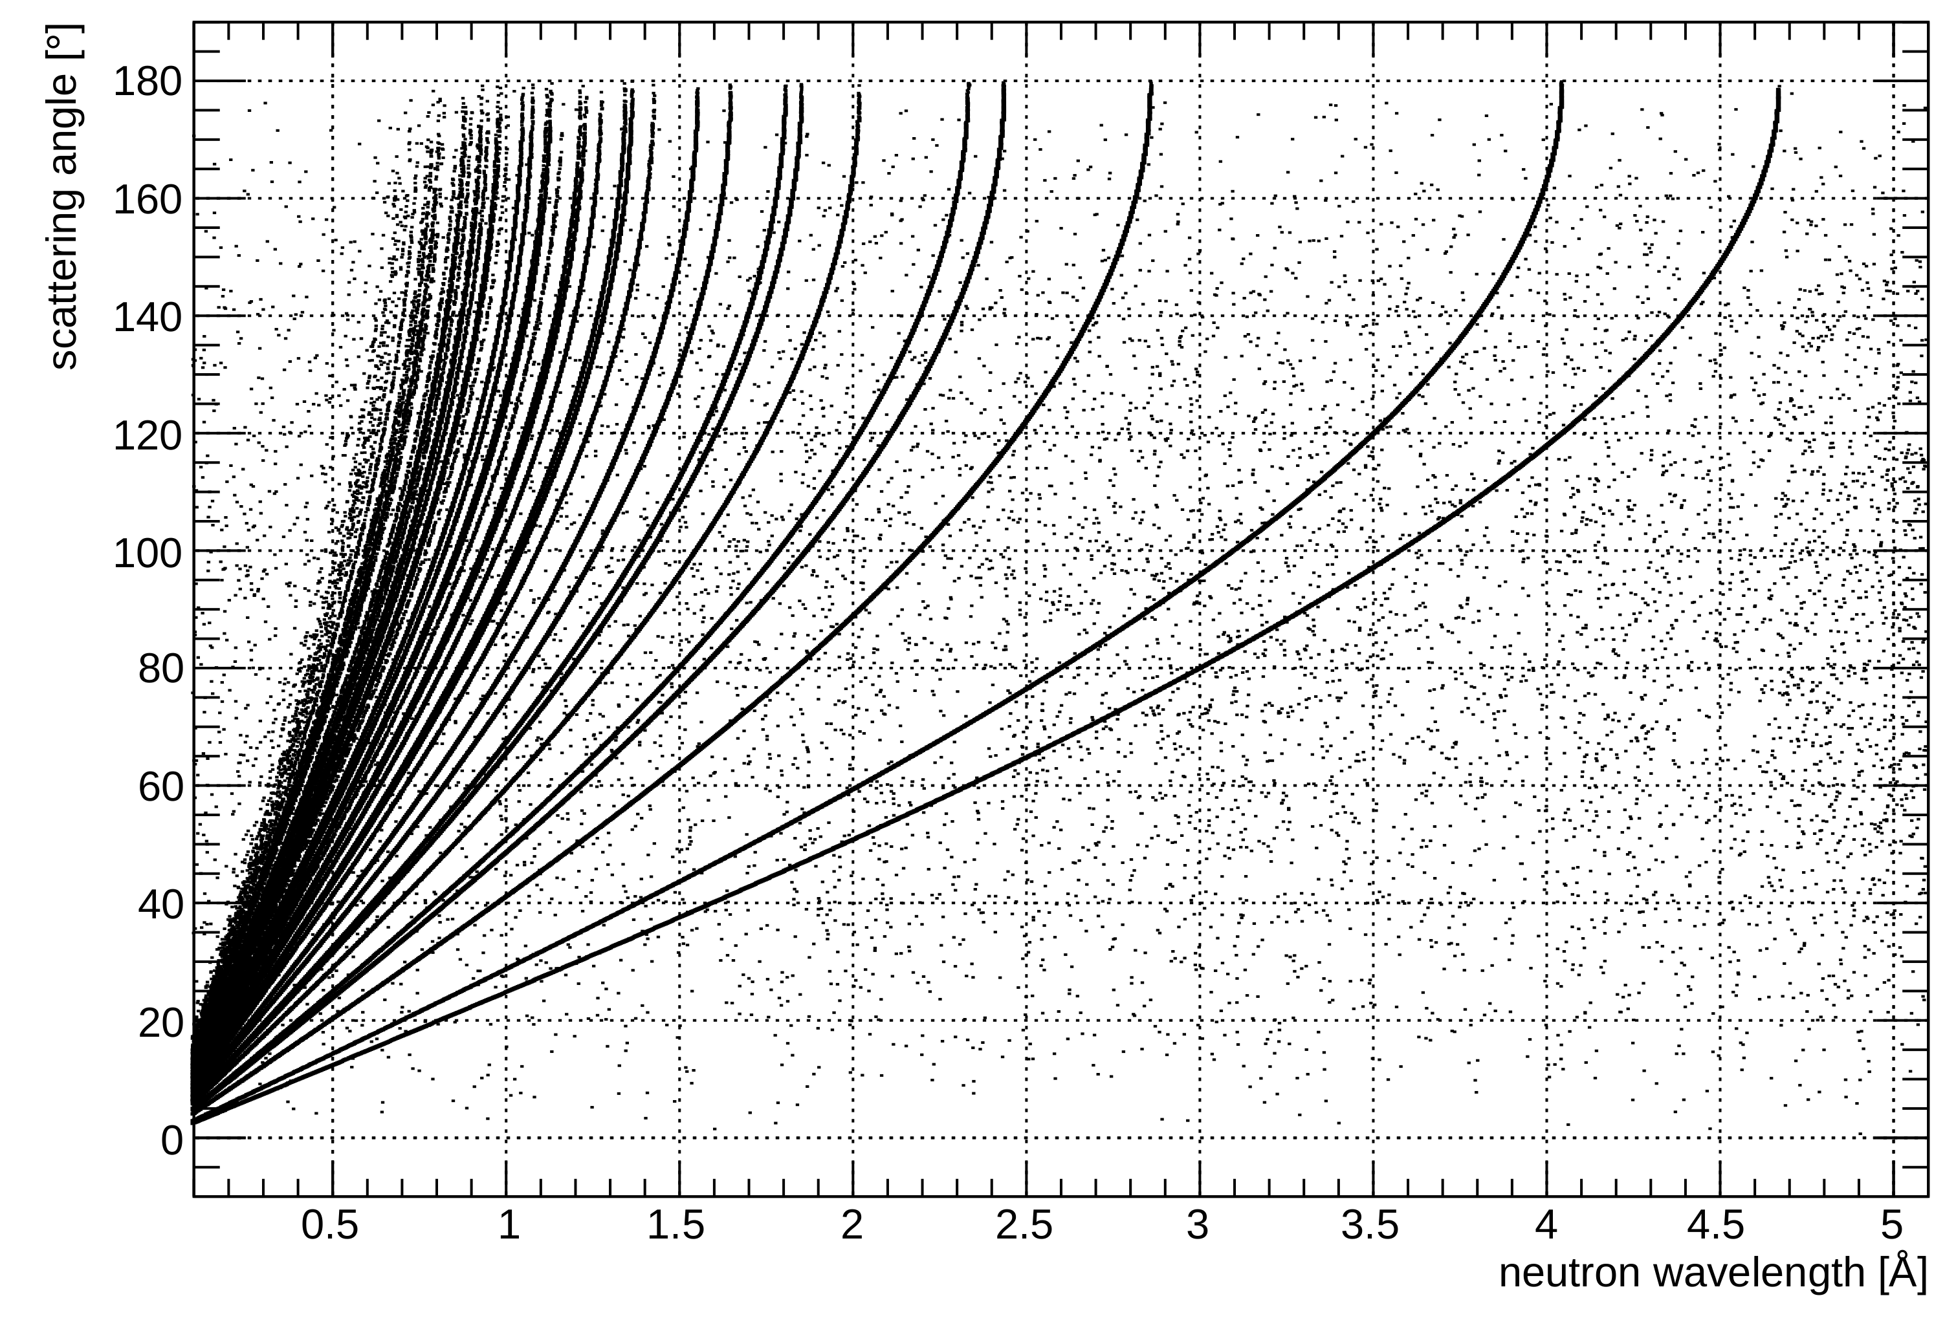
Simulation tools:
Diffractive processes in Geant4
For neutrons of a few Å diffractive scattering becomes important
Respective physics processes not included in Geant4
Functionality added with the integration of NXSLib library from McStas
NXSLib – Geant4 integration extends the capabilities of Geant4 to become a complete tool for investigations at neutron scattering facilities
T. Kittelmann, poster NPO2-138, NSS IEEE 2013
T. Kittelmann, CHEP 2013 proceedings
13

Slide 14
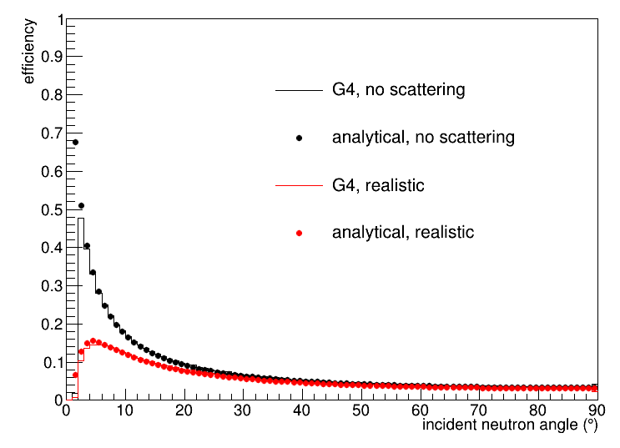
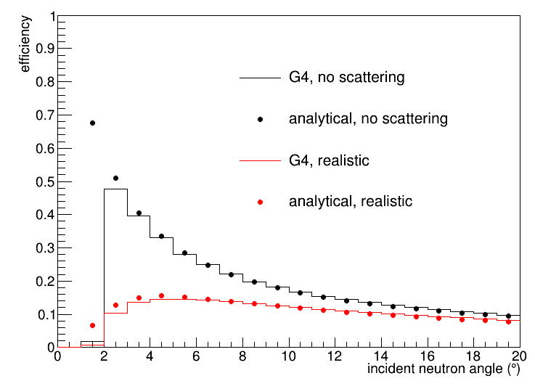

Efficiency: Geant4 vs. analytical
simplified cylindrical geometry
neutron wavelength = 2 Å
Al vacuum vessel window = 0.3cm
Al detector window = 0.3cm
below 2°-3° the comparison is
not reliable due to detector edge effects
Geant4 is validated for coherent neutron scattering!!
14

Slide 15
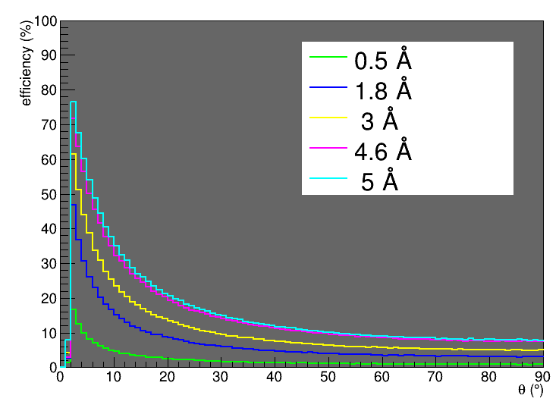
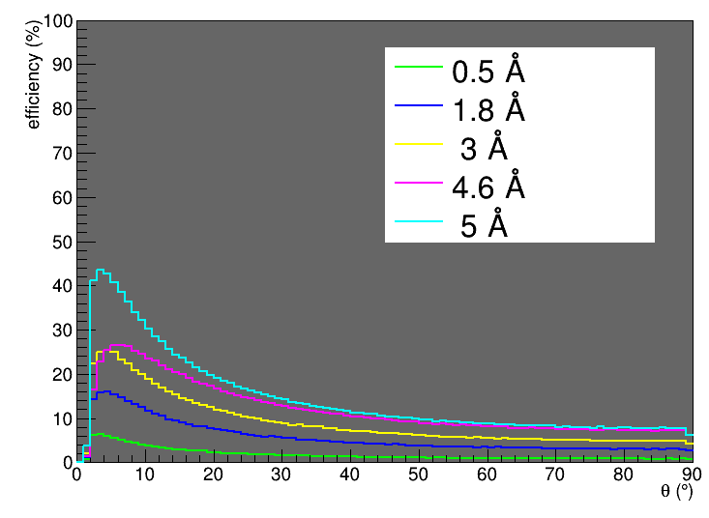
Impact of scattering on efficiency
Geant4 realistic LoKI geometry with octagonal cross section
Al vacuum vessel window = 0.3cm
Al detector cathode window = 0.1cm
Scattering impact on efficiency has to be minimized
no scattering
with scattering
15

Slide 16
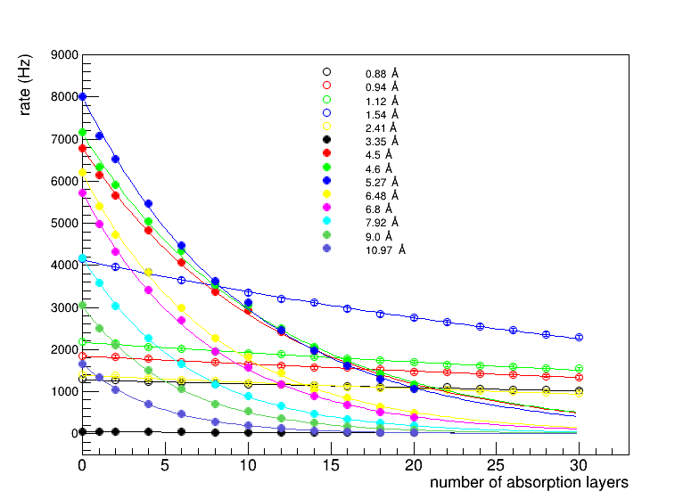
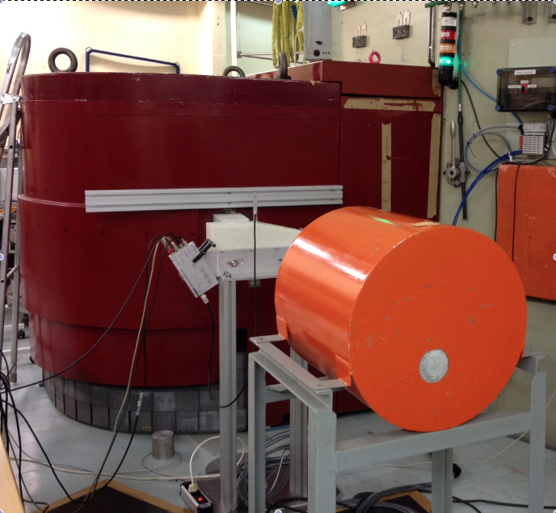
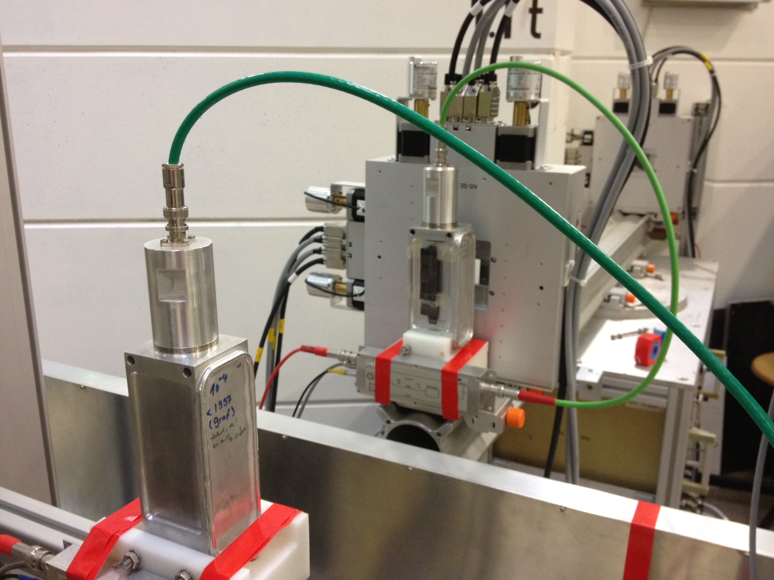
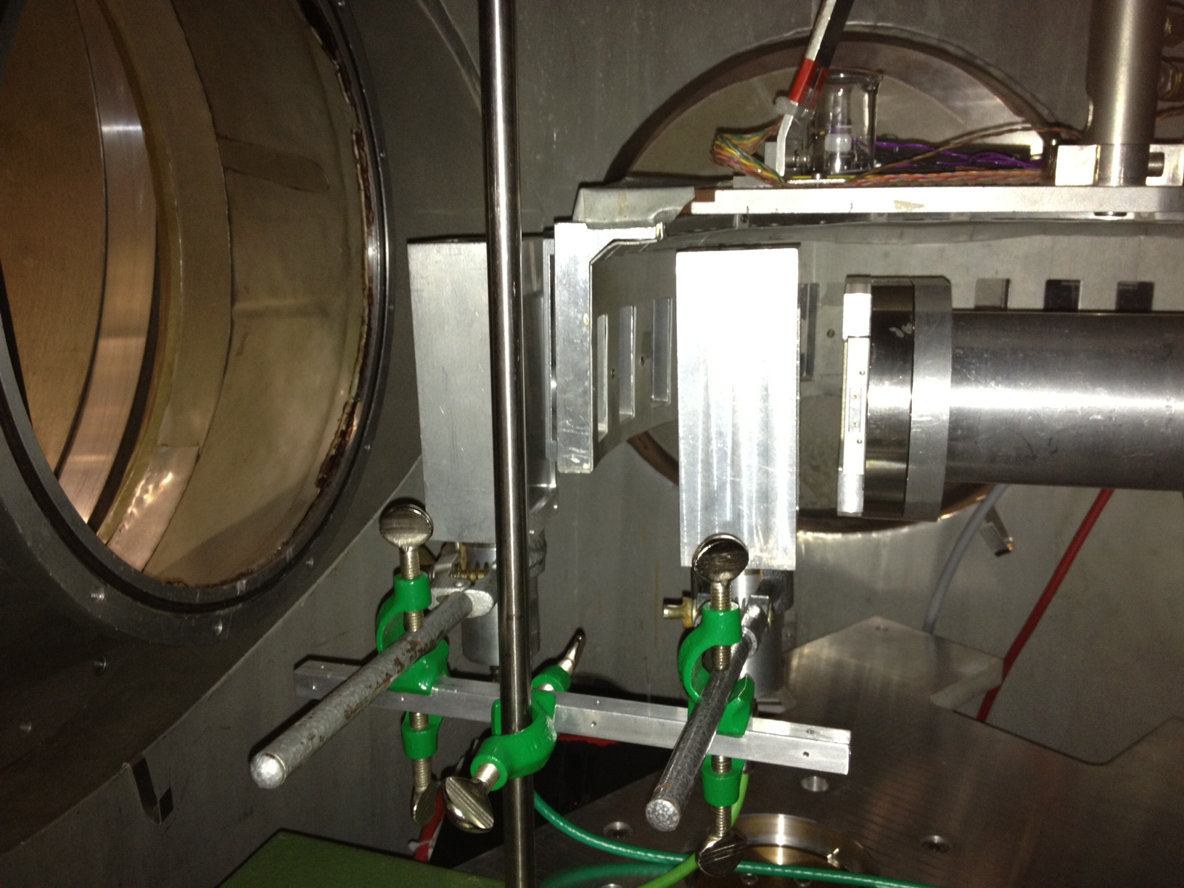
Neutron energy determination
Idea: deconvolution of neutron energy spectrum
with statistical inference methods
Method is applicable for all multi-layer detectors
Bonner sphere-like deconvolution
Exploit the depth of interaction
Absorption profile measurements from 3 facilities
as first approach (monochromator & chopper lines)
1 MSc and 1 PhD student working on the topic
First results are very encouraging!

Slide 17
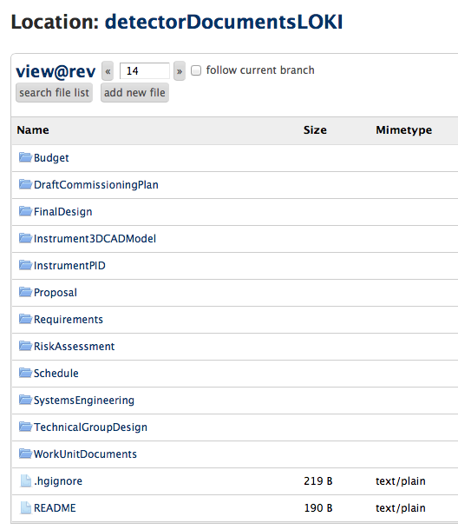
Deliverables for Phase 1:
documents to be prepared by November 2014
mercurial screenshot
Monthly discussions &
quarterly document revisions
with:
instrument scientist (Andrew)
instrument engineer (Stewart)
detector scientist (Kelly)
communication folders
forgotten in the official list, added by us

Slide 18
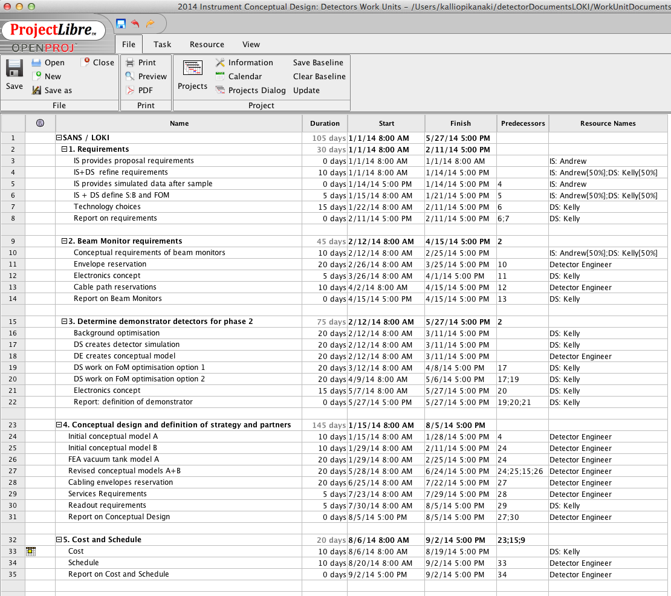
Snapshot of the LoKI detector schedule
Not redone yet
Covers first year
Assumes all people are already hired
Generic approach for beam monitors: will be done commonly for all instruments

Slide 19
Summary
Extensive ¹⁰B technology development at ESS/ILL/FRM-II
Several geometries are considered
Other technologies monitored and supported
Final decisions on LoKI detectors in 2016
Advanced simulation tools in place for detector optimization
The outlook is positive ☺

