Slide 2
Introduction to Neutron Instrument networks
PRESENTED BY Johan christensson

Slide 3
Agenda
1 Introduction
2 Considerations
3 Network documentation
4 Physical network layout
5 Data connections
6 Requirements / Budget / Additional services

Slide 4
Introduction
Intention
Communicate
    A data network working group exists.
    To present some high-level information on the work done so far.
Notify
    Heads-up on the commencement of the detailed design of networks for neutron instruments (instrument halls, labs, etc).
Agree
Space reservation
    Use existing resources (Frame-work agreements) and standards for uniformity.

Slide 5
Introduction
ESS networks
GPN (General Purpose Network)
    Groups of office sub-networks. Used for general use by all ESS users. Access to services like E-mail, ESSOn, Confluence, Internet access, etc.
    Available on both wired and wireless networks
TN (Technical Networks)
    Grouping of sub-networks for the operational technologies. Includes the controls network (EPICS/SCADA systems), including PLC networks, either for facilities control and monitoring (HVAC) or for the machine (LINAC, Cryogenics, Target or Neutron Instrument), as well as radiation and environment monitoring and interfaces to safety or safety related systems.
    Only available on wired networks
NIN (Neutron Instrument Network)
    Experimental Data acquisition/curation networks. Data analyses, high-performance computing clusters.
    Available on wired networks

Slide 6
Introduction
Areas of responsibilities
DMSC – Data Systems Technology (DST) Group - NIN
ICS – Controls System Infrastructure (CSI) Group - TN
IT – IT Operations & Support Group - GPN

Slide 7
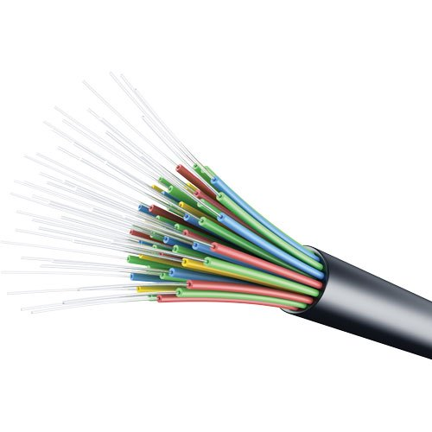
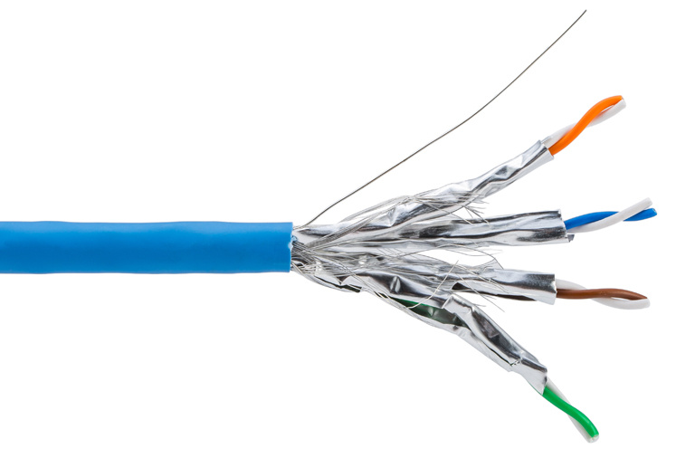
Introduction
Physical network distribution
Optical fibre (intra-builing)
  Distance >100m.
  Immune to Electro-Magnetic Interference (EMI) and Radio Frequency Interference (RFI).
  Greater considerations needed during installation. More expensive compare to copper.
  Bonding and grounding not needed and can there for be used between grounding zones without additional considerations.
Copper (structured cabling)
  Distance < 100m.
  Not immune to EMI and RFI.
  Both installation and active equipment have a relatively lower cost (compared to optical fibre) and installations are less challenging.
  Used for local distribution networks and within grounding zones.

Slide 8
Introduction
Data Connections – structured cabling
Network wall/panel/equipment outlets
  Located in hutch, offices, beams, etc.
  Usage reserved for PCs, laptops, WIFI access points, printers, etc.
Copper patch panel
  Termination of network wall/panel or rack outlets.
  Only available in cabinets or industrial racks (where required).
Fibre optic patch panel
  Detector readout, network switches, timing system.
  Only available in cabinets or industrial racks (where required).

Slide 9
Introduction
Engineering workflow
Requirements & Analysis Phase
Conceptual Design
Detailed Design
Installation Phase
Testing Phase
ESS-0062062 Technical Network requirements specification
ESS-0092617 European Spallation Source - Technical Network data cables specification
ESS-0110333 Framework Agreement regarding the supply and installation of cables
ESS-0222810 Network Test Template

Slide 10
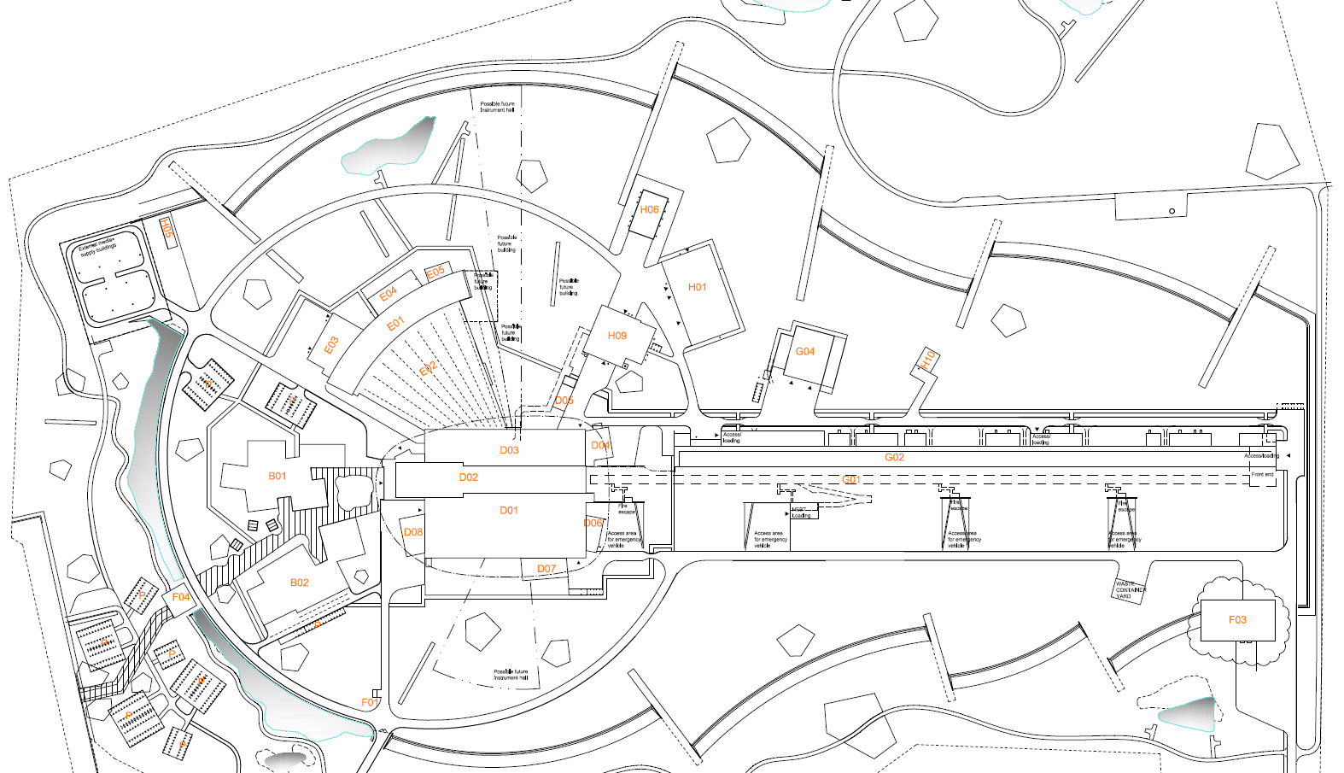
Introduction
Interbuilding connectivity Global fibre conduits and routes
Global fibre routes & conduits
H01 – ESS Central server hall
D02 – ESS Secondary server room

Slide 11
Considerations: Redundancy
Fibre path between instrument and server hall
Delivery during 2021
H01
ESS Central server hall
Comm room
Neutron Instrument
Active equipment
Passive connection
Active equipment
Delivery during early science 2023
H01/D02
Server rooms
Comm rooms
Neutron Instrument
Active equipment
Passive connection
Active equipment

Slide 12
Considerations: Grounding zones
Grounding zones will have a infrastructure rack
Connections between the infrastructure racks will be using fibre cabling.
Connections between infrastructure rack and device racks in the same grounding zones will be using copper cabling.
If Timing signals is also required in the device racks, there will also be a additional fibre cable going between the infrastructure rack and device rack.

Slide 13
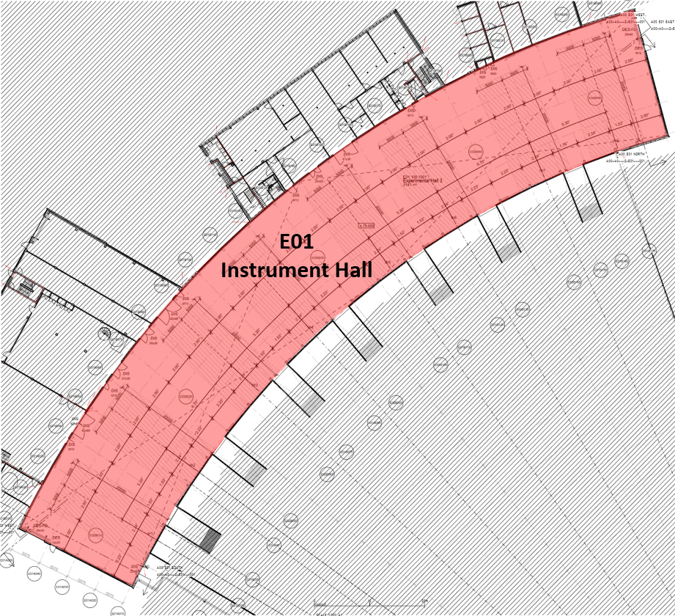
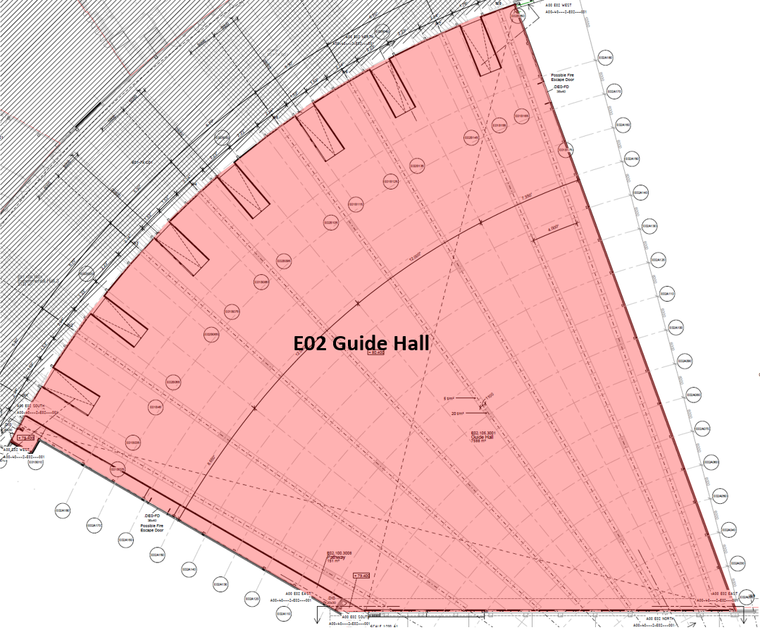
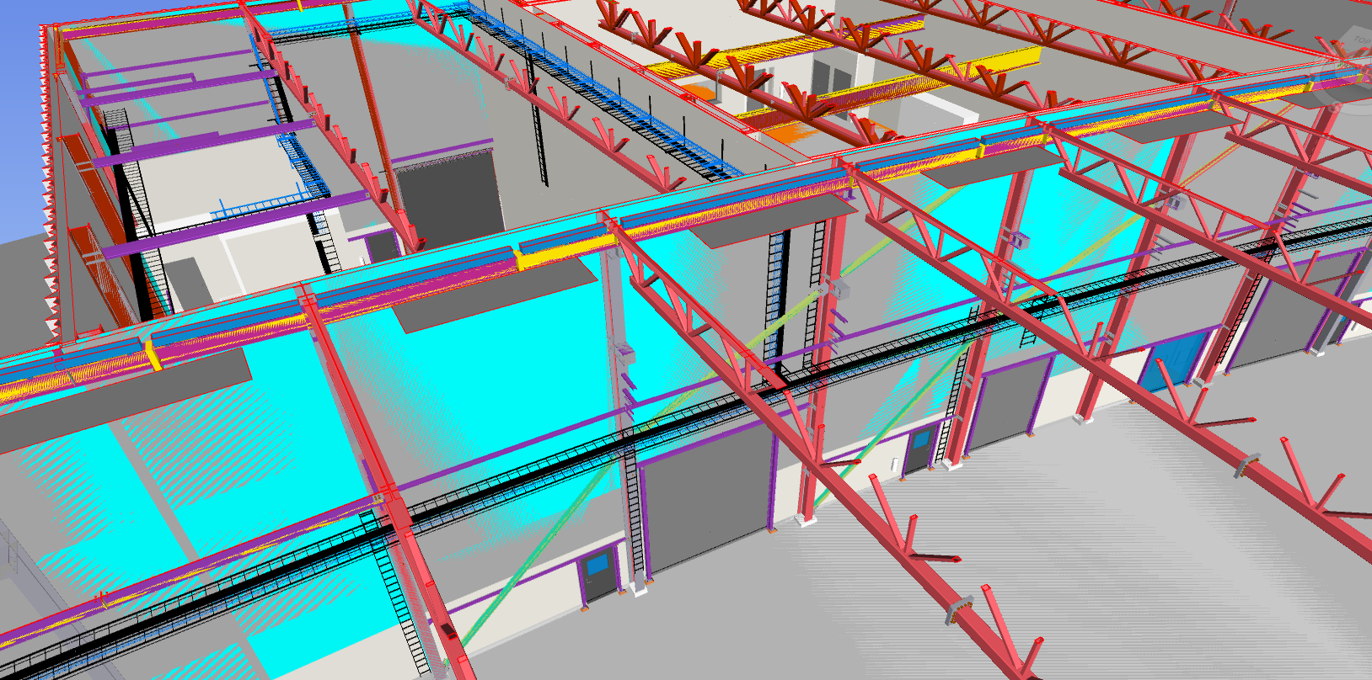
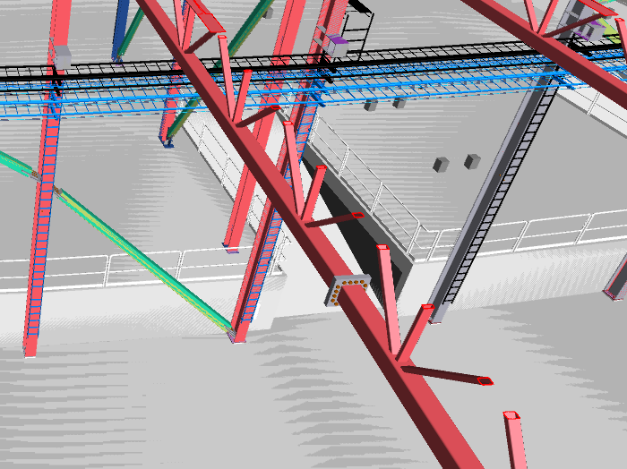
Considerations
Cable ladders and routing in E01 and E02
Cable ladders for network cabling
will be installed as a part of the NSS
package for providing cable ladders
for instrument power.
These ladders will provide room for
both initial space requirements as well
as future expansions.

Slide 14
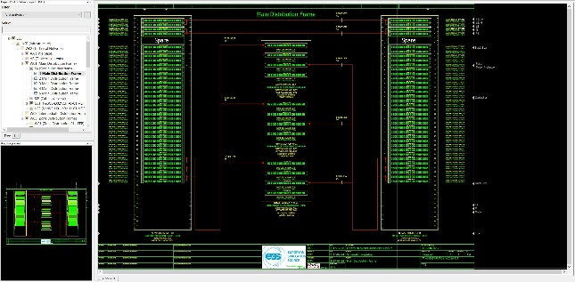
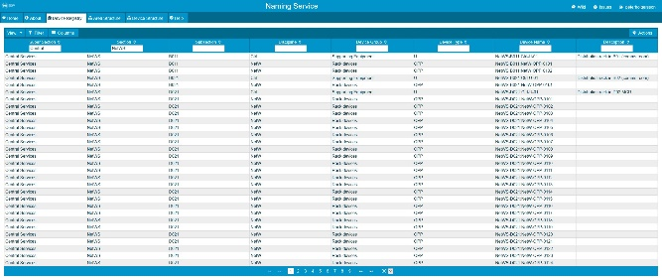
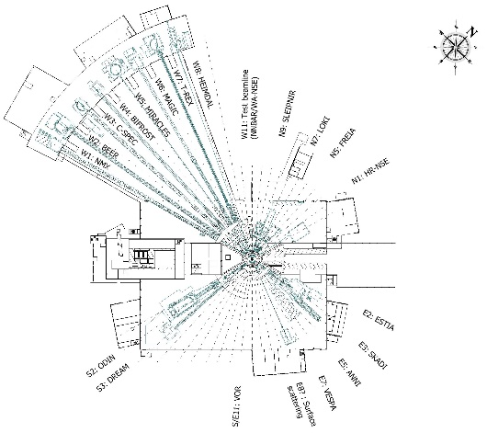
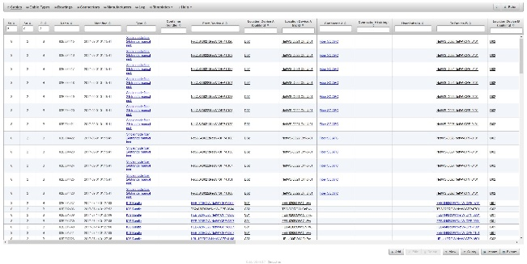
Network Documentation
2D & 3D Design and databases
Line drawings in E-plan
  ESS-0092617 Physical network layout (wiring diagram)
Administration in naming services
  CableDB
  Chess (FBS)
Cable routing
  Electrical and I&C section EIS

Slide 15
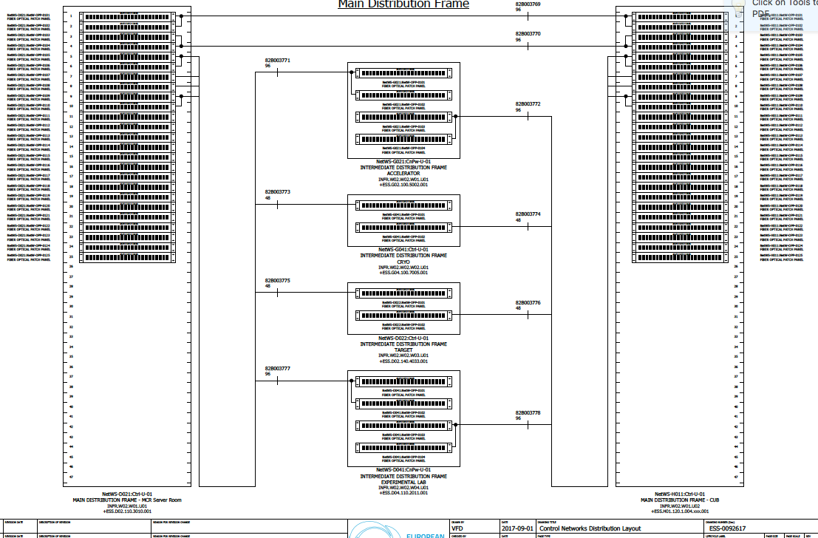
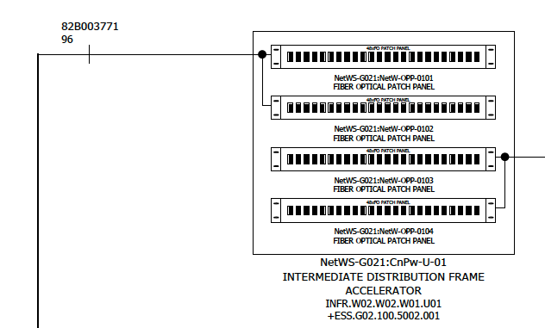
Network Documentation
2D Design - ESS-0092617 Physical Network Layout

Slide 16
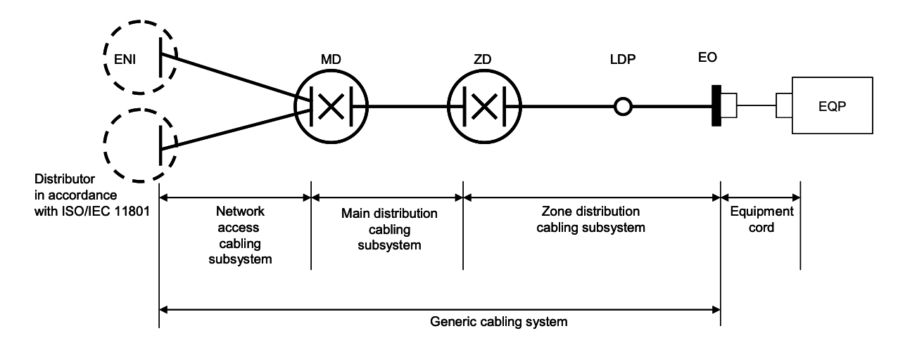
Physical Network Model
ISO/IEC 24764
Equipment Outlets (EO)
Zone Distribution Frame (ZD)
Intermediate Distribution (ID)
Main Distribution (MD)

Slide 17
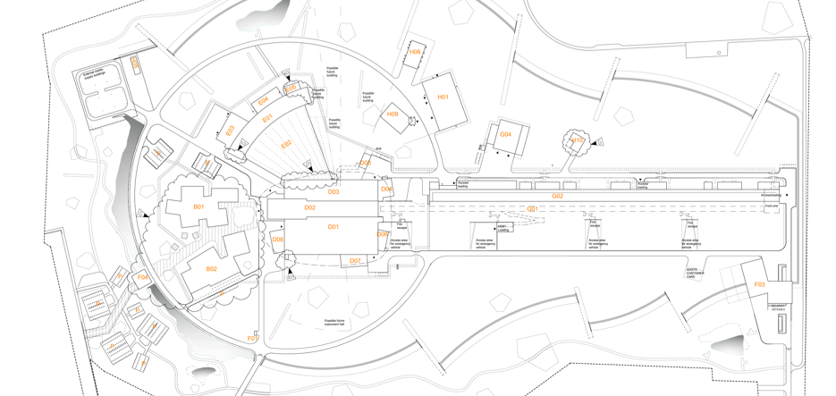
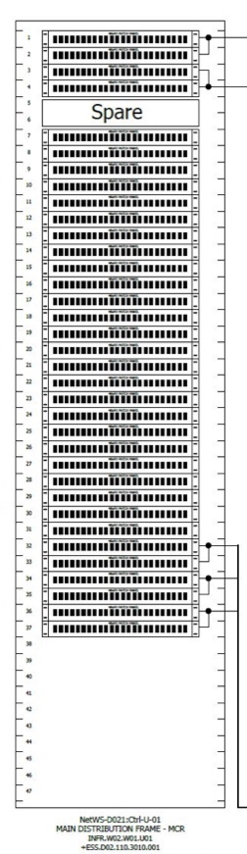
Physical Network Layout
Main distribution
Equipment Outlets (EO)
Zone Distribution Frame (ZD)
Intermediate Distribution (ID)
Interconnects IDs
Located in server rooms (H01, D02)
Main Distribution (MD)

Slide 18
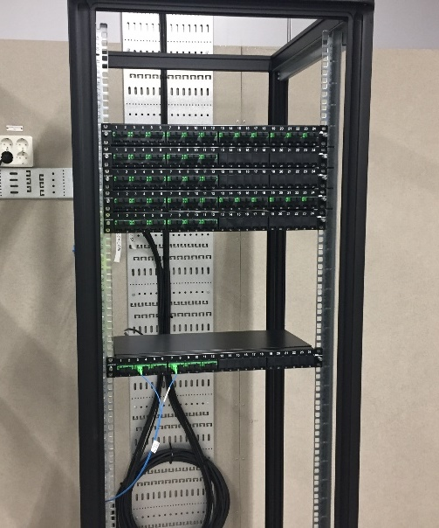
Physical Network Model
Intermediate distribution
Equipment Outlets (EO)
ID racks in E03 Comms room
Zone Distribution Frame (ZD)
Intermediate Distribution (ID)
Aggregates ZDs to a communication rooms
  Using optical fibre
Permits direct connection across the gallery
Main Distribution (MD)

Slide 19
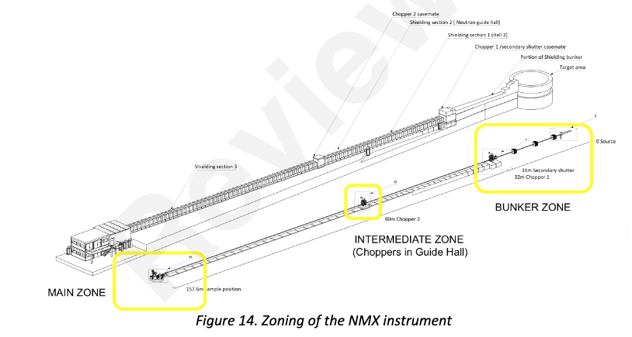
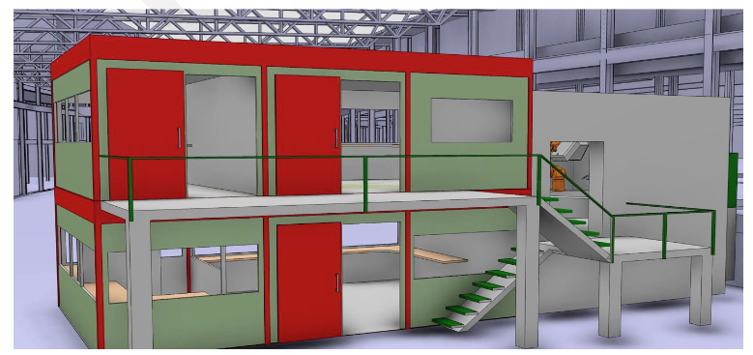
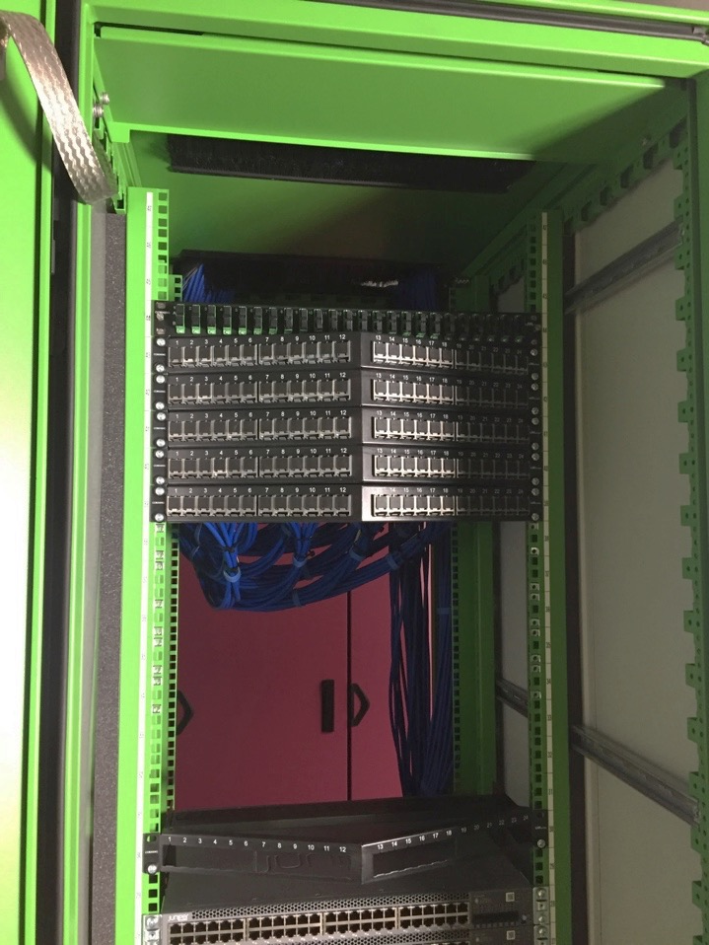
Physical Network Model
Zone or Local distribution
Equipment Outlets (EO)
Zone Distribution Frame (ZD)
Intermediate Distribution (ID)
Provides network outlets to devices
Located in all racks that need network connectivity
Modular system that an be easily expanded
Main Distribution (MD)

Slide 20
Physical Network Model
Wall outlet
Equipment Outlets (EO)
Zone Distribution Frame (ZD)
Intermediate Distribution (ID)
Interconnects IDs
Located in the instrument hutch or equipment cabinet/rack
Main Distribution (MD)

Slide 21
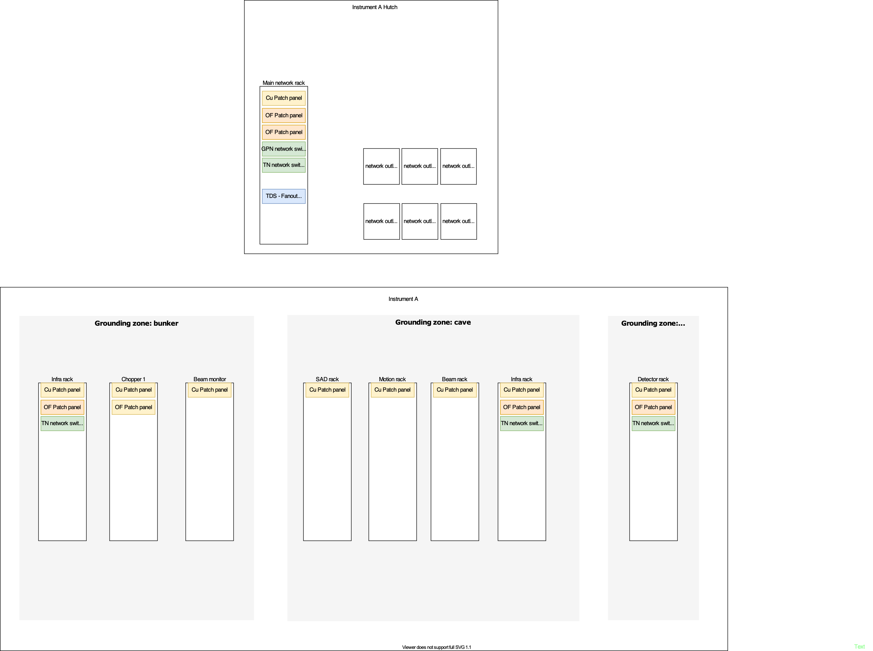
Data connections
Connections between grounding zones and infrastructure racks
https://confluence.esss.lu.se/display/CSI/Physical+Network+layout+-+Neutron+Instrument

Slide 22

Data connections
Connections between zones: infrastructure racks
Fibre cable interconnecting infrastructure racks
24-strand cable
Fibre cable from comms
room in E03/E04
48-strand cable carries signals for GPN, NIN and TN
Grounding zone
Racks on-top detector cave
Racks on-top bunker cave
Racks on-top of hutch
Infrastructure rack
Infrastructure rack
Infrastructure rack

Slide 23
Data connections
Infrastructure racks
Patch panel for optical fibre cables going between infrastructure racks.
Patch panels for copper connections going to device racks within the same grounding zone.
Active network equipment, network switch bridging between optical fibre and copper cables. Each network scope needs a separate switch.
(TBD) uMTCA for timing system
(TBD) Fibre patch panels for timing fibres.
Infrastructure rack

Slide 24
Data connections
Within grounding zone
Patch panel housing copper connections for
Technical Network and fibre for timing system.
Both copper and fibre are installed in sets of 3.
Combi panel that can house both copper and fibre in same unit.
Each rack unit can hold up to 24 modules.
  Example:
  6 copper outlets
  3 fibres for timing signals.
  15 for future expansion
Bundle of Category 6a S/FTP, in sets of 3 cables
(TBD) Timing fibre
Infrastructure rack
Device rack

Slide 25
Data connections
Space reservations for active equipment
Each network scope have separate network switches. Standard setup is:
  Racks above control hutch
        1 network switch for General Purpose Network (1 rack unit)
        1 network switch for Technical Network (1 rack unit)
        1 uTCA for Timing system (up to 9 rack units
  Racks above detector cave and bunker cave
        1 network switch for Technical Network (1 rack unit)
        (TBD) NIN equipment (x rack unit(s))

Slide 26
Data connections
Total Space reservations
The number of rack units needed in the racks for the standard setup is:
  Racks above control hutch (12 units)
        1U fibre patch for fibre from E03/E04 comms room.
        1U fibre patch panel for fibres going to infrastructure racks on-top of detector and bunker cave.
        1U copper patch panel for up to 24 copper outlets in device racks and outlets inside control hutch.
        2U for network switches for GPN and TN.
        6U for uTCA for Timing system.
        1U for fibre patch panel for up to 24 timing fibres to device racks.
  Racks above detector cave and bunker cave (3 units)
        1U fibre patch panel for connection to hutch infrastructure rack.
        1U copper patch panel for up to 24 copper outlets in device racks.
        1U for network switch for TN.
        (Optional) 1U fibre patch panel for up to 24 timing fibres to device racks.

Slide 27
Power and cooling requirements
Power and cooling needed in different racks.
Power and cooling needs in the racks for the standard setup is:
  Racks above control hutch
        Power: 3,5kW 230V
        Cooling: 3,5kW
  Racks above detector cave and bunker cave
        Power: 600W, 230V
        Cooling: 400W

Slide 28
Budget
Cost considerations
ICS Infrastructure to fund inter/intra building fibres
      Fibre connections between infrastructure racks and device racks
Neutron Instrument to fund structured cabling (hutch, with racks).
      Fibre and copper connections between infrastructure racks and device racks
      Network switches

Slide 29
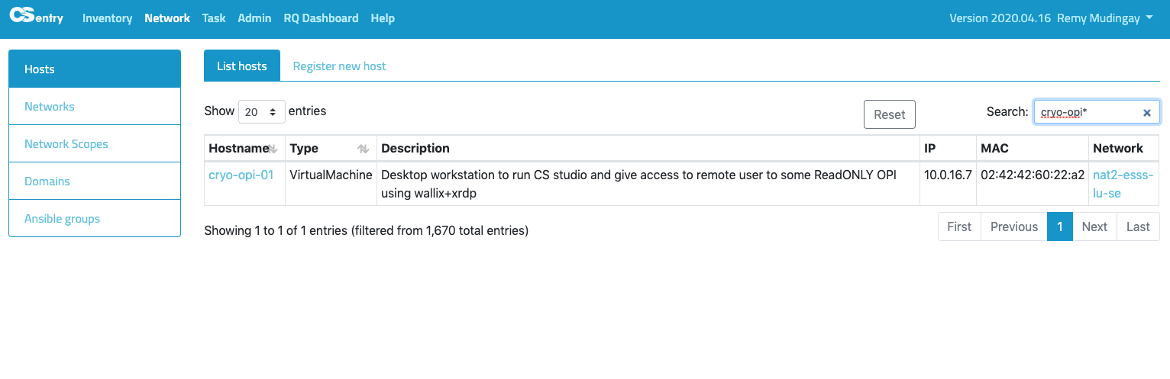
Additional Services
Registering hosts on the network
Registration of equipment
  CSEntry (Hostname, IP, Mac address)

Slide 30
Additional Information
Network equipment - Statistics
We will most likely use switches from the same vendor as we previously procured.
In the previous procurement we standardized around 3 different types:
  Access/Edge switches:
    2 types (client devices and servers POE+)
    6900 1Gbit copper connections
    2100 of them with PoE+
    1080 10Gbit/s connections
    468 40Gbit/s connections
  Network Core switches
    1008 10Gbit/s connections, or….
    252 40Gbit/s connections, or…
    84 100Gbit/s connections
  1400 optical transceivers
  between 1 – 100Gbit/s
  All switches have dual power supply.
  All access switches can be configured in stacks.
Juniper EX3400-48T and EX3400-48P
Juniper EX4600-40F
Juniper QFX10002-72Q

Slide 31
Next steps
Documentations and installation milestones
Activity ID | Activity Name | Start | Finish
A20152790 | Collect requirements for neutron instruments | 2020-03-31 | 2020-04-28
A20152800 | Compile Physical Network requirements for Neutron Instruments | 2020-05-05 | 2020-06-28
A20160400 | MS Network requirements for Neutron instruments completed |  | 2020-07-28
A20152790 | Detailed networking wiring diagram for LoKI | 2020-09-01 | 2020-09-07
 | Detailed networking wiring diagram for NMX | 2020-09-08 | 2020-09-16
A20152800 | Detailed networking wiring diagram for ODIN | 2020-09-17 | 2020-09-24
A20160400 | Detailed networking wiring diagram for BEER | 2020-09-25 | 2020-10-01
 | Detailed networking wiring diagram for SKADI | 2020-10-02 | 2020-10-09
A20152790 | Detailed networking wiring diagram for DREAM | 2020-10-10 | 2020-10-17
A20152800 | Detailed networking wiring diagram for ESTIA | 2020-10-18 | 2020-10-25
A20160400 | Detailed networking wiring diagram for C-SPEC | 2020-11-02 | 2020-11-09
A20152790 | Detailed networking wiring diagram for FREIA | 2020-11-16 | 2020-11-23
A20152800 | Detailed networking wiring diagram for HEIMDAL | 2020-11-30 | 2020-12-07
A20160400 | Detailed networking wiring diagram for BIFROST | 2021-01-15 | 2020-01-23
A20152790 | Detailed networking wiring diagram for T-REX | 2021-01-24 | 2021-02-02
 | Detailed networking wiring diagram for MIRACLES | 2021-02-03 | 2021-02-10
A20152800 | Detailed networking wiring diagram for VESPA | 2021-02-11 | 20201-02-18
A20160400 | Detailed networking wiring diagram for MAGIC | 2021-02-19 | 2021-02-26
Will need to rebaseline
Installation
LOKI June-2021
ESS-2700991
Physical Network requirements
for Neutron Instruments
Installation
NMX July-2021
2020
2021
ESS-27xxxxxx
Detailed networking wiring diagram for NMX
ESS-27xxxxx
Detailed networking wiring diagram for LoKi
ESS-27xxxxx
Detailed networking wiring diagram for NN

Slide 32
Finish presentation

