Slide 1
In-Kind at ISIS
Matt Fletcher
ISIS Design Division Head
26/2/14

Slide 2
Talk content
ISIS and context to In-kind
View on In-Kind
Summary
My viewpoint in an open and honest way – doesn’t mean it’s right though

Slide 3
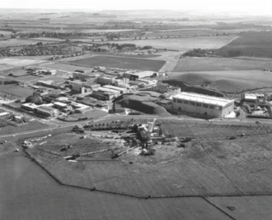
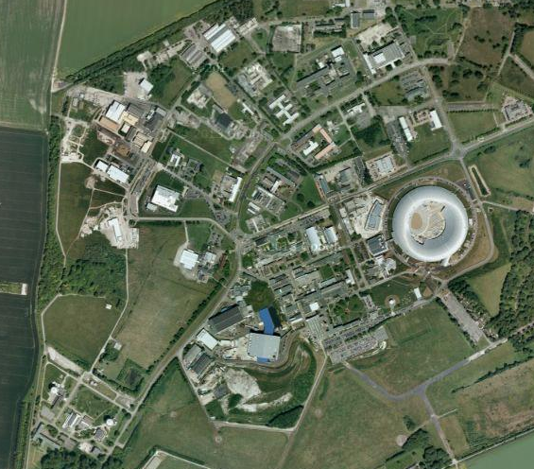
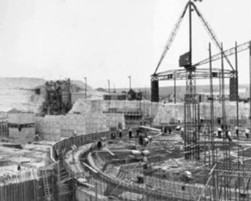
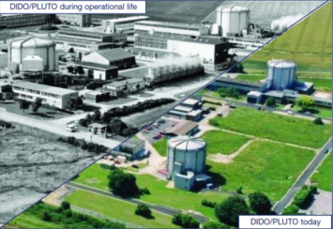
ISIS: a short history
The
Harwell
Linac
(HELIOS)
NIMROD
PLUTO
and
DIDO
Nimrod was a 7 GeV proton synchrotron operating in the Rutherford Appleton Laboratory in the United Kingdom between 1964 and 1978. It was used for studies of nuclear and sub-nuclear phenomena. Nimrod was dismantled and the space it occupied reused for the synchrotron of the ISIS neutron source.

Slide 4
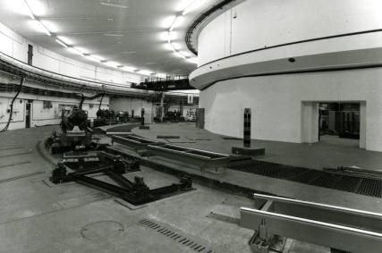
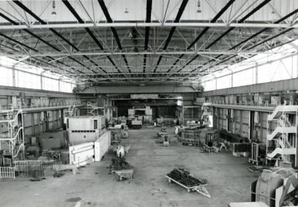
… from the ashes of NIMROD …

Slide 5
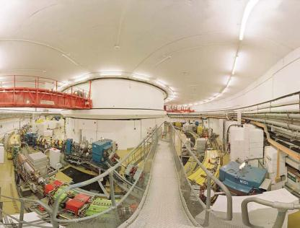
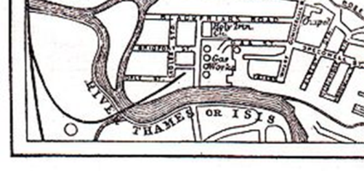

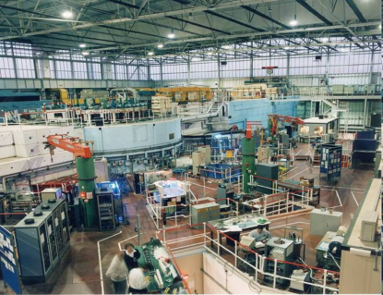
… ISIS rises …
The name ISIS is not an acronym: it refers to the Ancient Egyptian goddess and the local name for the River Thames. The name was selected for the official opening of the facility in 1985, prior to this it was known as the SNS, or Spallation Neutron Source. The name was considered appropriate as Isis was a goddess who could restore life to the dead, and ISIS made use of equipment previously constructed for the Nimrod and NINA accelerators.

Slide 6
Wikipedia
History and background of ISIS[edit]The source was approved in 1977 for the RAL site on the Harwell campus and recycled components from earlier UK science programmes including the accelerator hall which had previously been occupied by the Nimrod accelerator. The first beam was produced in 1984, and the facility was formally opened by the then Prime Minister Margaret Thatcher in October 1985.[3]
The second target station was given funding in 2003 by Lord Sainsbury, then science minister, and was completed in 2009, on time and budget, with the opening of 7 instruments. In April 2010, the Science Minster, David Willetts gave a £21 million investment[4] to build 4 new instruments, which are due to be completed in 2013.
ISIS was originally expected to have an operational life of 20 years (1985 to 2005), but its continued success led to a process of refurbishment and further investment, which has extended its operational life for a further 20 years. [5]

Slide 7
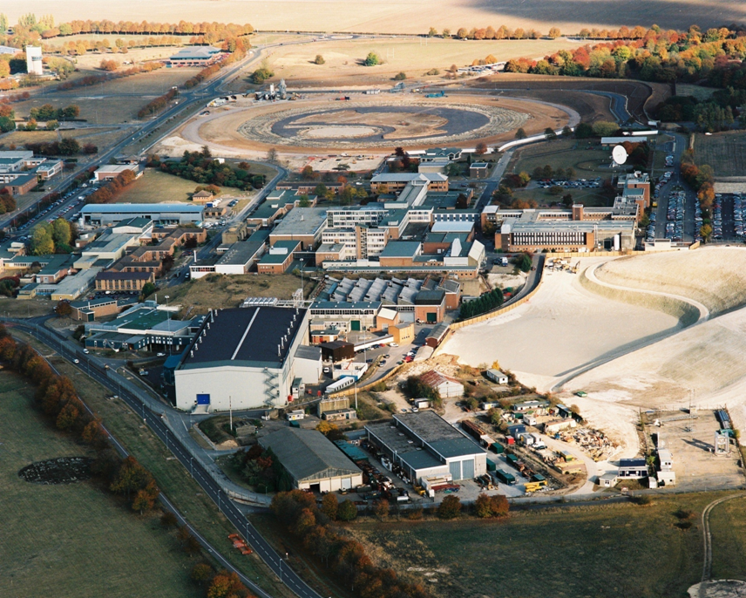
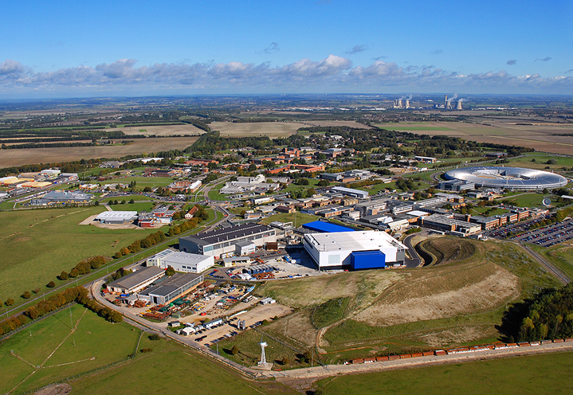
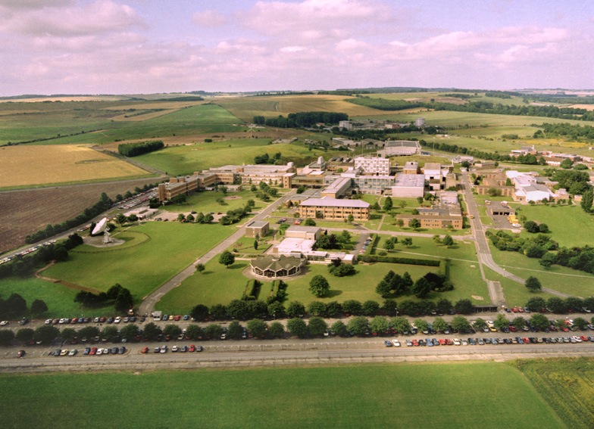

Slide 8
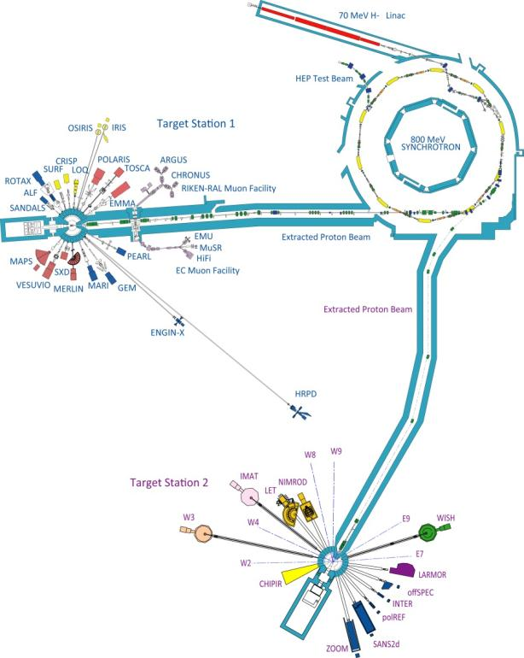
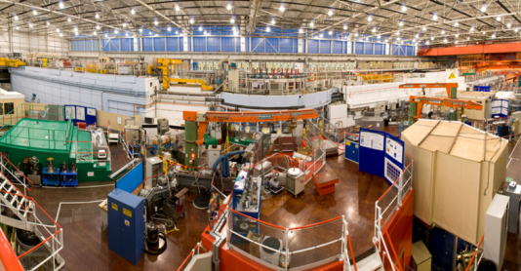
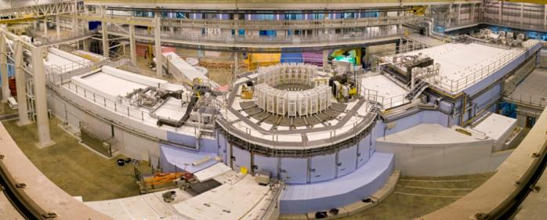
ISIS TS1 & TS2 (2013)

Slide 9
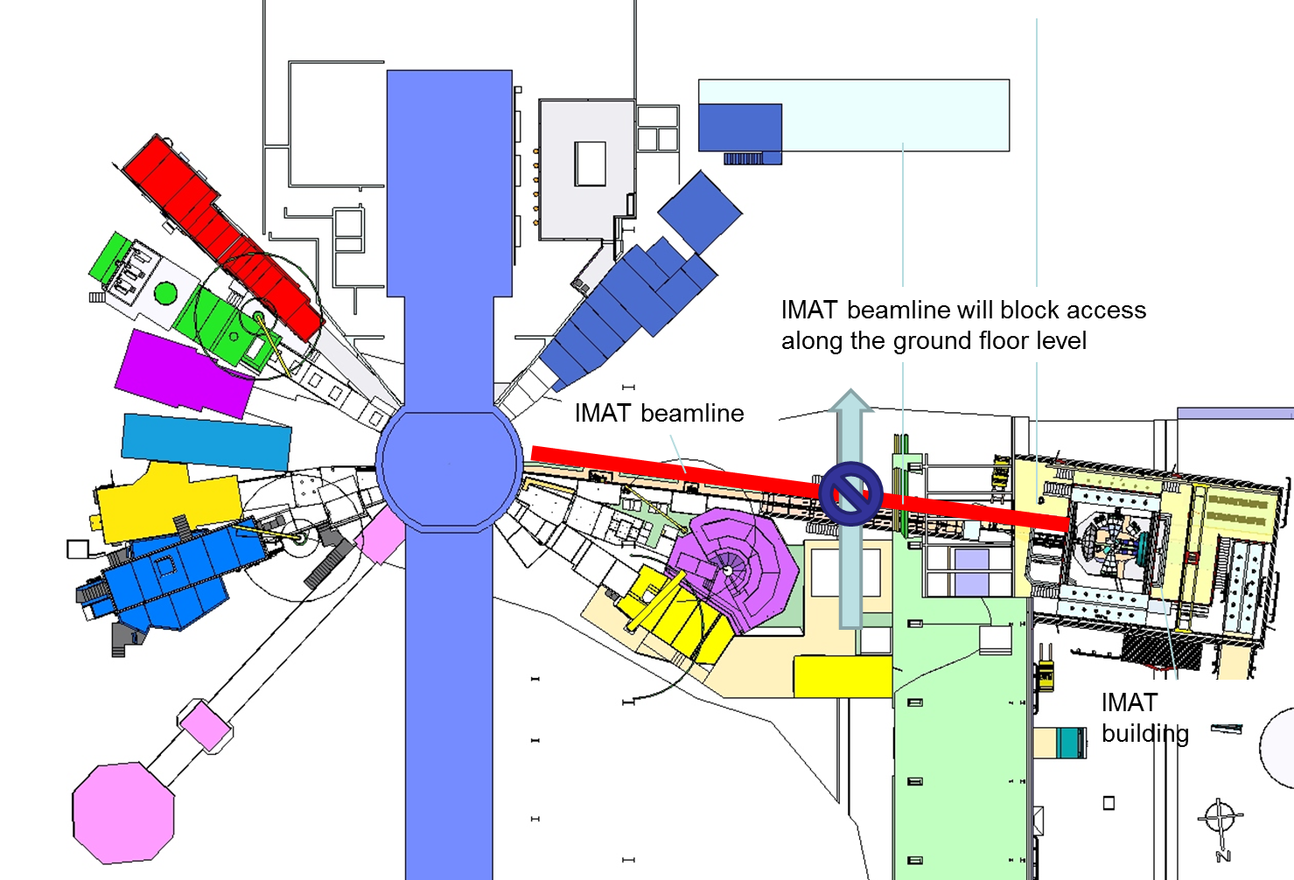
TS2 Phase II
Zoom
Chipir
Larmor
IMAT

Slide 10
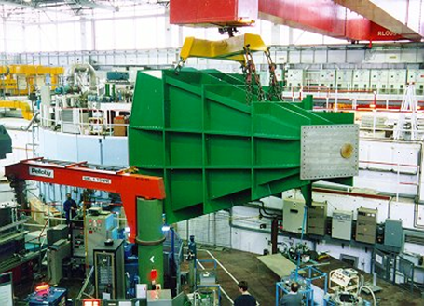
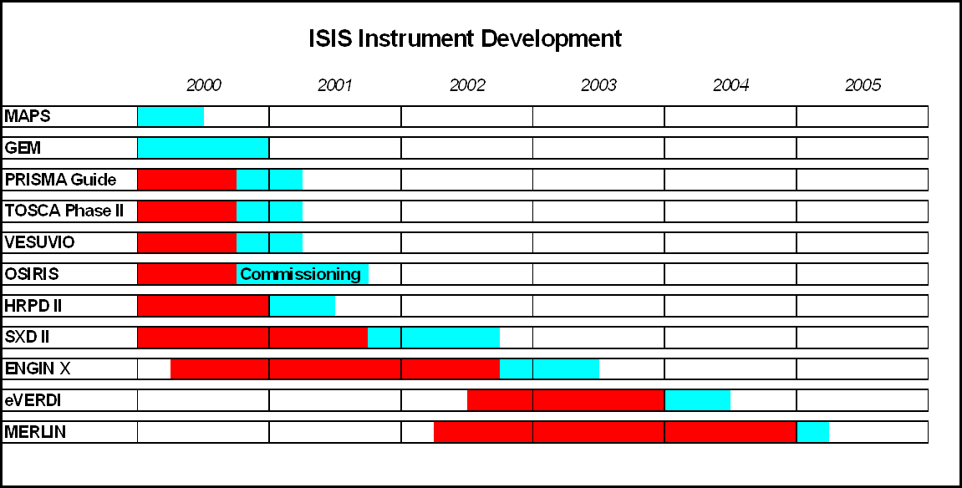
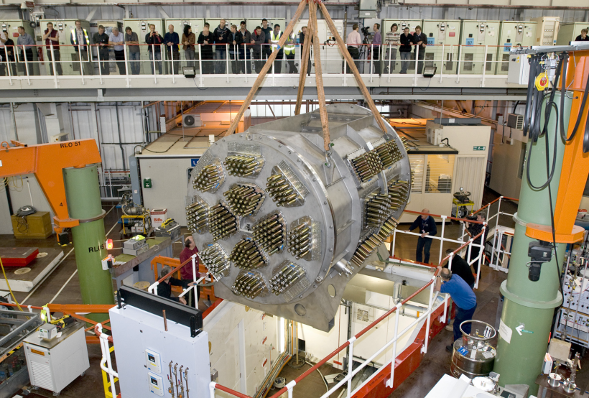
Instrument Developments 1993- 1998

Slide 11
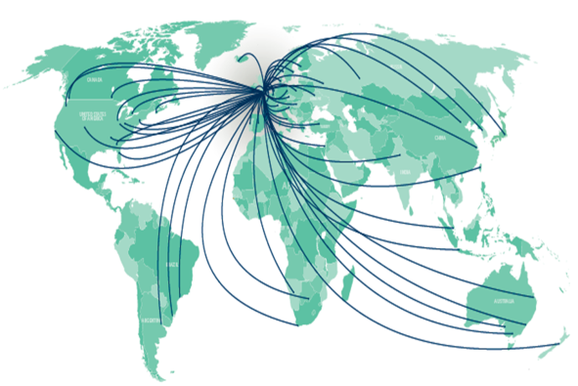
Use of ISIS
2012/13:
Breakdown of users by country

Slide 13
Point to this history lesson…
ISIS is mature, means we have:
    experience in operations
    stable structure
      Long serving staff
        Can have downsides – assumed knowledge across all which does not exist etc
    delivery capability in most areas (but not all)
    Almost constant instrument upgrades
With TS2
  7 new instruments, 2005-2008
  4 new instruments, 2010-2014
Additional capacity (7 available beamports)
  Retain delivery capability
Mainly funded from UK

Slide 14
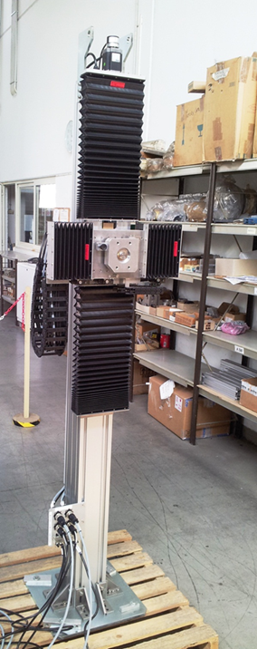
Delivery routes
Do it yourself
  Requires you to know how and to have capability and capacity
Buy it in (contract)
  Requires you to know what you want – as you will create a specification
In-Kind
  Can be brilliant – but it is more like an artistic commission.

Slide 15
Disclaimer
The following comments and pictures have absolutely no correlation – just some recent examples of some in-kind contributions

Slide 16
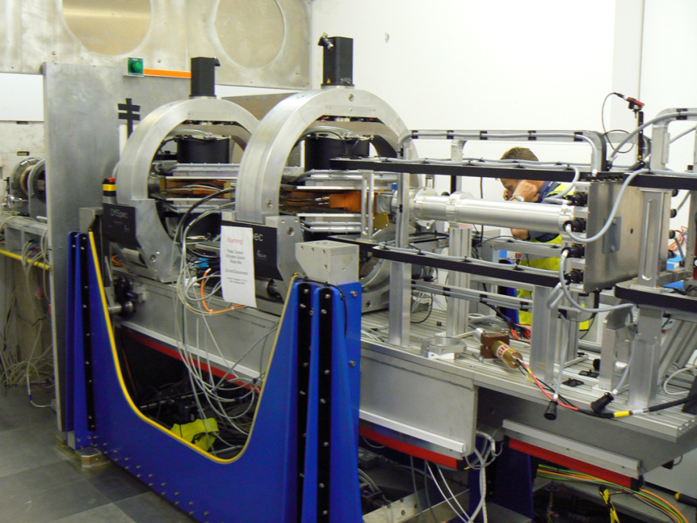
In-Kind at ISIS
In general we have been a receiver rather than a deliverer
Examples of Excellent value and also not
Examples where we could not do it ourselves (capability) – therefore excellent value
Value as measured in a project sense is mostly poor
  The price put on the deliverable is significantly higher than it might cost to do yourself

Slide 17
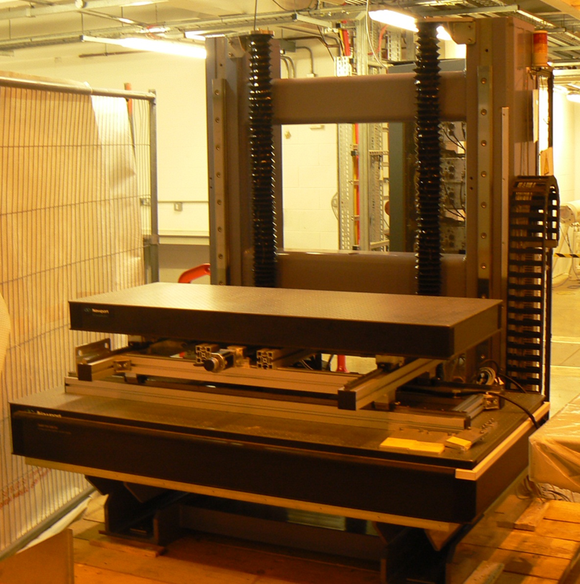
Some thoughts on what makes it go well
Experience is everything – for everyone involved
  Technical is perhaps obvious
  Experience of working in-kind…
  At remote ultimate destinations
  Experience of delivering
Clarity
  What / How / Who / When / Where
  not forgetting the WHY
  Has to be clear to everyone involved
  Interface complexity

Slide 18
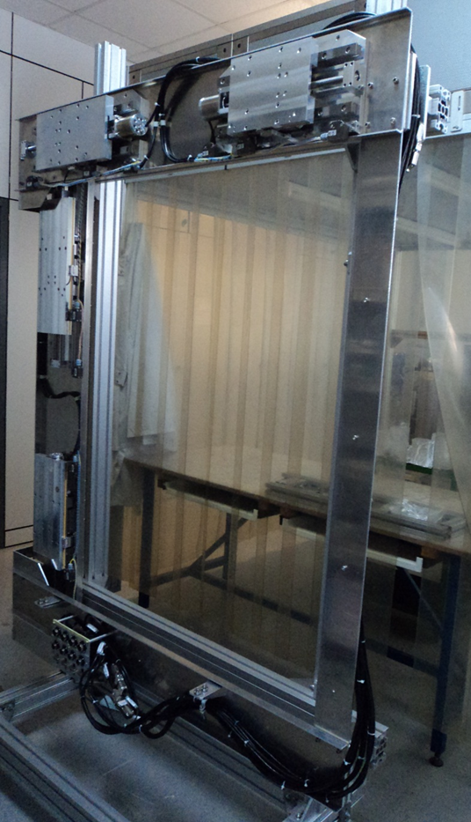
Alignment of objectives
  Different organisations
  Try to build teams
Visibility of what is happening
  When changes come (and they will) – early raising of issues
Communication
  Clear lines of communication identified
  Not just up / down
  Co-locate teams (or parts, or at times)

Slide 19
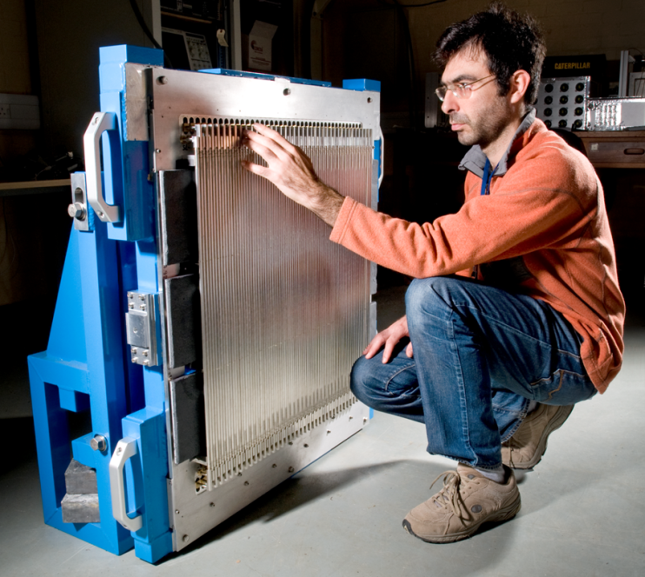
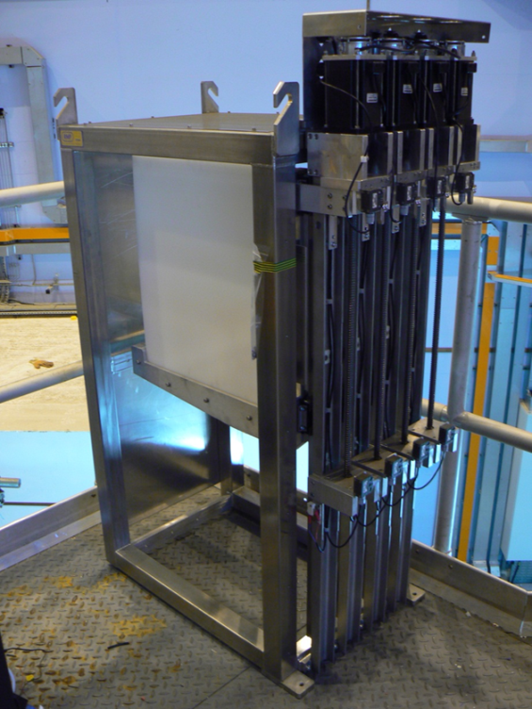
Different cultures in the laboratories
  Operational expectations
  Health and Safety
  Codes to be applied
  Quality expectations
    Fit for purpose or looks good also
    Expectations for life and maintenance / fixing ‘bugs’ – what is an acceptable level of ‘bugs’
    Documentation etc etc

Slide 20
Considerations
Upgradability
Technical support
  When things break / need upgrading
  Comissioning – technical and scientific
    Knowledge retention
Operational input at design review
  Maintainability
  Operational use
Small amount of in-kind into existing structure (ISIS)
Standardisation – Relatively simple for ISIS
  Expect this to be critical for ESS in operations
  Additional challenge

Slide 21
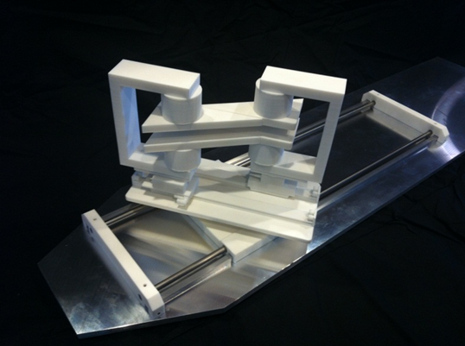
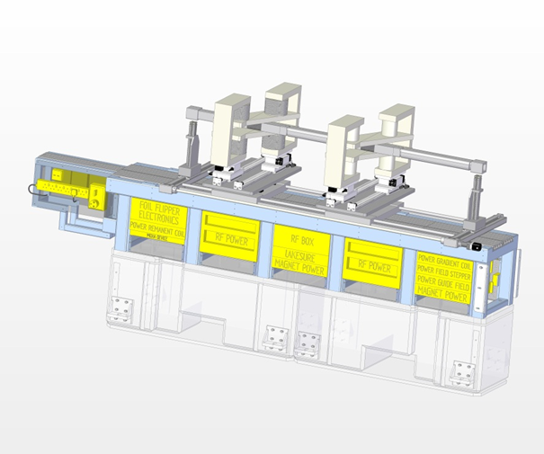
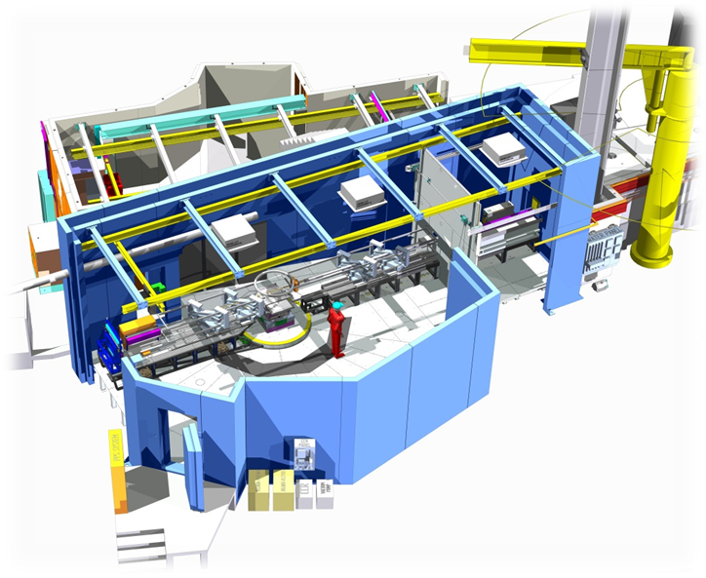
Summary
In-kind is extremely complex and difficult – but can be great
Likely higher cost to the value
  Increased effort in communication
  Mis-alignment of objectives
Experience is Key
  Picking the right work to the right people
Timescale and Quality NOT just cost
Operations

Slide 22

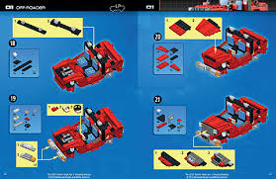

Standardisation – (follow instructions)
At the end – has to be a success
Responsibility for delivery and operations rests with the project team

