Slide 1
The Construction of ATLAS at the CERN LHC
Scientific motivation
CERN & LHC
ATLAS
Layout
Different detectors
Key numbers
Collaboration
Scientists, institutions, Funding Agencies
Organization
Governance
Management
The construction & commissioning
Physics output
Lunds universitet / Presentation 2010

Slide 2
Particle Physics
The fundamental principles governing our world; forces and basic constituents. The conceptual picture is quantified by mathematically formulated theories (laws of nature).
Evolves through experiments, development of theories and models. Today’s theory is the Standard Model which has an exceptional predictive power, but is incomplete.
We explore the predictions of the Standard Model and seek a more complete understanding, i.e. Beyond the Standard Model.
Lunds universitet / Presentation 2010

Slide 3
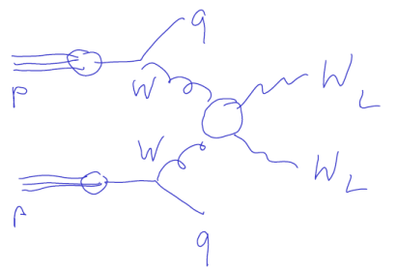
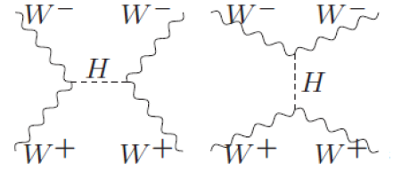
SM and Masses: Higgs; we need it in the toolbox
The Standard Model is a toolbox
Does not work if the W and the Z⁰ are just assigned masses
The world is permeated by a field, the Higgs field. W and Z⁰ have masses because they interact with this field.
--> the corresponding field particle should exist and can be produced
The Standard Model predicts
how it should be produced and how it decays
A wide mass range for the Higgs; The LHC covers this range
LHC: Discovered that this particle exists
Example WW scattering
the divergence is cancelled by:
Lunds universitet / Presentation 2010

Slide 4
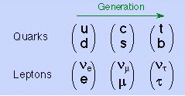
Incompleteness of the Standard Model; cannot predict the quark masses
top quark
Pb-nuclei
Pb-volume > 10¹² times larger
(Mass ~ surface, while all quark sizes < 10⁻¹⁸ m)
Lunds universitet / Presentation 2010

Slide 5
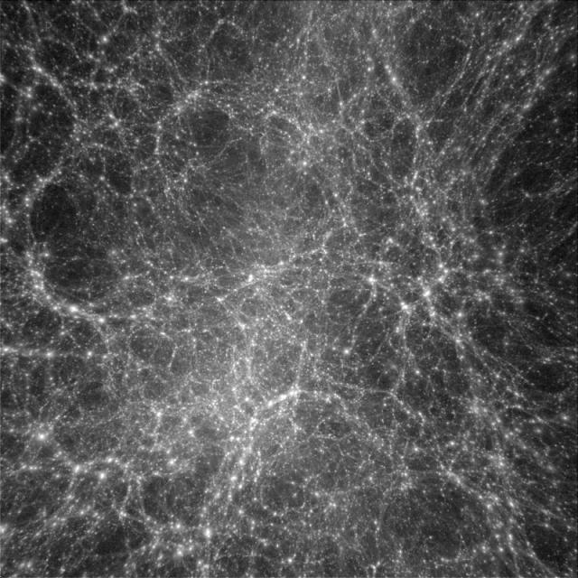
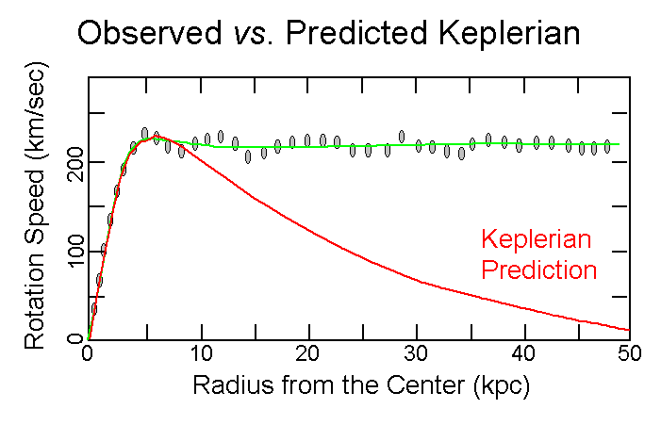
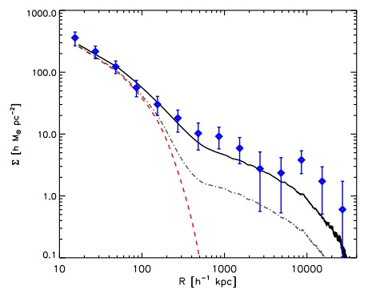
Incompleteness of the Standard Model; no candidate for Dark Matter
Jan Oort, 1932
Despite the velocity of the stars perpendicular to the galactic plane, the galaxies are not dissolved
Fritz Zwicky, 1933
The galaxies move in the galaxy clusters as if there is more materia than what emits and absorbs radiation
Vera Rubin, 1970
Galaxies rotate as if there is more materia than what emits and absorbs radiation
S Masaki et al, February 2012 [1]
The intergalactic space is filled with Dark Matter; simulation results using gravitational lensing measured around millions of galaxies using SDSS
30 Mpc
Lunds universitet / Presentation 2010
[1] The Astrophysical Journal 746, 38 ( 2012 February 10 )
Notes:
The mean surface mass density profile as a function of the distance from the centre of
galaxies. The thick solid curve is the mean of all haloes above the mass threshold. The dash-dotted
curve represents the contribution from particles bound to haloes, i.e., particles that reside within
the virial radius of all haloes. The data with error bars are the observational estimate by MSFR
as in the previous figure.
(h = 0.719, the Hubble constant in units of 100 km s−1 Mpc−1)

Slide 6
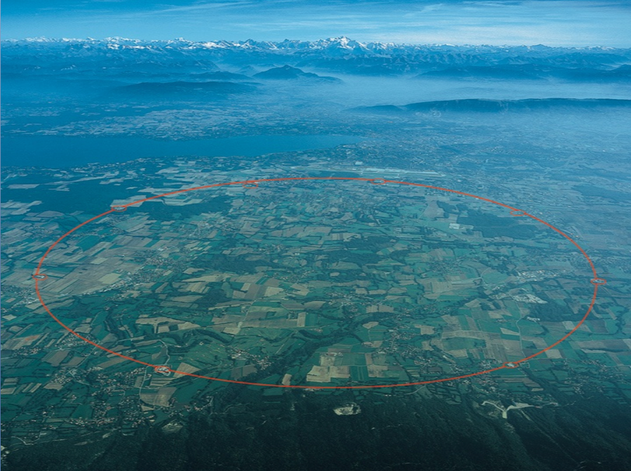
CERN; a European project and a global centre for Particle Physics
Annual budget of ~ 7’300 Mkr
Swedish contribution ~ 170 Mkr
People paid by CERN: ~ 3’500 whereof ~ 2’400 staff
Scientific users: ~ 10’000
Lunds universitet / Presentation 2010

Slide 7
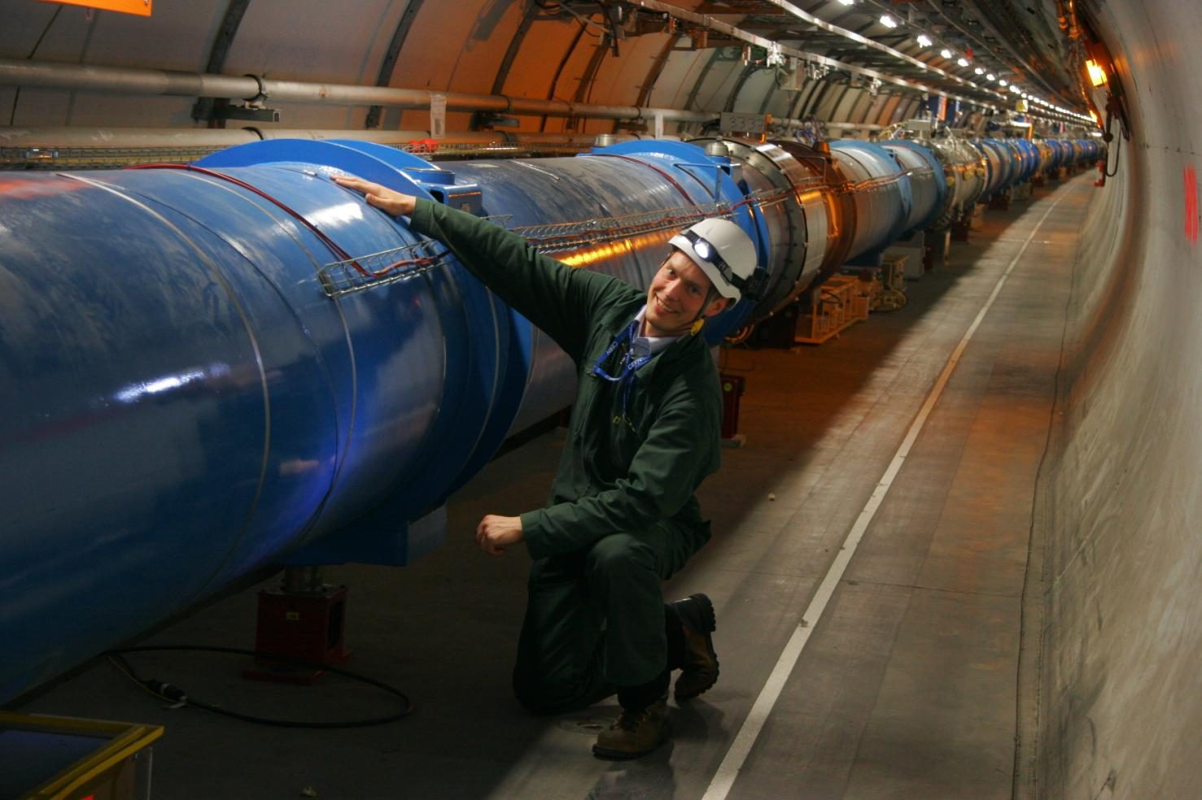
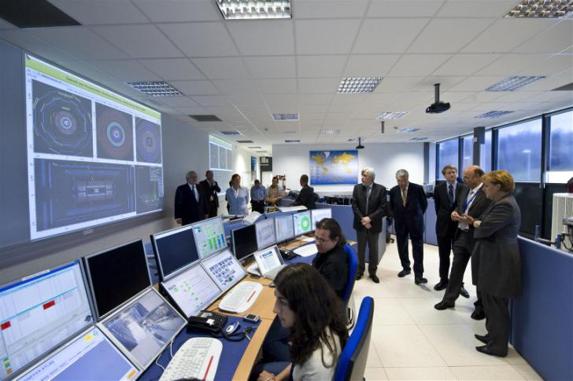
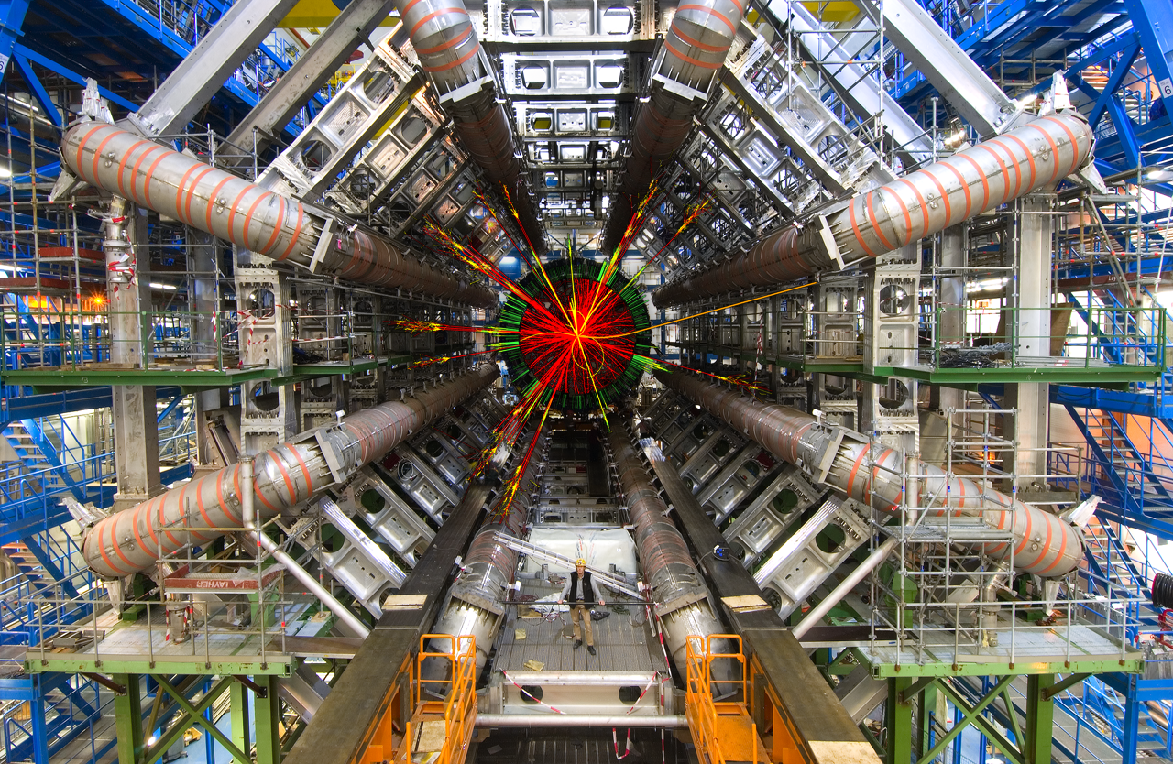
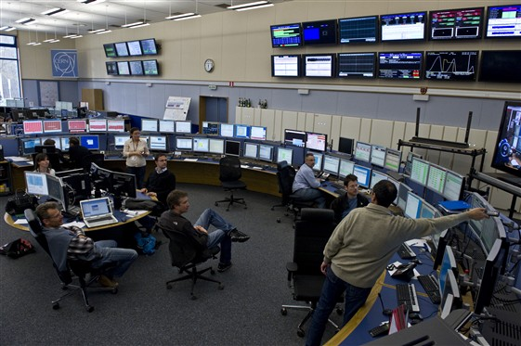
Accelerators supplied by CERN and experiments by the Universities/Research Councils
Lunds universitet / Presentation 2010

Slide 8
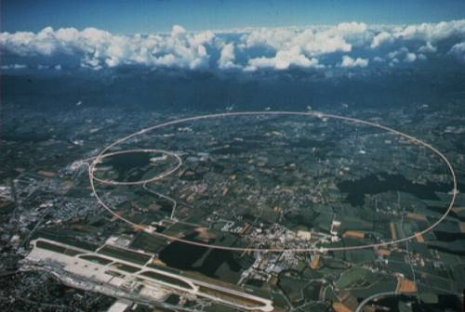
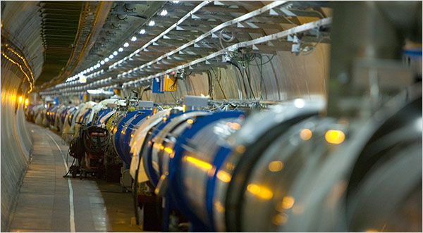
The Large Hadron Collider [1]
~9300 magnets
8’870 MJ stored energy in dipole magnets ( 2 tons TNT)
334 MJ energy in each proton beam (90 kg TNT)
[1] http://en.wikipedia.org/wiki/Large_Hadron_Collider
Lunds universitet / Presentation 2010

Slide 9
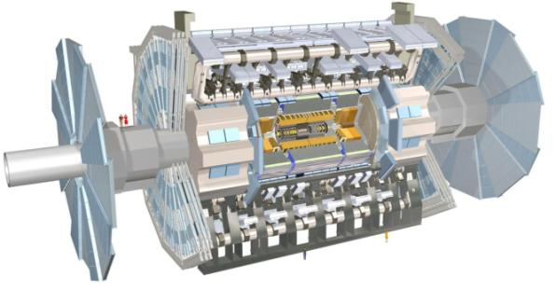
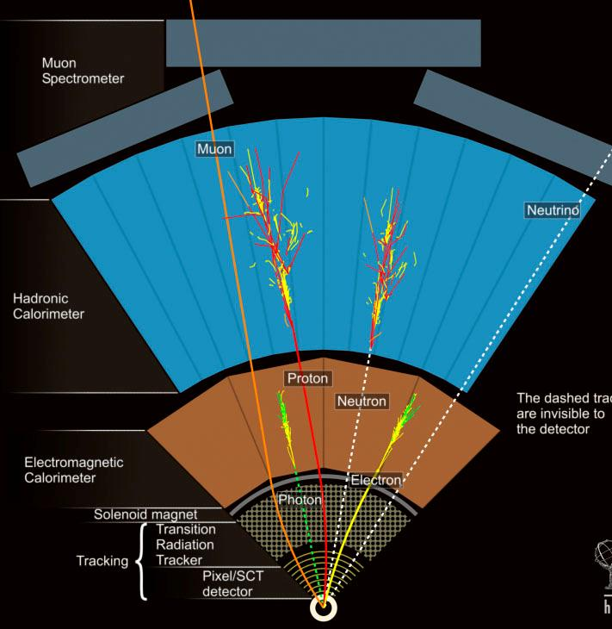
ATLAS
46 m
25 m
Lunds universitet / Presentation 2010

Slide 10
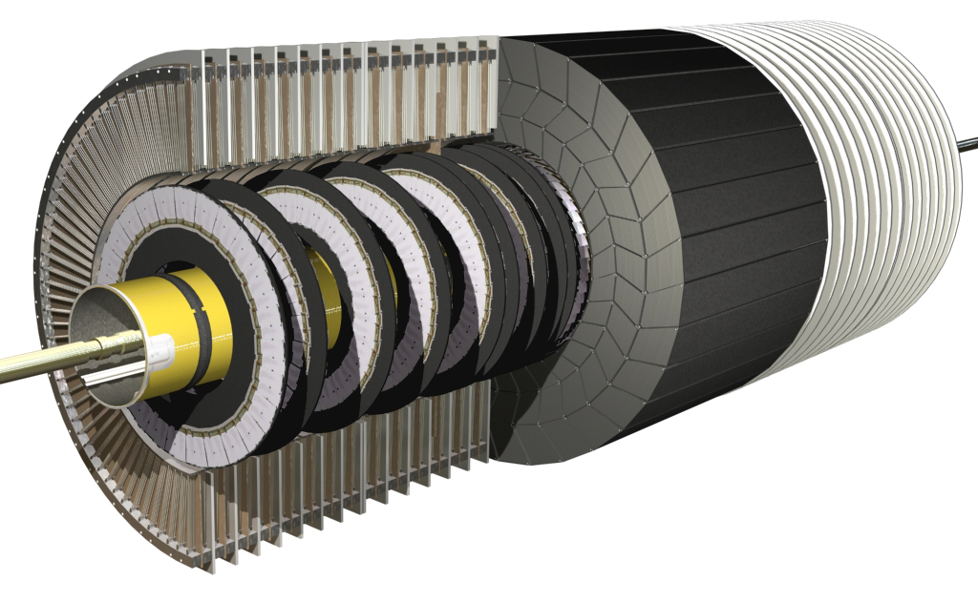
The Inner Tracker: 100 million r/o channels
Lunds universitet / Presentation 2010

Slide 11
The Inner Tracker
Lunds universitet / Presentation 2010

Slide 12
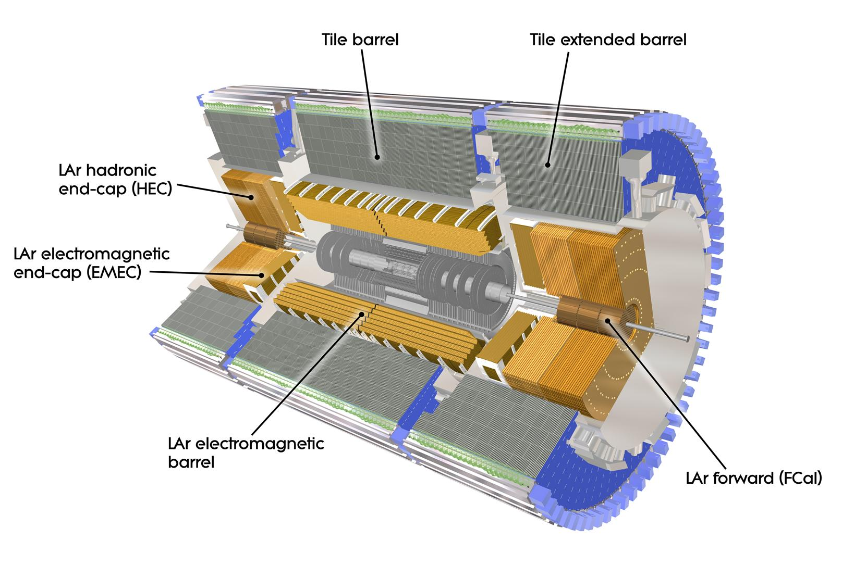
Calorimeter: 120’000 r/o channels
Lunds universitet / Presentation 2010

Slide 13
Calorimeter
Lunds universitet / Presentation 2010

Slide 14
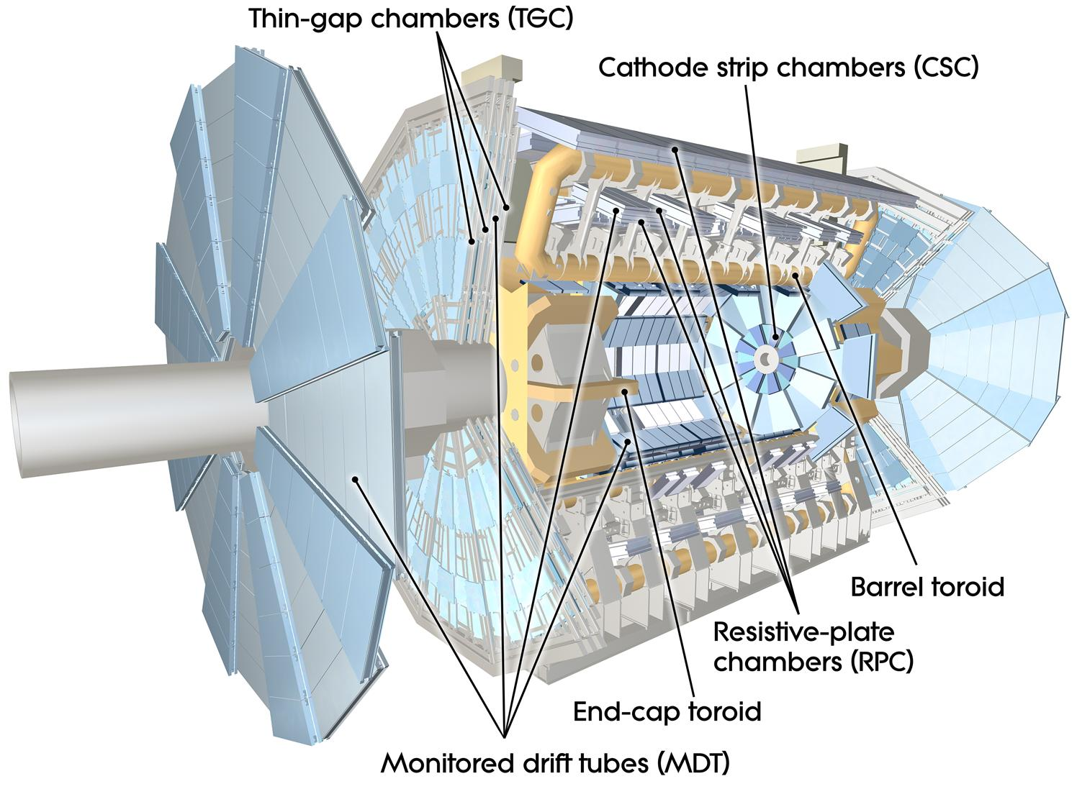
Muon Spectrometer: 1.25 million r/o channels
Lunds universitet / Presentation 2010

Slide 15
Muon Spectrometer
Lunds universitet / Presentation 2010

Slide 16
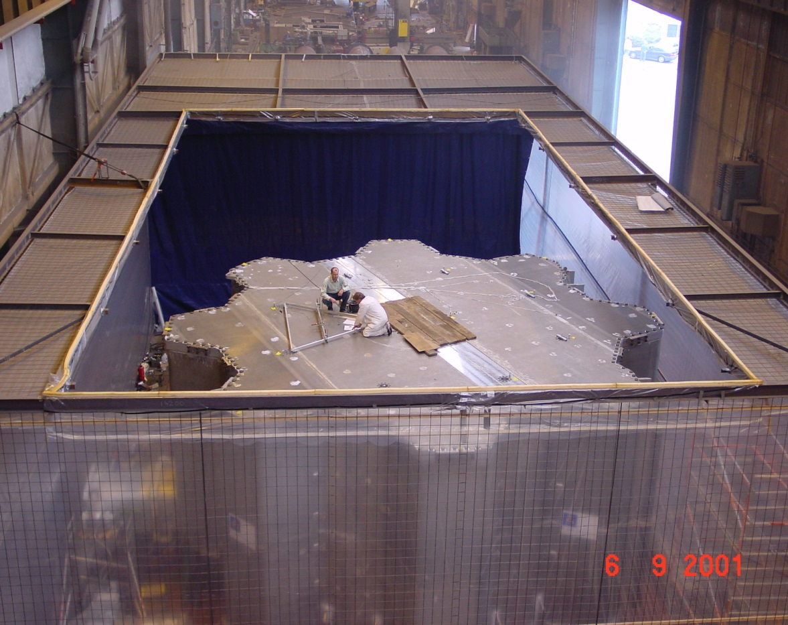
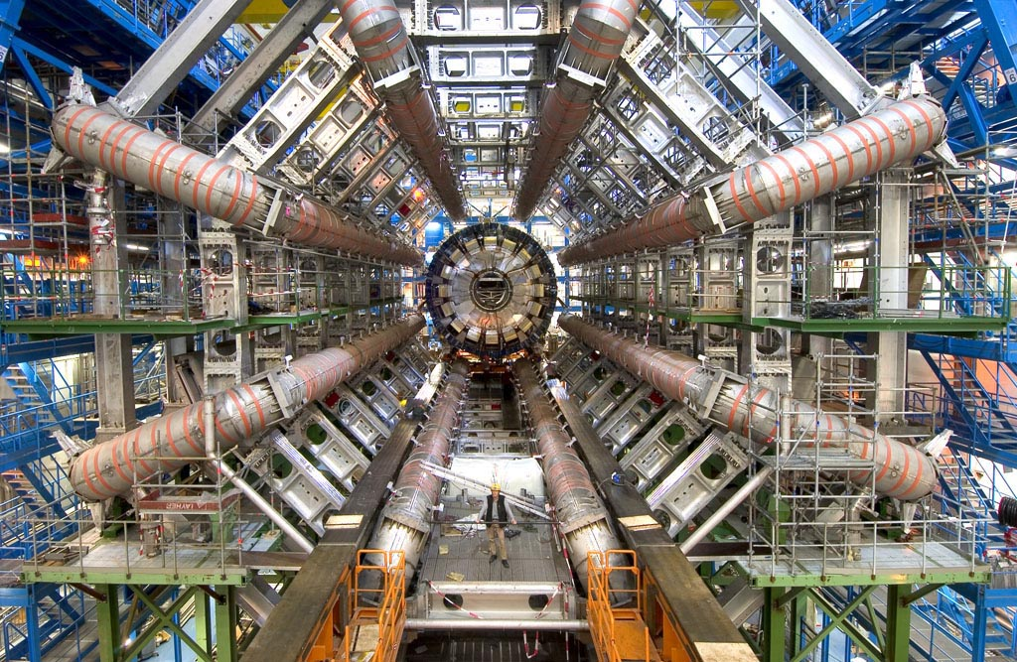
Magnets
Lunds universitet / Presentation 2010

Slide 17
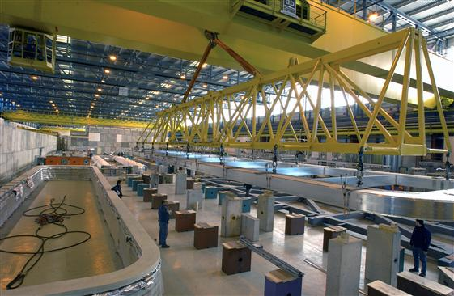
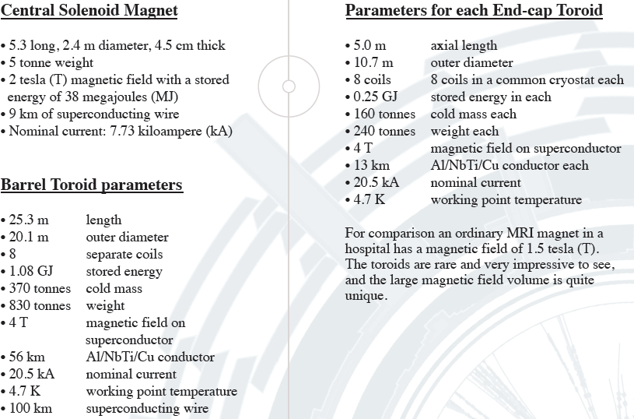
Magnets
Lunds universitet / Presentation 2010

Slide 18
Collaboration: 38 countries, 174 institutions, 3000 scientists
Lunds universitet / Presentation 2010

Slide 19
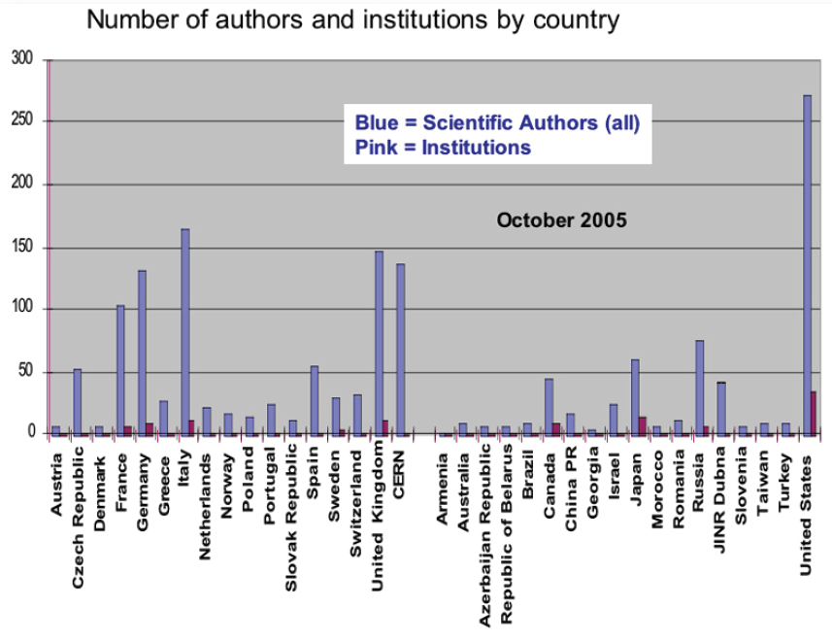
Collaboration: 38 countries, 174 institutions, 3000 scientists
No dominating national or international actor
Lunds universitet / Presentation 2010

Slide 20
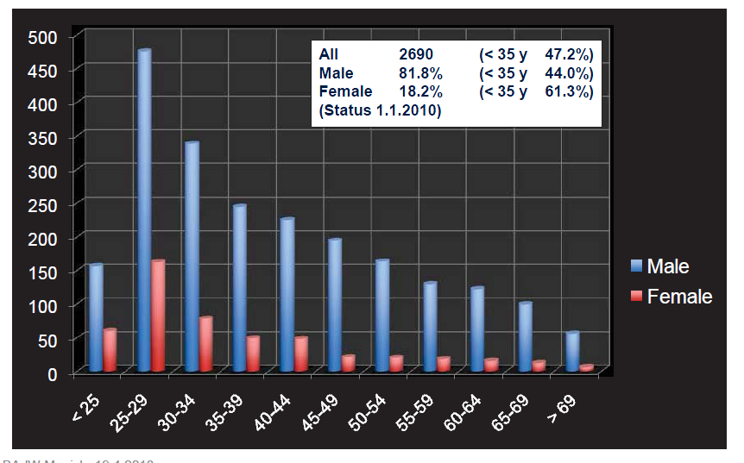
Collaboration: 38 countries, 174 institutions, 3000 scientists
Lunds universitet / Presentation 2010

Slide 21
Construction contributions
Lunds universitet / Presentation 2010

Slide 22
Cost
Universal cost estimate difficult to establish for a project largely composed of inkind contributions
Salaries different in different countries
Procurement rules varies
Overhead rules are different
…
CORE cost: An estimate largely based on procurement from CERN, no overhead, assuming free institutional technical manpower for engineering
Purpose: A standardized yardstick to compare contributions
CORE-cost of ATLAS: About 500 MCHF
Corresponding green field cost: About 1’000 M€
Computing not included
About 65% correspond to detectors with electronics, that has been developed by the collaborating institutions: Institutional deliverables.
Remaining 45% in general big engineering objects: Superconducting magnets, Cryostats, Support Structure, etc. But also services like geodesics, manpower, installation etc 2/3 of these were also transformed to deliverables
Deliverable: Inkind where the provider takes full cost responsibility
Lunds universitet / Presentation 2010

Slide 23
Legal Framework
ATLAS is not a legal entity
CERN takes that role on behalf of the scientific collaboration
CERN is the enabler of the Collaboration
Accounts
Purchases
Work/residence permits
Short term employments/per diem
CERN oversees ATLAS through peer reviews and by requiring that some key personnel should be CERN staff
Formal steps
LoI, Proposal, TDRs
Document: Conditions for Experiment at CERN
CERN requirements on the Collaboration and its organization
General principles defining the interfaces between CERN and the Collaboration (electricity cost, etc)
Memorandum of Understanding between CERN and each National Funding Agency
Lunds universitet / Presentation 2010

Slide 24
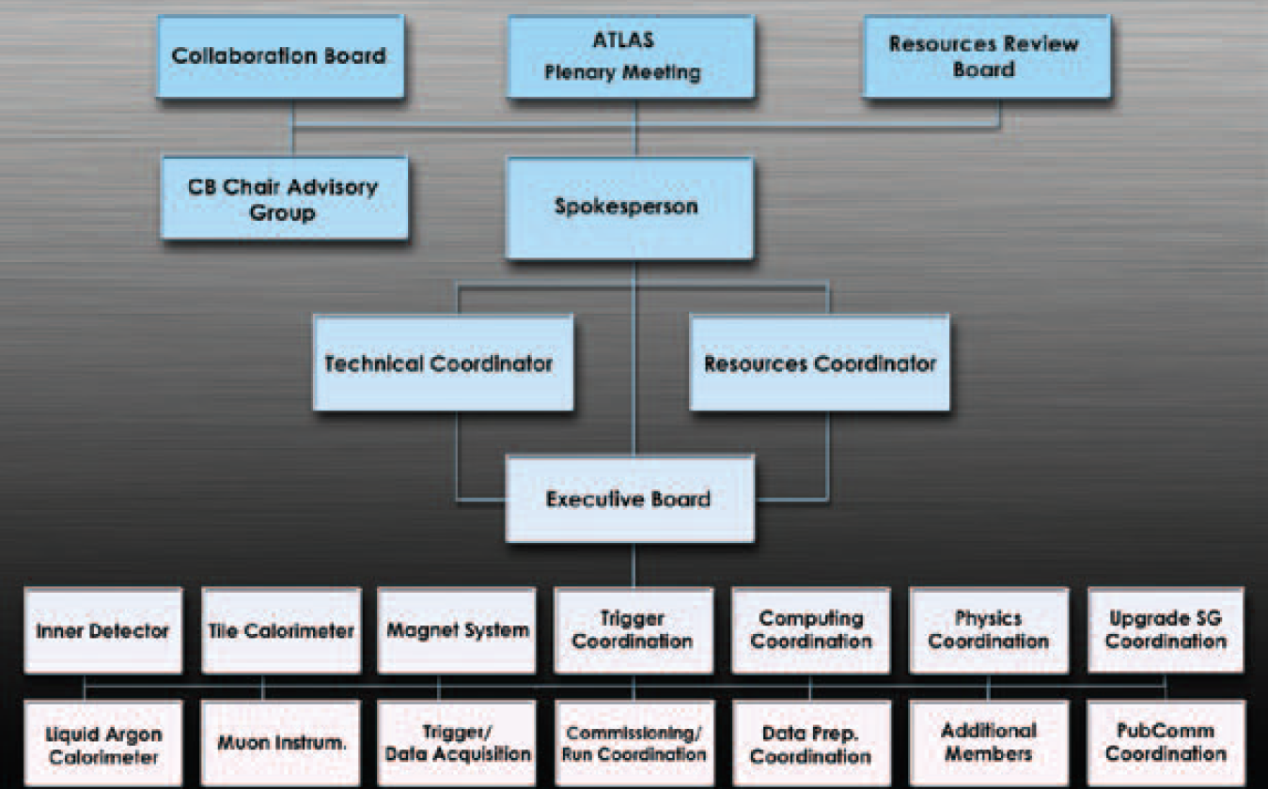
Governance
Chair: CB chair
Chair: Spokesperson
Chair: CERN Director of research
Institutions 3/year
All scientists 3/year
Funding agencies 2/year
The overall management
CERN staff
CERN staff
Chair: Spokesperson
Project leaders with management 1/month
Lunds universitet / Presentation 2010

Slide 25
System governance
Institute Board
Chair: IB-chair
Plenary Meeting
Chair: Project Leader
Institutions 3/year
Steering group
Chair: Project Leader
Activity leader 1
Activity leader 1
ATLAS management
Ex-officio
Project Leader is selected by the Institute Board in process followed by the Spokesperson The Spokesperson proposes the Project Leader as Executive Board member, to the Collaboration Board
Lunds universitet / Presentation 2010

Slide 26
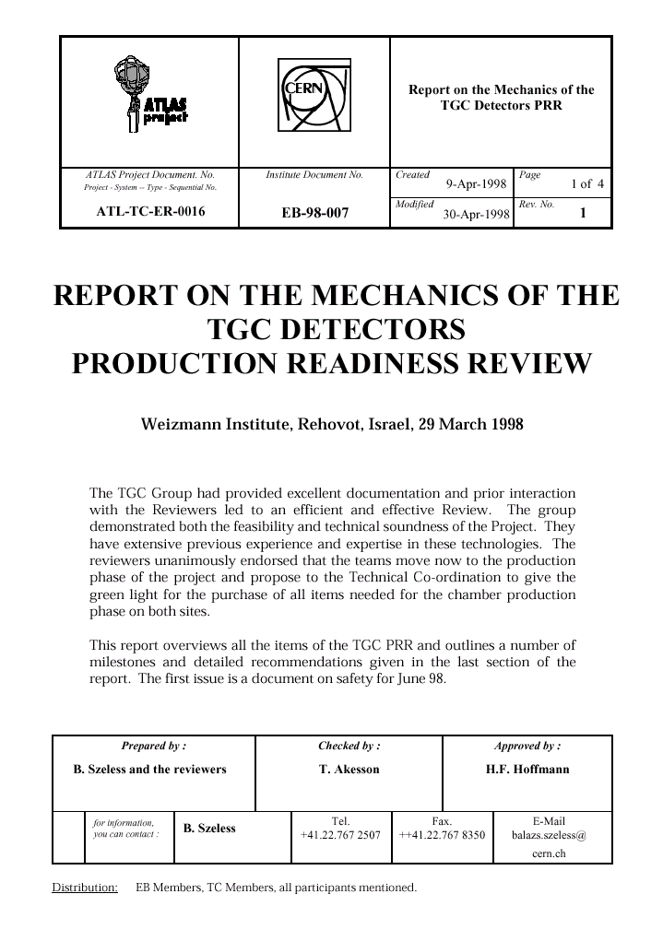
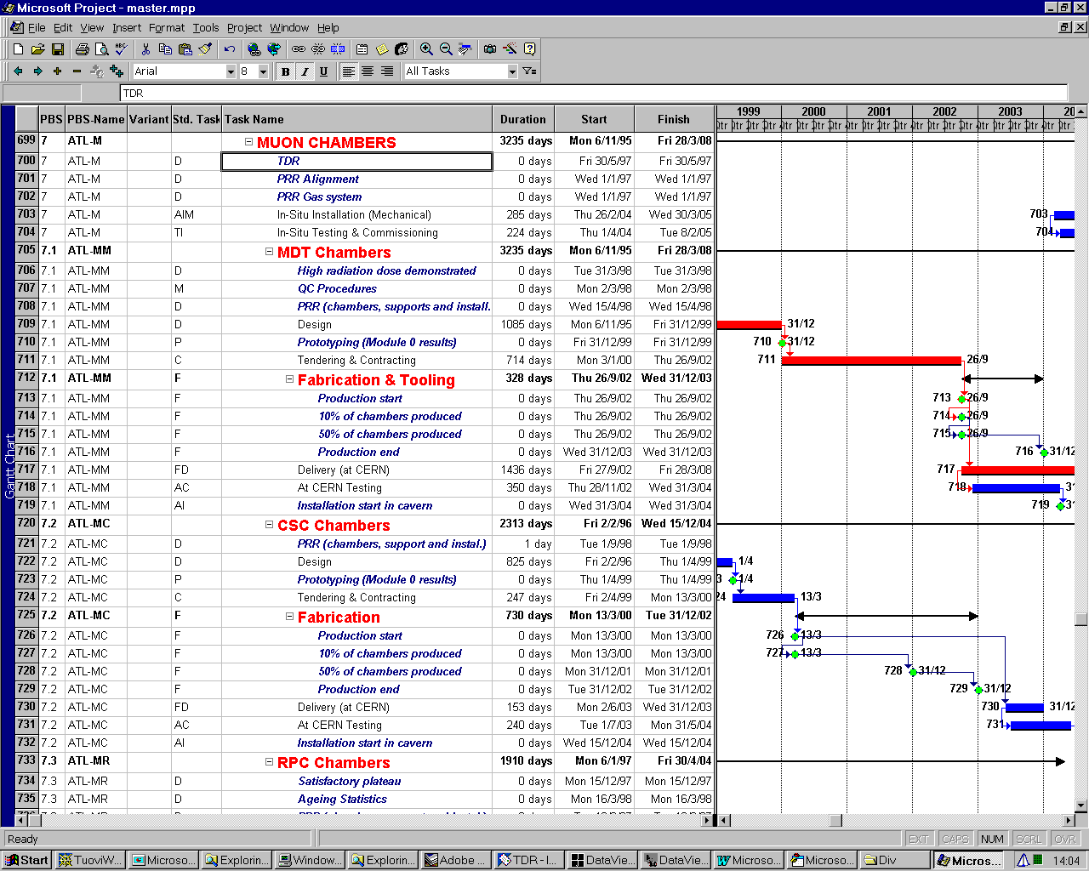
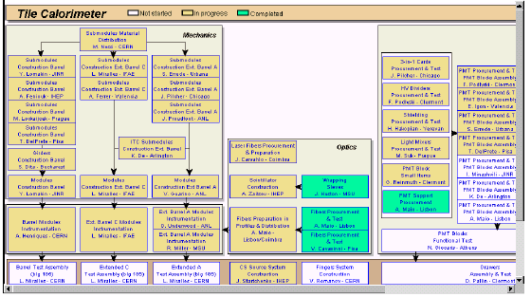
Technical management
Routinely executed formal reviews (average 1 per week)
Well defined procedures for configuration management and control
Breakdown structured schedule for construction, installation and computing.
Well-defined computerized follow-up-procedure
1’500 milestones
Computerized www-based workpackage reporting system for all institutions

Slide 27
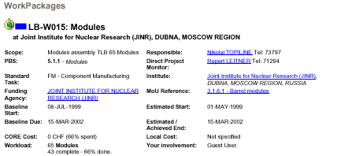
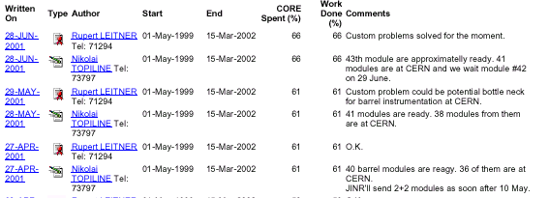
Technical management

Slide 28
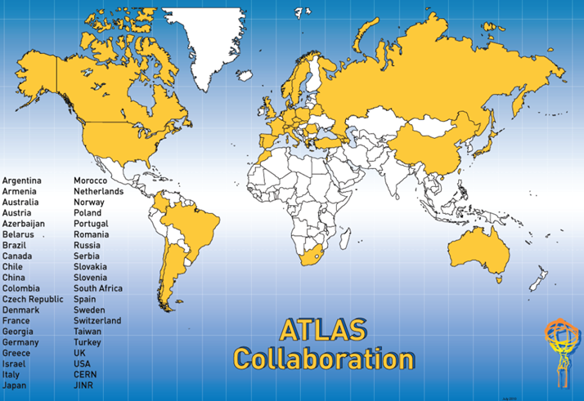
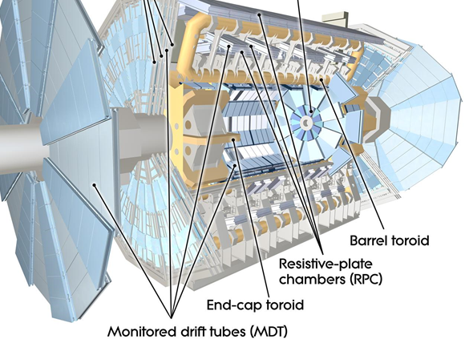
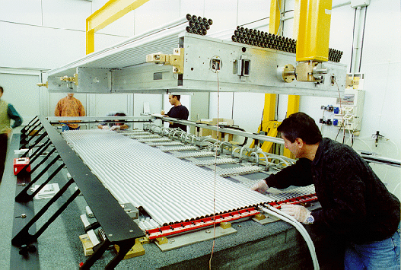

Slide 29
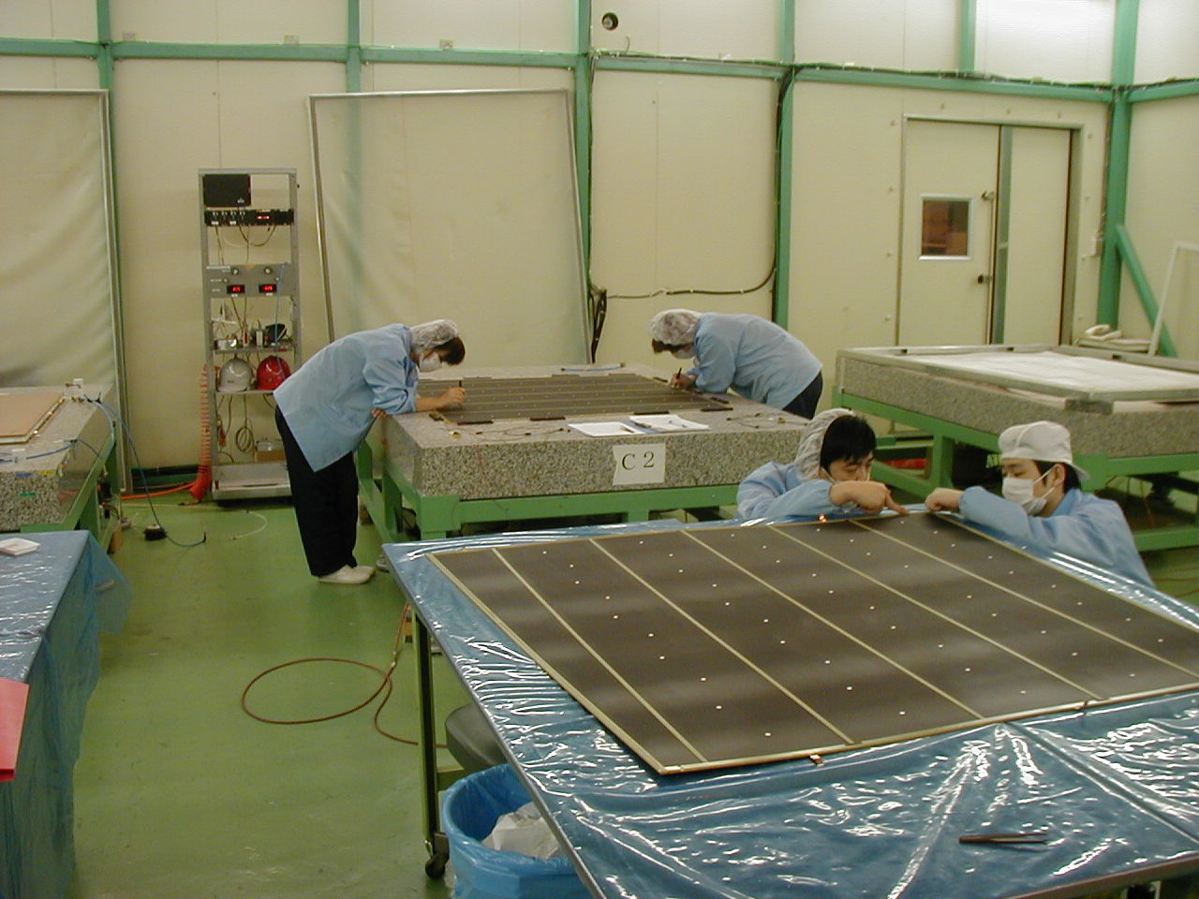
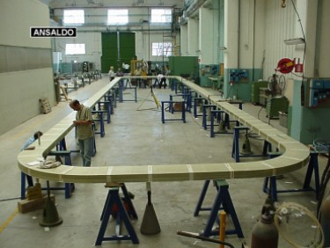
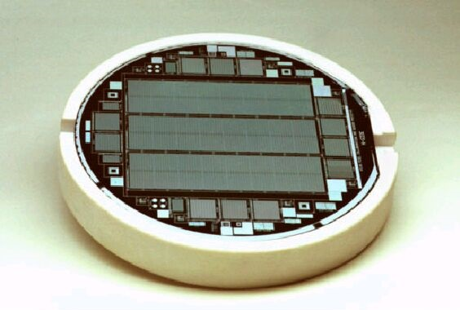
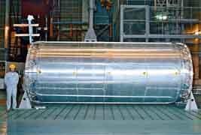
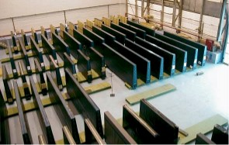
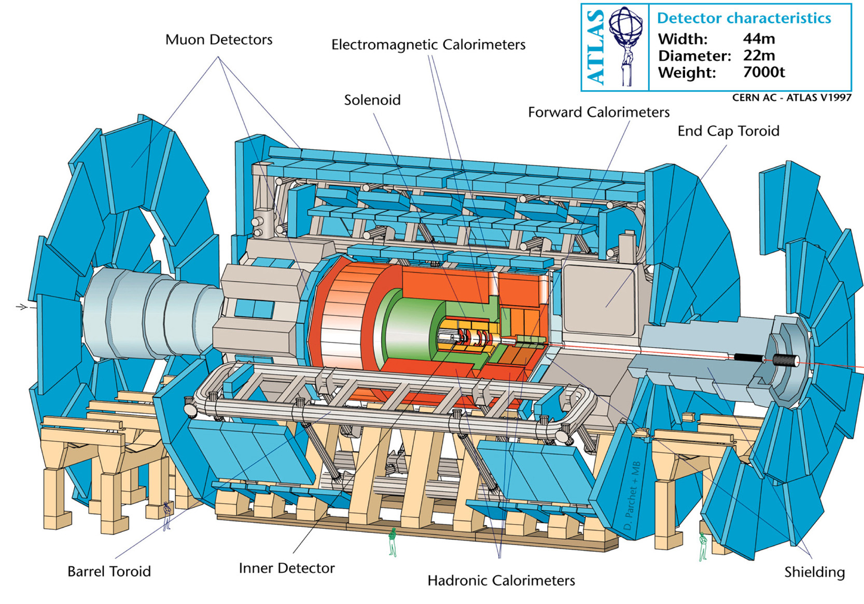
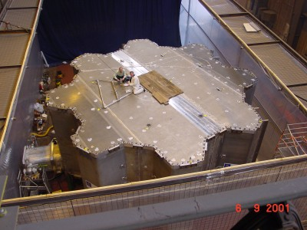
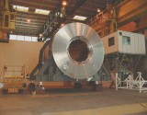
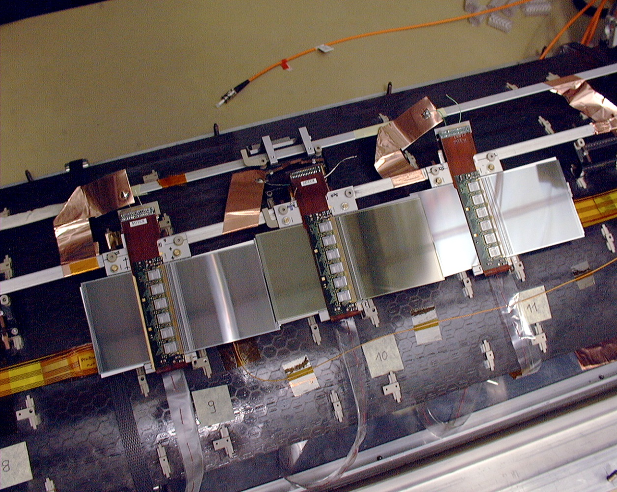
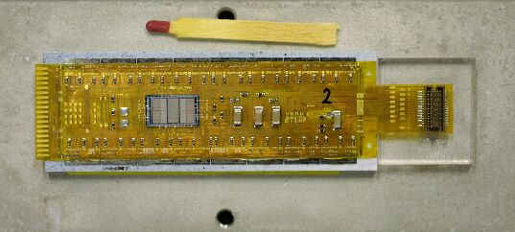
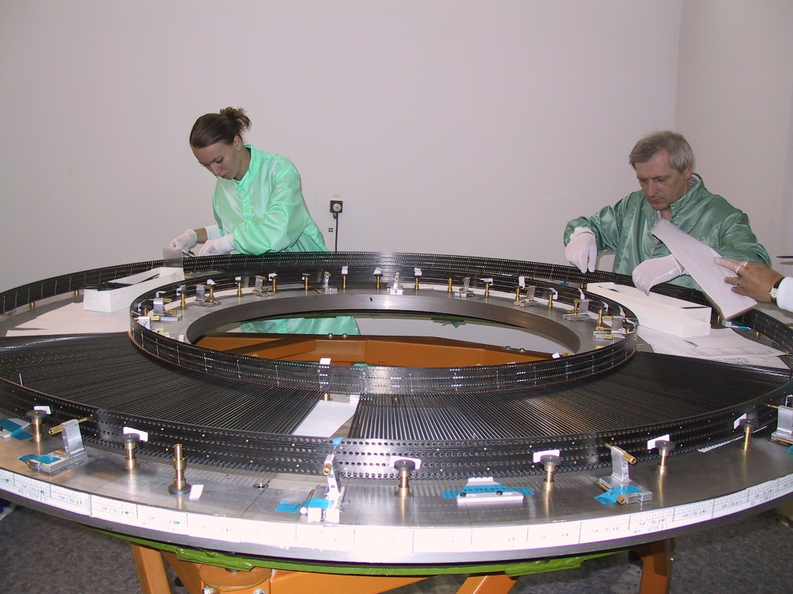
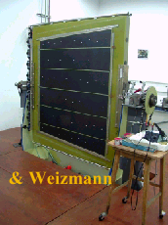
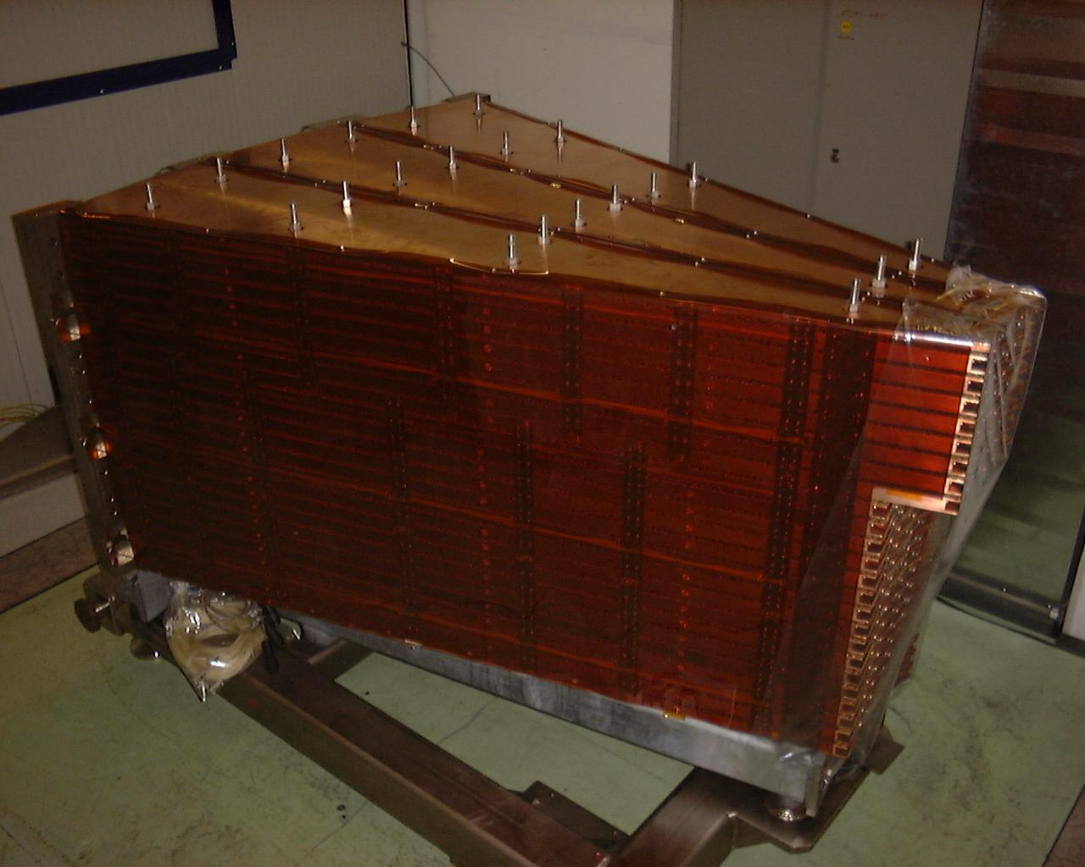
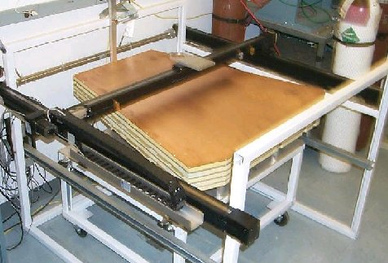
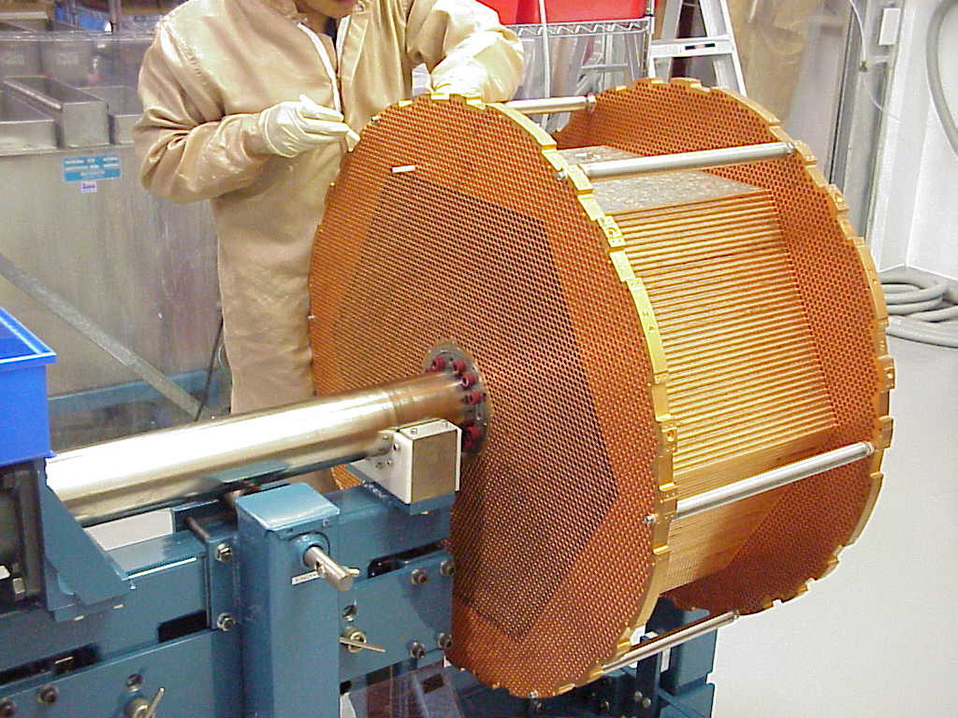
The ATLAS facility

Slide 30
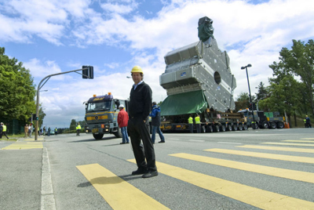
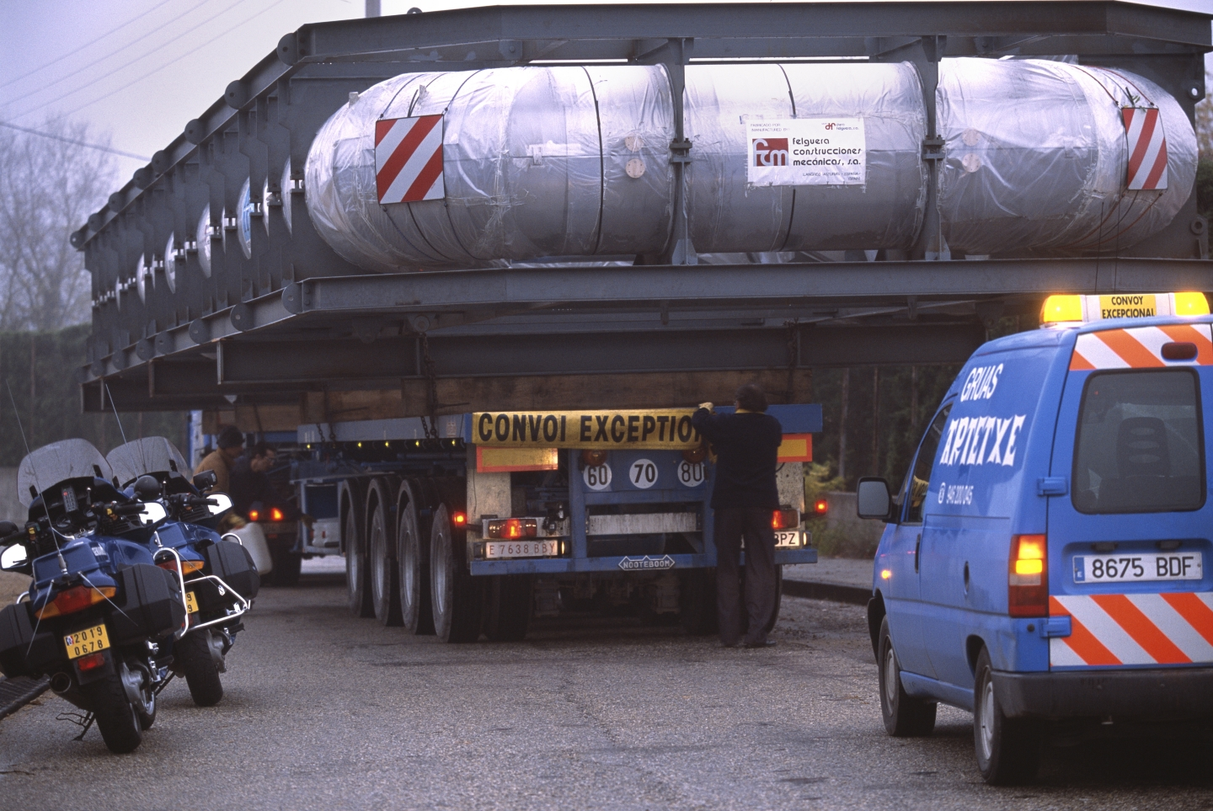

Slide 32
Achieved top-level milestones with time
Lunds universitet / Presentation 2010

Slide 33
First collisions at the LHC end of November 2009 with beams at the injection energy of 450 GeV
Lunds universitet / Presentation 2010

Slide 34
Delivered number of proton collisions
Lunds universitet / Presentation 2010

Slide 35
Scientific output up to last week
Most important result: Discovery of the Higgs
Lunds universitet / Presentation 2010

Slide 36
Lunds universitet / Pres
Lunds universitet / Presentation 2010

Slide 37
Back-up

Slide 38
The Standard Model
Proton
u u
d
+ antimatter partners
Neutron
u d
d
π⁺
u
d
Electromagnetic force
Strong force
Weak force
Z, W
Lunds universitet / Presentation 2010

Slide 39
The Standard Model and Masses
Mixing between electro-magnetism and the weak force; γ and Z⁰ are combinations from the two sectors
Z⁰ = -B⁰sinΘ_{W} + W⁰cosΘ_{W}
γ = B⁰cosΘ_{W} + W⁰sinΘ_{W}
The Standard Model is a toolbox
Does not work if the W and the Z⁰ are just assigned masses
W and Z⁰ have masses; that’s why weak interaction is weak
Θ_{W} is e.g determined from the ratio between charged and neutral current reactions
Lunds universitet / Presentation 2010

Slide 40
The Standard Model and Masses
cosΘ_{W} = M_{W} / M_{Z}
Strength of weak interaction; Fermi Constant
M_{W} = πα/(√2G_{F}sin²Θ_{W})
1/137
Lunds universitet / Presentation 2010

Slide 41
Incompleteness of the Standard Model
No force unification in the early universe
Cannot explain the matter-antimatter imbalance
Cannot explain why there are only three fermion families
How does gravity fit in?
Have we really reached the fundamental scale?
Lunds universitet / Presentation 2010

Slide 42
Luminosity
Reactions/unit time = Flux × Number scattering centra × σ
[1/T] = [1/TL²] ×[ ] × [L²]
Reactions/unit time = Luminosity (L) × σ
[L] = cm⁻²s⁻¹
Number of reactions = ∫L dt × σ
σ expressed in cm² or b; 1 b = 10⁻²⁴ cm²; 1 pb = 10⁻¹² b; 1 fb = 10⁻¹⁵ b
Integrerad luminosity ∫L dt given in cm⁻² eller t ex fb⁻¹
O(σ(pp)) = 100 mb; O(σ(Higgs)) = 10 pb; O(σ(H → γγ)) = 10 fb
LHC
O(L) = 10³³ cm⁻²s⁻¹ = 10⁻³ pb⁻¹s⁻¹
∫L dt = 25 fb⁻¹ (eof 2012)
Lunds universitet / Presentation 2010

