Slide 1
In-kind contributions to the European XFEL project scientific instruments
ESS meeting
February 25, 2014
Thomas Tschentscher for European XFEL
thomas.tschentscher@xfel.eu
Notes:
How to edit the title slide
Upper area: Title of your talk, max. 2 rows of the defined size (55 pt)
Lower area (subtitle): Conference/meeting/workshop, location, date,
your name and affiliation,
max. 4 rows of the defined size (32 pt)
Change the partner logos or add others in the last row.

Slide 2
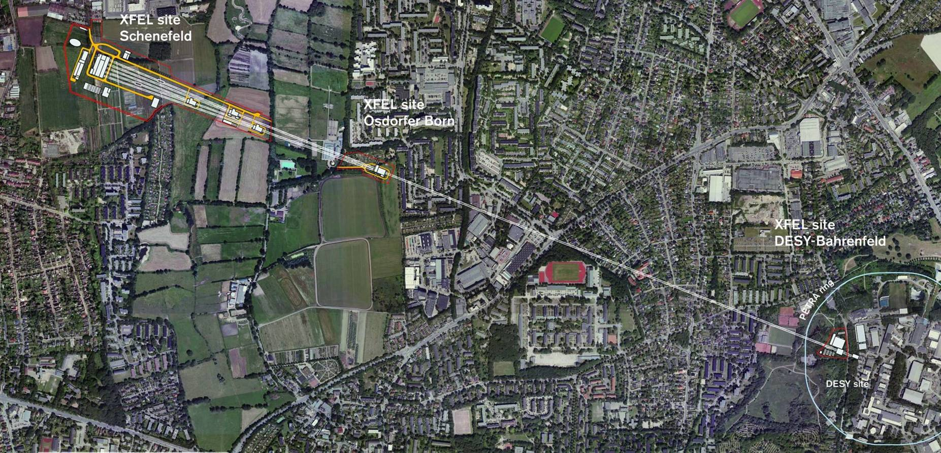
European XFEL
International user facility for FEL research by a multi-disciplinary science community using soft & hard X-ray FEL radiation.
  Multidisciplinary: physics, chemistry, biology, materials sciences, geo-sciences, ...
  Users propose experiments: peer-review, invitation, support
  Basic science: establish the foundations for future high tech applications

Slide 3
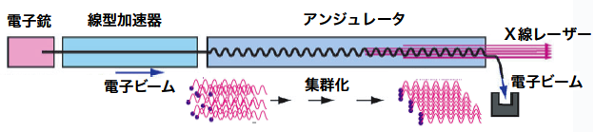
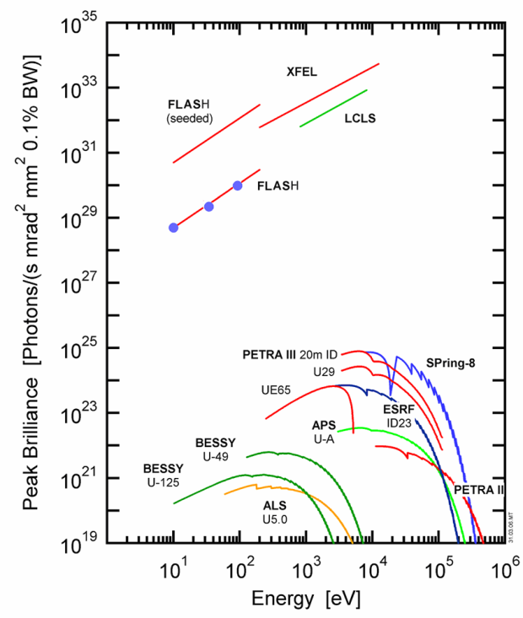
X-ray Free-Electron Laser (X-ray FEL)
Electron-
injector
Supra-conducting
electron accelerator
Undulator
(periodic magnet arrangement)
X-ray FEL
beam
Electron
beam
Electron beam
Bunching
Properties of the x-rays light
  10³-10⁴×shorter light pulses
  10⁶×higher flux density
  Full transverse coherence
X-ray
FELs
Intensity
Synchrotron
X-ray sources
Time
➔New scientific applications

Slide 4
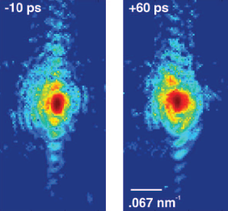
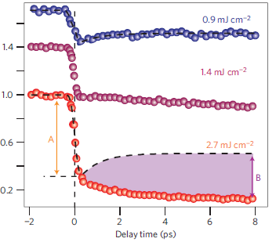
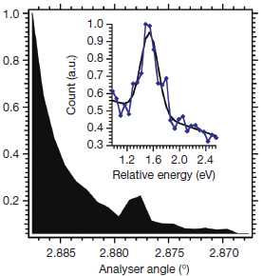
New science capabilities
Imaging and structure determination
  Use high coherence & flux
  Nano-scale objects
  Single molecules or cells
Ultrafast processes
  Use extremely short x-ray pulses
  Photo- & reaction chemistry
  Condensed-matter phase transitions
Non-linear processes and extreme states
  Higher order x-ray processes
  X-ray excitation of matter
High peak & average flux applications
Au nanocrystals
Clark et al.,
Science 341, 56 (2013)
Insulator-metal-transition
De Jong et al.,
DOI: 10.1038/NMAT3718
Non-linear mixing
Glover et al.,
Nature 488, 603 (2012)

Slide 5
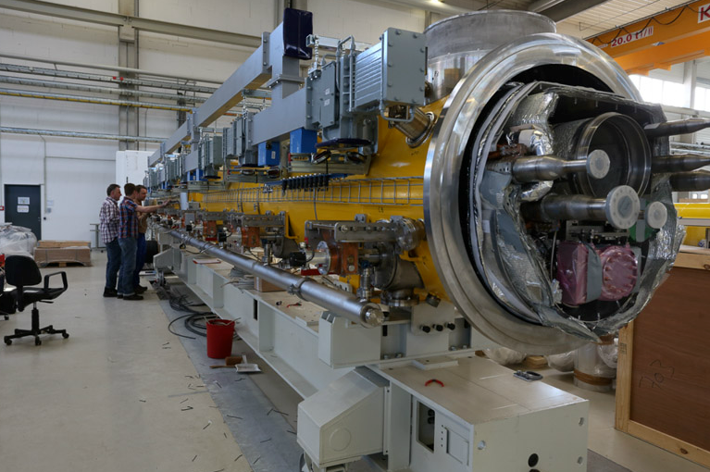
The electron accelerator
  Low electron beam emittances < 10⁻⁶ m
  High peak currents ~5 kA

Slide 6
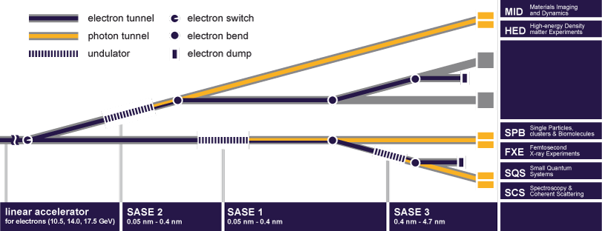
X-ray FEL delivery to 6 science instruments
Provision to add 2 more FEL sources and additional scientific instruments

Slide 7
Scientific instruments – Hard X-rays
SPB: Ultrafast Coherent Diffraction Imaging of Single Particles, Clusters, and Biomolecules
  Will determine the structure of single particles, such as atomic clusters, viruses, and biomolecules.
MID: Materials Imaging & Dynamics
  Will be able to image and analyze nano-sized devices and materials used in engineering.
FXE: Femtosecond X-ray Experiments
  Will investigate chemical reactions at the atomic scale in short time scales—molecular movies.
✓ HED: High Energy Density Matter
  Will look into some of the most extreme states of matter in the universe, such as the conditions at the center of planets.

Slide 8
Scientific instruments – Soft X-rays
SQS: Small Quantum Systems
  Will examine the quantum mechanical properties of atoms and molecules.
SCS: Soft X-ray Coherent Scattering/Spectroscopy
  Will determine the structure and properties of large, complex molecules and nano-sized structures.

Slide 9
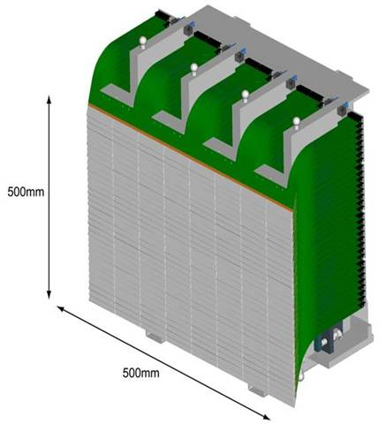
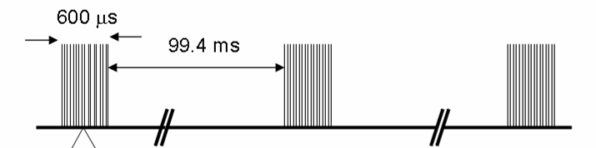
X-ray delivery and instrumentation @ 4.5 Mz
Sample delivery
Refresh & reposition samples
X-ray optics
Shape x-ray pulse
in space & spectrum
Photon diagnostics
Measure
x-ray pulse properties
Detectors / DAQ
Take and store large number
of large data data sets
Optical laser
Excite sample systems

Slide 10
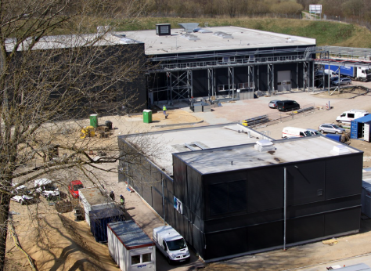
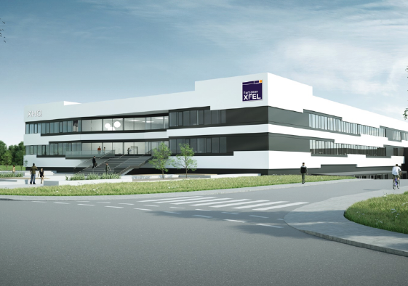
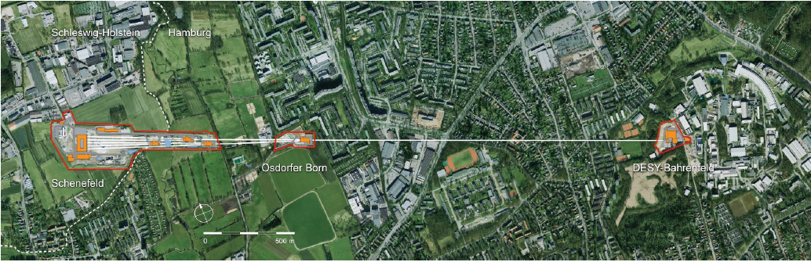
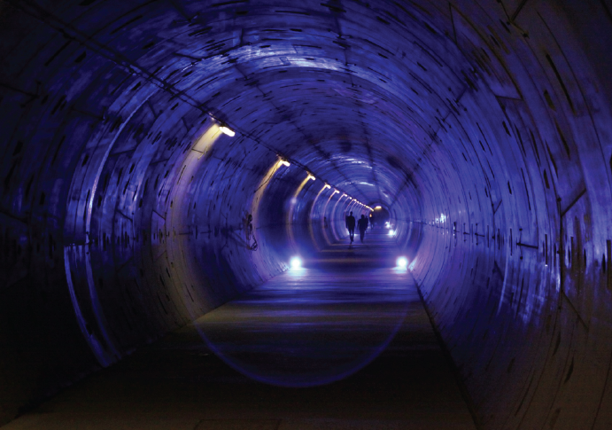
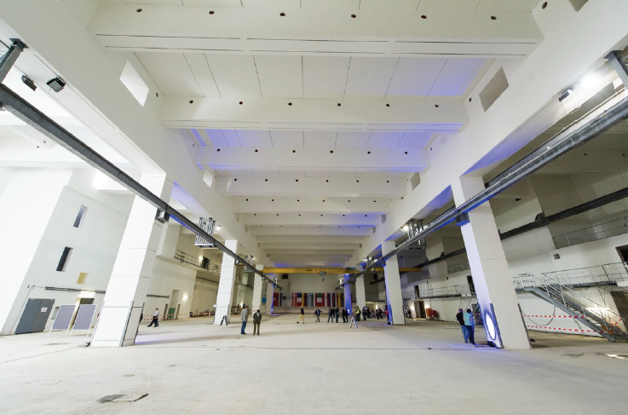
Civil construction well on track

Slide 11
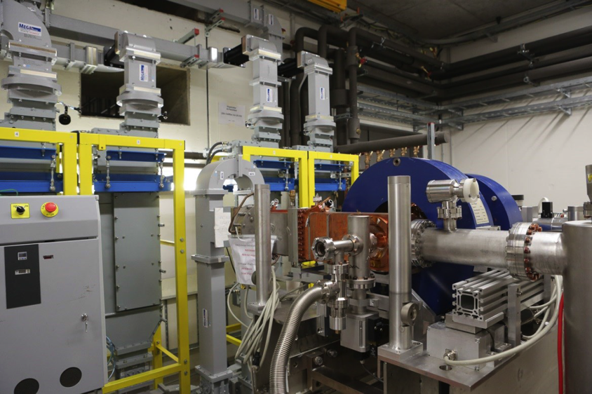
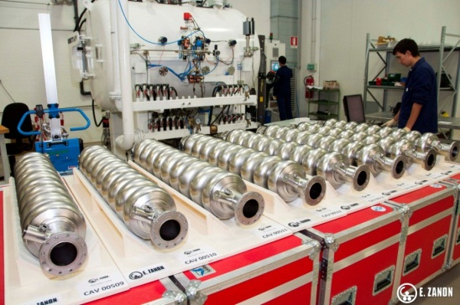
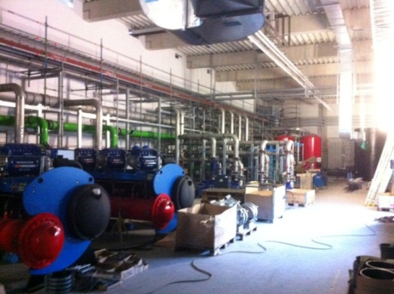
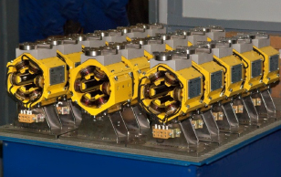
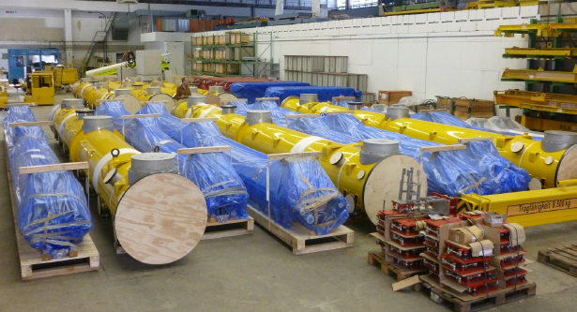
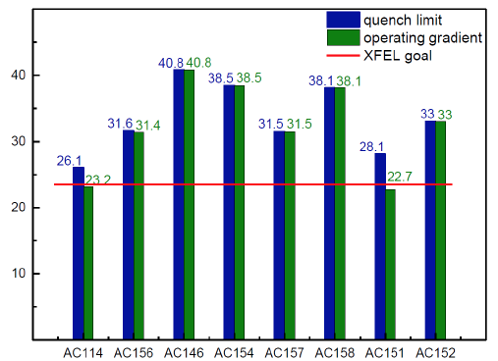
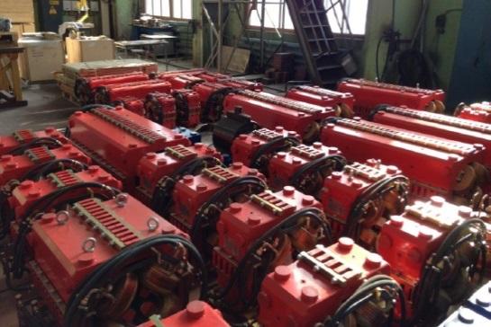


Accelerator components arriving and tests

Slide 12
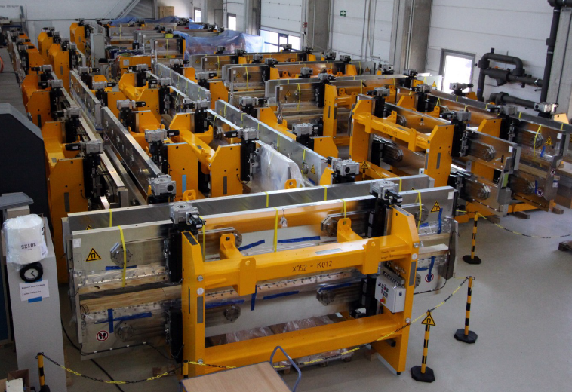
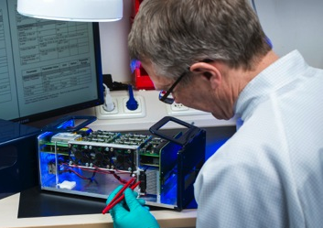
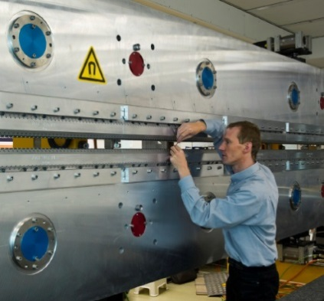
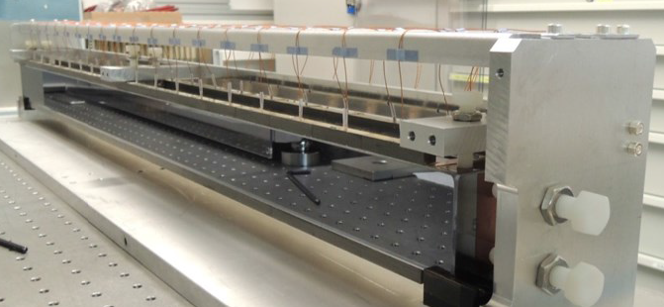
X-ray beam systems

Slide 13
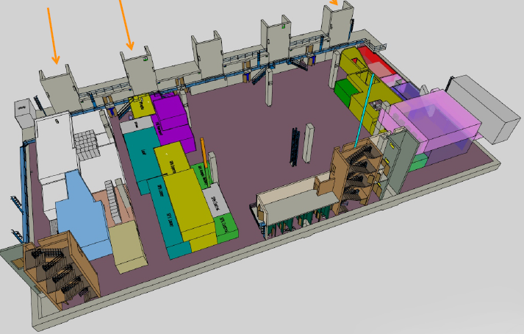
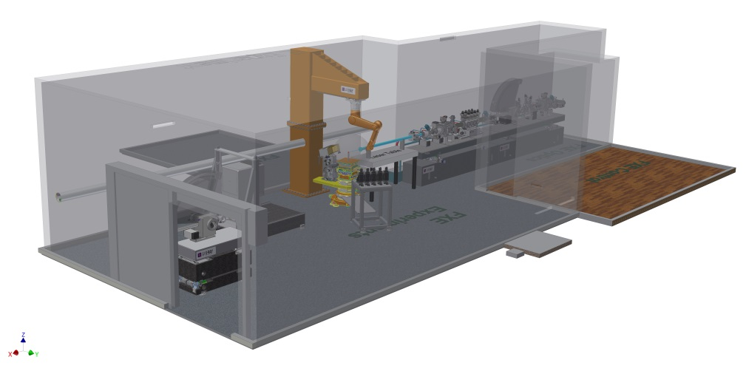
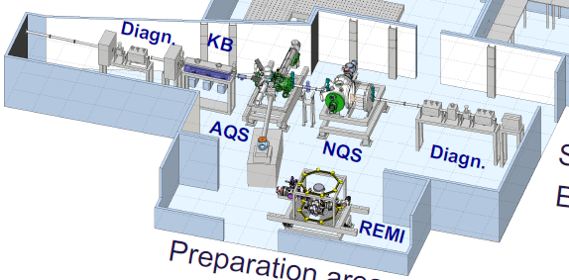
Experiment hall layout

Slide 14




















European XFEL as an international project
Partner countries
  GmbH under German law
Total project cost
  Construction (2009-2016) 1.15 B€
    Contribution in-cash or in-kind
  Operation (>2016) ~100 M€/yr
    ~4800 hrs/yr x-ray FEL beam delivery
Partners & In-Kind contributions (~50%)
  About 30 different contributions
  Accelerator is biggest object
    DESY: coordinator of the Accelerator Consortium
  Operation:
    DESY → Accelerator & tech. Infrastructure;
    XFEL.EU → X-ray units & scientific user program

Slide 15
In-Kind Contributions at European XFEL
  In-Kind Contributions (IKCs) are on-going in several areas of the accelerator and the overall technical infrastructure
  Civil construction is considered not suitable for IKC
  For the X-ray systems & instruments several IKCs in place, but at much smaller volume than for accelerator
  While accelerator is almost entirely provided through in-kind contributions, there are distinct differences for the x-ray systems which reduce the amount of available budget for in-kind contributions
    European XFEL GmbH needs to build up (technical & administrative staff)
    Development of experience for instrumentation to be operated
    Several large contracts are in place (detectors, undulators, diagnostics, ..)
  Relative volume of x-ray systems is much smaller than of accelerator

Slide 16
Definition of x-ray systems
  2001/2006 TDR included only conceptual ideas of the x-ray systems
  defining workshops with science community 2007-2010
  conceptual designs as basis of technical designs of increasing detail
    conceptual designs,
    technical designs,
    production readiness designs
  are done alongside the project (2010 – 2013)
  X-ray systems include various areas
    undulator systems
    x-ray optics and beam transport
    x-ray diagnostics
    scientific instruments (6)
    detectors
    optical lasers
    sample environments
    DAQ/DM
    technical infrastructure enabling scientific instrumentation

Slide 17
Conditions for IKCs (specific to x-ray systems)
  Basic requirements to IKC
    Cost should be within budget book values or (for many detailed x-ray system components) below quotes by commercial vendors
    Time envelope must be maintained
    Proposers should have well-documented expertise in area of contribution
  Provision of instrumentation or personnel matching the requirements of the project
    Develop and build state-of-the-art instrumentation
    Large number of small items with specific requirements
    Time pressure high (time delay between component definition and delivery is very small)
    Human resources fitting the needs to build up the project

Slide 18
IKCs in the x-ray systems in progress
  7 mechanical support frames for undulators (ES01)
  Build-up of dose measurement system for undulator magnets (SE09)
  Quadrupole movers in undulator intersections (ES04)
  Heat load investigations for diffractive optics (SE02)
  MCP-based detectors for FEL diagnostic (RU03)
  FXE instrument components (DK01)
  Sample injector (SE01)
  Secondment physicist for structural biology (SE08)
  Single shot spectrometer for SQS instrument (SE..)
  Electron spectrometer for SQS instrument (SE..)

Slide 19
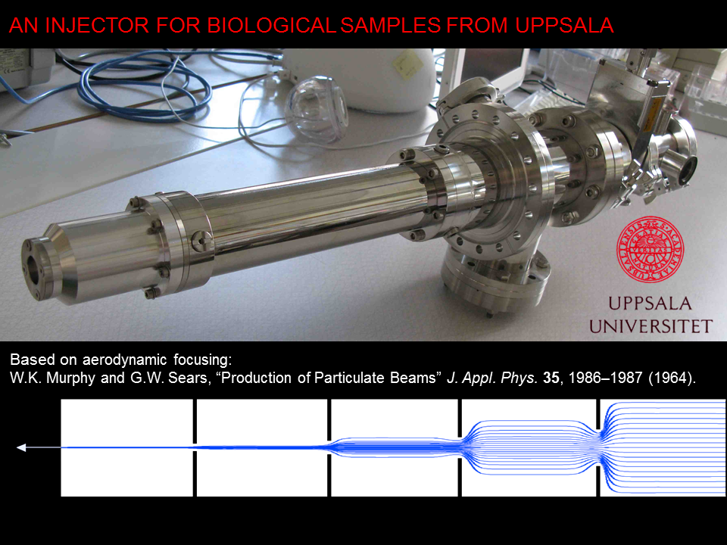
  Example 1: Sample injector (SE01)
Will get updated design using first FEL experiment results
  Tested, documented, characterized, R&D on pulsed inj.
Catcher for rest gas and better vacuum conditions
In-built sample characterization by fluorescence techn.

Slide 20
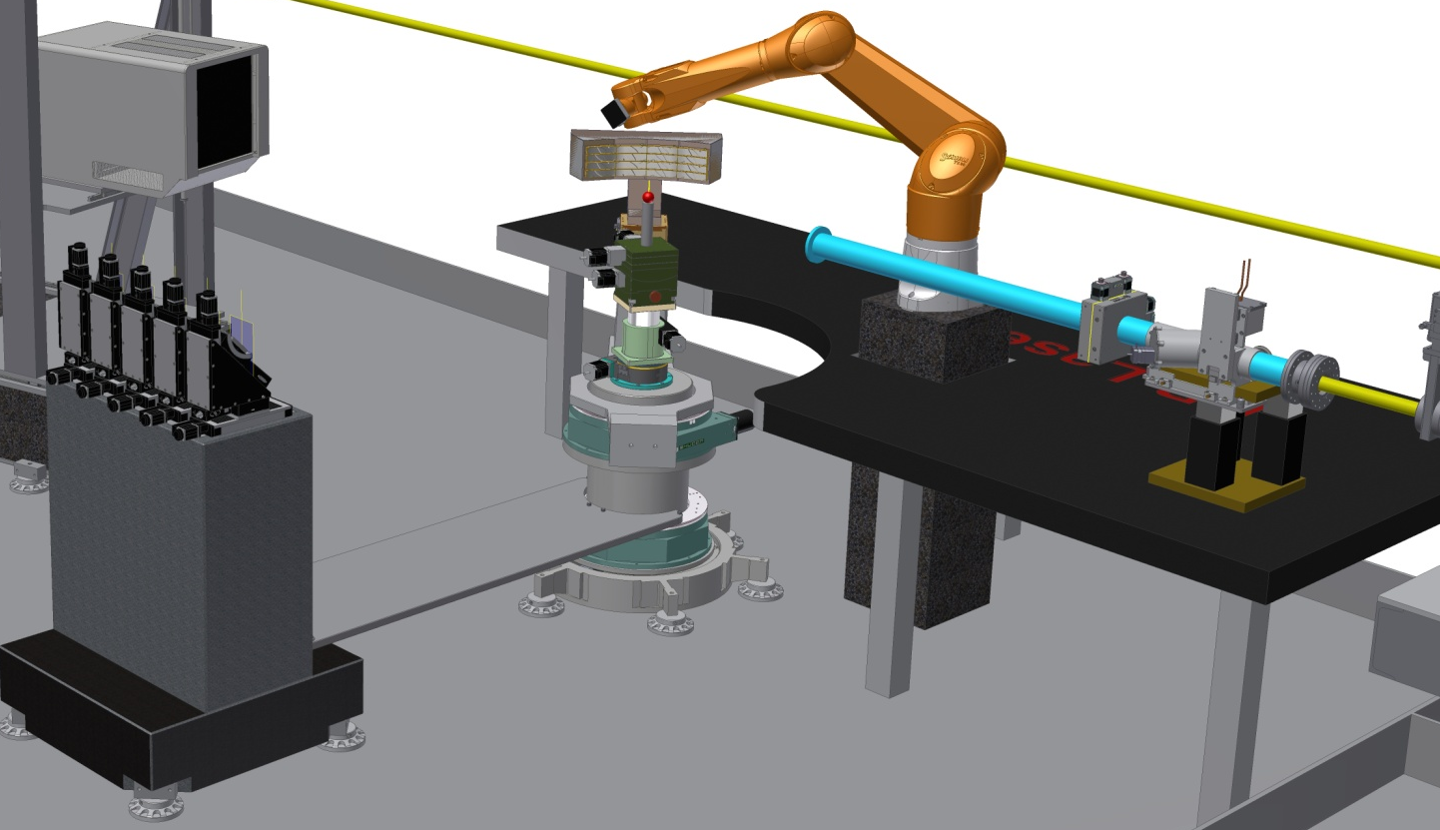
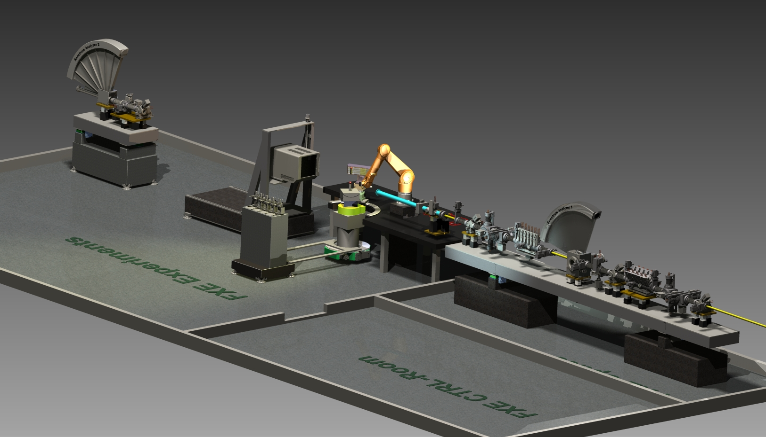
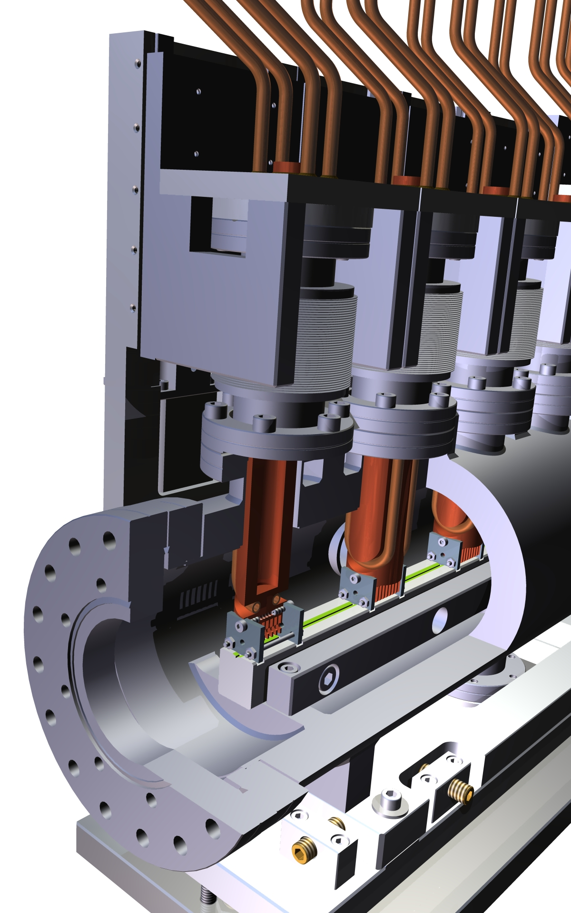
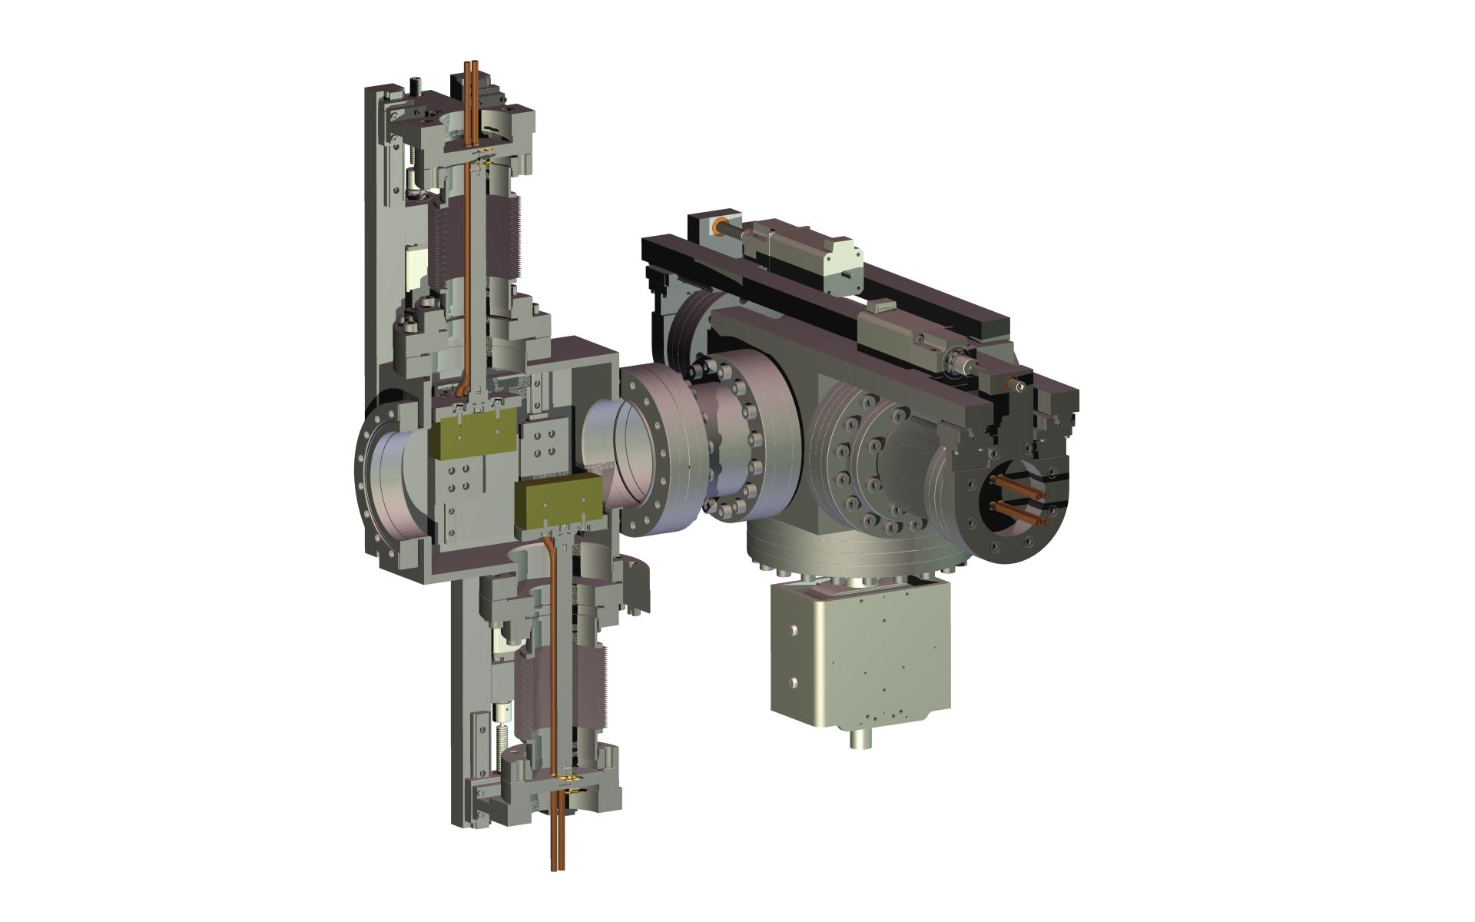
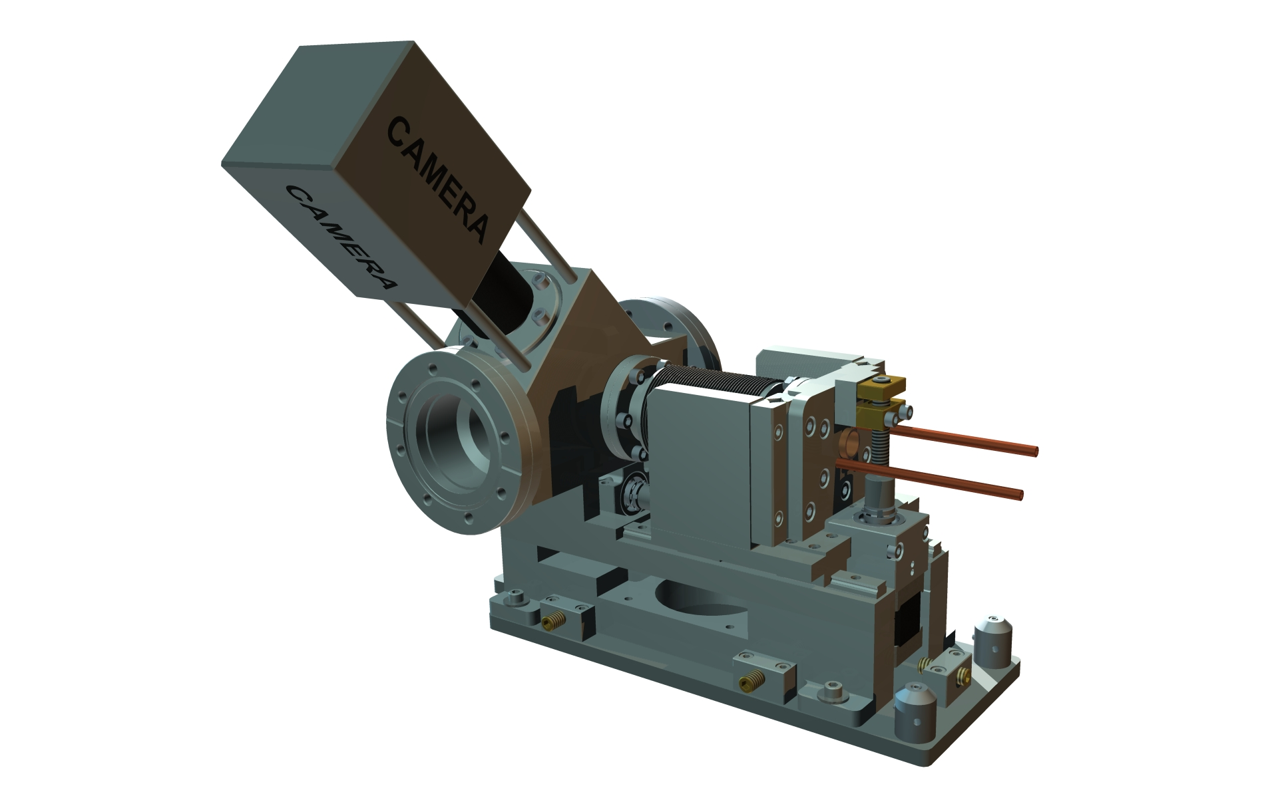
  Example 2: FXE instrument components (DK01)
Will get designs, construction, installation, commissioning
  Tested, documented, characterized
Envisage to harmonize designs to use on other instruments

Slide 21
Examples of IKCs, discussed but not concluded
  X-ray beam transport components
    Several 100 m of vacuum components, pumps (def. type), stands
    Man-power for build-up
    Problem: Cost, time-schedule
  X-ray hutches for scientific instruments
    Steel/lead enclosures, technical design, installation
    Problem: Technical expertise/qualification, time-schedule
  Optical lasers
    Subsystems
    Problem: Technical expertise/qualification
  Provision of personnel
    Skilled engineers, technical staff for installation phase
    Problem: Availability
  Quite often proposed contributions were motivated by scientific interest of contributing institutes aiming to support their research efforts. The project, however, does in general not include the staff provisions to fund such type of projects.

Slide 22
Summary & ‚Lessons learned‘
  Due to the fact that the x-ray systems initially were much less defined and also much more fragmented (no large series) the conclusion of (large) IKC contracts was difficult. Smaller and more specifc contracts exist, using the expertise of partner institutes. The administrative level is sometimes high.
  Budgeted personnel resources are needed to build up experienced staff.
  Lessons learned
    Expertise: Don‘t make compromises when it comes to expertise of partner
    Expertise: Little interest in ‚low-tech‘ contributions
    IKC or contract: several of our partners prefer contract (risk issue)
    Cost: add overhead (10-20 %) for IKCs to project for covering additional work, travel / coordination, overcost

