Slide 1
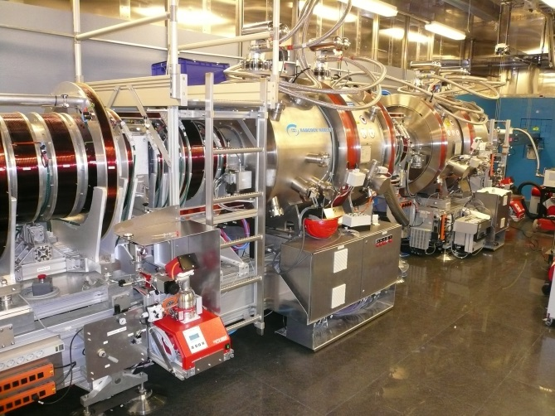
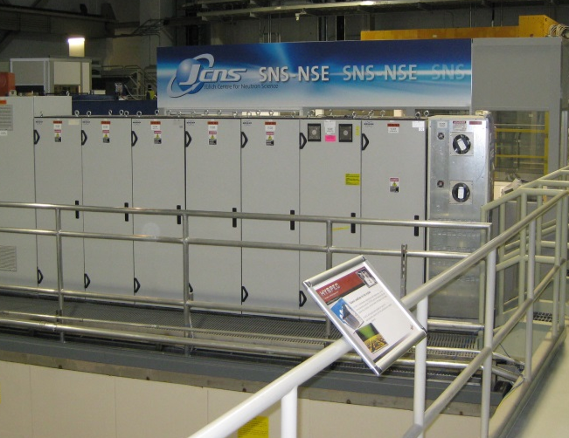
Lessons learned from
developing, installing and commissioning the NSE at SNS
February 25. 2014 | Michael Butzek, ZEA-1, Forschungszentrum Jülich

Slide 2
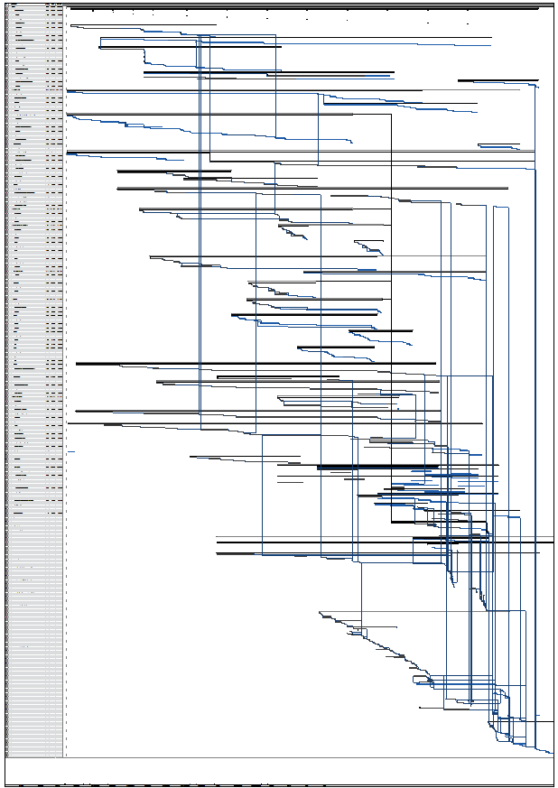
Outline
Background
The NSE for SNS
What is essential for a successful project
General challenges we expected
General challenges we faced
Lessons learned
About 700 task from feasibility study to final operation

Slide 3
Background
Juelich has about 30 years of experience in developing and operating neutron scattering instruments
Neutron Scattering Instruments build by Juelich are operated in Juelich, Munich, (FRM II), ILL, NIST, SNS and CARR (Beijing)
Building and operating instrument components (e.g. choppers) and non-neutron scattering instrument worldwide
Juelich is a multi discipline research center; basically all competencies and faculties are available on campus
Juelich has a set of central institutes with special competencies in mechanical and electrical engineering as well as analytics

Slide 4
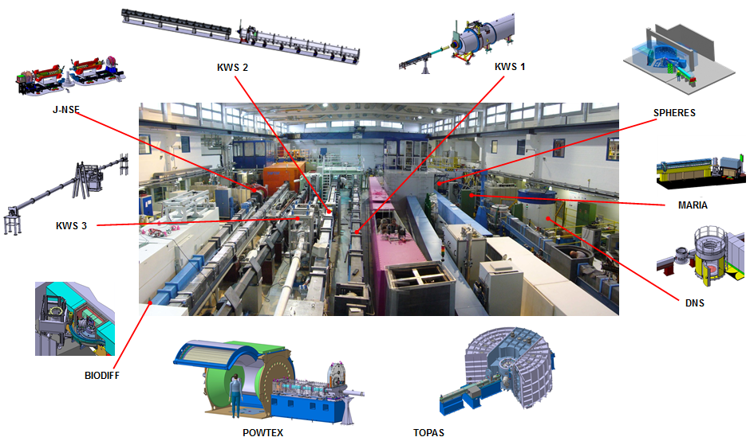
E.g. Juelich Instruments at FRM II (Munich)

Slide 5
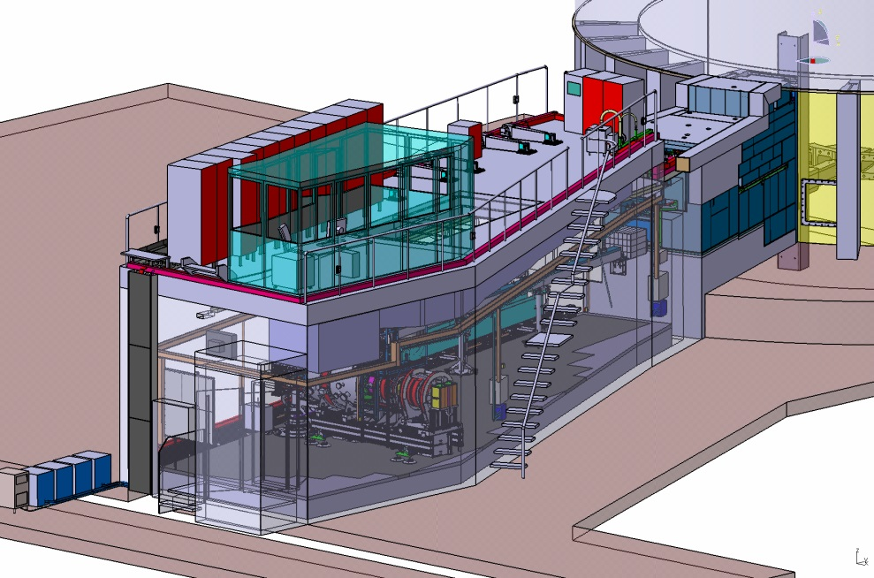
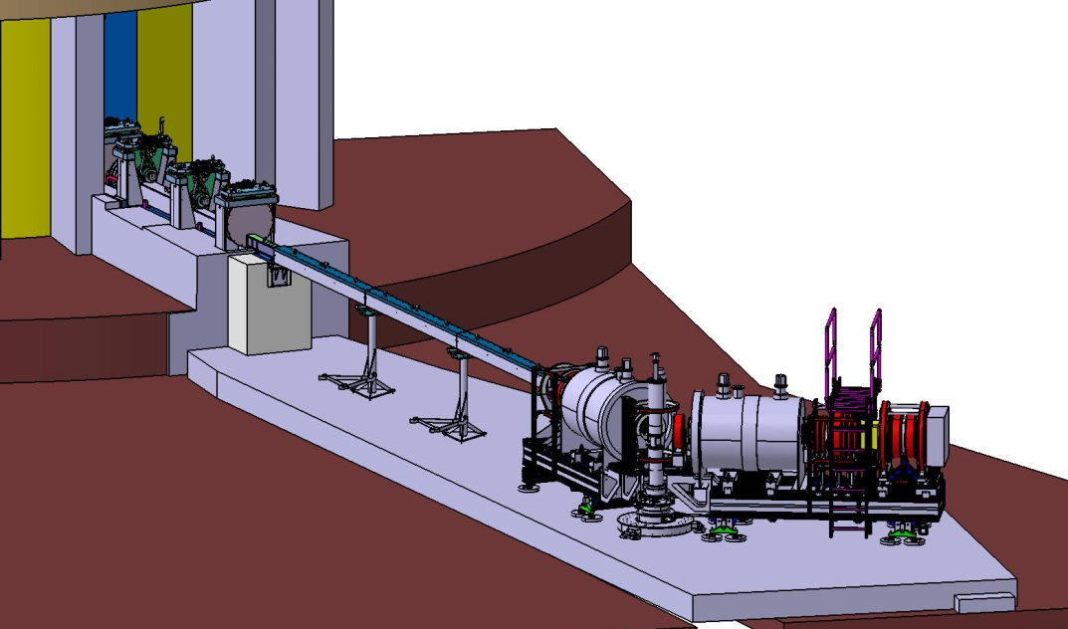
The NSE for SNS
Neutron Spin Echo with superconducting main coils
High current and high precision power supplies
Magnetic and radiation shielded cave (20 m long)
4 chopper system
Revolver containing three different benders and an safety relevant instrument beam shutter
Heavy beam line shielding

Slide 6
Challenges we Expected
Communication over the long distance (Germany – USA)
Went well with modern travel and communication systems
Communication issues due to different language
Language was not the main issue – “cultural difference” was
Dealing with non-european standards and codes
Thanks to the help and patience by SNS – no issue
Coordination with local craft workers
Done by SNS – worked well
Testing and bug-fixes at a “remote” location (long distance)
Worked well as long as firewall was not too much restricting
Working with non-metric units
Unfamiliar to us but not an issue

Slide 7
Challenges we Faced
Fighting (negotiating!) about real estate (only 12.5° sector available for the instrument)
Necessary type and amount of shielding compared to a reactor source
Rules and routines are under development and not established yet at a new facility (although SNS did well and was embedded into the ORNL)
Customs produces

Slide 8
General Tips and Lessons learned
General elements needed to conduct a successful science project
Necessity to define and document interfaces and specifications
Project management (including controlling cost and schedule)
The project team and it´s environment
Procurement issues
Engineering issues specific to a pulsed / spallation source
Issues during installation on site
Issues during commissioning

Slide 9
Conducting a Successful Science Project
You need an experienced technical team with expertise in different fields necessary for the specific type of neutron scattering instrument
Project coordination
Dealing with different vendors
High precision machining
Vacuum technology
Detector technology
Simulation techniques (structural, magnetic, fluid dynamics, …)
Control systems (scientific instrument controls, safety relevant interlocks, …)
…

Slide 10
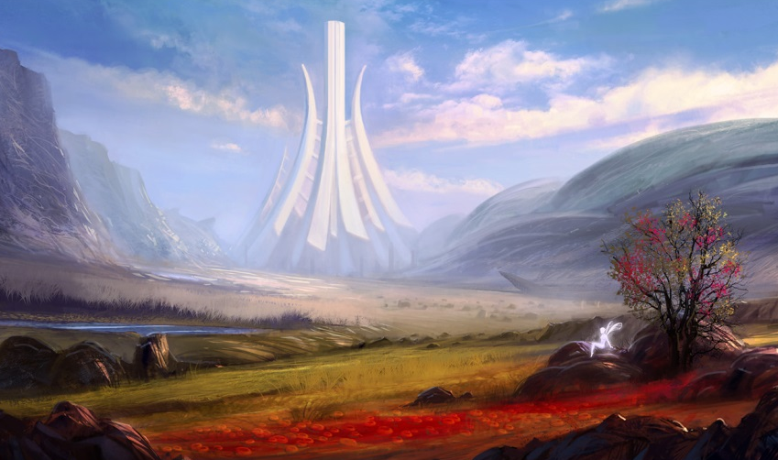
Conducting a Successful Science Project (II)
Experience in interacting with the science community (most engineers from regular companies are not used to that).
Engineers need to be “embedded” in / have direct contact to the scientist. Contact needs to be on a days working base rather than “formal”
Finding the balance between “free scientific thinking” and engineering necessities like freezing parameters, freezing the design, looking after schedule and cost, etc.
A good administrative background for project controlling

Slide 11
Conducting a Successful Science Project (III)
Lessons we learned with the NSE-SNS project
Having the whole project team as well as other colleagues with experience in developing neutron scattering instruments components available on campus was very helpful.
Having most necessary technologies on campus (classic work shop, special joining techniques, PLC and detector electronic experts, …)
During design phase, face to face meetings every 2-3 month are essential. The rest can be done by email or videoconference.
Approaching construction phase, having an experienced engineer on side, familiar with local peculiarities helped speeding up construction.

Slide 12
Define and Document Interfaces and Specs
Define technical scope (can change throughout the project but you must be aware of that)
Define interfaces. Both internal and external to the instrument. External interfaces are very important to be clearly defined!!!
Lessons we learned with the NSE-SNS project
Although SNS did a very good job in trying to establish rules and routines in the beginning, these rules and routines changed/developed over time (SNS was a new facility).
Interfaces for such a complex project at a new facility are moving targets. Make sure to establish good communication so everybody is “on the same page”.

Slide 13
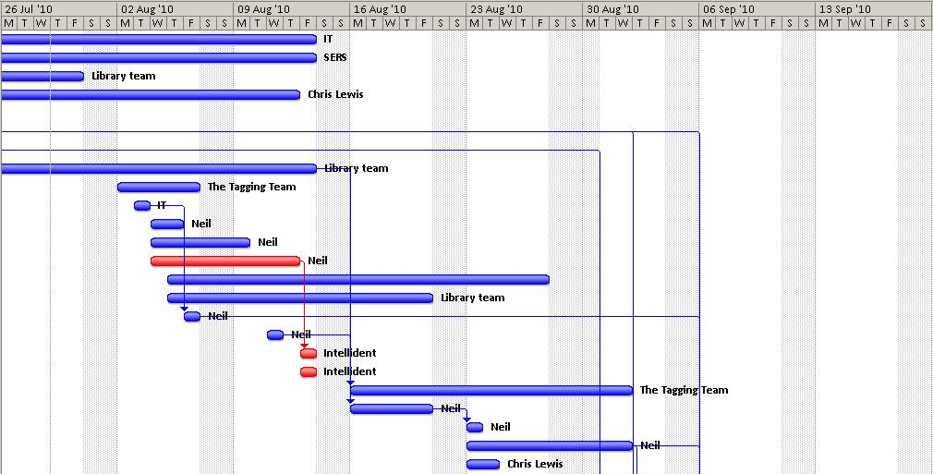
Project Management
Experience in managing scientific engineering projects is essential. (Project plan for NSE for SNS had > 700 tasks)
Project management should be done by engineers while scientist remain focused on the scientific part of the project.
Lessons we learned with the NSE-SNS project
We benefit greatly from our > 30 years of experience in managing scientific engineering projects (of all kind).

Slide 14
The Project Team and it´s Environment
It is important to:
have direct access to experienced (old) engineers and scientist.
have direct access to various engineering technologies.
be embedded in a grown structure (campus)
have good contact to engineers on site (SNS)
Lessons we learned with the NSE-SNS project
Being embedded inside the Juelich engineering/scientific infrastructure was essential for success.
Contact to engineers on site needs frequent traveling but was less problematic than expected.
Approaching construction having a dedicated “local” with good connections to local workshops was very important.

Slide 15
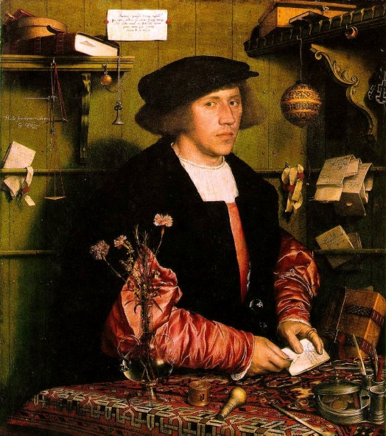
Procurement Issues
Dedicated procurement staff that is familiar with the project and project schedule
Procurement staff with expertise in scientific projects as well as world wide procurement and knowledge about local procurement rules.
Purchase high risk items earlier than needed.
Work closely with vendors. Especially on technological challenging items. Sometimes vendors simply underestimate the challenges.
Lessons we learned with the NSE-SNS project
Juelich procurement department was of great help.
E. g. purchase order for non magnetic hexapods. Lead time given by vendor 9 month. Final delivery time > 3 years.

Slide 16
Engineering Issues Specific to a Pulsed / Spallation Source
Lessons we learned with the NSE-SNS project
Space (real estate) is always short. Even building an instrument on a 12.5° sector we had to fight for each centimeter. SNS installed a “space allocation committee” that took care of boundary disputes.
Necessary shielding will always be thicker and more heavy than you thought… and more expensive too.
Access to components close to the monolith is very difficult. Plan for high-reliability components and expect longer shut downs for repair.
Instrument control and data acquisition had to be triggered to an external clock. Precise definition about hardware and protocols is important.

Slide 17
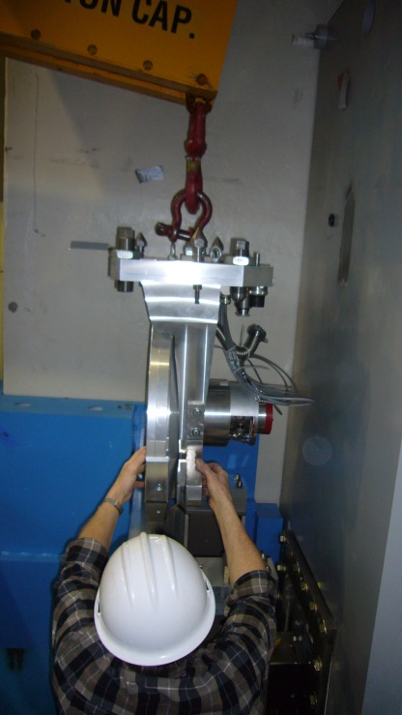
Issues During Installation on Site
Local installation team must coordinate all activities on site (more than just one instrument will be build simultaneous)
Often different activities are fighting for priorities.
Have at minimum one workshop on-site and good (quick) access to further local workshops
Plan space for storage of delivered components (and make sure you find them when you need them)
Plan space for cold testing delivered components.
Plan ahead necessary power and media supply
Have installation drawing and documents complete before installation.
Update drawings (as build drawings)

Slide 18
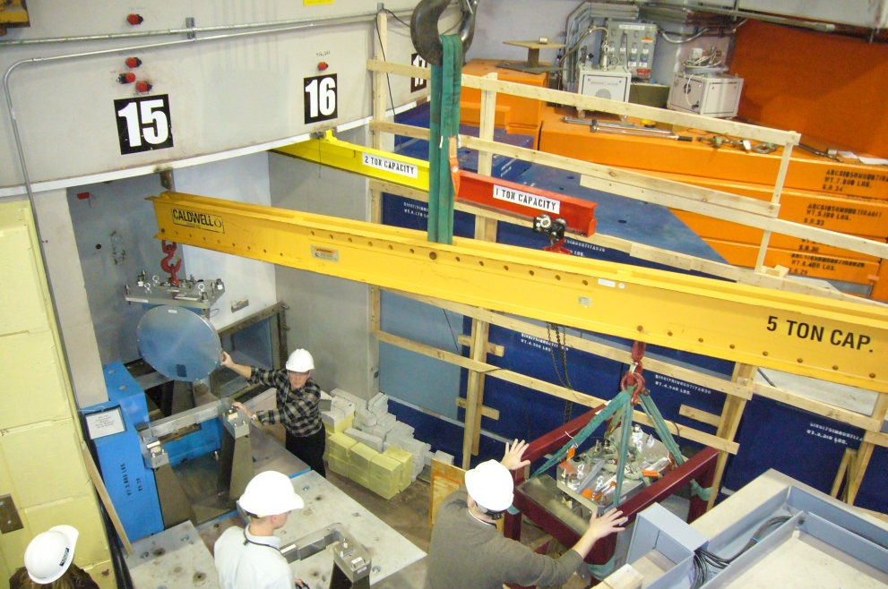
Issues During Installation on Site (cont.)
Lessons we learned with the NSE-SNS project
Local management of installation is essential.
Close collaboration of installation crew and instrument development team is important. Install procedures for regular, frequent feedback.
Coordination of installation resources and task must be done on-site. Fight for resources most time limits progress.
Most limiting resource on site: CRANE!!!!!!!

Slide 19
Issues During Commissioning
The project is not completed when the instrument is installed. Allow enough time for commissioning.
Same scientist who developed the instrument should commination it and start initial user operation.
Same engineering team that developed the instrument needs to be available during commissioning phase.
Lessons we learned with the NSE-SNS project
Every feature that can be “simulated” should be tested on campus before shipping the instrument. We tried hard but still found issues on site.
Allow for remote service and bug-fixing safes a lot of time and resources. Don´t blog remote access by overdo firewall-protection.

Slide 20
Lessons Learned for ESS
At least from time of construction on, have a local contact / care person (100% dedicated to this instrument) on site with engineering background
Space for instrument, temporary and long term storage as well as cold testing on site needs to be provided by ESS.
Communication between a remote Instrument development team and ESS needs attention but seems feasible if properly managed

Slide 21
Thank you for
your attention

