Slide 1
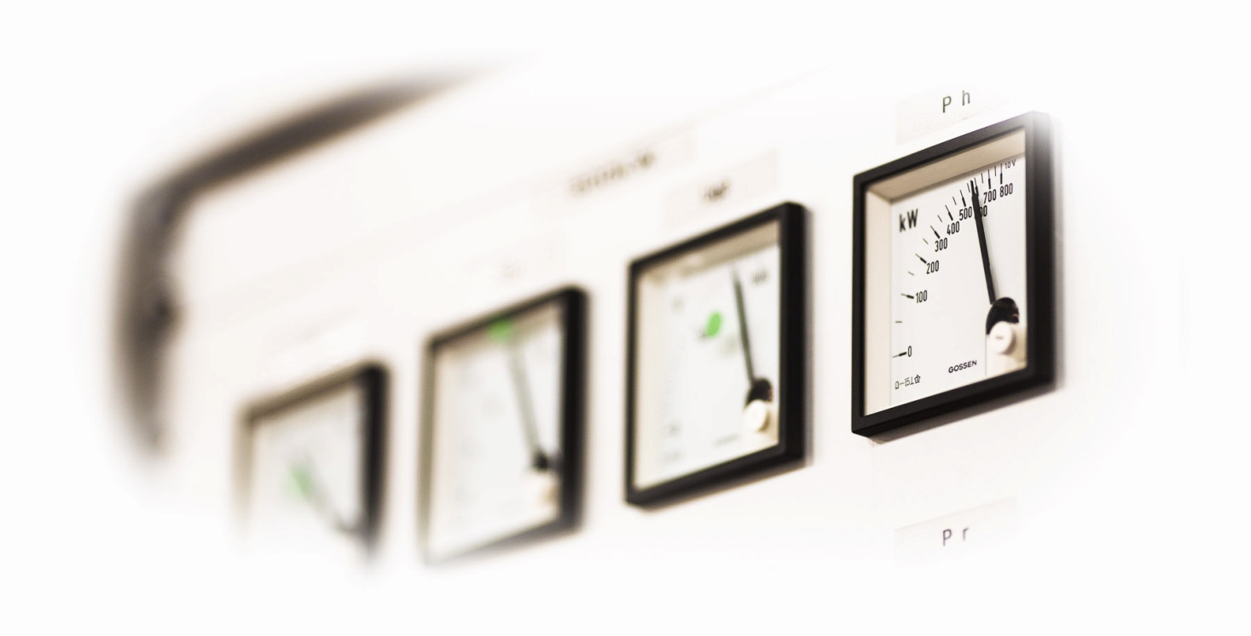
EnEfficient – a networking activity for particle accelerators
M.Seidel, PSI
EuCARD-2 Workshop on Cooling and Heat Recovery, Lund, April 28-29, 2014

Slide 2
Integrating Activity Project for coordinated Research and Development on Particle Accelerators, 2013-17
Management and Communication
WP1: Management and Communication (MANCOM)
Networking Activities
WP2: Catalysing Innovation (INNovation)
WP3: Energy Efficiency (EnEfficient)
WP4: Accelerator Applications (AccApplic)
WP5: Extreme Beams (XBEAM)
WP6: Low Emittance Rings (LOW-e-RING)
WP7: Novel Accelerators (EuroNNAc2)
Transnational Access
WP8: ICTF@STFC
WP9: HiRadMat@SPS and MagNet@CERN
Joint Research Activities
WP10: Future Magnets (MAG)
WP11: Collimator Materials for fast High Density Energy Deposition (COMA-HDED)
WP12: Innovative Radio Frequency Technologies (RF)
WP13: Novel Acceleration Techniques (ANAC2)

Slide 3
Motivation for EnEfficient
worldwide scarcity of resources and climate change also impacts research facilities and is of great political importance
[e.g. Swiss “Energiestrategie 2050”:
public institutions asked to reduce by 20% till 2020 …]
next generation accelerator facilities provide a new quality of research opportunities, but often connected with a new quality of energy consumption as well
[EuroXFEL, FAIR, ESS, LHeC, FCC, ILC, CLIC, Project-X …]
→ wee need to intensify our efforts to optimize the energy efficiency of accelerator systems

Slide 4
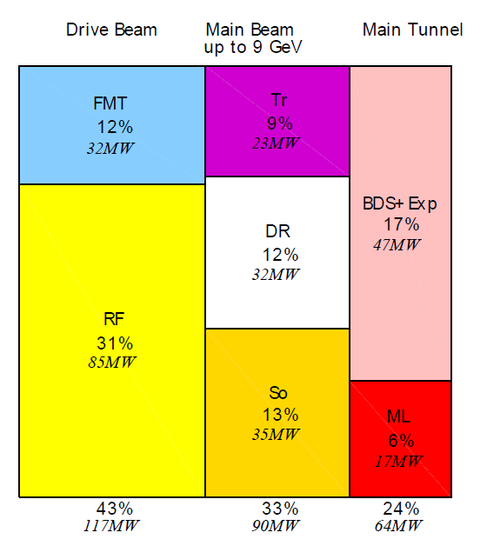
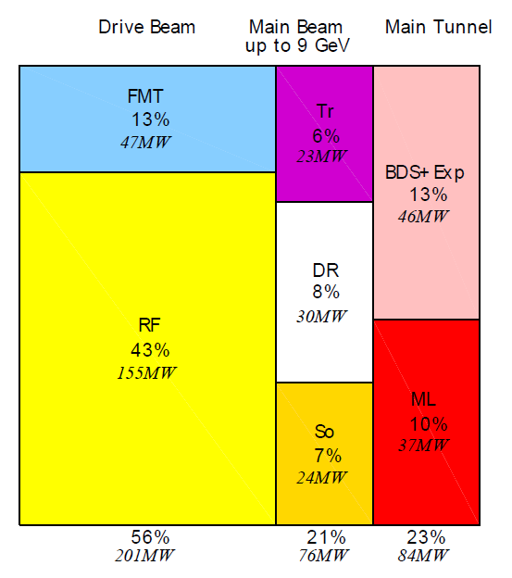
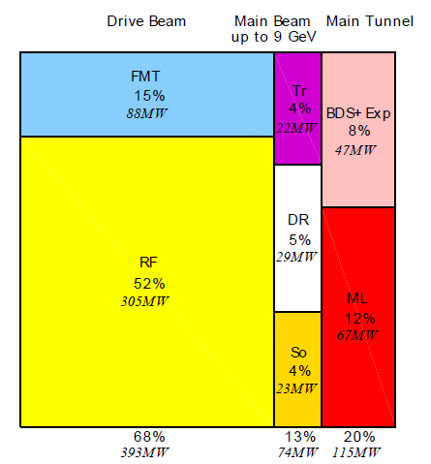
CLIC CDR power consumption by WBS domain
Power consumption of ancillary systems ventilated pro rata and included in numbers by WBS domain
500 GeV A
Total 272 MW
1.5 TeV
Total 364 MW
3 TeV
Total 589 MW
RF: drive beam linac, FMT: frequency multiplication & transport, So: sources & acceleration up to 2.5 GeV, DR: damping rings, Tr: booster linac up to 9 GeV & transport, ML: main linacs, BDS: beam delivery system, main dump & experimental area

Slide 5
Powerflow in Accelerator Facilities
rare: direct application:
p-therapy
isotope production
public GRID
Accelerator
Radio Frequency
Magnets
Vacuum etc.
beam
conversion to secondary radiation (beam collisions, targets, undulators …)
secondary radiation
exotic particles, e.g. Higgs, B-mesons
synchrotron radiation
neutrons
muons
Auxiliary systems
cryogenics
conv. cooling, AC etc.
Instruments
e.g. particle detectors
finally all converted to waste heat !
figure of merit:
secondary particles, X-rays on sample, destroyed cancer cells …
per KWh

Slide 6
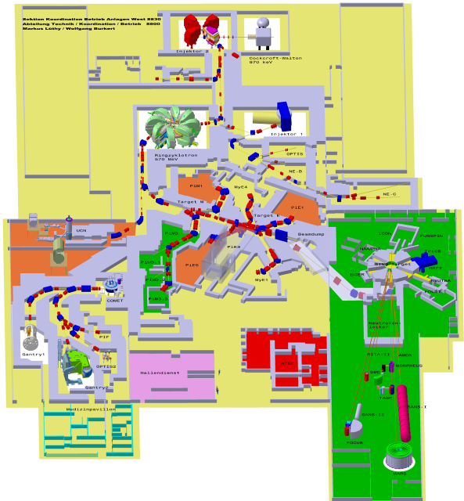
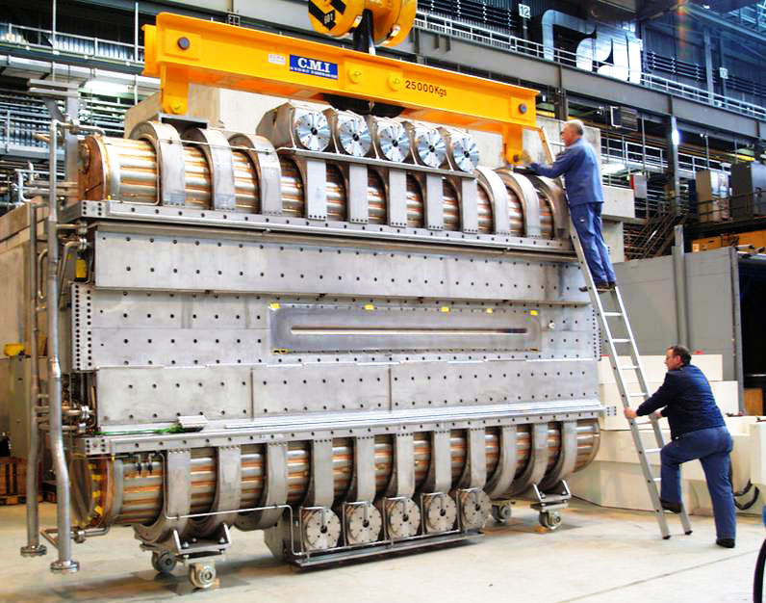
Example: PSI Facility, 10MW
Muon production targets
Ring Cyclotron 590 MeV
loss ≈ 10⁻⁴
Power transfer through
4 amplifier chains
4 resonators 50MHz
SINQ
spallation source
2.2 mA /1.3 MW
50MHz resonator
proton therapie center [250MeV sc. cyclotron]
dimensions:
120 x 220m²

Slide 7
Example: PSI-HIPA Powerflow
Efficiency of RF:
0.90 (AC/DC) × 0.64 (DC/RF) × 0.55 (RF/Beam) = 32%
n: per beamline:
10¹³s⁻¹@ 10eV ≈ 20µW
public grid ca. 10MW
RF Systems 4.1MW
Beam on targets
1.3MW
neutrons
μ⁺: per beamline
5·10⁸s⁻¹ @ 30MeV/c
≈ 300µW
muons
Magnets
≈ 2.6MW
focus of EnEfficient:
energetic efficiency of typical accelerator systems
energy storage/intelligent use
energy recovery
aux.Systems
Instruments
≈ 3.3MW
cryogenics
heat → to river, to air

Slide 8
tasks within EnEfficient
task 1: energy recovery from cooling circuits, Th.Parker, E.Lindström (ESS)
[→ this workshop, survey of European Labs, applications of heat, T-levels etc.]
task 2: higher electronic efficiency RF power generation, E.Jensen (CERN)
[workshop Daresbury in June, e.g. Multi Beam IOT’s]
task 3: short term energy storage systems, R.Gehring (KIT)
[non-interruptable power, short term storage, wide spread of time scales …]
task 4: virtual power plant, J.Stadlmann (GSI)
[adaptation of operation to grid situation – context renewables…, possibly backup power generator …]
task 5: beam transfer channels with low power consumption, P.Spiller (GSI)
[pulsed magnets, low power conventional magnets, permanent magnets, parameter comparison etc.]

Slide 9
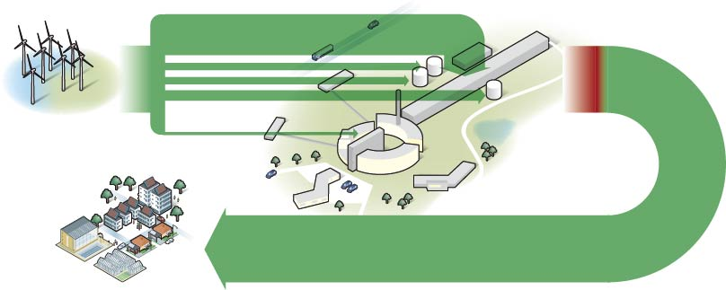
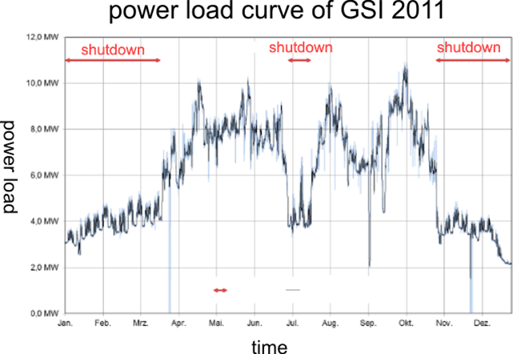
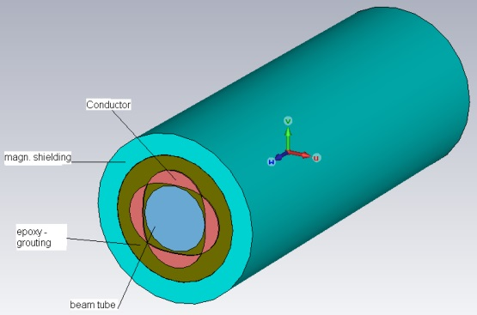
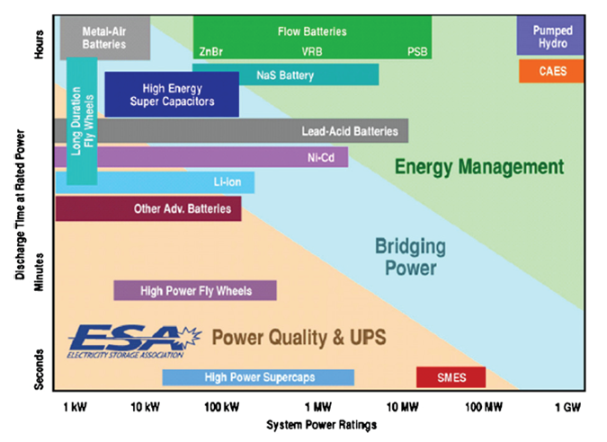
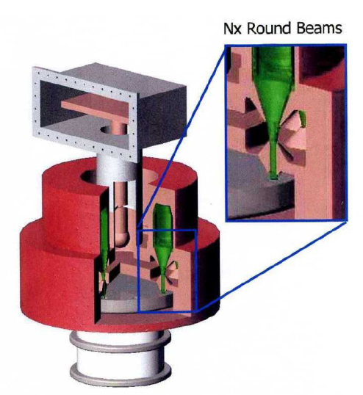
EnEfficient examples
need for energy management
heat recovery at ESS
energy storage systems
pulsed quads [GSI]
multi-beam IOT by company CPI

Slide 10
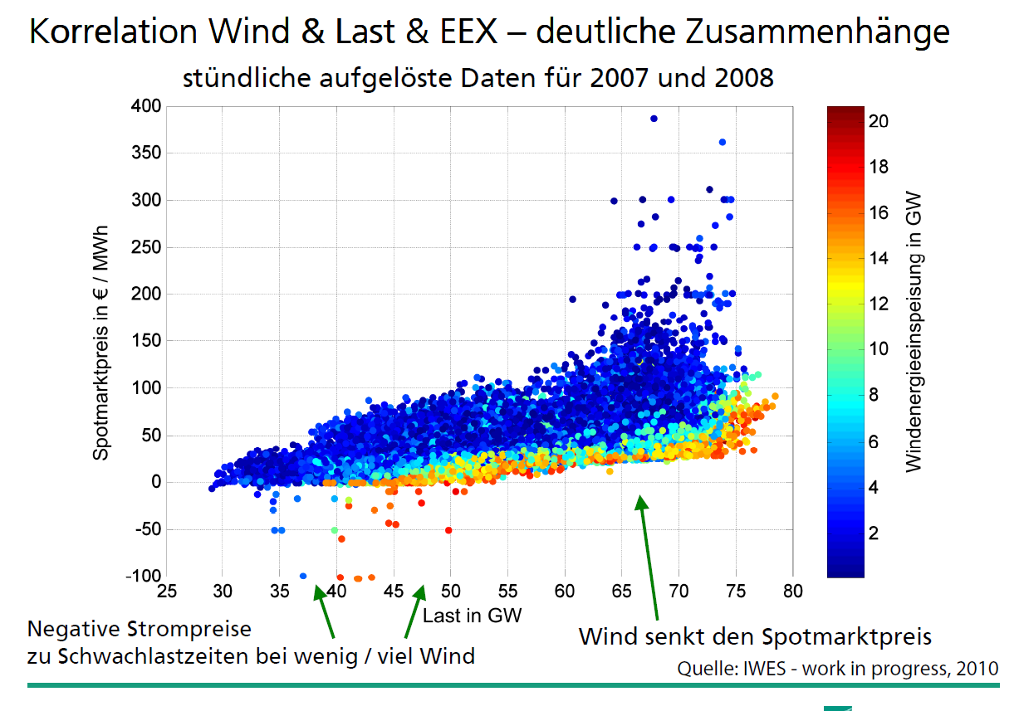
energy spot market prices → energy managment, virtual power plant
renewables cause strong variations
Impact on accelerators?

Slide 11
EnEfficient: summary and outlook
EnEfficient is a new networking activity related to efficient utilization of electrical power in accelerator based facilities
at present participating institutes and interested partners: CERN, ESS, GSI, KIT, PSI, DESY
next workshops:
May 19-21, 2014 - Annual Eucard-II Meeting at DESY in Hamburg: More Information: http://eucard2.web.cern.ch/content/annual-meeting-desy
June 3-4, 2014 - Workshop on EnEfficient RF Sources, organized at Cockroft Institute in Daresbury More Information: https://indico.cern.ch/conferenceDisplay.py?confId=297025
November 26-28, 2014: Compact and Low Consumption Magnet Design for Future Linear and Circular Colliders, at CERN.
interested colleagues are very welcome to participate in this network
information and contact under: www.psi.ch\enefficient

