Slide 1

Instruments &
Moderator Optimization
Ken Andersen
SAC 10
6 February 2014

Slide 2
Flattened Moderators
Baseline
Flattened

Slide 3
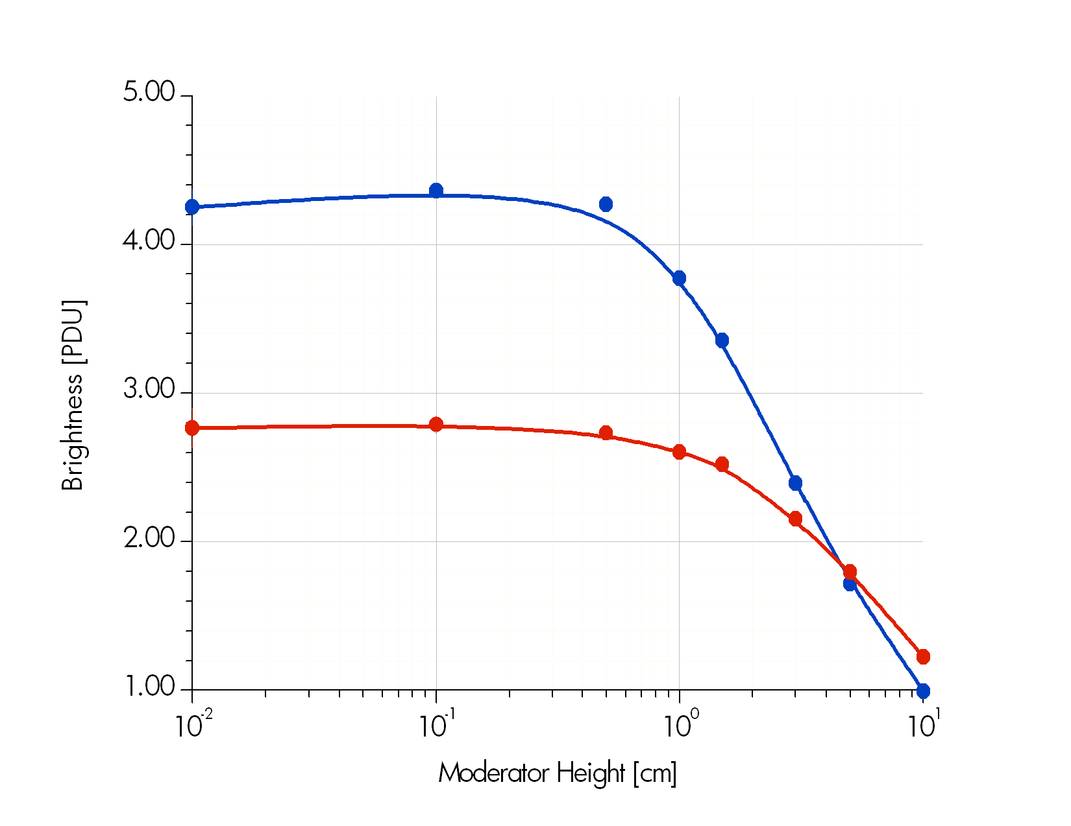

Flattened Moderators
4x10¹³ n/cm²/s/sr
H₂ mod, 0-5meV integral
2cm H₂O, 20-100meV integral
1 PDU = 1.75x10¹² n/cm²/s/sr/MW

Slide 4
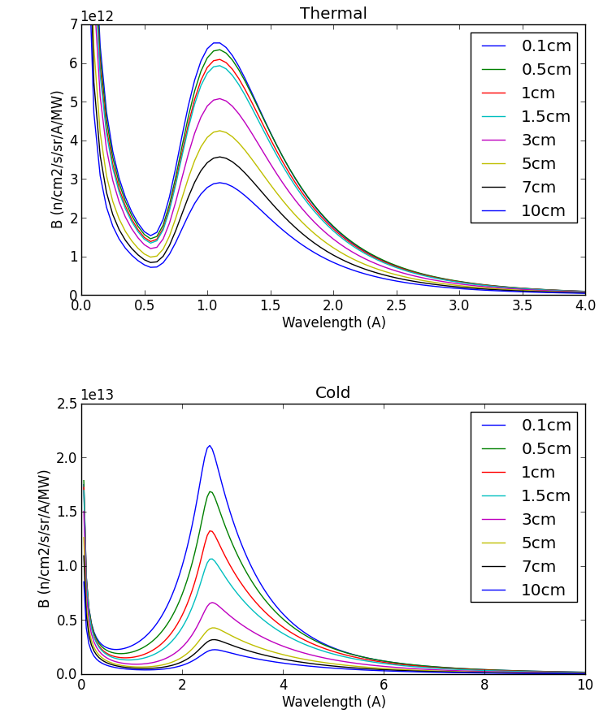
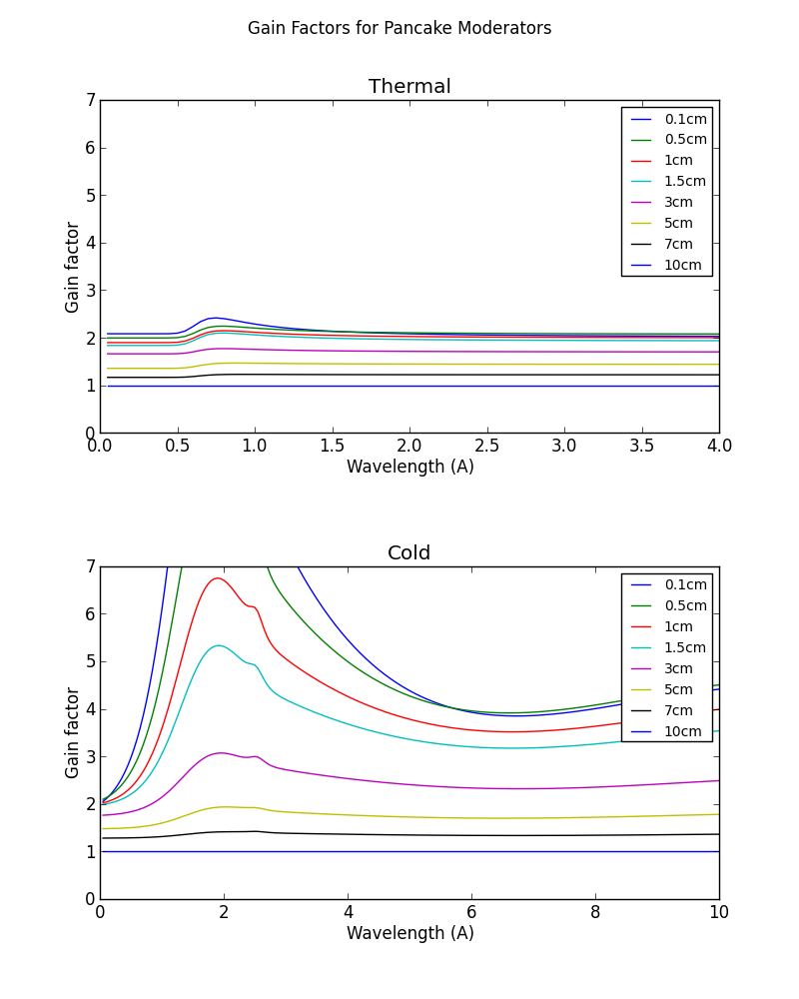
Brightness Gains
Thermal
Thermal
Brightness
Brightness Gain
Cold
Cold

Slide 5
Guide_Bot McStas Optimisation
Mads Bertelsen (Kim Lefmann)
Copenhagen University

Slide 6
Guide_Bot McStas Optimisation

Slide 7
The Reference Instrument Suite

Slide 8
Instrument Optimisations (1/3)
Large-Scale Structure Instruments

Slide 9
Instrument Optimisations (2/3)
Diffraction Instruments

Slide 10
Instrument Optimisations (3/3)
Inelastic Instruments

Slide 11
Example: PowHow Diffractometer

Slide 12
Plan of action for instrument optimization
FoM
N
22 x
A
B
h
h
Instrument results by 28th of January
  update reference suite
Big coordination meeting 12th of February
  agree on remaining work
Freeze moderator design by end-April
  arrive at global optimum for all instruments
  arrive at new reference suite layout

Slide 13
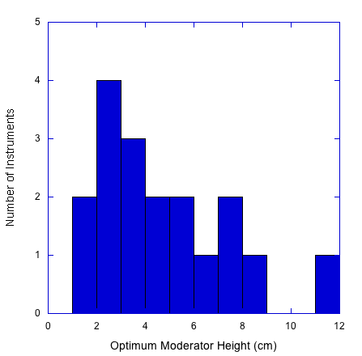
Preliminary Results

Slide 14
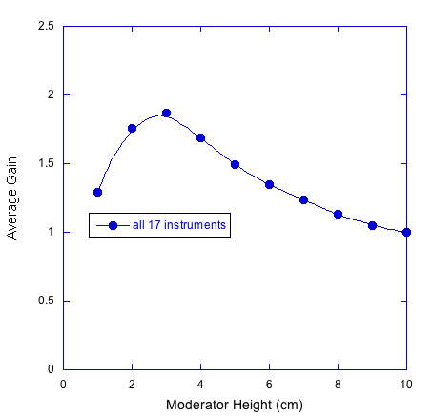
Preliminary Results

Slide 15
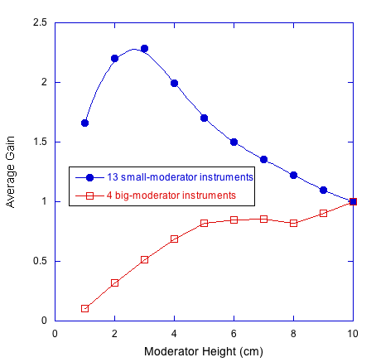
Preliminary Results

Slide 16
Optimising Reference Suite layout:
- constrained by building layout

Slide 17
Baseline layout
12cm height
12cm height

Slide 18
Possible layout with 1 moderator
3cm height
6cm height

Slide 19
Possible layout with 2 moderators
2cm height
7cm height

