Slide 1

ESS
Status of Fundamental Physics @ ESS
C. Theroine

Slide 2
Introduction
With the ESS, major progress in FP is achievable thanks to :
The high neutron intensity.
The pulse time structure.
The possibility to optimize the facilities during the design phase.
1st STAP meeting for FP : 16/12/2013.
Determine scientific opportunities at the ESS.
3 different categories of experiments have been discussed

Slide 3
Contents
Single beam experiments
High intensity cold neutron beam + large area moderator.
Wide beam experiments
Maximum neutron flux integrated over both area and divergence + large area moderator + large extraction channel in the shielding monolith.
Through tube experiments
Access to a volume with the very highest neutron density thanks a through going tube inside the moderator reflector system.

Slide 4
Single beam experiments
Physics program
Lifetime
Neutron decay
Standard Model of particle physics (SM)
Correlations coefficients
nEDM
Properties of the neutron
Precision experiments
Neutron charge
Neutron as a quantum wave
Neutron interference
Beyond SM
Gravity
Short-range forces
Nucleon nucleon interaction
Hadronic parity violation with neutrons

Slide 5
Example : PERC
Atominstitut, TU Wien
Hartmut Abele
Jacqueline Erhart
Harald Fillunger
Christoph Gösselsberger
Miklos Horvath
Erwin Jericha
Gertrud Konrad
Reinhard Maix
Xiangzun Wang
Physikalisches Institut, Universität Heidelberg
Dirk Dubbers
Henry Lopez
Bastian Märkisch – spokesperson
Holger Mest
Lukas Raffelt
Nataliya Rebrova
Christoph Roick
Ulrich Schmidt
Carmen Ziener
PERC collaboration
2015/2016 FRMII
ILL
Christine Klauser
Torsten Soldner
Oliver Zimmer
FRM II
Jens Klenke
Thorsten Lauer
Heiko Saul
Universität Mainz
Marcus Beck
Werner Heil
‘’The new instrument PERC is designed to improve the sensitivity of neutron decay studies by one order of magnitude’’.

Slide 6
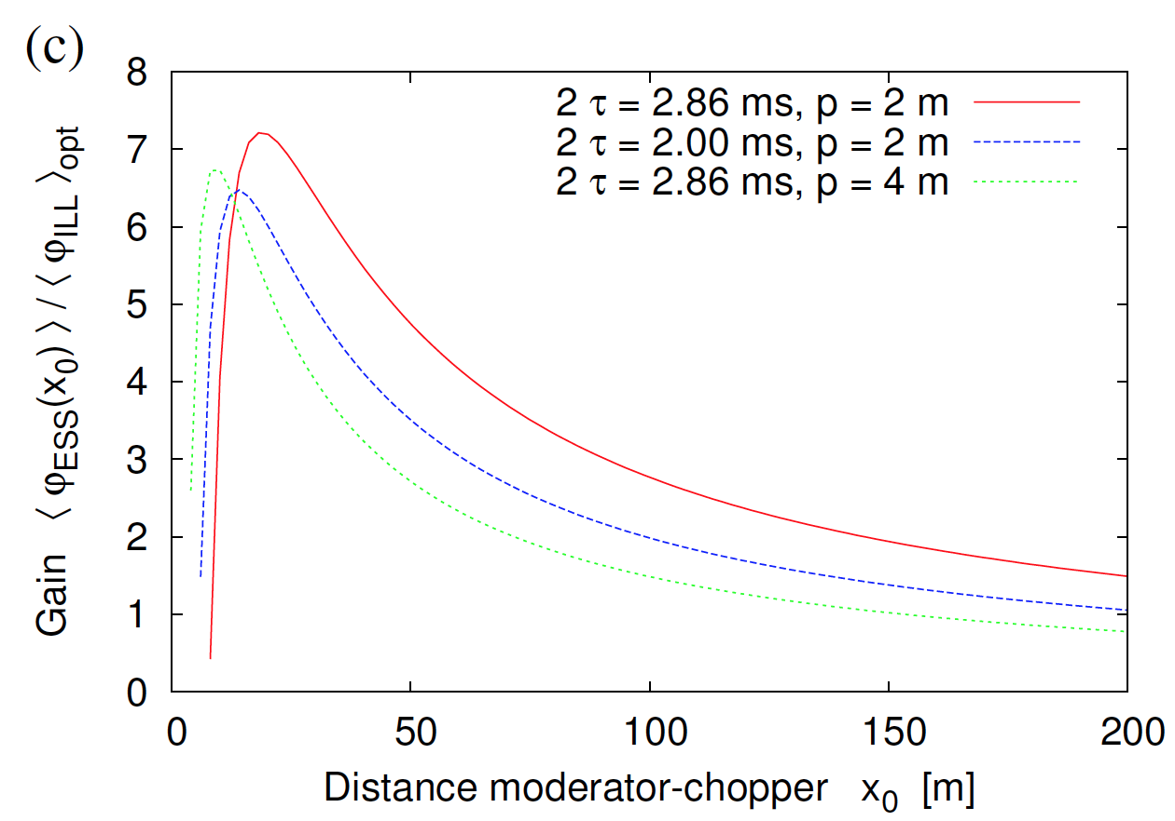
Example : PERC @ ESS ?
e,p
selector
Polarizer
Chopper
Decay volume : 8m
Set-up for
PERC @ ESS
neutrons
Spin flipper
detector
systems
C.Klauser et al.
(proceeding for npp@lps 2013)
Benefit in term of flux for
PERC @ ESS

Slide 7
Example : PERC @ ESS ?
Very preliminary

Slide 8
Example NPDγ
n + p → d + γ
Why ? to measure the parity-violating asymmetry Aγ. The significance of this asymmetry is that its size is a direct measure of the strength of the hadronic weak interaction between nucleons.
How ? Asymmetry of γ emission after capture of polarized neutrons in H₂
Average beam
polarization

Slide 9
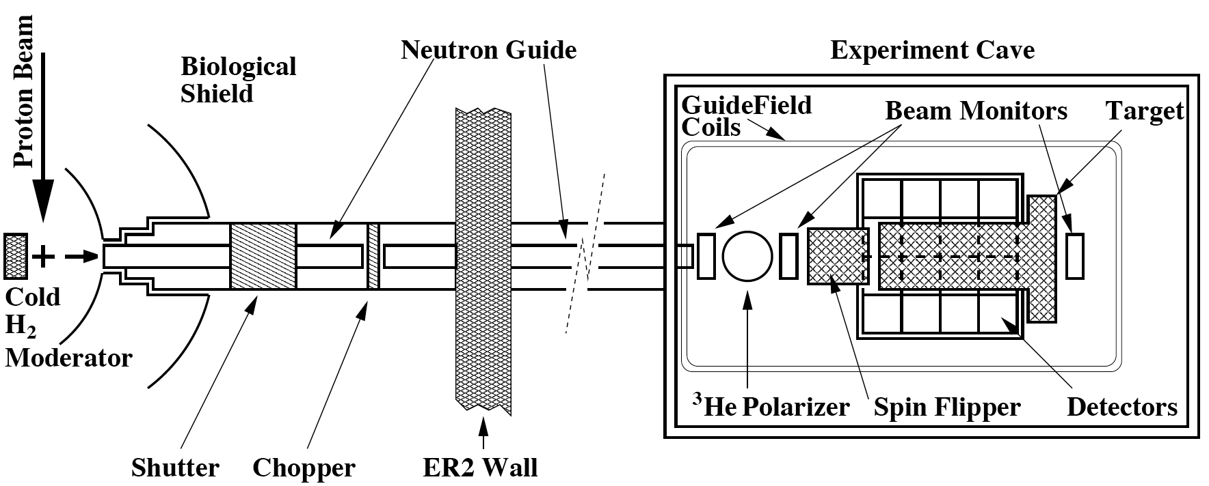
Example NPDγ
³He cell : n polarization
Experimental layout @ LANSCE
Chopper : Frame overlap
Pulsed neutron source : to know the neutron time of flight or energy accurately.
Benefit in term of systematic study for NPDγ @ ESS
  Pulsed structure useful to suppress some instrumental systematic effects.

Slide 10
Example : NPDγ @ ESS ?
Very preliminary

Slide 11
Single beam experiments
Requirements:
Moderator that is optimized for the highest integrated cold flux.
A high total neutron intensity.
Lowest achievable background.
A neutron guide coated with supermirrors and with large cross section.
A large experimental area.
Temperature stabilization.
Appropriate floor load, crane capacity, electrical power, water, high-pressure air …

Slide 12
Contents
Single beam experiments
High intensity cold neutron beam + large area moderator.
Wide beam experiments
Maximum neutron flux integrated over both area and divergence + large area moderator + large extraction channel in the shielding monolith.
Through tube experiments
Access to a volume with the very highest neutron density thanks a through going tube inside the moderator reflector system.

Slide 13
Wide beam experiments
Physics program
Gravitational level spectroscopy
Standard Model of particle physics (SM)
Beam UCN source
nEDM
Neutron decay
Precision experiments
Neutron charge
Neutron antineutron oscillations
Beyond SM
Gravity
Short-range forces

Slide 14
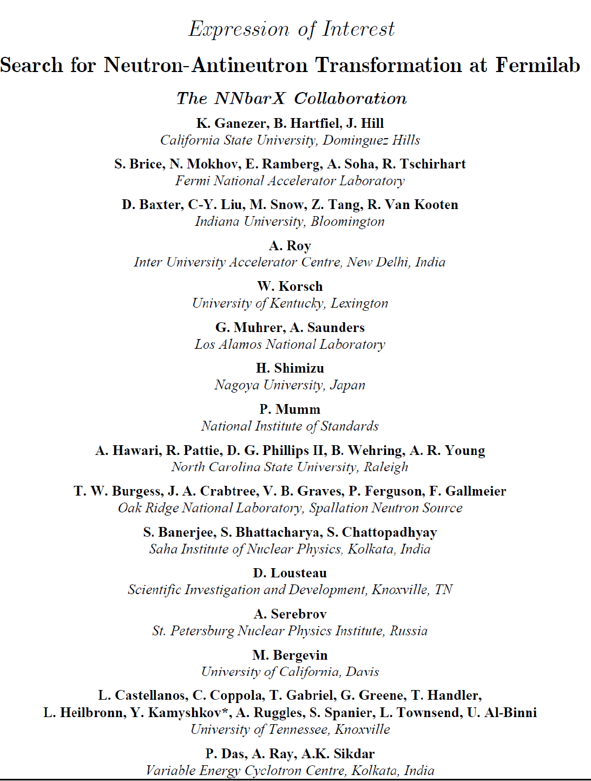
nnbar experiment
Origin of Matter in the Universe
Observation of nnbar oscillations
Nobel prize level discovery
OR
No observation of nnbar oscillations
Improvement of the current limit to explain Baryon Asymmetry of the Universe (BAU)

Slide 15
nnbar experiment @ ESS ?
observe neutrons propagating in free space for a maximum of time without wall collisions
wide beam
port
Detector
Large
moderator
Horn-shaped supermirror reflector with a high m
Long direct flight path (> 200m)
high vacuum
must be protected from
magnetic fields + radiation

Slide 16
Sensitivity Simulation Parameters
Z₀
m
2×RTARG
Cold
Moderator
Δθ
2×BTUB
Z_{m}
Y_GRAV
ZTARG
ESS TDR baseline cold moderator geometry and spectrum (dia 30 cm in PX)
Z₀ – distance of reflector start (1.5 m)
Z_{m} – distance of reflector end (40 m)
m – supermirror reflector parameter (m=6)
ZTARG – distance moderator-detector = 2×large demi-axis (200 m)
RTARG – radius of the annihilation detector (1 m)
BTUB – small demi-axis (~ linearly related to Δθ - angular occupancy) (2 m)
Y_GRAV – neutron gravity fall (detector vertical offset) (‒0.45 m)
Y. Kamyshkov / UT

Slide 17
Moderators assumed
TDR Baseline 100% ParaH2
full view of half-cylinder
with 16(dia) × 13 cm²
Dia 16 cm
H13 cm
 TDR Baseline 100% ParaH2
limited central view 12×12 cm²
12 cm
TDR Flat 100% ParaH2, double
brightness, 15(dia) ×1.4 cm²
Dia 15 cm
Y. Kamyshkov / UT

Slide 18
Comparison of moderator options
Moderator Configuration | Sensitivity in ILL Units per year
TDR Baseline 100% ParaH2, full view of half-cylinder with 16(dia) × 13 cm² | 686
 TDR Baseline 100% ParaH2 limited central view 12×12 cm² | 522
TDR Flat 100% ParaH2, double brightness, 15(dia) ×1.4 cm² | 155
Δθ=10°; Z₀ = 10 m ; Z_{m} = 50 m ; ZTARG = 200 m ; RTARG = 1 m ; m=6 ; BTUB = 2.0
Y. Kamyshkov / UT

Slide 19
Beam UCN source @ ESS
Horn-shaped reflector
External UCN source with a large cold superfluid helium converter.
Big production volume for UCN
wide beam
port
Large
moderator
Horn-shaped supermirroir reflector with a high m

Slide 20
Contents
Single beam experiments
High intensity cold neutron beam + large area moderator.
Wide beam experiments
Maximum neutron flux integrated over both area and divergence + large area moderator + large extraction channel in the shielding monolith.
Through tube experiments
Access to a volume with the very highest neutron density thanks a through going tube inside the moderator reflector system.

Slide 21
Through tube experiments
Physics program
part 1
Neutron beta decay
Precision spectra
Standard Model of particle physics (SM)
Branching ratio
Bound beta decay
Precision experiments
Atomic states
of H
Lifetime
UCN production
Beyond SM
Gravity
Short-range forces
nEDM

Slide 22
Through tube experiments
Physics program
part 2
Neutron induced reactions
Nuclear physics
High resolution gamma ray facilities

Slide 23
Through-going beam port @ ESS ?
Outer reflector (steel)
Moderator (H₂)
Best flux
but technically
difficult
Target (W)
Premoderator (H₂0)
Inner reflector (Be)
ESS study
Feasible
25x25cm²
< 2,4.10¹³/cm²s
(E. Klinkby)
Best compromise ?
Through-going tube

Slide 24
Through-going beam port @ ESS ?
STAP: “Maturity of projects not yet sufficient to warrant inclusion of a through tube in the ESS baseline design.” BUT …
Prepare penetrations
for a future implementation of a through going tube
Best compromise ?
STAP Recommendation
… ‘’Nonetheless the ESS baseline design should incorporate penetrations in the monolith shielding that allow the implementation of a through going tube in the future’’.

Slide 25
Outlook
Technical considerations
Design and optimization of beamlines.
Background versus pulse dilatation.
Spatial requirements.
Magnetic fields.
Stability of the temperature inside the experimental area.
…

Slide 26
Recommendations of the STAP
Recommendation 1
“The ESS should consider a Fundamental Neutron Physics Beamline as a candidate to be a member of the initial instrument suite.”
Recommendation 2
“The ESS baseline design should include a beam port that views a large area moderator and allows for the installation of a beamline that can accommodate a large area, high-m, expanding neutron guide. This beam-port should aim in a direction that would allow the longest possible neutron flight path with a length of > 200m.”
Recommendation 3
“The ESS baseline design should incorporate penetrations in the monolith shielding that could allow for the future implementation of a through going tube that passes close to a moderator.”
Big Moderator
Size of Moderator ?

Slide 27
Thank you

Slide 28
Back-up

Slide 29
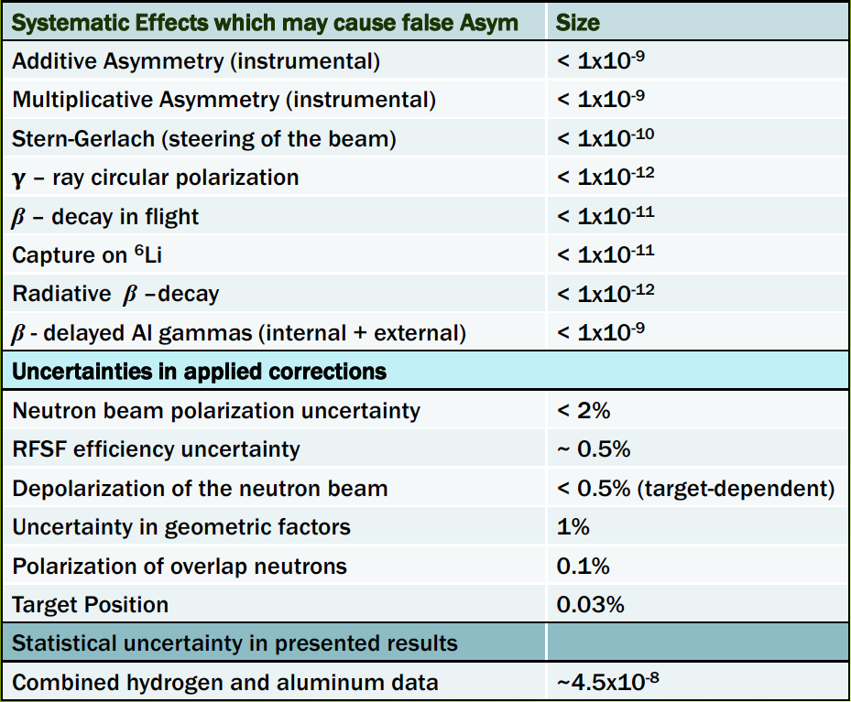
Systematic & Statistical Uncertainties NPDγ
C. Crawford

Slide 30
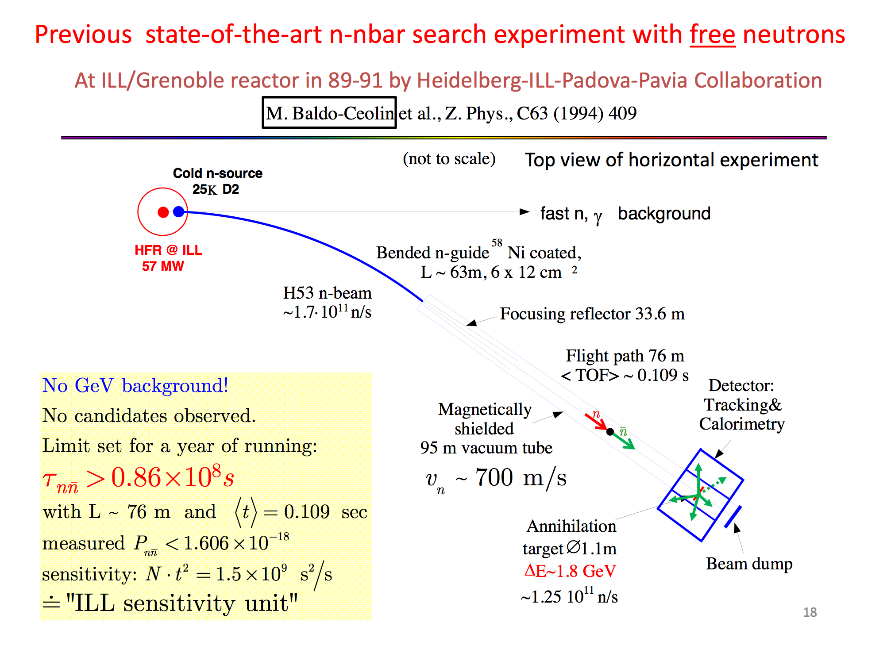
Y. Kamyshkov

