Slide 1

European Spallation Source
Science Advisory Committee
February 5-6, 2014
Jim Yeck
CEO & Director General

Slide 2
Outline
Progress and Milestones 2014
1st Annual Review Results
Licensing, Civil Construction, and Technical Coordination
In-kind Goals
Initial Operations and Ramp-up Phase

Slide 3
2013 progress
Key approvals by ESS Steering Committee (STC)
  Technical Design Report, Construction Cost, and Annual Operations Cost Target
ESS organization clarified for project delivery
Strengthened support for construction decisions by STC Members
  Cost Book, Call for Expressions of Interest, Partner Days, ILOs
  Maturing In-kind plans
Regular advisory committee meetings (AFC, IKRC, SAC, TAC, CFAC)
Completed the 1st Annual Project Review in November 2013
Focus shifted to project execution plans

Slide 4
Next 6 months
Letters of Intent or Agreements with Member countries
Demonstrate accelerator and target station technology readiness
– ensure key interfaces resolved for the civil construction start
Increase engagement of the scientific user community and continue selection of instruments for engineering development
Partner days to promote opportunities to participate in ESS construction
Select conventional facilities partner company/start final design in Feb 2014
Secure permits for facility construction, funding plans, and establish Project Performance Measurement Baseline by May 2014
Start facility construction!

Slide 5
2014 top level milestones
ID | Name | Proj | Planned | Forecast | Actual
G1500 | Start of Concept Design for instrument 1-3 | NSS | 7 Jan | 7 Jan | 7 Jan
G5220 | Start of Detail Design Accelerator Building | Convf | 7 Jan | 18 Feb
G5180 | Contract C101 Signed | Convf | 18 Feb | 18 Feb
 | First in-kind contracts presented to IKRC | Accsys | 7 Mar | 7 Mar
G8000 | Establish the ES&H Advisory Committee | Admin | 31 Mar | 31 Mar
G28900 | SSM Permit | Licens | 30 Apr | 31 July
G63640 | Moderator Concept Finalized | Target | 30 Apr | 30 Apr
G5040 | Environmental Court Verdict | Licens | 14 May | 30 May
G8010 | Annual Review update | Admin | 26 May | 26 May
G5060 | Ground Break | Convf | 2 Jun | 2 Jun
G1665 | Decision on 2013 Instrument proposals (instr. 4 plus ) | NSS | 1 Oct* | 1 Oct
G36450 | Lattice database version 2 available | ICS | 30 Jun | 30 Jun
G63720 | Preliminary design review of beam extraction | Target & NSS | 10 Jul | 10 Jul
G36460 | ICS Hardware Platform freeze | ICS | 30 Sep | 30 Sep
G36470 | Audit on MPS technical design specification finished | ICS | 1 Oct | 28 Nov
G31210 | Cryogenic transfer line ordered | Accsys | 8 Oct | 8 Oct
G31250 | Spoke Cavity Prototype available For Uppsala test stand | Accsys | 3 Nov | 3 Nov
G148900 | Start construction of Tunnel G01 | Convf | 18 Nov | 18 Nov
G1460 | Define and implement the In-kind collaboration model for the construction of the neutron instruments | NSS | 19 Dec | 19 Dec
*) The decision on 2013 instrument proposals will be taken at the September STC meeting

Slide 6
Preparing the construction project
Deliver on the Technical Design Report performance and Steering Committee commitments
  5 MW accelerator capability
  Construction cost of 1,843 B€
  Operations cost target of 140 M€
  22 “public” instruments
Start w/ unconstrained resources (technically limited schedule) and develop credible project execution plans ☑
Comprehensive review of project baseline and execution plans ☑
Secure funding and resources and align schedules with the available resources ☐

Slide 7
Review Charge
∗ A Performance Measurement Baseline (PMB) is an integrated work plan made up of a sequence of activities which cover the complete scope, cost and schedule of a project. Once the PMB established and approved, the PMB can be used to evaluate actual cost and schedule performance to determine whether the project is meeting its planned scope, cost and schedule objectives.

Slide 8
First impressions
The first ESS annual review took place at LUND the 12th-14th November 2013
Present : ESS project team, 33 members of the review team organized in 7 subcommittees and 7 observers (see next slide for details)
First impressions:
The review committee congratulates the ESS team and its management for the quality of the material and presentations submitted to the reviewers
The ESS is now a real project from all points of view, well shaped and well organized. ESS is now managing to the established baseline.
A big effort was made in the last 10 months to build up an organization structure with names and clear responsibilities attached to it
The management of the project is strong, well determined, motivated and success oriented. The ESS overall schedule foresees first protons on target in December 2019. The cost cap has been fixed to 1.843 Beuro (year 2013).
ESS will start real construction work in June 2014 (ground break)

Slide 10
Review Charge
1
2
3
4
5
6
7
11. Will ESS be ready to establish the project performance baseline∗ in early 2014 and start conventional construction in mid-2014?
Yes, if environmental permits and regulatory licence are available, the possible interfaces with the various systems is mastered and the mitigation of possible late changes is taken into account in the CF contract.
In addition, CF funding and overall 85% of commitments to the project secured.

Slide 11
Licensing – status and plans
2014
Jan | Feb | Mar | Apr | May | Jun | Jul | Aug | Sep | Oct | Nov | Dec
Environmental Court
SSM Opinion to Court
Main Hearing April 25th
Court ruling and permit
Ground break June 2nd
Radiation Safety Authority (SSM)
Public announcement: Info from ESS complete for construction permit
Reviews and reports
Assessment
Issue of permit to construct
Start of concrete works
EU Notification, Euratom art 37
~6 month process
Opinion needed before permit for
test ops
Swedish Environmental Court currently requires EU Opinion before main hearing. ESS, with support of SSM and EU, is appealing as EU Opinion is an operations requirement.

Slide 12
Conventional facilities contract
The Collaboration contract and Option 1 (Special conditions for Phase 1) will be signed on February 18
Contractor to provide project management staff to assist ESS in planning for the start of civil construction
Initial contract commitment is for 10-15 people for 6-9 months (600k -1,25M E)
ESS can terminate the contract at any time without additional liabilities
Why now?
Joint development of detailed facility designs, target cost including detailed estimate and schedule, procurement plan for sub contractors, and performance plan for phase 2
Critical path activity that should start now even if we experience some delay in construction permit

Slide 13
ESS organization

Slide 15
Technical coordination role
The primary responsibility for technical coordination and management resides with the new Technical Director (currently the Machine Director)
  Technical interface management and integration at the directorate level
Deputy Technical Director is in place now
  Configuration Management and Configuration Control Board
  Engineering processes including systems engineering, design processes, design reviews
  Technical documentation and design tools

Slide 16
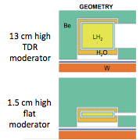
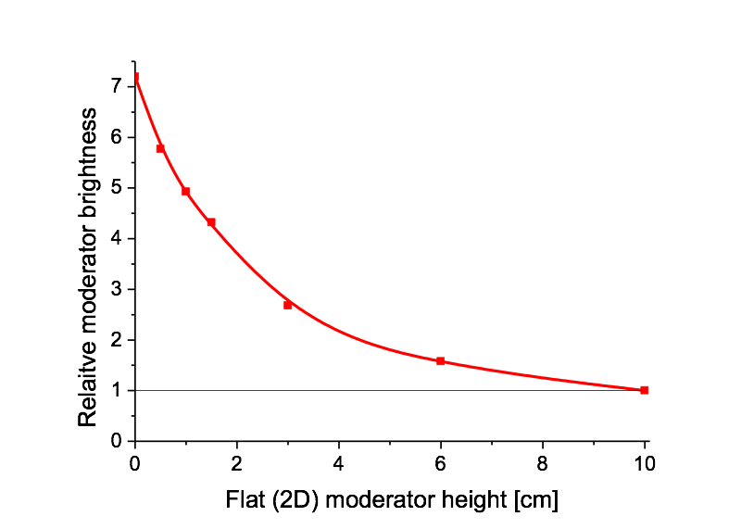
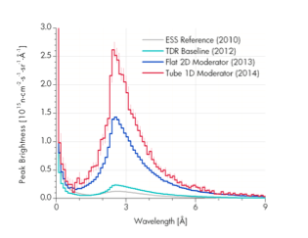
Enhanced flux neutron moderators
New moderator concept
  Mechanism understood
  Works for all neutron sources, including reactors
Harmonization with instrument suite
  Complex optimization is in progress for the potential instrument suite and sample sizes
  Collaboration within ESS (Instruments and Target) and with the Instrument Consortia from our partners
Timeline and milestones
  Feb. 12: 1st moderator workshop, refine parameter space for further optimization
  March, second half: 2nd moderator workshop
  April 30: New moderator configuration to CCB

Slide 17
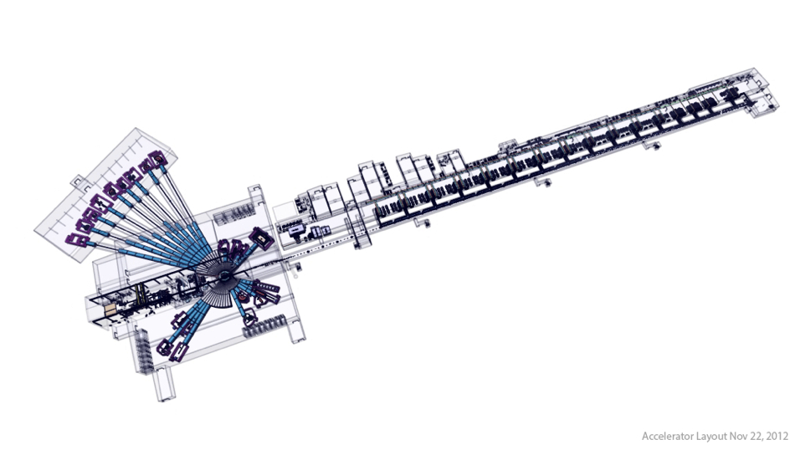
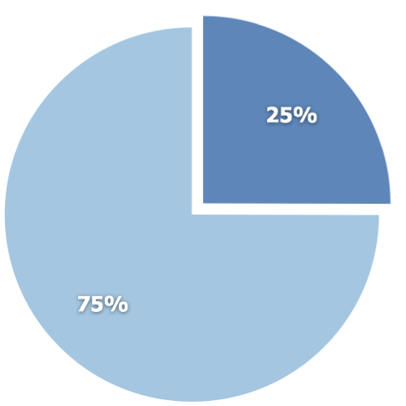
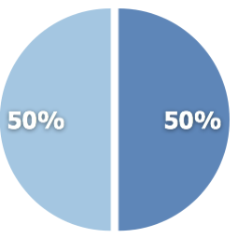
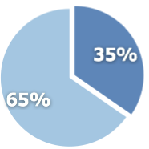
ESS In-kind contributions potential
Total construction cost:
€ 1,84 billion
Target station
€ 154M
Accelerator
€ 510M
In-kind
NSS/Instruments
€ 350M
Cash
Potential In-kind identified is ~36%. Working to increase potential above 40%.

Slide 18
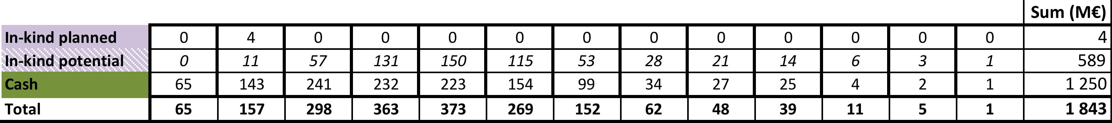
Cash vs. In-kind

Slide 19
Transition from construction into steady-state operations
Basic Principles
Three phases to the ESS project: construction, initial operations and ramp-up, and steady-state operations
Construction Phase complete in 2025 (13 year construction phase)
Initial Operations and Ramp-up Phase begins in 2019 with production of 1st neutrons and ends in 2025 when Construction Phase complete
Spallation source facilities construction and commissioning complete in 2022
  Neutron Scattering Systems construction complete in 2025
Steady-State Operations Phase (2026 – )
  Routine facility operations includes construction and commissioning of the final 22 public instruments

Slide 20
Initial Operations planning & budget
Status of activity and resource planning for transition to operations

Slide 21
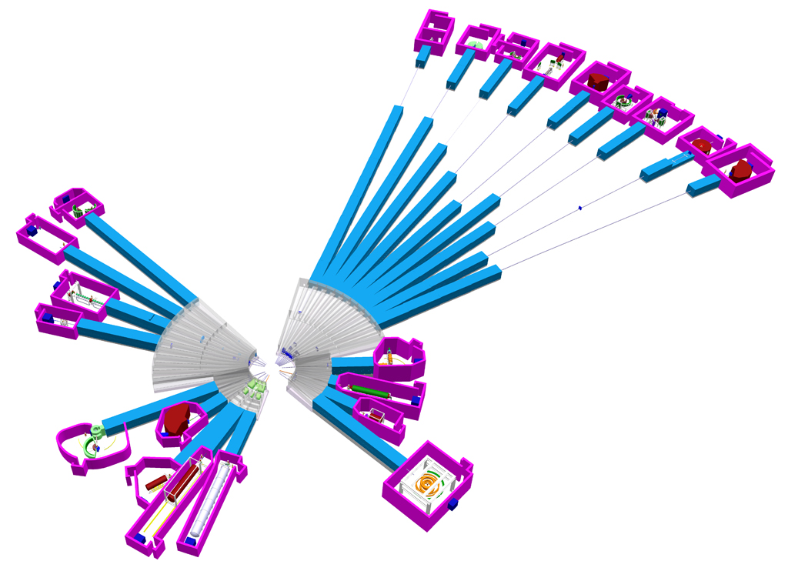
Instrument investments
ESS will deliver 22 “public” instruments
  Substantial funds planned as part of the construction commitment (350 Meuro investment in Neutron Scattering Systems)
  Provision for additional instrument investment as part of operations until 22 instruments installed and commissioned
Instrument fabrication, installation, and hot commissioning schedule constrained by technical feasibility and resources
Initial limited instrument suite available for fully open user program by 2023, and significant number of instruments by start of steady-state ops in 2026

Slide 22
Initial operations and ramp-up phase and commitment to 22 instruments
Decision Outlook and Scenario for Construction of 22 Instruments
Start of Instrument Construction
1st Neutrons
Start of User Program
Construction Budget
2013 | 2014 | 2015 | 2016 | 2017 | 2018 | 2019 | 2020 | 2021 | 2022 | 2023 | 2024 | 2025 | 2026 | 2027 | 2028
STC Decision on
Instruments
Initial Operations and Ramp-up
Steady-Sate Budget
3
12
16
17
22
Plans for
Instruments 17 to 22
Engineering Design
Construction of instrument 17 to 22
Expected Instruments in hot commissioning
3
6
9
12
15
18
20
22
Expected Instruments in user programme
6
9
12
16
20
22

Slide 23
ESS is ready for STC member commitments
STC commitment to share in support of ESS project phases: construction, initial operations and ramp-up, and steady state operations
STC commitment to start construction!
  Each member’s share of total construction investment (LoI)
  Development of cash flow plans
STC commitment to work with the ESS organization to deliver 22 public instruments and the funding necessary for facility operations

