Slide 1

Conventional
Facilities
Update
Michelle Everett
SAC 2014-02-05

Slide 2
Level 100
Bldg 3B
Hall 3
Bldg 3A
Guide Hall
Bldg 2
Hall 2
Bldg 1A
Hall 1
Bldg 1B

Slide 3
Level 110

Slide 4
Level 120

Slide 5
Level 90

Slide 6
CF Baseline and Budget for NSS
Baseline for instrument halls and adjacent buildings ➔ 31,000m²
Construction | € 67,843,300
Installations
Electrical | € 5,392,900
Transport | € 4,800,000
Process | € 1,185,200
HVAC/BMS | € 7,507,600
Grand Total | € 86,729,000
At the end of December, we were at ~34,000m²

Slide 7
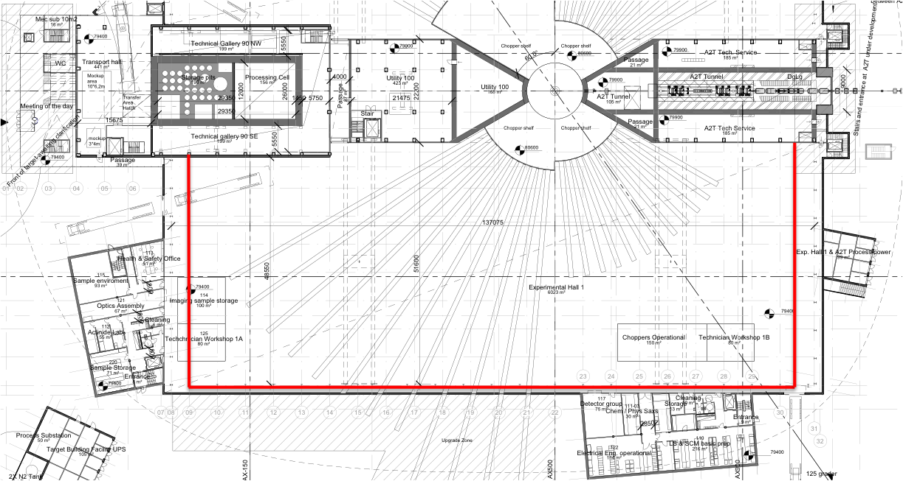
Value Engineering workshop Hall 1
Façades on both short sides reduced 5m
All circulation on level 100 removed
Circulation on level 110 located inside crane coverage and dismountable

Slide 8
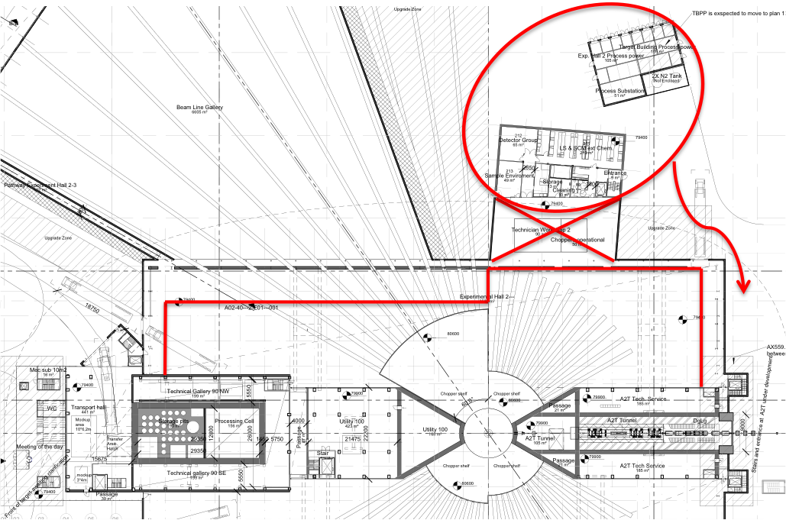
Value Engineering workshop Hall 2
Façade on west sector adjacent to guide hall is reduced 10m, façade on north sector left as is. Overhead cranes will overlap by 2m
Lab and technical substation moved to north sector towards accelerator. Floor slab on upgrade area will not be built.
Façades on both short sides reduced 5m
All circulation on level 100 removed
Circulation on level 110 located inside crane coverage and dismountable
Stainless steel rebar in north sector reduced by 2/3.

Slide 9
Draft of Instrument Positions

Slide 10
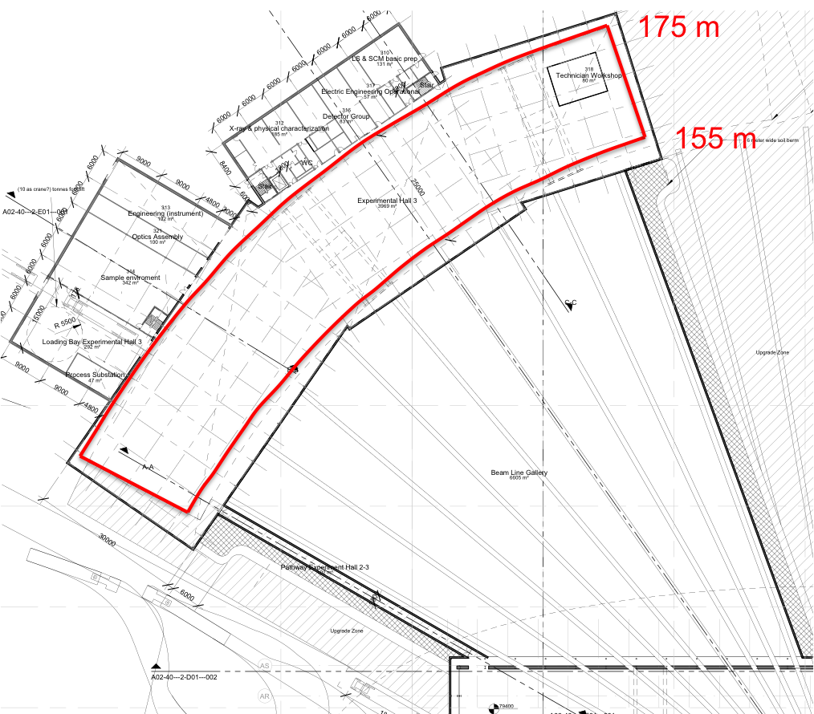
Value Engineering workshop Hall 3
Crane coverage reduced to 20m
Perimeter facades will follow the radius given by the crane coverage

Slide 11
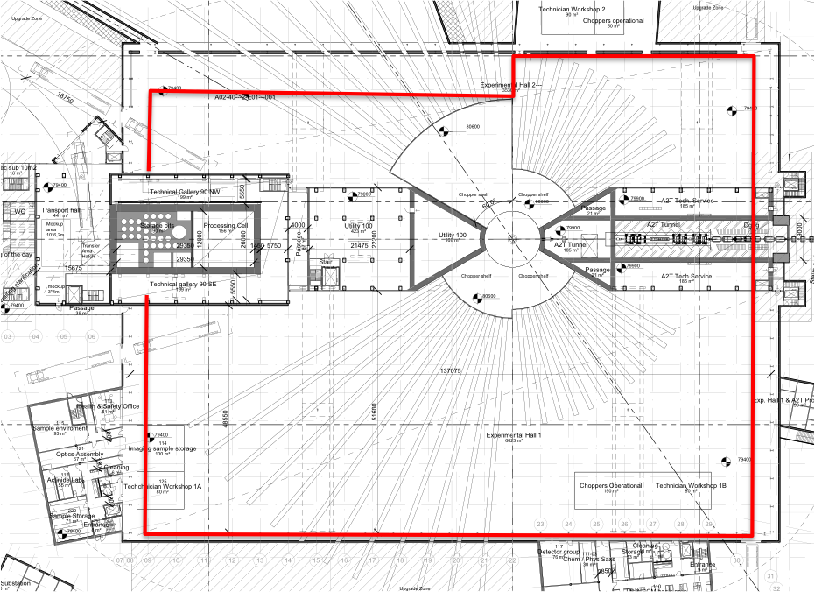
Cost Saving?
Floor reduction ~2000m² – leaving us ~ 1000m² over
The roof is smaller
Reduced piling

