Slide 1
Matt’s Code Dojo I
PRESENTED BY Matt

Slide 2
Preamble
Setting up
Need Python 3 installed if not already.
Clone repo:
  git clone https://github.com/mattclarke/code_dojo_tcr.git
Follow instructions in the README
Check the tests pass

Slide 3
Code Dojo
Deliberate practice
A safe environment
  A chance to try things without pressure
Stretch goal
  Something challenging
  Unlikely to finish in the time available
  Not aiming for perfection
Fun
  Hopefully!
Clone repo:
  git clone https://github.com/mattclarke/code_dojo_tcr.git
Follow instructions in the README
Check the tests pass

Slide 4
Code Dojo
Pair or solo
Normally these sort of exercises are done in pairs, but COVID19
Options:
  Do it solo
  Remote pairing
    VSCode with the Live Share plugin for “screen-sharing” and Slack for audio
    Slack screen-sharing
    etc.
Completely your choice!
Clone repo:
  git clone https://github.com/mattclarke/code_dojo_tcr.git
Follow instructions in the README
Check the tests pass

Slide 5
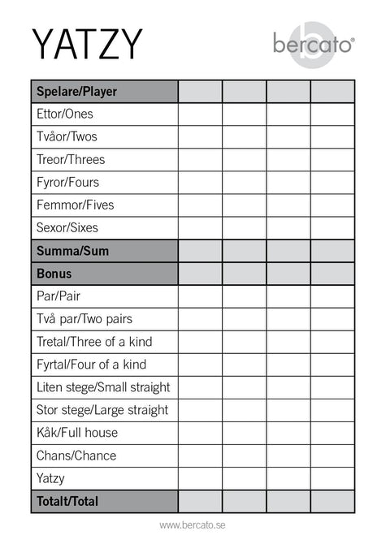
Code Dojo
Yahtzee Yatzy Scoring
https://en.wikipedia.org/wiki/Yatzy
Just the scoring:
  Individual hands
  Bonuses
  Total score
Clone repo:
  git clone https://github.com/mattclarke/code_dojo_tcr.git
Follow instructions in the README
Check the tests pass

Slide 6
Code Dojo
The catch
test && commit || revert
Restrictions:
  The aim is to get and keep 100% code coverage with the tests
  We use test && commit || revert*
    Don’t cheat: if it gets reverted then treat it as gone forever
  Try to run the tests at least every few minutes
  *actual command:
    pytest --cov . && git commit -am working || git reset --hard

Slide 7
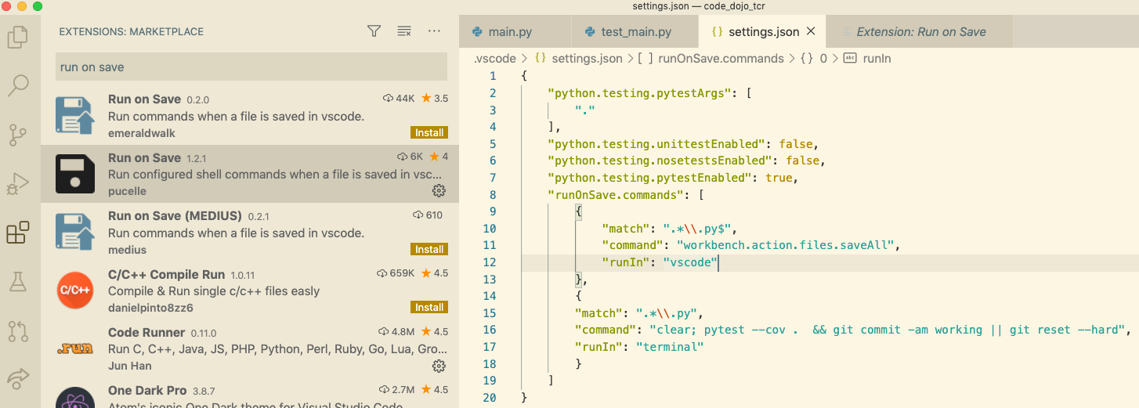
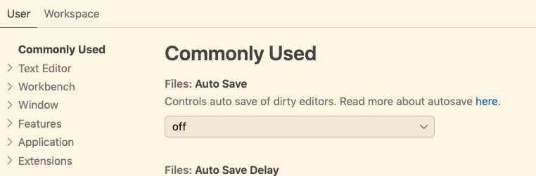
Code Dojo
VS Code
VS Code can be configured to run “test && commit || revert” automatically when saving
Settings

Slide 8
Code Dojo
Demo
Fizzbuzz
Restrictions:
  The aim is to get and keep 100% code coverage with the tests
  Try to run the tests at least every few minutes
  We use test && commit || revert*
    Don’t cheat: if it gets reverted then treat it as gone forever
  *actual command:
    pytest --cov . && git commit -am working || git reset --hard
Notes:
Okay, I’m pretty sure I can write this in one go but let’s play the game just to get an idea of how it works

Slide 9
Code Dojo
Let’s do it!
https://en.wikipedia.org/wiki/Yatzy
Just the scoring:
  Individual hands
  Bonuses
  Total score
Restrictions:
  The aim is to get and keep 100% code coverage with the tests
  Try to run the tests at least every few minutes
  We use pytest --cov . && git commit -am working || git reset --hard
    Don’t cheat: if it gets reverted then treat it as gone forever

