Slide 1
Matt’s Code Dojo II
PRESENTED BY Matt

Slide 2
Code Dojo
Deliberate practice – a reminder
A safe environment
  A chance to try things without pressure
Stretch goal
  Something challenging
  Unlikely to finish in the time available
  Not aiming for perfection
Fun
  Hopefully!

Slide 3
Code Dojo
Pair or solo
Normally these sort of exercises are done in pairs, but COVID19
Options:
  Do it solo
  Remote pairing
    VSCode with the Live Share plugin for “screen-sharing” and Slack for audio
    Slack screen-sharing
    etc.
Completely your choice!

Slide 4
Code Dojo
Legacy code
An example of a trivia quiz game grabbed off the ‘net
The aim is to tidy it up, so it is more “maintainable”
Clone repo:
  git clone https://github.com/mattclarke/code_dojo_tcr.git
*Follow instructions in the README
git fetch && git checkout legacy_code
Check the example tests pass

Slide 5
Code Dojo
Restrictions
The Four Rules of Simple Design:
  Tests pass
  Expresses intent
      Names of methods, functions, classes and variables
  No duplication
      Every piece of knowledge should have one and only one representation
  Small
      Remove any extraneous pieces
Iterative
Clone repo:
  git clone https://github.com/mattclarke/code_dojo_tcr.git
*Follow instructions in the README
git fetch && git checkout legacy_code
Check the example tests pass
Notes:
In order of importance
You’ll notice that there are no tests, so that may be a good place to start…
Small: Code not used; duplicate abstractions or behaviours; over extracted?
Iterative: e.g. removing some duplication may lead to a better name etc.

Slide 6
Code Dojo
Restrictions
Small descriptive commits, so it reads like a log, e.g.
  Created test for fizzbuzz(1)
  Renamed do_something method to be more accurate
  Moved x into it’s own class
  …
Clone repo:
  git clone https://github.com/mattclarke/code_dojo_tcr.git
*Follow instructions in the README
git fetch && git checkout legacy_code
Check the example tests pass

Slide 7
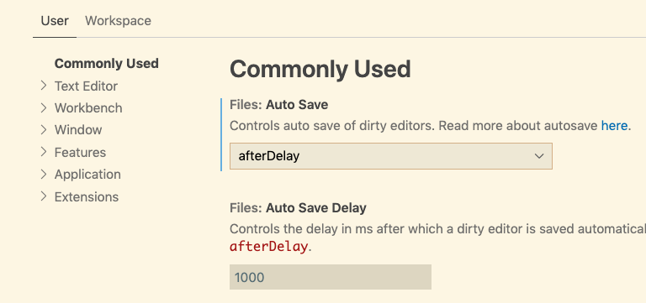
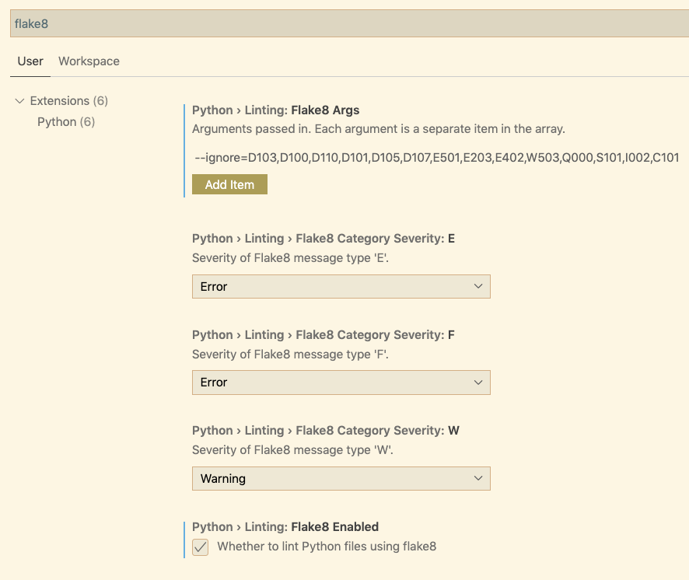
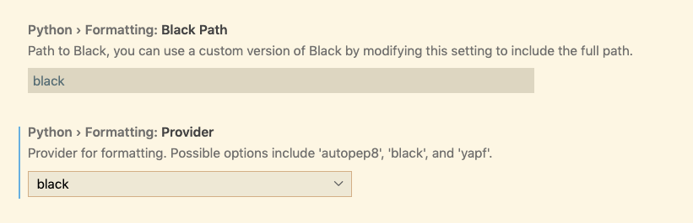
Code Dojo
VSCode

Slide 8
Code Dojo
Let’s do it!
The Four Rules of Simple Design:
  Tests pass
  Expresses intent
      Names of methods, functions, classes and variables
  No duplication
      Every piece of knowledge should have one and only one representation
  Small
      Remove any extraneous pieces
Small descriptive commits, so it reads like a log

