Slide 1
Degauss: An HTML5 Application
Dylan Maxwell Software Engineer

Slide 2
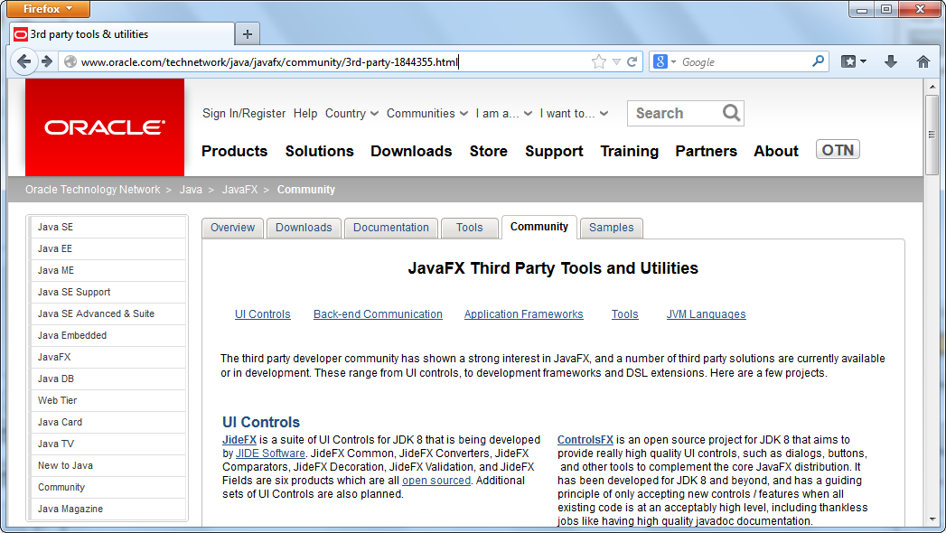
Introduction

Slide 3
Why HTML5?
Best-in-class libraries: D3
Deploy: Desktop or Web
Embed: JavaFX, CS-Studio, etc.
Familiar: CSS, HTML, JavaScript
Standard: W3C, etc.

Slide 4
What is HTML5?
Broader definition of HTML5
Audio and Video Tags
Web Socket API
Web Storage API
Web Audio API
Canvas API
SVG
CSS3

Slide 5
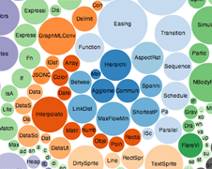
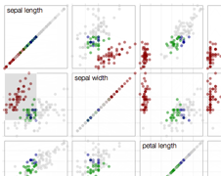
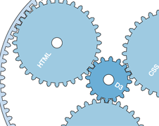
Data-Driven Documents (D3)
HTML, CSS, Canvas, SVG
Extremely Flexible!
http://d3js.org
http://nvd3.org

Slide 6
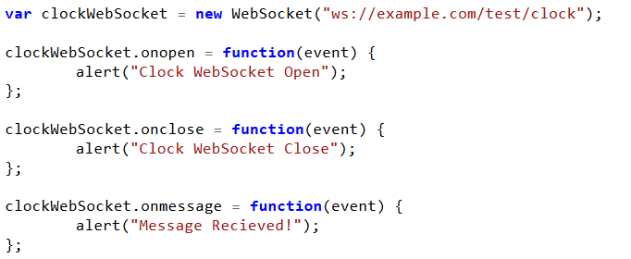
WebSocket
Full-duplex Communication Channel
JavaScript API
W3C Standard

Slide 7
Web Socket Standards
Standard History
hixie-75 (February 4, 2010)
hixie-76 (May 6, 2010)
hybi-00 (May 23, 2010)
7 hybi-07 (April 22, 2011)
8 hybi-10 (July 11, 2011)
13 RFC 6455 (December, 2011)
Java Standard
JSR356 - Java API for WebSockets (May 22, 2013)

Slide 8
The Problem with Web Sockets
Most applications require a higher level protocol than WebSockets provide!

Slide 9
Solution
Spring Framework
WebSocket support recently added in v4
Integrates WebSockets with messaging framework
Simple built in message broker for easy deployment
STOMP
Simple Text Oriented Messaging Protocol
Stomp.js library implements protocol in Javascript
Supported by most message brokers (* not all support WebSockets)
Inspired by HTTP protocol
http://stomp.github.io

Slide 10
Architecture
Degauss Application (JVM)
EmWeb Browser (JavaFX)
EmWeb Server (Jetty)
Degauss Service (Servlet)

Slide 11
EmWeb Extension
Browser
Simple browser implementation (Alert dialog, etc.)
JavaFX Application (using WebView class)
Do you know of any open source alternatives?
Requires Java 1.8 for client-side WebSockets!
Server
Simple wrapper around Jetty v9
Capable of server multiple applications

Slide 12
Degauss Service
RESTful API
Message Queue API

Slide 13
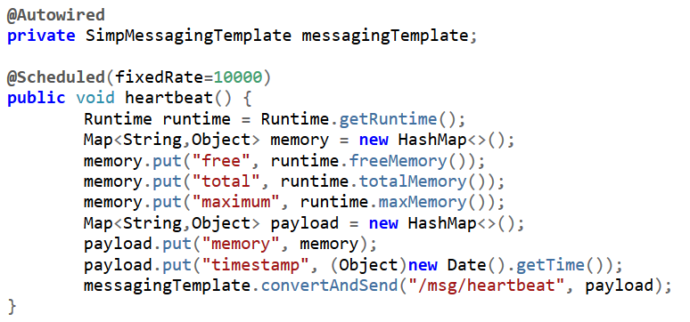
Degauss Service
Publish Message

Slide 14
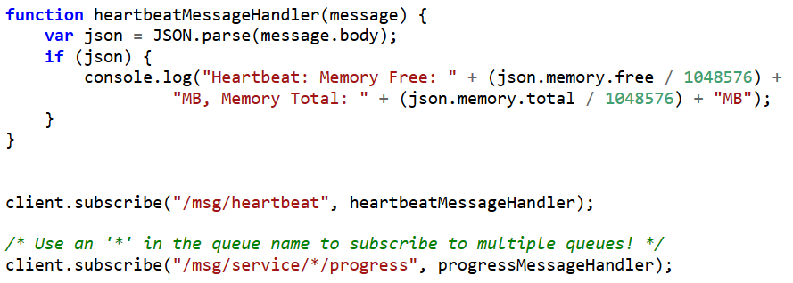
Degauss Service
Receive Message (JavaScript)

Slide 15
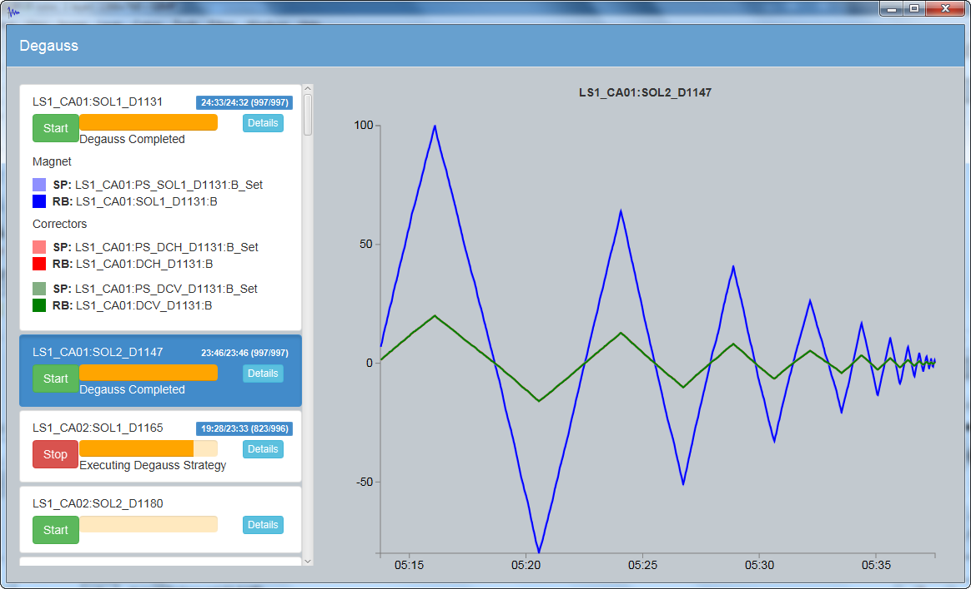
Demonstration

Slide 16
Questions?

