Slide 1
Building OpenXAL using Gradle
Dylan Maxwell Software Engineer

Slide 2
Disclaimer
I am NOT an expert!

Slide 3
Gradle
From the Gradle website: http://www.gradle.org
Uses the Groovy scripting language to provide DSL
Build system for the Android operation system
http://tools.android.com/tech-docs/new-build-system
http://www.youtube.com/watch?v=LCJAgPkpmR0
Integrates with both ANT and Maven-based projects

Slide 4
Comparison
Gradle
Configuration using Groovy
Android, etc.
Multi-Project Support
Task Oriented (like Make)
Good Documentation
Open Source
Slower
Maven
Configuration using XML
De-facto Standard w/ Java
Can be Done (but not Easily!)
Uses Plugins and Build Stages
Documentation
Open Source
Slow
*Completely my Subjective Opinions

Slide 5
Build Overview
Clone Source
Repositories
Build Eclipse Projects
Resolve
Dependencies
(Local and Remote)
Compile
Compile Tests
Package
Run Tests

Slide 6
Gradle Files
build.gradle
settings.gradle
gradle.properties
~/.gradle/gradle.properties
core.gradle
app.degauss.gradle
Service.degauss.gradle
Extension.emweb.gradle
…
Standard Gradle Project Files
Standard Gradle Config Files
Gradle Project Files for Subprojects

Slide 7
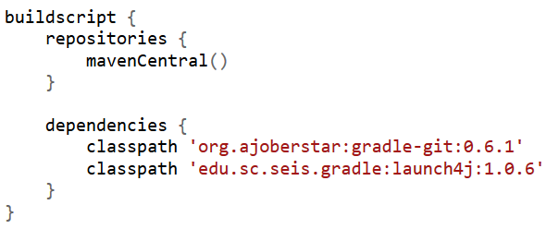
build.gradle (1)

Slide 8
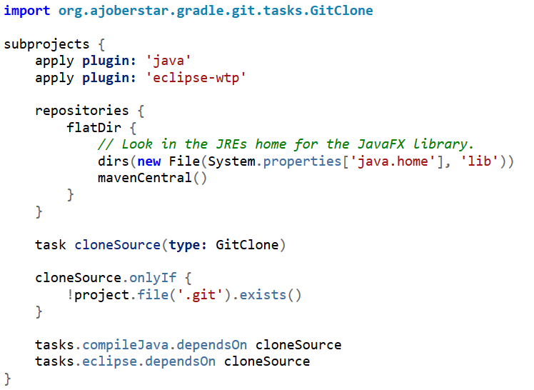
build.gradle (2)

Slide 9
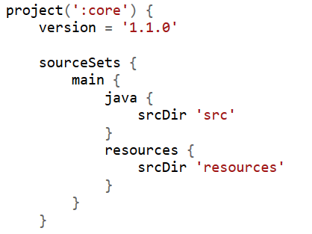
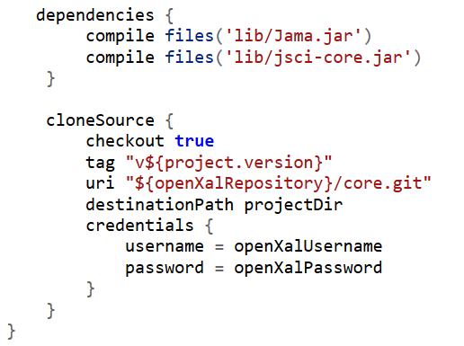
core.gradle

Slide 10
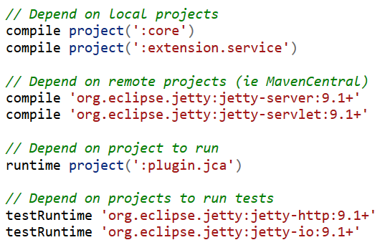
Other Snippets
Dependency Examples:
Move resource NOT in package hierarchy:

Slide 11
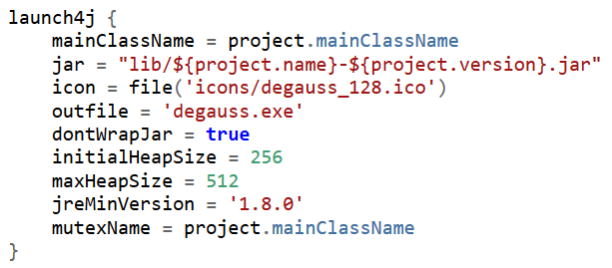
Launch4j Support
Creates a Windows executable
Available on Linux, Mac OS X, Windows
Can select a preferred version of Java
http://launch4j.sourceforge.net
Configuration (using Gradle):

Slide 12
Eclipse Support
Creates projects that can be imported to Eclipse
Configures projects correctly with dependences
Works with both Java and Web Projects
Builds within the IDE still work as expected

Slide 13
Questions

