Slide 1
FRIB configuration OpenXAL with DISCS DB
Dylan Maxwell Software Engineer

Slide 2
Outline
Online Model
Model Schema
Model API/Service
Model Manager App
PVLogger/SCORE
PVLogger/SCORE database schema
PVLogger/SCORE API/Service
PVLogger App
SCORE App

Slide 3
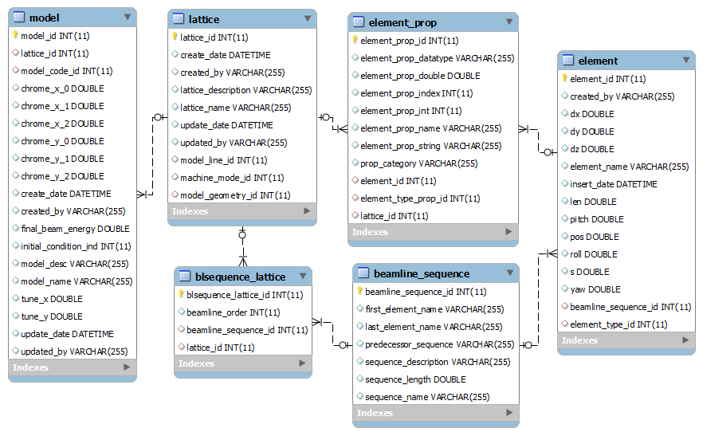
Model (Physics) Schema (1)

Slide 4
Model (Physics) Schema (2)
Element
The element table is for all modeling elements’ layout data, i.e. without element settings.
Beamline Sequence
An accelerator is divided into multiple segments, for beam tuning, physics applications or other purposes.
Lattice
The lattice table is for saving general lattice information.
Model
The model table saves general information for models.
Details: http://sourceforge.net/projects/openepicsmodel

Slide 5
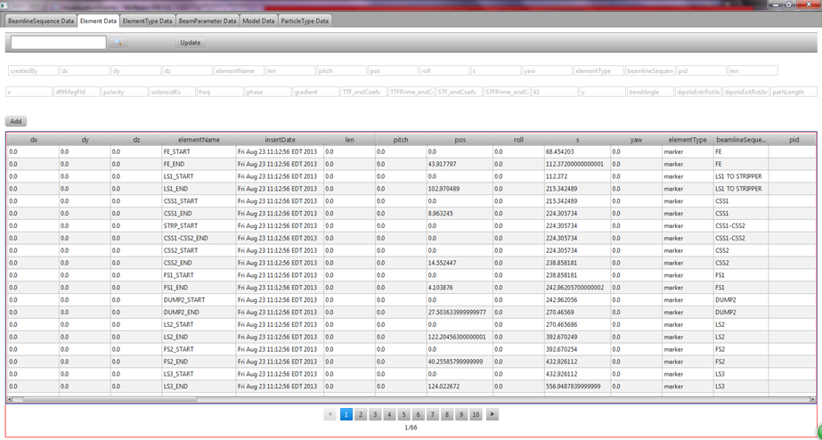
Model Service
Adding more Model API as applications need
Java API
REST API
Test data (FRIB Linac Segment 1) for both lattice and model entered in database via Java API
Prototype Model Service
J2EE web service
Web interface for data editing
Use REST API
Similar to Excel data template
JavaFX based GUI
Same GUI code for desktop and Web

Slide 6
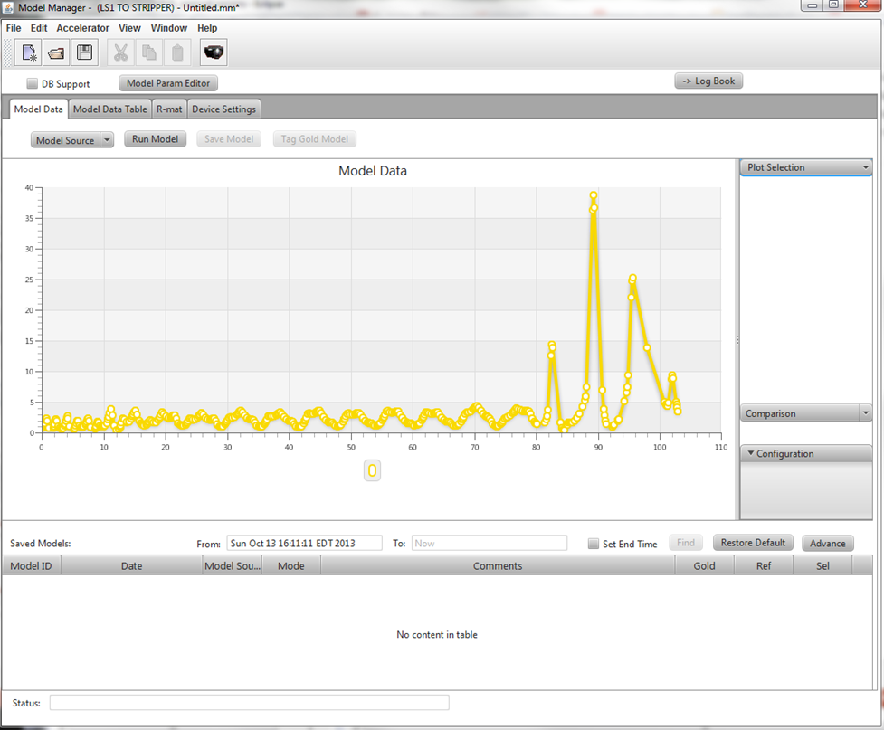
Model Manager App
Model GUI to replace MPX (XAL), Machine Simulator (Open XAL) and Model Manager (LCLS XAL)
Real-time model display
Database model display/save
Support design, live, “what-if” models
Future
Comparison between any 2 models
Lattice optimization
Content JavaFX based, embedded in Open XAL GUI Framework
β_{x} for FRIB LS1 design

Slide 7
Source Repositories
Model DB and Tools
http://sourceforge.net/p/openepicsmodel/code
Model Service
http://sourceforge.net/p/modelrest/modelDBService
Model Web App
http://sourceforge.net/p/modelrest/ModelLatticeDisplay
Model Manager
http://sourceforge.net/projects/openxalmodelmanager

Slide 8
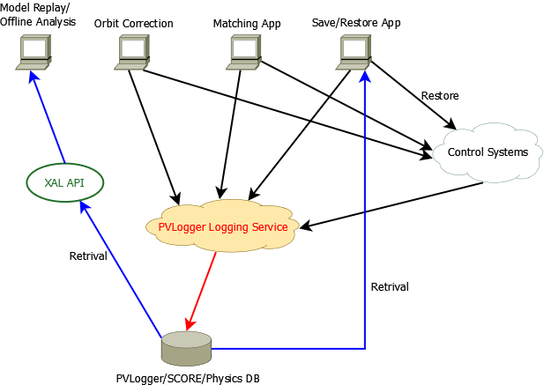
General Purpose PV Logging
Architecture overview
Most physics applications only need to save PV data
Each application defines own PV logging list(s)
An “app_type” in schema to identify the applications
“Physics PV List”
All magnets, RF, diagnostics
Can be SCORE “Save World” list
PVLogger Services
Logging can run on multiple servers
Periodic logging
Automated machine snapshots
All data saved in RDB
All data access via APIs
API support Online Model replay

Slide 9
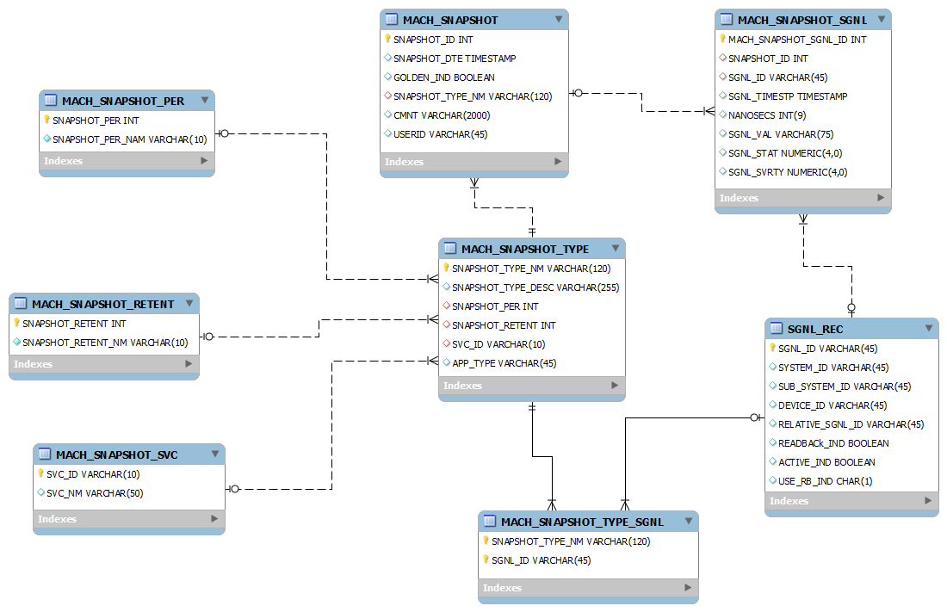
PVLogger/SCORE Database Schema [1]
Database schemas for PVLogger and SCORE merged
Mach_snapshot:
- golden_ind: flag to show if
this is the “default” snapshot
- userid: computer account
who takes the snapshot
Mach_snapshot_type:
- snapshot_per: snapshot
period
- snapshot_retent: how long
should this snapshot be kept
- svc_id: service ID this
mach_snapshot_type attached to - app_type: application ID
which logs the PVs
Mach_snapshot_sgnl:
- sgnl_timestp: date and
time from this PV record
- nanosecs: the nanoseconds
from this PV timestamp
Sgnl_rec:
- system_id: the system this signal belongs.
eg. LS1 TO STRIPPER
- sub_system_id: the sub system this signal
belongs. Eg. BPM, magnet
- device_id

Slide 10
PVLogger/SCORE Database Schema [2]
Database schemas for PVLogger and SCORE merged
Sgnl_rec:
- system_id: the system this signal belongs, e.g. LS1 TO STRIPPER
- sub_system_id: the sub system this signal belongs, e.g. BPM, magnet
- device_id: device ID
- related_sgnl_id: for some devices, there is a pair of signals, set point and
readback. This is the signal id coupled with the sgnl_id
- readback_ind: the flag to show if this is a readback signal.
- active_ind: the flag to show if this is an active signal.
- use_rb_ind: used for SCORE.

Slide 11
PVLogger/SCORE API Modification
SCORE was a standalone application with no published API
Due to database schema change, the Open XAL API for PVLogger has to be modified accordingly
Modify the existing API as little as possible
For the existing classes, create new extended classes to extend for additional APIs.
For the new tables, we add new corresponding API class
However, we do modify some existing API.
e.g. The API for saving and retrieving ChannelSnapshot
Two DB columns instead of one to save the entire PV timestamp in MySQL
Saving and retrieving API modified, e.g. the insert and fetch method

Slide 12
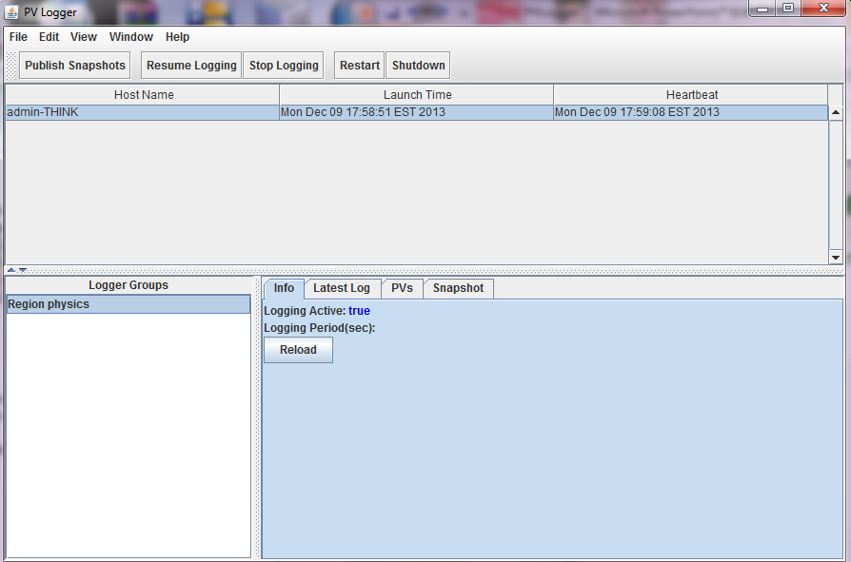
PVLogger/SCORE Service
The JSON-RPC based service can run right out of box without any modification
PVLogger app
showing running
services

Slide 13
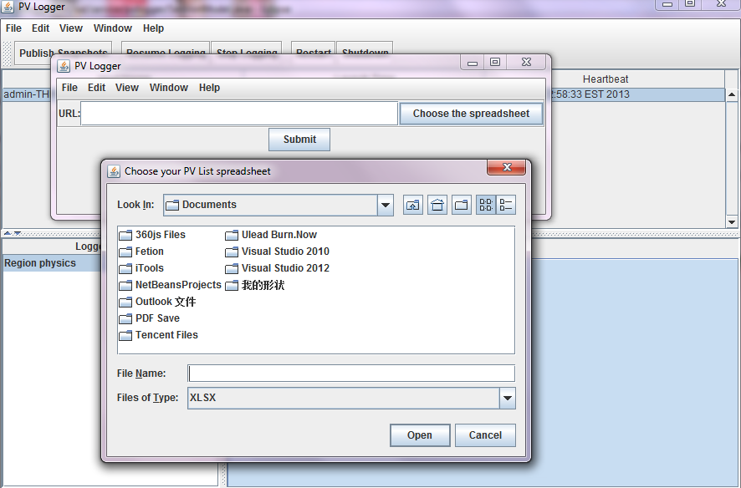
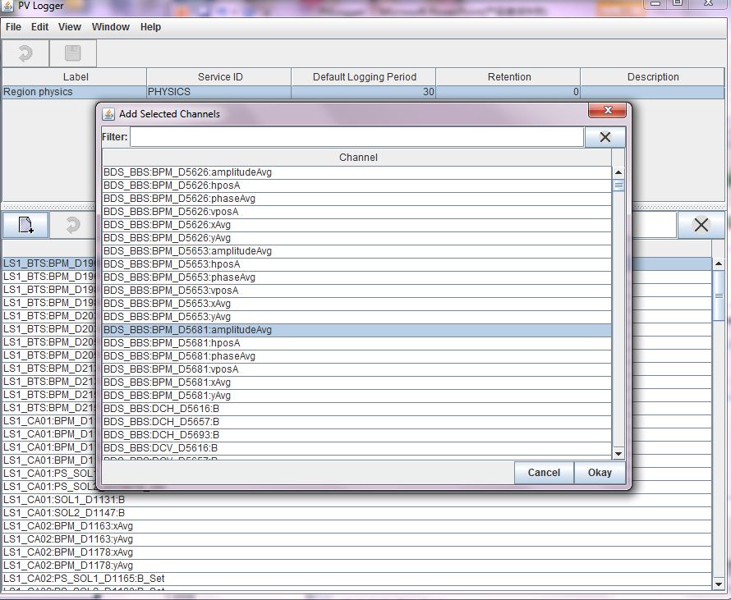
PVLogger and SCORE Applications [1]
New functions for PVLogger – batch uploading from Excel
Can browse saved PV data
Configure PV list
The selected PV must have already been in the DB
Upload PV list from a spreadsheet.
It should include the set point PV
name, readback PV name,
system, sub system, device

Slide 14
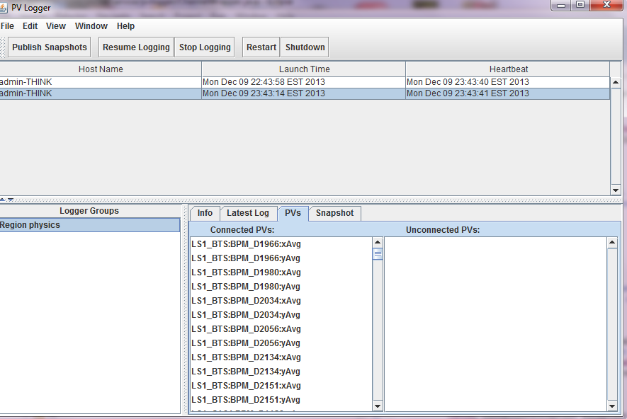
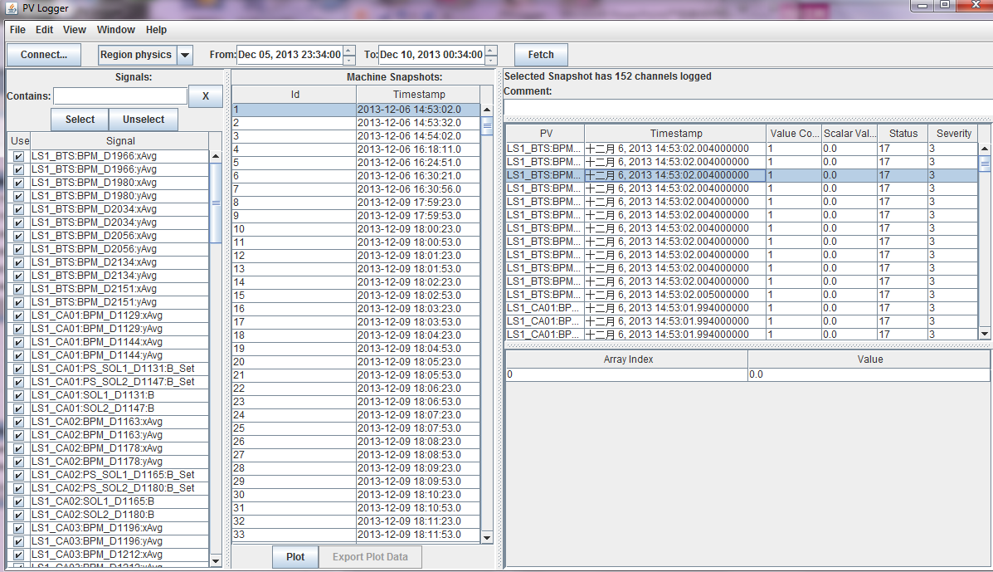
PVLogger and SCORE Applications [2]
Display the existing PV data in DB.
selected by group and time range.
Select a logger group, all the connected PVs could be logged periodically or on demand.

Slide 15
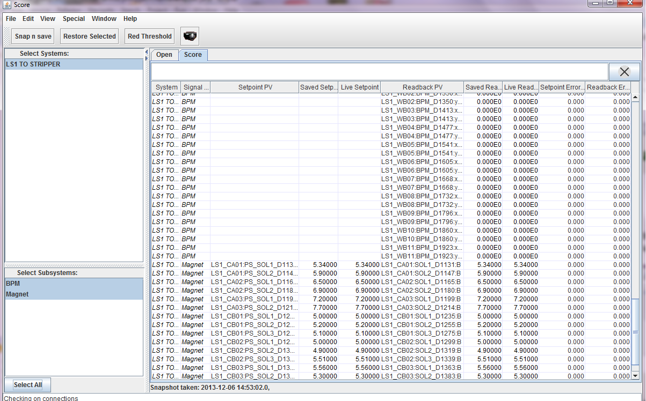
PVLogger and SCORE Applications[3]
SCORE
It takes snapshots on demand.
Using the PVLogger JSON-RPC service which supports both on-demand and periodical logging
Select PVs filtered by system and subsystem
All PVs are displayed in pairs if related PV exist.
Define PV list
Identify period, retention time, service id
Log PVs periodically

Slide 16
Source Repository
PVLogger
http://sourceforge.net/p/pvlogger/pvlogger

