Slide 1
PLCs and Integration Activities at Controls Division
Daniel Piso
Controls Division
www.europeanspallationsource.se
February 21, 2013

Slide 2
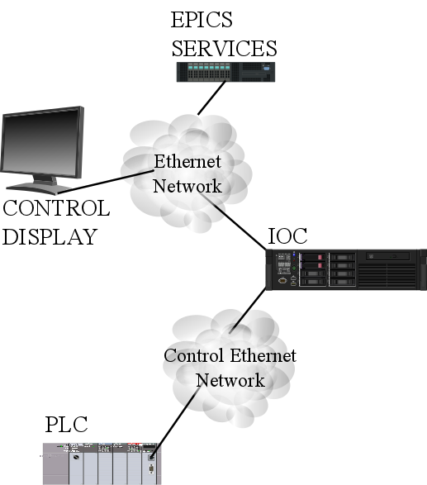
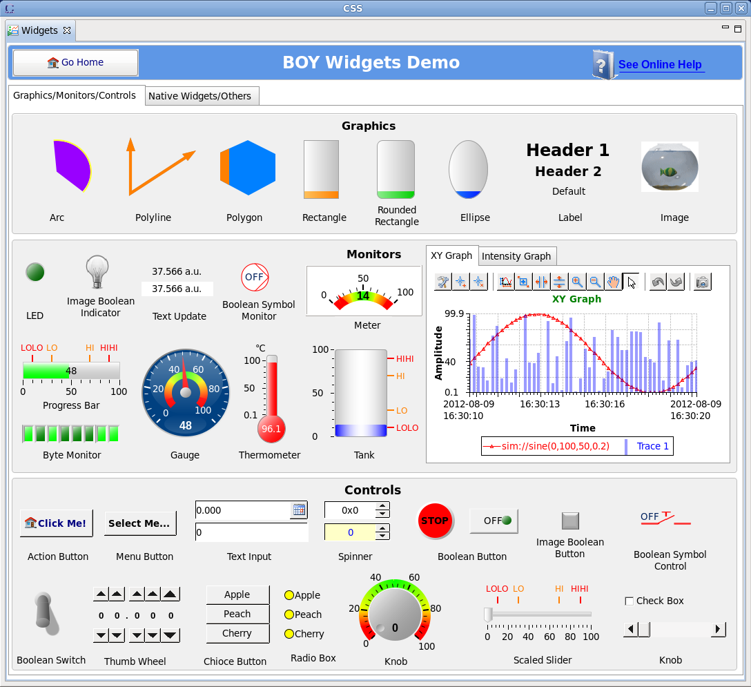
EPICS & PLCs Integration

Slide 3
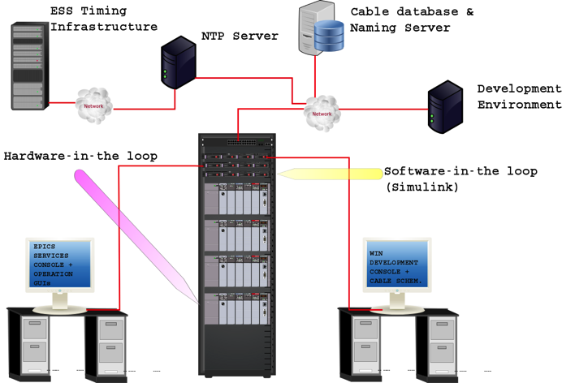
PLC Test Stand

Slide 4
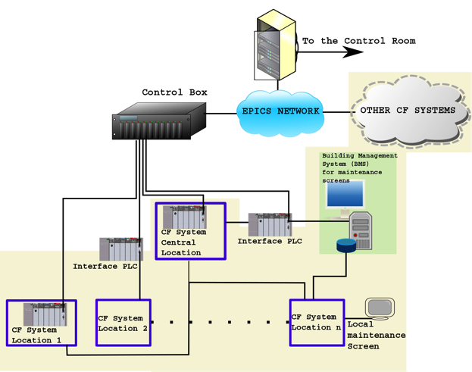
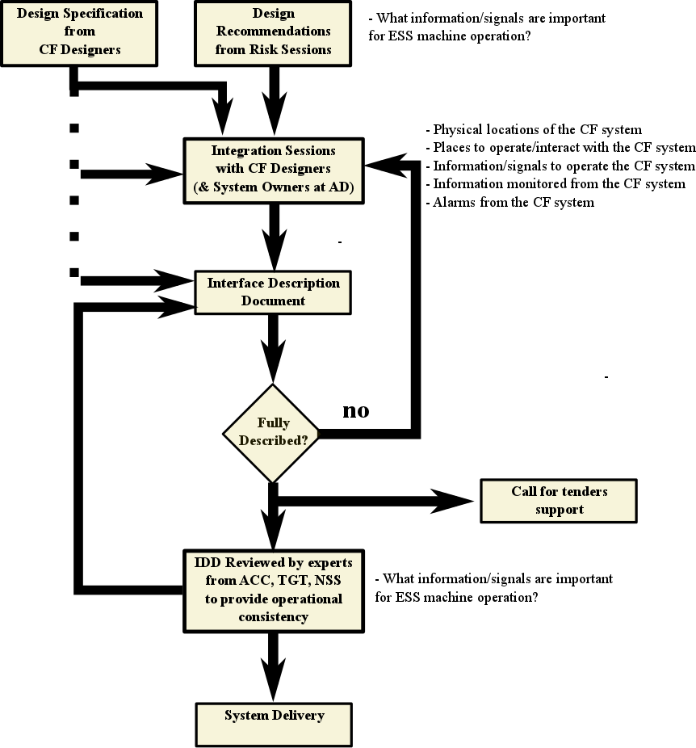
Conventional Facilities Integration

Slide 5
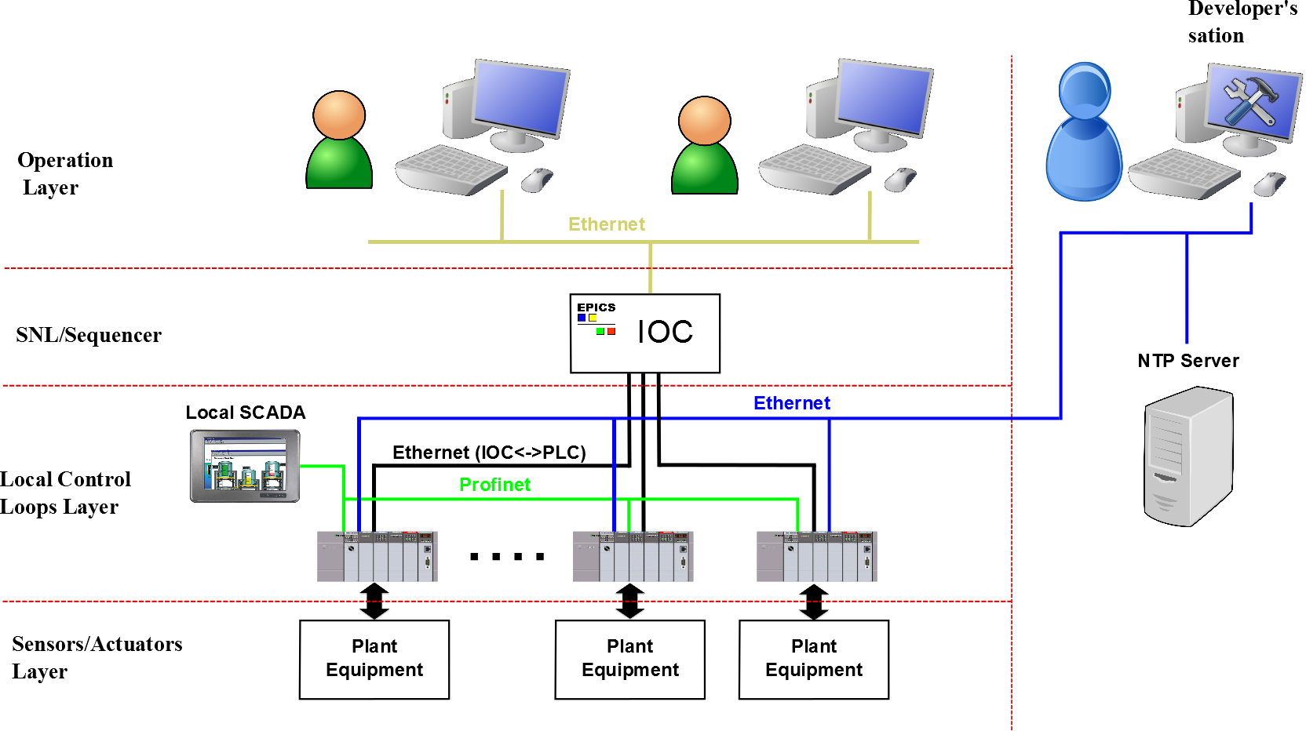
Cryogenics Integration

Slide 6
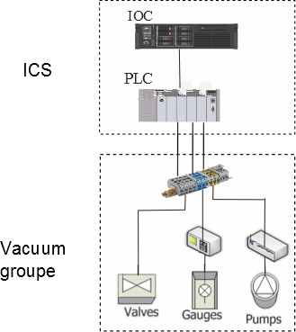
VACUUM CONTROLS SCOPE

Slide 7
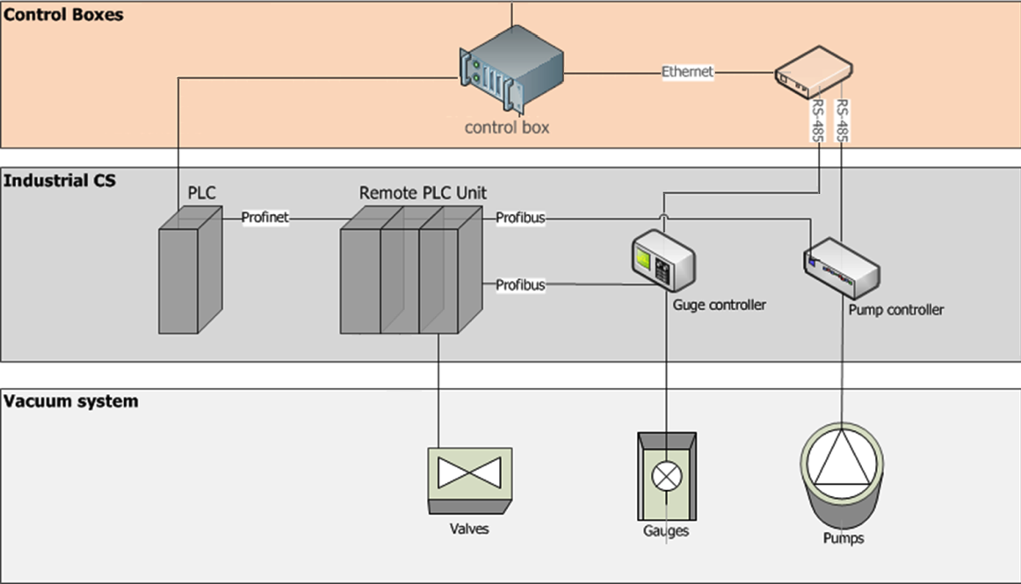
Vacuum Systems Integration

Slide 8
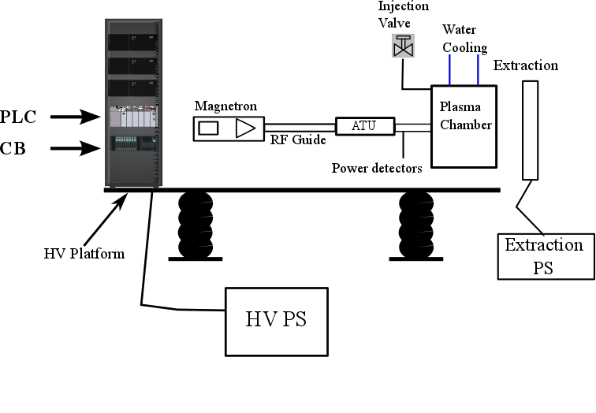
ION SOURCE & LEBT INTEGRATION
Collecting information for:
Identifying control requirements
Writing a design document
Trying to share acquisition with other projects.
Same process ongoing
for the LEBT

Slide 9
Thank you!

