Slide 1
Software Core Components (ICS WP3)
Suzanne Gysin
Work Package Lead
www.europeanspallationsource.se
February 22, 2014

Slide 2
What are the "Software Core Components”?
5 Databases
15 Software Services
and
the Naming Convention

Slide 3
Control System - Software Core Compents
WBS: Project 14 Integrated Control System (ICS)
WP 3. Software Core Components
WU 3.1 Configuration Data Management
WU 3.2 Control System Services
WU 3.3 Naming Convention

Slide 4
Lattice Database
Contains the ESS Accelerator configuration as it is simulated prior to being built.
It includes the geographical and physical information for:
Simulated beam line elements
Accelerating structures
Auxiliary elements
Beam diagnostics
Vacuum
[1] Lattice Database Requirements Document v1.1, S.Gysin
[2] Lattice Browser Requirements Document v1.0, S.Molloy
Notes:
Software Requirements:
Import data from the simulation
Lattice Browser (web application)
API (Java)
Restful Interface (other languages)
Relational database (Postgres)
Exports and reports for OpenXAL, Mechanical Engineering, Global Coordinate report, comparison between versions.
Requirement for versioning: current baseline, history of prior baselines, and the Lattice under Development (LuD)

Slide 5
Controls Configuration Database - CCDB
Scope: the physical attributes of a specific device. (barcode, location, status calibration test results, user defined attributes)
What devices/data is included: Control Boxes, MPS devices, PSS devices. Devices controlling vacuum, RF, Cryogenics, target, neutron instruments, and conventional facilities.
Software Requirements:
Water connections, callibration records, test records
History, documentation, user defined attributes
Authentication and authorization of users
Integraged with naming convention
Relational Database (Postgres)
Reports and exports
API – java
Restful interfaces
1 million records
[3] ICS Configuration Database – Requirements v1.7, S.Gysin
[4] Evaluation of selected DISCS collaboration modules, M.Vitorovik

Slide 6
CCDB Home screen

Slide 7
Logical components (system)

Slide 8
Physical devices

Slide 9
Properties

Slide 10
Cable Database
Scope: A database of cables and their connectors, and software tools to label the physical cables.
What is included:
ICS is responsible for data of cables to and from the Control Boxes, MPS devices, and PSS devices.
The software tools are available for use by all ESS for cable data.
Typical question the configuration database can answer are:
Which devices are connected to port A of device SSSS-BBBB:DDDD-III ?
How long is the cable connecting HBL-PBI:BPM-01a to its power supply.
Software requirements:
Cable request form
Standard cable list to choose from
Import from spreadsheet
Routing information
Relational DB (Postgres)
Web based GUI
Search and reports
[5] Cabling Requirements, K.Rathsman

Slide 11
Device Configuration Database DCDB
Scope: Stores the configuration files for the EPICS IOC’s and PLC interface
What is included:
Version control and storage for EPICS configuration files and PLC interfaces
Verifying ESS standards in the configuration files in the EPICS files
Design and testing of files at remote sites
Integration into the central database at Factory Acceptance Testing (FAT) and Site Acceptance Testing (SAT)
Strategy:
Collaboration with TATA Consulting Services to:
Adapt ITER’s SDD to be a generic open source tool to store device configuration
Adapt ITER’s SDD to ESS

Slide 12
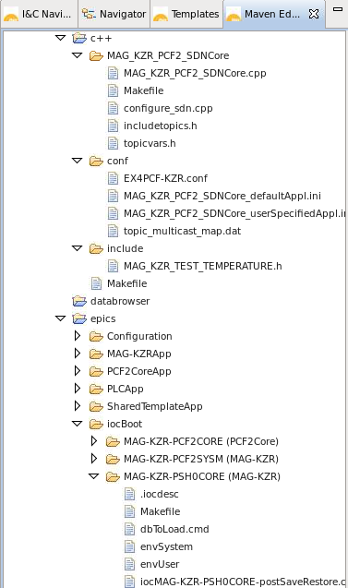
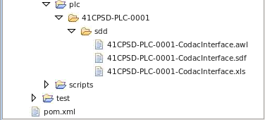
SDD Translator generates all configuration files
Generate config files
SDN C++ program
STEP-7 files
EPICS records
EPICS IOC files

Slide 13
Unit Conversion Database
Scope: magnet unit conversion, between engineering unit (Ampere), physics unit (Tesla), and model unit (K1, K2).
Candidates: DISCS unit conversion module (NSLS II)

Slide 14
WU 3.1 Configuration Data Management
Scope: The collection, storage, and distribution of configuration data.[9]
[9] Work Unit Description document Configuration Data Management
Lattice Database
Virtual components
Controls Configuration Database (CCDB)
Physical components
Device Configuration Database (DCDB):
EPICS devices
Cable Database
Unit Conversion Database:

Slide 15
WU 3.2 Control System Services
Provide the common software services to the users of the control system [10]
A software service is software that benefits from having a single standard implementation. For example Role Based Access Control.
Services can be combined by other software applications to provide the complete functionality of a large software application.
The service includes the applications, application programmer interface, and repositories that provide the service.
Includes Accelerator, Target, Instruments and Conventional Facilities
[10] Work Unit Description document Control System Services

Slide 16
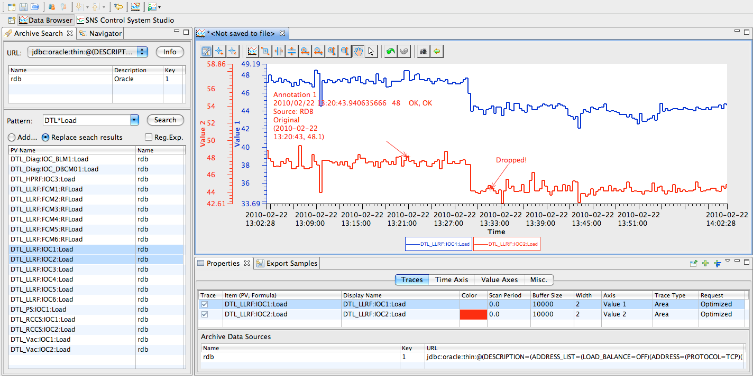
Archive, Alarms, and Logbook
ESS-CODAC package (based on ITER’s CODAC):
CS Studio (EPICS control system studio)
Operator Screen GUI builder (BOY)
Short term archive/logging (BEAUTY)
Logbook (Olog)
Alarms Server (BEAST)

Slide 17
Measuring Alarm Problems
EEMUA Guidelines
Plant statistics
Before / after snapshots
Donald Campbell Brown numbers
Classify alarm situation
Average alarms per hour
Max alarms per hour
Percentage of hours with > 30 alarms
Plants classified in 5 categories
Overloaded dangerous alarm revision, alarm shelving
Reactive bad alarm revision, alarm shelving
Stable regularly bad situations root cause analysis, state-based alarm priority
Robust good root cause analysis, state-based alarm priority
Predictive excellent root cause analysis
** Slide was Provided by GoalArt AB
Per hour | Max / hour | Percent | Classification
> 600 | > 6000 | > 50% | Overloaded
> 60 | > 6000 | > 25% | Reactive
> 6 | > 600 | > 5% | Stable
> 6 | > 60 | > 1% | Robust
< 6 | < 60 | < 1% | Predictive

Slide 18
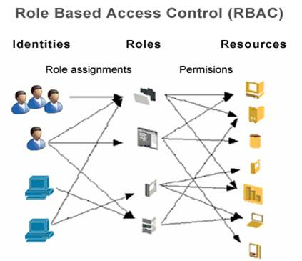
RBAC – Role Based Access Control
Role Based Access Control for EPICS IOC’s and control system applications
Extend the design of LHC RBAC to EPICS and Applications
Authentication service using LDAP
RBAC database
Authorization by roles/location/beam mode in the IOC server.
RBAC is not IT security, it is a means to prevent mistakes by a well meaning user.
DISCS collaboration: security module

Slide 19
The RBAC database
Roles:
Each role has a Role Manager
The Role Manager assigns the users to the role
Resources:
Each resource has an RBAC Resource Manager
The Resource Manager defines the permissions and assigns the roles to the permissions
Permissions paramters are: role, ip address, and machine state (regular expression

Slide 20
Long Term Archive
Scope: PV archive for a longer time ( 30+ years?)
Smaller set of process variables, saved less frequently
Write once, read often, optimized for fast read (data warehouse technology)
Candidates:
SLAC’s archive service
CSS with Cassandra back end
Timeframe: 2Q 2016

Slide 21
Save, Compare and Restore
Scope: Save machine settings, compare live values with saved values, restore saved values.
Features include
a golden snapshot,
grouping PV’s into snapshots,
grouping snapshots into machine configurations,
highlighting changed values and database storage of the information.
Candidates: MASAR
Timeline:
Requirements are complete [6]
Development has not started
2Q 2016 – operational
[6] Save, Compare & Restore Requirements, S.Gysin

Slide 22
Other Control System Services
Fast Data Acquisition
Data on Demand:
Archiving on a trigger from the timing system
Post Mortem Support:
Collecting the post mortem buffers and providing the tools for analysis
Diagnostic Logging Service
Centralization of the diagnostic logs of distributed systems.
Directory Service
Finds PV’s based on search criteria
Candidate – Chanel Finder
EPICS Naming Service
EPICS PV to IP address/TCP port mapping

Slide 23
Other Control System Services
Video Service
Live image stream from instrumentations
How large are the images?
Maintenance Log
log of preventive maintenance
Operations Logistics
Beam statistics, run hours, shift summaries, down time, experiment schedules, reliability statistics and analysis.
Search Service
Google like search on all ICS
On-line/Off-line Model Service
Accelerator Modeling as a service, indpenedent of simulation software
Device Oriented Access Service
Provide the ability to change an IOC/PV based on a higher level unit.

Slide 24
WU 3.3 ESS Naming Convention
Scope: provides the tools, repositories and processes to generate meaningful and consistent names for devices
Scope includes all of ESS
Name database includes 1000 items now
Definition of the naming syntax[7][8] : SSSS-BBBB:DDDD-III:TTTIIIXXX
Tools:
WEB GUI to generate a name for a device and let the user browse the names
Database to keep track of the names and convention rules
[7]The ESS Naming Convention
[8] ESS Naming Convention, K. Rathsman

Slide 25
Software Core Components
DISCS
Thank you

Slide 26
References
[WP3 - 1] Lattice Database Requirements Document v1.1, S.Gysin
[WP3 - 2] Lattice Browser Requirements Document v1.0, S.Molloy
[WP3 - 3] ICS Configuration Database – Requirements v1.7, S.Gysin
[WP3 - 4] Evaluation of selected DISCS collaboration modules, M.Vitorovic
[WP3 - 5] Cabling Requirements, K.Rathsman
[WP3 - 6] Save, Compare & Restore Requirements, S.Gysin
[WP3 - 7] The ESS Naming Convention, K.Rathsman
[WP3 - 8] ESS Naming Convention, K. Rathsman
[WP3 - 9] Work Unit Description document “Configuration Data Management”
[WP3 - 10] Work Unit Description document “Control System Services”
[WP3 - 11] Work Unit Description document "Naming Convention"

Slide 27
The Team
Name | Role
Suzanne Gysin (ESS) | Work Package Leader
Karin Ratsman (ESS) | Naming Convention Work Unit Leader Lattice Database Developer
Stephen Molloy (ESS – 25%) | Lattice Browser developer
Jakob Battelino (Cosylab) | Lattice Database and Naming tools developer
Jaka Bobnar (Cosylab) | RBAC lead developer
Miki Pavleski (Cosylab) | Development Environment and Cosylab’s Project Manager
Andraz Poznar (Cosylab) | Lattice Database developer
Miha Vitorovic (Cosylab) | Controls Configuration Database Lead

