Slide 1
Update ESS Strain Rigs
Malcolm Guthrie
European Spallation Source ERIC

Slide 2
Overview ESS stress rigs:
Up to 4 different rigs envisaged in plans:
“Rig 1” – 100kN rig manufactured by NPI, Czech Republic
”Rig 2” – 30-50kN rig, optimised for imaging
“Rig 3” – modular portable rig optimised for soft matter
“Rig 4” (“Robin’s Rig”) – not owned by ESS, but integrated portable rig.

Slide 3
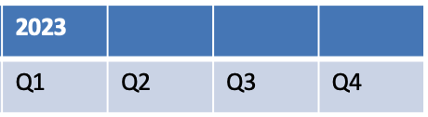
schedule
Prev. plan:
= system ready to deploy
NOW
BOT
2019 | 2020 |  |  |  | 2021 |  |  |  | 2022
Q4 | Q1 | Q2 | Q3 | Q4 | Q1 | Q2 | Q3 | Q4 | Q1 | Q2 | Q3 | Q4
RIG 1
INTEGRATION
COMMISSIONING IN LUND
RIG 4
INTEGRATION
RIG 2+3?
Gather requirements
CONCEPT. DESIGN
DETAIL. DESIGN
PROC,MFG,ASSEMBLY
INTEGRATION
COMM LUND
Current plan:
BOT
NOW
2019 | 2020 |  |  |  | 2021 |  |  |  | 2022
Q4 | Q1 | Q2 | Q3 | Q4 | Q1 | Q2 | Q3 | Q4 | Q1 | Q2 | Q3 | Q4
RIG 1
INTEGRATION
COMMISSIONING IN LUND
RIG 4
INTEGRATION
RIG 2+3?
Gather requirements
CONCEPT. DESIGN
DETAIL. DESIGN
PROC,MFG,ASSEMBLY
INTEGRATION
COMM LUND

Slide 4
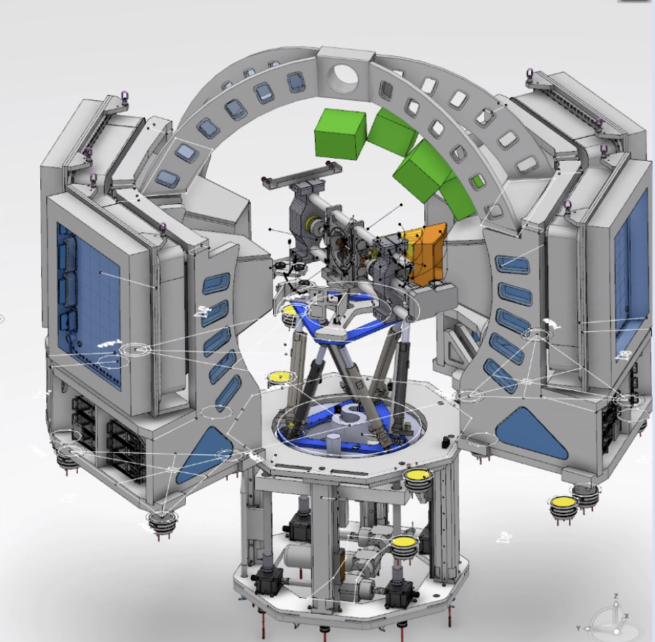
Rig 1 – 100kN “BEER” Rig
Device already exists. Physically located at NPI (Czech Republic)
Controls integration of project has been ongoing since early 2020
progress has been a little slow,
COVID
lack of resources with partners
to mitigate: considering reducing scope of integration to delay kHz time sampling
Mechanical integration:
Decision to focus on BEER integration
Requirements gathered from BEER team (https://confluence.esss.lu.se/display/SA/NPI-rig+mech+integration+Meeting+notes )
installation boundary conditions,
orientation of device,
mounting interface (Level 1 Kipps on hexapod)
Further work pending engineering resource (and 21 budget uncertain)
Safety/Quality integration
hope to gain experience with Robin’s rig
then plan to bring Rig 1 to Lund Q1/2021

Slide 5
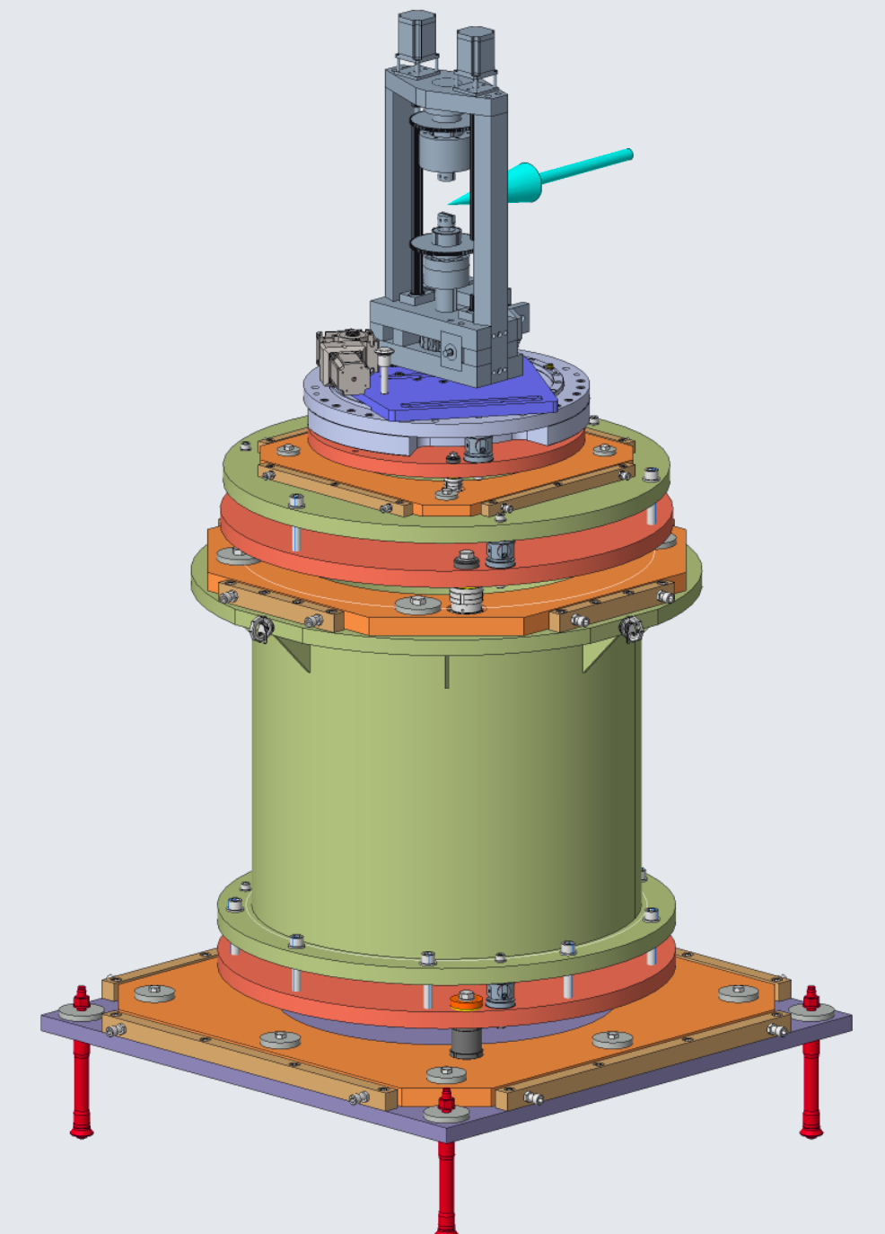
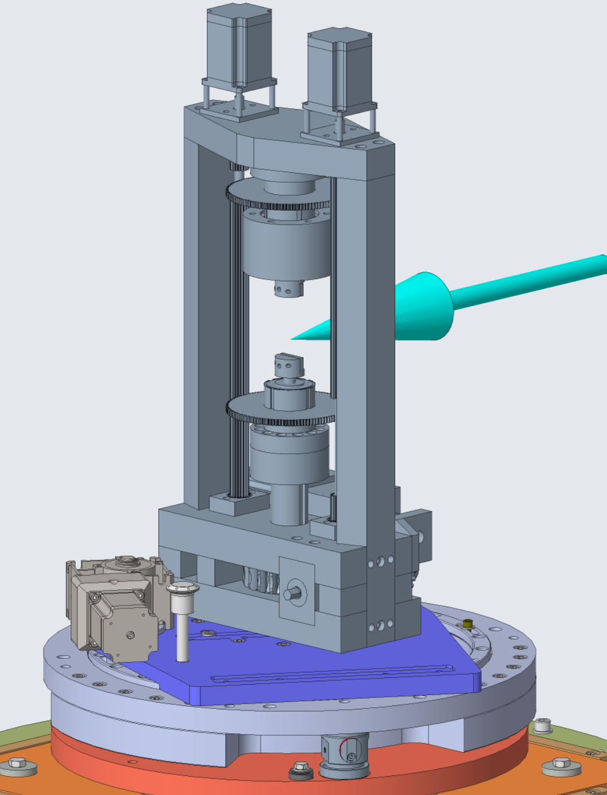
Robins rig
Device already exists. Physically located at ESS
Controls integration of project has not started
Significant activities on defining project
Mechanical integration:
Required requirements from instruments (https://jira.esss.lu.se/browse/PREMP-17)
installation boundary conditions,
orientation of device,
mounting interface
Very preliminary conceptual design (https://jira.esss.lu.se/browse/PREMP-20)
Safety/Quality integration
Not started yet
Some issues immediately clear

Slide 6
Rigs 2 and 3
Have good set of requirements for Rig 2 in particular
Rig 3 is still less well defined.
Still haven’t coalesced on whether to go with commercial or collaborative solution.
Preliminary investigation into costs for commercial systems suggests might not be possible to buy two rigs

