Slide 1
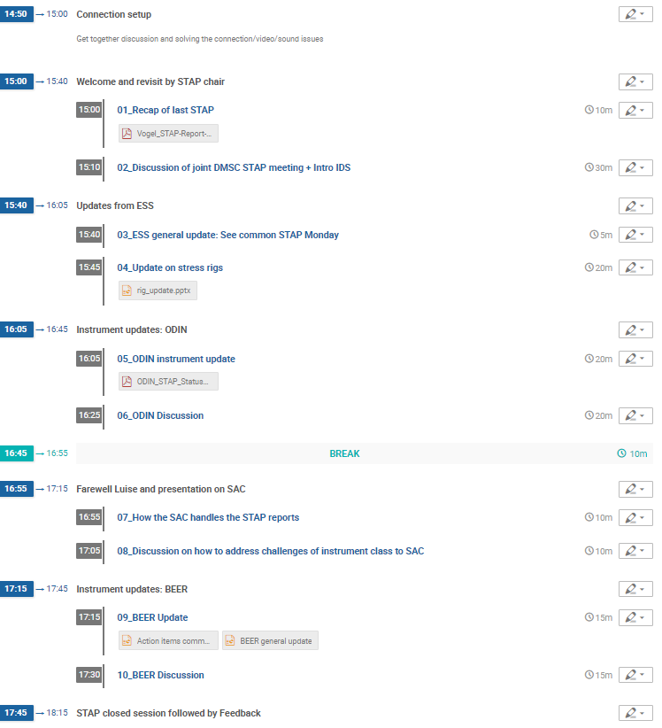
AGENDA

Slide 2
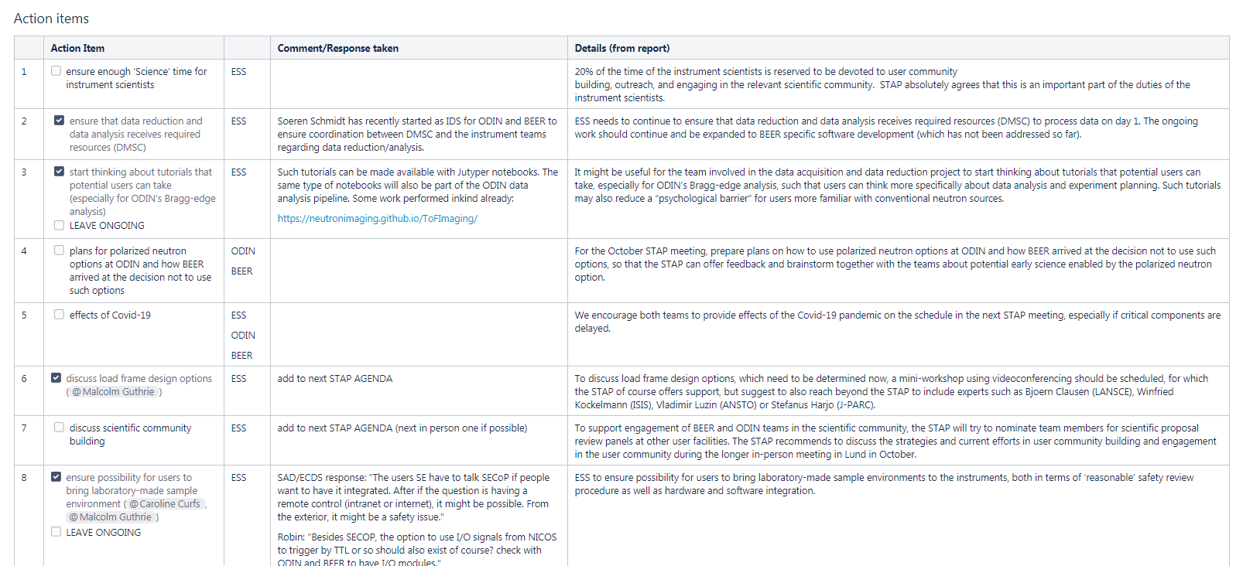
Open Action items form previous STAP meeting
ESS supports science time and outreach activities with time effort 20% agreed
20% however can be on the limit to engage deeply (journal and panel reviews, own research,..)
New IDS started.
Previous work now documented (GitHub)
ODIN+BEER updates
Regular exchange between all partners
ODIN+BEER updates
2 new STAP members can be appointed

Slide 3
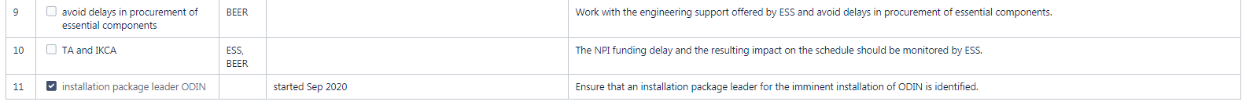
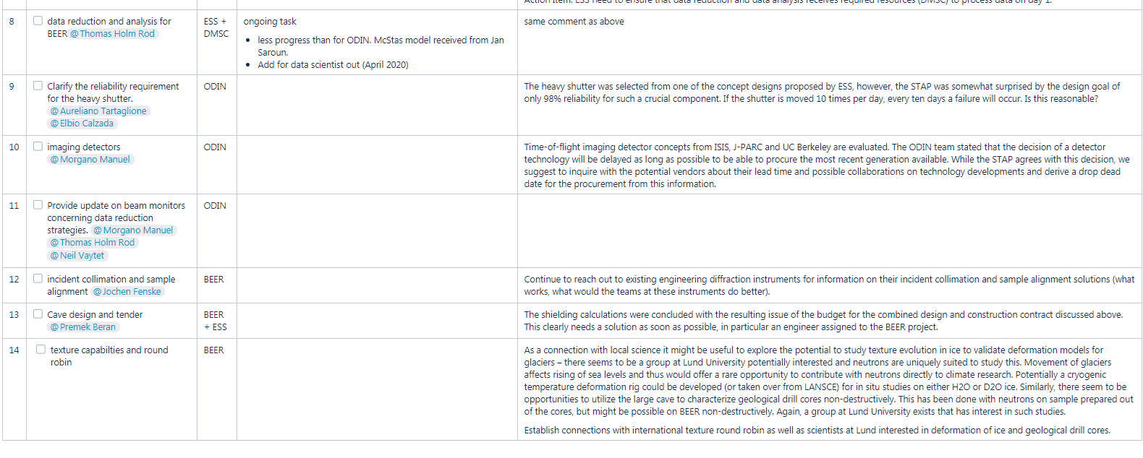
Open Action items form previous STAP meeting
BEER update
We are also surprised that this has still not happened
BEER update
We are tracking the comments and open ACTIONS also from previous reports. Updates will be presented.

