Slide 1
Progress Update
NPI

Slide 2
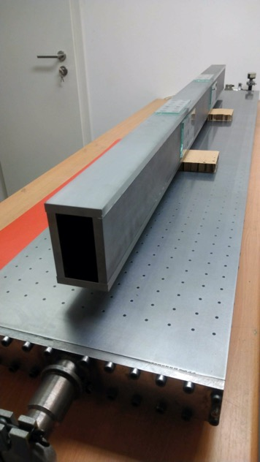
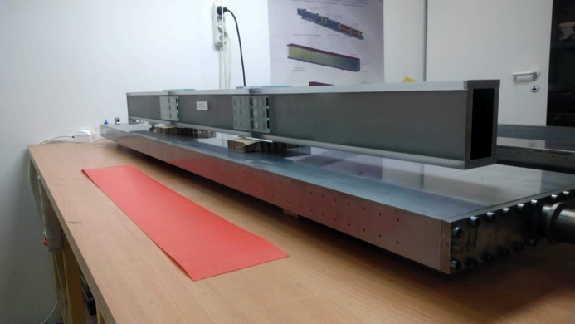
Progress Update
Update from last STAP
TA and funding issue
Several IKCA drafts exchanged between NPI and ESS (now already 3 months with ESS)
No new schedule (TA update) – just simple shift so far:
Guide manufacturing (except early manufacturing deal – 90 m of guide) in-hold
Delay of tenders for cave, hutch and shutter
Possibility to join the common media project
Guide early manufacturing (hall E02-1)
Progressing well, polishing, sputtering and assembly restarted
Substrate for about 43 m is ready
Delivery is expected in Nov/20 > Mar/21 (unknown)

Slide 3
Progress Update
Update from last STAP
TA and funding issue
Several IKCA drafts exchanged between NPI and ESS (now already 3 months with ESS)
No new schedule (TA update) – just simple shift so far:
Guide manufacturing (except early manufacturing deal – 90 m of guide) in-hold
Delay of tenders for cave, hutch and shutter
Possibility to join the common media project
Guide early manufacturing (hall E02-1)
Progressing well, polishing, sputtering and assembly restarted
Substrate for about 43 m is ready
Delivery is expected in Nov/20 > Mar/21 (unknown)
Sub-TG3s
Sub-TG3 for guide out of the bunker APPROVED
Sub-TG3 for cave, hutch almost ready – minor things under evaluation
Update of documentation and 3D model finalised
Lack of engineer
ESS offered to hire the lead engineer – no open position without TA!
2 months support from ESS engineer to help with CTV documentation used

Slide 4
Progress Update
HZG

Slide 5
Progress Update
Contracts
Work on TA on going
Remaining issue, e.g. concerning installation and integration has to be solved
Timeline has to be discussed
Impact of Covid-19
Impact of Covid-19 at the moment not so significant due to missing TA
Delays could be expected for the delivery of neutron guides and choppers
Detector development could be further delayed due to missing test
capabilities with reactor neutrons

Slide 6
Progress Update
Work Packages
Discussion on integration of stress rigs
Small changes to NBPI/NBOA
Detector development progressing

Slide 7
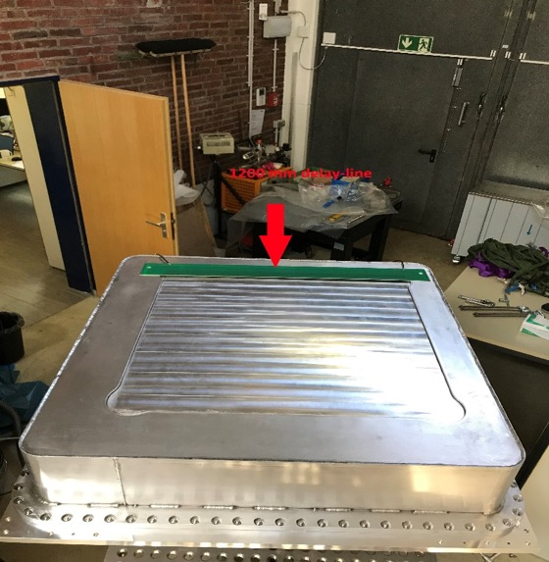
BEER Detector
Status
Last STAP April/20‘ Detector status headlines (recap!):
²⁴¹Am/Be source unit went in operation
First Neutron maps with small prototype
Delivery of large detector housing in pieces
New:
Assembly of large detector housing AND leak tests:
p_{inside} decoupled from p_{outside}!
p_{inside} strongly coupled to T_{outside}!
Housing assembly finished!
leakage rate for air @ 1010 mbar:
2x10⁻⁷(L/s) or 17 (ml/day)

Slide 8
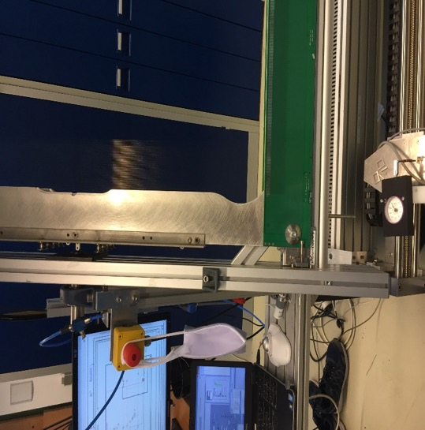
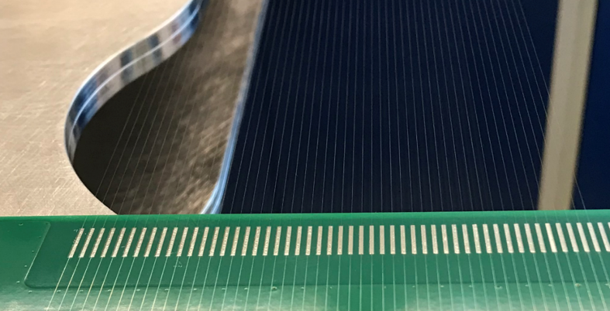
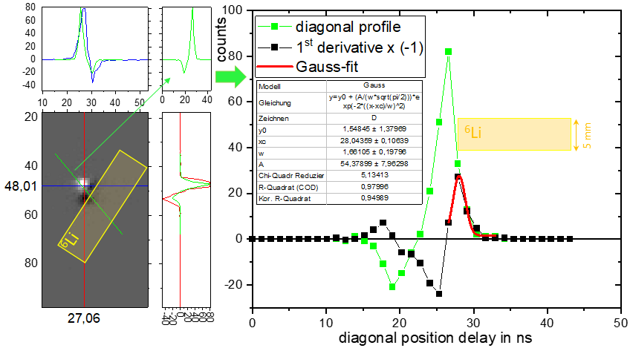
BEER Detector
Status
Wiring started:
-Testing out of wiring and soldering parameters
Electronics and position resolution tests at small prototype in Rez
(friendly support from NPI-colleagues: 1-day beam time):
Transition width of ⁶Li edge:
FWHM of ≈ 1.7 ns (= 3.4 mm position resolution)
without optical corrections
Further improvement achievable

Slide 9
BEER Detector
Detector summary
Detector housing assembly and tests successful/critical parameters recognize
Wiring and soldering of detection wires in progress
Final tuning of read-out electronics for envisaged position resolution on going
Now, all major componets in place but not on time due to outbreak of CoViD-19 in
spring/ Project was prolongated by 6 months (end 31.01.2021).
Additional delays due to second Wave of CoViD-19 expected.

