Slide 1
Action Items

Slide 2
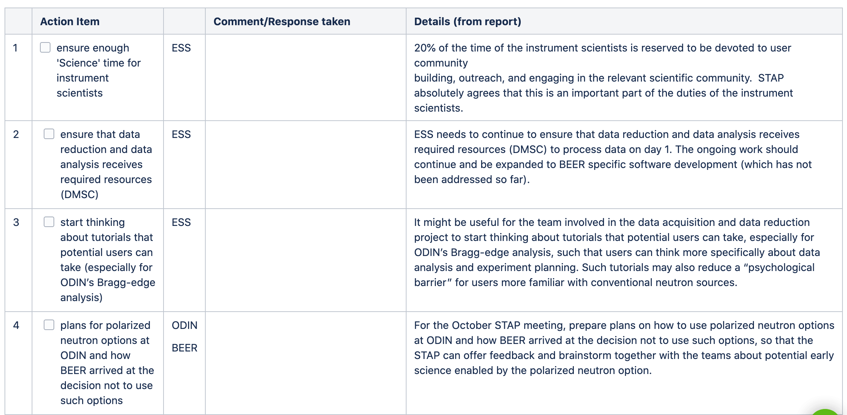
ESS fully support science time and outreach activities
Difficult to arrange when no engineer in place – no much time think about science
To have HZG really on board will be appreciated
With the new data scientist the situation seems to be improving
Polarisation was discussed during the early STAPs – rejected without science case
No engineering instrument world-wide has this option
BEER concept is already Swiss-knife for engineering with SANS, off-plane and back-scattering detectors – makes it even more complicated can be overkilling
No science case found so far

Slide 3
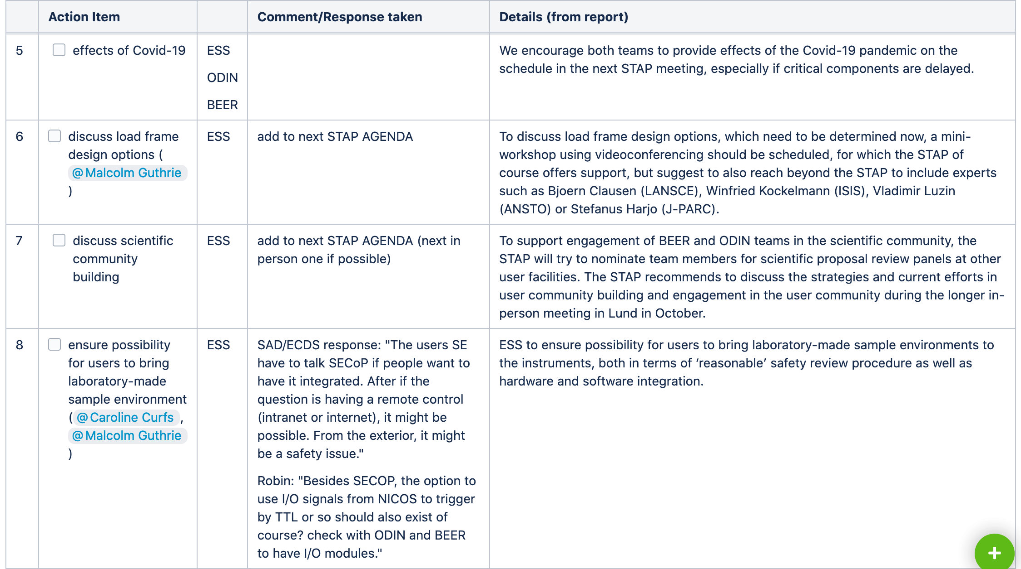
So far small effects – possible delays in delivery of choppers and in-bunker guide
Bigger issue is no IKCA/TA
As reported by Malcolm on IKON integration of Rig1 is under way (NPI and ESS)
Integration discussion within the sample tower (HZG) designer took place briefly
Discussion with other facilities about the technical solution or special arrangement didn’t started yet

Slide 4
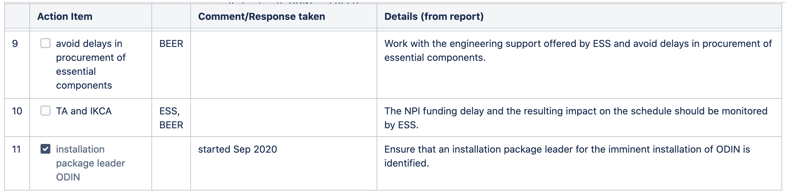
Engineering support from ESS used for two months (June, July) – documents for CTV (cave, shutter, hutch) were created – help appreciated
….. It is a TRAIN!!!!!
Not solved so far, no forecast, a light at the end of the tunnel?

