Slide 1
SANS and the DMSC
Wojtek Potrzebowski, Judith Houston, Richard Heenan

Slide 2
Recap on the instrument data scientists
Who are they?
Technique | Instruments (1-8) | Who | Start
Img & Eng | ODIN, BEER | Søren Schmidt | Sep 2020
Diffraction | DREAM, MAGIC | Céline Durniak
SANS | LoKI | Wojciech Potrzebowski
Reflectometry | ESTIA | Andrew McCluskey | Jan 2021
Spectroscopy | BIFROST, C-SPEC | Gregory Tucker | Jan 2021

Slide 3
Instrument data scientist role
Input from the instrument class coordinators
Short term – next 2 years
Work with the instrument scientists to define and to develop the required data reduction workflow and appropriate data formats etc. (may require a common approach between instrument classes so they should work with the other data scientists to define this)
Translate and liaise with DMSC / Mantid / Scipp to implement it
Assist with the communication of requirements to ECDC / ICS
Assist with cold and hot commissioning
Coordinate the technique specific data analysis software development
Long term
Local contacting for the more complex experiments
Lead any technique dependent software developments (e.g. Artificial Intelligence etc)
Establish their own scientific research program

Slide 4
Wojtek in IDS role today and in the future
Reflectometry | SANS | Research
BornAgain in-kind | SasView development and maintenance | Macromolecular modelling
Open Reflectivity Standards Organisation (ORSO) | scipp - liaison between DMSC and instrument teams | Bayesian Statistics, Pattern recognition and Machine Learning
 | User training (SasView + Python) | TR-SAXS and SANS experiments
 |  | Self-assembling viruses

Slide 5
Wojtek in IDS role today and in the future
Reflectometry | SANS | Research
BornAgain in-kind | SasView development and maintenance, ESS specific | Macromolecular modelling
Open Reflectivity Standards Organisation (ORSO) | Support for scipp and other DMSC software | Bayesian Statistics, Pattern recognition and Machine Learning
 | User training (SasView, scipp, Python, etc) | TR-SAXS and SANS experiments
 | canSAS | Self-assembling viruses
 | Local contacting

Slide 6
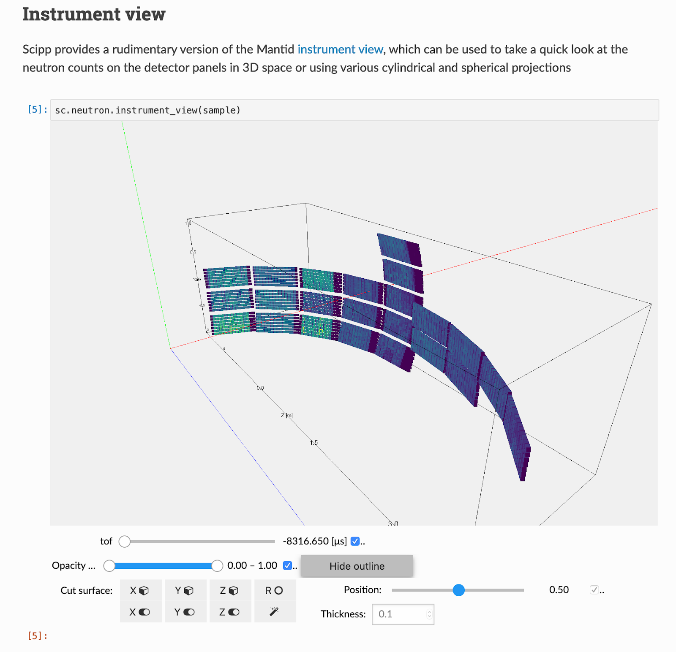
Scipp for data reduction
Scipp for data reduction
Handling of physical units
Propagation of uncertainties
The internal data structure for multidimensional arrays is far better
Support for histograms
Support for event data
Support for masks
Written in C++
Python interface
Current version 0.4 - maturing
6
6

Slide 7
Scipp SANS Team
Software developers
Simon Heybrook (DMSC, ESS)
Neil Vaytet (DMSC, ESS)
Owen Arnold (ISIS)
Matthew Andrew
Matthew Jones
Piotr Rozyczko
SANS data scientist
Wojtek Potrzebowski
Instrument scientists:
Judith Houston
Richard Heenan

Slide 8
SCIPP
SANS Functionality and user experience

Slide 9
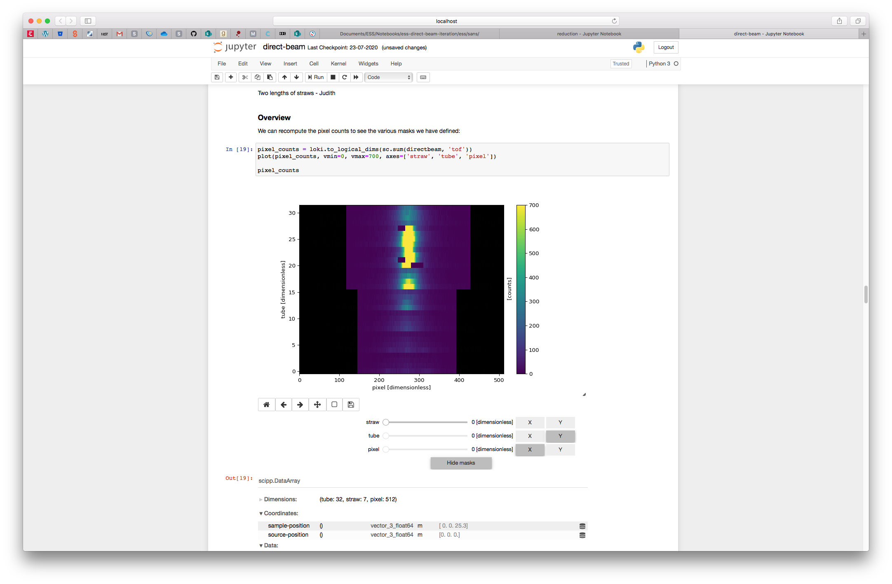
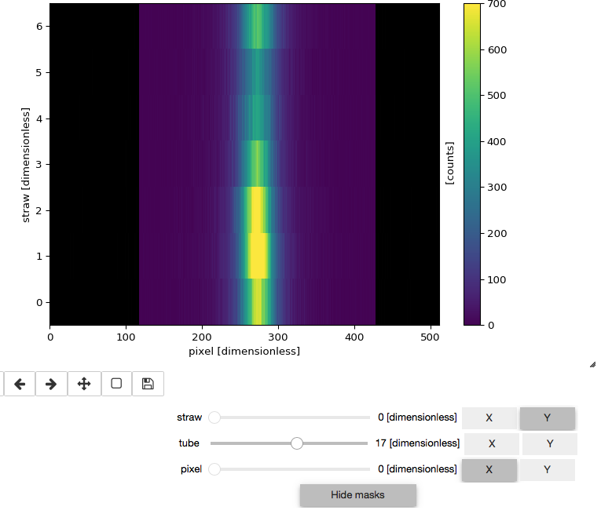
Instrument Visualisation
3D LoKI test module with 32 tubes x 7 straws
2D Straws versus pixel
Multiple, dynamic visualisation tools
Showing only pixels with <100 counts
Tube versus pixel
Full LoKI array: 1142400 pixels
Notes:
Easy and flexible to define:
setting intensity limits, defining shapes, masking of straws (e.g. “tube 7, straw 2”), masking TOF (prompt pulse)
Easy and flexible to visualize

Slide 10
Masking
Easy and flexible to define:
Masking TOF (prompt pulse)
Simple masking of straws/tubes/pixels (e.g. tube 7, straw 2, pixels 100-150)
Shapes: beamstop and tube ends
Intensity limits
Required: a way of drawing a mask on the screen in real space
Easy and flexible to visualise:
X-Y projections of straws
3D view
1D spectra
Simple mask on/off buttons
Non-destructive masks (unlike Mantid)
Notes:
Easy and flexible to define:
setting intensity limits, defining shapes, masking of straws (e.g. “tube 7, straw 2”), masking TOF (prompt pulse)
Easy and flexible to visualize

Slide 11
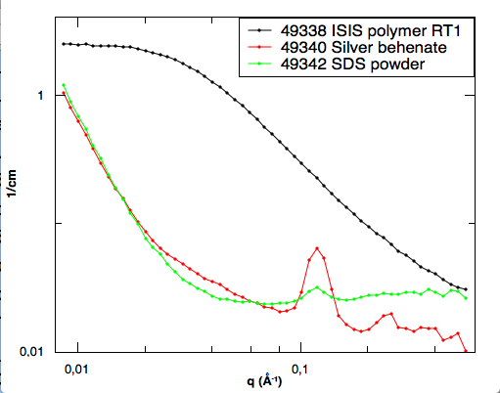
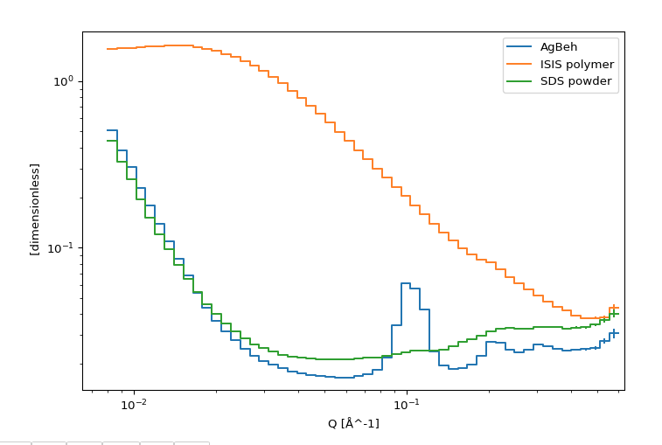
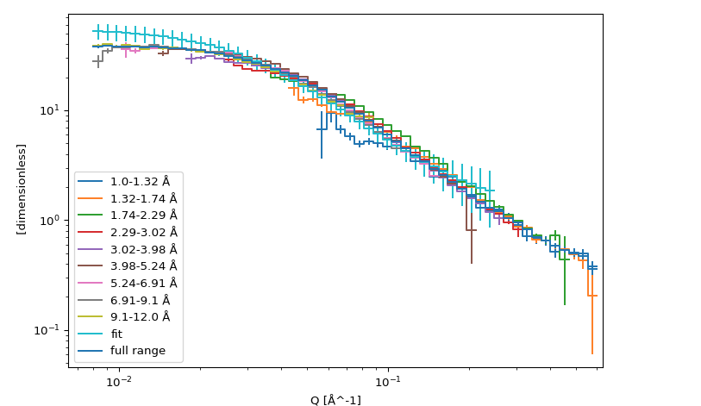
SANS reduction
https://github.com/scipp/ess/blob/master/sans/reduction.ipynb
Background calculation
Transmission calculation
Q resolution
Q1D* (wavelength space to momentum transfer space)
Wavelength slices* → huge opportunity for on-the-fly analysis of multiple scattering event
* Both significantly faster than Mantid
Mantid
Scipp
Front face of the long tubes (4 straws only)
Notes:
Easy and flexible to define:
setting intensity limits, defining shapes, masking of straws (e.g. “tube 7, straw 2”), masking TOF (prompt pulse)
Easy and flexible to visualize

Slide 12
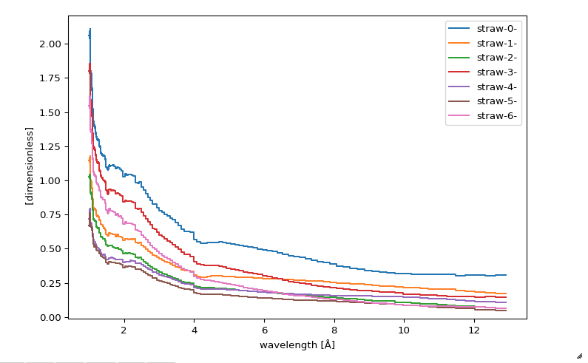
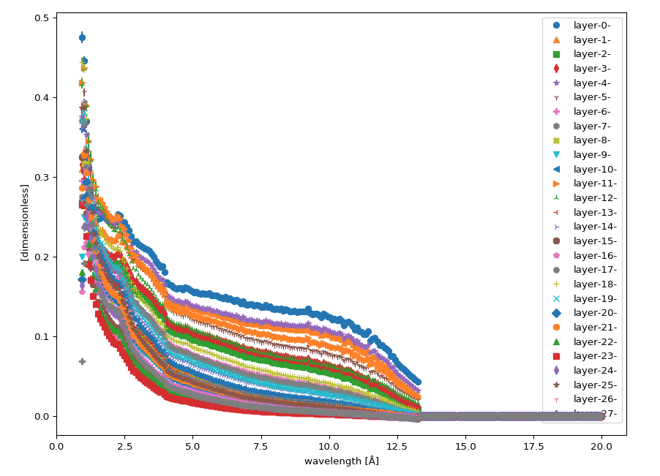
SANS direct beam function
The relative efficiency of the monitor versus the main detector per straw in a reasonable timescale
Relative efficiency through the 7 straws in the front tube → no groups possible
https://github.com/scipp/ess/blob/master/sans/direct-beam.ipynb

Slide 13
SCIPP - summary & where next?
Advantages
Much faster processing than Mantid
SCIPP seems to be much better suited to the modularity of the LoKI detectors
Disadvantages
Being built from the ground up with the instrument team (time-consuming and learning curve)
Concerns about usability (prototype GUI exists but will need some man-power)
Next steps:
Implementing SANS2D in SCIPP
Good baseline to directly check against
Test coordinate corrections
Merging detector panels

Slide 14
Other progress
SANS data processing document
Living document detailing data processing work flows for hot commissioning, calibration and a general data reduction procedure for time-of-flight SANS.
Reference for scientists and software developers
Will be owned by the instrument data scientist
Any feedback, comments, please send on to Tom, Judith or Wojchek

Slide 15
Scipp functionality
Notebook | Functionality | Link
Scipp neutron | Unit Conversions Beamline geometry Loading Nexus files | https://scipp.github.io/scipp-neutron/overview.html
Reduction | Splitting, flattening and combining event data | https://scipp.github.io/scipp-neutron/groupby.html
From Mantid to scipp | Workspace and spectra operations (scipp equivalents) Rebining Scaling | https://scipp.github.io/scipp-neutron/from-mantid-to-scipp.html
Instrument View | Spatial slicing, navigation through the time-of-flight dimension via a slider | https://scipp.github.io/scipp-neutron/instrument-view.html

Slide 16
Scipp functionality for SANS
Notebook | Functionality | Link
SANS Direct Beam | Direct-beam iteration X-Y projection Bad straw Bad pixels Beam stop Tube ends Instrument View Prompt pulse mask | https://github.com/scipp/ess/blob/master/sans/direct-beam.ipynb
Reduction | Masking Background calculation Transmission calculation Q resolution Q1D (wavelength space to momentum transfer space) | https://github.com/scipp/ess/blob/master/sans/reduction.ipynb

